Slide 1
Indistinguishability Obfuscation for all Circuits
Sanjam Garg, Craig Gentry*, Shai Halevi*, Mariana Raykova, Amit Sahai, Brent Waters
Faces in Modern Cryptography, Oct-2013
A Celebration in Honor of Goldwasser and Micali’s Turing Award
* Supported by IARPA contract number D11PC20202

Slide 2
Code Obfuscation
Make programs “unintelligible” while maintaining their functionality
Example from Wikipedia:
Why do it?
How to define “unintelligible”?
Can we achieve it?
@P=split//,".URRUU\c8R";@d=split//,"\nrekcah xinU / lreP rehtona tsuJ";sub p{ @p{"r$p","u$p"}=(P,P);pipe"r$p","u$p";++$p;($q*=2)+=$f=!fork;map{$P=$P[$f^ord ($p{$_})&6];$p{$_}=/ ^$P/ix?$P:close$_}keys%p}p;p;p;p;p;map{$p{$_}=~/^[P.]/&& close$_}%p;wait until$?;map{/^r/&&<$_>}%p;$_=$d[$q];sleep rand(2)if/\S/;print

Slide 3
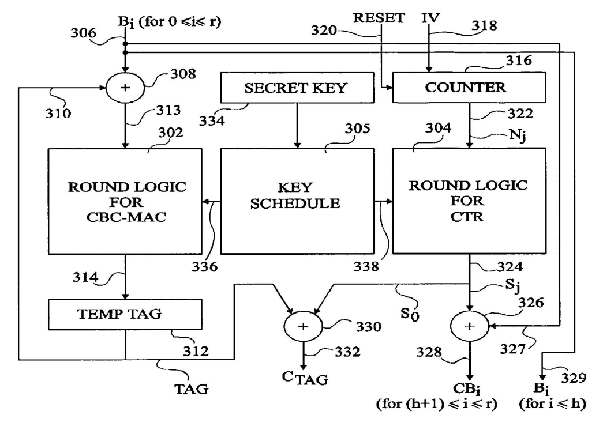
Why Obfuscation?
Hiding secrets in software
AES encryption
Plaintext
strutpatent.com
Ciphertext

Slide 4
Why Obfuscation?
Hiding secrets in software
AES encryption ➔ Public-key encryption
Plaintext
@P=split//,".URRUU\c8R";@d=split//,"\nrekcah xinU / lreP rehtona tsuJ";sub p{ @p{"r$p","u$p"}=(P,P);pipe"r$p","u$p";++$p;($q*=2)+=$f=!fork;map{$P=$P[$f^ord ($p{$_})&6];$p{$_}=/ ^$P/ix?$P:close$_}keys%p}p;p;p;p;p;map{$p{$_}=~/^[P.]/&& close$_}%p;wait until$?;map{/^r/&&<$_>}%p;$_=$d[$q];sleep rand(2)if/\S/;print
Ciphertext

Slide 5
Why Obfuscation?
Hiding secrets in software
Distributing software patches
Vulnerable
program
1,2d0
< The Way that can be told of is not the eternal Way;
< The name that can be named is not the eternal name
4c2,3
< The Named is the mother of all things.
---
> The named is the mother of all things.
11a11,13
> They both may be called deep and profound.
> Deeper and more profound,
> The door of all subtleties!
Patched
program

Slide 6
Why Obfuscation?
Hiding secrets in software
Distributing software patches while hiding vulnerability
Vulnerable
program
@P=split//,".URRUU\c8R";@d=split//,"\nrekcah xinU / lreP rehtona tsuJ";sub p{ @p{"r$p","u$p"}=(P,P);pipe"r$p","u$p";++$p;($q*=2)+=$f=!fork;map{$P=$P[$f^ord ($p{$_})&6];$p{$_}=/ ^$P/ix?$P:close$_}keys%p}p;p;p;p;p;map{$p{$_}=~/^[P.]/&& close$_}%p;wait until$?;map{/^r/&&<$_>}%p;$_=$d[$q];sleep rand(2)if/\S/;print
Patched
program

Slide 7
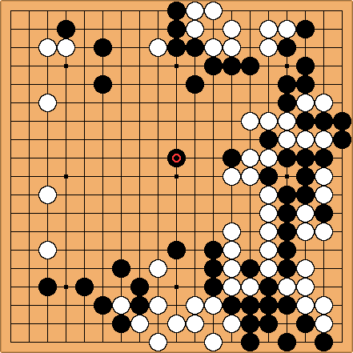
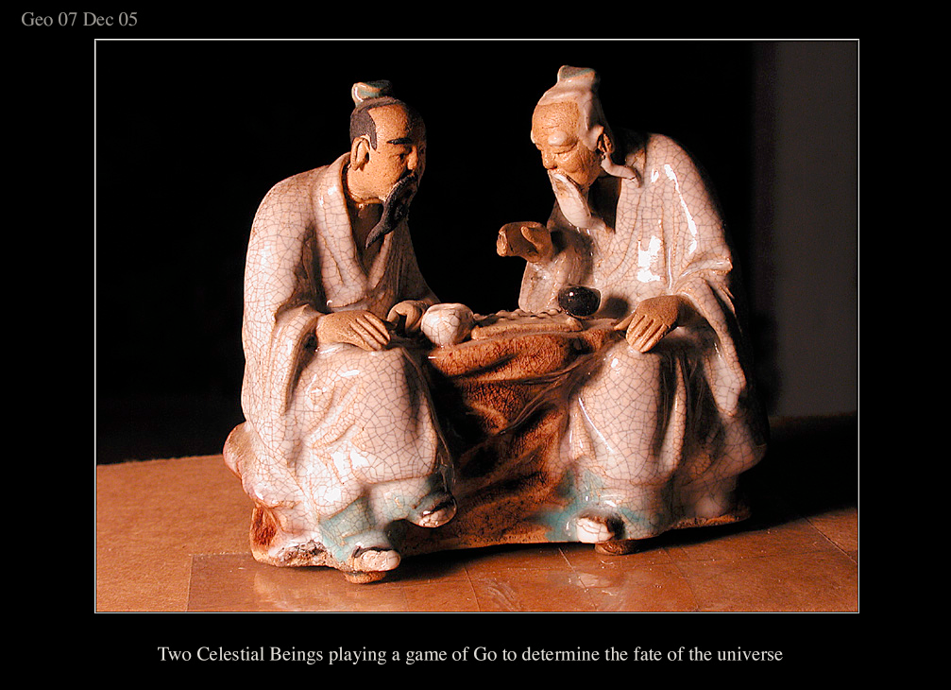
Why Obfuscation?
Hiding secrets in software
Uploading my expertise to the web
http://www.arco-iris.com/George/images/game_of_go.jpg
Game of Go
Next
move

Slide 8
Why Obfuscation?
Hiding secrets in software
Uploading my expertise to the web without revealing my strategies
@P=split//,".URRUU\c8R";@d=split//,"\nrekcah xinU / lreP rehtona tsuJ";sub p{ @p{"r$p","u$p"}=(P,P);pipe"r$p","u$p";++$p;($q*=2)+=$f=!fork;map{$P=$P[$f^ord ($p{$_})&6];$p{$_}=/ ^$P/ix?$P:close$_}keys%p}p;p;p;p;p;map{$p{$_}=~/^[P.]/&& close$_}%p;wait until$?;map{/^r/&&<$_>}%p;$_=$d[$q];sleep rand(2)if/\S/;print
Game of Go
Next
move

Slide 9
Contemporary Obfuscation
Used fairly widely in practice
Mostly as an art form
Some rules-of-thumb, sporadic tool support
Relies on human ingenuity, security-via-obscurity
“At best, obfuscation merely makes it time-consuming, but not impossible, to reverse engineer a program” (from Wikipedia)
Can it be done the Goldwasser-Micali way?
Definitions, constructions, concrete assumptions
Question addressed 1st by Barak et al. in 2001 [B+01]
Notes:
[B+01] Barak, Goldreich, Impagliazzo, Rudich, Sahai, Vadhan, Yang, “On the (im)possibility of obfuscating programs”

Slide 10
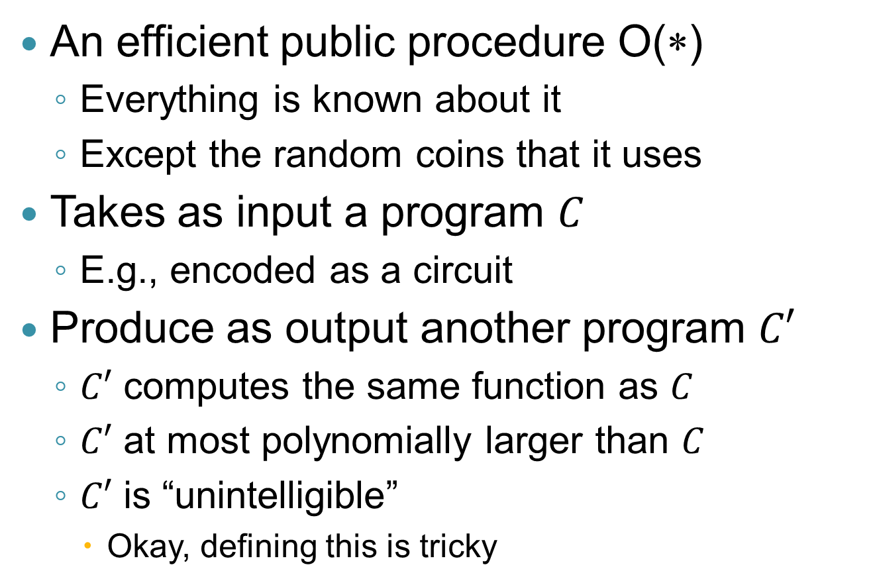
Defining Obfuscation
An efficient public procedure O(∗)
Everything is known about it
Except the random coins that it uses
Takes as input a program $C$
E.g., encoded as a circuit
Produce as output another program $C′$
$C′$ computes the same function as $C$
$C′$ at most polynomially larger than $C$
$C′$ is “unintelligible”
Okay, defining this is tricky

Slide 11
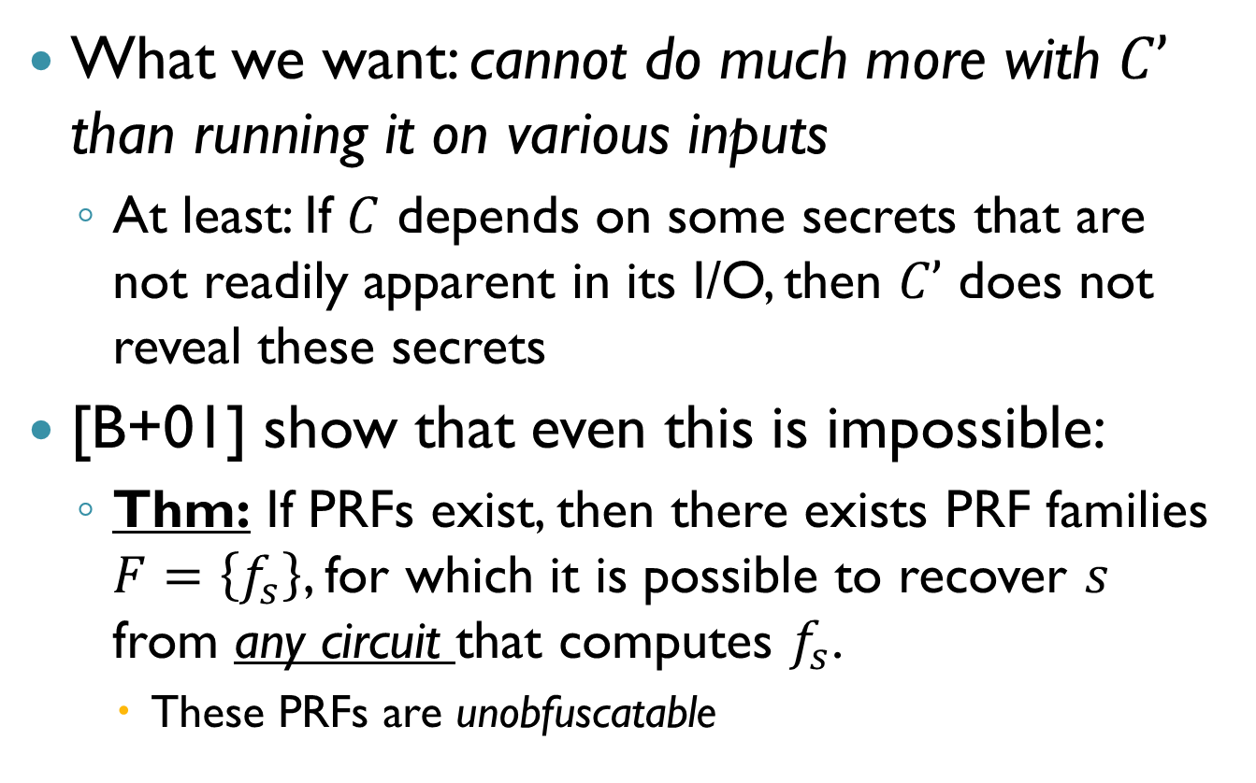
What’s “Unintelligible”?
What we want: cannot do much more with $C’$ than running it on various inputs
At least: If $C$ depends on some secrets that are not readily apparent in its I/O, then $C’$ does not reveal these secrets
[B+01] show that even this is impossible:
Thm: If PRFs exist, then there exists PRF families $F=\left\{f_{s}\right\}$, for which it is possible to recover $s$ from any circuit that computes $f_{s}$.
These PRFs are unobfuscatable

Slide 12
What’s “Unintelligible”?
Okay, some function are bad, but can we get O() that does “as well as possible” on every function?
[B+01] suggested the weaker notion of “indistinguishability obfuscation” (iO)
Gives the “best-possible” guarantee [GR07]
It turns out to suffice for many applications (examples in [GGH+13, SW13,…])
Notes:
[GR07] Goldwasser, Rothblum, “On best-possible obfuscation”
[SW13] Sahai, Waters, “How to Use Indistinguishability Obfuscation: Deniable Encryption, and More”

Slide 13

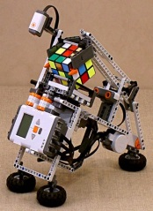
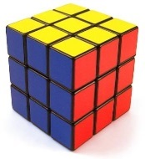
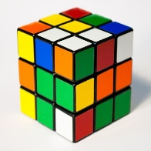
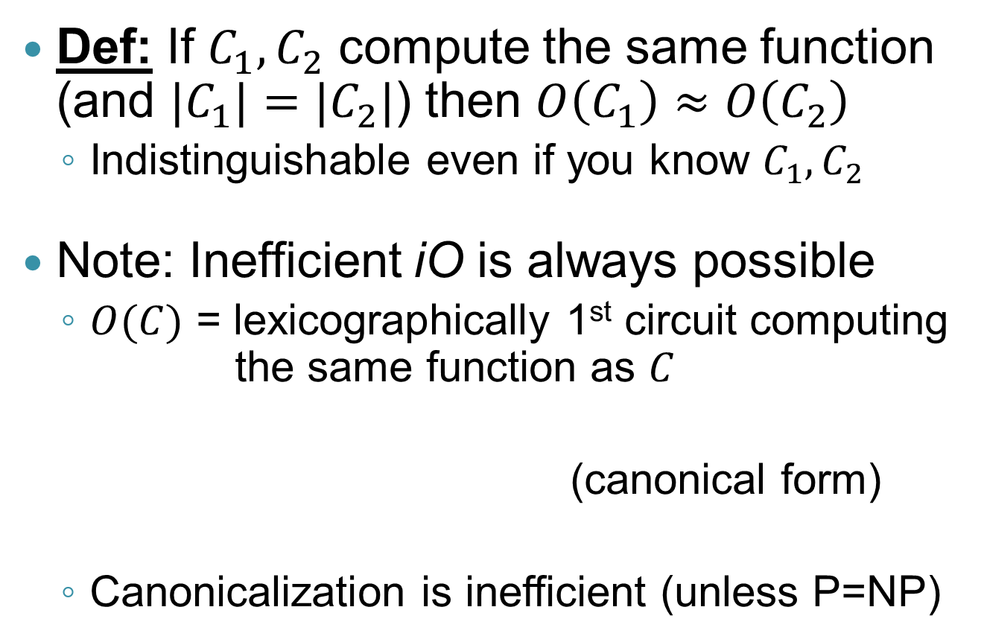
Indistinguishability Obfuscation
Def: If $C_{1},C_{2}$ compute the same function (and ${|C}_{1}|=|C_{2}|$) then $O\left(C_{1}\right)≈O\left(C_{2}\right)$
Indistinguishable even if you know $C_{1},C_{2}$
Note: Inefficient iO is always possible
$O(C)$ = lexicographically 1st circuit computing the same function as $C$
(canonical form)
Canonicalization is inefficient (unless P=NP)

Slide 14
Best-Possible Obfuscation
x
x
Indist. Obfuscation
Indist. Obfuscation
≈
Best Obfuscation
Padding
Some circuit C
Computationally Indistinguishable
Some circuit C
C(x)
C(x)

Slide 15
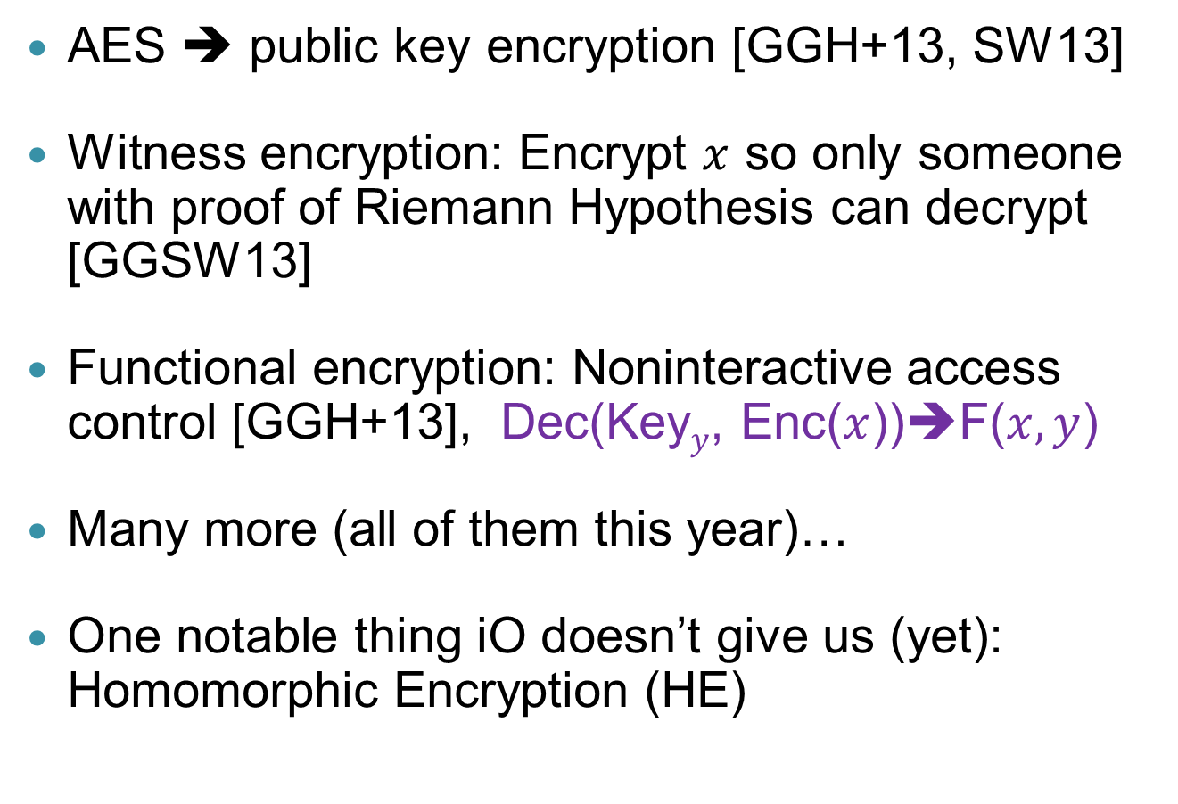
Many Applications of iO
AES ➔ public key encryption [GGH+13, SW13]
Witness encryption: Encrypt $x$ so only someone with proof of Riemann Hypothesis can decrypt [GGSW13]
Functional encryption: Noninteractive access control [GGH+13], Dec(Key$y$, Enc($x$))➔F($x,y$)
Many more (all of them this year)…
One notable thing iO doesn’t give us (yet): Homomorphic Encryption (HE)
Notes:
[GGSW13] Garg, Gentry, Sahai, Waters, “Witness encryption”

Slide 16
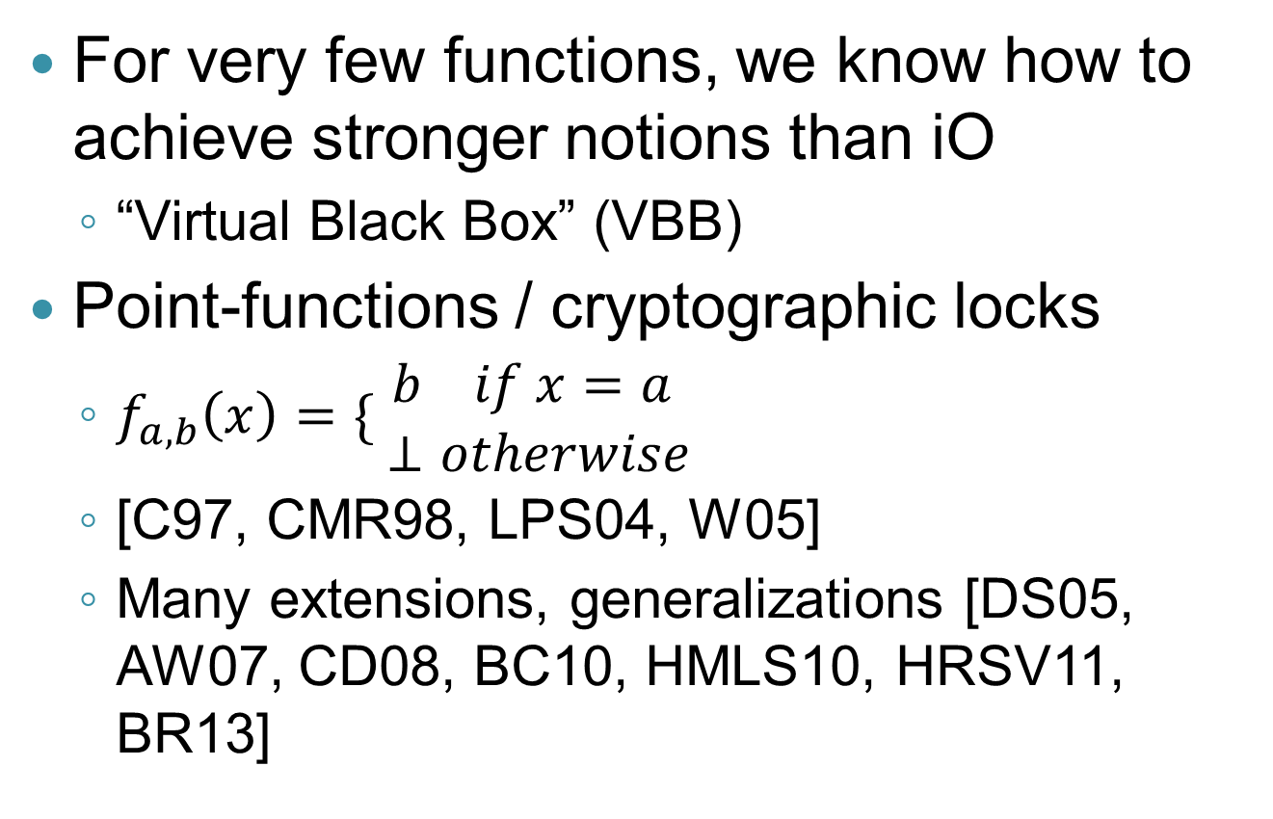
Beyond iO
For very few functions, we know how to achieve stronger notions than iO
“Virtual Black Box” (VBB)
Point-functions / cryptographic locks
$f_{a,b}\left(x\right)=\{ \begin{matrix}b if x=a \\ ⊥otherwise\end{matrix}$
[C97, CMR98, LPS04, W05]
Many extensions, generalizations [DS05, AW07, CD08, BC10, HMLS10, HRSV11, BR13]
Notes:
[C97] Canetti, “Towards realizing random oracles: hash functions that hide all partial information”
[CMR98] Canetti, Micciancio, Reingold, “Perfectly one-way probabilistic hash functions”
[LPS04] Lynn, Prabhakaran, Sahai, “Positive results and techniques for Obfuscation”
[W05] Wee, “On obfuscating point functions”
[DS05] Dodis, Smith, “Correcting errors without leaking partial information”
[AW07] Adida, Wikstrom, “How to shuffle in public”
[CD08] Canetti, Dakdouk, “Obfuscating Point Functions with Multibit Output”
[BC10] Bitansky, Canetti, “On strong simulation and composable point obfuscation”
[HMLS10] Hofheinz, Malone-Lee, Stam, “Obfuscation for cryptographic Purposes”
[HRSV11] Hohenberger, Rothblum, Shelat, Vaikuntanathan, “Securely obfuscating re-encryption”
[BR13] Brakerski, Rothblum, “Obfuscating Conjunctions”

Slide 17
Aside: Obfuscation vs. HE
F
Obfuscation
F
+
➔
F(x)
x
Result in the clear
F
Encryption
F
+
➔
F(x)
x
or
x
Result encrypted

Slide 18
Our Construction

Slide 19
Obfuscating Arbitrary Circuits
A two-step construction
Obfuscating “shallow circuits” (NC¹)
This is where the meat is
Using multilinear maps
Security under a new (ad-hoc) assumption
Bootstrapping to get all circuits
Using homomorphic encryption with NC¹ decryption
Very simple, provable, transformation

Slide 20
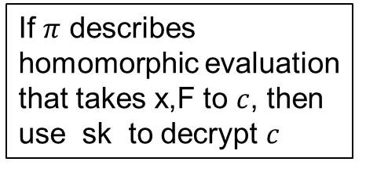
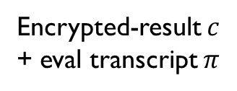
NC¹ Obfuscation→P Obfuscation
F
Homomorphic Encryption
F
+
F(x)
x
Encrypted-result $c$ + eval transcript $π$
NC¹ Circuit
If $π$ describes homomorphic evaluation that takes x,F to $c$, then use sk to decrypt $c$
CondDec
F(x)

Slide 21
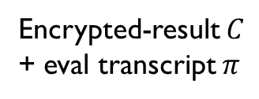
NC¹ Obfuscation→P Obfuscation
F
Homomorphic Encryption
F
+
F(x)
x
Encrypted-result $C$ + eval transcript $π$
NC¹ Circuit
@P=split//,".URRUU\c8R";@d=split//,"\nrekcah xinU / lreP rehtona tsuJ";sub p{ @p{"r$p“…
Obfuscate only this part
CondDec
Output of P obfuscator
F(x)

Slide 22
Conditional Decryption with iO
We have iO, not “perfect” obfuscation
But we can adapt the CondDec approach
We use two HE secret keys

Slide 23
iO for CondDec → iO for All Circuits
π, x, and two ciphertexts c₀ = Enc_{PK0}(F(x)) and c₁ = Enc_{PK1}(F(x))
π, x_{i}’s, and two ciphertexts c₀ = Enc_{PK0}(F(x)) and c₁ = Enc_{PK1}(F(x))
Indist. Obfuscation
≈
Indist. Obfuscation
CondDec_{F,SK0}(·, …, ·)
CondDec_{F,SK1}(·, …, ·)
F(x) if π verifies
F(x) if π verifies

Slide 24
Analysis of Two-Key Technique
1st program has secret SK₀ inside (but not SK₁).
2nd program has secret SK₁ inside (but not SK₀).
But programs are indistinguishable
So, neither program “leaks” either secret.
Two-key trick is very handy in iO context.
Similar to Naor-Yung ’90 technique to get encryption with chosen ciphertext security

Slide 25
NC¹ Obfuscation

Slide 26
Outline of Our Construction
Describe Circuits as Branching Programs (BPs) using Barrington’s theorem [B86]
Randomized BPs (RBPs) a-la-Kilian [K88]
Encode RBPs “in the exponent” using multilinear maps [GGH13,CLT13]
Modifications to defeat attacks
Multiplicative bundling against ”partial evaluation” and “mixed input” attacks
Defenses against “DDH attacks”, “rank attacks”

Slide 27
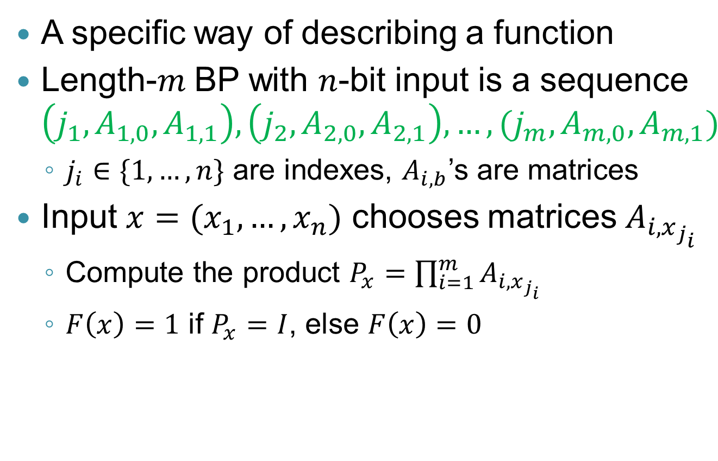
(Oblivious) Branching Programs
A specific way of describing a function
Length-$m$ BP with $n$-bit input is a sequence $\left(j_{1},A_{1,0}, A_{1,1}\right),\left(j_{2},A_{2,0},A_{2,1}\right),…,(j_{m},A_{m,0},A_{m,1})$
$j_{i}∈\{1,…,n\}$ are indexes, $A_{i,b}$’s are matrices
Input $x=(x_{1},…,x_{n})$ chooses matrices $A_{i,x_{j_{i}}}$
Compute the product $P_{x}=\prod_{i=1}^{m}{A_{i,x_{j_{i}}}}$
$F\left(x\right)=1$ if $P_{x}=I$, else $F\left(x\right)=0$

Slide 28
(Oblivious) Branching Programs
This length-9 BP has 4-bit inputs
A_{1,0}
A_{2,0}
A_{3,0}
A_{4,0}
A_{5,0}
A_{6,0}
A_{7,0}
A_{8,0}
A_{9,0}
A_{1,1}
A_{2,1}
A_{3,1}
A_{4,1}
A_{5,1}
A_{6,1}
A_{7,1}
A_{8,1}
A_{9,1}
0

Slide 29
(Oblivious) Branching Programs
This length-9 BP has 4-bit inputs
A_{1,0}
A_{2,0}
A_{3,0}
A_{4,0}
A_{5,0}
A_{6,0}
A_{7,0}
A_{8,0}
A_{9,0}
A_{1,1}
A_{2,1}
A_{3,1}
A_{4,1}
A_{5,1}
A_{6,1}
A_{7,1}
A_{8,1}
A_{9,1}
0
1

Slide 30
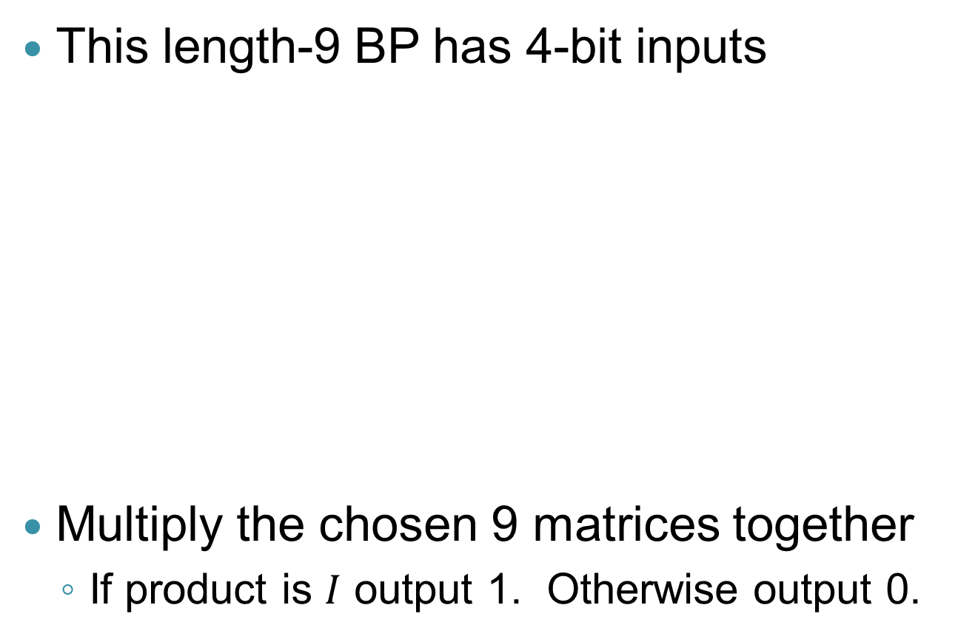
(Oblivious) Branching Programs
This length-9 BP has 4-bit inputs
Multiply the chosen 9 matrices together
If product is $I$ output 1. Otherwise output 0.
A_{1,0}
A_{2,0}
A_{3,0}
A_{4,0}
A_{5,0}
A_{6,0}
A_{7,0}
A_{8,0}
A_{9,0}
A_{1,1}
A_{2,1}
A_{3,1}
A_{4,1}
A_{5,1}
A_{6,1}
A_{7,1}
A_{8,1}
A_{9,1}
0
1
1
0

Slide 31
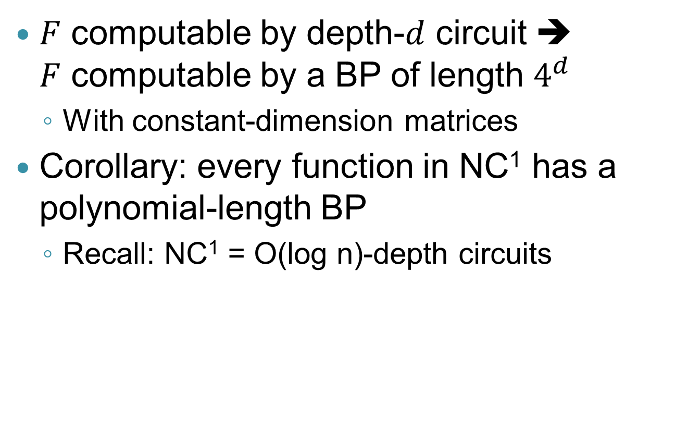
Barrington’s Theorem [B86]
$F$ computable by depth-$d$ circuit ➔ $F$ computable by a BP of length $4^{d}$
With constant-dimension matrices
Corollary: every function in NC¹ has a polynomial-length BP
Recall: NC¹ = O(log n)-depth circuits

Slide 32
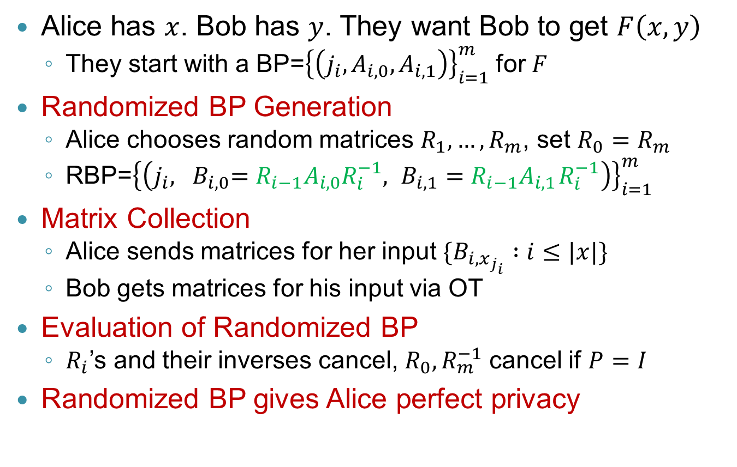
Oblivious BP Evaluation [K88]
Alice has $x$. Bob has $y$. They want Bob to get $F\left(x,y\right)$
They start with a BP=${\left\{\left(j_{i},A_{i,0},A_{i,1}\right)\right\}}_{i=1}^{m}$ for $F$
Randomized BP Generation
Alice chooses random matrices $R_{1},…,R_{m}$, set $R_{0}=R_{m}$
RBP=${\left\{\left(j_{i}, {{ B}_{i,0}=R_{i−1}A}_{i,0}R_{i}^{−1},{ {B_{i,1}=R}_{i−1}A}_{i,1}R_{i}^{−1}\right)\right\}}_{i=1}^{m}$
Matrix Collection
Alice sends matrices for her input $\{B_{i,x_{j_{i}}} :i≤|x|\}$
Bob gets matrices for his input via OT
Evaluation of Randomized BP
$R_{i}$’s and their inverses cancel, $R_{0}, R_{m}^{−1}$ cancel if $P=I$
Randomized BP gives Alice perfect privacy

Slide 33
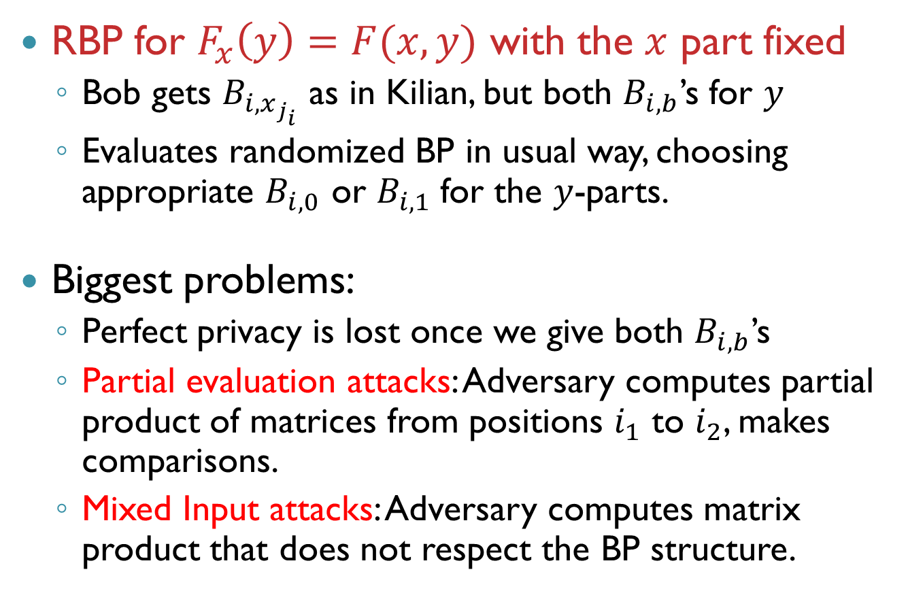
Kilian’s Protocol➔BP-Obfuscation?
RBP for $F_{x}\left(y\right)=F(x,y)$ with the $x$ part fixed
Bob gets $B_{i,x_{j_{i}}}$ as in Kilian, but both $B_{i,b}$’s for $y$
Evaluates randomized BP in usual way, choosing appropriate $B_{i,0}$ or $B_{i,1}$for the $y$-parts.
Biggest problems:
Perfect privacy is lost once we give both $B_{i,b}$’s
Partial evaluation attacks: Adversary computes partial product of matrices from positions $i_{1}$ to $i_{2}$, makes comparisons.
Mixed Input attacks: Adversary computes matrix product that does not respect the BP structure.

Slide 34
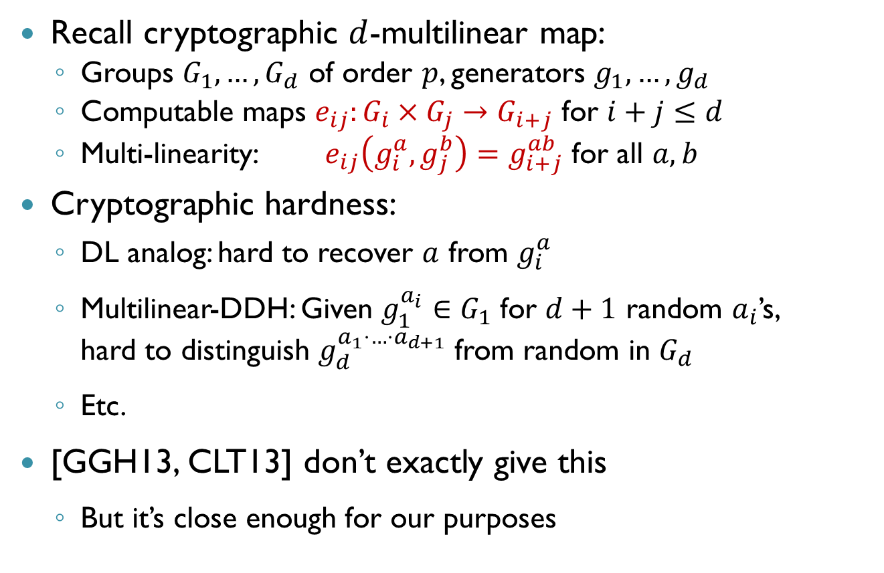
Multilinear Maps to Hide Matrices
Recall cryptographic $d$-multilinear map:
Groups $G_{1},…,G_{d}$ of order $p$, generators $g_{1}, …, g_{d}$
Computable maps $e_{ij}:G_{i}×G_{j}→G_{i+j}$ for $i+j≤d$
Multi-linearity: $e_{ij}\left(g_{i}^{a}, g_{j}^{b}\right)=g_{i+j}^{ab}$ for all $a,b$
Cryptographic hardness:
DL analog: hard to recover $a$ from $g_{i}^{a}$
Multilinear-DDH: Given $g_{1}^{a_{i}}∈G_{1}$ for $d+1$ random $a_{i}$’s, hard to distinguish $g_{d}^{a_{1}⋅…⋅a_{d+1}}$ from random in $G_{d}$
Etc.
[GGH13, CLT13] don’t exactly give this
But it’s close enough for our purposes

Slide 35
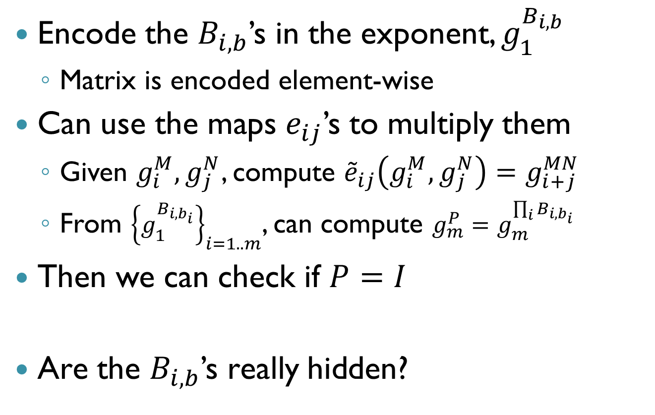
Multilinear Maps to Hide Matrices
Encode the $B_{i,b}$’s in the exponent, $g_{1}^{B_{i,b}}$
Matrix is encoded element-wise
Can use the maps $e_{ij}$’s to multiply them
Given $g_{i}^{M},g_{j}^{N}$, compute ${\tilde{e}}_{ij}\left(g_{i}^{M},g_{j}^{N}\right)=g_{i+j}^{MN}$
From ${\left\{g_{1}^{B_{i,b_{i}}}\right\}}_{i=1..m}$, can compute $g_{m}^{P}=g_{m}^{\prod_{i}{B_{i,b_{i}}}}$
Then we can check if $P=I$
Are the $B_{i,b}$’s really hidden?

Slide 36
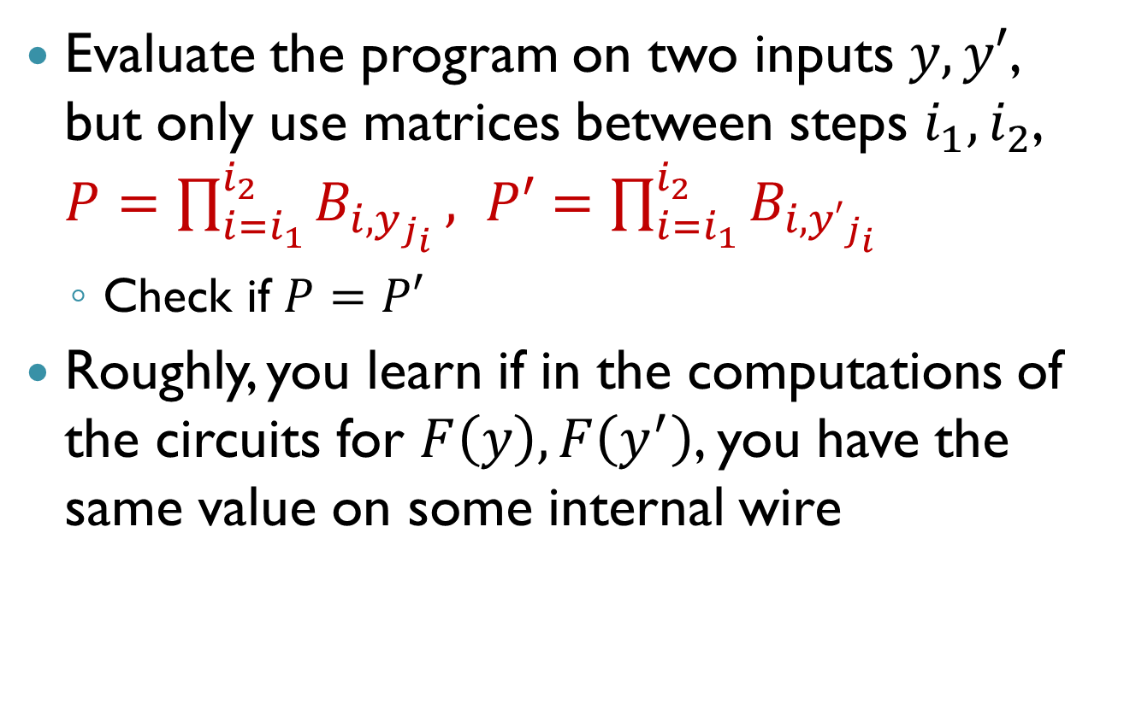
“Partial Evaluation” Attacks
Evaluate the program on two inputs $y,y′$, but only use matrices between steps $i_{1},i_{2}$, $P=\prod_{i=i_{1}}^{i_{2}}{B_{i,y_{j_{i}}}}, P′=\prod_{i=i_{1}}^{i_{2}}{B_{i,{y′}_{j_{i}}}}$
Check if $P=P′$
Roughly, you learn if in the computations of the circuits for $F\left(y\right),F\left(y^{′}\right)$, you have the same value on some internal wire

Slide 37
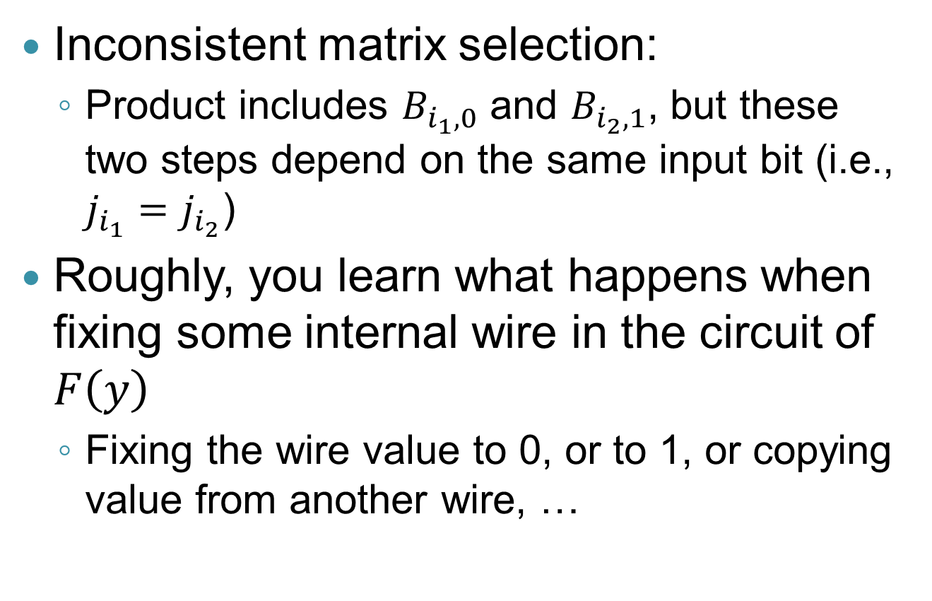
“Mixed Input” Attack
Inconsistent matrix selection:
Product includes $B_{i_{1},0}$ and $B_{i_{2},1}$, but these two steps depend on the same input bit (i.e., $j_{i_{1}}=j_{i_{2}}$)
Roughly, you learn what happens when fixing some internal wire in the circuit of $F\left(y\right)$
Fixing the wire value to 0, or to 1, or copying value from another wire, …

Slide 38
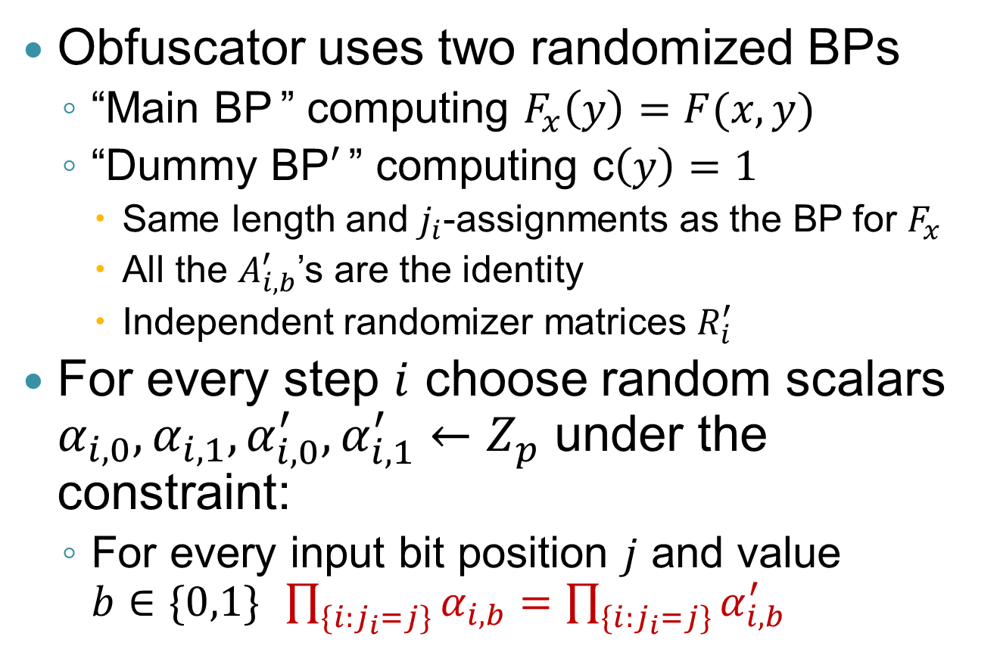
“Multiplicative Bundling”
Obfuscator uses two randomized BPs
“Main BP ” computing $F_{x}\left(y\right)=F(x,y)$
“Dummy BP$′$ ” computing c$\left(y\right)=1$
Same length and $j_{i}$-assignments as the BP for $F_{x}$
All the $A_{i,b}^{′}$’s are the identity
Independent randomizer matrices $R_{i}^{′}$
For every step $i$ choose random scalars $α_{i,0}, α_{i,1},α_{i,0}^{′},α_{i,1}^{′}←Z_{p}$ under the constraint:
For every input bit position $j$ and value $b∈\{0,1\}$ $\prod_{\{i:j_{i}=j\}}{α_{i,b}=\prod_{\{i:j_{i}=j\}}{α_{i,b}^{′}}}$

Slide 39
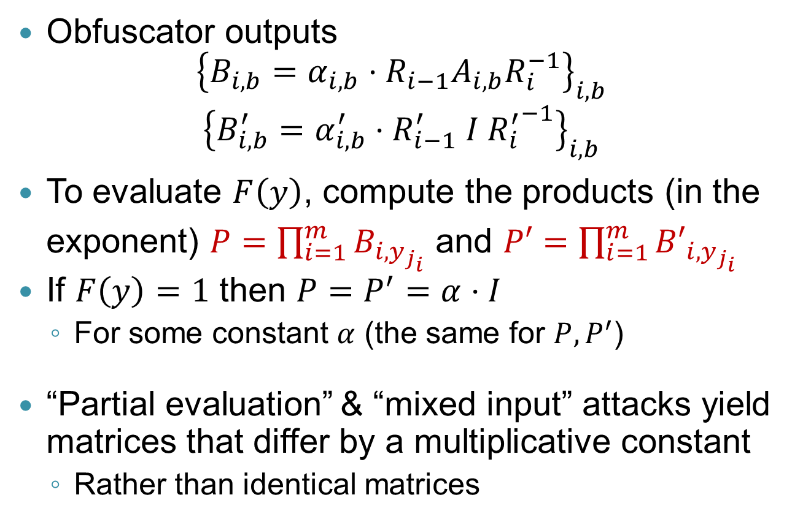
“Multiplicative Bundling”
Obfuscator outputs ${\left\{B_{i,b}=α_{i,b}⋅R_{i−1}A_{i,b}R_{i}^{−1}\right\}}_{i,b}$
$${\left\{B_{i,b}^{′}=α_{i,b}^{′}⋅R_{i−1}^{′} I {R_{i}^{′}}^{−1}\right\}}_{i,b}$$
To evaluate $F\left(y\right)$, compute the products (in the exponent) $P=\prod_{i=1}^{m}{B_{i,y_{j_{i}}}}$ and $P′=\prod_{i=1}^{m}{{B′}_{i,y_{j_{i}}}}$
If $F\left(y\right)=1$ then $P=P^{′}=α⋅I$
For some constant $α$ (the same for $P,P^{′}$)
“Partial evaluation” & “mixed input” attacks yield matrices that differ by a multiplicative constant
Rather than identical matrices

Slide 40
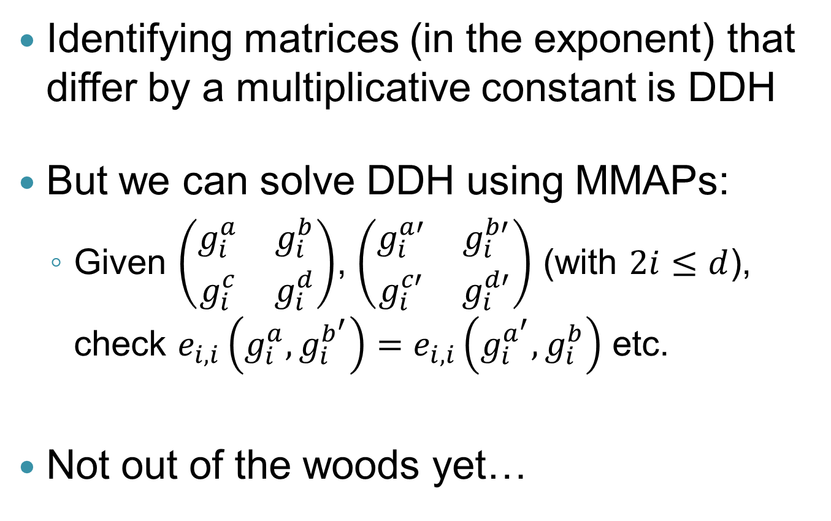
DDH Attacks
Identifying matrices (in the exponent) that differ by a multiplicative constant is DDH
But we can solve DDH using MMAPs:
Given $\left(\begin{matrix}g_{i}^{a} & g_{i}^{b} \\ g_{i}^{c} & g_{i}^{d}\end{matrix}\right)$, $\left(\begin{matrix}g_{i}^{a′} & g_{i}^{b′} \\ g_{i}^{c′} & g_{i}^{d′}\end{matrix}\right)$ (with $2i≤d$), check $e_{i,i}\left(g_{i}^{a},g_{i}^{b^{′}}\right)=e_{i,i}\left(g_{i}^{a^{′}},g_{i}^{b}\right)$ etc.
Not out of the woods yet…

Slide 41
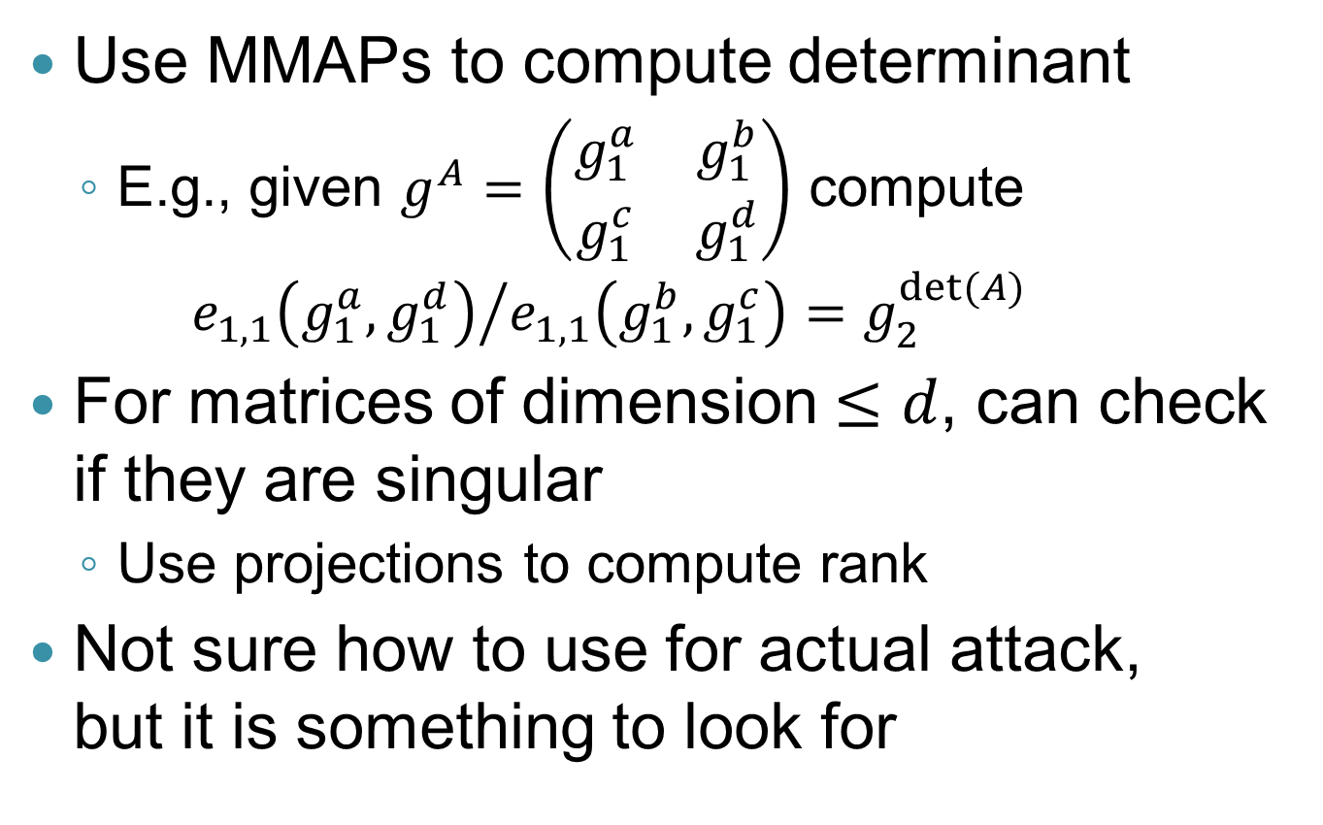
More Attacks: Determinant & Rank
Use MMAPs to compute determinant
E.g., given $g^{A}=\left(\begin{matrix}g_{1}^{a} & g_{1}^{b} \\ g_{1}^{c} & g_{1}^{d}\end{matrix}\right)$ compute ${e_{1,1}\left(g_{1}^{a},g_{1}^{d}\right)}/{e_{1,1}\left(g_{1}^{b},g_{1}^{c}\right)}=g_{2}^{det⁡(A)}$
For matrices of dimension $≤d$, can check if they are singular
Use projections to compute rank
Not sure how to use for actual attack, but it is something to look for

Slide 42
Fixing DDH, Rank Attacks
One option (also used in [BR13b]) is to switch to “asymmetric maps”
Just like XSDH for bilinear maps, DDH can potentially be hard in the different groups, even though you have pairing
A little awkward to define in the multilinear setting, so will not do it here

Slide 43
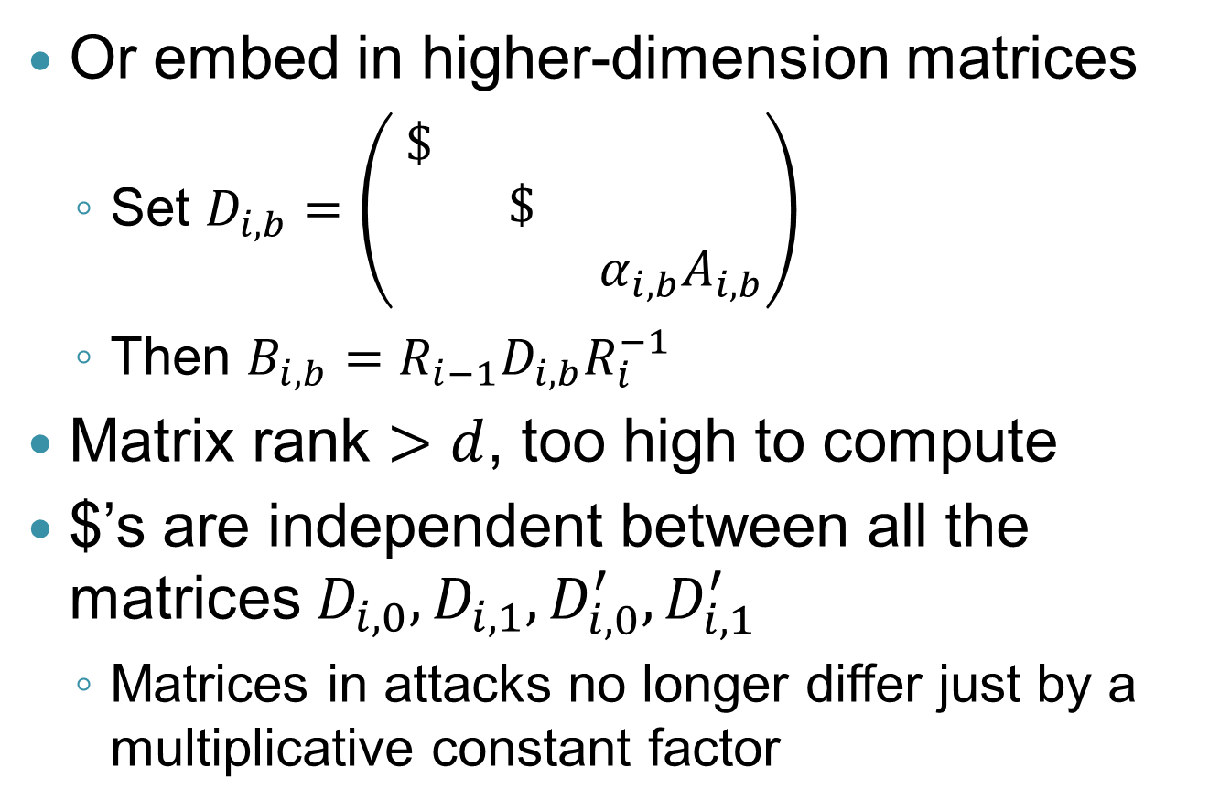
Fixing DDH, Rank Attacks
Or embed in higher-dimension matrices
Set $D_{i,b}=\left(\begin{matrix}\$ & & \\ & \$ & \\ & & α_{i,b}A_{i,b}\end{matrix}\right)$
Then $B_{i,b}=R_{i−1}D_{i,b}R_{i}^{−1}$
Matrix rank $>d$, too high to compute
$’s are independent between all the matrices $D_{i,0},D_{i,1},D_{i,0}^{′},D_{i,1}^{′}$
Matrices in attacks no longer differ just by a multiplicative constant factor
…

Slide 44
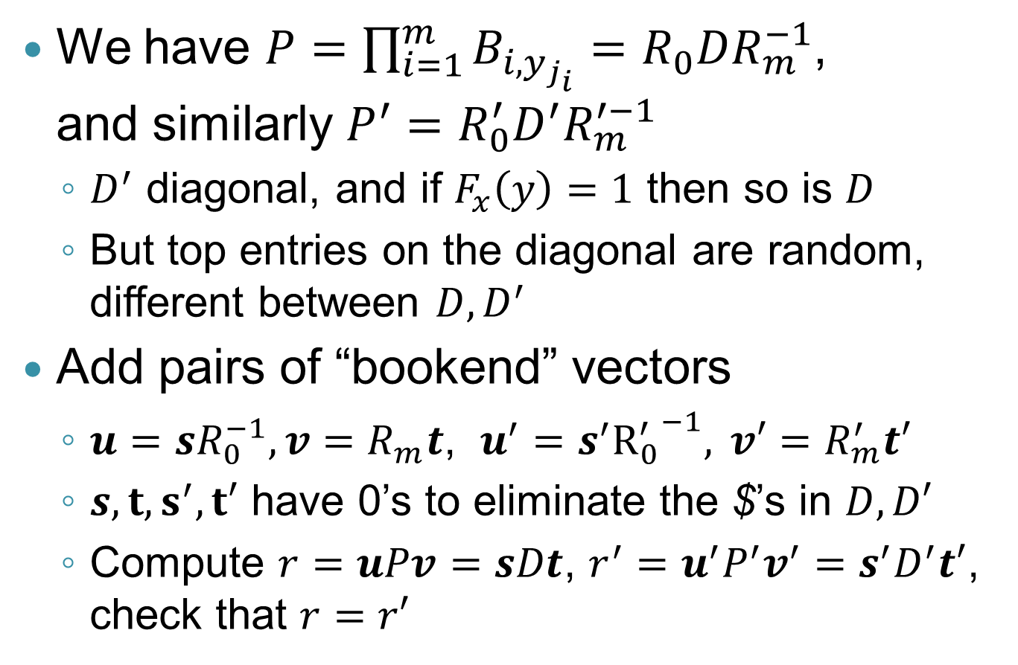
How To Evaluate?
We have $P=\prod_{i=1}^{m}{B_{i,y_{j_{i}}}}=R_{0}DR_{m}^{−1}$, and similarly $P^{′}=R_{0}^{′}D^{′}R_{m}^{′−1}$
$D^{′}$ diagonal, and if $F_{x}\left(y\right)=1$ then so is $D$
But top entries on the diagonal are random, different between $D, D^{′}$
Add pairs of “bookend” vectors
$u=sR_{0}^{−1}, {v=R}_{m}t$, ${u^{′}=s}^{′}{R_{0}^{′}}^{−1},{ v′=R}_{m}^{′}t′$
$s,t,s^{′},t′$ have 0’s to eliminate the $’s in $D, D′$
Compute $r=uPv=sDt$, $r^{′}=u^{′}P^{′}v^{′}=s^{′}D^{′}t′$, check that $r=r′$

Slide 45
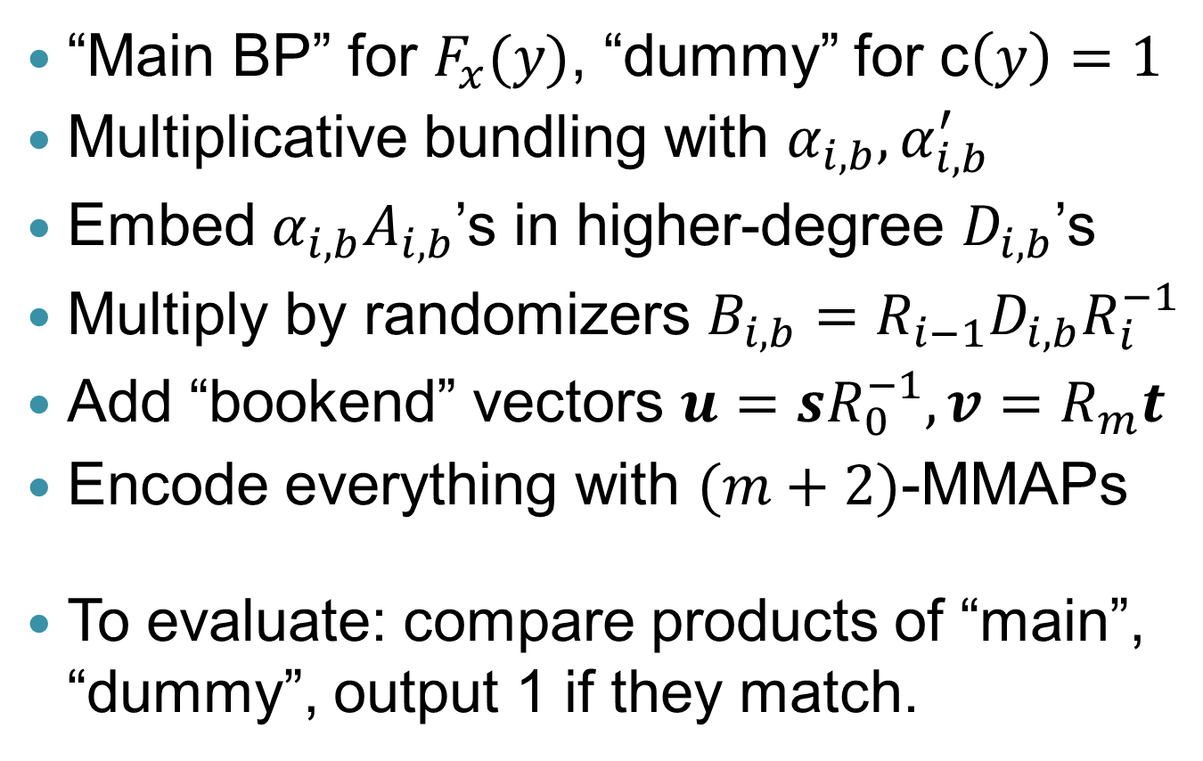
Summary of BP-Obfuscation
“Main BP” for $F_{x}(y)$, “dummy” for c$\left(y\right)=1$
Multiplicative bundling with $α_{i,b}, α_{i,b}^{′}$
Embed $α_{i,b}A_{i,b}$’s in higher-degree $D_{i,b}$’s
Multiply by randomizers $B_{i,b}=R_{i−1}D_{i,b}R_{i}^{−1}$
Add “bookend” vectors $u=sR_{0}^{−1}, {v=R}_{m}t$
Encode everything with $(m+2)$-MMAPs
To evaluate: compare products of “main”, “dummy”, output 1 if they match.

Slide 46
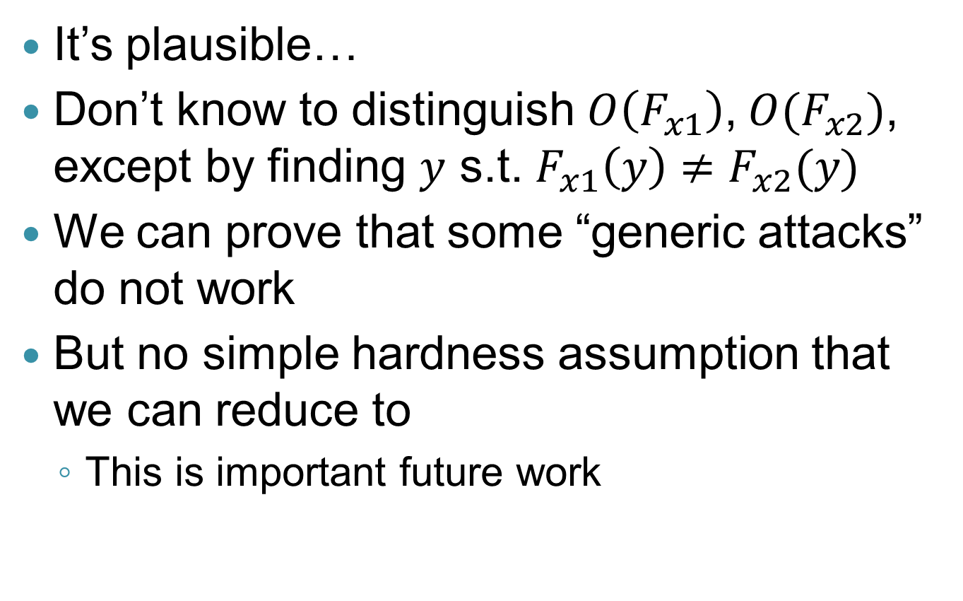
Is This Indistinguishable?
It’s plausible…
Don’t know to distinguish $O\left(F_{x1}\right)$, $O(F_{x2})$, except by finding $y$ s.t. $F_{x1}\left(y\right)≠F_{x2}(y)$
We can prove that some “generic attacks” do not work
But no simple hardness assumption that we can reduce to
This is important future work

Slide 47
Open Problems
Better underlying hardness assumptions
Faster constructions
Complexity of our construction is horrendous
Better notions
iO is okay for some things, not others
Certainly does not capture our intuition of what an obfuscator is
Doesn’t even capture the intuition of what the current construction achieves
Applications
The sky is the limit…

Slide 48

Thank You
Questions?

