Slide 1

Graded Encoding Schemes:
Survey of Recent Attacks
Shai Halevi (IBM Research)
NYC Crypto Day
January 2015

Slide 2



Graded Encoding Schemes (GES)
Very powerful crypto tools
Resembles “Cryptographic Multilinear Maps”
Enable computation on “hidden data”
Similar to homomorphic encryption (HE)
But HE is too “all or nothing”
No key: result is meaningless
Has key: can read result and intermediate values

Slide 3

Graded Encoding Schemes (GES)
Leak “some information” about result
Can tell if results equals zero
Not decrypt result or intermediate values
This partial leakage can do great things
Multipartite non-interactive key-exchange, Witness-encryption, Attribute-based encryption, Cryptographic code obfuscation, Functional encryption, …
But implementing “limited leakage” is messy

Slide 4
Plan for this Talk
Background
Some details of [GGH13], [CLT13]
The [GGH13] “zeroizing” attack
New attacks (Cheon,Han,Lee,Ryu,Stehle’14)
Extensions of the attacks (Coron, Gentry, H, Lepoint, Maji, Miles, Raykova, Sahai, Tibouchi’15)
Limitations of attacks
Tentative conclusions
Notes:
Cheon, Han, Lee, Ryu, and Stehle
Coron, Gentry, Halevi, Lepoint, Maji, Miles, Raykova, Sahai, Tibouchi

Slide 5

Constructing GES
The GGH Recipe:
Start from some HE scheme
Publish a “defective secret key”
Called “zero-test parameter”
Can be used to identify encryptions of zero
Cannot be used for decryption
Instantiated from NTRU in [GGH13], from approximate-GCD in [CLT13]
Another proposal in [GGH14] (but not today)

Slide 6
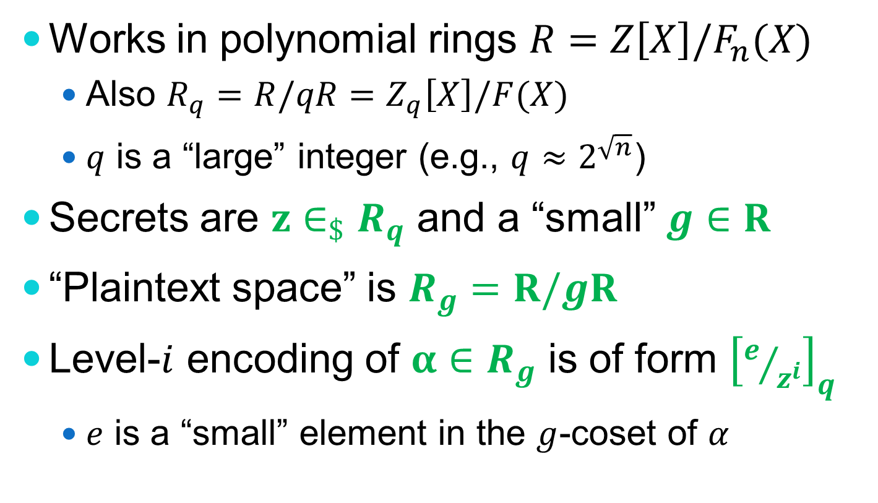
The [GGH13] Construction
Works in polynomial rings $R=Z\left[X\right]/F_{n}(X)$
Also $R_{q}=R/qR=Z_{q}\left[X\right]/F(X)$
$q$ is a “large” integer (e.g., $q≈2^{\sqrt{n}}$)
Secrets are $z∈_{\$}R_{q}$ and a “small” $g∈R$
“Plaintext space” is $R_{g}=R/gR$
Level-$i$ encoding of $α∈R_{g}$ is of form ${\left[e/{z^{i}}\right]}_{q}$
$e$ is a “small” element in the $g$-coset of $α$
Notes:
Why polynomial rings?
Quantities of interest correspond to high-dimensional lattices and their cosets
Finding “small representatives” is hard

Slide 7
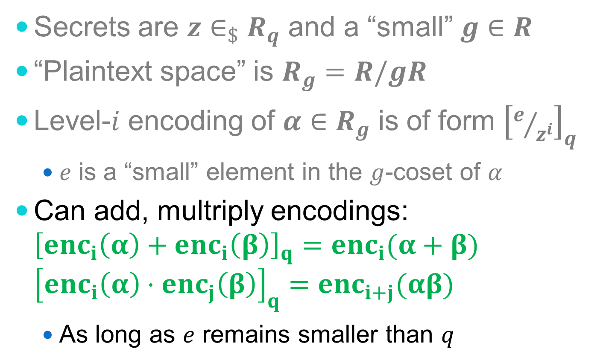
The [GGH13] Construction
Secrets are $z∈_{\$}R_{q}$ and a “small” $g∈R$
“Plaintext space” is $R_{g}=R/gR$
Level-$i$ encoding of $α∈R_{g}$ is of form ${\left[e/{z^{i}}\right]}_{q}$
$e$ is a “small” element in the $g$-coset of $α$
Can add, multriply encodings: ${\left[enc_{i}\left(α\right)+enc_{i}\left(β\right)\right]}_{q}=enc_{i}(α+β)$ ${\left[enc_{i}\left(α\right)⋅enc_{j}\left(β\right)\right]}_{q}=enc_{i+j}(αβ)$
As long as $e$ remains smaller than $q$

Slide 8
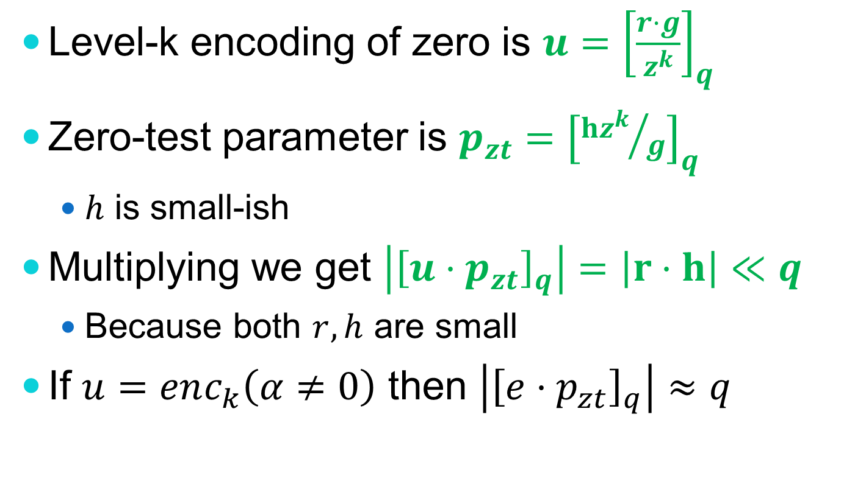
The [GGH13] Zero-Test
Level-k encoding of zero is ${u=\left[\frac{r⋅g}{z^{k}}\right]}_{q}$
Zero-test parameter is $p_{zt}={\left[{hz^{k}}/g\right]}_{q}$
$h$ is small-ish
Multiplying we get $\left|{\left[u⋅p_{zt}\right]}_{q}\right|=\left|r⋅h\right|≪q$
Because both $r,h$ are small
If $u=enc_{k}\left(α≠0\right)$ then $\left|{\left[e⋅p_{zt}\right]}_{q}\right|≈q$

Slide 9
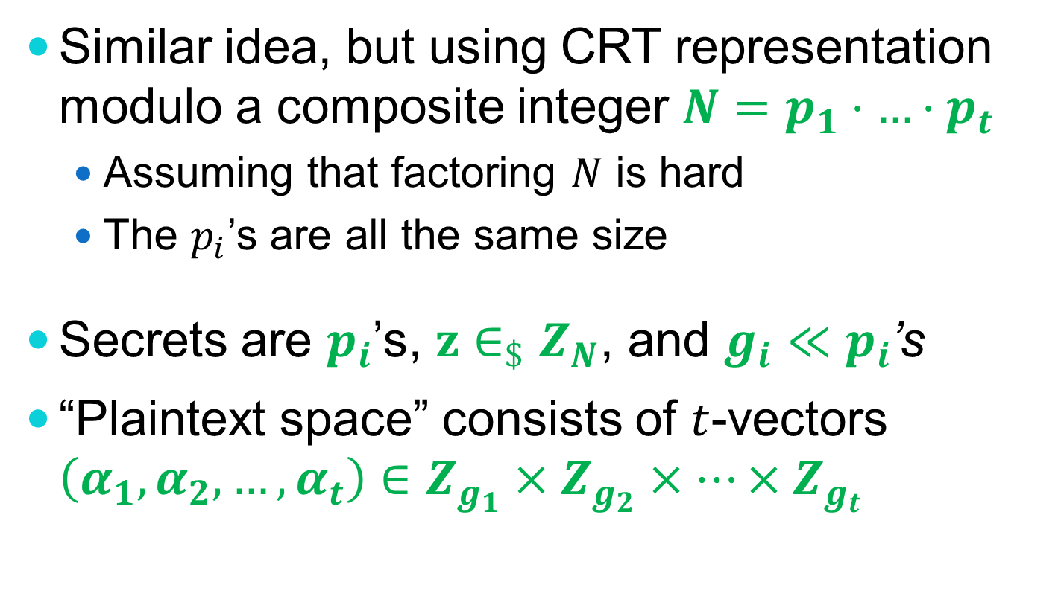
The [CLT13] Construction
Similar idea, but using CRT representation modulo a composite integer $N=p_{1}⋅…⋅p_{t}$
Assuming that factoring $N$ is hard
The $p_{i}$’s are all the same size
Secrets are $p_{i}$’s, $z∈_{\$}Z_{N}$, and $g_{i}≪p_{i}$’s
“Plaintext space” consists of $t$-vectors $\left(α_{1},α_{2},…,α_{t}\right)∈Z_{g_{1}}×Z_{g_{2}}×…×Z_{g_{t}}$

Slide 10

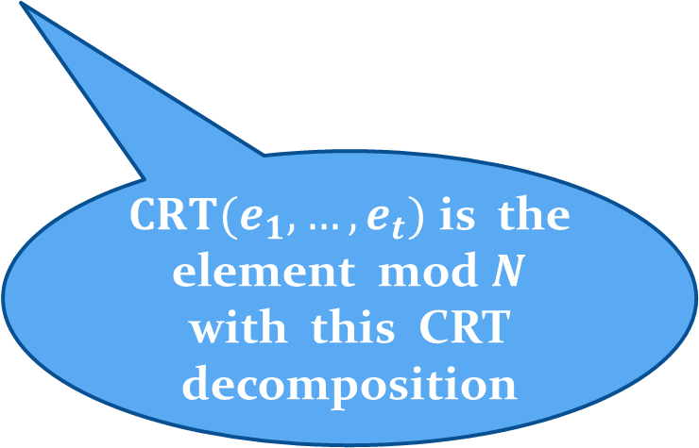
The [CLT13] Construction
Level-$i$ encoding of vector $\left(α_{1}…α_{t}\right)$ has the form ${\left[{CRT(e_{1},…,e_{t})}/{z^{i}}\right]}_{N}$, where $e_{i}=r_{i}g_{i}+α_{i}$
$e_{i}$‘s are small element in the $g_{i}$-cosets of $α_{i}$’s
$CRT(e_{1},…,e_{t})$ is the element mod $N$ with this CRT decomposition

Slide 11
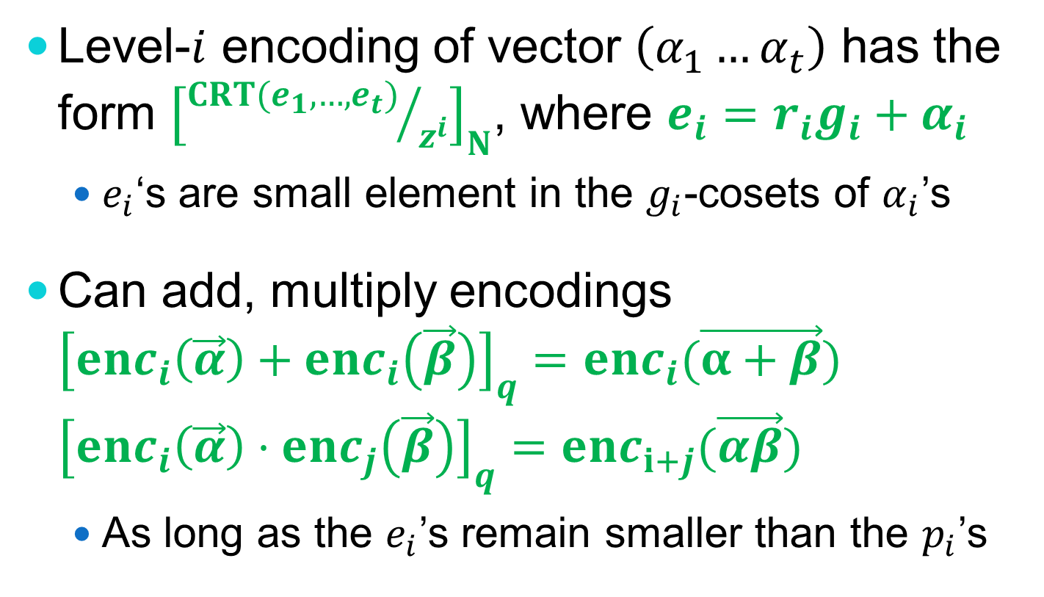
The [CLT13] Construction
Level-$i$ encoding of vector $\left(α_{1}…α_{t}\right)$ has the form ${\left[{CRT(e_{1},…,e_{t})}/{z^{i}}\right]}_{N}$, where $e_{i}=r_{i}g_{i}+α_{i}$
$e_{i}$‘s are small element in the $g_{i}$-cosets of $α_{i}$’s
Can add, multiply encodings ${\left[enc_{i}\left(\vec{α}\right)+enc_{i}\left(\vec{β}\right)\right]}_{q}=enc_{i}(\vec{α+β})$ ${\left[enc_{i}\left(\vec{α}\right)⋅enc_{j}\left(\vec{β}\right)\right]}_{q}=enc_{i+j}(\vec{αβ})$
As long as the $e_{i}$’s remain smaller than the $p_{i}$’s

Slide 12
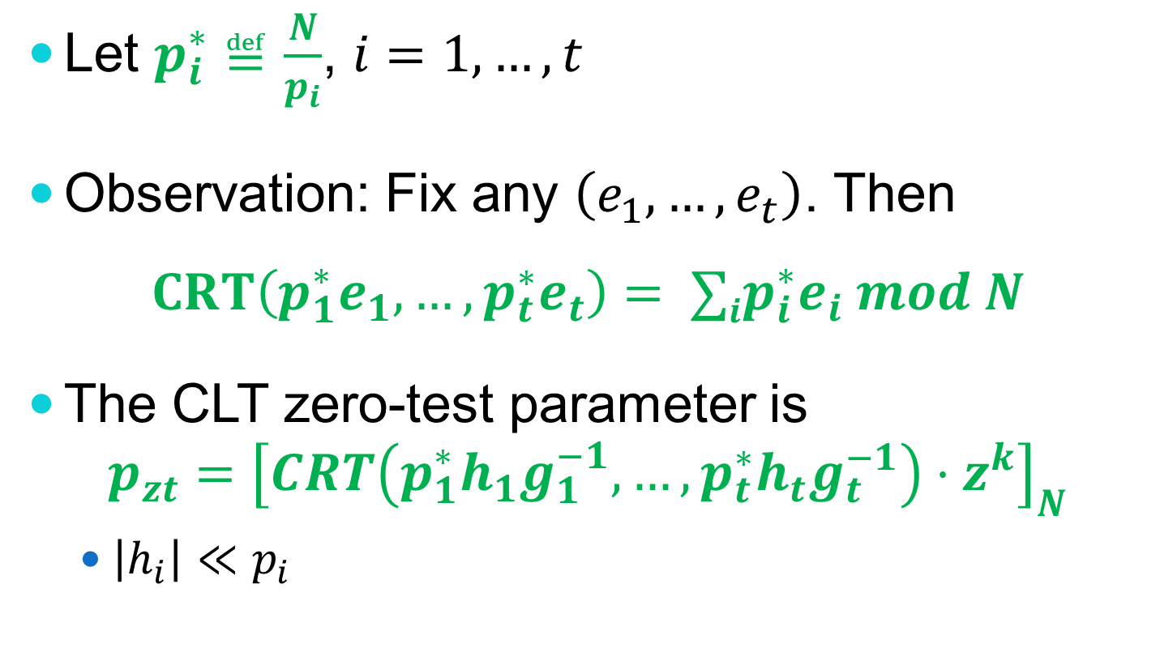
The [CLT13] Zero-Test
Let $p_{i}^{∗}≝\frac{N}{p_{i}}$, $i=1,…,t$
Observation: Fix any $\left(e_{1},…,e_{t}\right)$. Then
$$CRT\left(p_{1}^{∗}e_{1},…,p_{t}^{∗}e_{t}\right)= ∑ip_{i}^{∗}e_{i} mod N$$
The CLT zero-test parameter is $p_{zt}={\left[CRT\left({p_{1}^{∗}h}_{1}g_{1}^{−1},…,{p_{t}^{∗}h}_{t}g_{t}^{−1}\right)⋅z^{k}\right]}_{N}$
$\left|h_{i}\right|≪p_{i}$

Slide 13
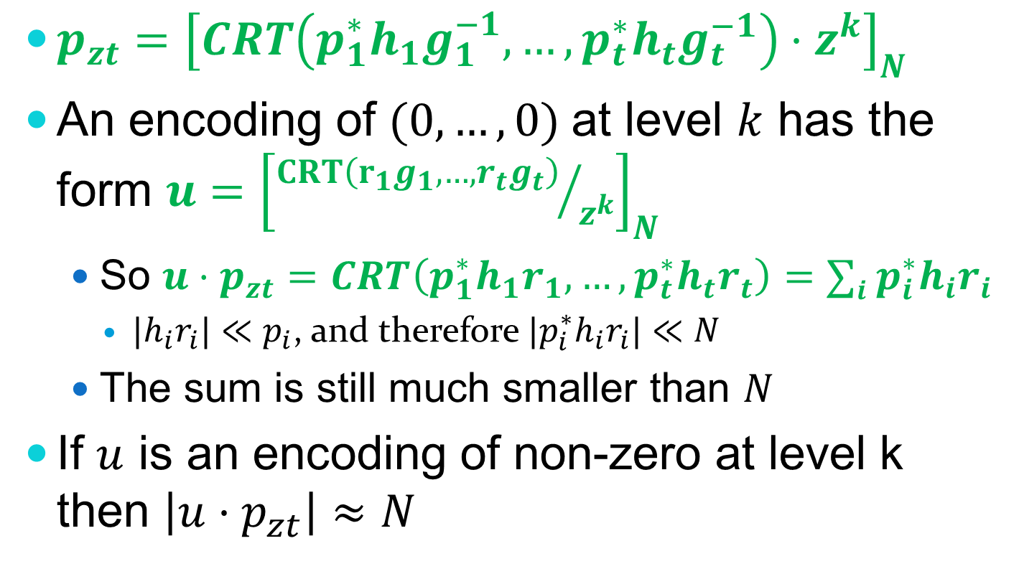
The [CLT13] Zero-Test
$p_{zt}={\left[CRT\left({p_{1}^{∗}h}_{1}g_{1}^{−1},…,{p_{t}^{∗}h}_{t}g_{t}^{−1}\right)⋅z^{k}\right]}_{N}$
An encoding of $(0,…,0)$at level $k$ has the form $u={\left[{CRT\left(r_{1}g_{1},…,r_{t}g_{t}\right)}/{z^{k}}\right]}_{N}$
So $u⋅p_{zt}=CRT\left({p_{1}^{∗}h}_{1}r_{1},…,{p_{t}^{∗}h}_{t}r_{t}\right)=∑i {p_{i}^{∗}h}_{i}r_{i}$
${|h}_{i}r_{i}|≪p_{i}$, and therefore ${|p_{i}^{∗}h}_{i}r_{i}|≪N$
The sum is still much smaller than $N$
If $u$ is an encoding of non-zero at level k then $\left|u⋅p_{zt}\right|≈N$

Slide 14
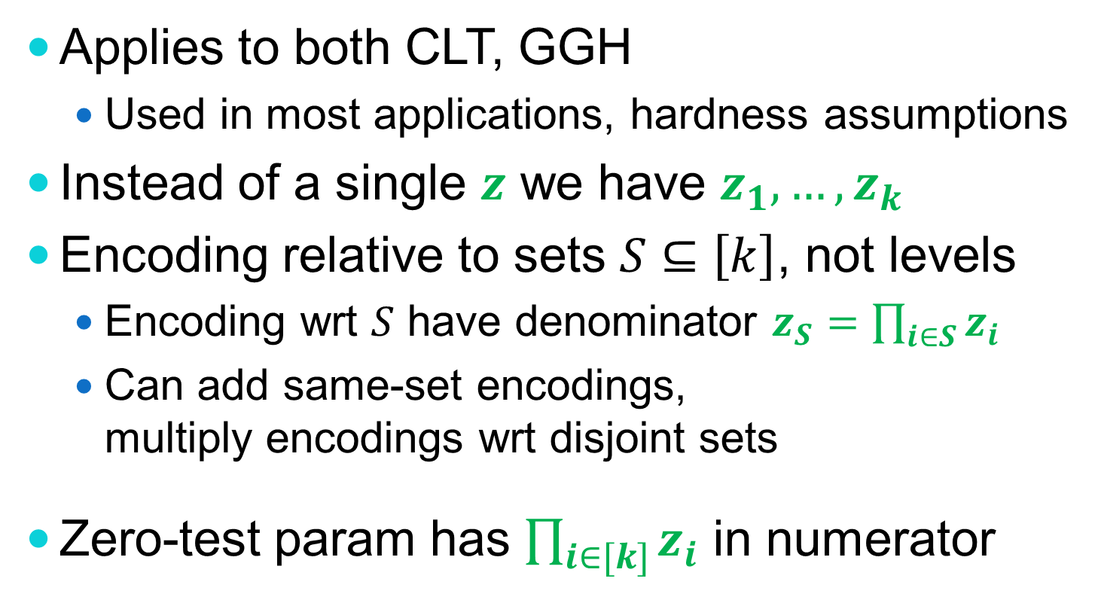
An “Asymmetric” Variant
Applies to both CLT, GGH
Used in most applications, hardness assumptions
Instead of a single $z$ we have $z_{1},…,z_{k}$
Encoding relative to sets $S⊆\left[k\right]$, not levels
Encoding wrt $S$ have denominator $z_{S}=\prod_{i∈S}{z_{i}}$
Can add same-set encodings, multiply encodings wrt disjoint sets
Zero-test param has $\prod_{i∈[k]}{z_{i}}$ in numerator

Slide 15
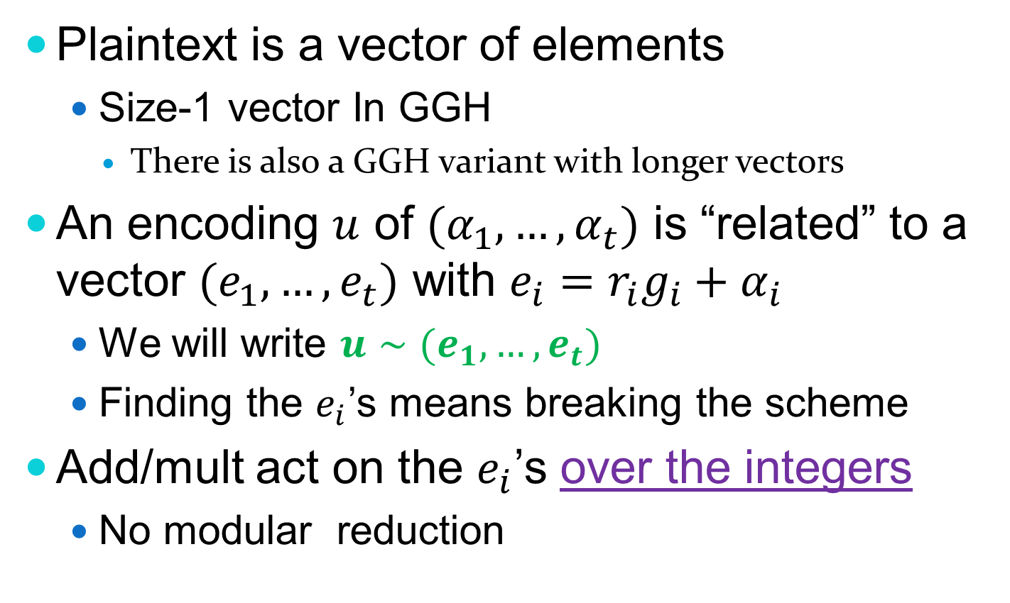
Common properties of GGH, CLT
Plaintext is a vector of elements
Size-1 vector In GGH
There is also a GGH variant with longer vectors
An encoding $u$ of $(α_{1},…,α_{t})$ is “related” to a vector $(e_{1}, …,e_{t})$ with $e_{i}=r_{i}g_{i}+α_{i}$
We will write $u∼(e_{1},…,e_{t})$
Finding the $e_{i}$’s means breaking the scheme
Add/mult act on the $e_{i}$’s over the integers
No modular reduction
Notes:
For GGH: ring-of-integers in some algebraic field

Slide 16
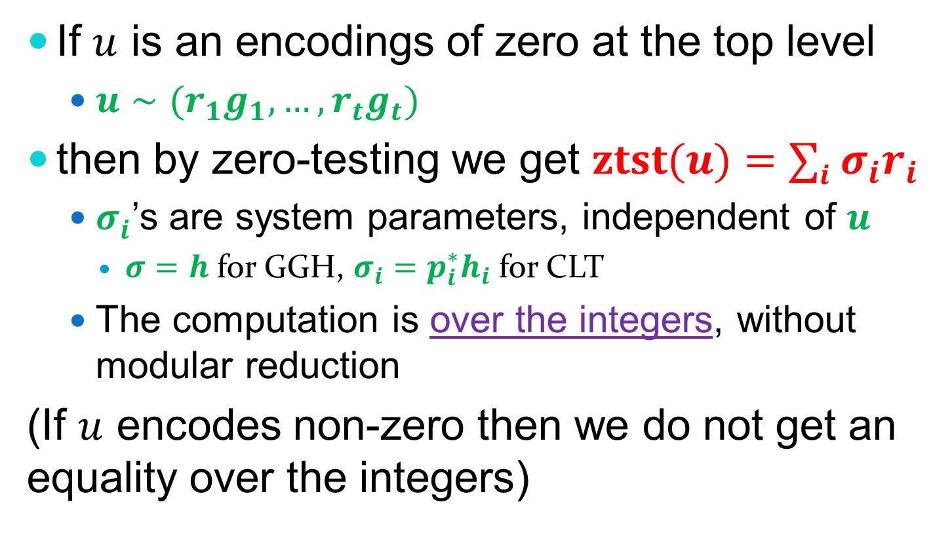
Common properties of GGH, CLT
If $u$ is an encodings of zero at the top level
$u∼(r_{1}g_{1},…,r_{t}g_{t})$
then by zero-testing we get $ztst(u)=∑i {σ_{i}r}_{i}$
$σ_{i}^{}$’s are system parameters, independent of $u$
$σ=h$ for GGH, $σ_{i}={p_{i}^{∗}h}_{i}$ for CLT
The computation is over the integers, without modular reduction
(If $u$ encodes non-zero then we do not get an equality over the integers)

Slide 17
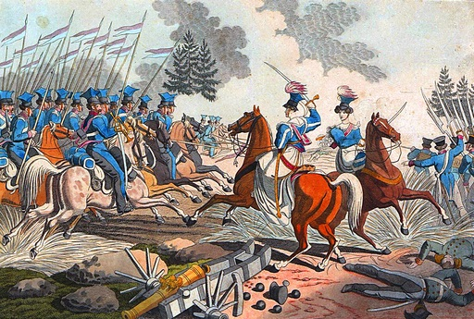
Attacks
Notes:
Note: Graded-Encoding is a tool, not a primitive, so attacks cannot “break it” per se
They break concrete assumptions made on it
Also break some applications that use it
We will see some examples

Slide 18
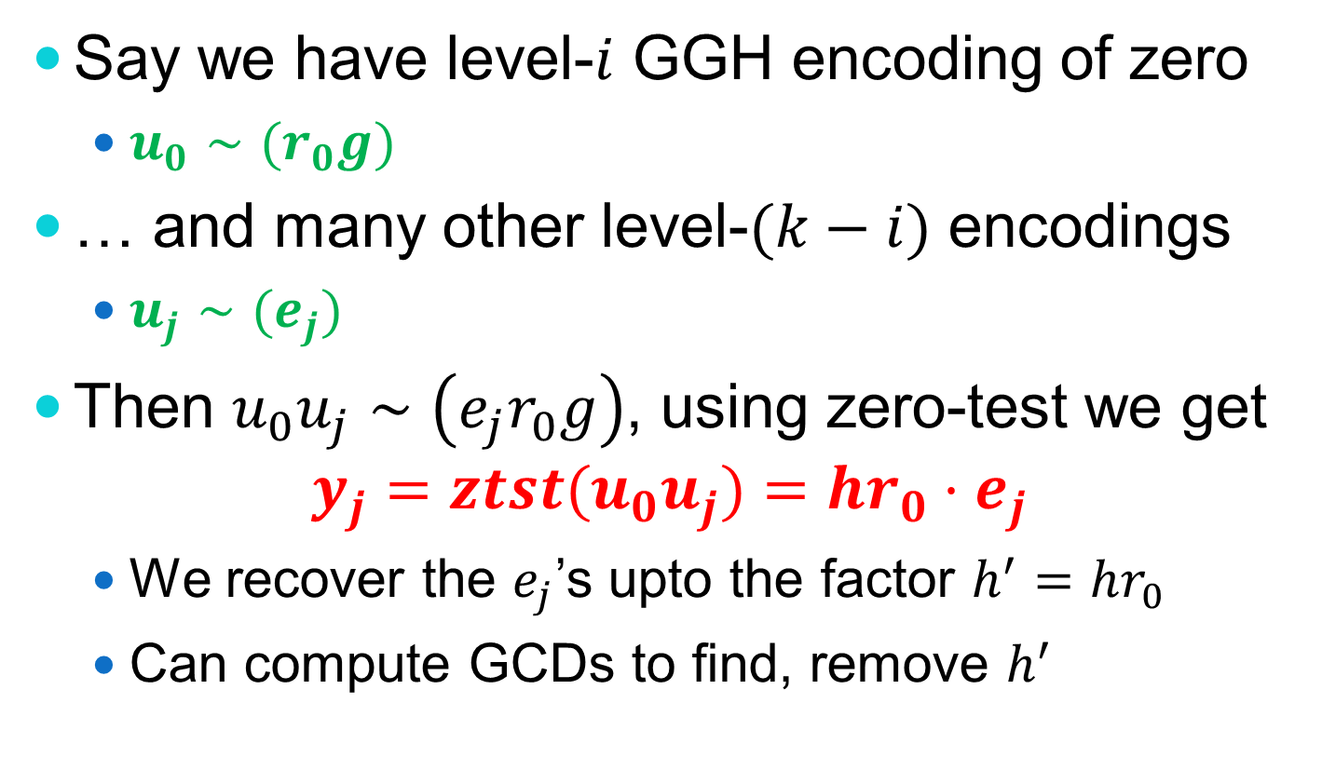
The [GGH13] “zeroizing” attack
Say we have level-$i$ GGH encoding of zero
$u_{0}∼(r_{0}g)$
… and many other level-$(k−i)$ encodings
$u_{j}∼(e_{j})$
Then $u_{0}u_{j}∼\left(e_{j}r_{0}g\right)$, using zero-test we get $y_{j}={ztst(u}_{0}u_{j})=hr_{0}⋅e_{j}$
We recover the $e_{j}$’s upto the factor $h^{′}=hr_{0}$
Can compute GCDs to find, remove $h^{′}$

Slide 19
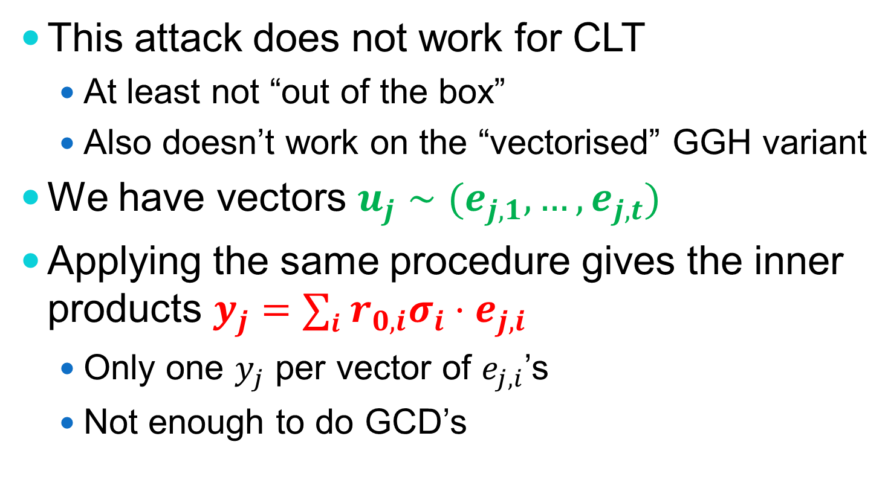
The [GGH13] “zeroizing” attack
This attack does not work for CLT
At least not “out of the box”
Also doesn’t work on the “vectorised” GGH variant
We have vectors $u_{j}∼(e_{j,1},…,e_{j,t})$
Applying the same procedure gives the inner products $y_{j}=∑i r_{0,i}σ_{i}⋅e_{j,i}$
Only one $y_{j}$ per vector of $e_{j,i}$’s
Not enough to do GCD’s

Slide 20
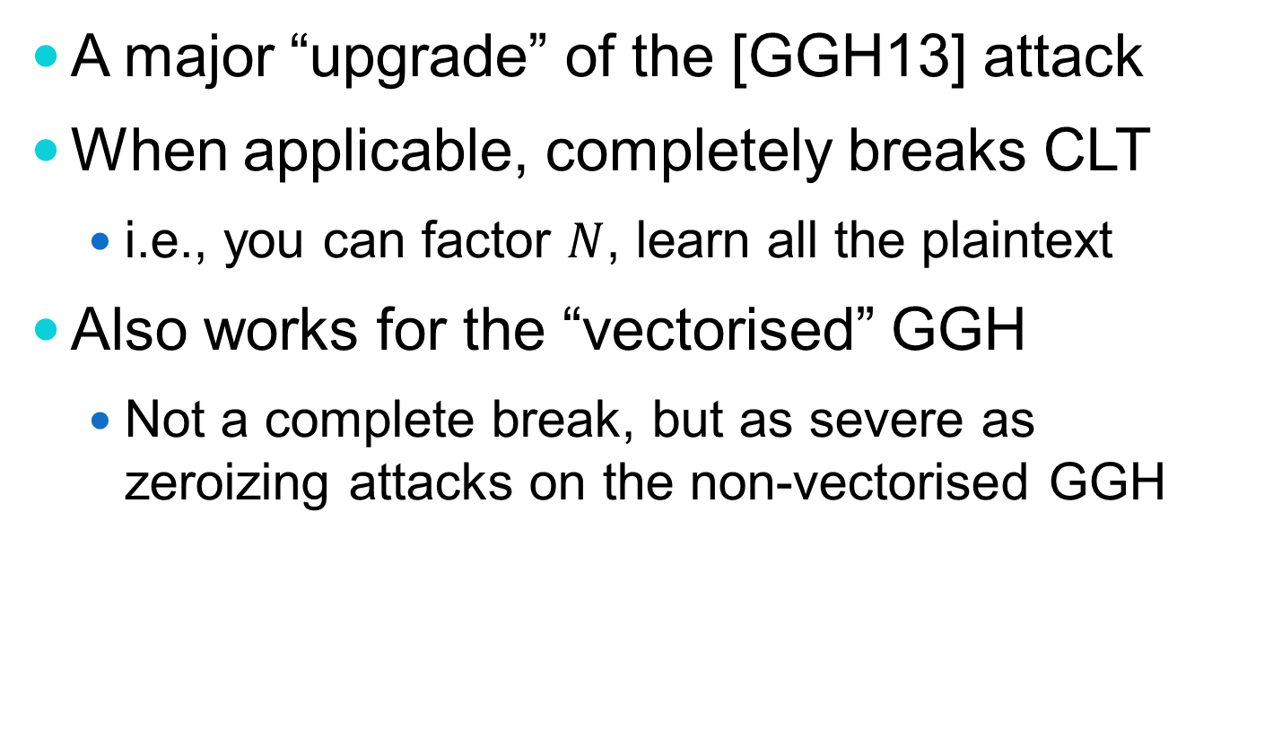
The Cheon et al. Attack [CHLRS14]
A major “upgrade” of the [GGH13] attack
When applicable, completely breaks CLT
i.e., you can factor $N$, learn all the plaintext
Also works for the “vectorised” GGH
Not a complete break, but as severe as zeroizing attacks on the non-vectorised GGH

Slide 21
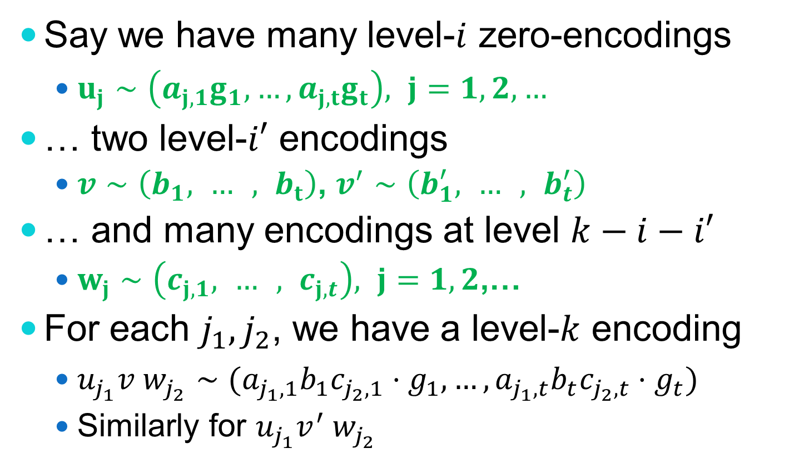
The Cheon et al. Attack [CHLRS14]
Say we have many level-$i$ zero-encodings
$u_{j}∼\left(a_{j,1}g_{1},…,a_{j,t}g_{t}\right), j=1,2,…$
… two level-$i′$ encodings
$v∼\left(b_{1}, … , b_{t}\right)$, $v^{′}∼\left(b_{1}^{′}, … , b_{t}^{′}\right)$
… and many encodings at level $k−i−i′$
$w_{j}∼\left(c_{j,1}, … , c_{j,t}\right), j=1,2$,…
For each $j_{1},j_{2}$, we have a level-$k$ encoding
$u_{j_{1}}v w_{j_{2}}∼(a_{j_{1},1}b_{1}c_{j_{2},1}⋅g_{1},…,a_{j_{1},t}b_{t}c_{j_{2},t}⋅g_{t})$
Similarly for $u_{j_{1}}v^{′} w_{j_{2}}$

Slide 22
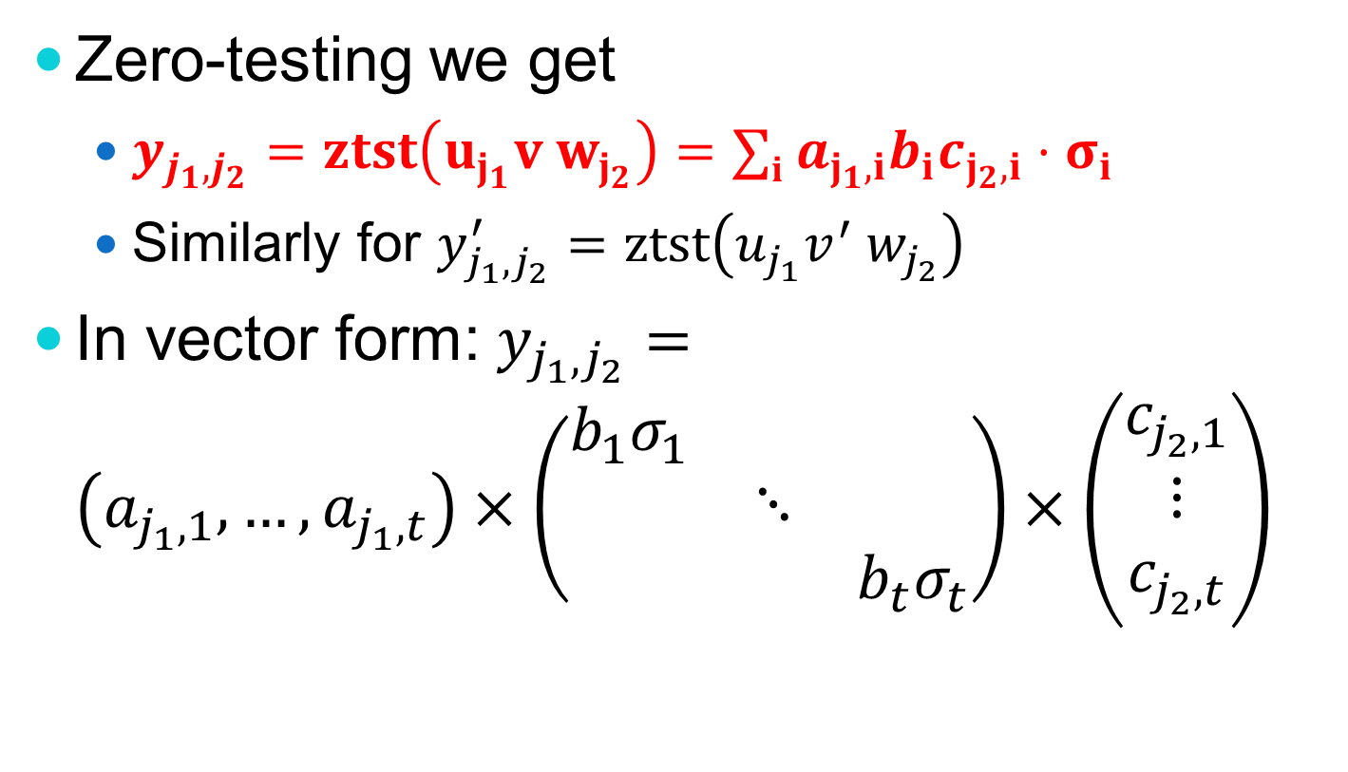
The Cheon et al. Attack [CHLRS14]
Zero-testing we get
$y_{j_{1},j_{2}}=ztst\left(u_{j_{1}}v w_{j_{2}}\right)=∑i a_{j_{1},i}b_{i}c_{j_{2},i}⋅σ_{i}$
Similarly for $y_{j_{1},j_{2}}^{′}=ztst\left(u_{j_{1}}v^{′} w_{j_{2}}\right)$
In vector form: $y_{j_{1},j_{2}}=$ $\left(a_{j_{1},1},…,a_{j_{1},t}\right)×\left(\begin{matrix}b_{1}σ_{1} & & \\ & ⋱ & \\ & & b_{t}σ_{t}\end{matrix}\right)×\left(\begin{matrix}c_{j_{2},1} \\ ⋮ \\ c_{j_{2},t}\end{matrix}\right)$
0
0

Slide 23

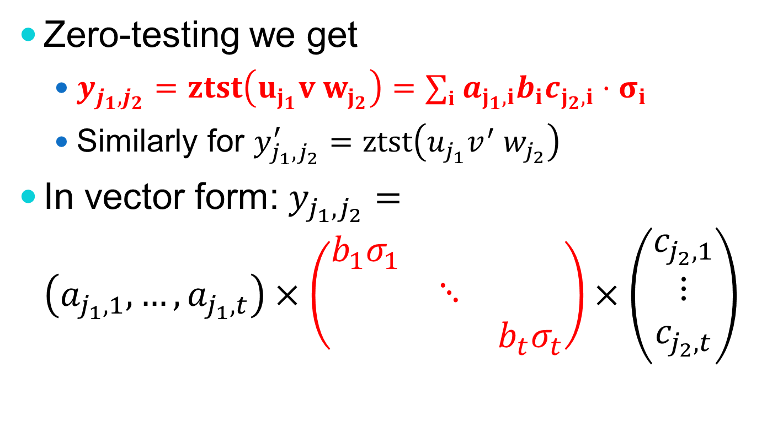


The Cheon et al. Attack [CHLRS14]
Zero-testing we get
$y_{j_{1},j_{2}}=ztst\left(u_{j_{1}}v w_{j_{2}}\right)=∑i a_{j_{1},i}b_{i}c_{j_{2},i}⋅σ_{i}$
Similarly for $y_{j_{1},j_{2}}^{′}=ztst\left(u_{j_{1}}v^{′} w_{j_{2}}\right)$
In vector form: $y_{j_{1},j_{2}}=$ $\left(a_{j_{1},1},…,a_{j_{1},t}\right)×\left(\begin{matrix}b_{1}σ_{1} & & \\ & ⋱ & \\ & & b_{t}σ_{t}\end{matrix}\right)×\left(\begin{matrix}c_{j_{2},1} \\ ⋮ \\ c_{j_{2},t}\end{matrix}\right)$
0
0
$$\vec{u_{j_{1}}}$$
$$V$$
$$\vec{w_{j_{2}}}$$

Slide 24
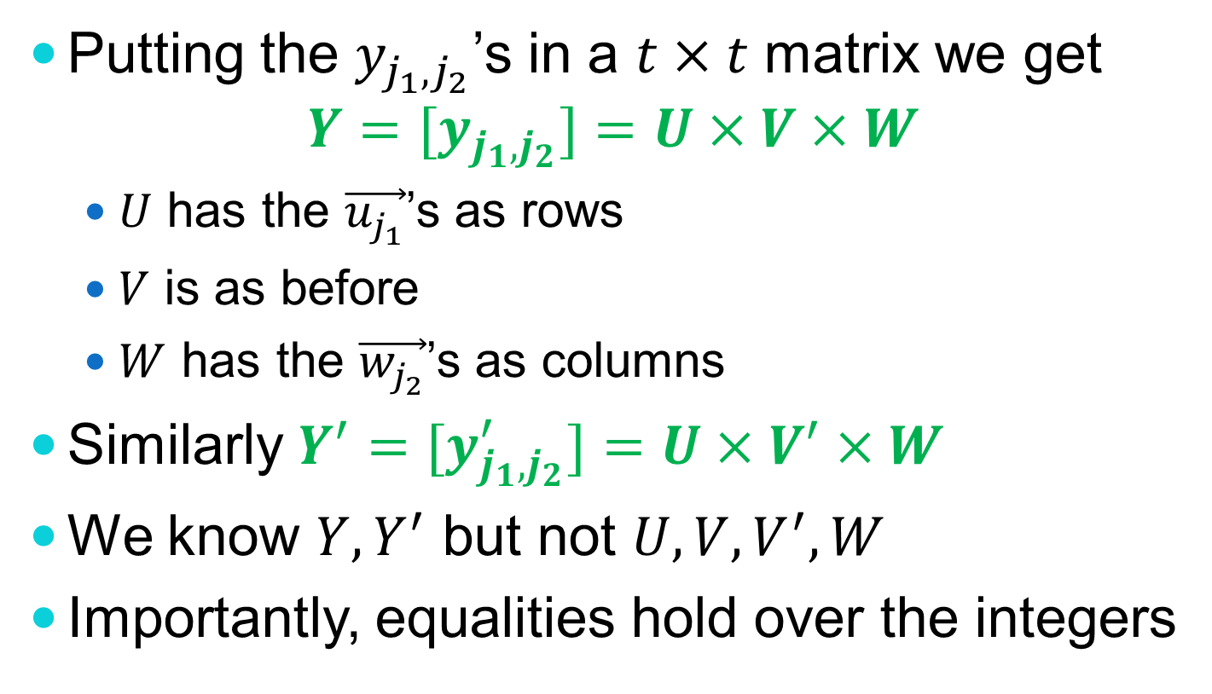
The Cheon et al. Attack [CHLRS14]
Putting the $y_{j_{1},j_{2}}$’s in a $t×t$ matrix we get $Y=[y_{j_{1},j_{2}}]=U×V×W$
$U$ has the $\vec{u_{j_{1}}}$’s as rows
$V$ is as before
$W$ has the $\vec{w_{j_{2}}}$’s as columns
Similarly $Y^{′}=[y_{j_{1},j_{2}}^{′}]=U×V^{′}×W$
We know $Y,Y^{′}$ but not $U,V,V^{′},W$
Importantly, equalities hold over the integers
Whp U,V,W are invertible

Slide 25
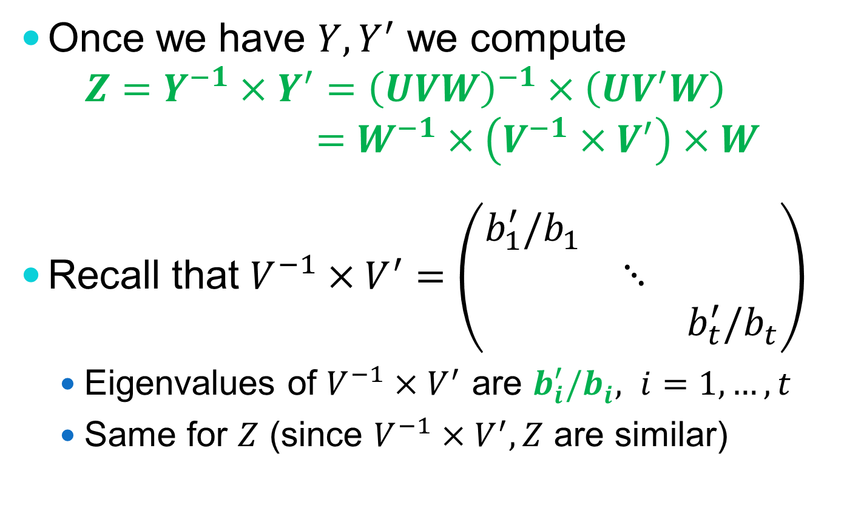
The Cheon et al. Attack [CHLRS14]
Once we have $Y, Y^{′}$ we compute $Z=Y^{−1}×Y^{′}={\left(UVW\right)}^{−1}×\left(UV^{′}W\right)$ $=W^{−1}×\left(V^{−1}×V^{′}\right)×W$
Recall that $V^{−1}×V^{′}=\left(\begin{matrix}b_{1}^{′}{/b}_{1} & & \\ & ⋱ & \\ & & b_{t}^{′}/b_{t}^{}\end{matrix}\right)$
Eigenvalues of $V^{−1}×V^{′}$ are $b_{i}^{′}{/b}_{i}^{}, i=1,…,t$
Same for $Z$ (since $V^{−1}×V^{′}, Z$ are similar)
0
0

Slide 26
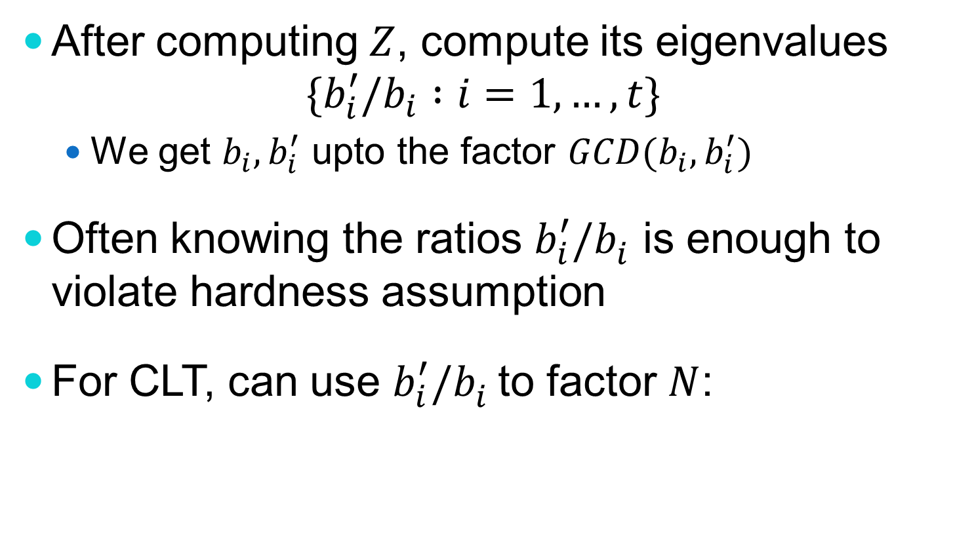
The Cheon et al. Attack [CHLRS14]
After computing $Z$, compute its eigenvalues $\{b_{i}^{′}/b_{i} :i=1,…,t\}$
We get $b_{i},b_{i}^{′}$ upto the factor $GCD(b_{i},b_{i}^{′})$
Often knowing the ratios $b_{i}^{′}/b_{i}^{}$ is enough to violate hardness assumption
For CLT, can use $b_{i}^{′}/b_{i}^{}$to factor $N$:

Slide 27
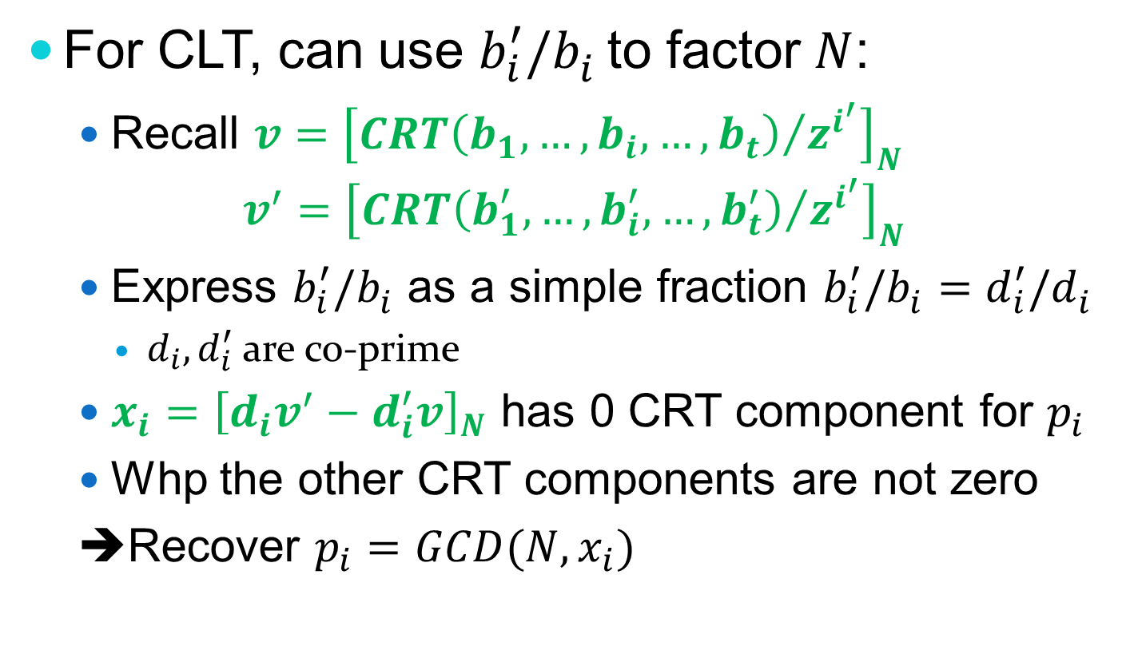
The Cheon et al. Attack [CHLRS14]
For CLT, can use $b_{i}^{′}/b_{i}^{}$to factor $N$:
Recall $v={\left[{CRT\left(b_{1},…,b_{i},…,b_{t}\right)}/{z^{i^{′}}}\right]}_{N}$ $v^{′}={\left[{CRT\left(b_{1}^{′},…,b_{i}^{′},…,b_{t}^{′}\right)}/{z^{i^{′}}}\right]}_{N}$
Express $b_{i}^{′}/b_{i}^{}$ as a simple fraction $b_{i}^{′}/b_{i}^{}=d_{i}^{′}/d_{i}^{}$
$d_{i}, d_{i}^{′}$ are co-prime
$x_{i}={\left[d_{i}v^{′}−d_{i}^{′}v\right]}_{N}$ has 0 CRT component for $p_{i}$
Whp the other CRT components are not zero
➔Recover $p_{i}=GCD(N,x_{i})$

Slide 28
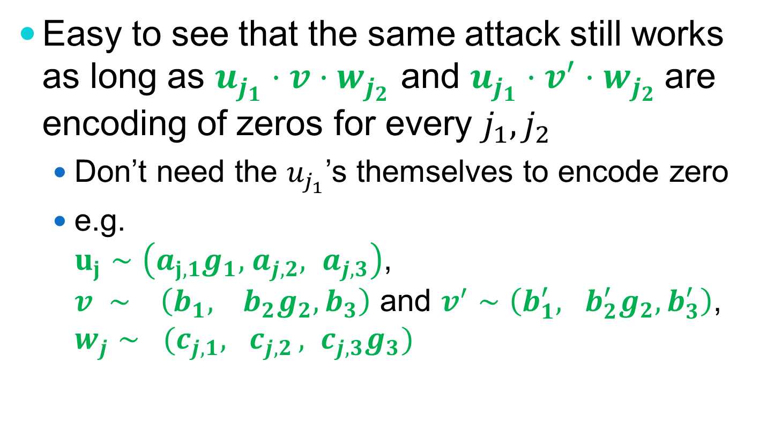
Extending the Attack
Easy to see that the same attack still works as long as $u_{j_{1}}⋅v⋅w_{j_{2}}$ and $u_{j_{1}}⋅v^{′}⋅w_{j_{2}}$are encoding of zeros for every $j_{1},j_{2}$
Don’t need the $u_{j_{1}}$’s themselves to encode zero
e.g. $u_{j}∼\left(a_{j,1}g_{1},{ a}_{j,2}, a_{j,3}\right)$, $v ∼ \left(b_{1}, b_{2}g_{2}, b_{3}\right)$ and $v^{′}∼\left(b_{1}^{′}, b_{2}^{′}g_{2}, b_{3}^{′}\right)$, $w_{j}∼ (c_{j,1}, c_{j,2 }, c_{j,3}g_{3})$

Slide 29
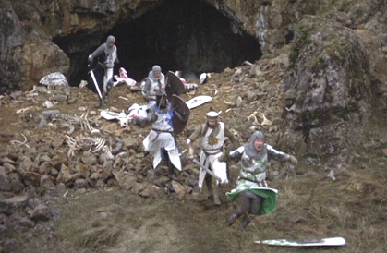
Attack Consequences

Slide 30
Some Schemes are Broken
For example, schemes that publish low-level encoding of zeros are likely broken
Publishing zero-encoding would be useful
E.g., to re-randomize encodings by adding a subset-sum of these zero encodings
Even some obfuscation schemes
E.g., the “simple IO scheme” from [Zim14] (this requires further extending the attacks)

Slide 31
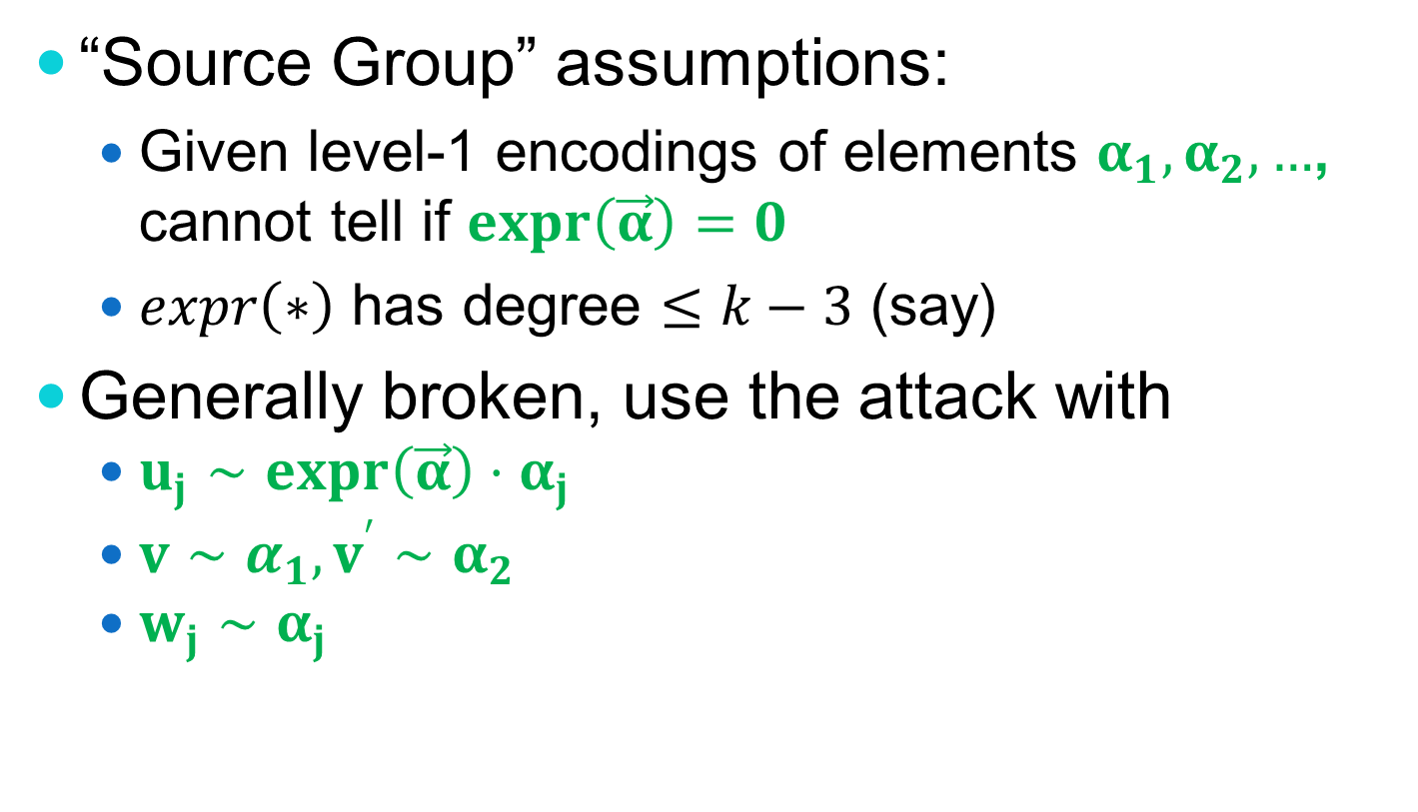
Many Assumptions are Broken
“Source Group” assumptions:
Given level-1 encodings of elements $α_{1},α_{2},…$, cannot tell if $expr\left(\vec{α}\right)=0$
$expr\left(∗\right)$ has degree $≤k−3$ (say)
Generally broken, use the attack with
$u_{j}∼expr\left(\vec{α}\right)⋅α_{j}$
$v∼α_{1}, v^{′}∼α_{2}$
$w_{j}∼α_{j}$

Slide 32
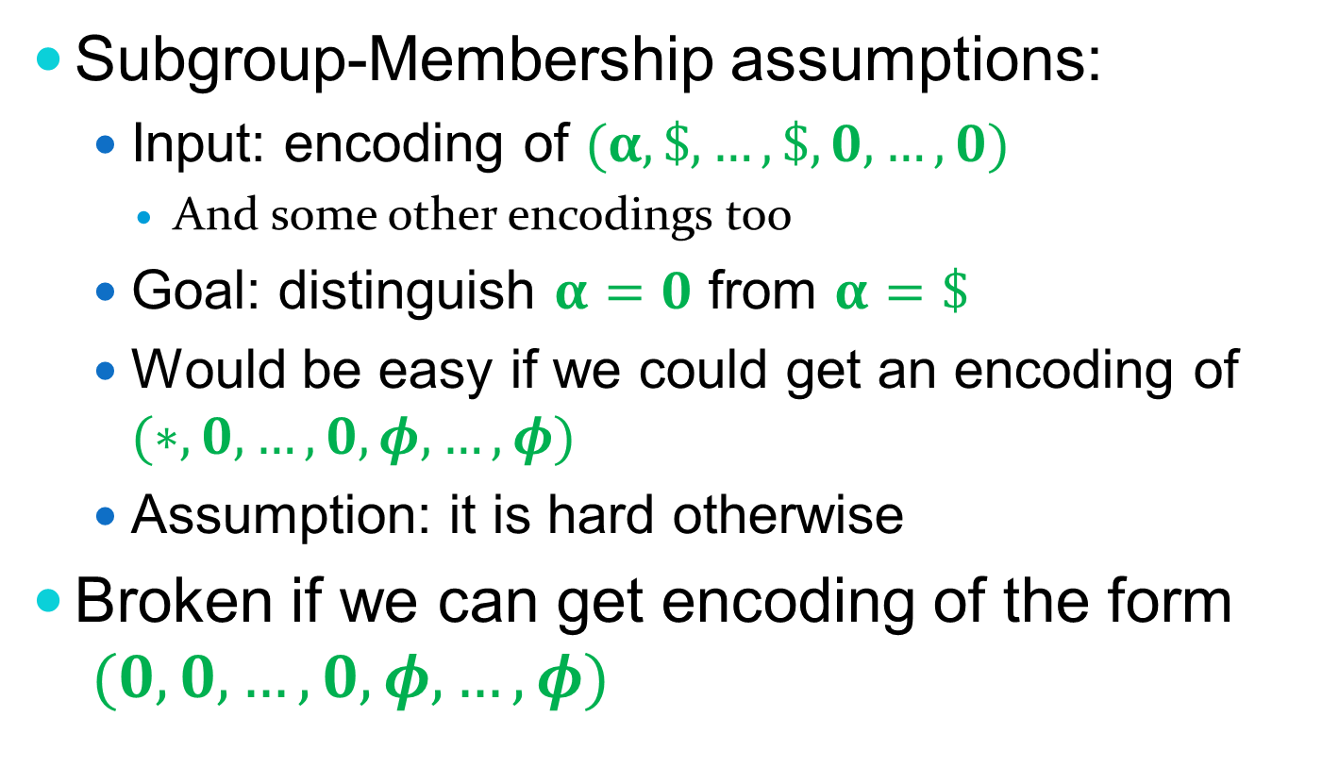
Many Assumptions are Broken
Subgroup-Membership assumptions:
Input: encoding of $(α,\$,…,\$,0,…,0)$
And some other encodings too
Goal: distinguish $α=0$ from $α=\$$
Would be easy if we could get an encoding of $(∗,0,…,0,φ,…,φ)$
Assumption: it is hard otherwise
Broken if we can get encoding of the form $(0,0,…,0,φ,…,φ)$
Notes:
Used e.g. in [GLW14,GLSW14] for witness-encryption, obfuscation

Slide 33
Many Assumptions are Broken
Currently we have no candidate GES with hard source-group or subgroup-membership problems

Slide 34
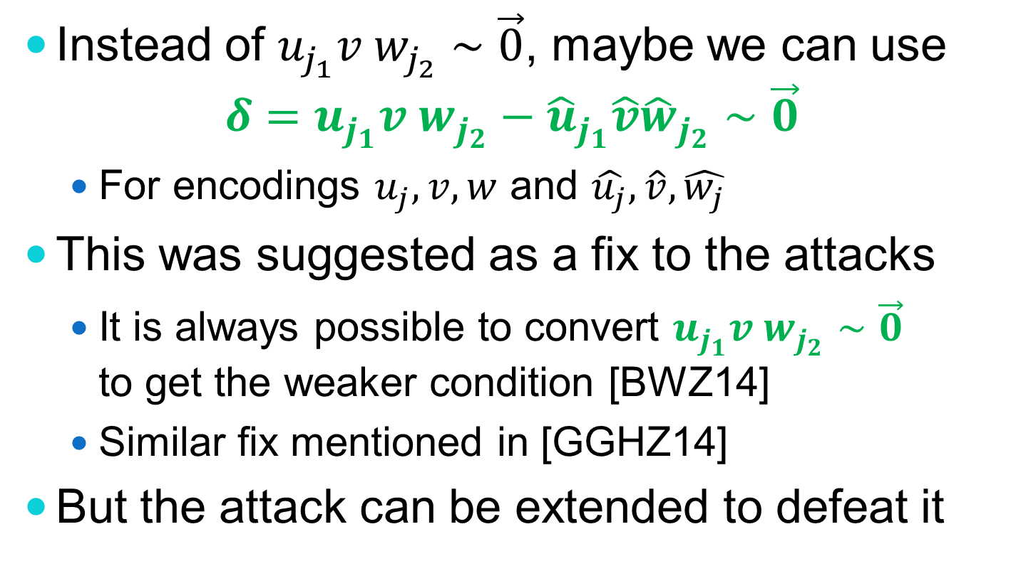
A Suggested Fix
Instead of $u_{j_{1}}v w_{j_{2}}∼\vec{0}$, maybe we can use $δ=u_{j_{1}}v w_{j_{2}}−{\hat{u}}_{j_{1}}\hat{v}{\hat{w}}_{j_{2}}∼\vec{0}$
For encodings $u_{j}, v, w$ and $\hat{u_{j}}, \hat{v}, \hat{w_{j}}$
This was suggested as a fix to the attacks
It is always possible to convert $u_{j_{1}}v w_{j_{2}}∼\vec{0}$ to get the weaker condition [BWZ14]
Similar fix mentioned in [GGHZ14]
But the attack can be extended to defeat it

Slide 35
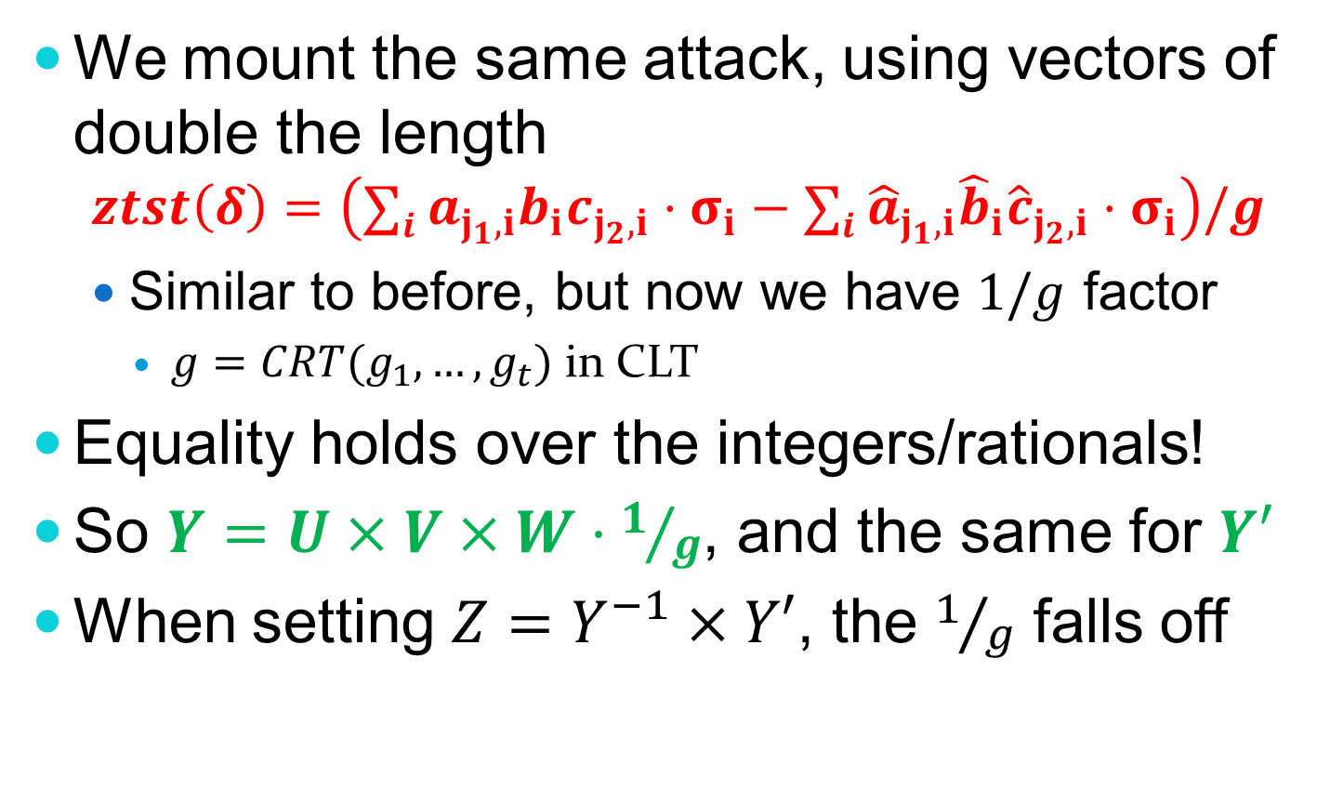
Further Extending the Attack
We mount the same attack, using vectors of double the length
$$ztst\left(δ\right)=\left(∑i a_{j_{1},i}b_{i}c_{j_{2},i}⋅σ_{i}−∑i {\hat{a}}_{j_{1},i}{\hat{b}}_{i}{\hat{c}}_{j_{2},i}⋅σ_{i}\right)/g$$
Similar to before, but now we have $1/g$ factor
$g=CRT(g_{1},…,g_{t})$ in CLT
Equality holds over the integers/rationals!
So $Y=U×V×W⋅1/g$, and the same for $Y′$
When setting $Z=Y^{−1}×Y′$, the $1/g$ falls off

Slide 36
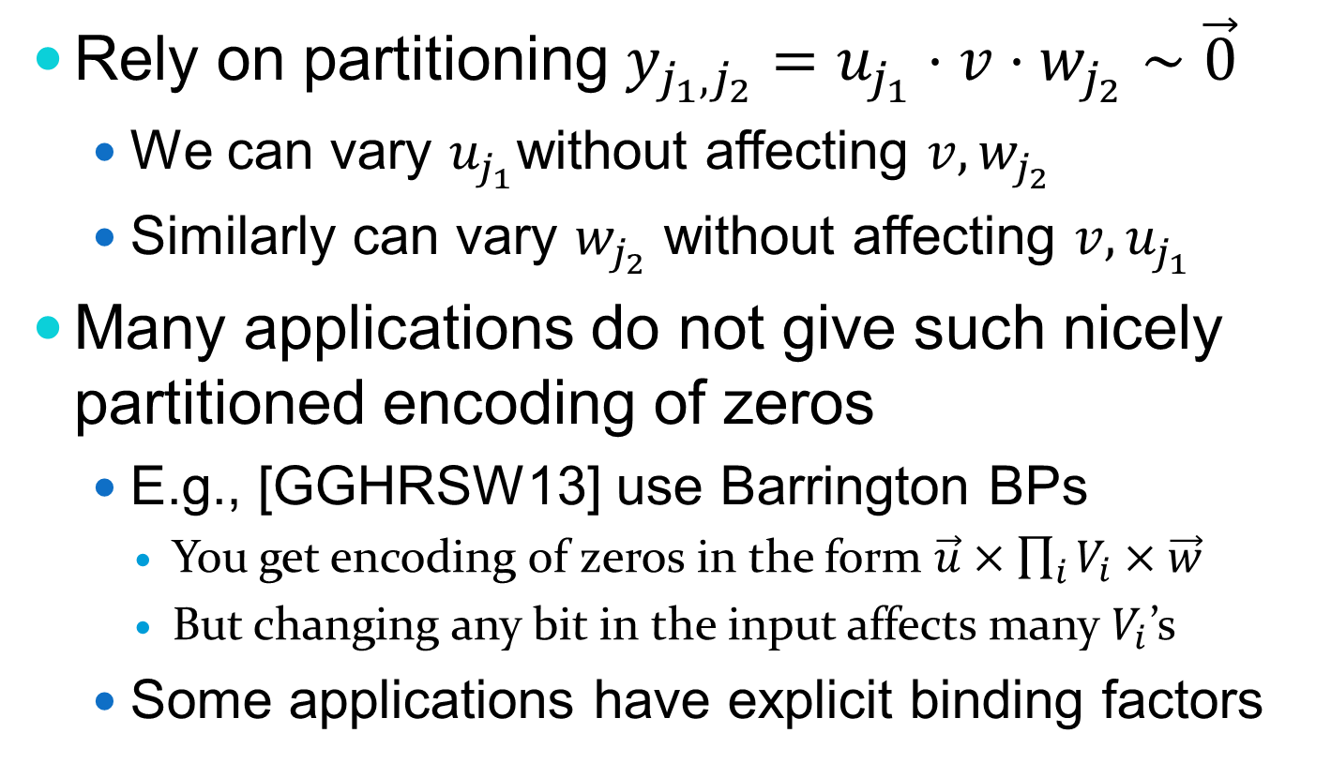
Limitations of the Attacks
Rely on partitioning $y_{j_{1},j_{2}}=u_{j_{1}}⋅v⋅w_{j_{2}}∼\vec{0}$
We can vary $u_{j_{1}}$without affecting $v,w_{j_{2}}$
Similarly can vary $w_{j_{2}}$ without affecting $v,u_{j_{1}}$
Many applications do not give such nicely partitioned encoding of zeros
E.g., [GGHRSW13] use Barrington BPs
You get encoding of zeros in the form $\vec{u}×\prod_{i}{V_{i}}×\vec{w}$
But changing any bit in the input affects many $V_{i}$’s
Some applications have explicit binding factors

Slide 37
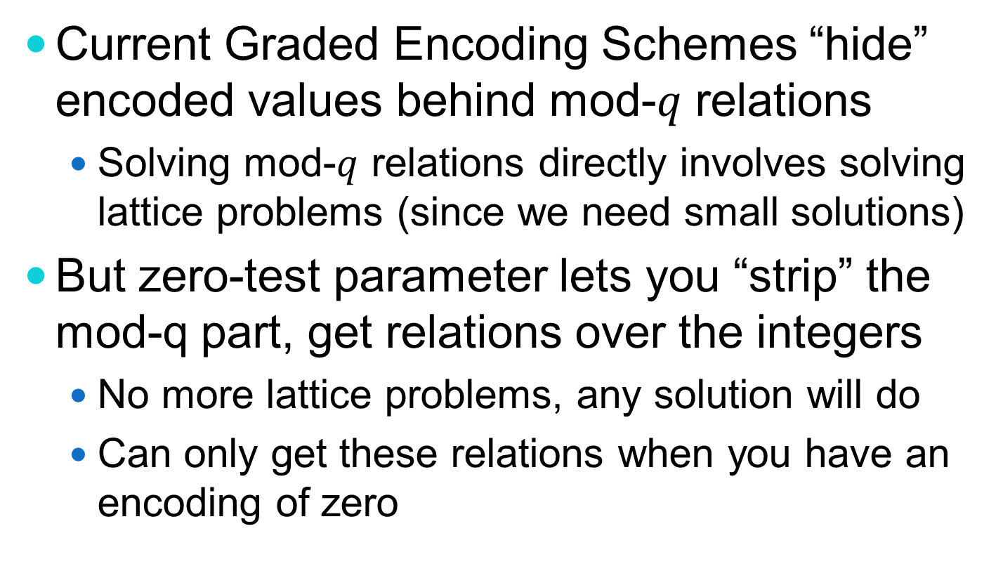
Final Musings About Security
Current Graded Encoding Schemes “hide” encoded values behind mod-$q$ relations
Solving mod-$q$ relations directly involves solving lattice problems (since we need small solutions)
But zero-test parameter lets you “strip” the mod-q part, get relations over the integers
No more lattice problems, any solution will do
Can only get these relations when you have an encoding of zero

Slide 38
Final Musings About Security
Security relies on the adversary’s inability to solve these relations
By the time you get a zero, the relations are too complicated to solve
Security feels more like HFE than FHE
HFE: Hidden Field Equations
FHE: Fully-Homomorphic Encryption
It’s going to be a bumpy ride..

