Slide 1
Cryptographic Multilinear Maps
Sanjam Garg, Craig Gentry, and Shai Halevi
(UCLA) (IBM) (IBM)
*Supported by IARPA contract number D11PC20202.

Slide 2
Cryptographic Bilinear Maps
Reminder:
(from Weil and Tate Pairings)

Slide 3
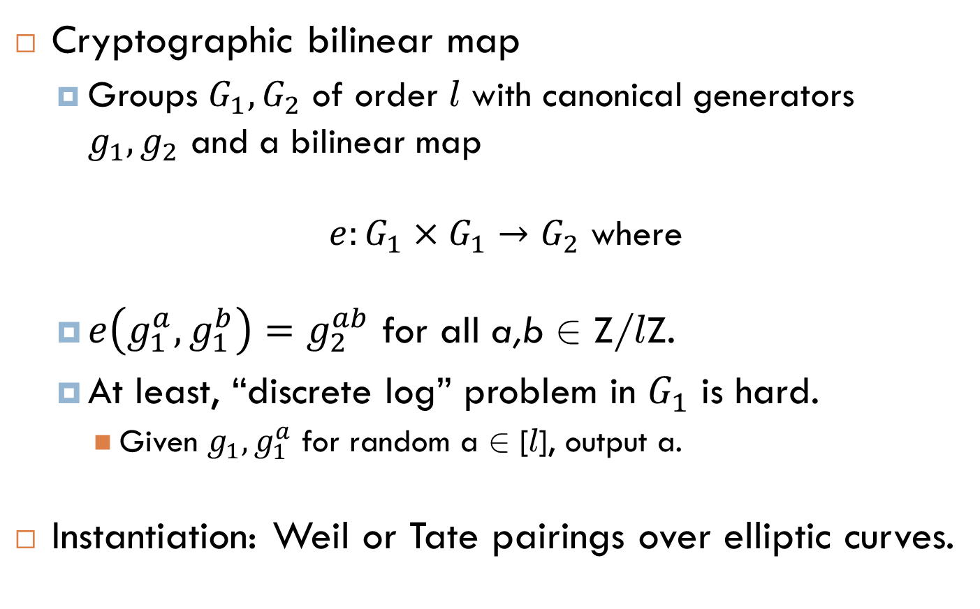
Bilinear Maps in Cryptography
Cryptographic bilinear map
Groups $G_{1}, G_{2}$ of order l with canonical generators $g_{1}, g_{2}$ and a bilinear map
$e:G_{1}×G_{1}→G_{2}$ where
$e\left(g_{1}^{a},g_{1}^{b}\right)=g_{2}^{ab}$ for all a,b 2 Z/ l Z.
At least, “discrete log” problem in $G_{1}$ is hard.
Given $g_{1},g_{1}^{a}$ for random a 2 [ l], output a.
Instantiation: Weil or Tate pairings over elliptic curves.

Slide 4
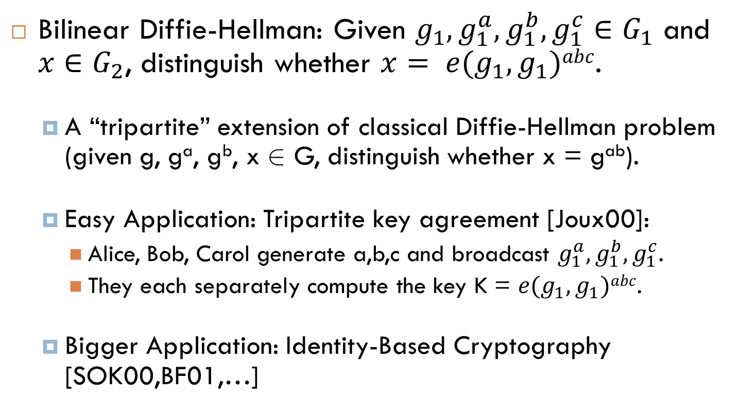
Bilinear Maps: “Hard” Problems
Bilinear Diffie-Hellman: Given $g_{1},g_{1}^{a},g_{1}^{b},g_{1}^{c}∈G_{1}$ and $x∈G_{2}$, distinguish whether $x= e(g_{1},g_{1})abc$.
A “tripartite” extension of classical Diffie-Hellman problem (given g, gª, g^{b}, x 2 G, distinguish whether x = g^{ab}).
Easy Application: Tripartite key agreement [Joux00]:
Alice, Bob, Carol generate a,b,c and broadcast $g_{1}^{a},g_{1}^{b},g_{1}^{c}$.
They each separately compute the key K = $e(g_{1},g_{1})abc$.
Bigger Application: Identity-Based Cryptography [SOK00,BF01,…]

Slide 5
Other Apps of Bilinear Maps: Attribute-Based and Predicate Encryption
Predicate Encryption: a generalization of IBE.
Setup(1^{λ}, predicate function F): Authority generates MSK,MPK.
KeyGen(MSK, x2{0,1}^{s}): Authority uses MSK to generate key SK_{x} for string x. (x could represent user’s “attributes”)
Encrypt(MPK,y2{0,1}^{t}, m): Encrypter generates ciphertext C_{y} for string y. (y could represent an “access policy”)
Decrypt(SK_{x},C_{y}): Decrypt works (recovers m) iff F(x,y)=1.
Predicate Encryption schemes using bilinear maps are “weak”.
They can only enforce simple predicates computable by low-depth circuits.

Slide 6
Cryptographic Multilinear Maps
Definition/Functionality and Applications

Slide 7
Multilinear Maps: Definition/Functionality
Cryptographic n-multilinear map (for groups)
Groups G₁, …, G_{n} of order l with generators g₁, …, g_{n}
Family of maps:
e_{i,k} : G_{i} × G_{k} → G_{i+k} for i+k ≤ n, where
e_{i,k}(g_{i}ª,g_{k}^{b}) = g_{i+k}^{ab} for all a,b 2 Z/ l Z.
At least, the “discrete log” problems in {G_{i}} are “hard”.
Notation Simplification: e(g_{j1}, …, g_{jt}) = g_{j1+...+jt}.

Slide 8
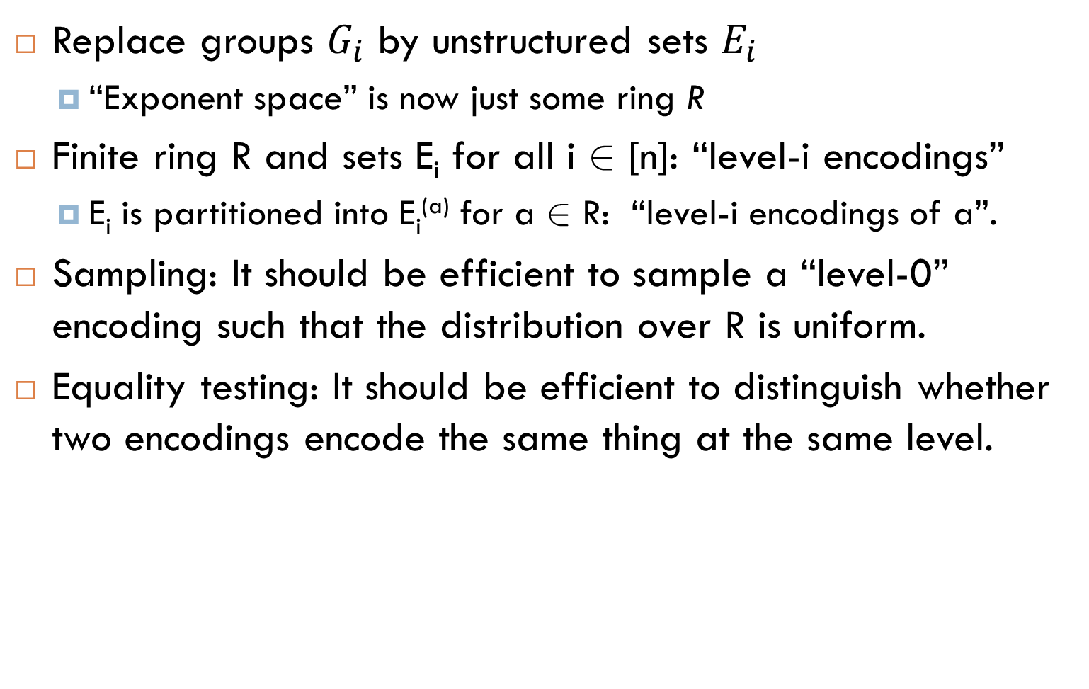
Multilinear Maps over Sets
Replace groups $G_{i}$ by unstructured sets $E_{i}$
“Exponent space” is now just some ring R
Finite ring R and sets E_{i} for all i 2 [n]: “level-i encodings”
E_{i} is partitioned into E_{i}^{(a)} for a 2 R: “level-i encodings of a”.
Sampling: It should be efficient to sample a “level-0” encoding such that the distribution over R is uniform.
Equality testing: It should be efficient to distinguish whether two encodings encode the same thing at the same level.
Note: In the “group” setting, there is only one level-i encoding of a – namely, g_{i}ª.
Note: In the “group” setting, a level-0 encoding is just a number in [l].
Note: In the “group” setting, equality testing is trivial, since the encodings are literally the same.

Slide 9
Multilinear Maps over Sets (cont’d)
Addition/Subtraction: There are ops + and – such that:
For every i 2 [n], every a₁, a₂ 2 R, every u₁ 2 E_{i}^{(a1)}, u₂ 2 E_{i}^{(a2)}:
We have u₁+u₂ 2 E_{i}^{(a1+a2)} and u₁-u₂ 2 E_{i}^{(a1-a2)}.
Multiplication: There is an op × such that:
We have u₁×u₂ 2 E_{i+k}^{(a1∙a2)}.
For every i+k ≤ n, a₁,a₂ 2 R, u₁ 2 E_{i}^{(a1)}, u₂ 2 E_{k}^{(a2)}:
At least, the “discrete log” problems in {E_{i}} are “hard”.
Given level-i encoding of a, hard to compute level-0 encoding of the same a.
Analogous to multiplication and division within a group.
Analogous to the multilinear map function for groups

Slide 10
Multilinear Maps: Hard Problems
n-Multilinear DH (for sets): Given level-1 encodings of 1, a₁, …, a_{n+1}, and some level-n encoding u, distinguish whether u encodes the product a₁∙∙∙a_{n+1}.
n-Multilinear DH (for groups): Given g₁, g₁^{a1},…, g₁^{an+1} 2 G₁, and g’2G_{n}, distinguish whether g’ = g_{n}^{a1…an+1}.
Easy Application: (n+1)-partite key agreement [Boneh-Silverberg ‘03]:
Party i generates level-0 encoding of a_{i}, and broadcasts level-1 encoding of a_{i}.
Each party separately computes K = e(g₁, …, g₁) ^{a1…an+1}.

Slide 11
Bigger Application: Predicate Encryption for Arbitrary Circuits
Let F(x,y) be an arbitrarily complex boolean predicate function, computable in time T_{f}.
There is a boolean circuit C(x,y) of size O(T_{f} log T_{f}) that computes F.
Circuits have (say) AND, OR, and NOT gates
Using a depth(C)-linear map, we can construct a predicate encryption scheme for F whose performance is O(|C|) group operations.
[Garg-Gentry-Halevi-Sahai-Waters-2012]

Slide 12
Multilinear Maps: Do They Exist?
Boneh and Silverberg say it’s unlikely cryptographic m-maps can be constructed from abelian varieties:
“We also give evidence that such maps might have to either come from outside the realm of algebraic geometry, or occur as ‘unnatural’ computable maps arising from geometry.”

Slide 13
Whirlwind Tour of Lattice Crypto
Focusing on NTRU and Homomorphic Encryption

Slide 14
Lattices, and “Hard” Problems
0
A lattice is just an additive subgroup of R^{n}.

Slide 15
Lattices, and “Hard” Problems
v₂’
v₂
v₁’
0
v₁
In other words, any rank-n lattice L consists of all integer linear combinations of a rank-n set of basis vectors.

Slide 16
Lattices, and “Hard” Problems
v₂’
v₂
v₁’
0
v₁
Given some basis of L, it may be hard to find a good basis of L, to solve the (approximate) shortest/closest vector problems.

Slide 17
Lattice Reduction
[Lenstra,Lenstra,Lovász ‘82]: Given a rank-n lattice L, the LLL algorithm runs in time poly(n) and outputs a 2^{n}-approximation of the shortest vector in L.
[Schnorr’93]: Roughly, it 2^{k}-approximates SVP in 2^{n/k} time.

Slide 18
NTRU [HPS98]
Parameters:
Integers N, p, q with p « q, gcd(p,q)=1.
(Example: N=257, q=127, p=3.)
Polynomial rings R = Z[x]/(x^{N}-1), R_{p} = R/pR, and R_{q} = R/qR.
Secret key sk: Polynomials f, g 2 R, where:
f and g are “small”. Their coefficients are « q.
f = 1 mod p and g = 0 mod p.
Public key pk: Set h ← g/f 2 R_{q}.
Encrypt(pk, m2R_{p} with coefficients in (-p/2,p/2)):
Sample random “small” r from R.
Ciphertext c ← m + rh.
Decrypt(sk, c): Set e ← fc = fm+rg. Output m ← (e mod p).

Slide 19
NTRU: Where are the Lattices?
h = g/f 2 R_{q} → f(x)∙h(x) - q∙c(x) = g(x) mod (x^{N}-1)
f₀
f₁
f_{N-1}
c₀
c₁
c_{N-1}
1 | 0 |  | 0 | h₀ | h₁ |  | h_{N-1}
0 | 1 |  | 0 | h_{N-1} | h₀ |  | h_{N-2}
0 | 0 |  | 1 | h₁ | h₂ |  | h₀
0 | 0 |  | 0 | q | 0 |  | 0
0 | 0 |  | 0 | 0 | q |  | 0
0 | 0 |  | 0 | 0 | 0 |  | q
…
…
…
…
…
…
f₀ | f₁ |  | f_{N-1} | g₀ | g₁ |  | g_{N-1}
…
…

Slide 20
NTRU Security
NTRU could be broken via lattice reduction
If you could reduce them enough..
NTRU is semantically secure if ratios g/f 2 R_{q} of “small” elements are hard to distinguish from random elements of R_{q}.

Slide 21
NTRU
Parameters:
Integers N, p, q with p « q, gcd(p,q)=1.
(Example: N=257, q=127, p=3.)
Polynomial rings R = Z[x]/(x^{N}-1), R_{p} = R/pR, and R_{q} = R/qR.
Secret key sk: Polynomials f, g 2 R, where:
f and g are “small”. Their coefficients are « q.
f = 1 mod p and g = 0 mod p.
Public key pk: Set h ← g/f 2 R_{q}.
Encrypt(pk, m2R_{p} with coefficients in (-p/2,p/2)):
Sample random “small” r from R.
Ciphertext c ← m + rh.
Decrypt(sk, c): Set e ← fc = fm+rg. Output m ← (e mod p).

Slide 22
NTRU
Parameters:
Integers N, p, q with p « q, gcd(p,q)=1.
(Example: N=512, q=127, p=3.)
Polynomial rings R = Z[x]/(Φ_{N}(x)), R_{p} = R/pR, and R_{q} = R/qR.
Secret key sk: Polynomials f, g 2 R, where:
f and g are “small”. Their coefficients are « q.
f = 1 mod p and g = 0 mod p.
Public key pk: Set h ← g/f 2 R_{q}.
Encrypt(pk, m2R_{p} with coefficients in (-p/2,p/2)):
Sample random “small” r from R.
Ciphertext c ← m + rh.
Decrypt(sk, c): Set e ← fc = fm+rg. Output m ← (e mod p).

Slide 23
NTRU
Parameters:
Integers N, q. “Small” p 2 R, with ideal I = (p) relative prime to (q).
(Example: N=512, q=127)
Polynomial rings R = Z[x]/(Φ_{N}(x)), R_{p} = R/I, and R_{q} = R/qR.
Secret key sk: Polynomials f, g 2 R, where:
f and g are “small”. Their coefficients are « q.
f 2 1+I and g 2 I. (g is a small multiple of p.)
Public key pk: Set h ← g/f 2 R_{q}.
Encrypt(pk, m2R_{p} with small coefficients):
Sample random “small” r from R.
Ciphertext c ← m + rh.
Decrypt(sk, c): Set e ← fc = fm+rg. Output m ← (e mod I).

Slide 24
NTRU
Parameters:
Integers N, q. “Small” p 2 R, with ideal I = (p) relative prime to (q).
(Example: N=512, q=127)
Polynomial rings R = Z[x]/(Φ_{N}(x)), R_{p} = R/I, and R_{q} = R/qR.
Secret key sk: Polynomials f, g 2 R, where:
f and g are “small”. Their coefficients are « q.
f 2 1+I and g 2 I. (g is a small multiple of p.)
Public key pk: Set h₀ ← g/f 2 R_{q} and h₁ ← f/f 2 R_{q}.
Encrypt(pk, m2R_{p} with small coefficients):
Sample random “small” r from R.
Ciphertext c ← mh₁ + rh₀.
Decrypt(sk, c): Set e ← fc = fm+rg. Output m ← (e mod I).

Slide 25
NTRU
Parameters:
Integers N, q. “Small” p 2 R, with ideal I = (p) relative prime to (q).
(Example: N=512, q=127)
Polynomial rings R = Z[x]/(Φ_{N}(x)), R_{p} = R/I, and R_{q} = R/qR.
Secret key sk: Random z 2 R_{q}. Polynomials f, g 2 R, where:
f and g are “small”. Their coefficients are « q.
f 2 1+I and g 2 I. (g is a small multiple of p.)
Public key pk: Set h₀ ← g/z 2 R_{q} and h₁ ← f/z 2 R_{q}.
Encrypt(pk, m2R_{p} with small coefficients):
Sample random “small” r from R.
Ciphertext c ← mh₁ + rh₀.
Decrypt(sk, c): Set e ← zc = fm+rg. Output m ← (e mod I).

Slide 26
NTRU
NTRU Summary
A ciphertext that encrypts m 2 R_{p} has the form e/z 2 R_{q}, where e is “small” (coefficients « q) and e 2 m+I.
To decrypt, multiply z to get e. Then reduce e mod I.
The public key contains encryptions of 0 and 1 (h₀ and h₁). To encrypt m, multiply m with h₁ and add “random” encryption of 0.

Slide 27
NTRU: Additive Homomorphism
Given: Ciphertexts c₁, c₂ that encrypt m₁, m₂ 2 R_{p}.
c_{i} = e_{i}/z 2 R_{q} where e_{i} is small and e_{i} = m_{i} mod p.
Claim: Set c = c₁+c₂ 2 R_{q} and m = m₁+m₂ 2 R_{p}. Then c encrypts m.
c = (e₁+e₂)/z where e₁+e₂=m mod p and e₁+e₂ is “sort of small”. It works if |e_{i}| « q.

Slide 28
NTRU: Multiplicative Homomorphism
Given: Ciphertexts c₁, c₂ that encrypt m₁, m₂ 2 R_{p}.
c_{i} = e_{i}/z 2 R_{q} where e_{i} is small and e_{i} = m_{i} mod p.
Claim: Set c = c₁∙c₂ 2 R_{q} and m = m₁∙m₂ 2 R_{p}. Then c encrypts m under z² (rather than under z).
c = (e₁∙e₂)/z² where e₁∙e₂=m mod p and e₁∙e₂ is “sort of small”. It works if |e_{i}| « √q.

Slide 29
NTRU: Any Homogeneous Polynomial
Given: Ciphertexts c₁, …, c_{t} encrypting m₁,…, m_{t}.
c_{i} = e_{i}/z 2 R_{q} where e_{i} is small and e_{i} = m_{i} mod p.
Claim: Let f be a degree-d homogeneous poly. Set c = f(c₁, …, c_{t}) 2 R_{q} and m = f(m₁, …, m_{t}) 2 R_{p}. Then c encrypts m under z^{d}.
c = f(e₁, …, e_{t})/z^{d} where f(e₁, …, e_{t})=m mod p and f(e₁, …, e_{t}) is “sort of small”. It works if |e_{i}| « q^{1/d}.

Slide 30

Homomorphic Encryption
The special sauce! For security parameter k, Eval’s running should be Time(f)∙poly(λ)
“I want 1) the cloud to process my data 2) even though it is encrypted.
Run
Eval[ f, Enc_{k}(x) ]
= Enc_{k}[f(x)]
Enc_{k}(x)
function f
Server (Cloud)
This could be encrypted too.
Alice
Delegation: Should cost less for Alice to encrypt x and decrypt f(x) than to compute f(x) herself.
(Input: data x, key k)
Enc_{k}[f(x)]
f(x)

Slide 31
Homomorphic Encryption from NTRU
Homorphic NTRU Summary
A level-d encryption of m 2 R_{p} has the form e/z^{d} 2 R_{q}, where e is “small” (coefficients « q) and e 2 m+I.
Given level-1 encryptions c₁, …, c_{t} of m₁, …, m_{t}, we can “homomorphically” compute a level-d encryption of f(m₁, …, m_{t}) for any degree-d polynomial f, if the initial e_{i}’s are small enough.
The “noise” – i.e., size of the numerator – grows exp. with degree.
Noise control techniques: bootstrapping [Gen09], modulus reduction [BV12,BGV12].
Big open problem: Fast reusable way to contain the noise.

Slide 32
“Noisy” Multilinear Maps
(Similar to NTRU-Based HE, but with Equality Testing)

Slide 33
Adding an Equality Test
Given level-d encodings c₁ = e₁/z^{d} and c₂ = e₂/z^{d}, how do we test whether they encode the same m?
Fact: If they encode same thing, then e₁-e₂ 2 I. Moreover, (e₁-e₂)/p is a “small” polynomial.
Zero-Testing parameter:
a_{ZT} = b∙z^{d}/p for “somewhat small b”
Multiply the zero-testing parameter with (c₁-c₂).
a_{ZT}(c₁-c₂) = b(e₁-e₂)/p has coefficients < q.
If c₁ and c₂ encode different things, the denominator p ensures that the result does not have small coefficients.

Slide 34
Example Application: (n+1)-partite DH
Parameters:
Rings R = Z[x]/(Φ_{N}(x)), R_{p} = R/I, and R_{q} = R/qR, where p is “small” and I = (p) relative prime to (q).
We don’t give out p.
Level-1 encodings h₀, h₁ of 0 and 1.
h_{i} = e_{i}/z, where e_{i} = i mod I and is “small”.
Party i samples a random level-0 encoding a_{i}.
Samples “small” a_{i} 2 R via Gaussian distribution
The coset of a_{i} in R_{p} will be statistically uniform.
Party i sends level-1 encoding of a_{i}: a_{i}h₁+r_{i}h₀ 2 R_{q}.
Each party computes level-n encoding of a₁∙∙∙a_{n+1}.
Note: Noisiness of encoding is exponential in n.

Slide 35
Example Application: (n+1)-partite DH
Each party i has a level-n e_{i}/z^{n} encoding of a₁∙∙∙a_{n+1}.
Party i sets K_{i}’ = a_{zt} (e_{i}/z^{n}), and key K_{i} = MSBs(K_{i}’).
Claim: Each party computes the same key.
K_{i}’ – K_{j}’ = a_{zt} (e_{i}-e_{j})/z^{n} = b(e_{i}-e_{j})/p
But e_{i}, e_{j} are “small” and both are in a₁∙∙∙a_{n+1}+I.
So, (e_{i}-e_{j})/p is some “small” polynomial E_{ij}. K_{i}’–K_{j}’ = b∙E_{ij}, small.
So, K_{i}’-K_{j}’ have the same most significant bits, with high probability.

Slide 36
Predicate Encryption for Circuits
Our “noisy” n-multilinear map permits predicate encryption for circuits of size up to n-1.
Noisiness of encodings grows exponentially with n, but that is ok.

Slide 37
Cryptanalysis: “Trivial” Attacks
For example, can an eavesdropper “trivially” generate a level-n encoding of a (n+1)-partite Diffie-Hellman key?

Slide 38
Trivial “Attacks”
Eavesdropper in (n+1)-partite DH gets:
Parameters:
Level-1 encodings h₀, h₁ of 0 and 1. h_{i} = e_{i}/z, where e_{i} = i mod I and is “small”.
Zero-testing parameter: a_{zt} = bz^{n}/p.
Party i’s constribution: level-1 encoding c_{i}/z of a_{i}.
Weighting of variables
Set w(e_{i}) = w(z) = w(p) = w(c_{i}) = 1 and w(b) = 1-n.
w(e_{i}/z) = 0. Weight of all terms above is 0.

Slide 39
Trivial “Attacks”
Straight-line program (SLP)
Only allowed to (iteratively) add, subtract, multiply, or divide pairs of elements that it has already computed.
A SLP that is given weight 0 terms can only compute more weight 0 terms.
The DH key is of the form K = e/z^{n}, where e 2 a₁∙∙∙a_{n+1}+I.
The key cannot be expressed as a weight 0 term.

Slide 40
Cryptanalysis
Algebraic and Lattice Attacks

Slide 41
Attack Landscape
All attacks on NTRU apply to our n-linear maps.
Additional attacks:
The principal ideal I = (p) is not hidden.
Recall a_{zt} = bz^{n}/p, h₀ = e₀/z and h₁ = e₁/z with e₀ = c₀p.
The terms a_{zt}∙h₀^{i}∙ h₁^{n-i} = b∙c₀^{i}∙p^{i-1}∙e₁^{n-I} likely generate the ideal I.
An attacker that finds a good basis of I can break our scheme.
There are better attacks on principal ideal lattices than on general ideal lattices. (But still inefficient.)

Slide 42
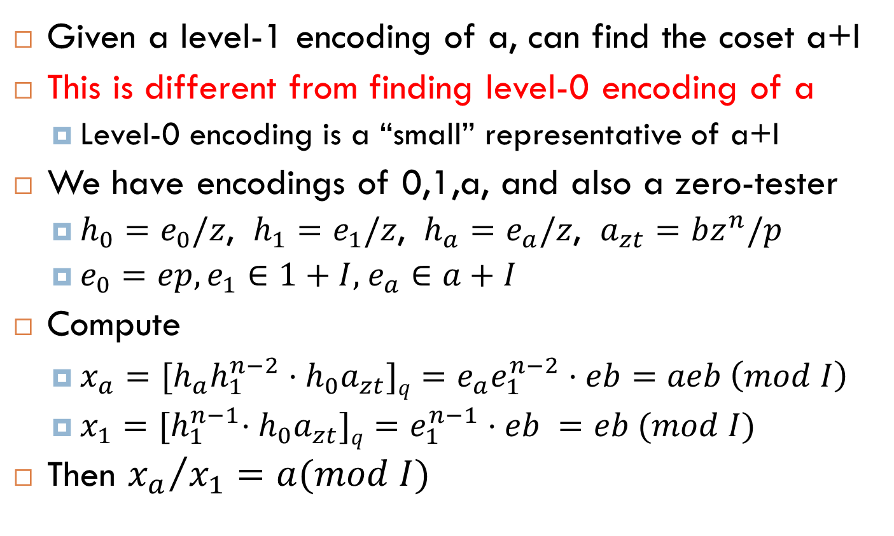
A “Weak Discrete-Log” Attack
Given a level-1 encoding of a, can find the coset a+I
This is different from finding level-0 encoding of a
Level-0 encoding is a “small” representative of a+I
We have encodings of 0,1,a, and also a zero-tester
$h_{0}=e_{0}/z$, ${h_{1}=e}_{1}/z$, ${h_{a}=e}_{a}/z$, $a_{zt}=bz^{n}/p$
$e_{0}=ep, e_{1}∈1+I$, $e_{a}∈a+I$
Compute
$x_{a}={[h}_{a}h_{1}^{n−2}⋅h_{0}a_{zt}]q=e_{a}e_{1}^{n−2}⋅eb=aeb \left(mod I\right)$
$x_{1}={[h}_{1}^{n−1}⋅h_{0}a_{zt}]q=e_{1}^{n−1}⋅eb =eb (mod I)$
Then ${x_{a}}/{x_{1}}=a(mod I)$

Slide 43
Effects of the “Weak DL” Attack
Multilinear-DDH Still Seems Hard
Because we can only compute “weak DL” in levels < n
But “subgroup membership” is easy
Given an encoding of a, can check if a is in a sub-ideal
Also “Decision Linear” is easy
Given an encoded matrix, can compute its rank
Can we eliminate this attack?
Yes, by not publishing encodings of 0,1
But in many applications we may need them

Slide 44
Dimension-Halving for Principal Ideal Lattices
[GS’02]: Given
a basis of I = (u) for u(x) 2 R and
u’s relative norm u(x)ū(x) in the index-2 subfield Q(ζ_{N}+ ζ_{N}⁻¹),
we can compute u(x) in poly-time.
Corollary: Set v(x) = u(x)/ū(x). We can compute v(x) given a basis of J = (v).
We know v(x)’s relative norm equal 1.

Slide 45
Dimension-Halving for Principal Ideal Lattices
Attack given a basis of I = (u):
First, compute v(x) = u(x)/ū(x).
Given a basis {u(x)r_{i}(x)} of I, multiply by 1+1/v(x) to get a basis {(u(x)+ ū(x))r_{i}(x)} of K = (u(x)+ū(x)) over R.
Intersect K’s lattice with subring R’ = Z[ζ_{N}+ ζ_{N}⁻¹] to get a basis {(u(x)+ ū(x))s_{i}(x) : s_{i}(x) 2 R’} of K over R’.
Apply lattice reduction to lattice {u(x)s_{i}(x) : s_{i}(x) 2 R’}, which has half the usual dimension.

Slide 46
Summary
We have a “noisy” cryptographic multilinear map
Can be used for predicate encryption, other apps
Construction is similar to NTRU-based homomorphic encryption, but with an equality-testing parameter
Security is based on stronger hardness assumptions than NTRU
Using them requires some care
Avoiding (or tolerating) “weak DL” attacks

Slide 47
Thank You! Questions?
TIME EXPIRED
?
?

Slide 48
Predicate Encryption for Circuits: Sketch of GGHSW Construction
Picture of Yao garbled circuit
Mention that Yao GC is a predicate encryption scheme, except that it doesn’t offer any resistance against collusions, which is a serious shortcoming in typical multi-user settings.

Slide 49
Predicate Encryption for Circuits: Sketch of GGHSW Construction
Now describe GGHSW as a gate-by-gate garbling, where the value for ‘1’ is a function of the encrypter’s randomness s, and randomness rw for the wire that is embedded in the user’s key.

