Slide 1
Introduction to Cryptographic Multilinear Maps
Sanjam Garg, Craig Gentry, Shai Halevi
IBM T.J. Watson Research Center

Slide 2
Multilinear Maps (MMAPs)
A technical tool
Think “trapdoor-permutations” or “smooth-projective-hashing”, or “randomized-encoding”
More a technique than a single primitive
Several different variants, all share the same core properties but differ in details
Extension of bilinear maps [J00,SOK00,BF01]
Bilinear maps are extensions of DL-based crypto
Took the crypto world by storm in 2000, used in dozens of applications, hundreds of papers
Applications from IBE to NIZK and more
Notes:
[J00] Joux, [SOK00] Sakai, Ohgishi, Kasahara, [BF01] Boneh, Franklin

Slide 3
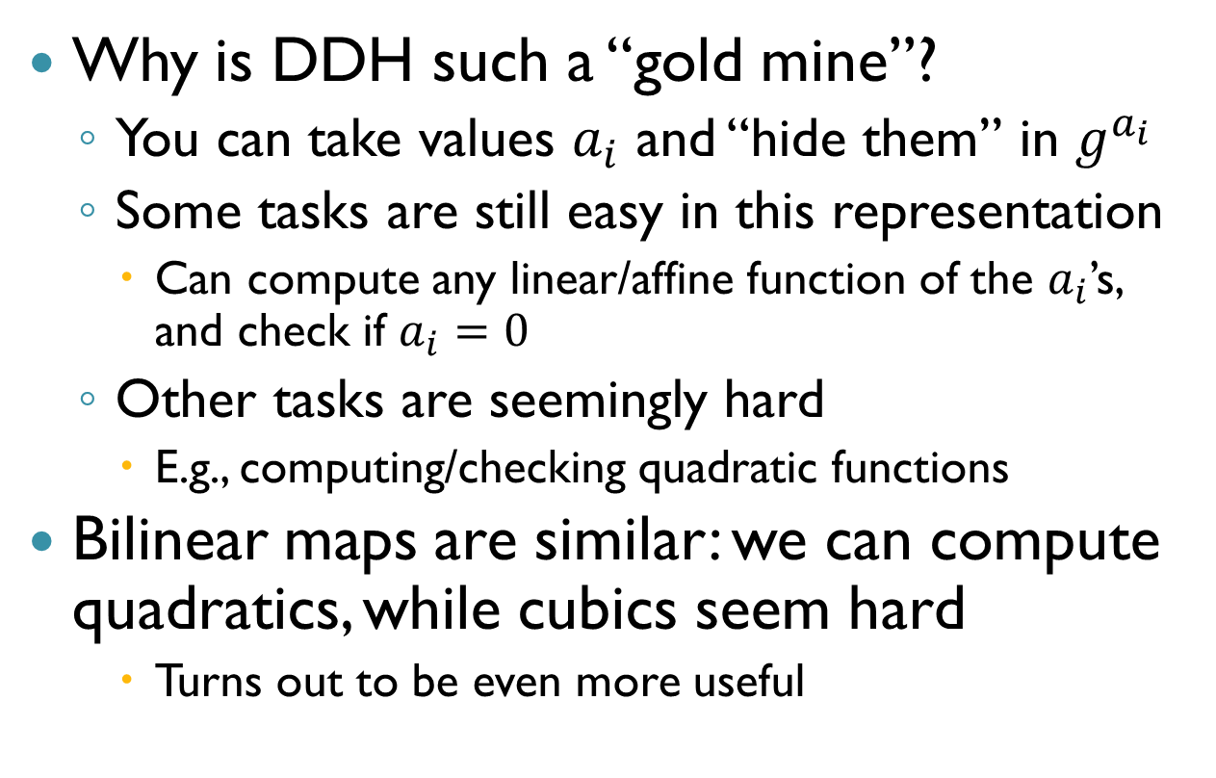
DL/DDH and Bilinear Maps
Why is DDH such a “gold mine”?
You can take values $a_{i}$ and “hide them” in $g^{a_{i}}$
Some tasks are still easy in this representation
Can compute any linear/affine function of the $a_{i}$’s, and check if $a_{i}=0$
Other tasks are seemingly hard
E.g., computing/checking quadratic functions
Bilinear maps are similar: we can compute quadratics, while cubics seem hard
Turns out to be even more useful

Slide 4
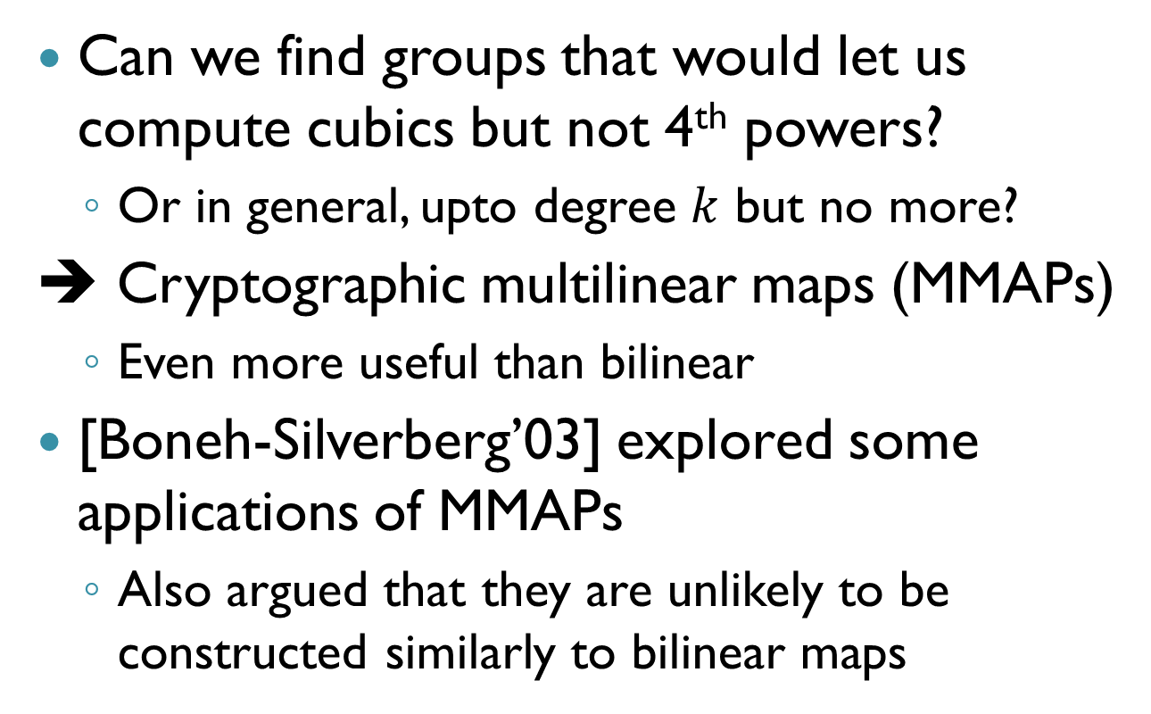
Why Stop at Two?
Can we find groups that would let us compute cubics but not 4th powers?
Or in general, upto degree $k$ but no more?
➔ Cryptographic multilinear maps (MMAPs)
Even more useful than bilinear
[Boneh-Silverberg’03] explored some applications of MMAPs
Also argued that they are unlikely to be constructed similarly to bilinear maps

Slide 5
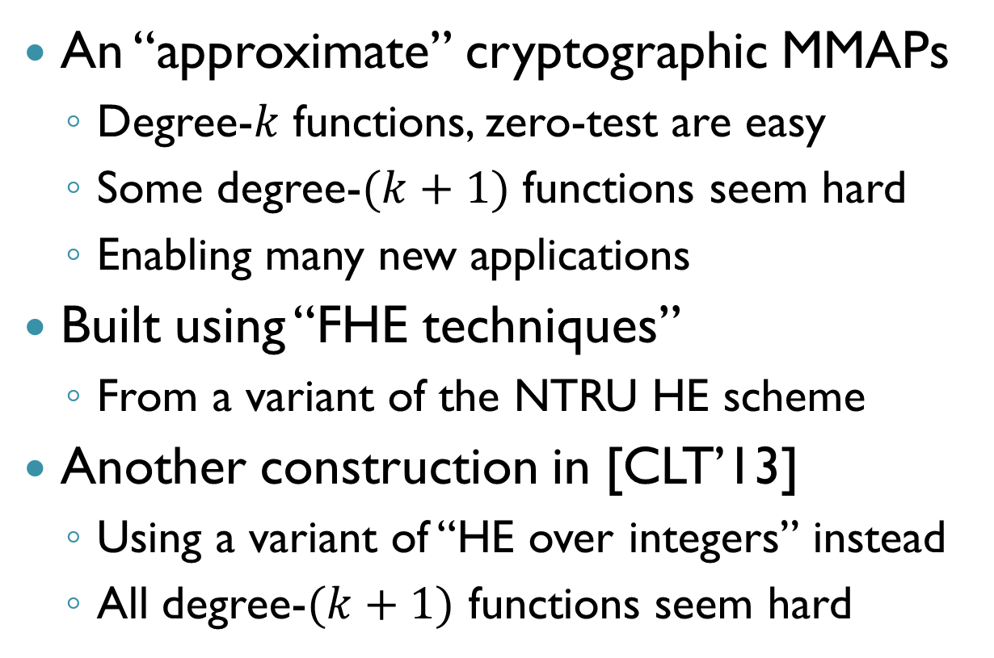
The [GGH’13] Approach
An “approximate” cryptographic MMAPs
Degree-$k$ functions, zero-test are easy
Some degree-$(k+1)$ functions seem hard
Enabling many new applications
Built using “FHE techniques”
From a variant of the NTRU HE scheme
Another construction in [CLT’13]
Using a variant of “HE over integers” instead
All degree-$(k+1)$ functions seem hard

Slide 6
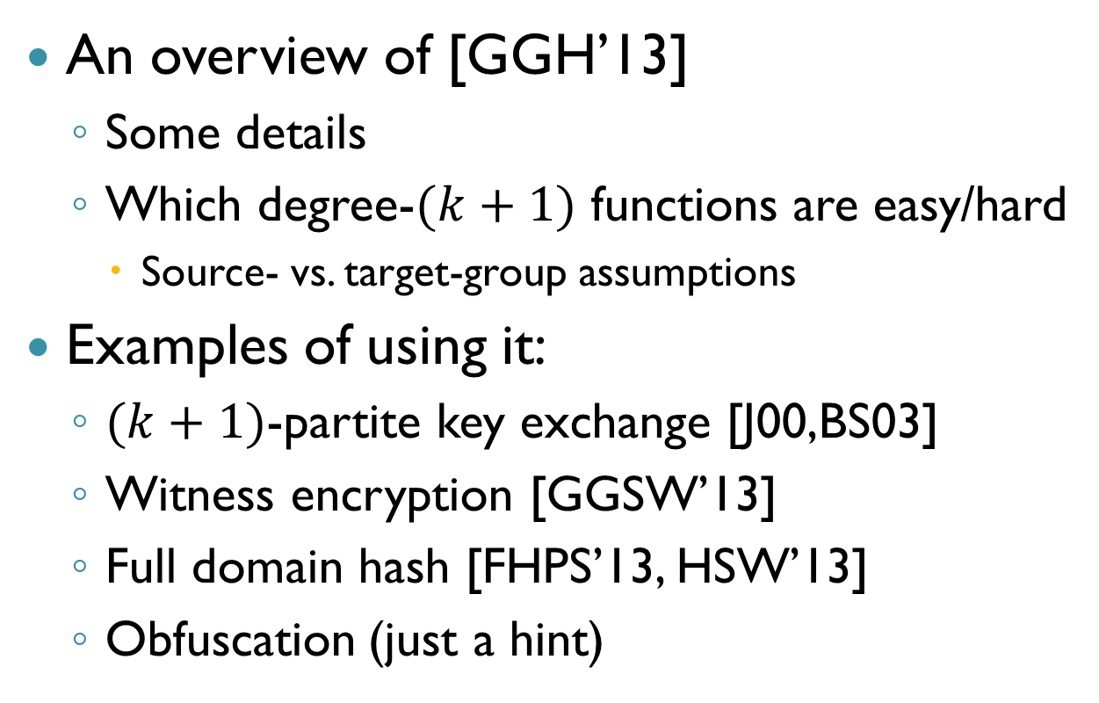
This Talk
An overview of [GGH’13]
Some details
Which degree-$(k+1)$ functions are easy/hard
Source- vs. target-group assumptions
Examples of using it:
$(k+1)$-partite key exchange [J00,BS03]
Witness encryption [GGSW’13]
Full domain hash [FHPS’13, HSW’13]
Obfuscation (just a hint)

Slide 7
The [GGH’13] Construction

Slide 8
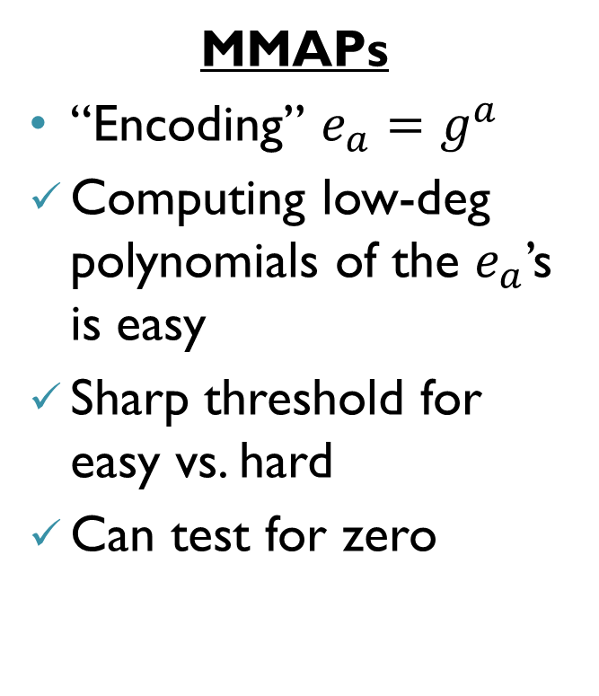
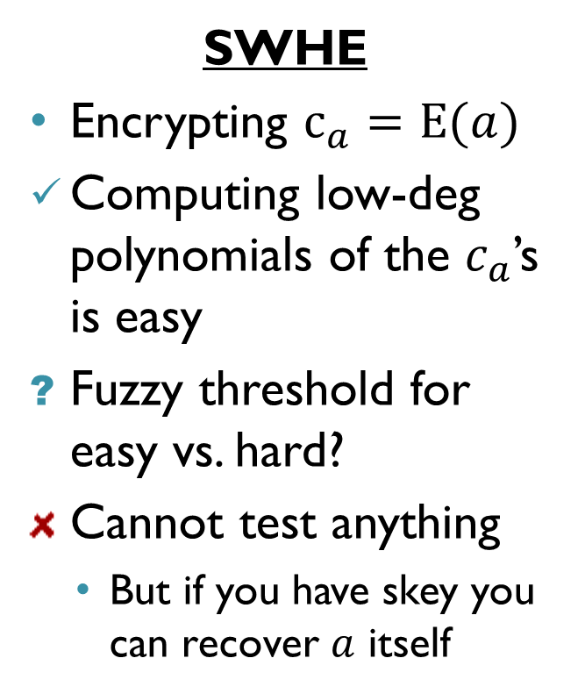
“Somewhat Homomorphic” Encryption (SWHE) vs. MMAPs
SWHE
Encrypting $c_{a}=E(a)$
Computing low-deg polynomials of the $c_{a}$’s is easy
Fuzzy threshold for easy vs. hard?
Cannot test anything
But if you have skey you can recover $a$ itself
MMAPs
“Encoding” $e_{a}=g^{a}$
Computing low-deg polynomials of the $e_{a}$’s is easy
Sharp threshold for easy vs. hard
Can test for zero

Slide 9
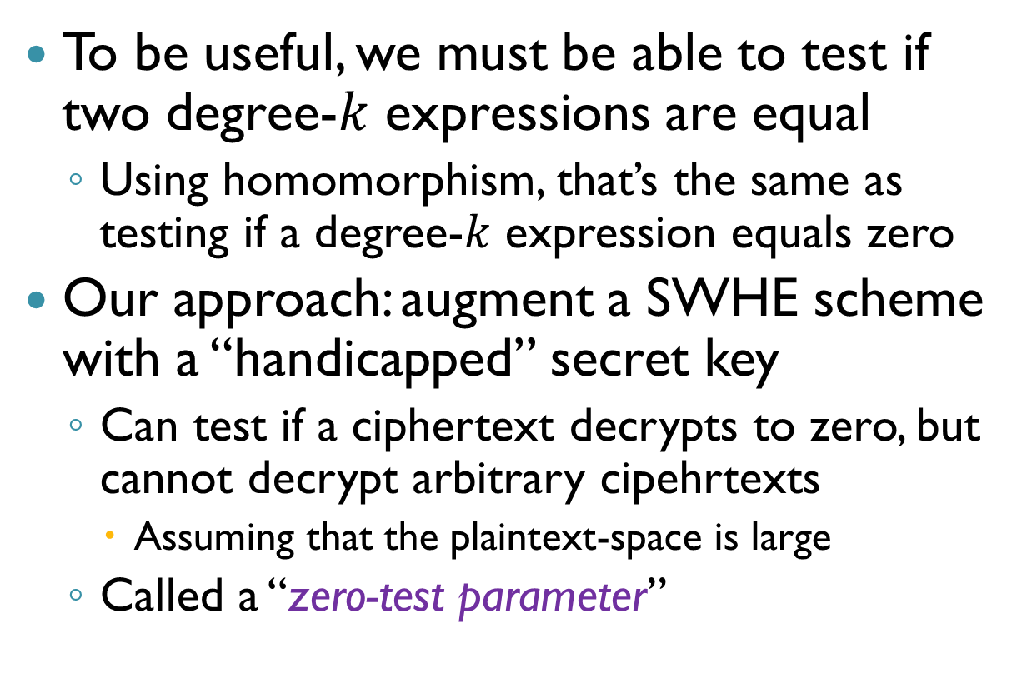
Main Ingredient: Testing for Zero
To be useful, we must be able to test if two degree-$k$ expressions are equal
Using homomorphism, that’s the same as testing if a degree-$k$ expression equals zero
Our approach: augment a SWHE scheme with a “handicapped” secret key
Can test if a ciphertext decrypts to zero, but cannot decrypt arbitrary cipehrtexts
Assuming that the plaintext-space is large
Called a “zero-test parameter”

Slide 10
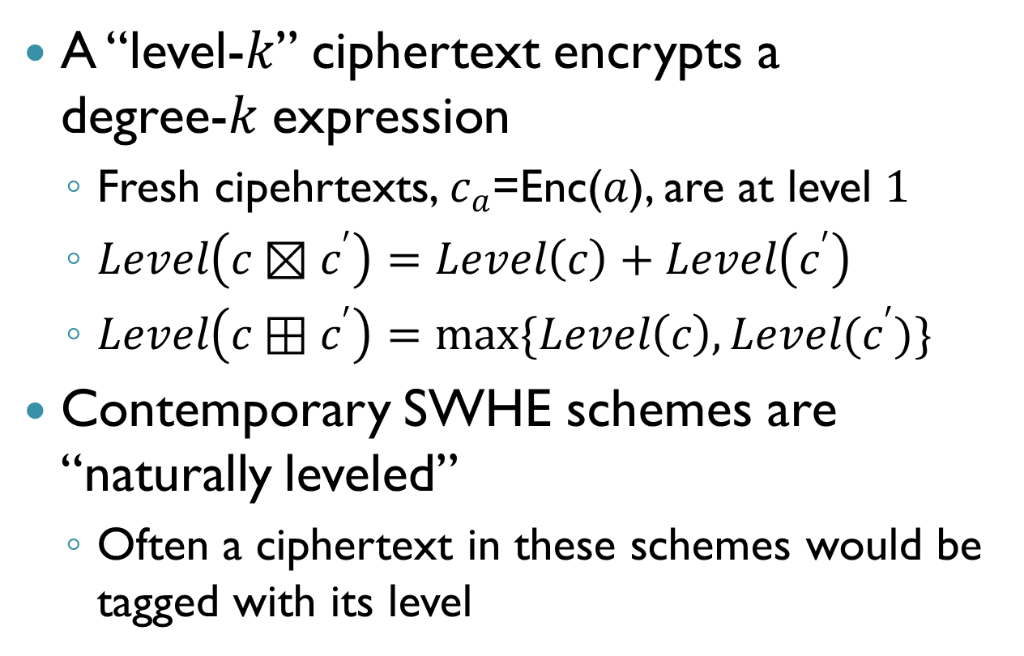
A Few Words About Levels
A “level-$k$” ciphertext encrypts a degree-$k$ expression
Fresh cipehrtexts, $c_{a}$=Enc($a$), are at level $1$
$Level\left(c⊠c^{′}\right)=Level\left(c\right)+Level\left(c^{′}\right)$
$Level\left(c⊞c^{′}\right)=\max{\{Level\left(c\right), Level(c^{′})\} }$
Contemporary SWHE schemes are “naturally leveled”
Often a ciphertext in these schemes would be tagged with its level

Slide 11
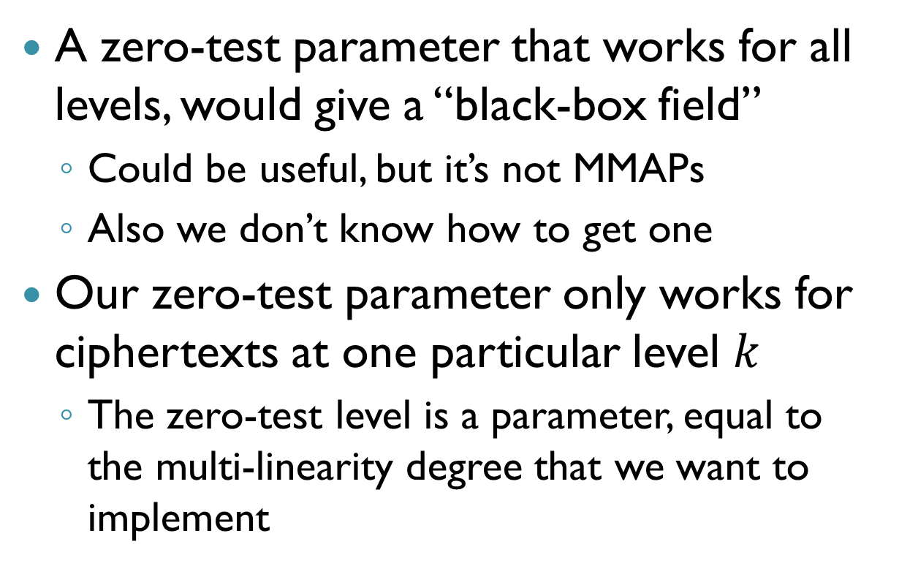
A Few Words About Levels (2)
A zero-test parameter that works for all levels, would give a “black-box field”
Could be useful, but it’s not MMAPs
Also we don’t know how to get one
Our zero-test parameter only works for ciphertexts at one particular level $k$
The zero-test level is a parameter, equal to the multi-linearity degree that we want to implement

Slide 12
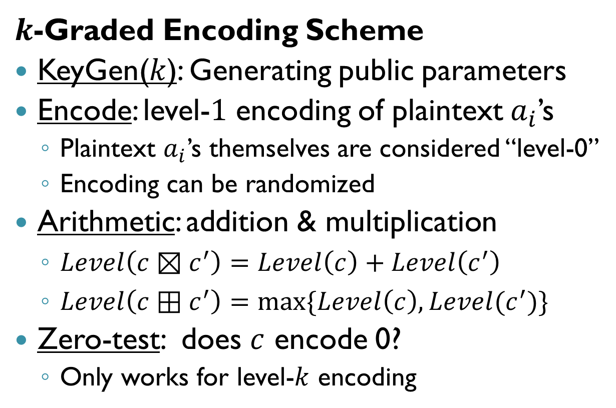
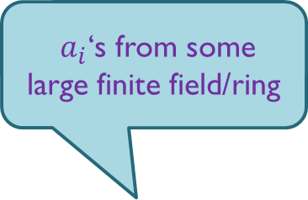
Our Goal (“approximate MMAPs”)
$a_{i}$‘s from some large finite field/ring
$k$-Graded Encoding Scheme
KeyGen($k$): Generating public parameters
Encode: level-$1$ encoding of plaintext $a_{i}$’s
Plaintext $a_{i}$’s themselves are considered “level-0”
Encoding can be randomized
Arithmetic: addition & multiplication
$Level\left(c⊠c^{′}\right)=Level\left(c\right)+Level\left(c^{′}\right)$
$Level\left(c⊞c^{′}\right)=\max{\{Level\left(c\right), Level(c^{′})\} }$
Zero-test: does $c$ encode 0?
Only works for level-$k$ encoding

Slide 13
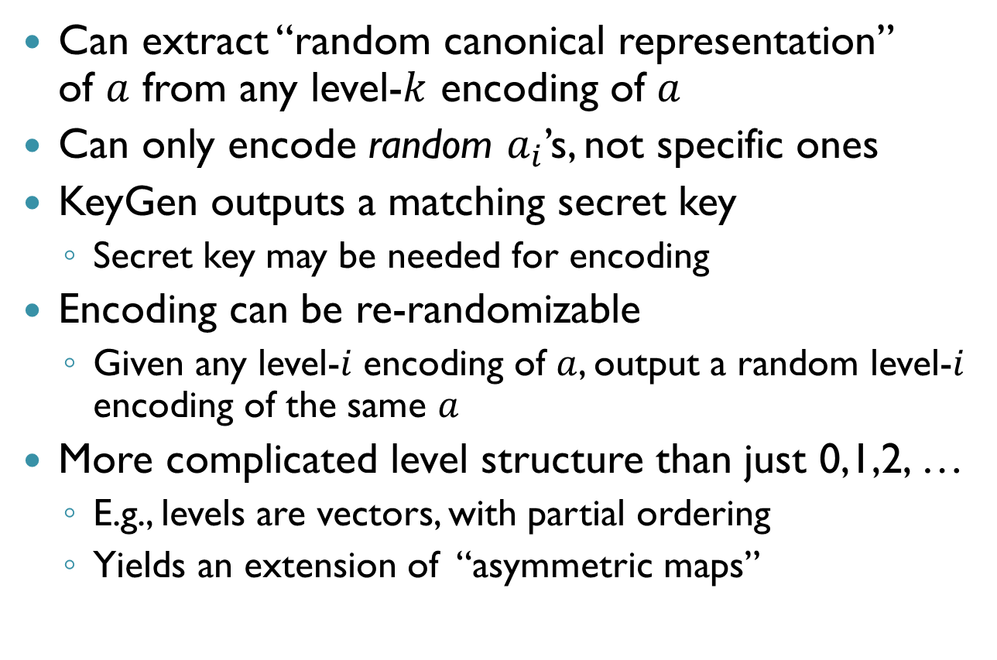
Some Variations
Can extract “random canonical representation” of $a$ from any level-$k$ encoding of $a$
Can only encode random $a_{i}$’s, not specific ones
KeyGen outputs a matching secret key
Secret key may be needed for encoding
Encoding can be re-randomizable
Given any level-$i$ encoding of $a$, output a random level-$i$ encoding of the same $a$
More complicated level structure than just 0,1,2, …
E.g., levels are vectors, with partial ordering
Yields an extension of “asymmetric maps”

Slide 14
Overview of [GGH’13]
Start from an NTRU-like SWHE scheme
Semantic-security under some “reasonable assumptions”
Add zero-test parameter
Some things that were hard now become easy
Other things are still seemingly hard
But hardness assumptions are stronger, uglier
Separating hard from easy is challenging

Slide 15
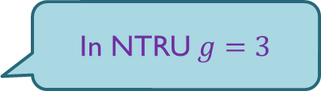
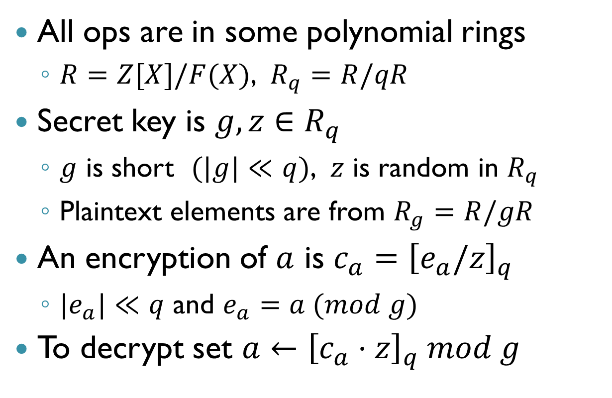
Starting From NTRU-like SWHE
All ops are in some polynomial rings
$R=Z[X]/F(X)$, $R_{q}=R/qR$
Secret key is $g,z∈R_{q}$
$g$ is short $(|g|≪q)$, $z$ is random in $R_{q}$
Plaintext elements are from $R_{g}=R/gR$
An encryption of $a$ is $c_{a}={\left[e_{a}/z\right]}_{q}$
${|e}_{a}|≪q$ and $e_{a}=a (mod g)$
To decrypt set $a←{\left[c_{a}⋅z\right]}_{q} mod g$
In NTRU $g=3$

Slide 16
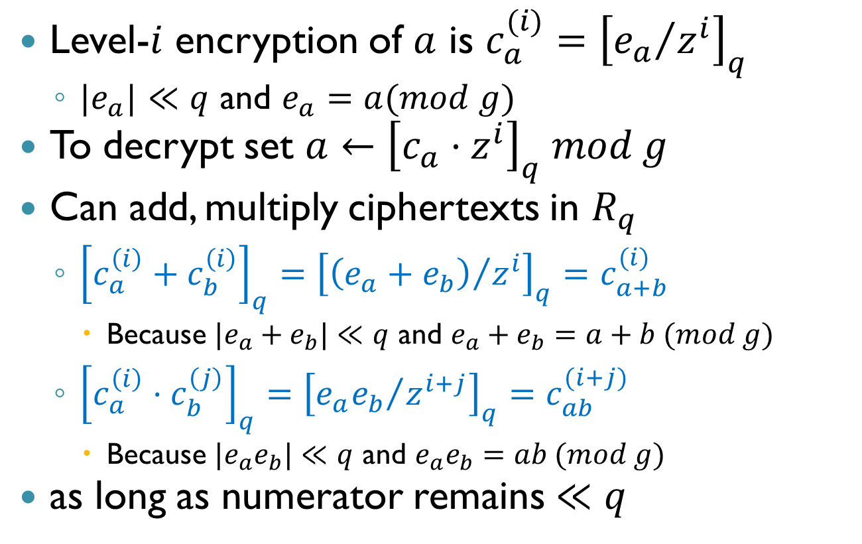
Homomorphic NTRU
Level-$i$ encryption of $a$ is $c_{a}^{(i)}={\left[{e_{a}}/{z^{i}}\right]}_{q}$
$|e_{a}|≪q$ and $e_{a}=a(mod g)$
To decrypt set $a←{\left[c_{a}⋅z^{i}\right]}_{q} mod g$
Can add, multiply ciphertexts in $R_{q}$
${\left[c_{a}^{\left(i\right)}+c_{b}^{\left(i\right)}\right]}_{q}={\left[{\left(e_{a}+e_{b}\right)}/{z^{i}}\right]}_{q}=c_{a+b}^{(i)}$
Because ${|e}_{a}+e_{b}|≪q$ and $e_{a}+e_{b}=a+b (mod g)$
${\left[c_{a}^{\left(i\right)}⋅c_{b}^{\left(j\right)}\right]}_{q}={\left[{e_{a}e_{b}}/{z^{i+j}}\right]}_{q}=c_{ab}^{(i+j)}$
Because ${|e}_{a}e_{b}|≪q$ and $e_{a}e_{b}=ab (mod g)$
as long as numerator remains $≪q$

Slide 17
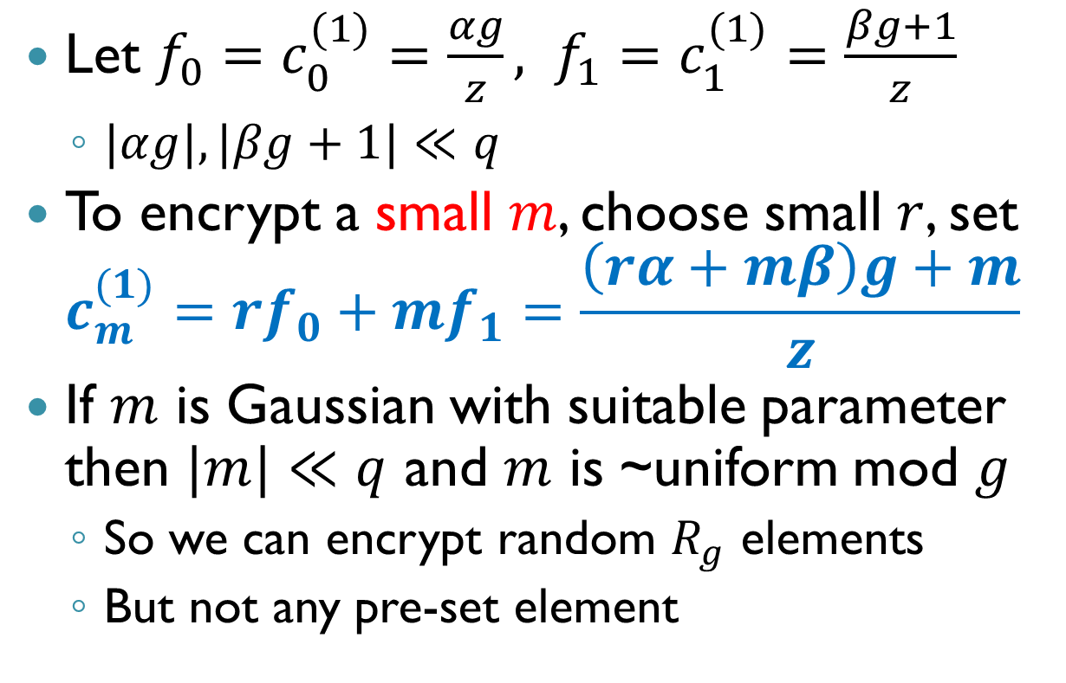
The Public Key
Let $f_{0}=c_{0}^{(1)}=\frac{αg}{z}, f_{1}=c_{1}^{(1)}=\frac{βg+1}{z}$
$|αg|, |βg+1|≪q$
To encrypt a small $m$, choose small $r$, set $c_{m}^{(1)}=rf_{0}+mf_{1}=\frac{\left(rα+mβ\right)g+m}{z}$
If $m$ is Gaussian with suitable parameter then $|m|≪q$ and $m$ is ~uniform mod $g$
So we can encrypt random $R_{g}$ elements
But not any pre-set element

Slide 18
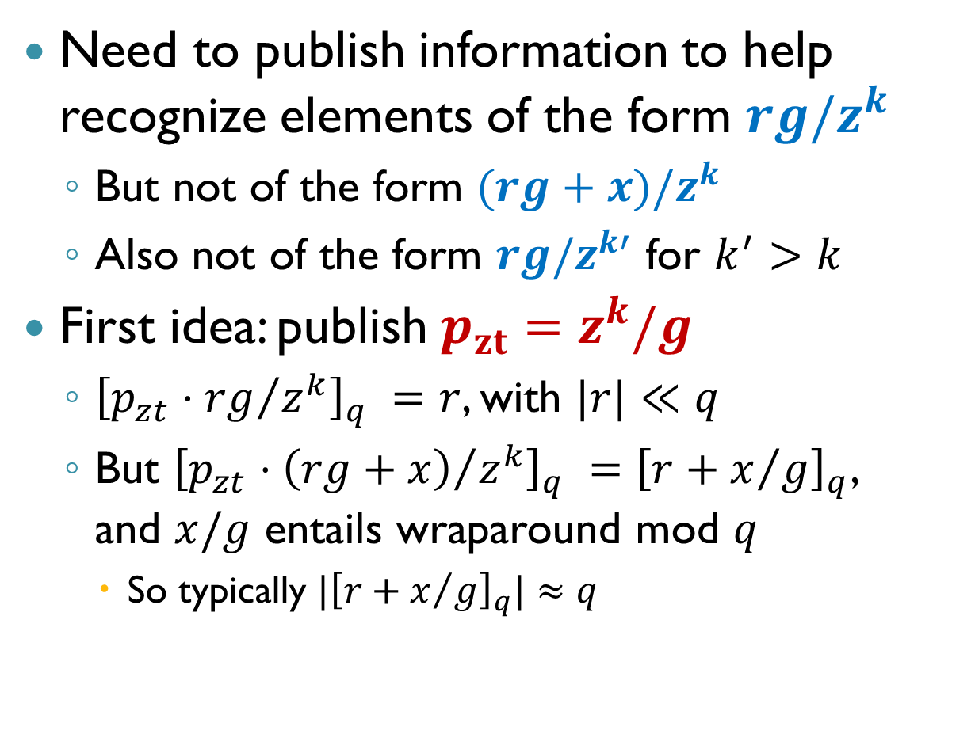
Zero-Test Parameter
Need to publish information to help recognize elements of the form $rg/z^{k}$
But not of the form $(rg+x)/z^{k}$
Also not of the form $rg/z^{k′}$ for $k^{′}>k$
First idea: publish $p_{zt}=z^{k}/g$
${\left[p_{zt}⋅{rg}/{z^{k}}\right]}_{q} =r$, with $|r|≪q$
But ${\left[p_{zt}⋅{\left(rg+x\right)}/{z^{k}}\right]}_{q} ={\left[r+x/g\right]}_{q}$, and $x/g$ entails wraparound mod $q$
So typically $|{\left[r+x/g\right]}_{q}|≈q$

Slide 19
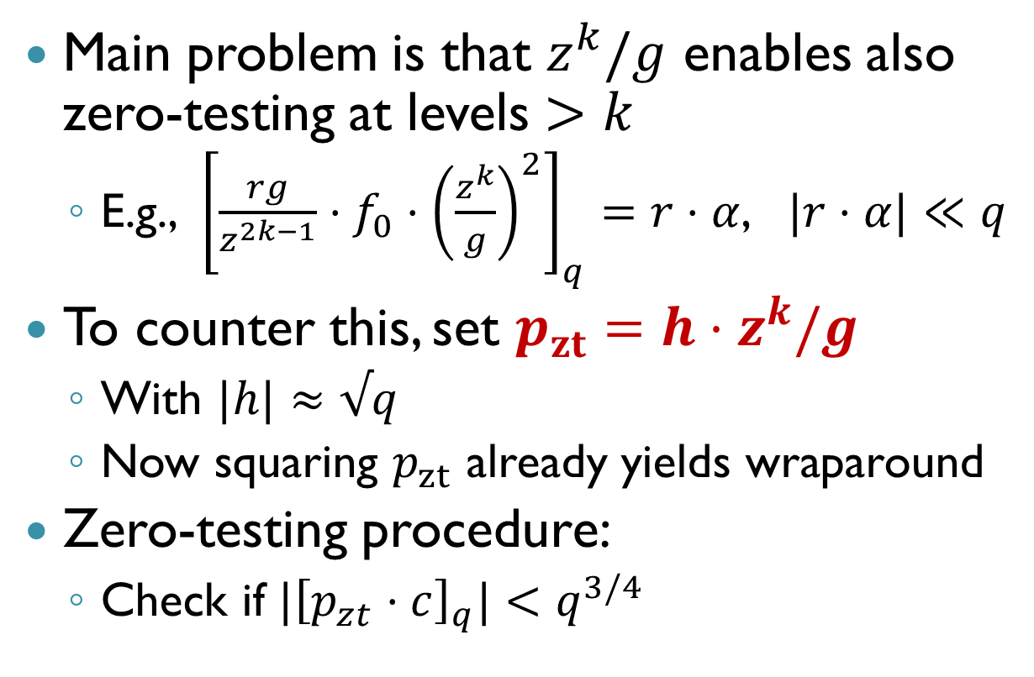
Zero-Test Parameter (2)
Main problem is that $z^{k}/g$ enables also zero-testing at levels $>k$
E.g., ${\left[\frac{rg}{z^{2k−1}}⋅f_{0}⋅{\left(\frac{z^{k}}{g}\right)}^{2}\right]}_{q}=r⋅α$, $|r⋅α|≪q$
To counter this, set $p_{zt}=h⋅z^{k}/g$
With $|h|≈√q$
Now squaring $p_{zt}$ already yields wraparound
Zero-testing procedure:
Check if ${|\left[p_{zt}⋅c\right]}_{q}|<q^{3/4}$

Slide 20
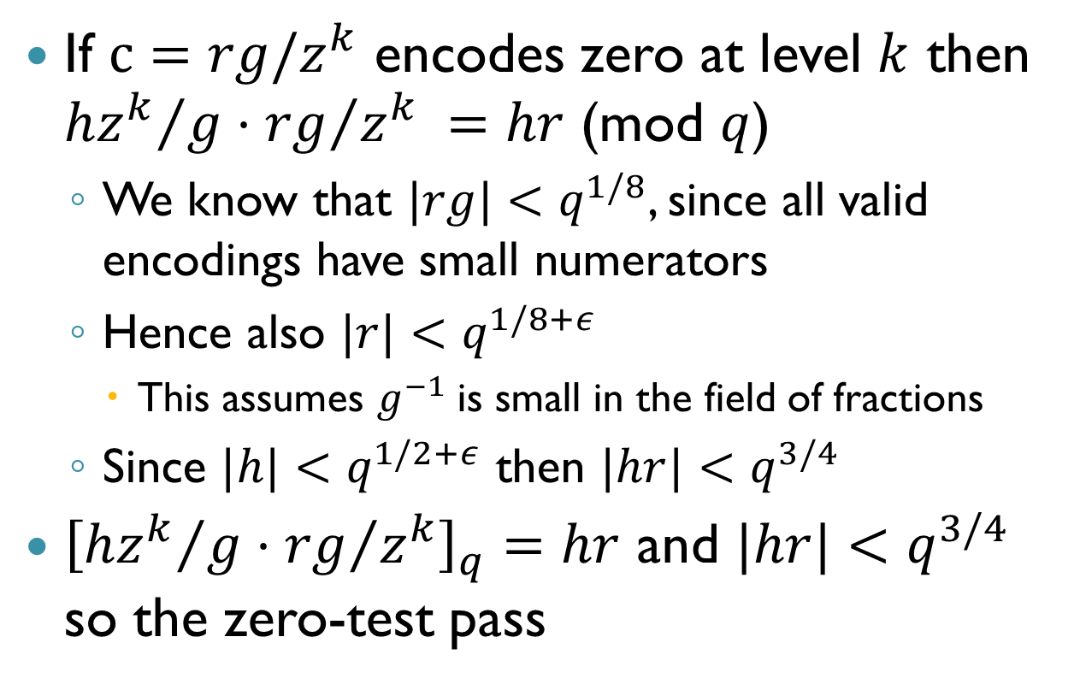
Correctness of Zero-Testing
If $c=rg/z^{k}$ encodes zero at level $k$ then ${hz^{k}}/g⋅{rg}/{z^{k}} =hr$ (mod $q$)
We know that $|rg|<q^{1/8}$, since all valid encodings have small numerators
Hence also $|r|<q^{1/8+ε}$
This assumes $g^{−1}$ is small in the field of fractions
Since $|h|<q^{1/2+ε}$ then $|hr|<q^{3/4}$
${\left[{hz^{k}}/g⋅{rg}/{z^{k}}\right]}_{q}=hr$ and $|hr|<q^{3/4}$ so the zero-test pass

Slide 21
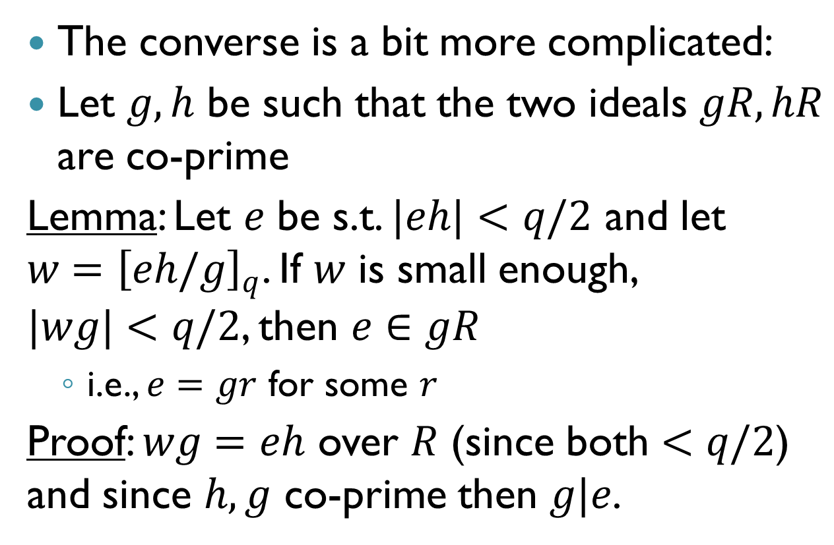
Correctness of Zero-Testing (2)
The converse is a bit more complicated:
Let $g,h$ be such that the two ideals $gR,hR$ are co-prime
Lemma: Let $e$ be s.t. $|eh|<q/2$ and let $w={\left[eh/g\right]}_{q}$. If $w$ is small enough, $|wg|<q/2$, then $e∈gR$
i.e., $e=gr$ for some $r$
Proof: $wg=eh$ over $R$ (since both $<q/2$) and since $h,g$ co-prime then $g|e$.

Slide 22
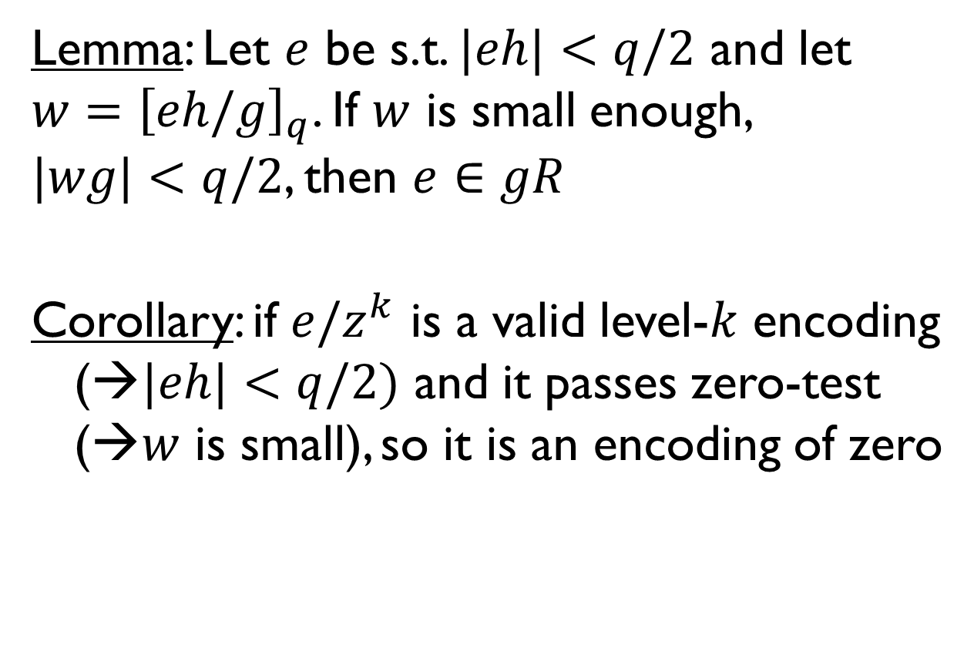
Correctness of Zero-Testing (3)
Lemma: Let $e$ be s.t. $|eh|<q/2$ and let $w={\left[eh/g\right]}_{q}$. If $w$ is small enough, $|wg|<q/2$, then $e∈gR$
Corollary: if $e/z^{k}$ is a valid level-$k$ encoding (→$|eh|<q/2)$ and it passes zero-test (→$w$ is small), so it is an encoding of zero

Slide 23
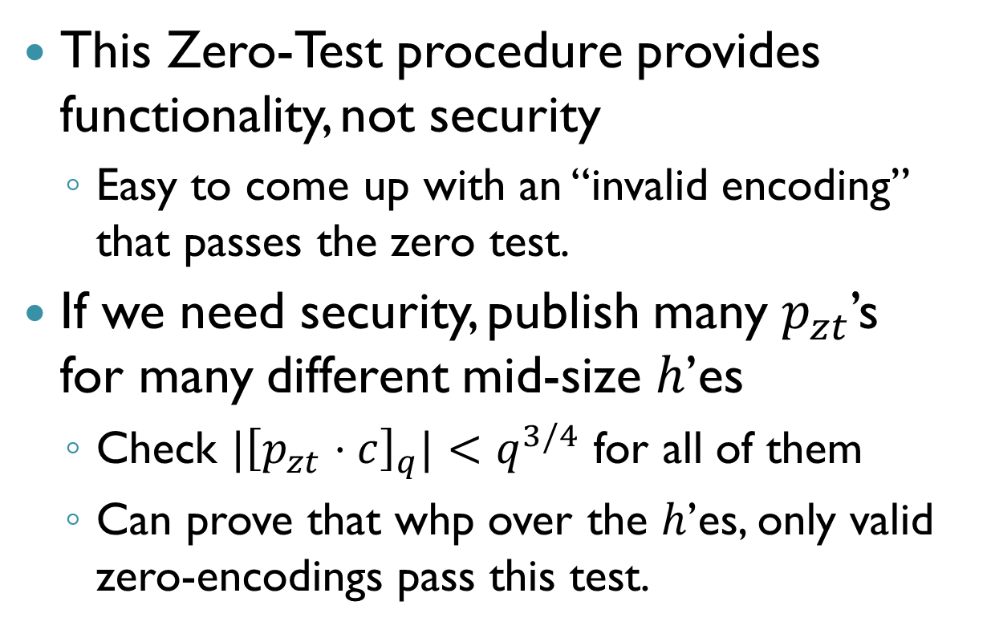
Security of Zero-Testing
This Zero-Test procedure provides functionality, not security
Easy to come up with an “invalid encoding” that passes the zero test.
If we need security, publish many $p_{zt}$’s for many different mid-size $h$’es
Check ${|\left[p_{zt}⋅c\right]}_{q}|<q^{3/4}$ for all of them
Can prove that whp over the $h$’es, only valid zero-encodings pass this test.

Slide 24
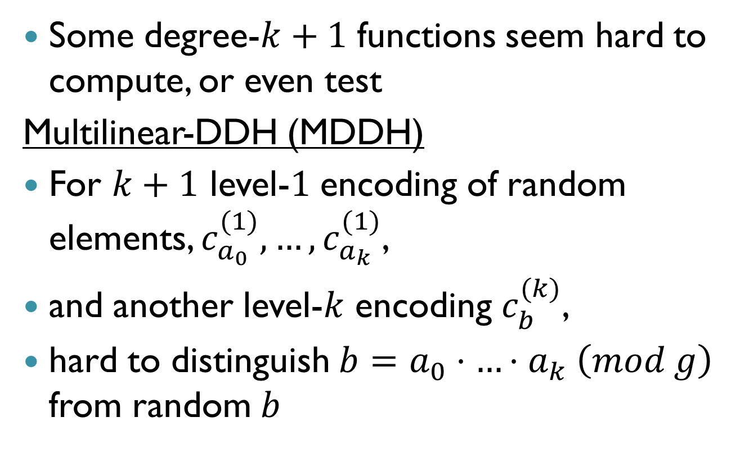
What’s Hard
Some degree-$k+1$ functions seem hard to compute, or even test
Multilinear-DDH (MDDH)
For $k+1$ level-$1$ encoding of random elements, $c_{a_{0}}^{(1)},…,c_{a_{k}}^{(1)}$,
and another level-$k$ encoding $c_{b}^{(k)}$,
hard to distinguish $b=a_{0}⋅…⋅a_{k} \left(mod g\right)$ from random $b$

Slide 25
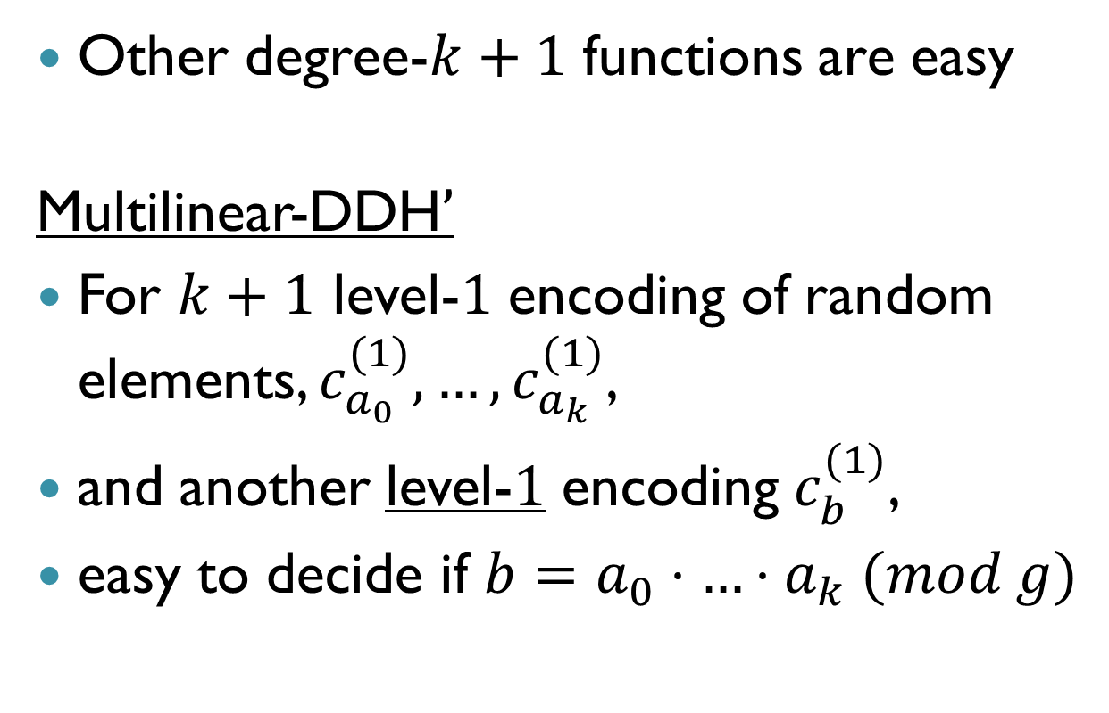
What’s Not Hard
Other degree-$k+1$ functions are easy
Multilinear-DDH$’$
For $k+1$ level-$1$ encoding of random elements, $c_{a_{0}}^{(1)},…,c_{a_{k}}^{(1)}$,
and another level-1 encoding $c_{b}^{(1)}$,
easy to decide if $b=a_{0}⋅…⋅a_{k} (mod g)$

Slide 26
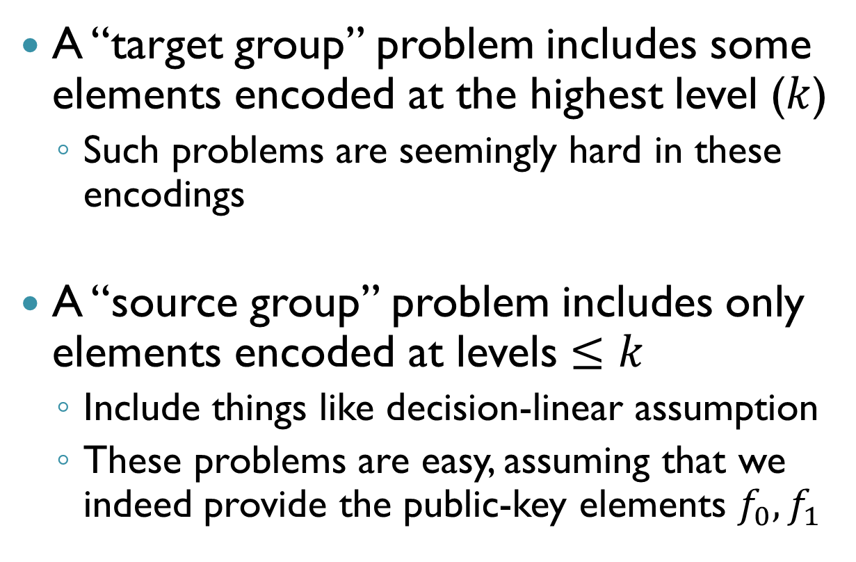
What’s the Difference?
A “target group” problem includes some elements encoded at the highest level ($k$)
Such problems are seemingly hard in these encodings
A “source group” problem includes only elements encoded at levels $≤k$
Include things like decision-linear assumption
These problems are easy, assuming that we indeed provide the public-key elements $f_{0},f_{1}$

Slide 27
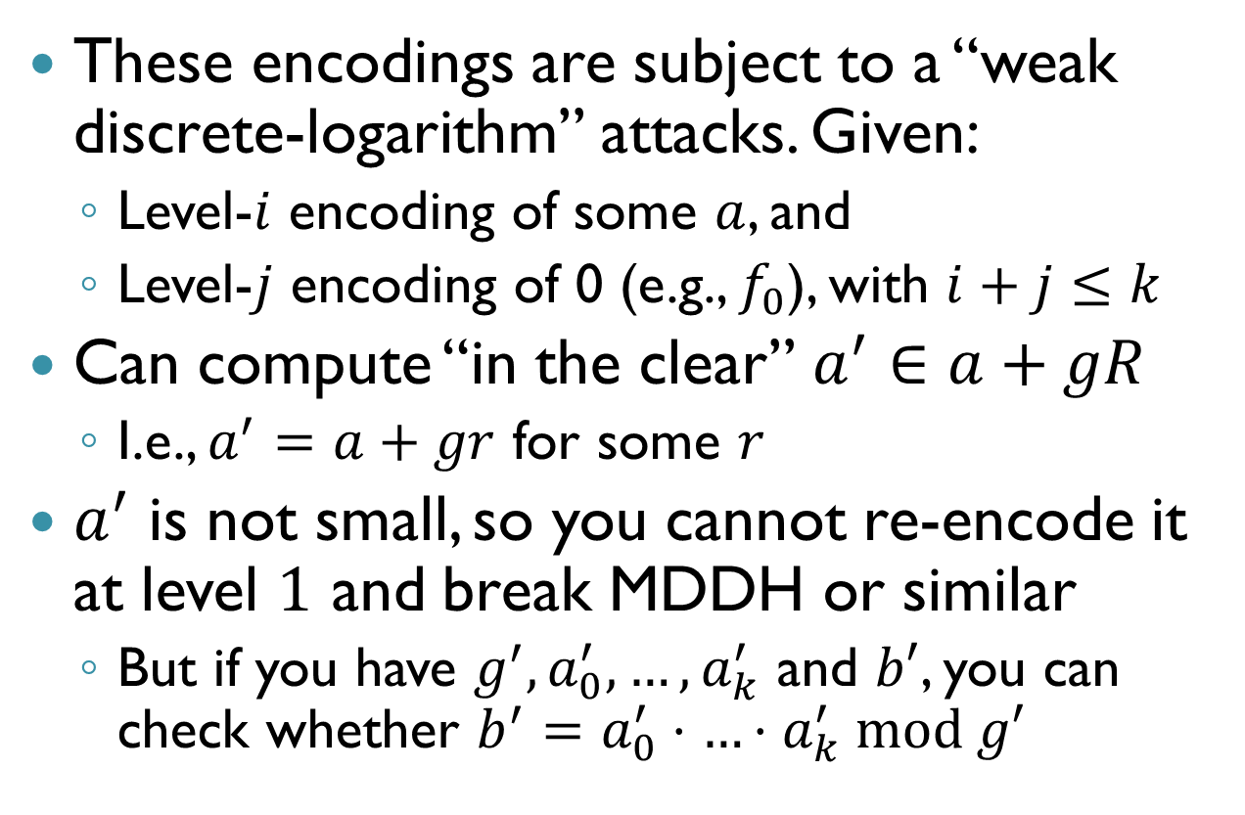
Why the Difference?
These encodings are subject to a “weak discrete-logarithm” attacks. Given:
Level-$i$ encoding of some $a$, and
Level-$j$ encoding of 0 (e.g., $f_{0}$), with $i+j≤k$
Can compute “in the clear” $a^{′}∈a+gR$
I.e., $a^{′}=a+gr$ for some $r$
$a^{′}$ is not small, so you cannot re-encode it at level $1$ and break MDDH or similar
But if you have ${g^{′}, a}_{0}^{′},…,a_{k}^{′}$ and $b′$, you can check whether ${b^{′}=a}_{0}^{′}⋅…⋅a_{k}^{′} mod g′$

Slide 28
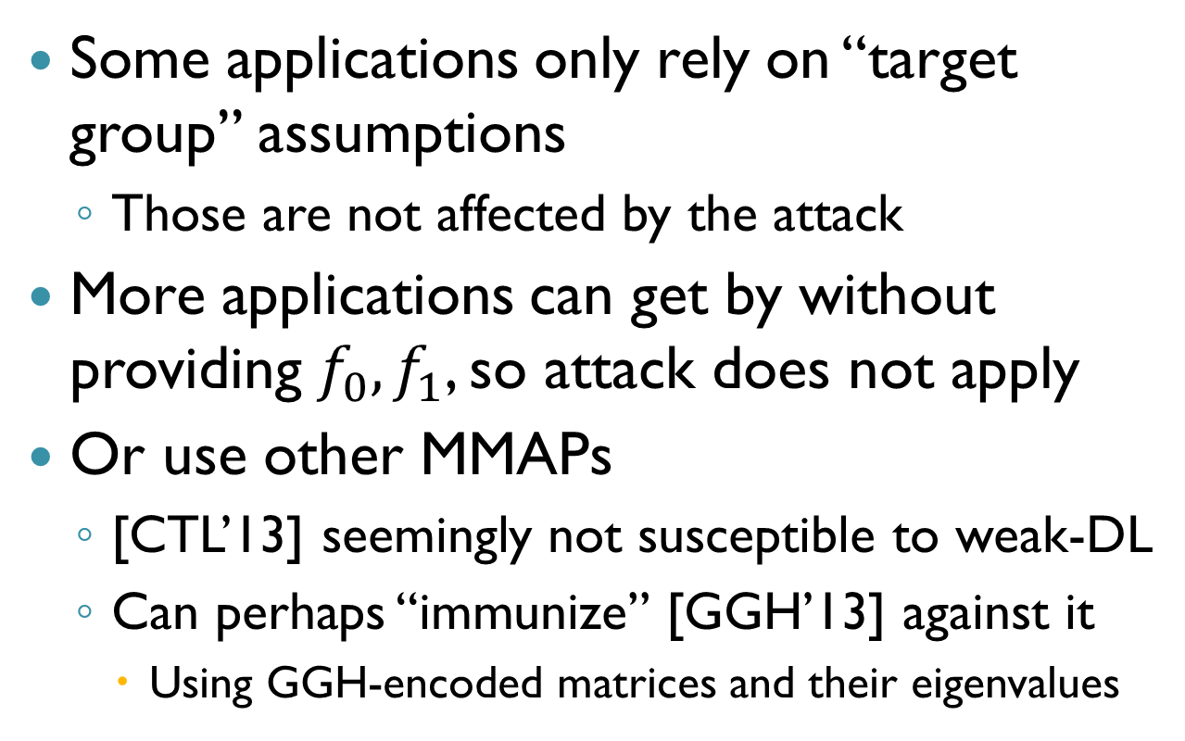
Dealing with “Weak DL” Attacks
Some applications only rely on “target group” assumptions
Those are not affected by the attack
More applications can get by without providing $f_{0},f_{1}$, so attack does not apply
Or use other MMAPs
[CTL’13] seemingly not susceptible to weak-DL
Can perhaps “immunize” [GGH’13] against it
Using GGH-encoded matrices and their eigenvalues

Slide 29
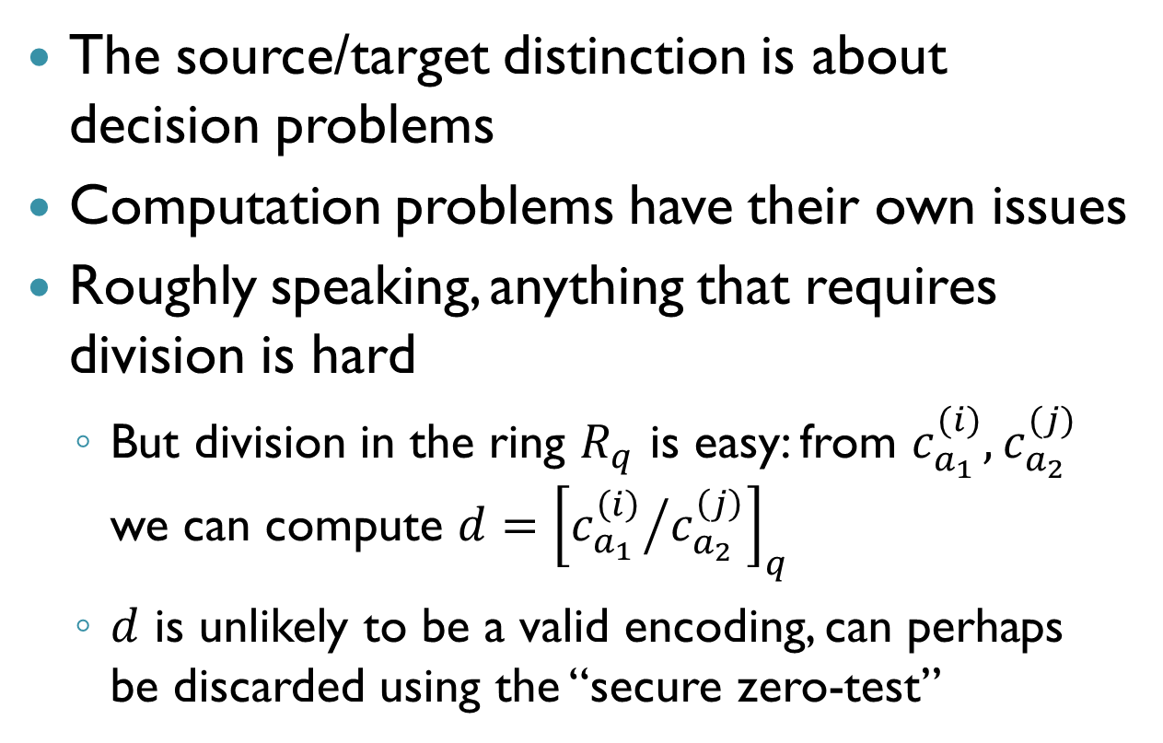
Computation Problems
The source/target distinction is about decision problems
Computation problems have their own issues
Roughly speaking, anything that requires division is hard
But division in the ring $R_{q}$ is easy: from $c_{a_{1}}^{(i)}, c_{a_{2}}^{(j)}$ we can compute $d={\left[{c_{a_{1}}^{\left(i\right)}}/{c_{a_{2}}^{\left(j\right)}}\right]}_{q}$
$d$ is unlikely to be a valid encoding, can perhaps be discarded using the “secure zero-test”

Slide 30
Applications of MMAPs

Slide 31
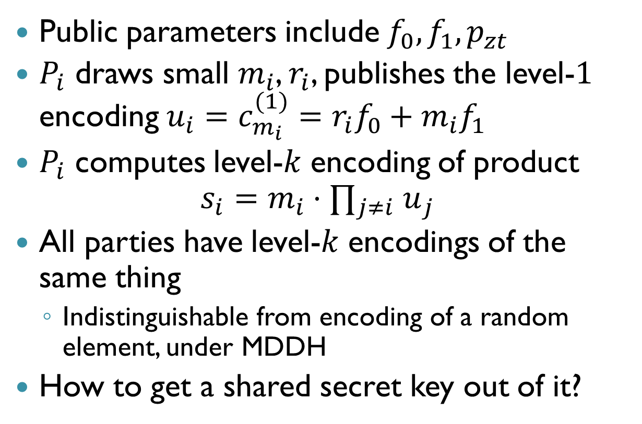
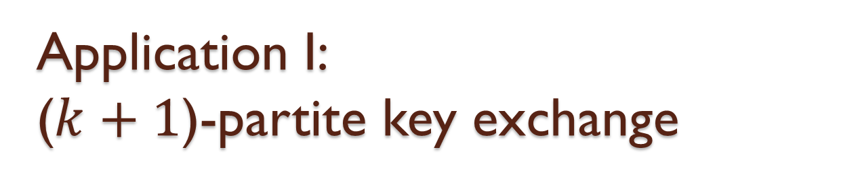
Application I: ($k+1$)-partite key exchange
Public parameters include $f_{0},f_{1},p_{zt}$
$P_{i}$ draws small $m_{i}$, $r_{i}$, publishes the level-$1$ encoding $u_{i}=c_{m_{i}}^{(1)}=r_{i}f_{0}+m_{i}f_{1}$
$P_{i}$ computes level-$k$ encoding of product $s_{i}=m_{i}⋅{ ∏_{j≠i} u}_{j}$
All parties have level-$k$ encodings of the same thing
Indistinguishable from encoding of a random element, under MDDH
How to get a shared secret key out of it?

Slide 32
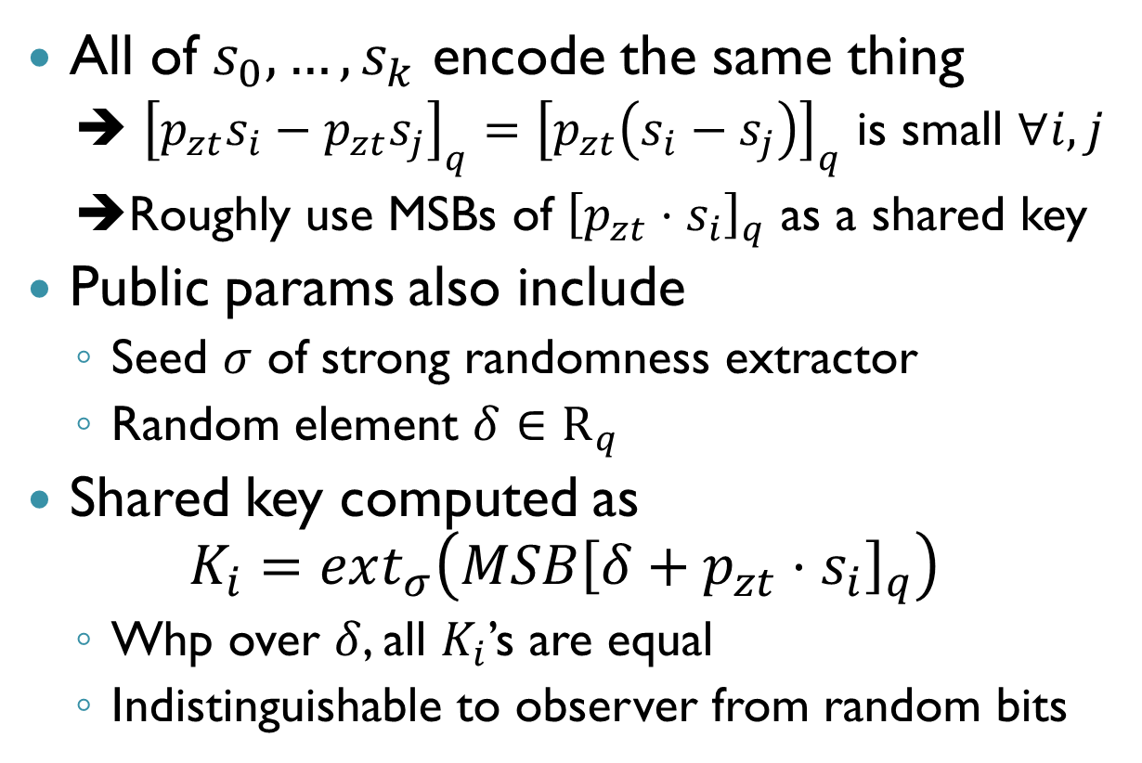
Extracting Canonical Representation
All of $s_{0},…,s_{k}$ encode the same thing
➔ ${\left[p_{zt}s_{i}−p_{zt}s_{j}\right]}_{q}={\left[p_{zt}\left(s_{i}−s_{j}\right)\right]}_{q}$ is small $∀i,j$
➔Roughly use MSBs of ${\left[p_{zt}⋅s_{i}\right]}_{q}$ as a shared key
Public params also include
Seed $σ$ of strong randomness extractor
Random element $δ∈R_{q}$
Shared key computed as $K_{i}=ext_{σ}\left(MSB{\left[δ+p_{zt}⋅s_{i}\right]}_{q}\right)$
Whp over $δ$, all $K_{i}$’s are equal
Indistinguishable to observer from random bits

Slide 33
Application II: Witness Encryption
“Encryption without any key”
Relative to an arbitrary riddle
Defined here relative to exact-cover (XC)
Use NP-hardness to get any NP statement
Message encrypted wrt to XC instance
Encryptor need not know a solution, or even if a solution exists
Anyone with a solution can decrypt
Semantic-security if no solution exists

Slide 34
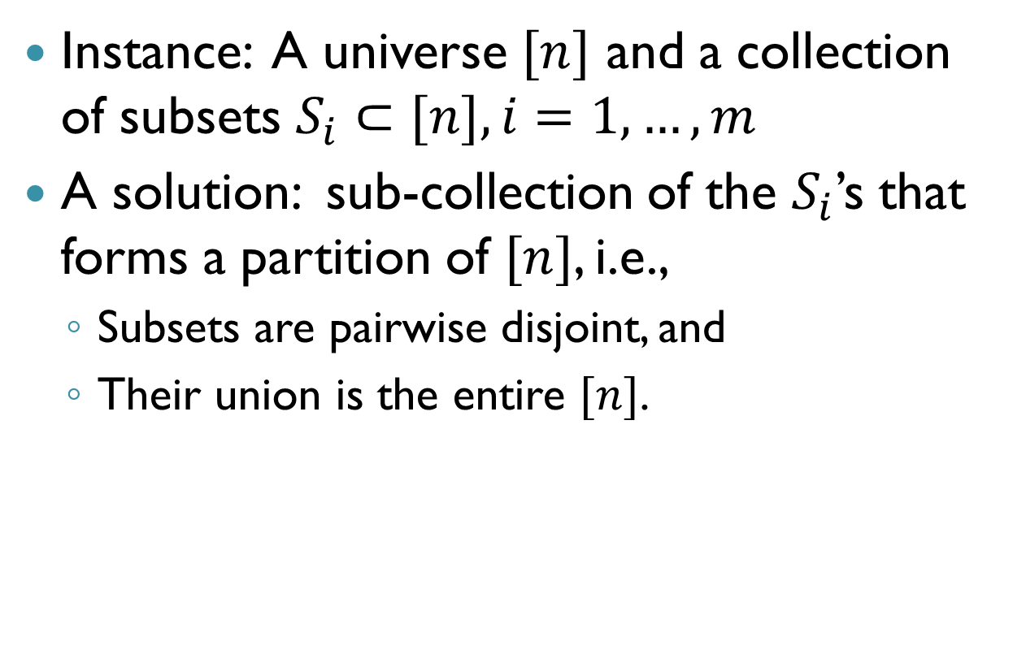
Recall Exact Cover
Instance: A universe $[n]$ and a collection of subsets $S_{i}⊂[n], i=1,…,m$
A solution: sub-collection of the $S_{i}$’s that forms a partition of $[n]$, i.e.,
Subsets are pairwise disjoint, and
Their union is the entire $[n]$.

Slide 35
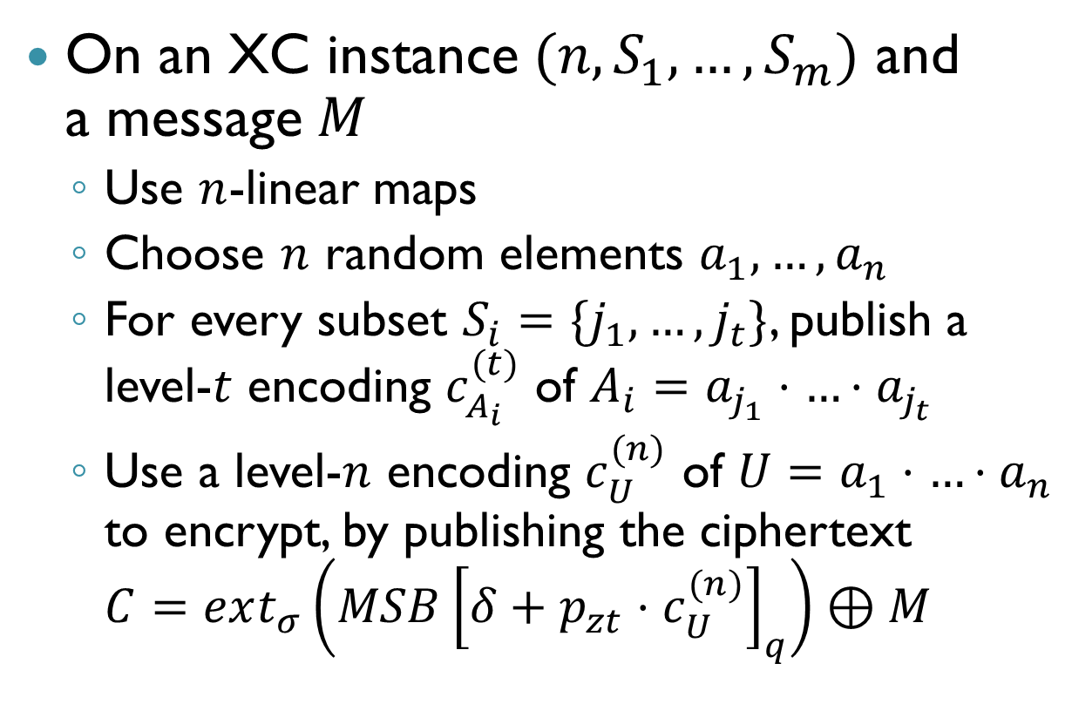
The [GGSW13] Construction
On an XC instance $(n,S_{1},…,S_{m})$ and a message $M$
Use $n$-linear maps
Choose $n$ random elements $a_{1},…,a_{n}$
For every subset $S_{i}=\{j_{1},…,j_{t}\}$, publish a level-$t$ encoding $c_{A_{i}}^{(t)}$ of $A_{i}=a_{j_{1}}⋅…⋅a_{j_{t}}$
Use a level-$n$ encoding $c_{U}^{(n)}$ of $U=a_{1}⋅…⋅a_{n}$ to encrypt, by publishing the ciphertext $C=ext_{σ}\left(MSB{\left[δ+p_{zt}⋅c_{U}^{(n)}\right]}_{q}\right)⊕M$

Slide 36
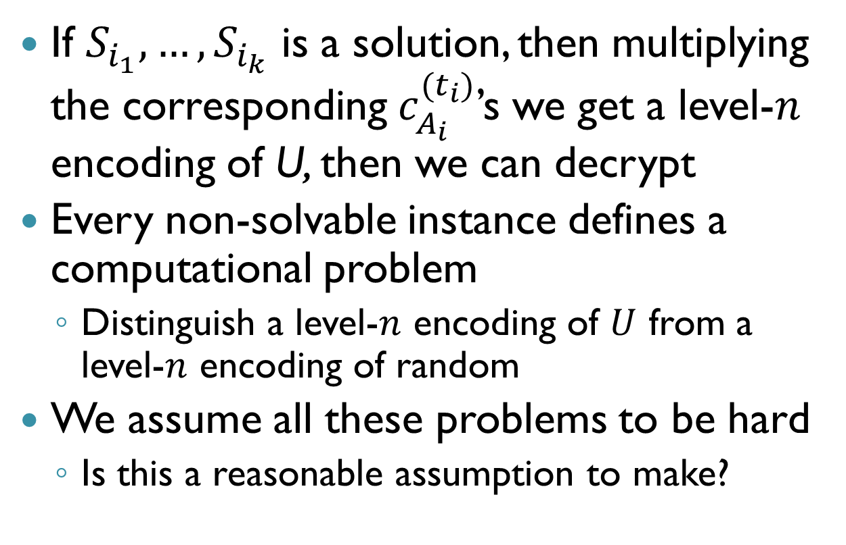
The [GGSW] Construction (2)
If $S_{i_{1}}, …, S_{i_{k}}$ is a solution, then multiplying the corresponding $c_{A_{i}}^{(t_{i})}$’s we get a level-$n$ encoding of U, then we can decrypt
Every non-solvable instance defines a computational problem
Distinguish a level-$n$ encoding of $U$ from a level-$n$ encoding of random
We assume all these problems to be hard
Is this a reasonable assumption to make?

Slide 37
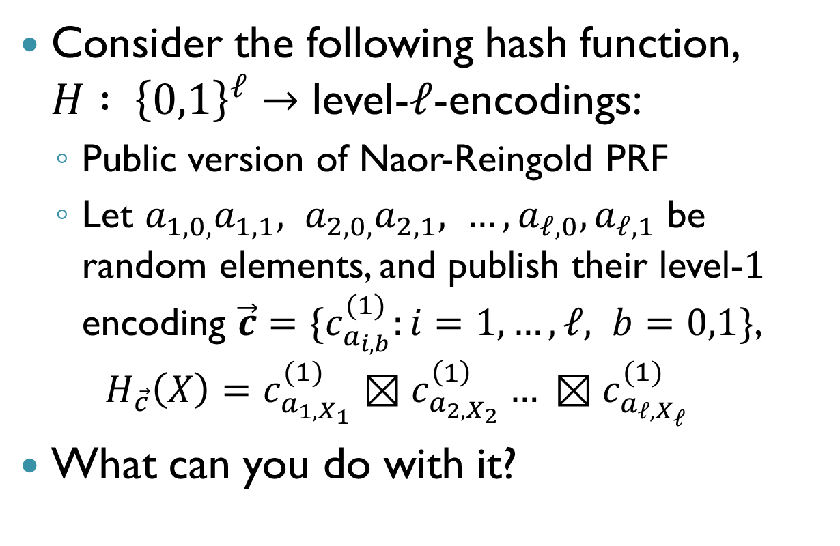
Application III: Full-Domain Hash
Consider the following hash function, $H : {\left\{0,1\right\}}^{ℓ}→$ level-$ℓ$-encodings:
Public version of Naor-Reingold PRF
Let $a_{1,0,}a_{1,1}, a_{2,0,}a_{2,1}, …, a_{ℓ,0},a_{ℓ,1}$ be random elements, and publish their level-$1$ encoding $\vec{c}=\{c_{a_{i,b}}^{(1)}:i=1,…,ℓ, b=0,1\}$,
$$H_{\vec{c}}\left(X\right)=c_{a_{1,X_{1}}}^{(1)}⊠c_{a_{2,X_{2}}}^{\left(1\right)}… ⊠c_{a_{ℓ,X_{ℓ}}}^{(1)}$$
What can you do with it?

Slide 38
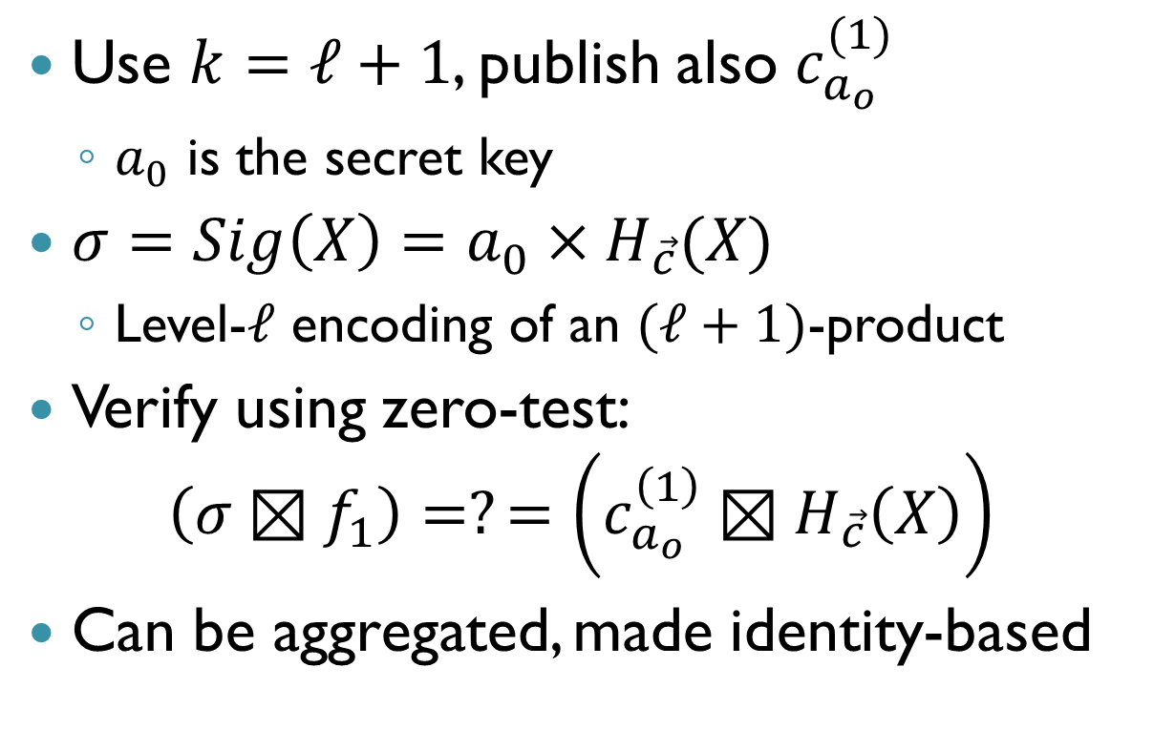
BLS-type Signatures [HWS13]
Use $k=ℓ+1$, publish also $c_{a_{o }}^{(1)}$
$a_{0}$ is the secret key
$σ=Sig\left(X\right)=a_{0}×H_{\vec{c}}(X)$
Level-$ℓ$ encoding of an $(ℓ+1)$-product
Verify using zero-test:
$$\left(σ⊠f_{1}\right)=?=\left(c_{a_{o }}^{\left(1\right)}⊠H_{\vec{c}}\left(X\right)\right)$$
Can be aggregated, made identity-based

Slide 39
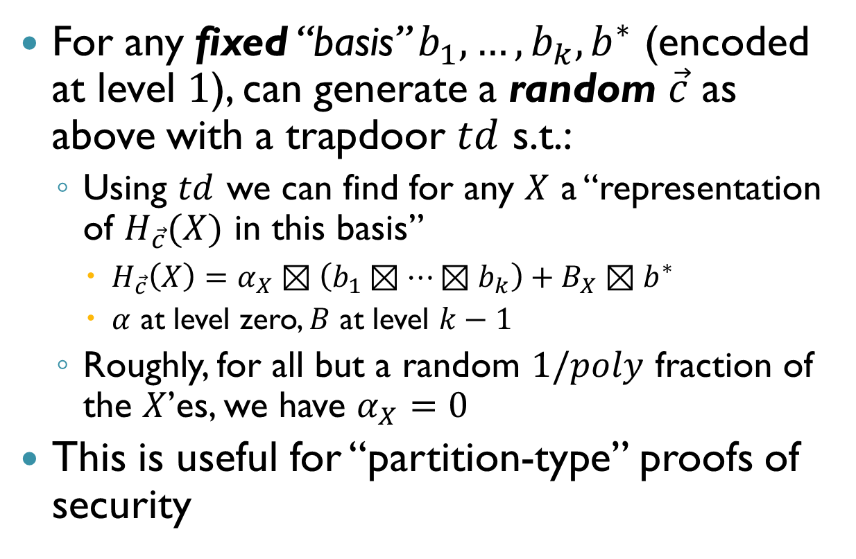
“Programmable” Hash Functions [FHPS13]
For any fixed “basis” $b_{1},…,b_{k}, b^{∗}$ (encoded at level $1$), can generate a random $\vec{c}$ as above with a trapdoor $td$ s.t.:
Using $td$ we can find for any $X$ a “representation of $H_{\vec{c}}(X)$ in this basis”
$H_{\vec{c}}\left(X\right)=α_{X}⊠\left(b_{1}⊠…⊠b_{k}\right)+B_{X}⊠b^{∗}$
$α$ at level zero, $B$ at level $k−1$
Roughly, for all but a random $1/poly$ fraction of the $X$’es, we have $α_{X}=0$
This is useful for “partition-type” proofs of security

Slide 40
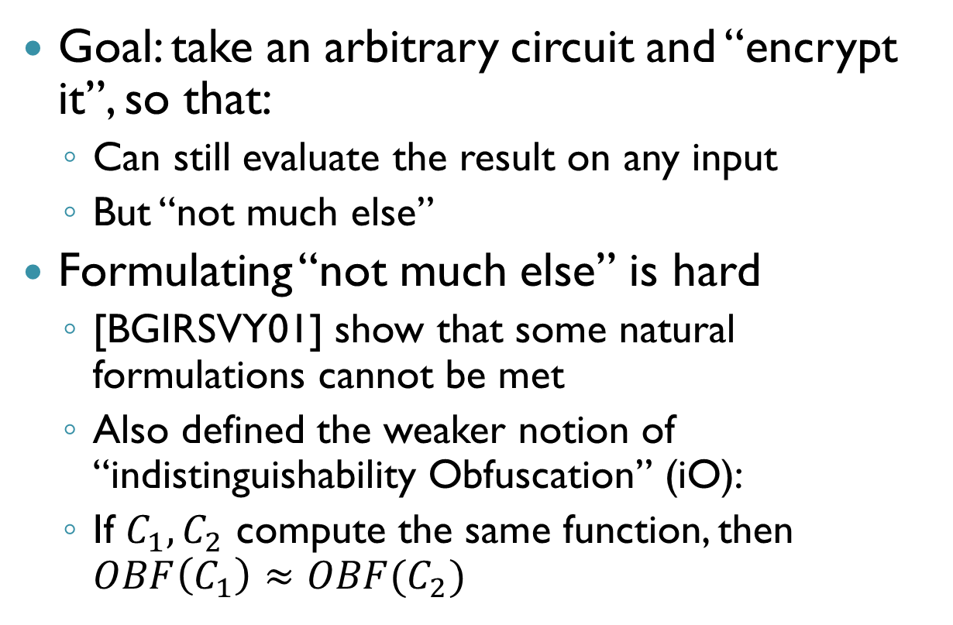
Obfuscation [GGHRSW13]
Goal: take an arbitrary circuit and “encrypt it”, so that:
Can still evaluate the result on any input
But “not much else”
Formulating “not much else” is hard
[BGIRSVY01] show that some natural formulations cannot be met
Also defined the weaker notion of “indistinguishability Obfuscation” (iO):
If $C_{1},C_{2}$ compute the same function, then $OBF\left(C_{1}\right)≈OBF(C_{2})$
Notes:
Barak, Goldreich, Impagliazzo, Rudich, Sahai, Vadhan, and Yang

Slide 41
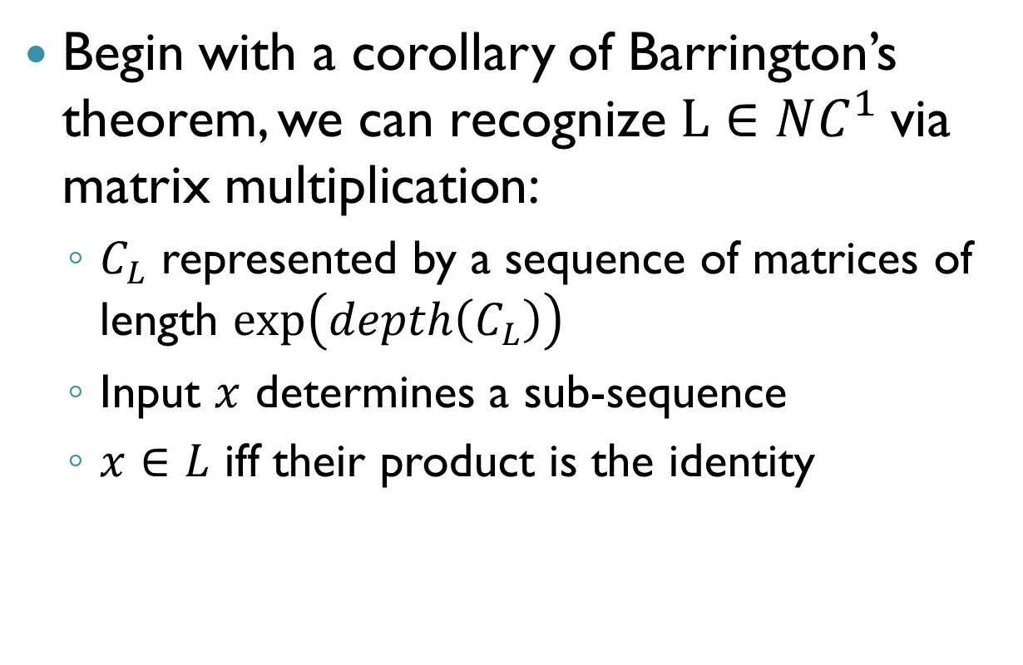

iO for $NC^{1}$
Begin with a corollary of Barrington’s theorem, we can recognize $L∈NC^{1}$via matrix multiplication:
$C_{L}$ represented by a sequence of matrices of length $\exp\left(depth\left(C_{L}\right)\right)$
Input $x$ determines a sub-sequence
$x∈L$ iff their product is the identity

Slide 42
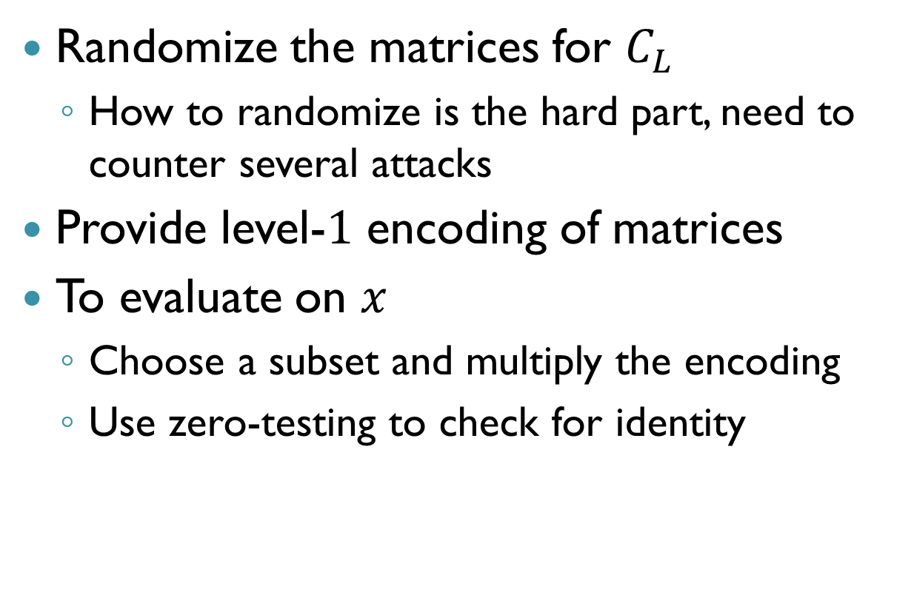

Obfuscating $C_{L}$
Randomize the matrices for $C_{L}$
How to randomize is the hard part, need to counter several attacks
Provide level-$1$ encoding of matrices
To evaluate on $x$
Choose a subset and multiply the encoding
Use zero-testing to check for identity

Slide 43
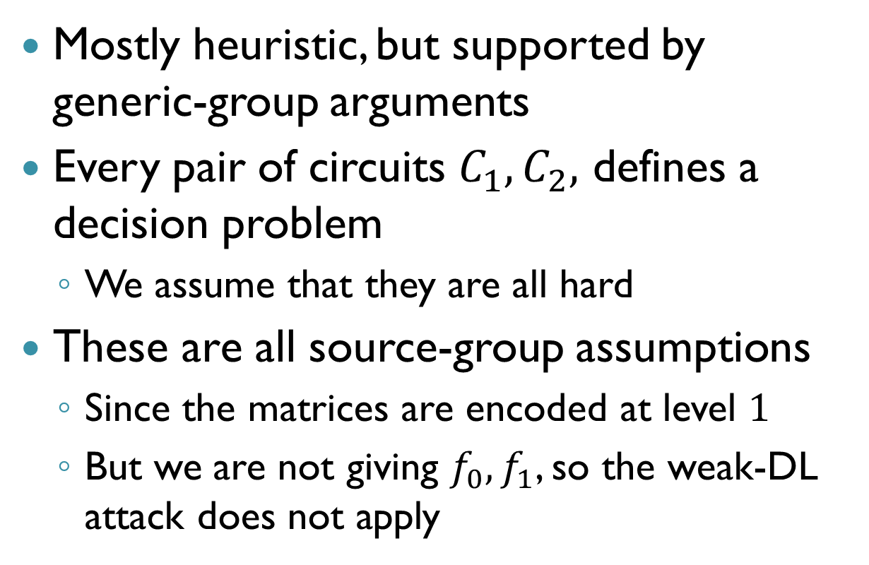
Security
Mostly heuristic, but supported by generic-group arguments
Every pair of circuits $C_{1},C_{2},$ defines a decision problem
We assume that they are all hard
These are all source-group assumptions
Since the matrices are encoded at level $1$
But we are not giving $f_{0}, f_{1}$, so the weak-DL attack does not apply

Slide 44
Summary
Can approximate cryptographic MMAPs
Using SWHE with “handicapped secret key”
Known constructions from NTRU, “integer HE”
Can we do the same thing from other schemes?
Enabling many new applications
But hardness assumptions are strong, “ugly”
In desperate need of a coherent theory
Practical performance lacking
Worse than the [Gen09] HE scheme

