Slide 1
Multilinear Maps and Obfuscation A Survey of Recent Results
Shai Halevi – IBM Research
PKC 2014
Notes:
1. Magnificent Maginot line
2. This doesn’t mean that fortification technology is useless
3. Lack of response may indicate that our tools/skills are not useful to solve these problems?
3a. If so, we may witness drop in funding
3b. We may be good at articulating notions of robustness

Slide 2
Prologue
We are in the midst of (yet another) “quantum leap” in our cryptographic capabilities
Things that were science fiction just two years ago are now plausible
General-purpose functional encryption
Crypto-strength code obfuscation
…
Fueled by new powerful building blocks
Combination of Homomorphic Encryption (HE) and Cryptographic Multilinear Maps (MMAPs)

Slide 3
This Talk
Overview of the main new tool
Constructing MMAPs using “HE techniques”
And application to obfuscation
There are many others
Witness Encryption
Full-Domain Hash
Functional Encryption
…
not today

Slide 4
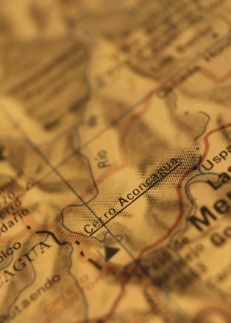


Chapter One: Multilinear Maps

Slide 5

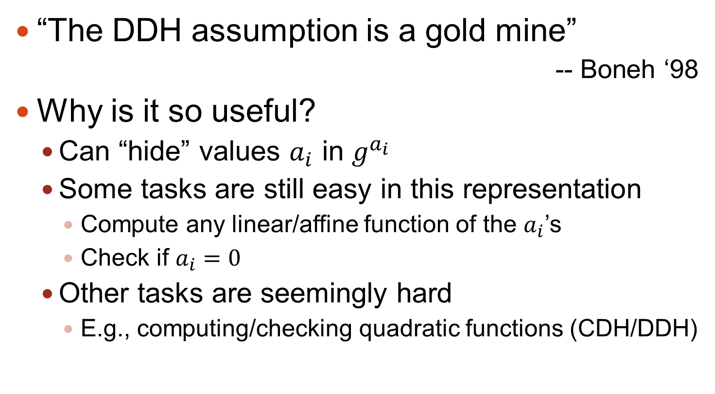
Starting Point: DL-based Crypto
“The DDH assumption is a gold mine”
-- Boneh ‘98
Why is it so useful?
Can “hide” values $a_{i}$ in $g^{a_{i}}$
Some tasks are still easy in this representation
Compute any linear/affine function of the $a_{i}$’s
Check if $a_{i}=0$
Other tasks are seemingly hard
E.g., computing/checking quadratic functions (CDH/DDH)

Slide 6
Starting Point: DL-based Crypto
To use DH in applications, ensure that:
legitimate parties only compute linear functions
adversary needs to compute/check quadratics
Some examples:
Diffie-Hellman key exchange, ElGamal Encryption, Cramer-Shoup CCA-Secure Encryption, Naor-Reingold PRF, Efficient ZKPs, …

Slide 7

Beyond DDH: Bilinear Maps [J00,SOK00,BF01]
In bilinear-map groups you can compute quadratic functions in the exponent
But computing/checking cubics is hard
Now the legitimate parties can do a lot more
Leads to new capabilities
Identity-based encryption (IBE)
Predicate encryption (for simple predicates)
Efficient non-interactive zero-knowledge proofs
…
Notes:
[J00] Joux, [SOK00] Sakai, Ohgishi, Kasahara, [BF01] Boneh, Franklin

Slide 8

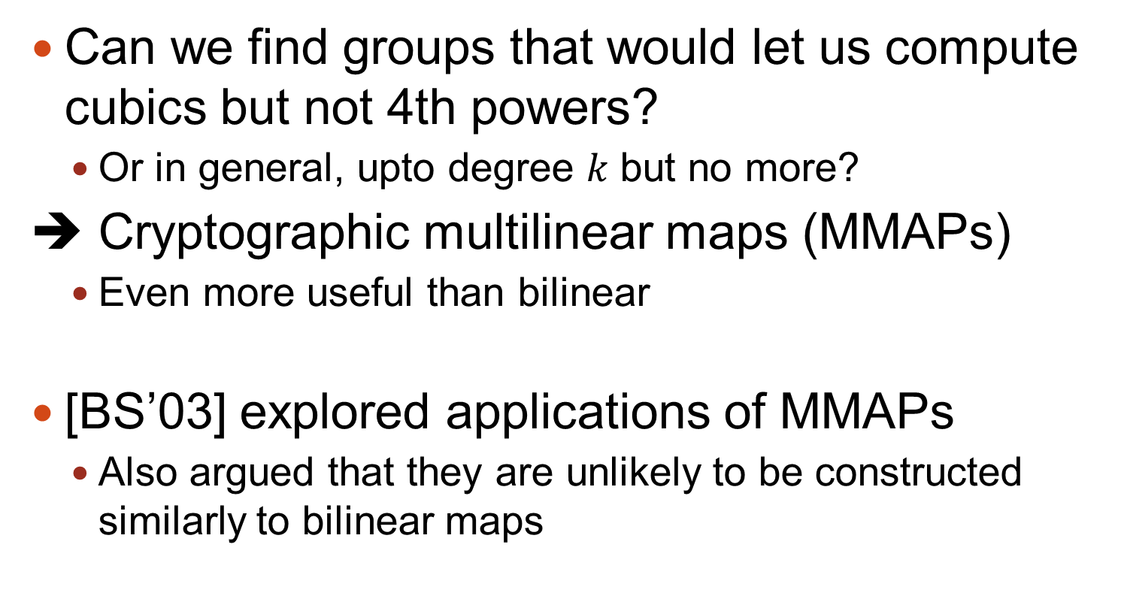
Why Stop at Two?
Can we find groups that would let us compute cubics but not 4th powers?
Or in general, upto degree $k$ but no more?
➔ Cryptographic multilinear maps (MMAPs)
Even more useful than bilinear
[BS’03] explored applications of MMAPs
Also argued that they are unlikely to be constructed similarly to bilinear maps

Slide 9
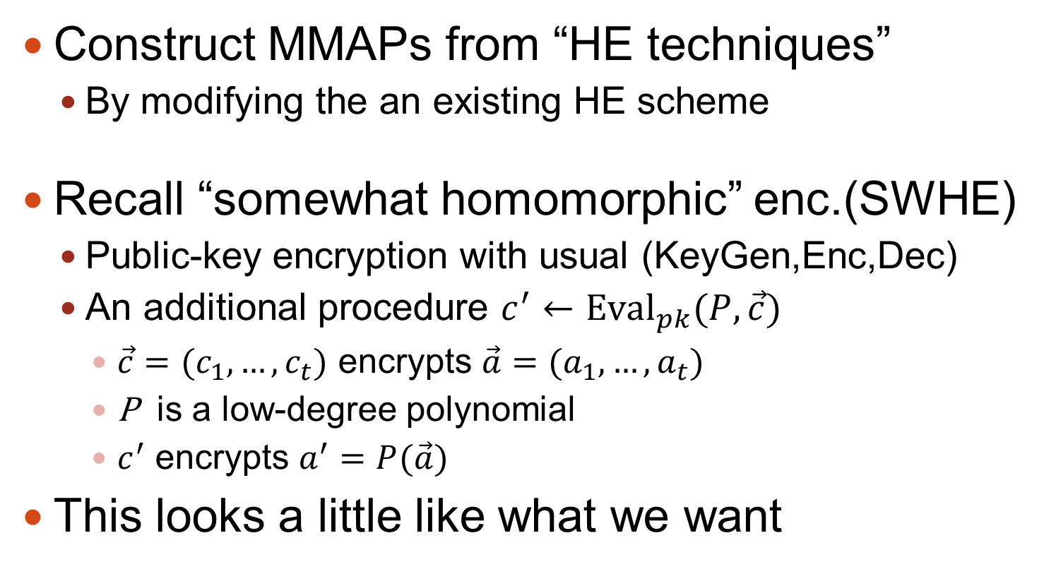
The [GGH’13] Approach to MMAPs
Construct MMAPs from “HE techniques”
By modifying the an existing HE scheme
Recall “somewhat homomorphic” enc.(SWHE)
Public-key encryption with usual (KeyGen,Enc,Dec)
An additional procedure $c^{′}←Eval_{pk}(P, \vec{c})$
$\vec{c}=(c_{1},…,c_{t})$ encrypts $\vec{a}=(a_{1},…,a_{t})$
P is a low-degree polynomial
$c^{′}$ encrypts $a^{′}=P(\vec{a})$
This looks a little like what we want

Slide 10
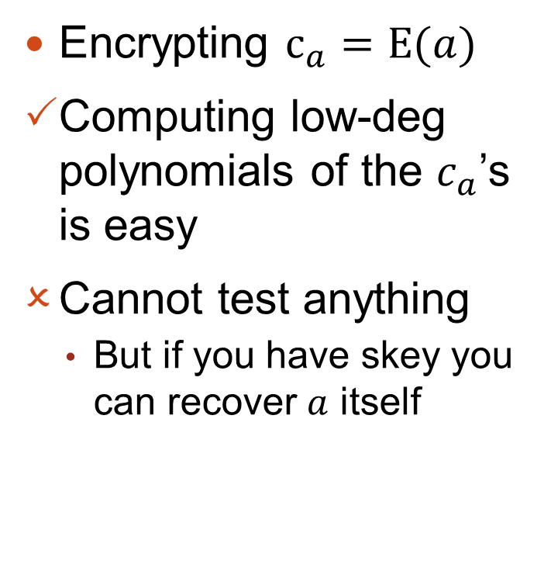
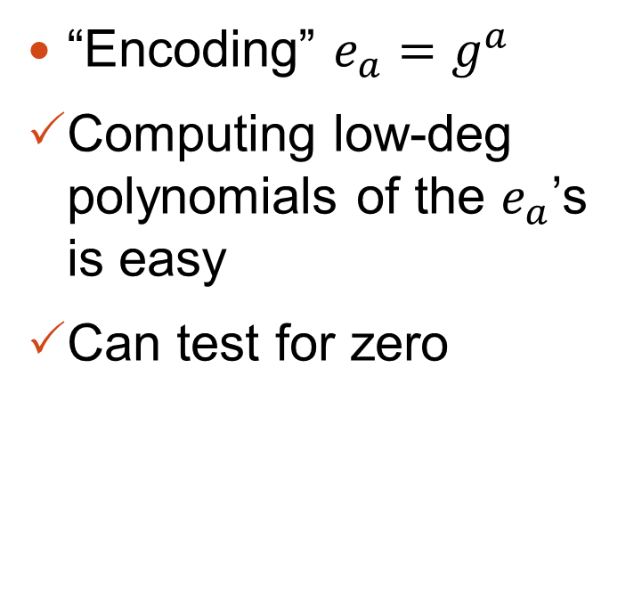
MMAPs vs. SWHE
MMAPs
SWHE
“Encoding” $e_{a}=g^{a}$
Computing low-deg polynomials of the $e_{a}$’s is easy
Can test for zero
Encrypting $c_{a}=E(a)$
Computing low-deg polynomials of the $c_{a}$’s is easy
Cannot test anything
But if you have skey you can recover $a$ itself

Slide 11
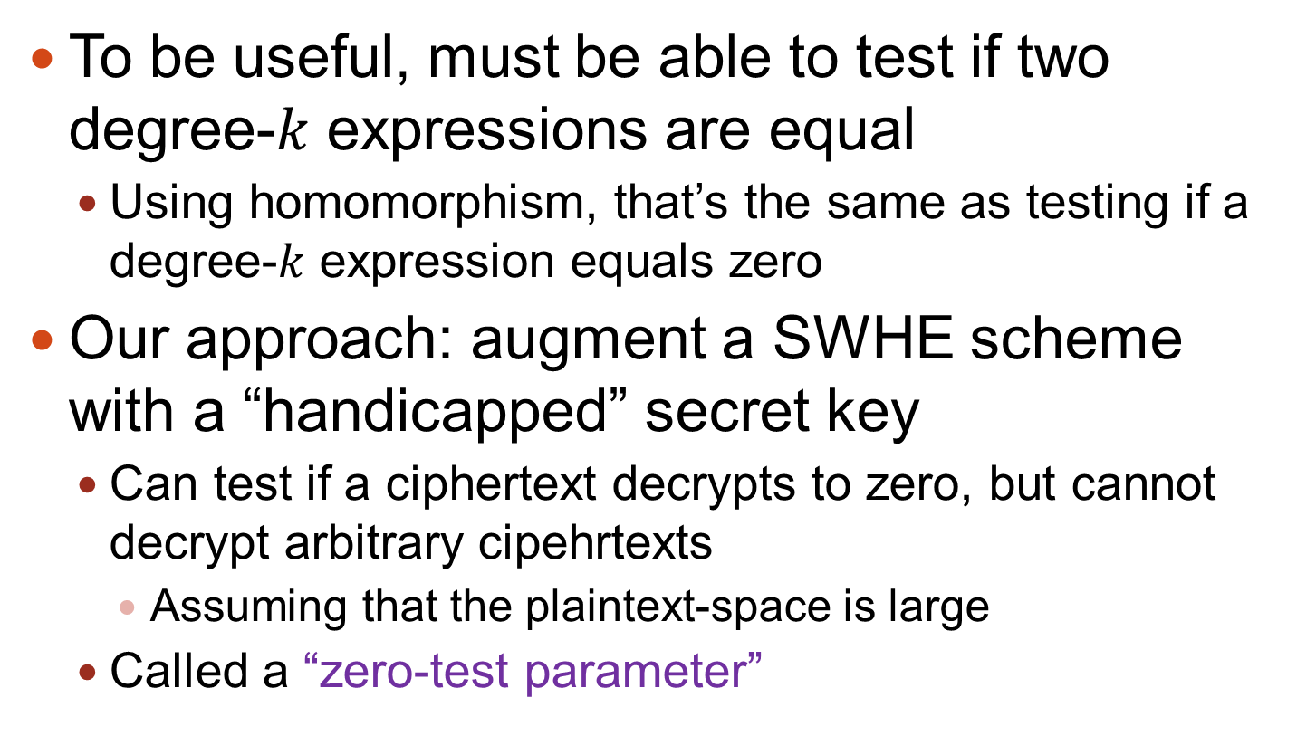
Main Ingredient: Testing for Zero
To be useful, must be able to test if two degree-$k$ expressions are equal
Using homomorphism, that’s the same as testing if a degree-$k$ expression equals zero
Our approach: augment a SWHE scheme with a “handicapped” secret key
Can test if a ciphertext decrypts to zero, but cannot decrypt arbitrary cipehrtexts
Assuming that the plaintext-space is large
Called a “zero-test parameter”

Slide 12

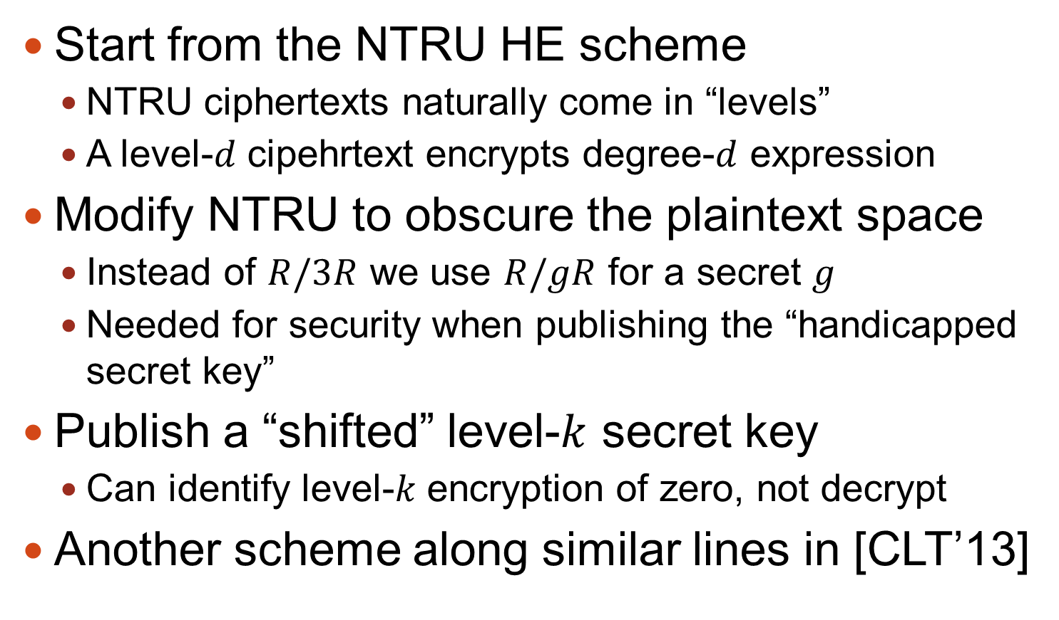
Bird-Eye View of [GGH’13]
Start from the NTRU HE scheme
NTRU ciphertexts naturally come in “levels”
A level-$d$ cipehrtext encrypts degree-$d$ expression
Modify NTRU to obscure the plaintext space
Instead of $R/3R$ we use $R/gR$ for a secret $g$
Needed for security when publishing the “handicapped secret key”
Publish a “shifted” level-$k$ secret key
Can identify level-$k$ encryption of zero, not decrypt
Another scheme along similar lines in [CLT’13]
Notes:
[GGH’13] Garg, Gentry, Halevi Eurocrypt 2013, [CLT’13] Coron, Lepoint, Tibouchi, CRYPTO 2013

Slide 13
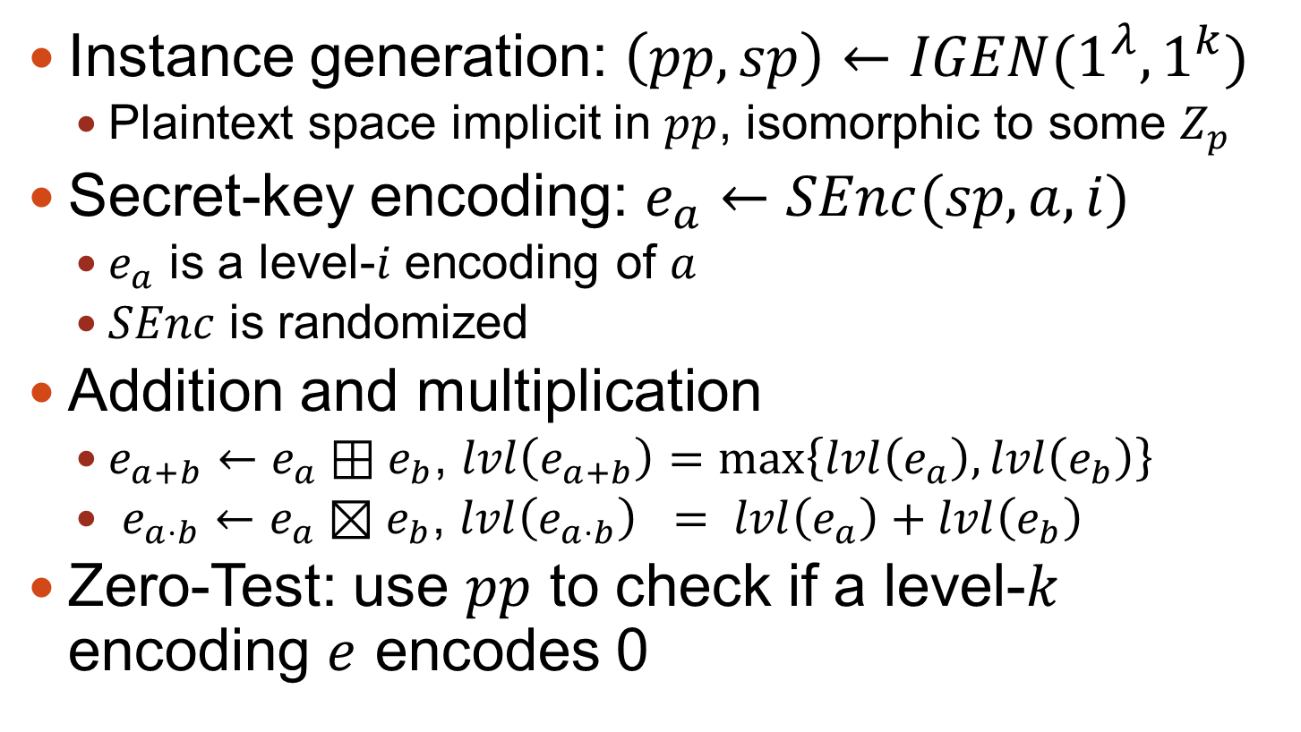
Graded Encoding Schemes
Instance generation: $\left(pp,sp\right)←IGEN(1^{λ},1^{k})$
Plaintext space implicit in $pp$, isomorphic to some $Z_{p}$
Secret-key encoding: $e_{a}←SEnc(sp,a,i)$
$e_{a}$ is a level-$i$ encoding of $a$
$SEnc$ is randomized
Addition and multiplication
$e_{a+b}←e_{a}⊞e_{b}$, $lvl\left(e_{a+b}\right)=\max\left\{lvl\left(e_{a}\right),lvl\left(e_{b}\right)\right\}$
$e_{a⋅b}←e_{a}⊠e_{b}$, $lvl\left(e_{a⋅b}\right) = lvl\left(e_{a}\right)+lvl\left(e_{b}\right)$
Zero-Test: use $pp$ to check if a level-$k$ encoding $e$ encodes 0

Slide 14
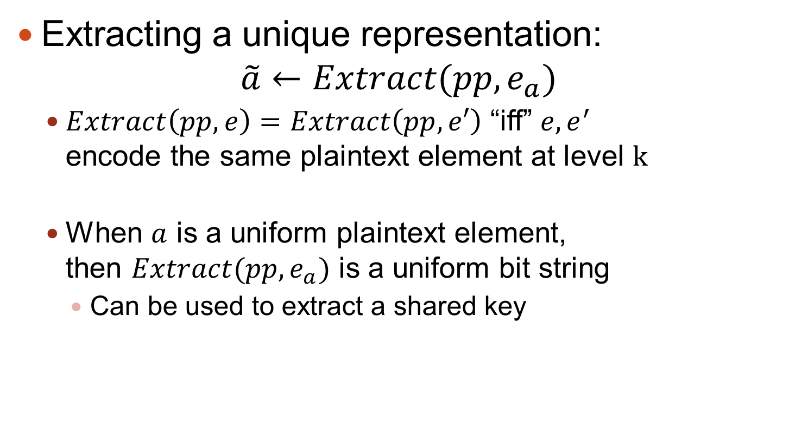
Graded Encoding Schemes
Extracting a unique representation: $\tilde{a}←Extract(pp, e_{a})$
$Extract\left(pp, e\right)=Extract\left(pp, e′\right)$ “iff” $e,e^{′}$ encode the same plaintext element at level $k$
When $a$ is a uniform plaintext element, then $Extract(pp, e_{a})$ is a uniform bit string
Can be used to extract a shared key

Slide 15
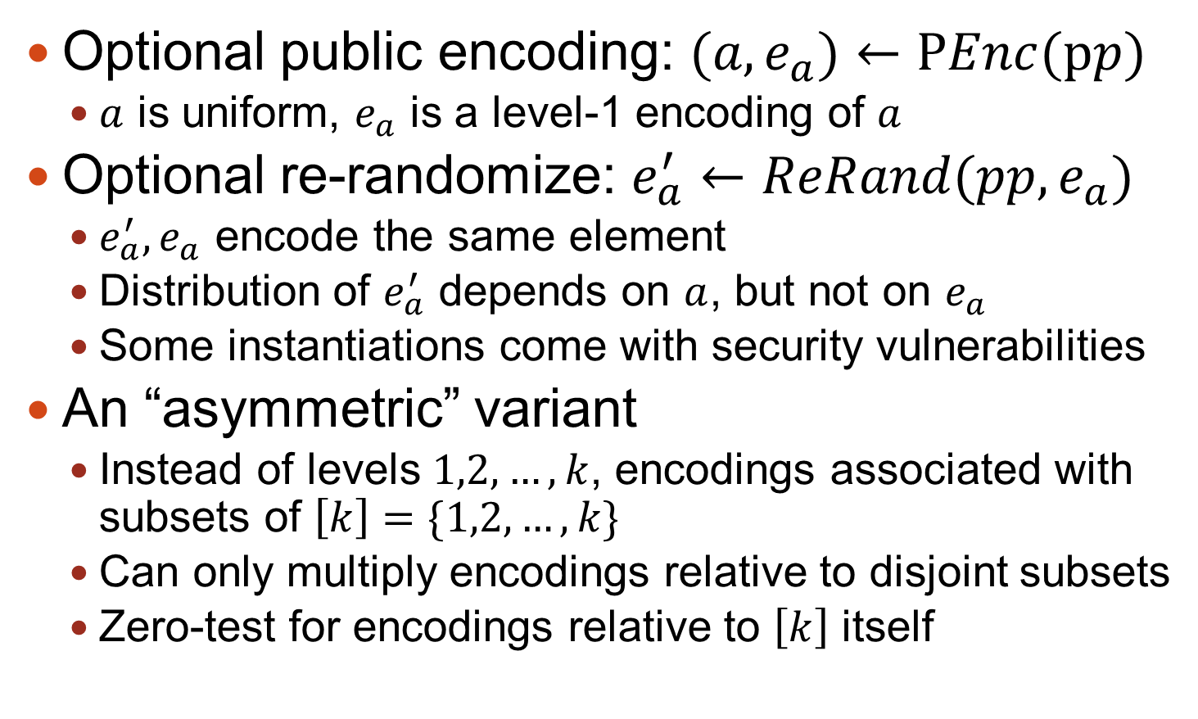
Some Variants
Optional public encoding: $(a,e_{a})←PEnc(pp)$
$a$ is uniform, $e_{a}$ is a level-1 encoding of $a$
Optional re-randomize: $e_{a}^{′}←ReRand(pp,e_{a})$
$e_{a}^{′}, e_{a}$ encode the same element
Distribution of $e_{a}^{′}$ depends on $a$, but not on $e_{a}$
Some instantiations come with security vulnerabilities
An “asymmetric” variant
Instead of levels $1,2,…, k$, encodings associated with subsets of $\left[k\right]=\{1,2,…,k\}$
Can only multiply encodings relative to disjoint subsets
Zero-test for encodings relative to $\left[k\right]$ itself

Slide 16
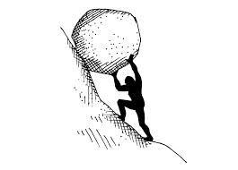
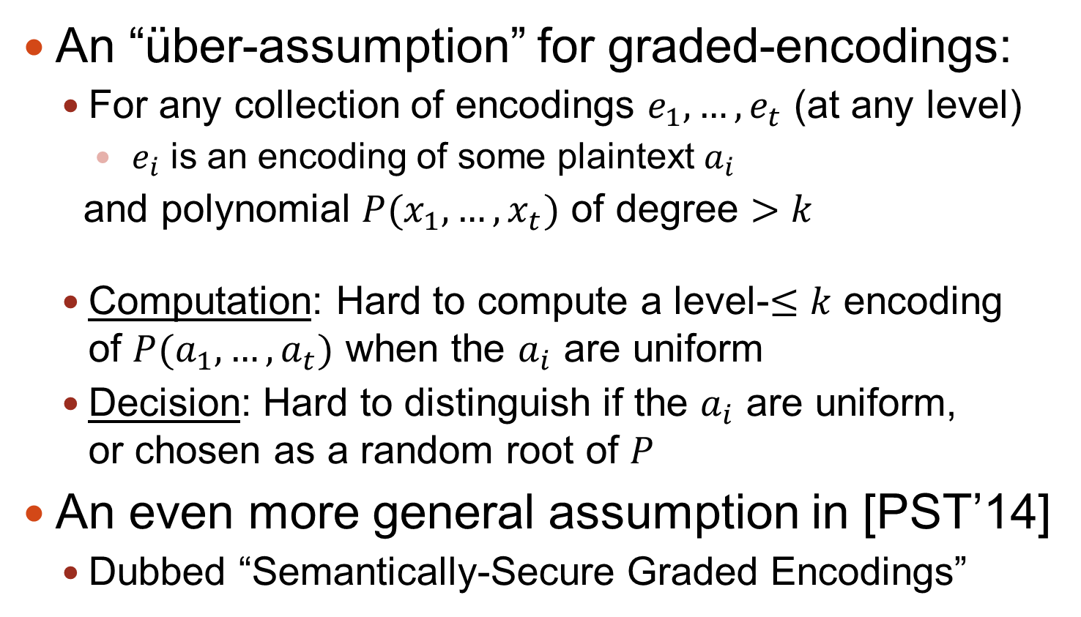
Hardness Assumptions
An “über-assumption” for graded-encodings:
For any collection of encodings $e_{1},…,e_{t}$ (at any level)
$e_{i}$ is an encoding of some plaintext $a_{i}$
and polynomial $P(x_{1},…,x_{t})$ of degree $>k$
Computation: Hard to compute a level-$≤k$ encoding of $P(a_{1},…,a_{t})$ when the $a_{i}$ are uniform
Decision: Hard to distinguish if the $a_{i}$ are uniform, or chosen as a random root of $P$
An even more general assumption in [PST’14]
Dubbed “Semantically-Secure Graded Encodings”
Notes:
Pass, Sethy, Telang

Slide 17
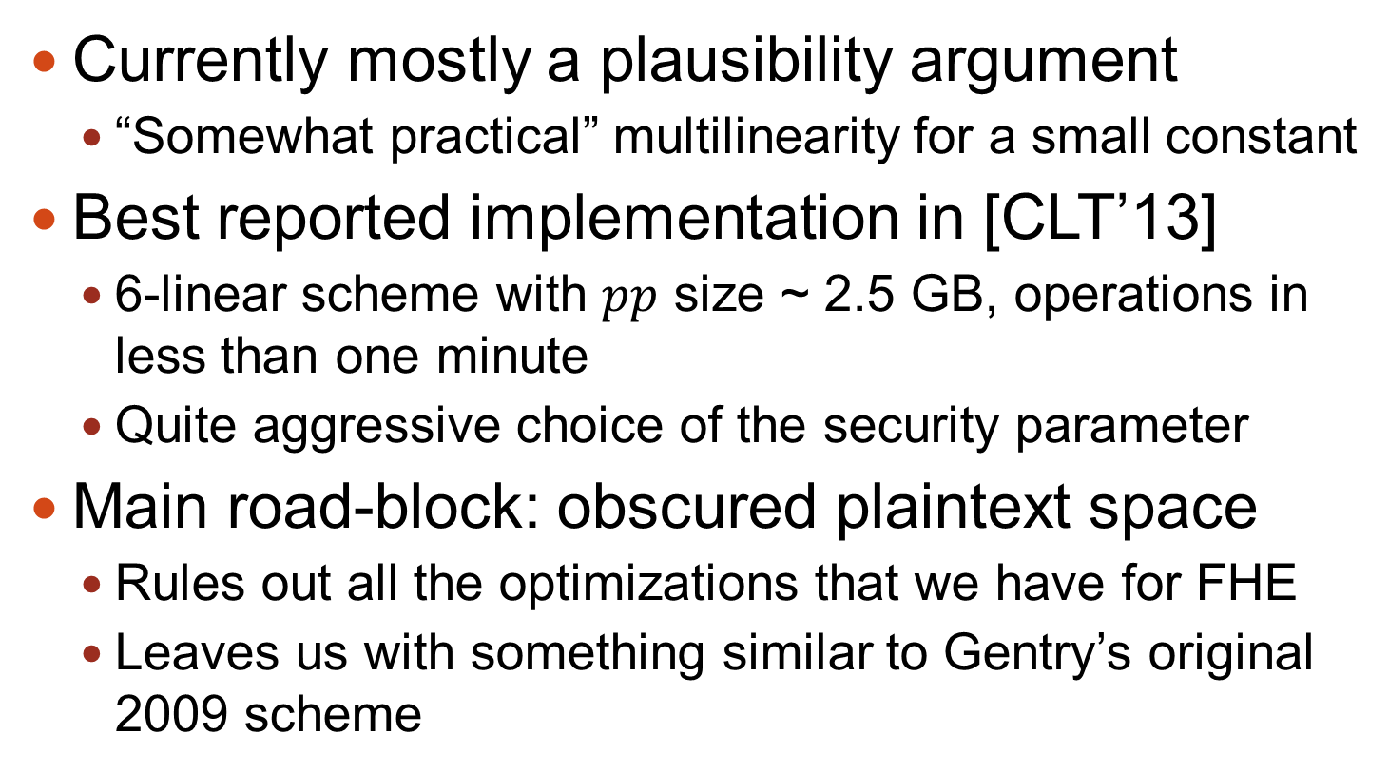
A Few Words About Performance
Currently mostly a plausibility argument
“Somewhat practical” multilinearity for a small constant
Best reported implementation in [CLT’13]
6-linear scheme with $pp$ size ~ 2.5 GB, operations in less than one minute
Quite aggressive choice of the security parameter
Main road-block: obscured plaintext space
Rules out all the optimizations that we have for FHE
Leaves us with something similar to Gentry’s original 2009 scheme

Slide 18
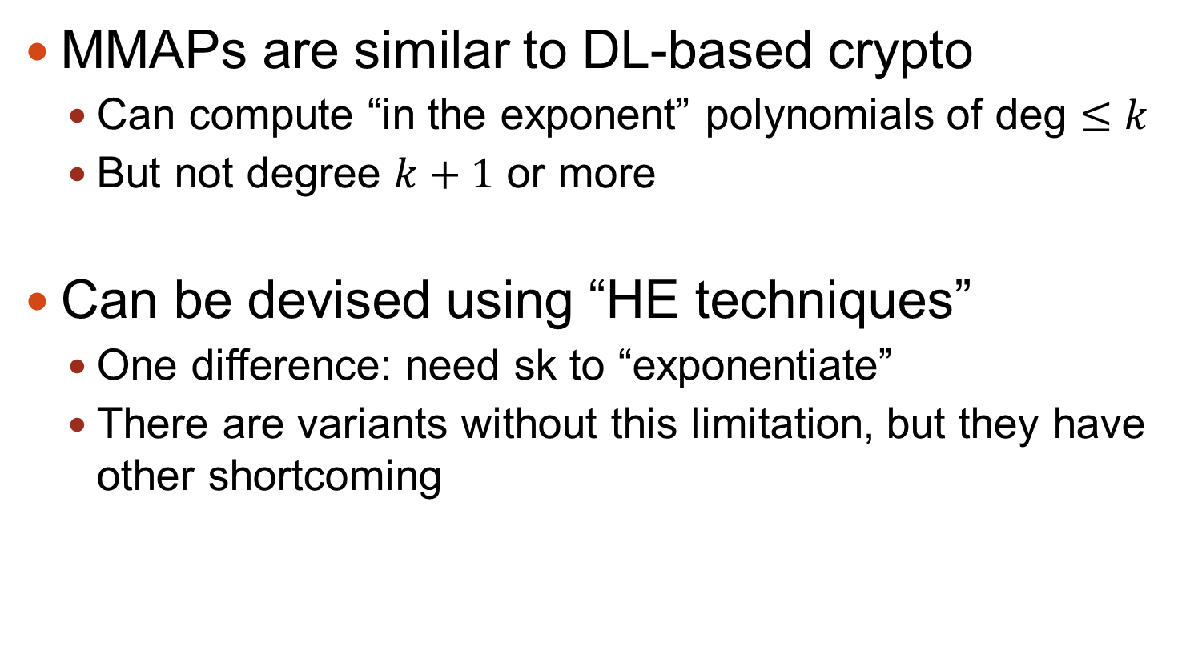
Take-Home from Chapter One
MMAPs are similar to DL-based crypto
Can compute “in the exponent” polynomials of deg $≤k$
But not degree $k+1$ or more
Can be devised using “HE techniques”
One difference: need sk to “exponentiate”
There are variants without this limitation, but they have other shortcoming

Slide 19
Chapter Two: Obfuscation

Slide 20
Code Obfuscation
Encrypting programs, maintaining functionality
Only the functionality should be “visible” in the output
Example of recreational obfuscation:
-- Wikipedia, accessed Oct-2013
Rigorous treatment [Hada’00, BGIRSVY’01,…]
@P=split//,".URRUU\c8R";@d=split//,"\nrekcah xinU / lreP rehtona tsuJ";sub p{ @p{"r$p","u$p"}=(P,P);pipe"r$p","u$p";++$p;($q*=2)+=$f=!fork;map{$P=$P[$f^ord ($p{$_})&6];$p{$_}=/ ^$P/ix?$P:close$_}keys%p}p;p;p;p;p;map{$p{$_}=~/^[P.]/&& close$_}%p;wait until$?;map{/^r/&&<$_>}%p;$_=$d[$q];sleep rand(2)if/\S/;print
Notes:
Barak, Goldreich, Impagliazzo, Rudich, Sahai, Vadhan, Yang, “On the (im)possibility of obfuscating programs”

Slide 21
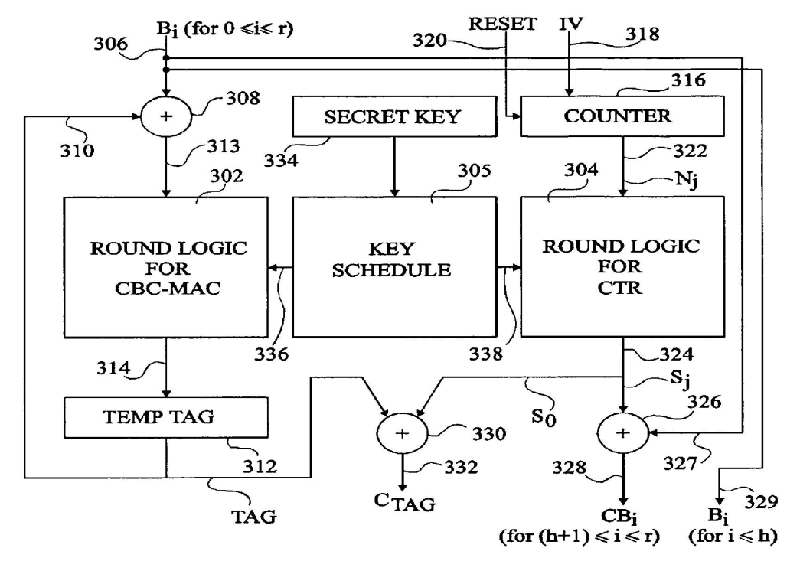
Why Obfuscation?
Hiding secrets in software
AES encryption
Plaintext
strutpatent.com
Ciphertext

Slide 22
Why Obfuscation?
Hiding secrets in software
AES encryption ➔ Public-key encryption
Plaintext
@P=split//,".URRUU\c8R";@d=split//,"\nrekcah xinU / lreP rehtona tsuJ";sub p{ @p{"r$p","u$p"}=(P,P);pipe"r$p","u$p";++$p;($q*=2)+=$f=!fork;map{$P=$P[$f^ord ($p{$_})&6];$p{$_}=/ ^$P/ix?$P:close$_}keys%p}p;p;p;p;p;map{$p{$_}=~/^[P.]/&& close$_}%p;wait until$?;map{/^r/&&<$_>}%p;$_=$d[$q];sleep rand(2)if/\S/;print
Ciphertext

Slide 23
Why Obfuscation?
Hiding secrets in software
Distributing software patches
Vulnerable
program
1,2d0
< The Way that can be told of is not the eternal Way;
< The name that can be named is not the eternal name
4c2,3
< The Named is the mother of all things.
---
> The named is the mother of all things.
11a11,13
> They both may be called deep and profound.
> Deeper and more profound,
> The door of all subtleties!
Patched
program

Slide 24
Why Obfuscation?
Hiding secrets in software
Distributing software patches while hiding vulnerability
Vulnerable
program
@P=split//,".URRUU\c8R";@d=split//,"\nrekcah xinU / lreP rehtona tsuJ";sub p{ @p{"r$p","u$p"}=(P,P);pipe"r$p","u$p";++$p;($q*=2)+=$f=!fork;map{$P=$P[$f^ord ($p{$_})&6];$p{$_}=/ ^$P/ix?$P:close$_}keys%p}p;p;p;p;p;map{$p{$_}=~/^[P.]/&& close$_}%p;wait until$?;map{/^r/&&<$_>}%p;$_=$d[$q];sleep rand(2)if/\S/;print
Patched
program

Slide 25
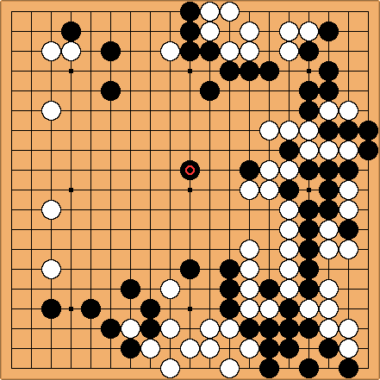
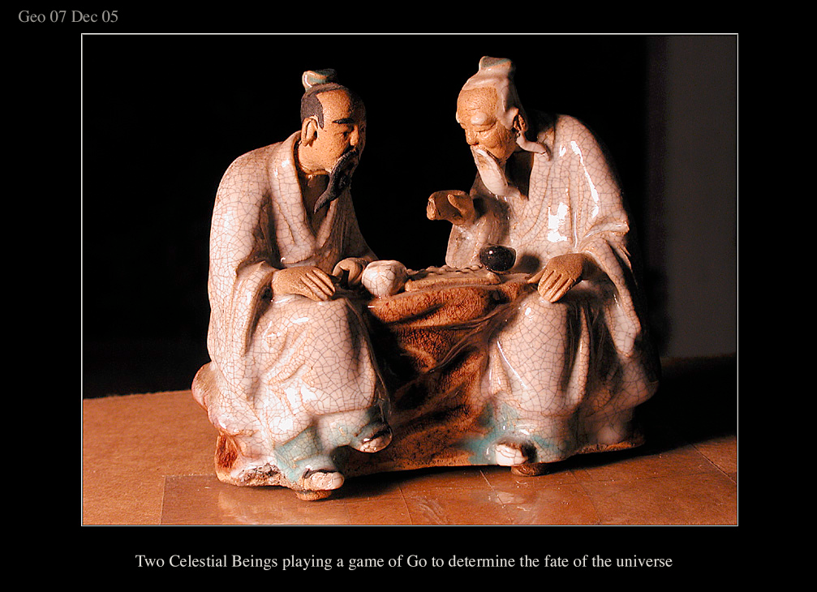
Why Obfuscation?
Hiding secrets in software
Uploading my expertise to the web
http://www.arco-iris.com/George/images/game_of_go.jpg
Game of Go
Next
move

Slide 26
Why Obfuscation?
Hiding secrets in software
Uploading my expertise to the web without revealing my strategies
@P=split//,".URRUU\c8R";@d=split//,"\nrekcah xinU / lreP rehtona tsuJ";sub p{ @p{"r$p","u$p"}=(P,P);pipe"r$p","u$p";++$p;($q*=2)+=$f=!fork;map{$P=$P[$f^ord ($p{$_})&6];$p{$_}=/ ^$P/ix?$P:close$_}keys%p}p;p;p;p;p;map{$p{$_}=~/^[P.]/&& close$_}%p;wait until$?;map{/^r/&&<$_>}%p;$_=$d[$q];sleep rand(2)if/\S/;print
Game of Go
Next
move

Slide 27
Defining Obfuscation
Want the output to reveal only functionality
E.g., If prog. depends on secrets that are not readily apparent in I/O, then the encrypted program does not reveal these secrets
[B+01] show that this is impossible in general
Thm: If secure encryption exists, then there are secure encryption schemes for which it is possible to recover the secret key from any program that encrypts.
Such encryption schemes are unobfuscatable

Slide 28
Defining Obfuscation
Okay, some function are bad, but can we do “as well as possible” on every given function?
[B+01] suggested the weaker notion of “indistinguishability obfuscation” (iO)
Gives the “best-possible” guarantee [GR07]
It turns out to suffice for many applications (examples in [GGH+13, SW13,…])
Notes:
[GR07] Goldwasser, Rothblum, “On best-possible obfuscation”
[SW13] Sahai, Waters, “How to Use Indistinguishability Obfuscation: Deniable Encryption, and More”

Slide 29
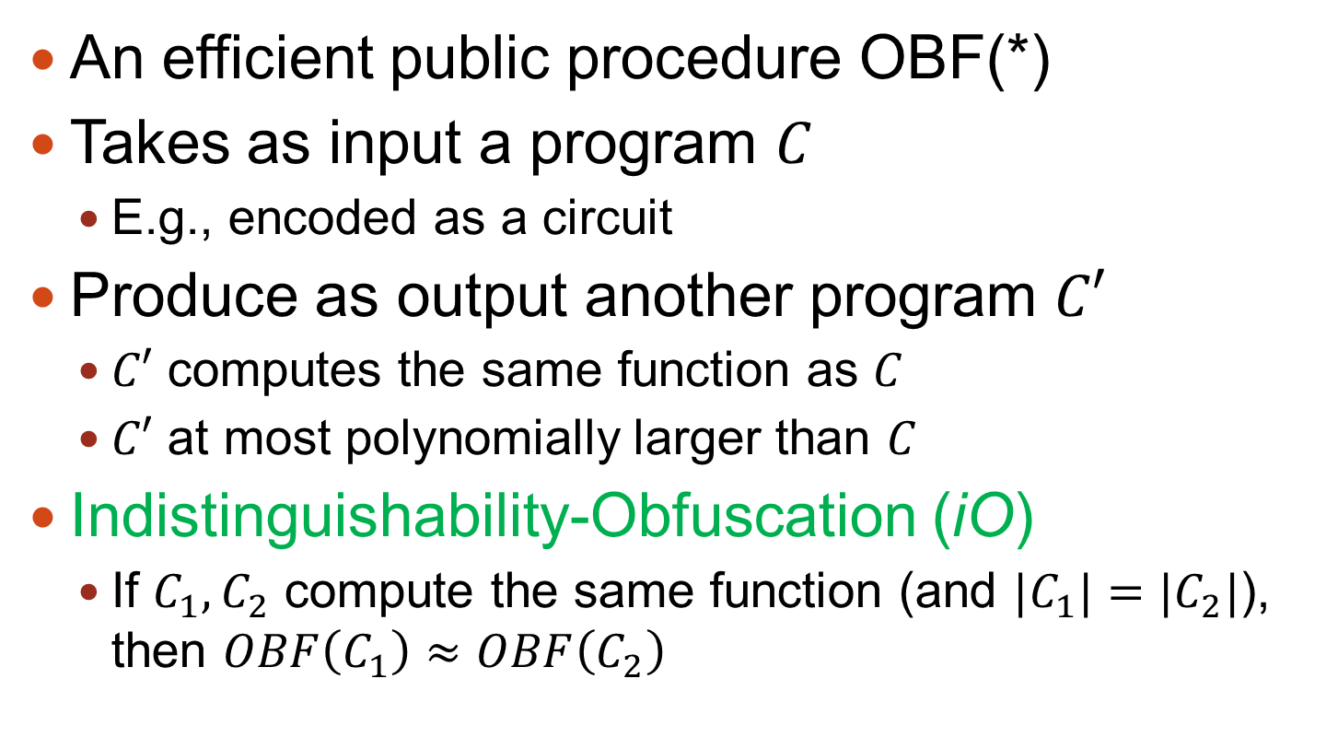
Defining Obfuscation [B+01]
An efficient public procedure OBF(*)
Takes as input a program $C$
E.g., encoded as a circuit
Produce as output another program $C′$
$C′$ computes the same function as $C$
$C′$ at most polynomially larger than $C$
Indistinguishability-Obfuscation (iO)
If $C_{1},C_{2}$ compute the same function (and ${|C}_{1}|=|C_{2}|$), then $OBF\left(C_{1}\right)≈OBF\left(C_{2}\right)$

Slide 30
Obfuscation vs. HE
F
Encryption
F
+
➔
F(x)
x
or
x
Result encrypted
F
Obfuscation
F
+
➔
F(x)
x
Result in the clear
Somewhat reminiscent of MMAPs vs. HE…

Slide 31
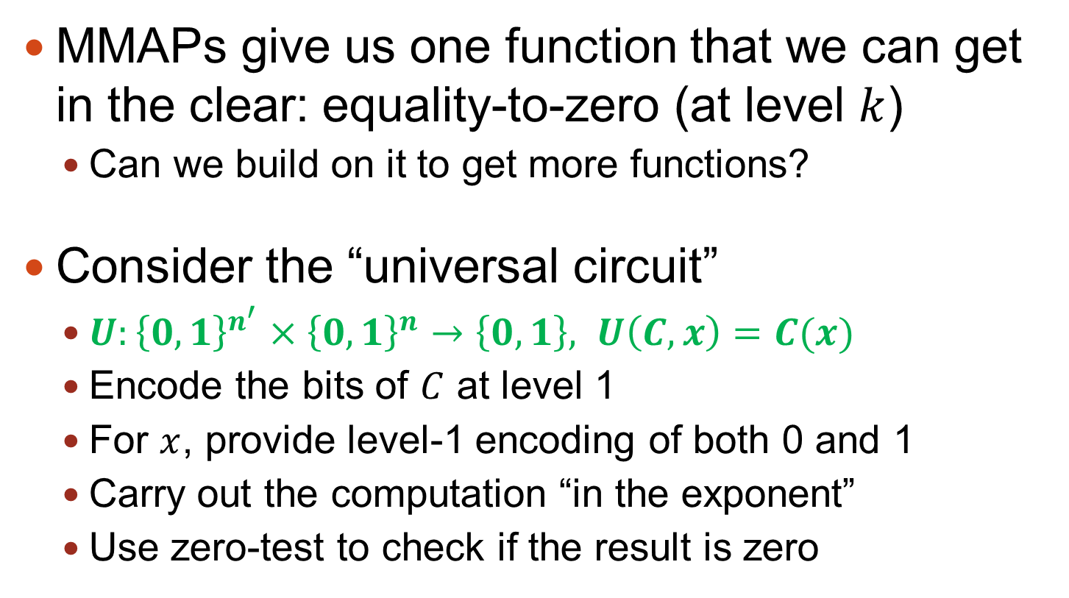
Obfuscation from MMAPs, 1st Try
MMAPs give us one function that we can get in the clear: equality-to-zero (at level $k$)
Can we build on it to get more functions?
Consider the “universal circuit”
$U:{\left\{0,1\right\}}^{n^{′}}×{\left\{0,1\right\}}^{n}→\left\{0,1\right\}, U\left(C,x\right)=C(x)$
Encode the bits of $C$ at level 1
For $x$, provide level-1 encoding of both 0 and 1
Carry out the computation “in the exponent”
Use zero-test to check if the result is zero

Slide 32
1st Try Does Not Work
Attack: comparing intermediate values
Checking if two intermediate wires carry same value
Checking if the computation on two different inputs yield the same value on some intermediate wire
If two equal intermediate values ever happen, they can be recognized using zero-test
Must randomize all intermediate values in all the computations
But such that the final result can still be recognized

Slide 33
Construction Outline
Describe Circuits as Branching Programs (BPs) using Barrington’s theorem [B86]
Randomized BPs (RBPs) a-la-Kilian [K88]
Additional randomization to counter “simple relations”
Encode RBPs “in the exponent” using MMAPs
Use zero-test to get the output
This allows obfuscating shallow circuits (NC1)
Another transformation (using FHE) to get all circuits

Slide 34
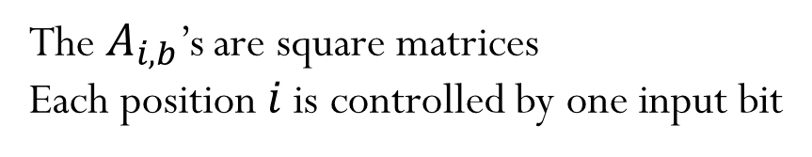
(Oblivious) Branching Programs
A specific way of describing a function
This length-9 BP has 4-bit inputs
A_{1,0}
A_{2,0}
A_{3,0}
A_{4,0}
A_{5,0}
A_{6,0}
A_{7,0}
A_{8,0}
A_{9,0}
A_{1,1}
A_{2,1}
A_{3,1}
A_{4,1}
A_{5,1}
A_{6,1}
A_{7,1}
A_{8,1}
A_{9,1}
0
The $A_{i,b}$’s are square matrices
Each position $i$ is controlled by one input bit

Slide 35
(Oblivious) Branching Programs
A specific way of describing a function
This length-9 BP has 4-bit inputs
A_{1,0}
A_{2,0}
A_{3,0}
A_{4,0}
A_{5,0}
A_{6,0}
A_{7,0}
A_{8,0}
A_{9,0}
A_{1,1}
A_{2,1}
A_{3,1}
A_{4,1}
A_{5,1}
A_{6,1}
A_{7,1}
A_{8,1}
A_{9,1}
0
1

Slide 36

(Oblivious) Branching Programs
A specific way of describing a function
This length-9 BP has 4-bit inputs
Multiply the chosen 9 matrices together
If product is $I$ output 1. Otherwise output 0.
A_{1,0}
A_{2,0}
A_{3,0}
A_{4,0}
A_{5,0}
A_{6,0}
A_{7,0}
A_{8,0}
A_{9,0}
A_{1,1}
A_{2,1}
A_{3,1}
A_{4,1}
A_{5,1}
A_{6,1}
A_{7,1}
A_{8,1}
A_{9,1}
0
1
1
0

Slide 37
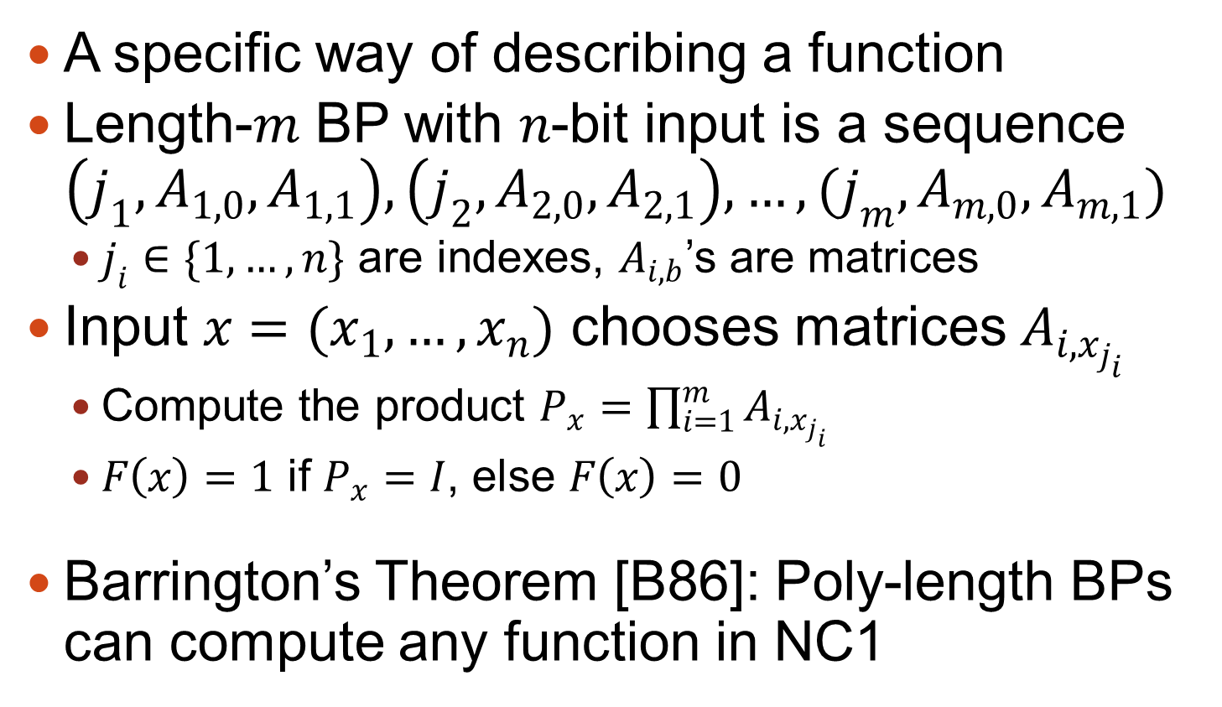
(Oblivious) Branching Programs
A specific way of describing a function
Length-$m$ BP with $n$-bit input is a sequence $\left(j_{1},A_{1,0}, A_{1,1}\right),\left(j_{2},A_{2,0},A_{2,1}\right),…,(j_{m},A_{m,0},A_{m,1})$
$j_{i}∈\{1,…,n\}$ are indexes, $A_{i,b}$’s are matrices
Input $x=(x_{1},…,x_{n})$ chooses matrices $A_{i,x_{j_{i}}}$
Compute the product $P_{x}=\prod_{i=1}^{m}{A_{i,x_{j_{i}}}}$
$F\left(x\right)=1$ if $P_{x}=I$, else $F\left(x\right)=0$
Barrington’s Theorem [B86]: Poly-length BPs can compute any function in NC1

Slide 38




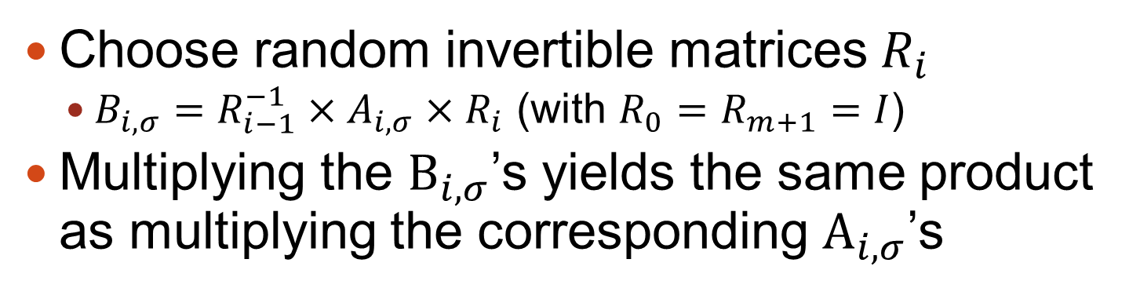






Kilian’s Randomized BPs
B_{1,0}
B_{2,0}
B_{3,0}
B_{4,0}
B_{5,0}
B_{6,0}
A_{1,0}
A_{2,0}
A_{3,0}
A_{4,0}
A_{5,0}
A_{6,0}
$$R_{1}$$
$$R_{1}^{−1}$$
$$R_{2}$$
$$R_{2}^{−1}$$
$$R_{3}$$
$$R_{3}^{−1}$$
$$R_{4}$$
$$R_{4}^{−1}$$
$$R_{5}$$
$$R_{5}^{−1}$$
A_{1,1}
A_{2,1}
A_{3,1}
A_{4,1}
A_{5,1}
A_{6,1}
B_{1,1}
B_{2,1}
B_{3,1}
B_{4,1}
B_{5,1}
B_{6,1}
Choose random invertible matrices $R_{i}$
$B_{i,σ}=R_{i−1}^{−1}×A_{i,σ}×R_{i}$ (with $R_{0}=R_{m+1}=I$)
Multiplying the $B_{i,σ}$’s yields the same product as multiplying the corresponding $A_{i,σ}$’s

Slide 39
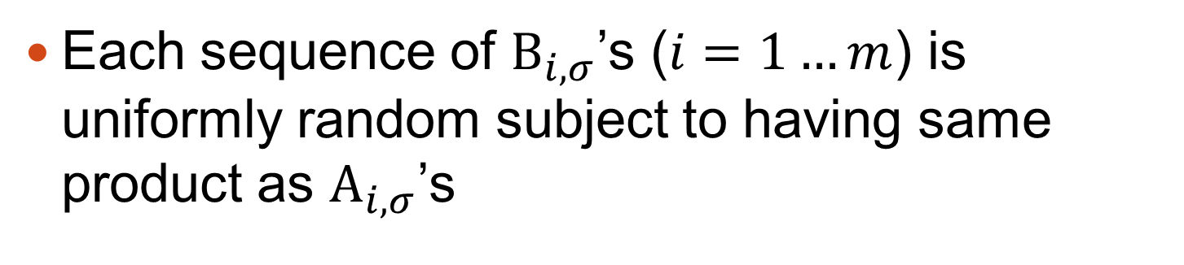
Kilian’s Randomized BPs
B_{1,0}
B_{2,0}
B_{3,0}
B_{4,0}
B_{5,0}
B_{6,0}
A_{1,0}
A_{2,0}
A_{3,0}
A_{4,0}
A_{5,0}
A_{6,0}
$$R_{1}$$
$$R_{1}^{−1}$$
$$R_{2}$$
$$R_{2}^{−1}$$
$$R_{3}$$
$$R_{3}^{−1}$$
$$R_{4}$$
$$R_{4}^{−1}$$
$$R_{5}$$
$$R_{5}^{−1}$$
A_{1,1}
A_{2,1}
A_{3,1}
A_{4,1}
A_{5,1}
A_{6,1}
B_{1,1}
B_{2,1}
B_{3,1}
B_{4,1}
B_{5,1}
B_{6,1}
Each sequence of $B_{i,σ}$’s ($i=1…m$) is uniformly random subject to having same product as $A_{i,σ}$’s

Slide 40
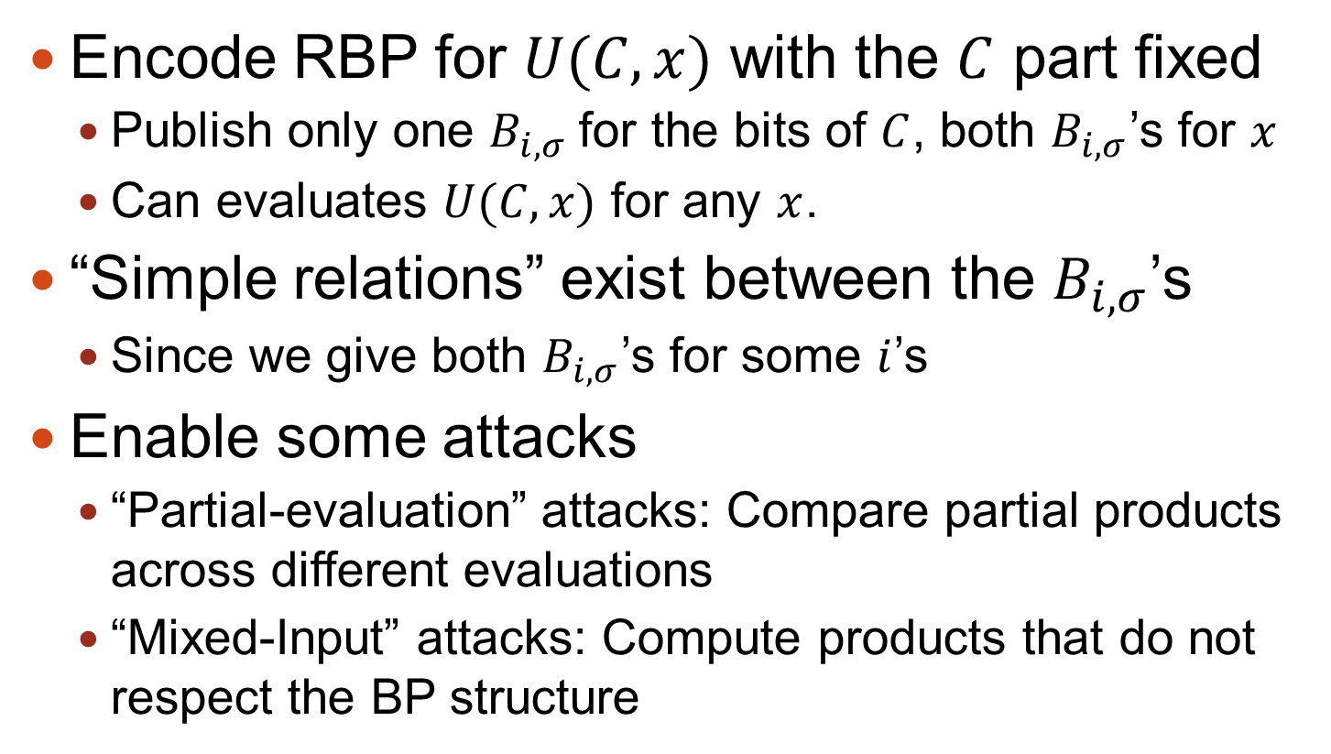
Kilian’s Protocol➔BP-Obfuscation?
Encode RBP for $U(C,x)$ with the $C$ part fixed
Publish only one $B_{i,σ}$for the bits of $C$, both $B_{i,σ}$’s for $x$
Can evaluates $U(C,x)$ for any $x$.
“Simple relations” exist between the $B_{i,σ}$’s
Since we give both $B_{i,σ}$’s for some $i$’s
Enable some attacks
“Partial-evaluation” attacks: Compare partial products across different evaluations
“Mixed-Input” attacks: Compute products that do not respect the BP structure

Slide 41
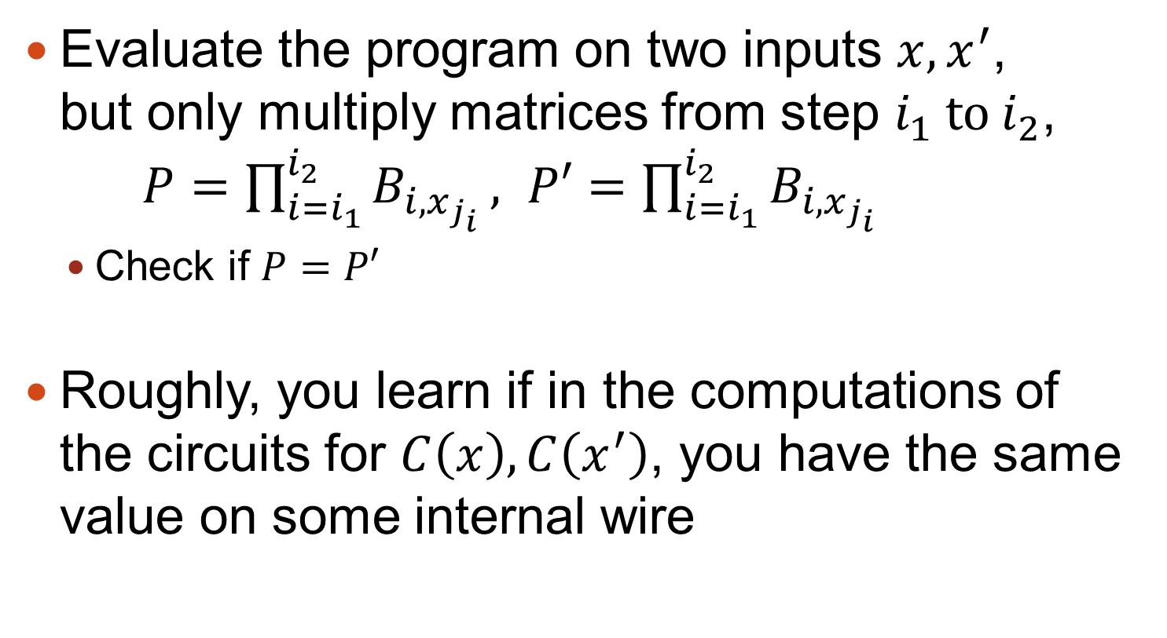
“Partial Evaluation” Attacks
Evaluate the program on two inputs $x,x^{′}$, but only multiply matrices from step $i_{1}$ to $i_{2}$, $P=\prod_{i=i_{1}}^{i_{2}}{B_{i,x_{j_{i}}}}, P′=\prod_{i=i_{1}}^{i_{2}}{B_{i,x_{j_{i}}}}$
Check if $P=P′$
Roughly, you learn if in the computations of the circuits for $C\left(x\right), C\left(x^{′}\right)$, you have the same value on some internal wire

Slide 42
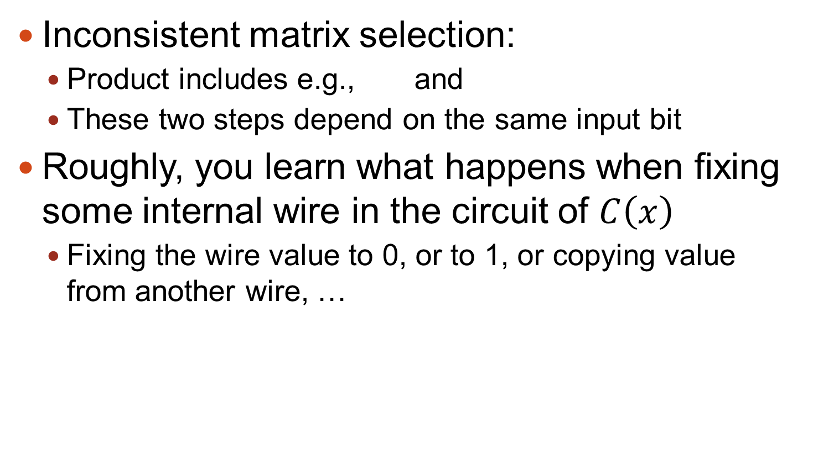
“Mixed Input” Attack
Inconsistent matrix selection:
Product includes e.g., and
These two steps depend on the same input bit
Roughly, you learn what happens when fixing some internal wire in the circuit of $C\left(x\right)$
Fixing the wire value to 0, or to 1, or copying value from another wire, …
B_{2,0}
B_{4,1}

Slide 43
Countering “Simple Relations”
Additional randomization steps
Different works use slightly different forms of additional randomization
“Multiplicative bundling” [GGHRHS’13, BR’13]
“Straddling” [BGKPS’13, PTS’14]
“Abelian component” [CV’13]
Can conjecture [GGHRHS’13, BR’13] or prove [BGKPS’13, CV’13, PTS’14] that no simple relations exist

Slide 44
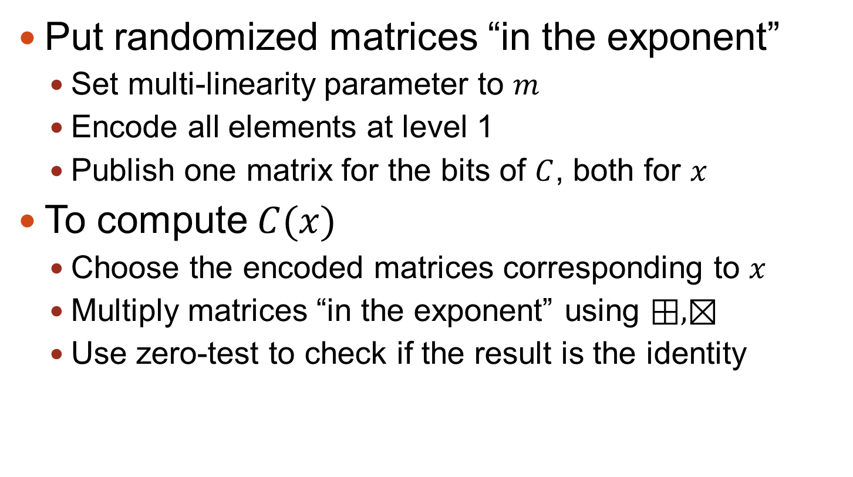
Completing the construction
Put randomized matrices “in the exponent”
Set multi-linearity parameter to $m$
Encode all elements at level 1
Publish one matrix for the bits of $C$, both for $x$
To compute $C(x)$
Choose the encoded matrices corresponding to $x$
Multiply matrices “in the exponent” using $⊞,⊠$
Use zero-test to check if the result is the identity

Slide 45
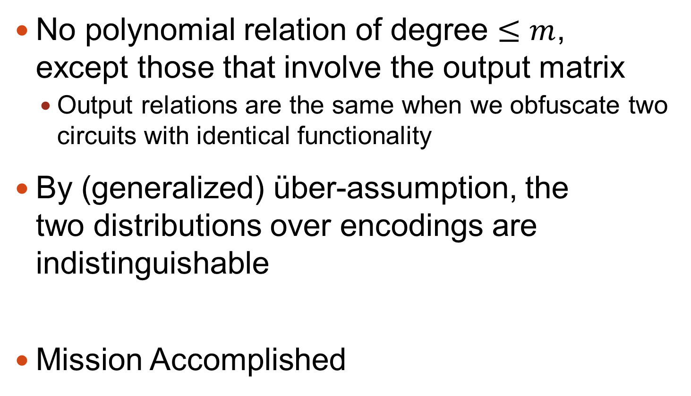
Security of Obfuscation
No polynomial relation of degree $≤m$, except those that involve the output matrix
Output relations are the same when we obfuscate two circuits with identical functionality
By (generalized) über-assumption, the two distributions over encodings are indistinguishable
Mission Accomplished

Slide 46

A Word About Performance
Needs $m$-linear maps for $m$ in the thousands
Need I say more?

Slide 47
Take-Home from Chapter Two
We can obfuscate a computation by:
Randomizing the internal values
Putting the randomized values “in the exponent” and computing on them using MMAPs

Slide 48
Future Directions
We only have two MMAPs candidates, and just one approach for using them in obfuscation
Hard to develop a theory from so few sample points
We need better formal notions of obfuscation
Current notions (such as iO) do not capture our intuition, not even for what the current constructions achieve
Faster constructions
Complexity of current constructions is scary
Applications
Already have a bunch, the sky is the limit…

Slide 49

Thank You
Questions?

Slide 50
Witness Encryption [GGSW’13]
A truly “keyless encryption”
Can encrypt relative to any arbitrary “riddle”
Defined here relative to exact-cover (XC)
XC is NP-complete, so we can translate any “riddle” to it
Notes:
Garg, Gentry, Sahai, Waters, STOC 2013

Slide 51

Recall Exact Cover
Instance: universe $[k]$ and a collection of subsets $S_{i}⊂[k], i=1,…,m$
A solution: sub-collection of the $S_{i}$’s that covers every element of $[k]$ exactly once
1
{1,2,3}
2
{2,4,5}
3
{1,4}
4
5
{2,3,5}

Slide 52
Witness Encryption
Message encrypted wrt to XC instance
Encryptor need not know a solution
Or even if a solution exists
Anyone with a solution can decrypt
Secrecy ensured if no solution exists
1
{1,2,3}
1
{1,2,3}
2
{2,4,5}
2
{2,4,5}
3
3
{1,4}
{1,4}
4
4
5
{2,3,5}
5
{2,3,4,5}
Decryptable
Secret

Slide 53





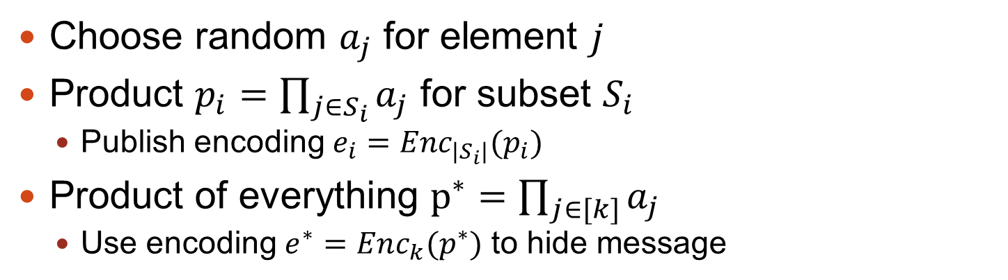






Witness Encryption Using MMAPs
Choose random $a_{j}$ for element $j$
Product $p_{i}=\prod_{j∈S_{i}}{a_{j}}$ for subset $S_{i}$
Publish encoding $e_{i}=Enc_{{|S}_{i}|}(p_{i})$
Product of everything $p^{∗}=\prod_{j∈[k]}{a_{j}}$
Use encoding $e^{∗}=Enc_{k}(p^{∗})$ to hide message
$$a_{1}$$
1
{1,2,3}
$$e_{1}=Enc_{3}(a_{1}⋅a_{2}⋅a_{3})$$
$$a_{2}$$
2
$$e_{2}=Enc_{3}(a_{2}⋅a_{4}⋅a_{5})$$
{2,4,5}
$$a_{3}$$
3
$$a_{4}$$
{1,4}
$$e_{3}=Enc_{2}(a_{1}⋅a_{4})$$
4
$$a_{5}$$
5
{2,3,5}
$$e_{4}=Enc_{3}(a_{2}⋅a_{3}⋅a_{5})$$
$$e_{3}⊠e_{4}≈e^{∗}$$
$$e^{∗}=Enc_{5}(a_{1}⋅a_{2}⋅a_{3}⋅{a_{4}⋅a}_{5})$$
ctxt = $(e_{1},…,e_{4}, Extract\left(e^{∗}\right)⊕M)$

Slide 54
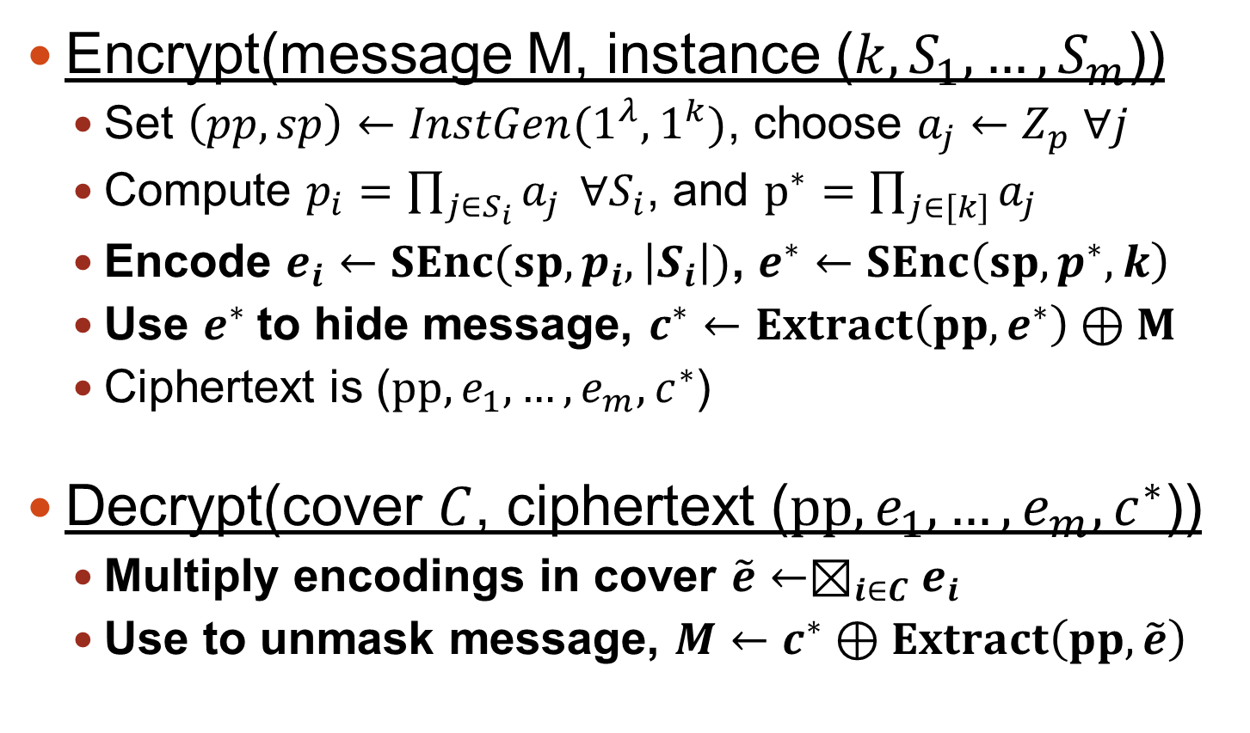
Witness Encryption Using MMAPs
Encrypt(message M, instance ($k,S_{1},…,S_{m}$))
Set $\left(pp,sp\right)←InstGen(1^{λ},1^{k})$, choose $a_{j}←Z_{p} ∀j$
Compute $p_{i}=\prod_{j∈S_{i}}{a_{j} }∀S_{i}$, and $p^{∗}=\prod_{j∈[k]}{a_{j}}$
Encode $e_{i}←SEnc(sp,p_{i}, \left|S_{i}\right|)$, $e^{∗}←SEnc\left(sp,p^{∗},k\right)$
Use $e^{∗}$to hide message, $c^{∗}←$ $Extract\left(pp, e^{∗}\right)⊕M$
Ciphertext is ($pp, e_{1},…,e_{m},c^{∗}$)
Decrypt(cover $C$, ciphertext ($pp, e_{1},…,e_{m},c^{∗}$))
Multiply encodings in cover $\tilde{e}←⊠_{i∈C}e_{i}$
Use to unmask message, $M←c^{∗}⊕Extract\left(pp, \tilde{e}\right)$

Slide 55
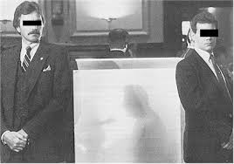
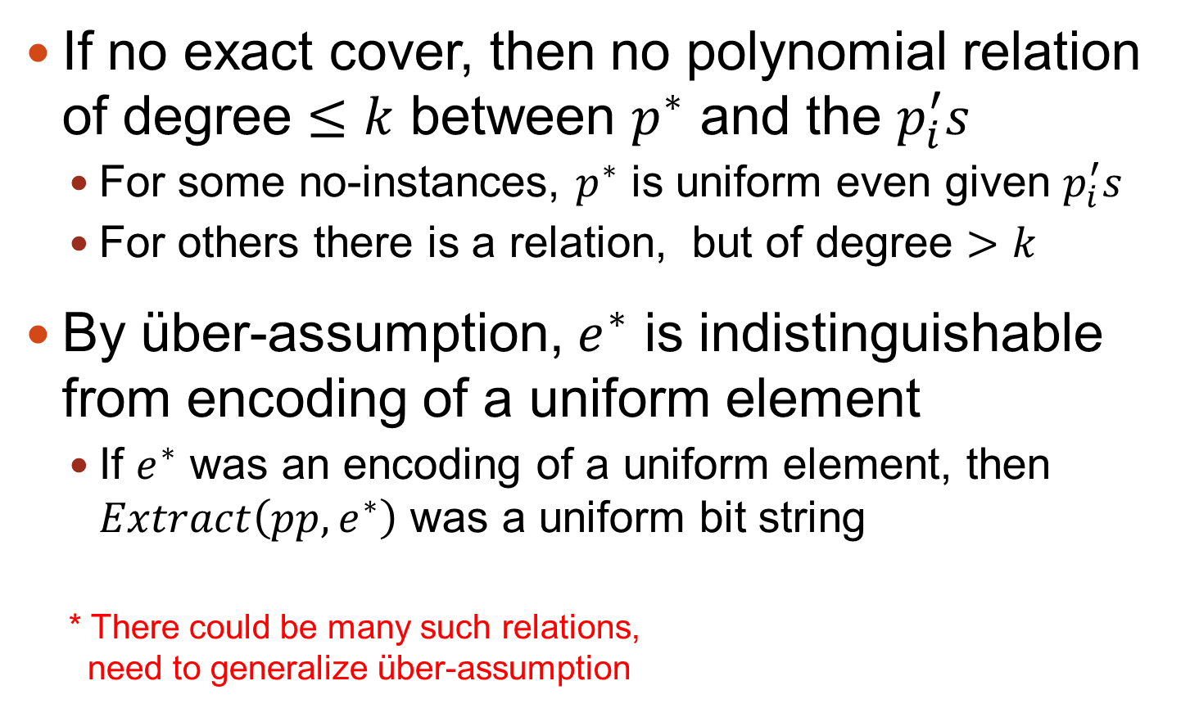
Security of Witness Encryption
If no exact cover, then no polynomial relation of degree $≤k$ between $p^{∗}$ and the $p_{i}^{′}s$
For some no-instances, $p^{∗}$ is uniform even given $p_{i}^{′}s$
For others there is a relation, but of degree $>k$
By über-assumption, $e^{∗}$ is indistinguishable from encoding of a uniform element
If $e^{∗}$ was an encoding of a uniform element, then $Extract\left(pp, e^{∗}\right)$ was a uniform bit string
* There could be many such relations, need to generalize über-assumption
*

