Slide 1


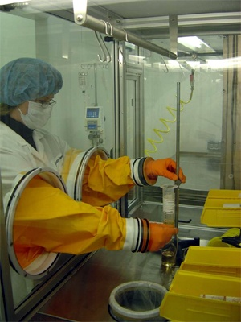
On Homomorphic Encryption and Secure Computation
challenge
response
Shai Halevi
IBM|NYU|Columbia Theory Day, May 7, 2010

Slide 2
Computing on Encrypted Data
Wouldn’t it be nice to be able to…
Encrypt my data in the cloud
While still allowing the cloud to search/sort/edit/… this data on my behalf
Keeping the data in the cloud in encrypted form
  Without needing to ship it back and forth to be decrypted

Slide 3
Computing on Encrypted Data
Wouldn’t it be nice to be able to…
Encrypt my queries to the cloud
While still allowing the cloud to process them
Cloud returns encrypted answers
  that I can decrypt

Slide 4
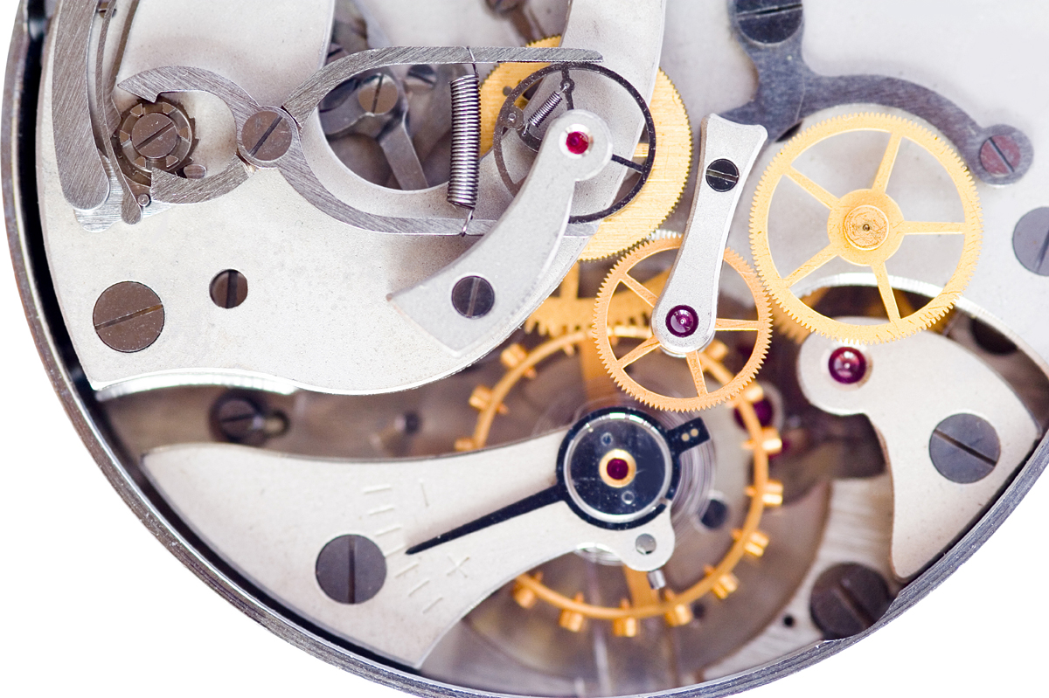


Computing on Encrypted Data
Directions
From: 19 Skyline Drive,
Hawothorne, NY 10532,
USA
To: Columbia University
$skj#hS28ksytA@ …

Slide 5
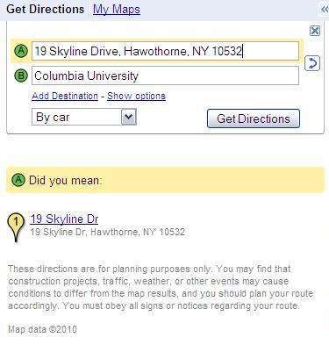
Computing on Encrypted Data
typo
$kjh9*mslt@na0
&maXxjq02bflx
m^00a2nm5,A4.
pE.abxp3m58bsa
(3saM%w,snanba
nq~mD=3akm2,A
Z,ltnhde83|3mz{n
dewiunb4]gnbTa*
kjew^bwJ^mdns0

Slide 6
Part I:
Constructing Homomorphic Encryption

Slide 7
Privacy Homomorphisms [RAD78]
Plaintext space P
Ciphertext space C
x₁ x₂
c_{i} ← Enc(x_{i})
c₁ c₂
∗
#
y ← Dec(d)
y
d
Some examples:
“Raw RSA”: c ← x^{e} mod N (x ← c^{d} mod N)
  x₁e x x₂e = (x₁ x x₂)^{e} mod N
GM84: Enc(0)∈_{R} QR, Enc(1)∈_{R} QNR (in Z_{N}*)
  Enc(x₁) x Enc(x₂) = Enc(x₁x₂) mod N

Slide 8
More Privacy Homomorphisms
Mult-mod-p [ElGamal’84]
Add-mod-N [Pallier’98]
NC1 circuits [SYY’00]
Quadratic-polys mod p [BGN’06]
Poly-size branching programs [IP’07]
See Part II for a “different type of solution” for any poly-size circuit [Yao’82,…]

Slide 9
(x,+)-Homomorphic Encryption
It will be really nice to have…
Plaintext space Z₂ (w/ ops +,x)
Ciphertext space some ring R (w/ ops +,x)
Homomorphic for both + and x
  Enc(x₁) + Enc(x₂) in R = Enc(x₁+ x₂ mod 2)
  Enc(x₁) x Enc(x₂) in R = Enc(x₁ x x₂ mod 2)
Then we can compute any function on the encryptions
  Since every binary function is a polynomial
We won’t get exactly this, but it’s a good motivation

Slide 10
Some Notations
An encryption scheme: (KeyGen, Enc, Dec)
  Plaintext-space = {0,1}
  (pk,sk) ←KeyGen($), c←Enc_{pk}(b), b←Dec_{sk}(c)
Semantic security [GM’84]:
(pk, Enc_{pk}(0))  (pk, Enc_{pk}(1))
  ● means indistinguishable by efficient algorithms

Slide 11
Homomorphic Encryption
H = {KeyGen, Enc, Dec, Eval}
  c* ← Eval_{pk}(f, c)
Homomorphic: Dec_{sk}(Eval_{pk}( f, Enc_{pk}(x))) = f(x)
  (“Fully” Homomorphic: for every function f )
  Enc_{pk}(f(x)), Eval_{pk}(f, Enc_{pk}(x)) may differ
    As long as both distributions decrypt to f(x)
Function-private: Eval_{pk}(f, Enc_{pk}(x)) hides f
Compact: |Eval_{pk}(f, Enc_{pk}(x))| independent of |f|

Slide 12
(x,+)-Homomorphic Encryption, the Gentry Way [G’09]
Evaluate any function in four “easy” steps
Step 1: Encryption from linear ECCs
  Additive homomorphism
Step 2: ECC lives inside a ring
  Also multiplicative homomorphism
  But only for a few operations (i.e., low-degree poly’s)
Step 3: Bootstrapping
  Few ops (but not too few) ➔ any number of ops
Step 4: Everything else

Slide 13
Step One:
Encryption from Linear ECCs
For “random looking” codes, hard to distinguish close/far from code
Many cryptosystems built on this hardness
  E.g., [McEliece’78, AD’97, GGH’97, R’03,…]

Slide 14
Encryption from linear ECCs
KeyGen: choose a “random” code C
  Secret key: “good representation” of C
    Allows correction of “large” errors
  Public key: “bad representation” of C
Enc(0): a word close to C
Enc(1): a random word
  Far from C (with high probability)

Slide 15
An Example: Integers mod p (similar to [Regev’03])
p
N
Code determined by an integer p
  Codewords: multiples of p
Good representation: p itself
Bad representation:
  N = pq, and also many many x_{i} = pq_{i} + r_{i}
Enc(0): subset-sum(x_{i}’s)+r mod N
Enc(1): random integer mod N
r_{i}  p

Slide 16
A Different Input Encoding
Plaintext bit is LSB of dist(c, C)
  Enc(0/1): close to C , distance is even/odd
  In our example of integers mod p:
    Enc(b) = 2(subset-sum(x_{i}’s)+r) +b mod N
    Dec(c) = (c mod p) mod 2
Thm: If “C co-prime with 2”, then Enc(0), Enc(1) indistinguishable
  w is near-C/random → 2w+b is Enc(b)/random
p is odd

Slide 17
Additive Homomorphism
c₁+c₂ = (codeword₁+codeword₂)
+2(r₁+r₂)+b₁+b₂
  codeword₁+codeword₂ ∈ C
  If 2(r₁+r₂)+b₁+b₂ < min-dist/2, then it is the distance between c₁+c₂ and C
  dist(c₁+c₂, C) = b₁+b₂ mod 2
Additively-homomorphic while close to C

Slide 18
Step 2: ECC Lives in a Ring R
What happens when multiplying in R:
  c₁c₂ = (codeword₁+2r₁+b₁) x (codeword₂+2r₂+b₂)
  = codeword₁ X + Y codeword₂
  + (2r₁+b₁)(2r₂+b₂)
If:
  codeword₁ X + Y codeword₂ ∈ C
  (2r₁+b₁)(2r₂+b₂) < min-dist/2
Then
  dist(c₁c₂, C) = (2r₁+b₁)(2r₂+b₂) = b₁b₂ mod 2
C is both a left-ideal and a right-ideal
Product in R of small elements is small

Slide 19
Integers Rings [vDGHV’10]
Recall mod-p scheme: c_{i} = q_{i}p + 2r_{i}+b_{i} (mod N=qp)
  Parameters: |r_{i}|=n, |p|=n², |q|=|q_{i}|=n⁵
c₁+c₂ mod N = (q₁+q₂−κq)p + 2(r₁+r₂)+(b₁+b₂)
  ➔sum mod p = 2(r₁+r₂) + (b₁+b₂)
c₁ x c₂ mod N = (c₁q₂+q₁c₂−q₁q₂−κq)p
+ 2(2r₁r₂+r₁m₂+m₁r₂) + b₁b₂
  ➔product mod p = 2(2r₁r₂+…) + b₁b₂
Can evaluate polynomials of degree ~ n
before the distance from C exceeds p/2

Slide 20
Integers Rings [vDGHV’10]
Thm: “Approximate GCD” is hard
➔ Enc(0), Enc(1) are indistinguishable
Apprixmate-GCD: Given N=qp and many
x_{i} = pq_{i} + r_{i}, hard to recover p

Slide 21
Polynomial Rings [G’09]
R = polynomial ring modulo some f(x)
  E.g., f(x) = x^{n} +1
C is an ideal in R
  E.g., random g(x), C_{g} = { gxh mod f : h ∈ R }
    C is also a lattice
  Good representation: g itself
  Bad representation: Hermite-Normal-Form
If g has t-bit coefficients, can evaluate polynomials of degree O(t/log n)

Slide 22
Polynomial Rings [G’09]
Thm: Bounded-Distance Decoding in ideal lattices is hard ➔ Enc(0), Enc(1) are indistinguishable
Bounded-Distance-Decoding: Given x close to the lattice, find dist(x, lattice)

Slide 23
Matrix Rings* [GHV’10]
*Doesn’t quite fit the mold
R = ring of mxm matrices over Z_{q}
  q = poly(n), m > n log q (n security-parameter)
C has low-rank matrices mod q (rank=n)
  A is a random nxm matrix, C_{A} = { AX : X∈R }
  Bad representation: A itself
  Good representation: full rank T_{mxm} (over Z),
  small entries, TA = 0 mod q
Problem: C_{A} is left-ideal, but not right-ideal
  Can still evaluate quadratic formulas, no more

Slide 24
Matrix Rings* [GHV’10]
*Doesn’t quite fit the mold
Thm: Learning with Errors hard
➔ Enc(0), Enc(1) are indistinguishable
Learning with Errors: Given A, Ax+e
(random A,x, small error e), find x

Slide 25
Step 3: Bootstrapping [G’09]
So far, can evaluate low-degree polynomials
x₁
P
x₂
…
P(x₁, x₂ ,…, x_{t})
x_{t}
Notes:
Explain “fresh” vs “evaluated” cipehrtexts

Slide 26
Step 3: Bootstrapping [G’09]
So far, can evaluate low-degree polynomials
Can eval y=P(x₁,x₂…,x_{n}) when x_{i}’s are “fresh”
But y is an “evaluated ciphertext”
  Can still be decrypted
  But eval Q(y) will increase noise too much
x₁
P
x₂
…
P(x₁, x₂ ,…, x_{t})
x_{t}
Notes:
Explain “fresh” vs “evaluated” cipehrtexts

Slide 27
Step 3: Bootstrapping [G’09]
So far, can evaluate low-degree polynomials
Bootstrapping to handle higher degrees:
For ciphertext c, consider D_{c}(sk) = Dec_{sk}(c)
  Hope: D_{c}(∗) is a low-degree polynomial in sk
  Then so are Ac₁,c₂(sk) = Dec_{sk}(c₁) + Dec_{sk}(c₂)
  and Mc₁,c₂(sk) = Dec_{sk}(c₁) x Dec_{sk}(c₂)
x₁
P
x₂
…
P(x₁, x₂ ,…, x_{t})
x_{t}
Notes:
Explain “fresh” vs “evaluated” cipehrtexts

Slide 28
Step 3: Bootstrapping [G’09]
Include in the public key also Enc_{pk}(sk)
x₁
x₂
Requires “circular security”
c₁
c₂
sk₁
Mc₁,c₂
c
sk₂
…
Mc₁,c₂(sk)
= Dec_{sk}(c₁) x Dec_{sk}(c₂) = x₁ x x₂
sk_{n}

Slide 29
Step 3: Bootstrapping [G’09]
Include in the public key also Enc_{pk}(sk)
Homomorphic computation applied only to the “fresh” encryption of sk
x₁
x₂
Requires “circular security”
c₁
c₂
sk₁
Mc₁,c₂
c
sk₂
…
Mc₁,c₂(sk)
= Dec_{sk}(c₁) x Dec_{sk}(c₂) = x₁ x x₂
sk_{n}

Slide 30

Step 4: Everything Else
Cryptosystems from [G’09, vDGHV’10] cannot handle their own decryption as-is
Apply some tricks to “squash” the decryption procedure

Slide 31
Part II:
Homomorphic Encryption vs. Secure Computation

Slide 32
Secure Function Evaluation (SFE)
Client Alice has data x
Server Bob has function f
Alice wants to learn f(x)
Without telling Bob what x is
Bob may not want Alice to know f
Client Alice may also want server Bob
to do most of the work computing f(x)

Slide 33
Two-Message SFE [Yao’82,…]
Alice(x)
Bob(f)
(c,s)←SFE1(x)
c
r ←SFE2(f,c)
r
y ←SFE3(s,r)
Many different instantiations are available
  Based on hardness of factoring/DL/lattices/…
Alice’s x and Bob’s f are kept private
But Alice does as much work as Bob
  Bob’s reply of size poly(n) x (|f|+|x|)

Slide 34
Recall:
Homomorphic Encryption
H = {KeyGen, Enc, Dec, Eval}
Semantic security: (pk, Enc_{pk}(0))  (pk, Enc_{pk}(1))
Homomorphic: Dec_{sk}(Eval_{pk}( f, Enc_{pk}(x))) = f(x)
  (“Fully” Homomorphic: for every function f )
  Enc_{pk}(f(x)), Eval_{pk}(f, Enc_{pk}(x)) may differ
    As long as both distributions decrypt to f(x)
Function-private: Eval_{pk}(f, Enc_{pk}(x)) hides f
Compact: |Eval_{pk}(f, Enc_{pk}(x))| independent of |f|

Slide 35
Aside: a Trivial Solution
Eval(f,c) = <f,c>, Dec*(<f,c>) = f (Dec(c))
Neither function-private, nor compact
Not very useful in applications

Slide 36
HE ➔ Two-Message SFE
Alice encrypts data x
  sends to Bob c ← Enc(x)
Bob computes on encrypted data
  sets c* ← Eval(f, c)
  c* is supposed to be an encryption of f(x)
  Hopefully it hides f (function-private scheme)
Alice decrypts, recovers y ← Dec(c*)

Slide 37
Two-Message SFE ➔ HE
Roughly:
  Alice’s message c ← SFE1(x) is Enc(x)
  Bob’s reply r ← SFE2(f,c) is Eval(f,c)
Not quite public-key encryption yet
  Where are (pk, sk)?
  Can be fixed with an auxiliary PKE scheme

Slide 38

Two-Message SFE ➔ HE
Alice(pk, x)
Alice(x)
Bob(f)
Dora(sk)
(c,s)←SFE1(x)
c
r ←SFE2(f,c)
r
y ←SFE3(s,r)
Add an auxiliary encryption scheme
  with (pk,sk)

Slide 39
Two-Message SFE ➔ HE
Alice(pk, x)
Bob(f)
Dora(sk)
c, c’
(c,s)←SFE1(x)
c’←Enc_{pk}(s)
r ←SFE2(f,c)
r, c’
s ←Dec_{sk}(c’)
y ←SFE3(s,r)
Enc’_{pk}(x)
Eval_{pk}(f,c,c’)
Dec_{sk}(r,c’)
Recall: |r| could be as large as poly(n)(|f|+|x|)
  Not compact

Slide 40

A More Complex Setting: i-Hop HE [GHV10b]
Alice(x)
Bob(f)
Charlie(g)
Dora(sk)
c₀
c₁
c₂
c₀←Enc(x)
c₁←Eval(f,c₀)
c₂←Eval(g,c₁)
y←Dec(c₂)
2-Hop Homomorphic Encryption
c₁ is not a fresh ciphertext
  May look completely different
Can Charlie process it at all?
  What about security?

Slide 41
Multi-Hop Homomorphic Encryption
H = {KeyGen, Enc, Eval, Dec} as before
i-Hop Homomorphic (i is a parameter)
  y = f_{j}(f_{j−1}(… f₁(x) …)) for any x, f₁,…,f_{j}
Similarly for i-Hop function-privacy, compactness
Multi-Hop: i-Hop for any i
c₀
c₁
c₂
…
c_{j}
x
Enc_{pk}(x)
Eval_{pk}(f₁,c₀)
Eval_{pk}(f₂,c₁)
Dec_{sk}(x)
y
Any number j≤i hops

Slide 42
1-Hop ➔ multi-Hop HE
(KeyGen,Enc,Eval,Dec) is 1-Hop HE
  Can evaluate any single function on ctxt
We have c₁=Eval_{pk}(f₁,c₀), and some other f₂
Bootstrapping:
Include with pk also c*=Enc_{pk}(sk)
Consider Fc₁, f₂(sk) = f₂( Dec_{sk}(c₁) )
  Let c₂=Eval_{pk}(Fc₁, f₂ , c*)

Slide 43
1-Hop ➔ multi-Hop HE
c*
f_{i}
c_{i−1}
sk
x_{i-1}
Fc_{i-1}, f_{i}
c_{i+1}
Fc_{i-1}, f_{i}(sk)
= f_{i}( Dec_{sk}(c_{i−1}) ) = f_{i}(x_{i−1})
Drawback: |c_{i}| grows exponentially with i:
  |Fc_{i−1}, f_{i}| ≥ |c_{i−1}|+| f_{i}|
  |c_{i}|= |Eval_{pk}(Fc_{i−1}, f_{i} , c*)| ≥ poly(n)(|c_{i−1}|+| f_{i}|)
Does not happen if underlying scheme is compact
        Or even |Eval_{pk}(Fc_{i−1}, f_{i} , c*)| = |c_{i−1}|+poly(n)| f_{i}|

Slide 44

Other Constructions
Private 1-hop HE + Compact 1-hop HE
➔ Compact, Private 1-hop HE
➔ Compact, Private multi-hop HE
A direct construction of multi-hop HE
from Yao’s protocol

Slide 45
Summary
Homomorphic Encryption is useful
  Especially multi-hop HE
A method for constructing HE schemes
from linear ECCs in rings
  Two (+ε) known instances so far
Connection to two-message protocols for secure computation

Slide 46
Thank You

