Slide 1
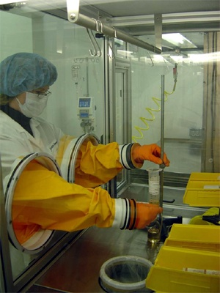
Fully homomorphic Encryption with Polylog overhead
Craig Gentry and Shai Halevi
IBM Watson
Nigel Smart
Univ. Of Bristol

Slide 2
Homomorphic Encryption
Usual procedures (KeyGen,Enc,Dec)
Say, encrypting bits
Usual semantic-security requirement
(pk, Enc_{pk}(0)) ~ (pk, Enc_{pk}(1))
Additional Eval procedure
Evaluate arithmetic circuits on ciphertexts
Result decrypted to the evaluation of the same circuit on the underlying plaintext bits
Ciphertext does not grow with circuit complexity
This work: asymptotically efficient Eval

Slide 3
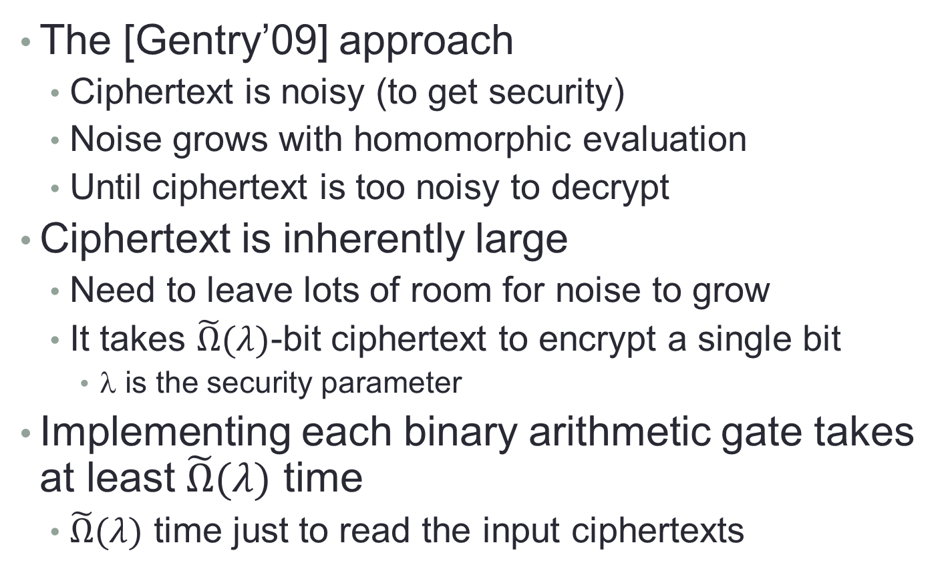
Contemporary HE Schemes
The [Gentry’09] approach
Ciphertext is noisy (to get security)
Noise grows with homomorphic evaluation
Until ciphertext is too noisy to decrypt
Ciphertext is inherently large
Need to leave lots of room for noise to grow
It takes $\tilde{Ω}(λ)$-bit ciphertext to encrypt a single bit
λ is the security parameter
Implementing each binary arithmetic gate takes at least $\tilde{Ω}(λ)$ time
$\tilde{Ω}(λ)$ time just to read the input ciphertexts

Slide 4
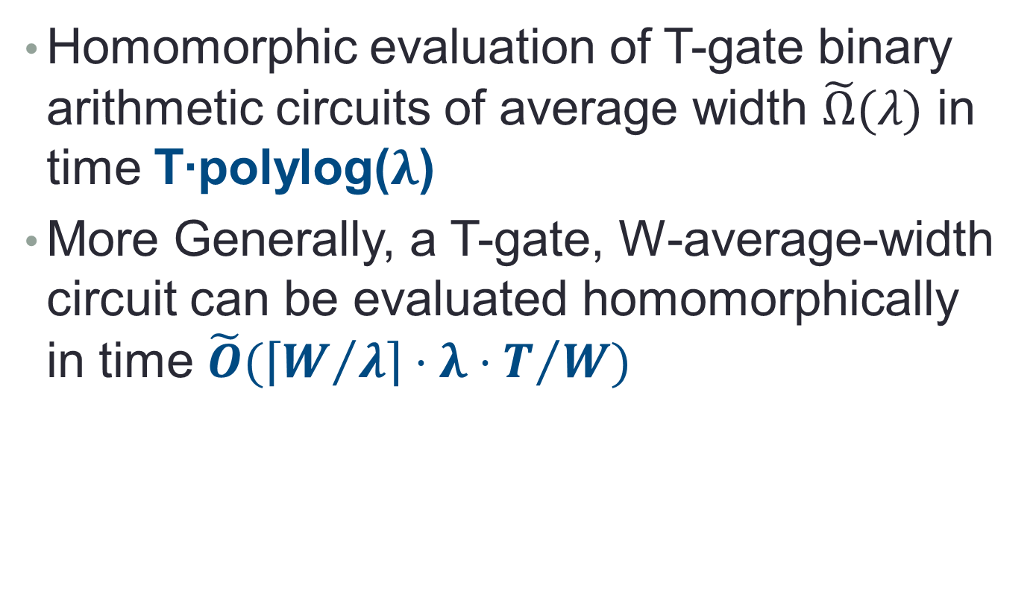
Our Result
Homomorphic evaluation of T-gate binary arithmetic circuits of average width $\tilde{Ω}(λ)$ in time T∙polylog($λ$)
More Generally, a T-gate, W-average-width circuit can be evaluated homomorphically in time $\tilde{O}(\left\lceil W/λ\right\rceil ⋅λ⋅T/W)$
time per level
# of levels

Slide 5
Our Approach
Use HE over polynomial rings
Pack an array of bits in each ciphertext
Use ring-automorphisms to move bits around in the arrays
Efficient data-movement schemes
Using Beneš/Waksman networks and extensions

Slide 6
Background
Homomorphic Encryption over Polynomials Rings
Evaluation representation, plaintext slots
Homomorphic SIMD operations

Slide 7
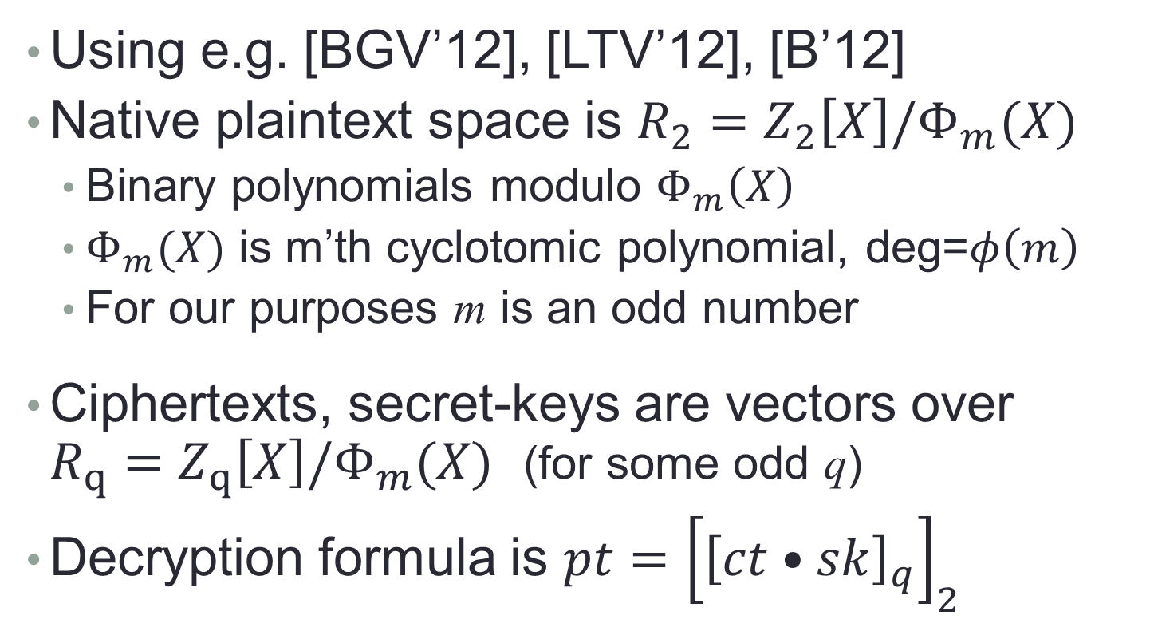
HE Over Polynomial Rings
Using e.g. [BGV’12], [LTV’12], [B’12]
Native plaintext space is $R_{2}=Z_{2}\left[X\right]/Φ_{m}(X)$
Binary polynomials modulo $Φ_{m}\left(X\right)$
$Φ_{m}(X)$ is m’th cyclotomic polynomial, deg=$φ\left(m\right)$
For our purposes m is an odd number
Ciphertexts, secret-keys are vectors over $R_{q}=Z_{q}\left[X\right]/Φ_{m}(X)$ (for some odd q)
Decryption formula is $pt={\left[{\left[ct•sk\right]}_{q}\right]}_{2}$

Slide 8
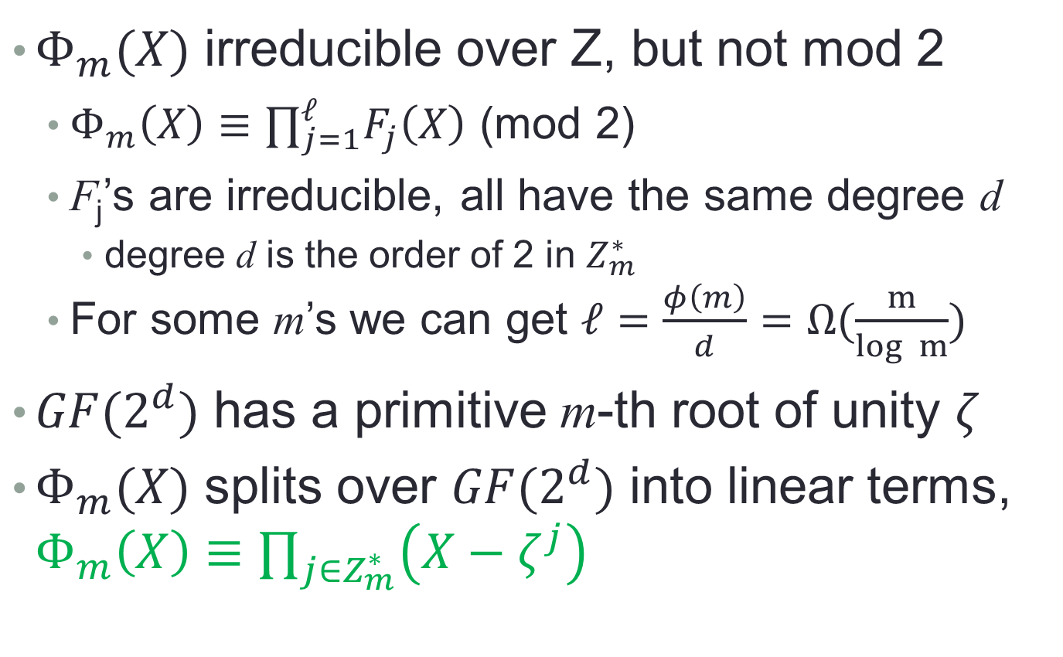
Plaintext Algebra (1)
$Φ_{m}(X)$ irreducible over Z, but not mod 2
$Φ_{m}\left(X\right)≡∏_{j=1}^{ℓ}F_{j}\left(X\right)$ (mod 2)
F_{j}’s are irreducible, all have the same degree d
degree d is the order of 2 in $Z_{m}^{∗}$
For some m’s we can get $ℓ=\frac{φ\left(m\right)}{d}=Ω(\frac{m}{log m})$
$GF(2^{d})$ has a primitive m-th root of unity $ζ$
$Φ_{m}(X)$ splits over $GF(2^{d})$ into linear terms, $Φ_{m}\left(X\right)≡∏_{j∈Z_{m}^{∗}}^{}\left(X−ζ^{j}\right)$

Slide 9
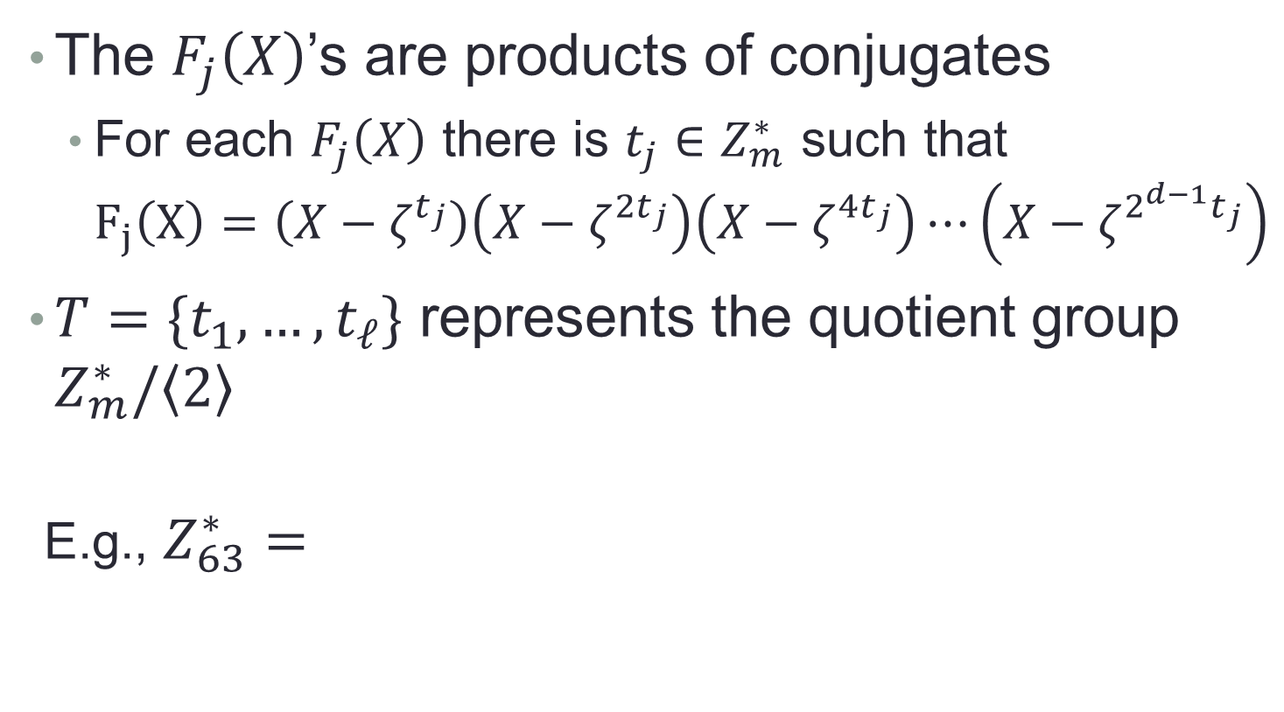
Plaintext Algebra (2)
The $F_{j}\left(X\right)$’s are products of conjugates
For each $F_{j}\left(X\right)$ there is $t_{j}∈Z_{m}^{∗}$ such that $F_{j}\left(X\right)=\left(X−ζ^{t_{j}}\right)\left(X−ζ^{2t_{j}}\right)\left(X−ζ^{4t_{j}}\right)⋯\left(X−ζ^{2^{d−1}t_{j}}\right)$
$T=\{t_{1},…,t_{ℓ}\}$ represents the quotient group $Z_{m}^{∗}/\left\langle 2\right\rangle$
E.g., $Z_{63}^{∗}=$
32T: | 32 | 34 | 44 | 31 | 29 | 19
16T: | 16 | 17 | 22 | 47 | 46 | 41
8T: | 8 | 40 | 11 | 55 | 23 | 52
4T: | 4 | 20 | 37 | 59 | 43 | 26
2T: | 2 | 10 | 50 | 61 | 53 | 13
T: | 1 | 5 | 25 | 62 | 58 | 38

Slide 10
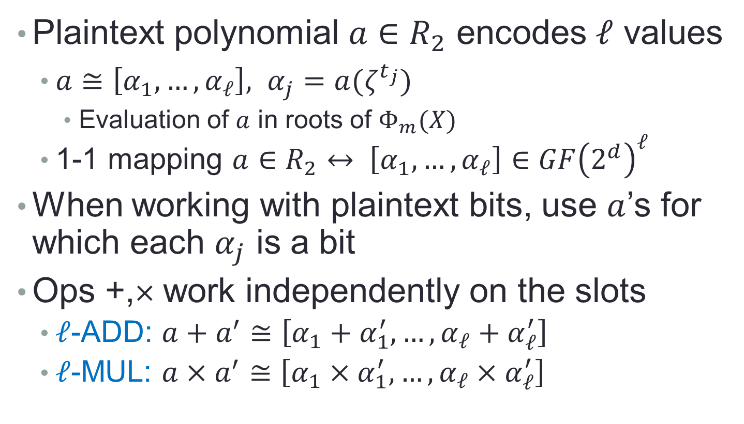
Plaintext Slots
Plaintext polynomial $a∈R_{2}$ encodes $ℓ$ values
$a≅\left[α_{1}, …, α_{ℓ}\right], α_{j}=a(ζ^{t_{j}})$
Evaluation of $a$ in roots of $Φ_{m}(X)$
1-1 mapping $a∈R_{2}↔ \left[α_{1}, …, α_{ℓ}\right]∈GF{\left(2^{d}\right)}^{ℓ}$
When working with plaintext bits, use $a$’s for which each $α_{j}$ is a bit
Ops +,× work independently on the slots
$ℓ$-ADD: $a+a^{′}≅\left[α_{1}+α_{1}^{′}, …, α_{ℓ}+α_{ℓ}^{′}\right]$
$ℓ$-MUL: $a×a^{′}≅\left[α_{1}×α_{1}^{′}, …, α_{ℓ}×α_{ℓ}^{′}\right]$

Slide 11
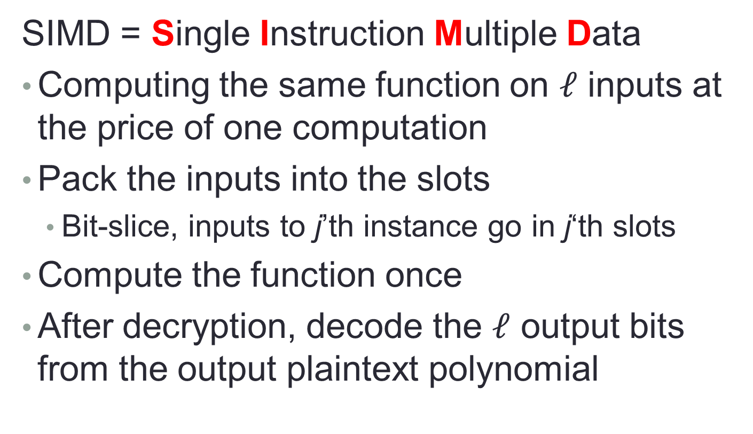
Homomorphic SIMD [SV’11]
SIMD = Single Instruction Multiple Data
Computing the same function on $ℓ$ inputs at the price of one computation
Pack the inputs into the slots
Bit-slice, inputs to j’th instance go in j‘th slots
Compute the function once
After decryption, decode the $ℓ$ output bits from the output plaintext polynomial

Slide 12

Aside: an $ℓ$-SELECT Operation
x₁ | x₂ | x₃ | x₄ | x₅ | x₆ | x₇
=
x₁ | 0 | 0 | x₄ | 0 | x₆ | 0
x
1 | 0 | 0 | 1 | 0 | 1 | 0
+
x₈ | x₉ | x₁₀ | x₁₁ | x₁₂ | x₁₃ | x₁₄
=
0 | x₉ | x₁₀ | 0 | x₁₂ | 0 | x₁₄
x
0 | 1 | 1 | 0 | 1 | 0 | 1
x₁ | x₉ | x₁₀ | x₄ | x₁₂ | x₆ | x₁₄
We will use this later

Slide 13
Computing on data arrays
Forget about encryption for the moment…

Slide 14
So you want to compute some function…
+
+
+
+
+
+
+
+
+
1
×
×
×
×
×
×
×
×
×
×
×
1
+
+
+
+
+
+
+
+
+
+
+
+
+
0
1
1
Input bits
x₁
x₂
x₃
x₄
x₅
x₇
x₈
x₉
x₁₀
x₁₁
x₁₂
x₁₄
x₁₅
x₁₆
x₁₇
x₁₈
x₁₉
x₂₁
x₂₂
x₂₃
x₂₄
x₂₅
x₂₆
ADD and MUL are a complete set of operations.

Slide 15
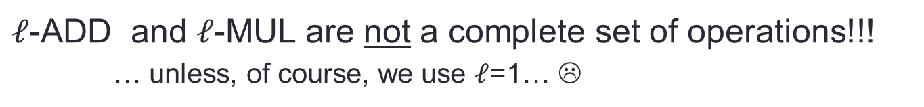
So you want to compute some function using SIMD…
+
+
+
+
+
+
+
+
+
1
×
×
×
×
×
×
×
×
×
×
×
1
+
+
+
+
+
+
+
+
+
+
+
+
+
0
1
1
Input bits
x₁
x₂
x₃
x₄
x₅
x₇
x₈
x₉
x₁₀
x₁₁
x₁₂
x₁₄
x₁₅
x₁₆
x₁₇
x₁₈
x₁₉
x₂₁
x₂₂
x₂₃
x₂₄
x₂₅
x₂₆
x₁ | x₂ | x₃ | x₄ | x₅ |  | x₇
x₈ | x₉ | x₁₀ | x₁₁ | x₁₂ |  | x₁₄
x₁₅ | x₁₆ | x₁₇ | x₁₈ | x₁₉ |  | x₂₁
x₂₂ | x₂₃ | x₂₄ | x₂₅ | x₂₆
$ℓ$-ADD and $ℓ$-MUL are not a complete set of operations!!!
… unless, of course, we use $ℓ$=1… ☹

Slide 16

Routing Values Between Levels
We need to map this
Into that
x₁ | x₂ | x₃ | x₄ | x₅ | 0 | x₇
x₈ | x₉ | x₁₀ | x₁₁ | x₁₂ | 1 | x₁₄
x₁₅ | x₁₆ | x₁₇ | x₁₈ | x₁₉ | 1 | x₂₁
x₂₂ | x₂₃ | x₂₄ | x₂₅ | x₂₆
… so we can use $ℓ$-add
+
+
+
+
+
+
+
+
+
+
+
+
+
x₁ | x₃ | x₅ | x₇ | x₉ | x₁₁ | 1
x₁₅ | x₁₇ | x₁₉ | x₂₁ | x₂₃ | x₂₅
x₂ | x₄ | 0 | x₈ | x₁₀ | x₁₂ | x₁₄
x₁₆ | x₁₈ | 1 | x₂₂ | x₂₄ | x₂₆

Slide 17
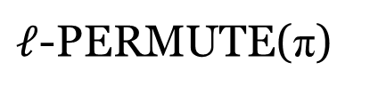
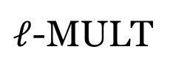
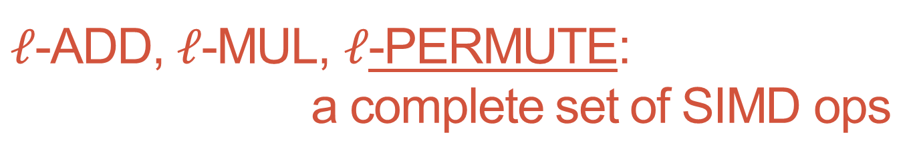
$ℓ$-ADD, $ℓ$-MUL, $ℓ$-PERMUTE: a complete set of SIMD ops
+
+
+
x₁
x₂
x₃
x₄
x₅
0
x₁ | x₂ | x₃ | x₄ | x₅ |  | x₇
x₁ | x₂ | x₃ | x₄ | x₅ |  | x₇
$ℓ$-PERMUTE(π)
x₁ | x₃ | x₅ | * | * | * | *
x₂ | x₄ | * | * | * | * | *
$ℓ$-MULT
1 | 1 | 1 | 0 | 0 | 0 | 0
1 | 1 | 0 | 0 | 0 | 0 | 0
x₁ | x₃ | x₅ | 0 | 0 | 0 | 0
x₂ | x₄ | 0 | 0 | 0 | 0 | 0

Slide 18
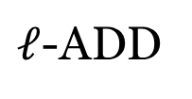
$ℓ$-ADD, $ℓ$-MUL, $ℓ$-PERMUTE: a complete set of SIMD ops
+
+
+
x₁
x₂
x₃
x₄
x₅
0
$ℓ$-ADD
x₁+ x₂ | x₃+ x₄ | x₅ | 0 | 0 | 0 | 0
x₁ | x₃ | x₅ | 0 | 0 | 0 | 0
x₂ | x₄ | 0 | 0 | 0 | 0 | 0

Slide 19
$ℓ$-ADD, $ℓ$-MUL, $ℓ$-PERMUTE: a complete set of SIMD ops
+
+
+
+
+
+
+
+
+
1
×
×
×
×
×
×
×
×
×
×
×
1
+
+
+
+
+
+
+
+
+
+
+
+
+
x₁
x₂
x₃
x₄
x₅
0
x₇
x₈
x₉
x₁₀
x₁₁
x₁₂
1
x₁₄
x₁₅
x₁₆
x₁₇
x₁₈
x₁₉
1
x₂₁
x₂₂
x₂₃
x₂₄
x₂₅
x₂₆
Input bits
Use $ℓ$-PERMUTE for routing between circuit levels
Not quite obvious

Slide 20
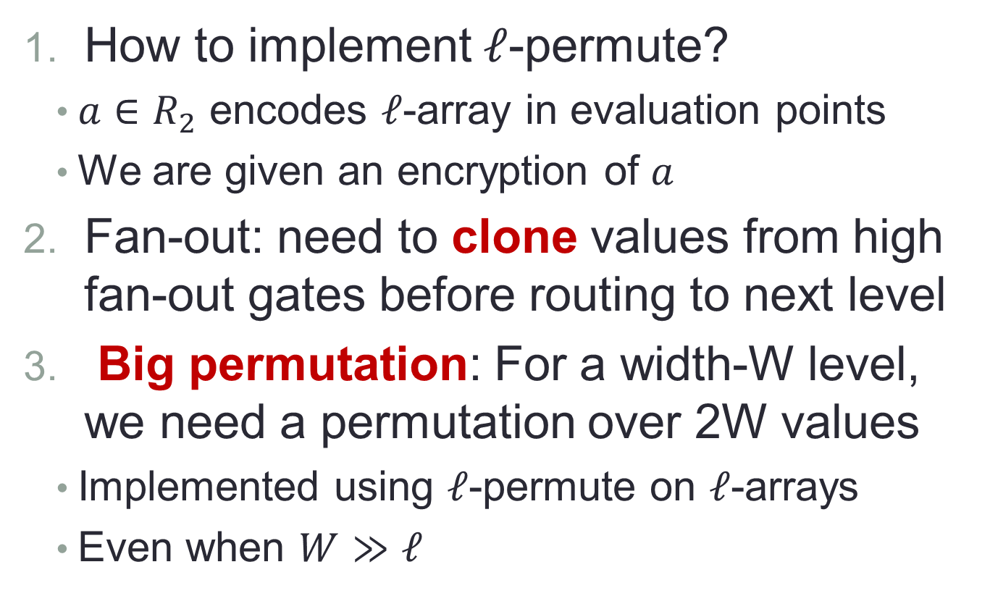
Routing Values Between Levels: Three Problems to Solve
How to implement $ℓ$-permute?
$a∈R_{2}$ encodes $ℓ$-array in evaluation points
We are given an encryption of $a$
Fan-out: need to clone values from high fan-out gates before routing to next level
Big permutation: For a width-W level, we need a permutation over 2W values
Implemented using $ℓ$-permute on $ℓ$-arrays
Even when $W≫ℓ$

Slide 21
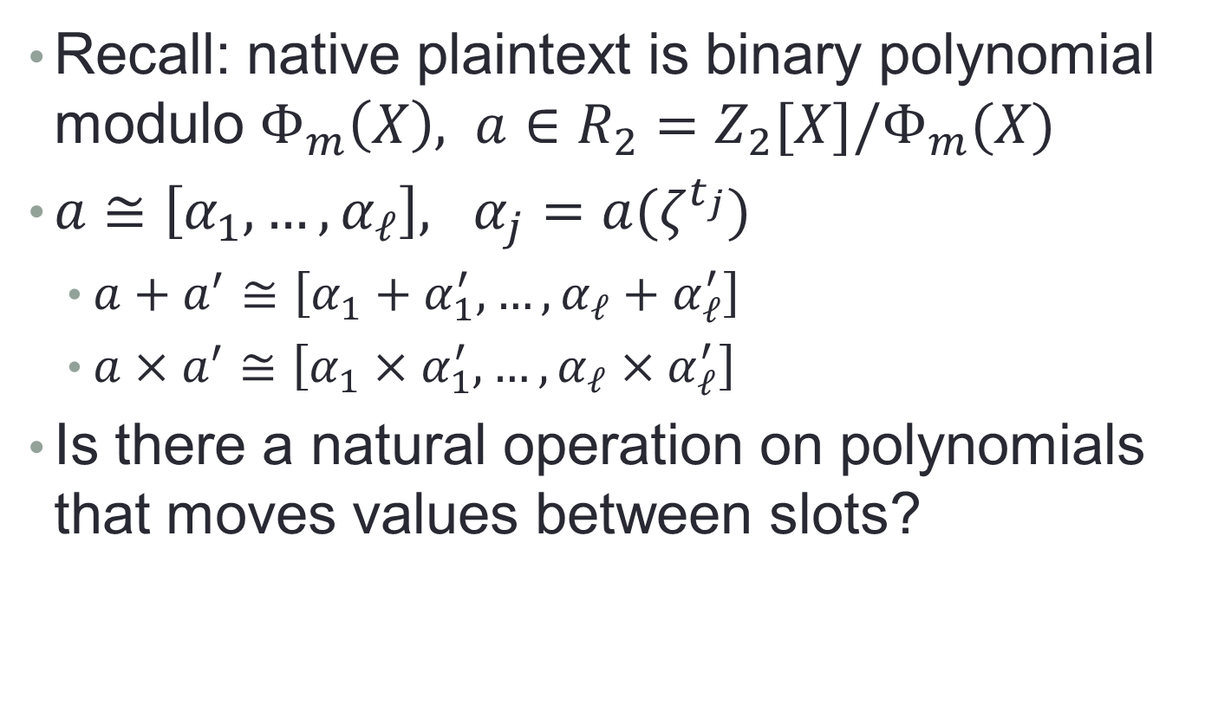
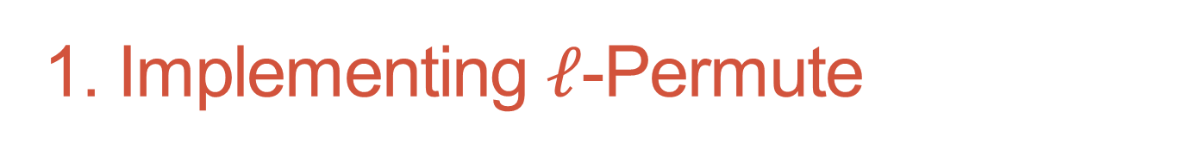
1. Implementing $ℓ$-Permute
Recall: native plaintext is binary polynomial modulo $Φ_{m}\left(X\right), a∈R_{2}=Z_{2}[X]/Φ_{m}(X)$
$a≅\left[α_{1}, …, α_{ℓ}\right], α_{j}=a(ζ^{t_{j}})$
$a+a^{′}≅\left[α_{1}+α_{1}^{′}, …, α_{ℓ}+α_{ℓ}^{′}\right]$
$a×a^{′}≅\left[α_{1}×α_{1}^{′}, …, α_{ℓ}×α_{ℓ}^{′}\right]$
Is there a natural operation on polynomials that moves values between slots?

Slide 22
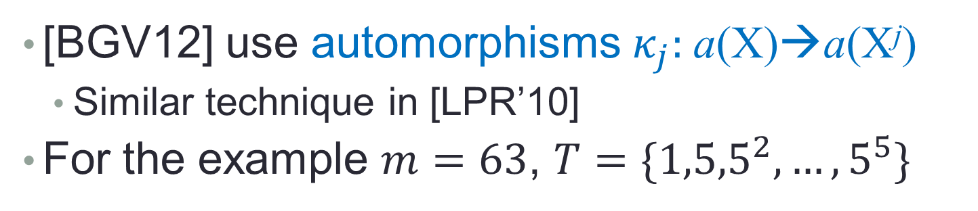
Moving Values Between Slots
[BGV12] use automorphisms $κ_{j}:$a(X)→a(X^{j})
Similar technique in [LPR’10]
For the example $m=63$, $T=\{{1,5,5}^{2},…,5^{5}\}$
32T: | 32 | 34 | 44 | 31 | 29 | 19
16T: | 16 | 17 | 22 | 47 | 46 | 41
8T: | 8 | 40 | 11 | 55 | 23 | 52
4T: | 4 | 20 | 37 | 59 | 43 | 26
2T: | 2 | 10 | 50 | 61 | 53 | 13
T: | 1 | 5 | 25 | 62 | 58 | 38

Slide 23
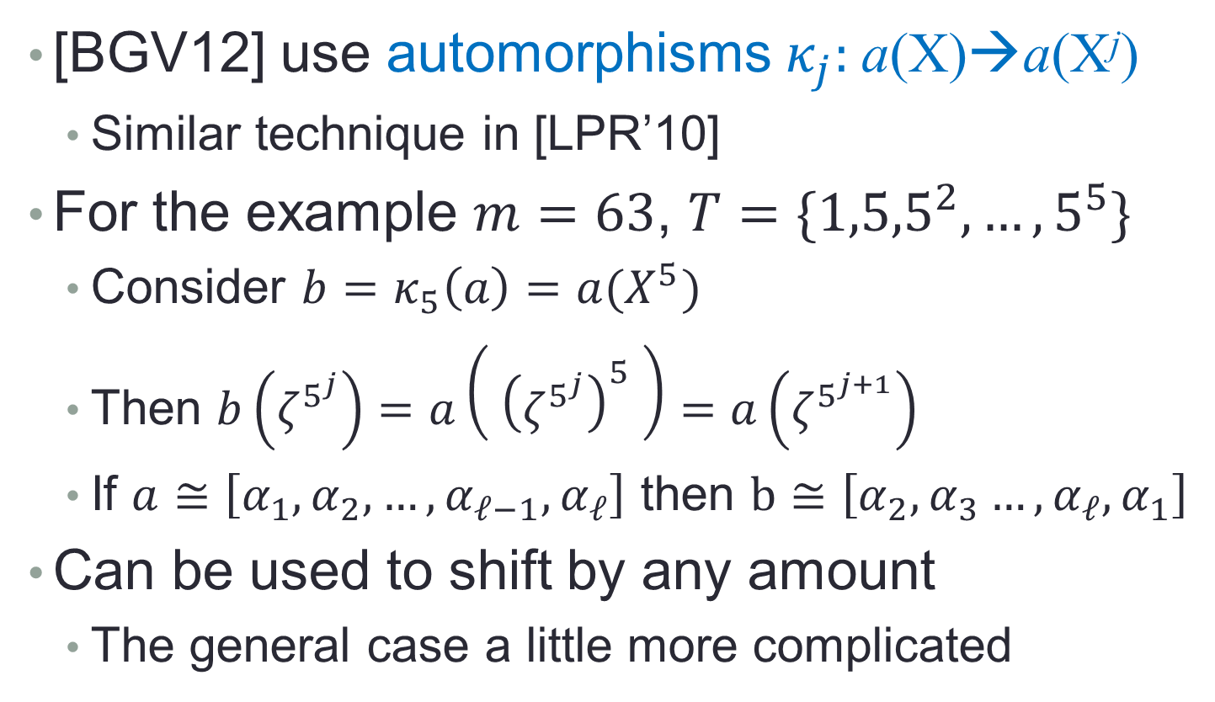
Moving Values Between Slots
[BGV12] use automorphisms $κ_{j}:$a(X)→a(X^{j})
Similar technique in [LPR’10]
For the example $m=63$, $T=\{{1,5,5}^{2},…,5^{5}\}$
Consider $b=κ_{5}\left(a\right)=a(X^{5})$
Then $b\left(ζ^{5^{j}}\right)=a\left({ \left(ζ^{5^{j}}\right)}^{5} \right)=a\left(ζ^{5^{j+1}}\right)$
If $a≅\left[α_{1},α_{2}, …, {α_{ℓ−1},α}_{ℓ}\right]$ then $b≅\left[α_{2},α_{3}…, α_{ℓ},α_{1}\right]$
Can be used to shift by any amount
The general case a little more complicated

Slide 24
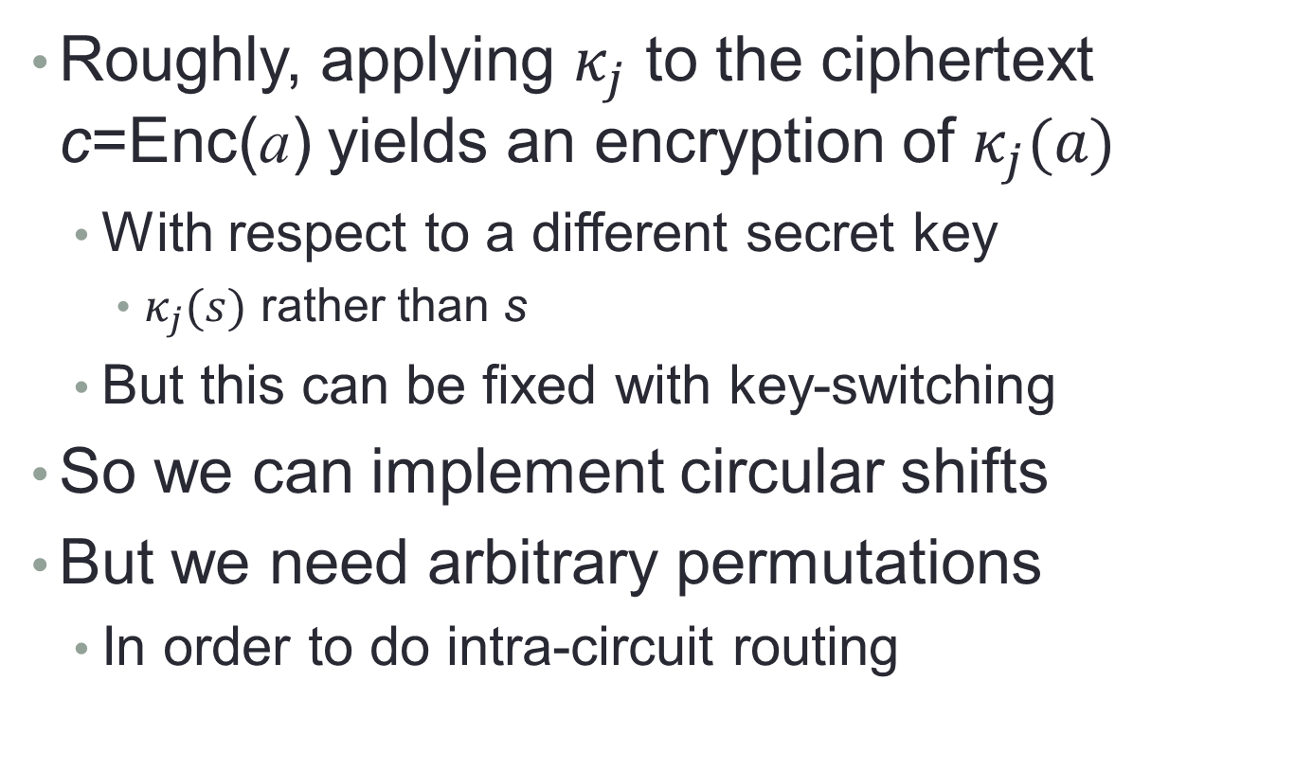
Homomorphic Automorphisms
Roughly, applying $κ_{j}$ to the ciphertext c=Enc(a) yields an encryption of $κ_{j}(a)$
With respect to a different secret key
$κ_{j}(s)$ rather than s
But this can be fixed with key-switching
So we can implement circular shifts
But we need arbitrary permutations
In order to do intra-circuit routing

Slide 25
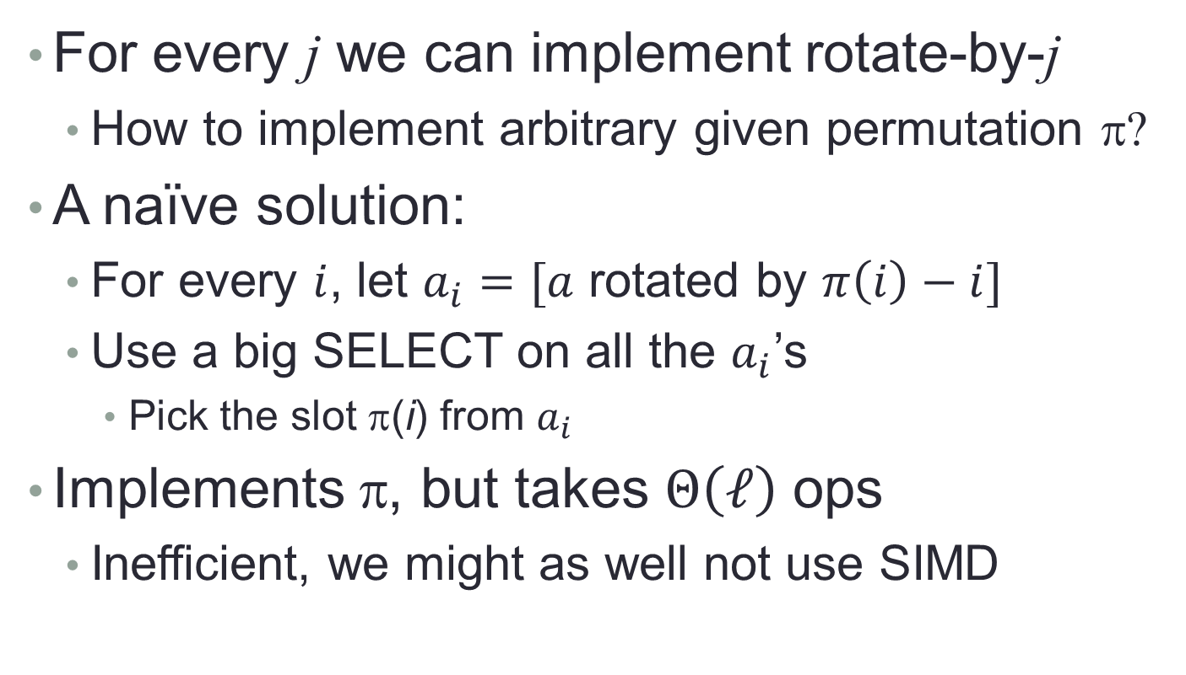
From Shifts to Arbitrary Permutations
For every j we can implement rotate-by-j
How to implement arbitrary given permutation π?
A naïve solution:
For every $i$, let $a_{i}=[a$ rotated by $π\left(i\right)−i]$
Use a big SELECT on all the $a_{i}$’s
Pick the slot π(i) from $a_{i}$
Implements π, but takes $Θ\left(ℓ\right)$ ops
Inefficient, we might as well not use SIMD

Slide 26
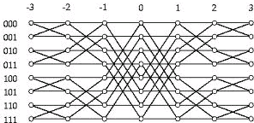
From Shifts to Arbitrary Permutations
Use Beneš/Walksman Permutation Networks:
Two back-to-back butterflies
Every exchange is controlled by a bit
Values sent on either straight edges or cross edges
Every permutation can be realized by appropriate setting of the control bits

Slide 27
Realizing Permutation Networks
Claim: every butterfly level can be realized by two shifts and two SELECTs
Example:
0
1
2
3
4
5
6
7
2
1
0
3
6
7
4
5
Control bits: 1 0 1 1

Slide 28
Realizing Permutation Networks
a₁
0
1
2
3
4
5
6
7
input
a₂
0
1
2
3
4
5
6
7
shift(-2)
a₃
0
1
2
3
4
5
6
7
shift(2)
2
1
0
3
6
7
4
5
output

Slide 29
Realizing Permutation Networks
a₁
0
1
2
3
4
5
6
7
input
a₂
2
3
4
5
6
7
0
1
shift(-2)
a₃
6
7
0
1
2
3
4
5
shift(2)
a₄
2
1
4
3
6
7
0
1
SELECT(a₁,a₂)
a₅
2
1
0
3
6
7
4
5
SELECT(a₃,a₄)
2
1
0
3
6
7
4
5
output

Slide 30
Realizing Permutation Networks
Claim: every level of the Benes network can be realized by two shifts and two SELECTs
Proof : In every level, all the exchanges are between nodes at the same distance
Distance 2^{i} for some i
Can implement all these exchanges using shift(2^{i}), shift(-2^{i}), and two SELECTs

Slide 31
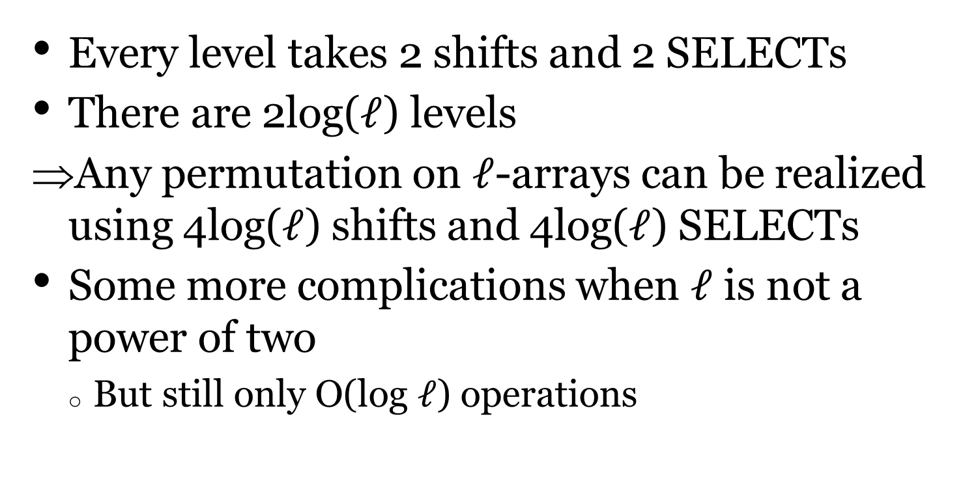
Realizing Permutation Networks
Every level takes 2 shifts and 2 SELECTs
There are 2log($ℓ$) levels
Any permutation on $ℓ$-arrays can be realized using 4log($ℓ$) shifts and 4log($ℓ$) SELECTs
Some more complications when $ℓ$ is not a power of two
But still only O(log $ℓ$) operations

Slide 32
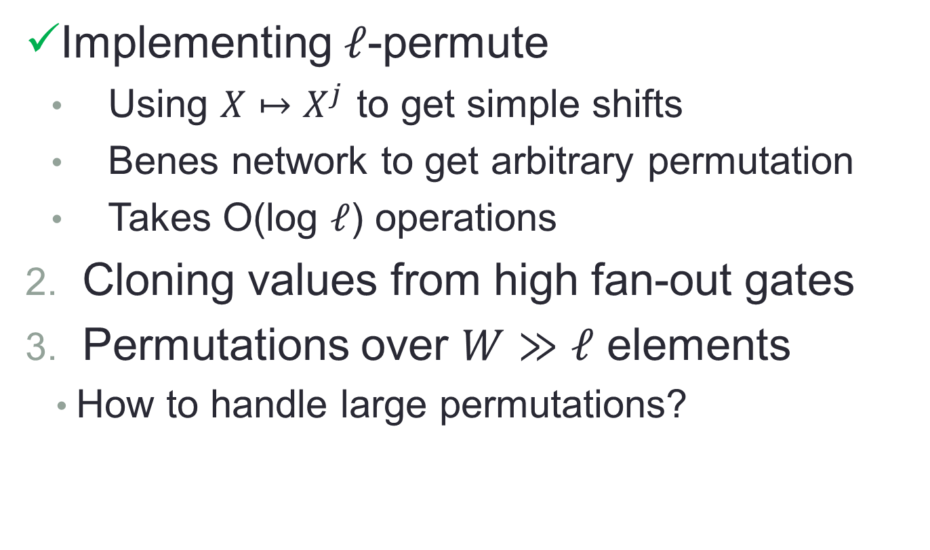
Routing Values Between Levels
Implementing $ℓ$-permute
Using $X↦X^{j}$ to get simple shifts
Benes network to get arbitrary permutation
Takes O(log $ℓ$) operations
Cloning values from high fan-out gates
Permutations over $W≫ℓ$ elements
How to handle large permutations?
see paper

Slide 33
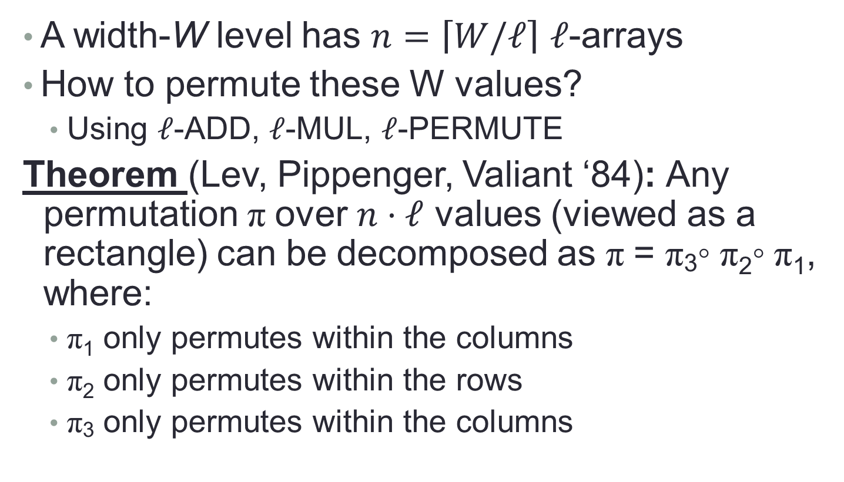
Handling Large Permutations
A width-W level has $n=\left\lceil W/ℓ\right\rceil$ $ℓ$-arrays
How to permute these W values?
Using $ℓ$-ADD, $ℓ$-MUL, $ℓ$-PERMUTE
Theorem (Lev, Pippenger, Valiant ‘84): Any permutation π over $n⋅ℓ$ values (viewed as a rectangle) can be decomposed as π = π₃◦ π₂◦ π₁, where:
π₁ only permutes within the columns
π₂ only permutes within the rows
π₃ only permutes within the columns

Slide 34
Decomposing Permutations
13 | 18 | 14 | 16 | 12
15 | 3 | 4 | 5 | 6
7 | 8 | 9 | 20 | 19
2 | 17 | 1 | 11 | 10
1 | 2 | 3 | 4 | 5
6 | 7 | 8 | 9 | 10
11 | 12 | 13 | 14 | 15
16 | 17 | 18 | 19 | 20
?
Notes:
The “random” matrix on the left was generated using the qwerty keyboard. In particular, q is the 13-th non-vowel letter (considering y is also a vowel), w is the 18-th, etc.

Slide 35
Decomposing Permutations
13 | 18 | 14 | 16 | 12
15 | 3 | 4 | 5 | 6
7 | 8 | 9 | 20 | 19
2 | 17 | 1 | 11 | 10
1 | 2 | 3 | 4 | 5
6 | 7 | 8 | 9 | 10
11 | 12 | 13 | 14 | 15
16 | 17 | 18 | 19 | 20
?
13 | 17 | 14 | 5 | 6
15 | 3 | 4 | 16 | 12
7 | 8 | 9 | 11 | 10
2 | 18 | 1 | 20 | 19
Notes:
The “random” matrix on the left was generated using the qwerty keyboard. In particular, q is the 13-th non-vowel letter (considering y is also a vowel), w is the 18-th, etc.

Slide 36
Decomposing Permutations
13 | 18 | 14 | 16 | 12
15 | 3 | 4 | 5 | 6
7 | 8 | 9 | 20 | 19
2 | 17 | 1 | 11 | 10
1 | 2 | 3 | 4 | 5
6 | 7 | 8 | 9 | 10
11 | 12 | 13 | 14 | 15
16 | 17 | 18 | 19 | 20
?
13 | 17 | 14 | 5 | 6
15 | 3 | 4 | 16 | 12
7 | 8 | 9 | 11 | 10
2 | 18 | 1 | 20 | 19
6 | 17 | 13 | 14 | 5
16 | 12 | 3 | 4 | 15
11 | 7 | 8 | 9 | 10
1 | 2 | 18 | 19 | 20
Notes:
The “random” matrix on the left was generated using the qwerty keyboard. In particular, q is the 13-th non-vowel letter (considering y is also a vowel), w is the 18-th, etc.

Slide 37
Decomposing Permutations
13 | 18 | 14 | 16 | 12
15 | 3 | 4 | 5 | 6
7 | 8 | 9 | 20 | 19
2 | 17 | 1 | 11 | 10
1 | 2 | 3 | 4 | 5
6 | 7 | 8 | 9 | 10
11 | 12 | 13 | 14 | 15
16 | 17 | 18 | 19 | 20
?
13 | 17 | 14 | 5 | 6
15 | 3 | 4 | 16 | 12
7 | 8 | 9 | 11 | 10
2 | 18 | 1 | 20 | 19
6 | 17 | 13 | 14 | 5
16 | 12 | 3 | 4 | 15
11 | 7 | 8 | 9 | 10
1 | 2 | 18 | 19 | 20
Notes:
The “random” matrix on the left was generated using the qwerty keyboard. In particular, q is the 13-th non-vowel letter (considering y is also a vowel), w is the 18-th, etc.

Slide 38
Decomposing Permutations
13 | 18 | 14 | 16 | 12
15 | 3 | 4 | 5 | 6
7 | 8 | 9 | 20 | 19
2 | 17 | 1 | 11 | 10
1 | 2 | 3 | 4 | 5
6 | 7 | 8 | 9 | 10
11 | 12 | 13 | 14 | 15
16 | 17 | 18 | 19 | 20
?
13 | 17 | 14 | 5 | 6
15 | 3 | 4 | 16 | 12
7 | 8 | 9 | 11 | 10
2 | 18 | 1 | 20 | 19
6 | 17 | 13 | 14 | 5
16 | 12 | 3 | 4 | 15
11 | 7 | 8 | 9 | 10
1 | 2 | 18 | 19 | 20
Notes:
The “random” matrix on the left was generated using the qwerty keyboard. In particular, q is the 13-th non-vowel letter (considering y is also a vowel), w is the 18-th, etc.

Slide 39

Decomposing Permutations
13 | 18 | 14 | 16 | 12
15 | 3 | 4 | 5 | 6
7 | 8 | 9 | 20 | 19
2 | 17 | 1 | 11 | 10
1 | 2 | 3 | 4 | 5
6 | 7 | 8 | 9 | 10
11 | 12 | 13 | 14 | 15
16 | 17 | 18 | 19 | 20
?
13 | 17 | 14 | 5 | 6
15 | 3 | 4 | 16 | 12
7 | 8 | 9 | 11 | 10
2 | 18 | 1 | 20 | 19
6 | 17 | 13 | 14 | 5
16 | 12 | 3 | 4 | 15
11 | 7 | 8 | 9 | 10
1 | 2 | 18 | 19 | 20
Notes:
The “random” matrix on the left was generated using the qwerty keyboard. In particular, q is the 13-th non-vowel letter (considering y is also a vowel), w is the 18-th, etc.

Slide 40
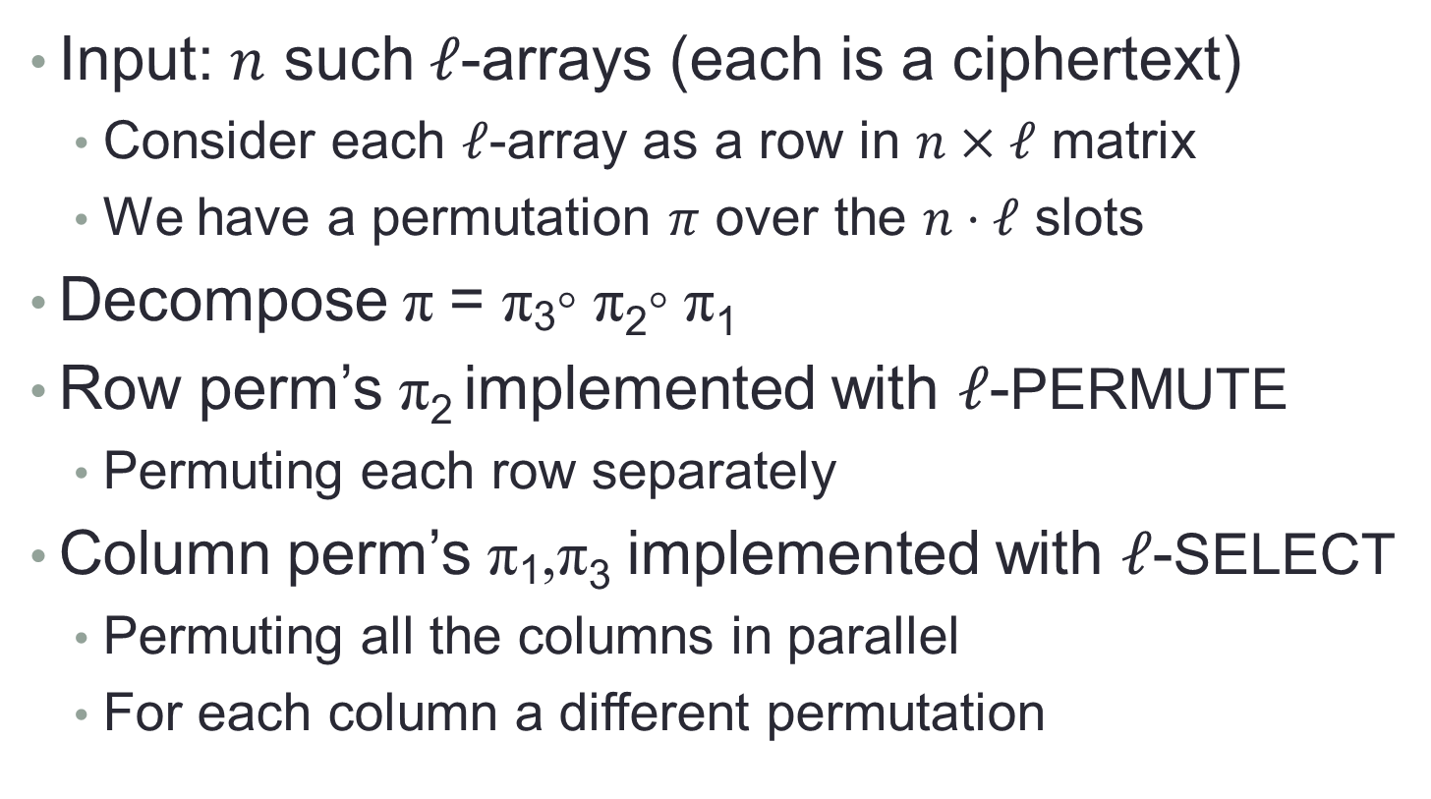
Handling Large Permutations
Input: $n$ such $ℓ$-arrays (each is a ciphertext)
Consider each $ℓ$-array as a row in $n×ℓ$ matrix
We have a permutation $π$ over the $n⋅ℓ$ slots
Decompose π = π₃◦ π₂◦ π₁
Row perm’s π₂ implemented with $ℓ$-PERMUTE
Permuting each row separately
Column perm’s π₁,π₃ implemented with $ℓ$-SELECT
Permuting all the columns in parallel
For each column a different permutation

Slide 41
Permuting The Columns
∗ | ∗ | ∗ | ∗ | ∗
∗ | ∗ | ∗ | ∗ | ∗
∗ | ∗ | ∗ | ∗ | ∗
∗ | ∗ | ∗ | ∗ | ∗
∗ | ∗ | ∗ | ∗ | ∗
∗ | ∗ | ∗ | ∗ | ∗
∗ | ∗ | ∗ | ∗ | ∗
∗ | ∗ | ∗ | ∗ | ∗
Implement a Beneš network over each column

Slide 42


Permuting The Columns
∗ | ∗ | ∗ | ∗ | ∗
∗ | ∗ | ∗ | ∗ | ∗
∗ | ∗ | ∗ | ∗ | ∗
∗ | ∗ | ∗ | ∗ | ∗
∗ | ∗ | ∗ | ∗ | ∗
∗ | ∗ | ∗ | ∗ | ∗
∗ | ∗ | ∗ | ∗ | ∗
∗ | ∗ | ∗ | ∗ | ∗
∗ | ∗ | ∗ | ∗ | ∗
∗ | ∗ | ∗ | ∗ | ∗
∗ | ∗ | ∗ | ∗ | ∗
∗ | ∗ | ∗ | ∗ | ∗
∗ | ∗ | ∗ | ∗ | ∗
∗ | ∗ | ∗ | ∗ | ∗
∗ | ∗ | ∗ | ∗ | ∗
∗ | ∗ | ∗ | ∗ | ∗
$ℓ$-SELECT
$ℓ$-SELECT
$ℓ$-SELECT
$ℓ$-SELECT
First level in all the networks

Slide 43

Permuting The Columns
∗ | ∗ | ∗ | ∗ | ∗
∗ | ∗ | ∗ | ∗ | ∗
∗ | ∗ | ∗ | ∗ | ∗
∗ | ∗ | ∗ | ∗ | ∗
∗ | ∗ | ∗ | ∗ | ∗
∗ | ∗ | ∗ | ∗ | ∗
∗ | ∗ | ∗ | ∗ | ∗
∗ | ∗ | ∗ | ∗ | ∗
∗ | ∗ | ∗ | ∗ | ∗
∗ | ∗ | ∗ | ∗ | ∗
∗ | ∗ | ∗ | ∗ | ∗
∗ | ∗ | ∗ | ∗ | ∗
∗ | ∗ | ∗ | ∗ | ∗
∗ | ∗ | ∗ | ∗ | ∗
∗ | ∗ | ∗ | ∗ | ∗
∗ | ∗ | ∗ | ∗ | ∗
$ℓ$-SELECT
$ℓ$-SELECT
$ℓ$-SELECT
$ℓ$-SELECT
Second level in all the networks
, etc.

Slide 44
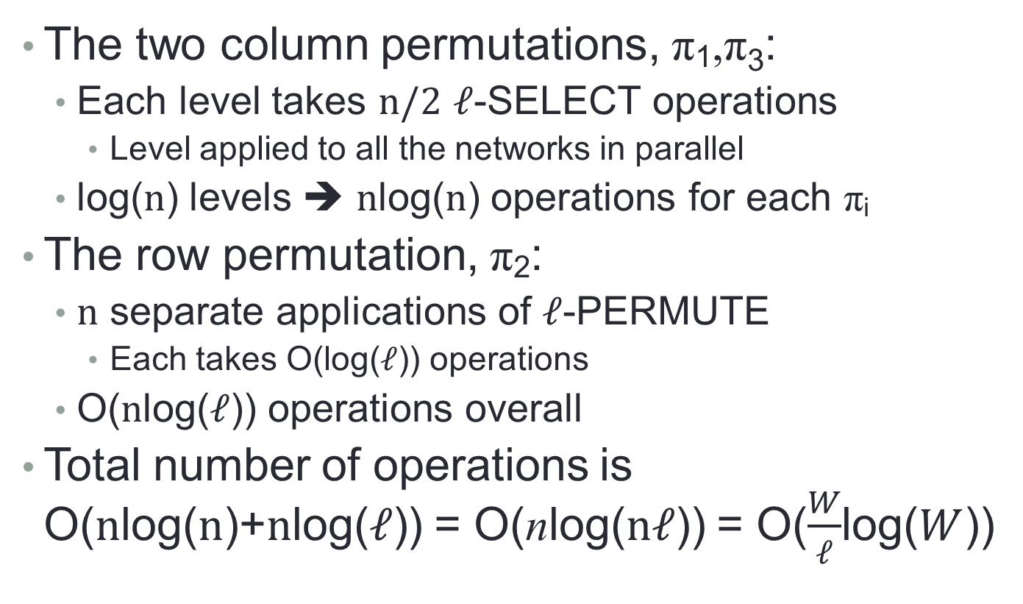
Handling Large Permutations
The two column permutations, π₁,π₃:
Each level takes $n/2$ $ℓ$-SELECT operations
Level applied to all the networks in parallel
log($n$) levels ➔ $n$log($n$) operations for each π_{i}
The row permutation, π₂:
$n$ separate applications of $ℓ$-PERMUTE
Each takes O(log($ℓ$)) operations
O($n$log($ℓ$)) operations overall
Total number of operations is O($n$log($n$)+$n$log($ℓ$)) = O(nlog($nℓ$)) = O($\frac{W}{ℓ}$log($W$))

Slide 45
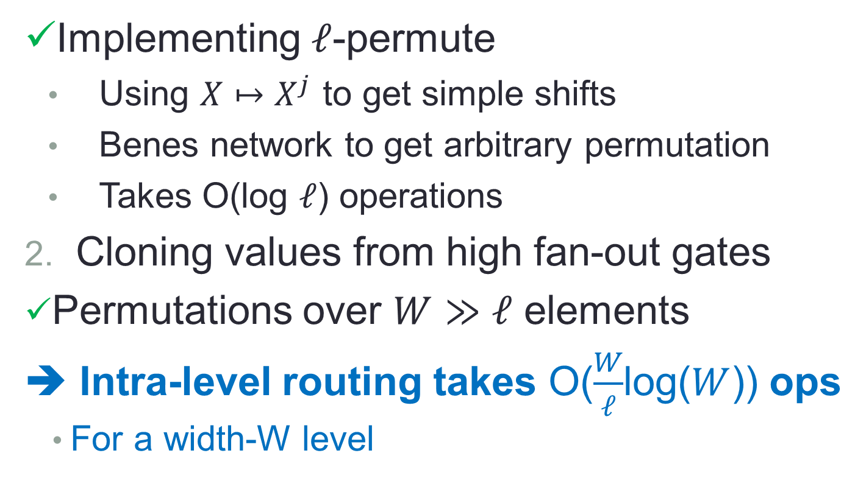
Routing Values Between Levels
Implementing $ℓ$-permute
Using $X↦X^{j}$ to get simple shifts
Benes network to get arbitrary permutation
Takes O(log $ℓ$) operations
Cloning values from high fan-out gates
Permutations over $W≫ℓ$ elements
➔ Intra-level routing takes O($\frac{W}{ℓ}$log($W$)) ops
For a width-W level
see paper

Slide 46
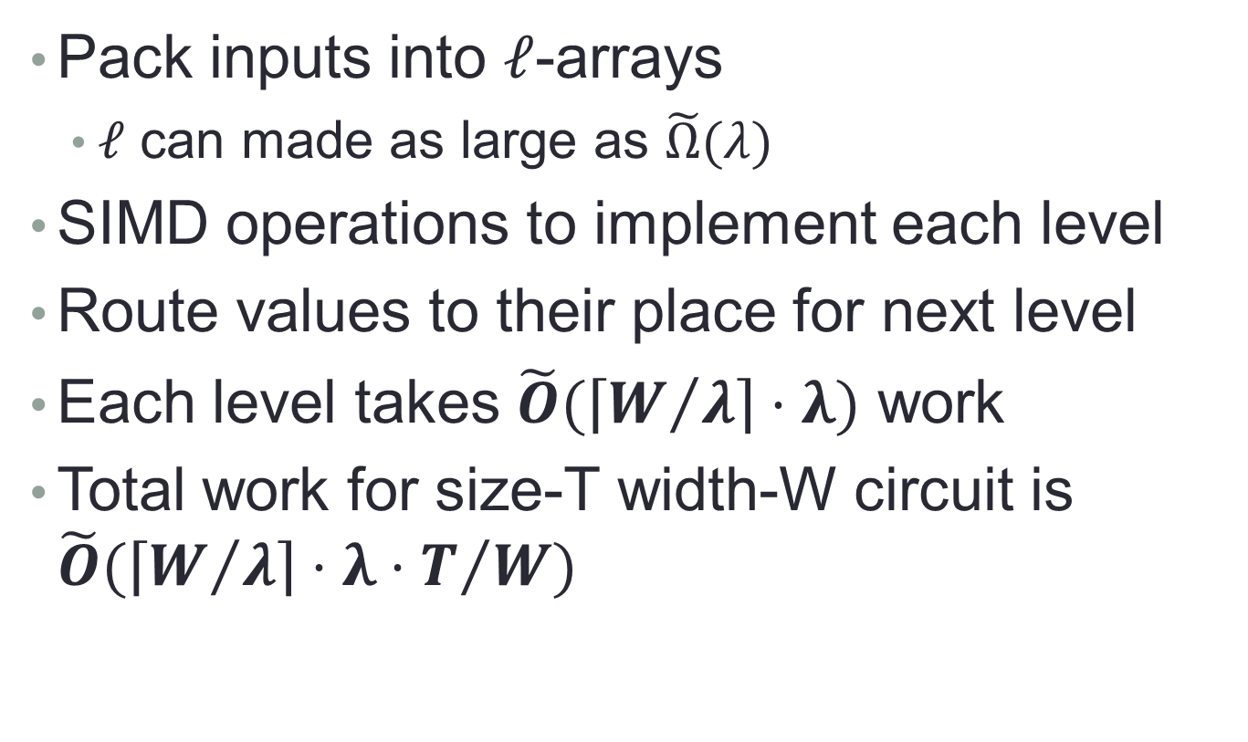
Low Overhead Homomorphic Encryption
Pack inputs into $ℓ$-arrays
$ℓ$ can made as large as $\tilde{Ω}(λ)$
SIMD operations to implement each level
Route values to their place for next level
Each level takes $\tilde{O}(\left\lceil W/λ\right\rceil ⋅λ)$ work
Total work for size-T width-W circuit is $\tilde{O}(\left\lceil W/λ\right\rceil ⋅λ⋅T/W)$

Slide 47

Questions?

Slide 48
Fan-Out and Cloning
intended multiplicity
2 | 3 | 1 | 1 | 2 | 2 | 1
x₁ | x₂ | x₃ | x₄ | x₅ | x₆ | x₇
1 | 2 | 2 | 4 | 1 | 2 | 1
x₈ | x₉ | x₁₀ | x₁₁ | x₁₂ | x₁₃ | x₁₄
2 | 1 | 3 | 1 | 2 | 1 | 2
x₁₅ | x₁₆ | x₁₇ | x₁₈ | x₁₉ | x₂₀ | x₂₁
variables

Slide 49
Fan-Out and Cloning
2 | 3 | 1 | 1 | 2 | 2 | 1
x₁ | x₂ | x₃ | x₄ | x₅ | x₆ | x₇
1 | 2 | 2 | 4 | 1 | 2 | 1
x₈ | x₉ | x₁₀ | x₁₁ | x₁₂ | x₁₃ | x₁₄
2 | 1 | 3 | 1 | 2 | 1 | 2
x₁₅ | x₁₆ | x₁₇ | x₁₈ | x₁₉ | x₂₀ | x₂₁
Sort by intended multiplicity:
4 | 3 | 3 | 2 | 2 | 2 | 2
x₁₁ | x₂ | x₁₇ | x₁ | x₅ | x₆ | x₉
2 | 2 | 2 | 2 | 2 | 1 | 1
x₁₀ | x₁₃ | x₁₅ | x₁₉ | x₂₁ | x₃ | x₄
1 | 1 | 1 | 1 | 1 | 1 | 1
x₇ | x₈ | x₁₂ | x₁₄ | x₁₆ | x₁₈ | x₂₀

Slide 50
Fan-Out and Cloning
4 | 3 | 3 | 2 | 2 | 2 | 2
x₁₁ | x₂ | x₁₇ | x₁ | x₅ | x₆ | x₉
2 | 2 | 2 | 2 | 2 | 1 | 1
x₁₀ | x₁₃ | x₁₅ | x₁₉ | x₂₁ | x₃ | x₄
1 | 1 | 1 | 1 | 1 | 1 | 1
x₇ | x₈ | x₁₂ | x₁₄ | x₁₆ | x₁₈ | x₂₀
Replicate
4 | 3 | 3
x₁₁ | x₂ | x₁₇
Replicate and shift
 |  |  | 4 | 3 | 3
 |  |  | x₁₁ | x₂ | x₁₇

Slide 51
Fan-Out and Cloning
4 | 3 | 3 | 2 | 2 | 2 | 2
x₁₁ | x₂ | x₁₇ | x₁ | x₅ | x₆ | x₉
2 | 2 | 2 | 2 | 2 | 1 | 1
x₁₀ | x₁₃ | x₁₅ | x₁₉ | x₂₁ | x₃ | x₄
1 | 1 | 1 | 1 | 1 | 1 | 1
x₇ | x₈ | x₁₂ | x₁₄ | x₁₆ | x₁₈ | x₂₀
Merge
4 | 3 | 3 | 4 | 3 | 3
x₁₁ | x₂ | x₁₇ | x₁₁ | x₂ | x₁₇

Slide 52
Fan-Out and Cloning
4 | 3 | 3 | 2 | 2 | 2 | 2
x₁₁ | x₂ | x₁₇ | x₁ | x₅ | x₆ | x₉
2 | 2 | 2 | 2 | 2 | 1 | 1
x₁₀ | x₁₃ | x₁₅ | x₁₉ | x₂₁ | x₃ | x₄
1 | 1 | 1 | 1 | 1 | 1 | 1
x₇ | x₈ | x₁₂ | x₁₄ | x₁₆ | x₁₈ | x₂₀
Replicate, shift, merge
4 | 3 | 3 | 4 | 3 | 3 | 2
x₁₁ | x₂ | x₁₇ | x₁₁ | x₂ | x₁₇ | x₁
2 | 2 | 2 | 2 | 2 | 2 | 2
x₅ | x₆ | x₉ | x₁₀ | x₁₃ | x₁₅ | x₁₉
2
x₂₁
Replicate, shift
4 | 3 | 3 | 4 | 3 | 3 | 2
x₁₁ | x₂ | x₁₇ | x₁₁ | x₂ | x₁₇ | x₁
2 | 2 | 2 | 2 | 2 | 2 | 2
x₅ | x₆ | x₉ | x₁₀ | x₁₃ | x₁₅ | x₁₉
 | 2
 | x₂₁

Slide 53
Fan-Out and Cloning
4 | 3 | 3 | 2 | 2 | 2 | 2
x₁₁ | x₂ | x₁₇ | x₁ | x₅ | x₆ | x₉
2 | 2 | 2 | 2 | 2 | 1 | 1
x₁₀ | x₁₃ | x₁₅ | x₁₉ | x₂₁ | x₃ | x₄
1 | 1 | 1 | 1 | 1 | 1 | 1
x₇ | x₈ | x₁₂ | x₁₄ | x₁₆ | x₁₈ | x₂₀
4 | 3 | 3 | 4 | 3 | 3 | 2
x₁₁ | x₂ | x₁₇ | x₁₁ | x₂ | x₁₇ | x₁
2 | 2 | 2 | 2 | 2 | 2 | 2
x₅ | x₆ | x₉ | x₁₀ | x₁₃ | x₁₅ | x₁₉
2 | 2
x₂₁ | x₂₁
Merge
4 | 3 | 3 | 4 | 3 | 3 | 2
x₁₁ | x₂ | x₁₇ | x₁₁ | x₂ | x₁₇ | x₁
2 | 2 | 2 | 2 | 2 | 2 | 2
x₅ | x₆ | x₉ | x₁₀ | x₁₃ | x₁₅ | x₁₉

Slide 54
Fan-Out and Cloning
4 | 3 | 3 | 2 | 2 | 2 | 2
x₁₁ | x₂ | x₁₇ | x₁ | x₅ | x₆ | x₉
2 | 2 | 2 | 2 | 2 | 1 | 1
x₁₀ | x₁₃ | x₁₅ | x₁₉ | x₂₁ | x₃ | x₄
1 | 1 | 1 | 1 | 1 | 1 | 1
x₇ | x₈ | x₁₂ | x₁₄ | x₁₆ | x₁₈ | x₂₀
Copy, merge
4 | 3 | 3 | 4 | 3 | 3 | 2
x₁₁ | x₂ | x₁₇ | x₁₁ | x₂ | x₁₇ | x₁
2 | 2 | 2 | 2 | 2 | 2 | 2
x₅ | x₆ | x₉ | x₁₀ | x₁₃ | x₁₅ | x₁₉
2 | 2 | 1 | 1
x₂₁ | x₂₁ | x₃ | x₄
Copy
4 | 3 | 3 | 4 | 3 | 3 | 2
x₁₁ | x₂ | x₁₇ | x₁₁ | x₂ | x₁₇ | x₁
2 | 2 | 2 | 2 | 2 | 2 | 2
x₅ | x₆ | x₉ | x₁₀ | x₁₃ | x₁₅ | x₁₉
1 | 1 | 1 | 1 | 1 | 1 | 1
x₇ | x₈ | x₁₂ | x₁₄ | x₁₆ | x₁₈ | x₂₀
Each variable appears at least as much as needed

