Slide 1
The unique-SVP World
Shai Halevi, IBM, July 2009
Ajtai-Dwork’97/07, Regev’03
  PKE from worst-case uSVP
Lyubashvsky-Micciancio’09
  Relations between worst-case
  uSVP, BDD, GapSVP
Many slides stolen from Oded Regev, denoted by
®

Slide 2
f(n)-unique-SVP
®
Promise: the shortest vector u is shorter by a factor of f(n)
Algorithm for 2^{n}-unique SVP [LLL82,Schnorr87]
Believed to be hard for any polynomial n^{c}
1
≥f(n)
1
n^{c}
2^{n}
believed hard
easy

Slide 3
Ajtai-Dwork & Regev’03 PKEs
Worst-case
Search
u-SVP
Worst-case
Decision
u-SVP
Regev03:
“Hensel lifting”
AD97:
Geometric
Basic
Intuition
“Worst-case
Distinguisher”
Wavy-vs-Uniform
Leftover hash lemma
AD97 PKE
bit-by-bit
n-dimensional
Nearly-trivial
worst-case/average-case
reductions
Projecting
to a line
Amortizing by
adding dimensions
Regev03 PKE
bit-by-bit
1-dimensional
AD07 PKE
O(n)-bits
n-dimensional

Slide 4

n-dimensional distributions
®
Distinguish between the distributions:
?
Wavy
Uniform
(In a random direction)

Slide 5
Dual Lattice
®
Given a lattice L, the dual lattice is
  L* = { x | for all y∈L, <x,y>∈Z }
1/5
L
L*
5
0
0

Slide 6
L* - the dual of L
®
L
L*
√n
Case 1
0
1/n
0
n
√n
Case 2
0

Slide 7
Reduction
Input: a basis B* for L*
Produce a distribution that is:
  Wavy if L has unique shortest vector (|u|≤1/n)
  Uniform (on P(B*)) if λ₁(L) > √n
Choose a point from a Gaussian of radius √n, and reduce mod P(B*)
  Conceptually, a “random L* point” with a Gaussian(√n) perturbation

Slide 8
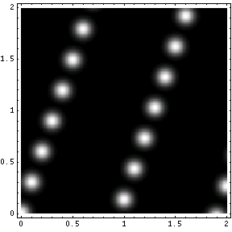
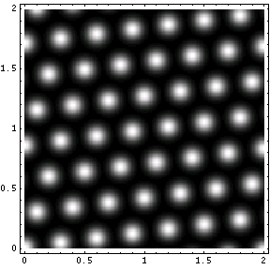
Creating the Distribution
®
L*
L*+ perturb
Case 1
0
n
Case 2

Slide 9
Analyzing the Distribution
®
Theorem: (using [Banaszczyk’93])
  The distribution obtained above depends only on the points in L of distance √n from the origin
  (up to an exponentially small error)
Therefore,
  Case 1: Determined by multiples of u →
  wavy on hyperplanes orthogonal to u
  Case 2: Determined by the origin →
  uniform

Slide 10
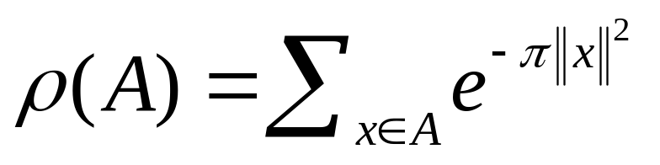
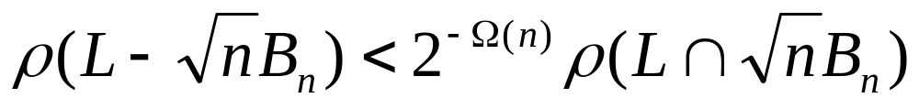
Proof of Theorem
®
For a set A in R^{n}, define:
Poisson Summation Formula implies:
Banaszczyk’s theorem:
For any lattice L,

Slide 11
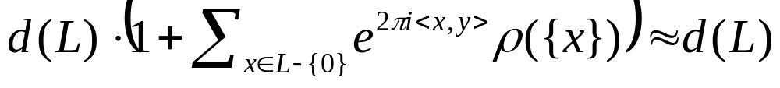
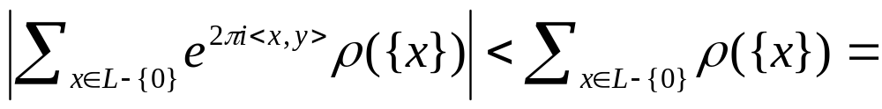
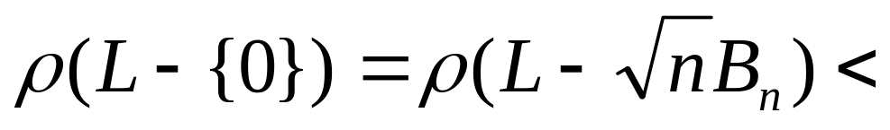
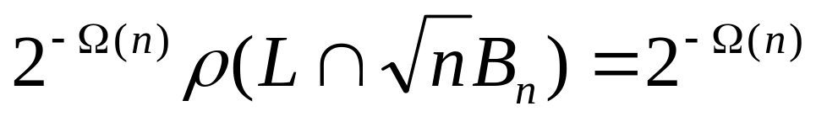
Proof of Theorem (cont.)
®
In Case 2, the distribution obtained is very close to uniform:
Because:

Slide 12

Ajtai-Dwork & Regev’03 PKEs
Worst-case
Search
u-SVP
Worst-case
Decision
u-SVP
Regev03:
“Hensel lifting”
AD97:
Geometric
next
Basic
Intuition
“Worst-case
Distinguisher”
Wavy-vs-Uniform

Slide 13
Distinguish→Search, AD97
Reminder: L* lives in hyperplanes
We want to identify u
  Using an oracle that distinguishes wavy distributions from uniform in P(B*)
u
H₁
H₀
H₋₁

Slide 14
The plan
Use the oracle to distinguish points close to H₀ from points close to H_{1}
Then grow very long vectors that are rather close to H₀
This gives a very good approximation
for u, then we use it to find u exactly

Slide 15
Distinguishing H₀ from H_{1}
Input: basis B* for L*, ~length of u, point x
  And access to wavy/uniform distinguisher
Decision: Is x 1/poly(n) close to H₀ or to H_{1}?
Choose y from a wavy distribution near L*
  y = Gaussian(σ)* with σ < 1/2|u|
Pick α∈_{R}[0,1], set z = αx + y mod P(B*)
Ask oracle if z is drawn from wavy or uniform distribution
* Gaussian(σ): variance σ² in each coordinate

Slide 16
Distinguishing H₀ from H_{1} (cont.)
Case 1: x close to H₀
αx also close to H₀
αx + y mod P(B*) close to L*, wavy
x
H₀

Slide 17
Distinguishing H₀ from H_{1} (cont.)
Case 2: x close to H_{1}
αx “in the middle” between H₀ and H_{1}
  Nearly uniform component in the u direction
αx + y mod P(B*) nearly uniform in P(B*)
x
H₁
H₀

Slide 18
Distinguishing H₀ from H_{1} (cont.)
Repeat poly(n) times, take majority
  Boost the advantage to near-certainty
Below we assume a “perfect distinguisher”
  Close to H₀ ➔ always says NO
  Close to H_{1} ➔ always says YES
  Otherwise, there are no guarantees
    Except halting in polynomial time

Slide 19
Growing Large Vectors
Start from some x₀ between H₋₁ and H₊₁
  e.g. a random vector of length 1/|u|
In each step, choose x_{i} s.t.
  |x_{i}| ~ 2|x_{i-1}|
  x_{i} is somewhere between H₋₁ and H₊₁
Keep going for poly(n) steps
Result is x* between H_{1} with |x*|=N/|u|
  Very large N, e.g., N=2^{n}
we’ll see how in a minute
2

Slide 20
From x_{i-1} to x_{i}
Try poly(n) many candidates:
Candidate w = 2x_{i-1} + Gaussian(1/|u|)
For j = 1,…, m=poly(n)
  w_{j} = j/m · w
  Check if w_{j} is near H₀ or near H_{1}
If none of the w_{j}’s is near H_{1} then accept w and set x_{i} = w
Else try another candidate
w=w_{m}
w₂
w₁

Slide 21
From x_{i-1} to x_{i}: Analysis
x_{i-1} between H_{1} → w is between H_{n}
  Except with exponentially small probability
w is NOT between H_{1} → some w_{j} near H_{1}
  So w will be rejected
So if we make progress, we know that we are on the right track

Slide 22
From x_{i-1} to x_{i}: Analysis (cont.)
With probability 1/poly(n), w is close to H₀
  The component in the u direction is Gaussian
  with mean < 2/|u| and variance 1/|u|²
noise
2x_{i-1}
H₁
H₀

Slide 23
From x_{i-1} to x_{i}: Analysis (cont.)
With probability 1/poly, w is close to H₀
  The component in the u direction is Gaussian
  with mean < 2/|u| and standard deviation 1/|u|
w is close to H₀, all w_{j}’s are close to H₀
  So w will be accepted
After polynomially many candidates, we will make progress whp

Slide 24
Finding u
Find n-1 x*’s
  x*_{t+1} is chosen orthogonal to x*₁,…,x*_{t}
  By choosing the Gaussians in that subspace
Compute u’  {x*₁,…,x*_{n-1}}, with |u’|=1
  u’ is exponentially close to u/|u|
    u/|u| = (u’+e), |e|=1/N
    Can make N  2^{n} (e.g., N=2^{n} )
Diophantine approximation to solve for u
2
(slide 71)

Slide 25
Ajtai-Dwork & Regev’03 PKEs
Worst-case
Search
u-SVP
(slide 47)
Worst-case
Decision
u-SVP
Regev03:
“Hensel lifting”
AD97:
Geometric
Basic
Intuition
“Worst-case
Distinguisher”
Wavy-vs-Uniform
Worst-case/average-case
+leftover hash lemma
next
AD97 PKE
bit-by-bit
n-dimensional

Slide 26
Average-case Distinguisher
Intuition: lattice only matters via the direction of u
Security parameter n, another parameter N
A random u in n-dim. unit sphere defines D_{u}(N)
  χ = disceret-Gaussian(N) in one dimension
    Defines a vector x=χ·u/<u,u>, namely xu and <x,u>=χ
  y = Gaussian(N) in the other n-1 dimensions
  e = Gaussian(n⁻⁴) in all n dimensions
  Output x+y+e
The average-case problem
  Distinguish D_{u}(N) from G(N)=Gaussian(N)+Gaussian(n⁻³)
  For a noticeable fraction of u’s

Slide 27
Worst-case/average-case (cont.)
Thm: Distinguishing D_{u}(N) from Uniform
→ Distinguishing Wavy_{B*} from Uniform_{B*} for all B*
  When you know λ₁(L(B)) upto (1+1/poly(n))-factor
  For parameter N = 2^{Ω(N)}
Pf: Given B*, scale it s.t. λ₁(L(B)) ∈ [1,1+1/poly)
Also apply random rotation
Given samples x (from Uniform_{B*} / Wavy_{B*})
  Sample y=discrete-Gaussian_{B*}(N)
    Can do this for large enough N
  Output z=x+y
“Clearly” z is close to G(N) /D_{u}(N) respectively

Slide 28
The AD97 Cryptosystem
Secret key: a random u ∈ unit sphere
Public key: n+m+1 vectors (m=8n log n)
  b₁,…b_{n}← D_{u}(2^{n}), v₀,v₁,…,v_{m} ← D_{u}(n2^{n})
    So <b_{i},u>, <v_{i},u> ~ integer
    We insist on <v₀,u> ~ odd integer
Will use P(b₁,…b_{n}) for encryption
  Need P(b₁,…b_{n}) with “width” > 2^{n}/n

Slide 29
The AD97 Cryptosystem (cont.)
Encryption(σ):
c’ ← random-subset-sum(v₁,…v_{m}) + σv₀/2
output c = (c’+Gaussian(n⁻⁴)) mod P(B)
Decryption(c):
If <u,c> is closer than ¼ to integer say 0,
else say 1
Correctness due to <b_{i},u>,<v_{j},u>~integer
  and width of P(B)

Slide 30
AD97 Security
The b_{i}’s, v_{i}’s chosen from D_{u}(something)
By hardness assumption, can’t distinguish from G_{u}(something)
Claim: if they were from G_{u}(something),
c would have no information on the bit σ
  Proven by leftover hash lemma + smoothing
Note: v_{i}’s has variance n² larger than b_{i}’s
  → In the G_{u} case v_{i} mod P(B) is nearly uniform

Slide 31
AD97 Security (cont.)
Partition P(B) to q^{n} cells, q~n⁷
For each point v_{i}, consider
the cell where it lies
  r_{i} is the corner of that cell
Σ_{S}v_{i} mod P(B) = Σ_{S}r_{i} mod P(B) + n⁻⁵ “error”
  S is our random subset
Σ_{S}r_{i} mod P(B) is a nearly-random cell
  We’ll show this using leftover hash
The Gaussian(n⁻⁴) in c drowns the error term
q
q

Slide 32
Leftover Hashing
Consider hash function H_{R}:{0,1}^{m} → [q]^{n}
  The key is R=[r₁,…,r_{m}]∈ [q]^{n×m}
  The input is a bit vector b=[σ₁,…,σ_{m}]^{T}∈{0,1}^{m}
H_{R}(b) = Rb mod q
H is “pairwise independent” (well, almost..)
  Yay, let’s use the leftover hash lemma
<R,H_{R}(b)>, <R,U> statistically close
  For random R∈ [q]^{n×m}, b∈{0,1}^{m}, U∈[q]^{n}
  Assuming m  n log q

Slide 33
AD97 Security (cont.)
We proved Σ_{S}r_{i} mod P(B) is nearly-random
Recall:
  c₀ = Σ_{S}r_{i} + error(n⁻⁵) + Gaussian(n⁻⁴) mod P(B)
For any x and error e, |e|~n⁻⁵, the distr. x+e+Gaussian(n⁻⁵), x+Gaussian(n⁻⁴) are statistically close
So c₀ ~ Σ_{S}r_{i} + Gaussian(n⁻³) mod P(B)
  Which is close to uniform in P(B)
  Also c₁ = c₀ + v₀/2 mod P(B) close to uniform

Slide 34
Ajtai-Dwork & Regev’03 PKEs
Worst-case
Search
u-SVP
Worst-case
Decision
u-SVP
Regev03:
“Hensel lifting”
AD97:
Geometric
Basic
Intuition
Average-case
Decision
Wavy-vs-Uniform
Leftover hash lemma
(slide 60)
AD97 PKE
bit-by-bit
n-dimensional
Projecting
to a line
Amortizing by
adding dimensions
Not
today
Regev03 PKE
bit-by-bit
1-dimensional
AD07 PKE
O(n)-bits
n-dimensional

Slide 35
u-SVP vs. BDD vs. GAP-SVP
Lyubashevsky-Micciancio, CRYPTO 2009
Good old-fashion worst-case reductions
  Mostly Cook reductions (one Karp reduction)
Worst-case
Search
u-SVP
BDD_{1/γ} ≤ uSVP_{γ/2}
Worst-case
Search
BDD
uSVP_{γ} ≤ BDD_{1/γ}
GapSVP_{γ} ≤ uSVP_{γ}
BDD_{1/γ} ≤ GapSVP_{γ n log n}
Worst-case
Decision
GAP-SVP

Slide 36
Reminder: uSVP and BDD
uSVP_{γ}: γ-unique shortest vector problem
Input: a basis B = (b₁,…,b_{n})
Promise: λ₁(L(B)) < γ λ₂(L(B))
Task: find shortest nonzero vector in L(B)
BDD_{1/γ}: 1/γ-bounded distance decoding
Input: a basis B = (b₁,…,b_{n}), a point t
Promise: dist(t, L(B)) < λ₁(L(B)) / γ
Task: find closest vector to t in L(B)

Slide 37
BDD_{1/γ} ≤ uSVP_{γ/2}
Input: a basis B = (b₁,…,b_{n}), a point t
  Assume that we know μ = dist(t, L(B))
Let B’ = b₁ … b_{n} t
0 0 μ
  Let v∈L(B) be the closest to t, |t-v|=μ
  Will show that the vector [(t-v) μ]^{T} is the
  γ/2-unique shortest vector in L(B’)
  So uSVP_{γ/2}(B’) will return it
The size of v’=[(t-v) μ]^{T} is (μ²+μ²)^{1/2} = 2×μ
Can get by with a good approximation for μ

Slide 38
BDD_{1/γ} ≤ uSVP_{γ/2} (cont.)
Every w’∈L(B’) looks like w’=[βt-w βμ]^{T}
  For some integer β and some w∈L(B)
  Write βt-w = (βv-w)-β(v-t)
  βv-w∈L(B), nonzero if w’ isn’t a multiple of v’
  So |βv-w| ≥ λ₁, also recall |v-t|=μ (≤ λ₁/γ)
  ➔|βt-w| ≥ |βv-w| - β|v-t| ≥ λ₁-βμ
  ➔|w’|² ≥ (λ₁-βμ)² + (βμ)² ≥ inf_{β∈R}[(λ₁-βμ)²+(βμ)²]
  = (λ₁)²/2 ≥ (γμ)²/2
So for any w’∈L(B’), not a multiple of v’,
we have |w’| ≥ μγ/ 2 = |v’| × γ/2

Slide 39
uSVP_{γ} ≤ BDD_{1/γ}
Input: a basis B = (b₁,b₂,…,b_{n})
  Let ρ be a prime, ρ≥γ
For i=1,2,…,n, j=1,2,…,p-1
  B_{i} = (b₁,b₂,…,ρ×b_{i},…,b_{n}), t_{ij} = j×b_{i}
  Let v_{ij} = BDD_{1/γ}(B_{i},T_{ij}), w_{ij} = v_{ij} – t_{ij}
Output the smallest nonzero w_{ij} in L(B)

Slide 40
uSVP_{γ} ≤ BDD_{1/γ} (cont.)
Let u be shortest nonzero vector in L(B)
  u = Σ ξ_{i}b_{i} , at least one ξ_{i} isn’t divisible by ρ (otherwise u/ρ would also be in L(B))
  Let j = -ξ_{i} mod ρ, j∈{1,2,…,ρ-1}
We will prove that for these i,j
  λ₁(L(B_{i})) > γλ₁(L(B))
  dist(t_{ij}, L(B_{i})) ≤ λ₁(L(B))

Slide 41
The smallest multiple of u in L(B_{i}) is ρu
  |ρu| = ρ λ₁(L(B)) ≥ γ λ₁(L(B))
  Any other vector in L(B_{i})L(B) is longer than
  γ λ₁(L(B)) (since L(B) is γ-unique)
  → λ₁(L(B_{i})) ≥ γ λ₁(L(B))
t_{ij}+u = jb_{i}+Σ ξ_{m}b_{m}= (j+ξ_{i})b_{i}+Σ_{mi} ξ_{m}b_{m} ∈L(B_{i})
  →dist(t_{ij},L(Bi)) ≤ λ₁(L(B_{i}))
→ (B_{i},t_{ij}) satisfies the promise of BDD_{1/γ}
→ v_{ij}=BDD_{1/γ}(B_{i},t_{ij}) is closest to t_{ij} in L(B_{i})
  w_{ij} = v_{ij}–t_{ij} ∈ L(B), since t_{ij}∈L(B) and v_{ij}∈L(B_{i})L(B)
  |w_{ij}|=λ₁(L(B))
divisible by p

Slide 42
Reminder: GapSVP
GapSVP_{γ}: decision version of approx_{γ}-SVP
  Input: Basis B, number δ
  Promise: either λ₁(L(B))≤δ or λ₁(L(B))>γδ
  Task: decide which is the case
The reduction uSVP_{γ} ≤ GapSVP_{γ} is the same as Regev’s Decision-to-Search uSVP reduction
(slide 47)

Slide 43
GapSVP_{γ} _{n log n} ≤ BDD_{1/γ}
Inputs: Basis B=(b₁,…,b_{n}), number δ
Repeat poly(n) times
  Choose a random s_{i} of length ≤ δ n log n
  Set t_{i} = s_{i} mod B, run v_{i}=BDD_{1/γ}(B,t_{i})
Answer YES if ∃i s.t. vt_{i}-s_{i}, else NO
Need will show:
λ₁(L(B))>γδ n log n→ v=t_{i}-s_{i} always
λ₁(L(B))≤δ → vt_{i}-s_{i} with probability ~1/2

Slide 44
Case 1: λ₁(L(B))>γ n log n ·δ
Recall: |s_{i}|≤δ n log n, t_{i}=s_{i} mod B
  → t_{i} is ≤δ n log n away from v_{i} = t_{i}-s_{i}∈L(B)
  → (B,t_{i}) satisfies the promise of BDD_{1/γ}
  → BDD_{1/γ}(B,t_{i}) will return some vector in L(B)
Any other L(B) point has distance from t_{i}
at least λ₁(L(B))-δ n log n > (γ-1)δ n log n
  → v_{i} is only answer that BDD_{1/γ}(B,t_{i}) can return

Slide 45
Case 2: λ₁(L(B))≤δ
Let u be shortest nonzero in L(B), |u|=λ₁
s_{i} is random in Ball(δ n log n)
With high probability s_{i}u also in ball
  t_{i}=s_{i} mod B could just as well
  be chosen as t_{i}=(s_{i}+u) mod B
  Whatever BDD_{1/γ}(B,t) returns
  it differs from t_{i}-s_{i} w.p. ≥ 1/2
s
radius
δ n log n
u

Slide 46
Backup Slides
Regev’s Decision-to-Search uSVP
Regev’s dimension reduction
Diophantine Approximation

Slide 47
uSVP Decision→Search
®
Search-uSVP
Decision mod-p
problem
Decision-uSVP

Slide 48
Reduction from:
Decision mod-p
®
Given a basis (v₁…v_{n}) for n^{1.5}-unique lattice, and a prime p>n^{1.5}
Assume the shortest vector is:
u = a₁v₁+a₂v₂+…+a_{n}v_{n}
Decide whether a₁ is divisible by p

Slide 49
Reduction to:
Decision uSVP
®
Given a lattice, distinguish between:
  Case 1. Shortest vector is of length 1/n and all non-parallel vectors are of length more than √n
  Case 2. Shortest vector is of length more than √n

Slide 50
The reduction
®
Input: a basis (v₁,…,v_{n}) of a n^{1.5} unique lattice
Scale the lattice so that the shortest vector is of length 1/n
Replace v₁ by pv₁. Let M be the resulting lattice
If p | a₁ then M has shortest vector 1/n and all non-parallel vectors more than √n
If p a₁ then M has shortest vector more than √n
|

Slide 51
The input lattice L
®
L
1/n
√n
-u
0
u
2u

Slide 52
The lattice M
®
The lattice M is spanned by pv₁,v₂,…,v_{n}:
If p|a₁, then u = (a₁/p)•pv₁ + a₂v₂ +…+ a_{n}v_{n} ∈M :
M
√n
1/n
0
u

Slide 53
The lattice M
®
The lattice M is spanned by pv₁,v₂,…,v_{n}:
If p a₁, then uM:
|
M
√n
-pu
0
pu

Slide 54
uSVP Decision→Search
®
Search-uSVP
Decision mod-p
problem
✓
Decision-uSVP

Slide 55
Reduction from:
Decision mod-p
®
Given a basis (v₁…v_{n}) for n^{1.5}-unique lattice, and a prime p>n^{1.5}
Assume the shortest vector is:
u = a₁v₁+a₂v₂+…+a_{n}v_{n}
Decide whether a₁ is divisible by p

Slide 56
The Reduction
®
Idea: decrease the coefficients of the shortest vector
If we find out that p|a₁ then we can replace the basis with pv₁,v₂,…,v_{n} .
u is still in the new lattice:
u = (a₁/p)•pv₁ + a₂v₂ + … + a_{n}v_{n}
The same can be done whenever p|a_{i} for some i

Slide 57
The Reduction
®
But what if p a_{i} for all i ?
Consider the basis v₁,v₂-v₁,v₃,…,v_{n}
The shortest vector is
u = (a₁+a₂)v₁ + a₂(v₂-v₁) + a₃v₃ + … + a_{n}v_{n}
The first coefficient is a₁+a₂
Similarly, we can set it to
a₁-bp/2ca₂ ,…, a₁-a₂ , a₁ , a₁+a₂ , … , a₁+bp/2ca₂
One of them is divisible by p, so we choose it and continue
|

Slide 58
The Reduction
Repeating this process decreases the coefficients of u are by a factor of p at a time
  The basis that we started from had coefficients ≤ 2^{2n}
  The coefficients are integers
➔After ≤ 2n² steps, all the coefficient but one must be zero
The last vector standing must be u

Slide 59
Regev’s dimension reduction

Slide 60

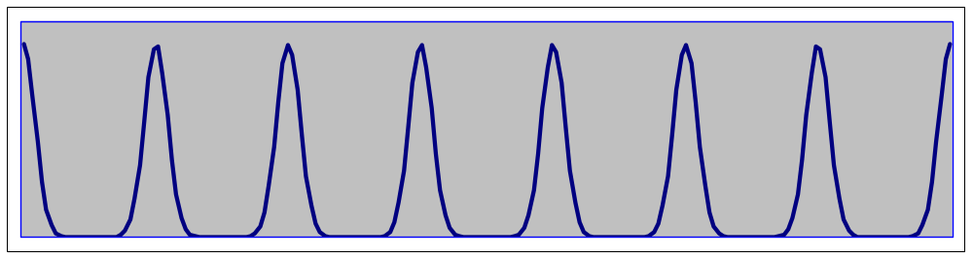
Reducing from n to 1-dimension
®
Distinguish between the 1-dimensional distributions:
Uniform:
0
R-1
Wavy:
0
R-1

Slide 61
Reducing from n to 1-dimension
®
First attempt: sample and project to a line

Slide 62

Reducing from n to 1-dimension
®
But then we lose the wavy structure!
We should project only from points very close to the line

Slide 63
The solution
®
Use the periodicity of the distribution
Project on a ‘dense line’ :

Slide 64
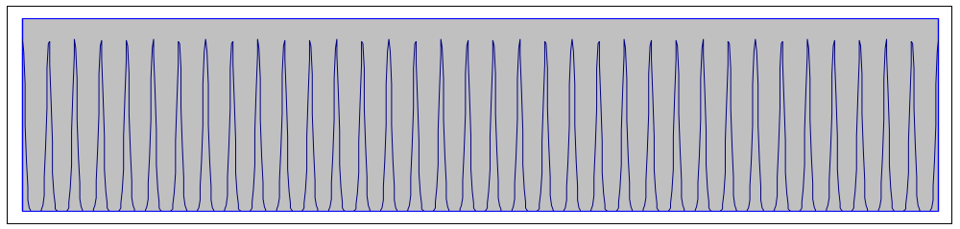
The solution
®

Slide 65
The solution
®
We choose the line that connects the origin to e₁+Ke₂+K²e₃…+K^{n-1}e_{n} where K is large enough
The distance between hyperplanes is n
The sides are of length 2^{n}
Therefore, we choose K=2^{O(n)}
Hence, d<O(K^{n})=2^(O(n²))

Slide 66
Worst-case vs. Average-case
®
So far: a problem that is hard in the worst-case: distinguish between uniform and d,γ-wavy distributions for all integers d<2^(n²)
For cryptographic applications, we would like to have a problem that is hard on the average: distinguish between uniform and d,γ-wavy distributions for a non-negligible fraction of d in [2^(n²), 2•2^(n²)]

Slide 67
Compressing
®
The following procedure transforms d,γ-wavy into 2d,γ-wavy for all integer d:
  Sample a from the distribution
  Return either a/2 or (a+R)/2 with probability ½
In general, for any real α≥1, we can compress d,γ-wavy into αd,γ-wavy
Notice that compressing preserves the uniform distribution
We show a reduction from worst-case to average-case

Slide 68
Reduction
®
Assume there exists a distinguisher between uniform and d,γ-wavy distribution for some non-negligible fraction of d in [2^(n²), 2•2^(n²)]
Given either a uniform or a d,γ-wavy distribution for some integer d<2^(n²) repeat the following:
  Choose α in {1,…,2×2^(n²)} according to a certain distribution
  Compress the distribution by α
  Check the distinguisher’s acceptance probability
If for some α the acceptance probability differs from that of uniform sequences, return ‘wavy’; otherwise, return ‘uniform’

Slide 69
Reduction
®
Distribution is uniform:
  After compression it is still uniform
  Hence, the distinguisher’s acceptance probability equals that of uniform sequences for all α
Distribution is d,γ-wavy:
  After compression it is in the good range with some probability
  Hence, for some α, the distinguisher’s acceptance probability differs from that of uniform sequences
1
2^(n²)
2×2^(n²)
…
…
d

Slide 70
Diophantine Approximation

Slide 71
Solving for u
(from slide 24)
Recall: We have B=(b₁,…b_{n}) and u’
  Shortest vector u∈L(B) is u = Σμ_{i}b_{i}, |μ_{i}| < 2^{n}
    Because the basis B is LLL reduced
  u’ is very very close to u/|u|
    u/|u| = (u’+e), |e|=1/N, N  2^{n} (e.g., N=2^{n} )
Express u’ = Σ ξ_{i}b_{i} (ξ_{i}‘s are reals)
Set ν_{i} = ξ_{i}/ξ_{n} for i=1,…,n-1
  ν_{i} very very close to μ_{i}/μ_{n} ( ν_{i}·μ_{n} = μ_{i}+O(2^{n}/N) )
2

Slide 72
Diophantine Approximation
Look for μ_{n}<2^{n} s.t. for all i, ν_{i}·μ_{n} is 2^{n}/N away from an integer (for N = 2^{n} )
z is the unique
shortest in L(M)
by a factor~N/2^{n}
Use LLL to find it
Compute the μ_{i}’s and u
2
1 –ν₁
1 –ν₂
…
1 –ν_{n-1}
1/N
μ₁
μ₂
…
μ_{n}
O(2^{n}/N)
O(2^{n}/N)
...
O(2^{n}/N)
O(2^{n}/N)
=
basis M
integer vector
short lattice point
z

Slide 73
Why is z unique-shortest?
Assume we have another short vector y∈L(M)
  μ_{n} not much larger than 2^{n}, also the other μ_{i}’s
Every small y∈L(M) corresponds to v∈L(B) such that v/|v| very very close to u’
  So also v/|v| very very close to u/|u| (~2^{n}/N)
  Smallish coefficient → v not too long (~2^{2n})
  → v very close to its projection on u (~2^{3n}/N)
  → ∃ χ s.t. (v–χu)∈L(B) is short
    Of length  2^{3n}/N + λ₁/2 < λ₁
  → v must be a multiple of u
θ~2^{n}/N
|v|~2^{2n}
u
v
~2^{3n}/N

