Slide 1
Compressible FHE with Applications to PIR
Craig Gentry, Shai Halevi
Algorand Foundation Research
*Work done while at IBM Research

Slide 2
Information Rate of Homomorphic Encryption
Contemporary (F)HE is a bandwidth hog
Ciphertext is larger than plaintext by at least a large constant factor (sometimes more)
This is NOT the case for standard encryption
Can do |ctxt|~|ptxt|
Can we hope to get similar efficiency with (F)HE?

Slide 3
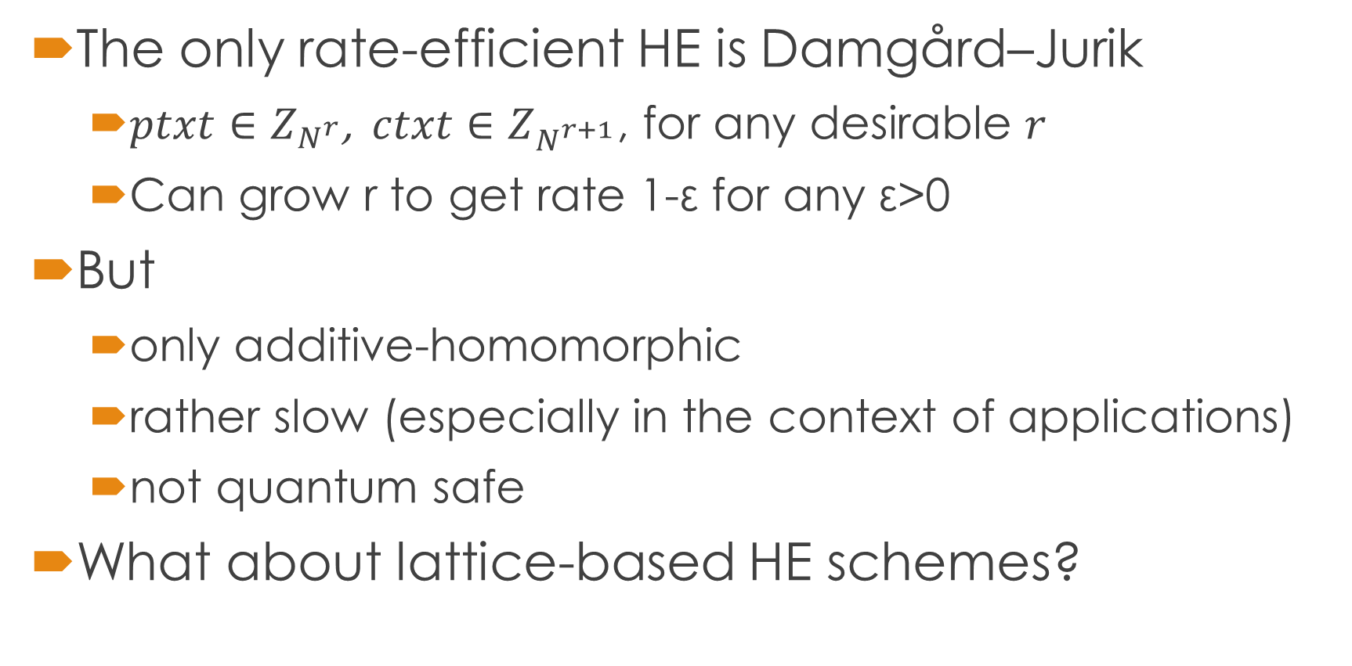
Information Rate of Homomorphic Encryption
The only rate-efficient HE is Damgård–Jurik
$ptxt∈Z_{N^{r}}$, $ctxt∈Z_{N^{r+1}}$, for any desirable $r$
Can grow r to get rate 1-ε for any ε>0
But
only additive-homomorphic
rather slow (especially in the context of applications)
not quantum safe
What about lattice-based HE schemes?

Slide 4
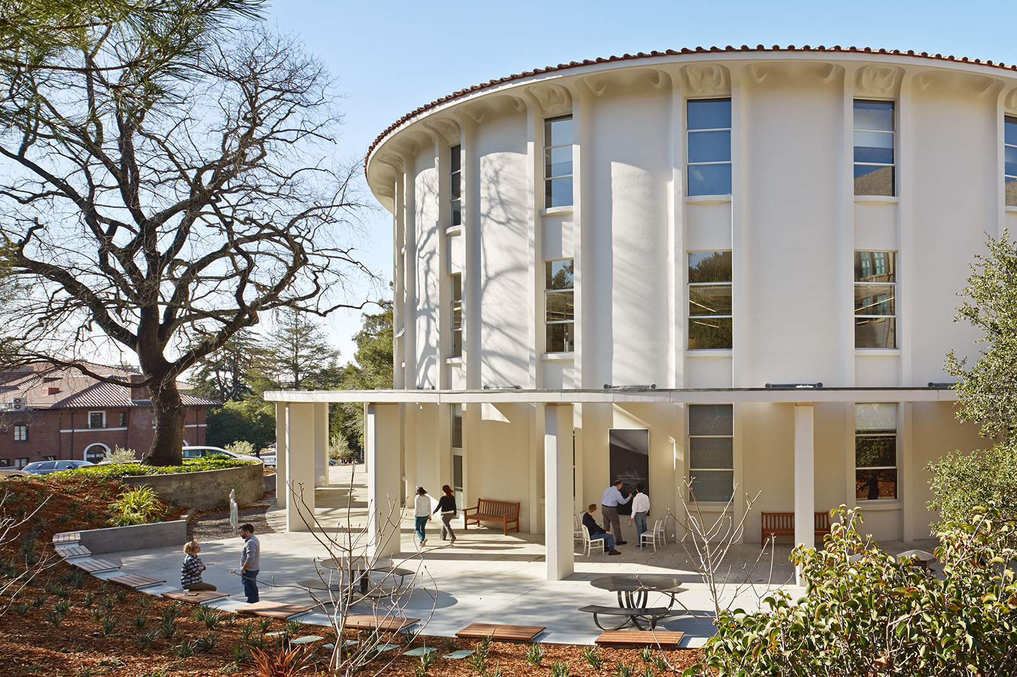
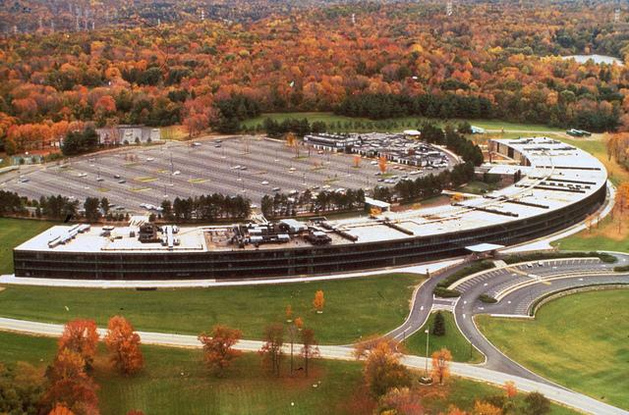

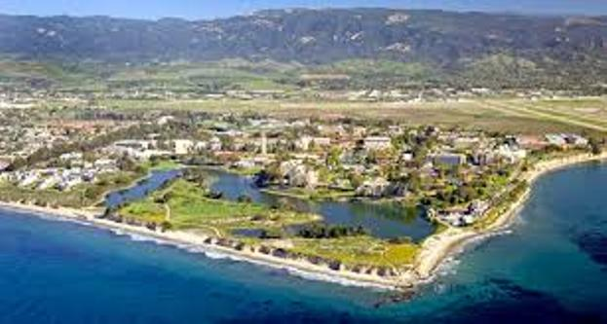

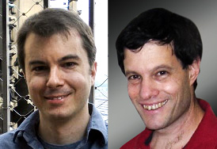
History of This Work
Eh… ½, maybe more?
What’s the rate of lattice-based HE schemes?
Yorktown Heights, 2017
Toronto, 2018
Berkley, 2015
UCSB, 2016

Slide 5
History of This Work
That’s embarrassing, we really should work on this
Okay
Back in Yorktown Heights, 2018

Slide 6
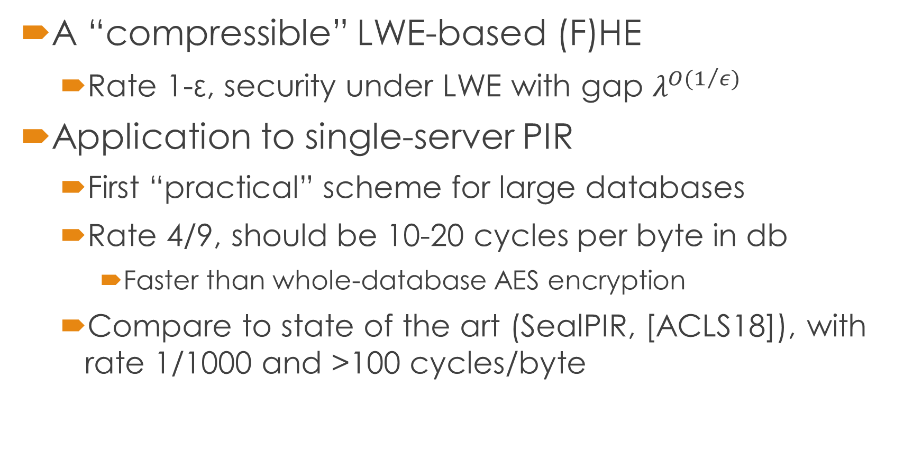
This Work
A “compressible” LWE-based (F)HE
Rate 1-ε, security under LWE with gap $λ^{O(1/ε)}$
Application to single-server PIR
First “practical” scheme for large databases
Rate 4/9, should be 10-20 cycles per byte in db
Faster than whole-database AES encryption
Compare to state of the art (SealPIR, [ACLS18]), with rate 1/1000 and >100 cycles/byte
Notes:
Sebastian Angel, Hao Chen, Kim Laine, Srinath T. V. Setty, PIR with Compressed Queries and Amortized Query Processing, IEEE Symposium on Security and Privacy (SP) 2017

Slide 7

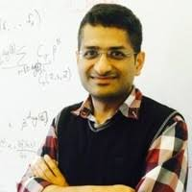
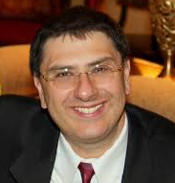



Meanwhile, elsewhere…
I’d better ask someone else

Slide 8
Independent Work
Döttling, Garg, Ishai, Malavolta, Mour, Ostrovsky. Trapdoor hash functions and their applications. CYRPTO 2019.
Limited homomorphism, choice of assumptions
Brakerski, Döttling, Garg, Malavolta. Leveraging linear decryption: Rate-1 fully-homomorphic encryption and time-lock puzzles. 2019.
FHE, based on LWE
More general than ours, less practically efficient
Notes:
Nico Döttling, Sanjam Garg, Yuval Ishai, Giulio Malavolta, Tamer Mour, Rafail Ostrovsky
Zvika Brakerski, Nico Döttling, Sanjam Garg, Giulio Malavolta

Slide 9
What is Compressible (F)HE?
An (F)HE Scheme (KeyGen, Enc, Dec, Eval)
Encrypted output ← Eval(circuit, encrypted Input)
But Dec is broken into:
Compression: c* ← Compress(c1,c2,…)
Compressed decryption: m1,m2,…← cDec(c*)
Rate α: For any circuit Π with long enough output
|Compress(Eval(Π, Enc(input)))|<| Π output|/α

Slide 10
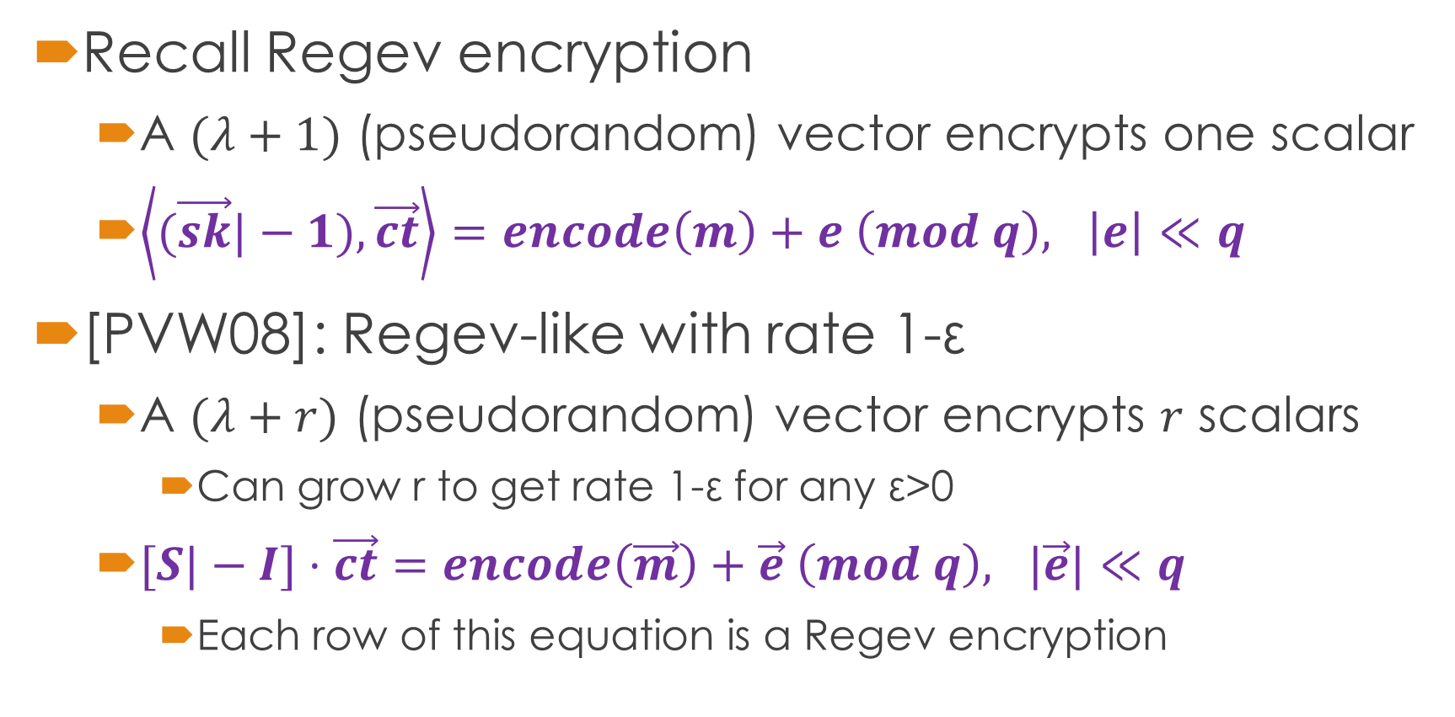
Background: [PVW08] Packing
Recall Regev encryption
A $(λ+1)$ (pseudorandom) vector encrypts one scalar
$\left\langle (\vec{sk}|−1),\vec{ct}\right\rangle =encode\left(m\right)+e \left(mod q\right), \left|e\right|≪q$
[PVW08]: Regev-like with rate 1-ε
A $(λ+r)$ (pseudorandom) vector encrypts $r$ scalars
Can grow r to get rate 1-ε for any ε>0
$[S|−I]⋅\vec{ct}=encode\left(\vec{m}\right)+\vec{e} \left(mod q\right), |\vec{e}|≪q$
Each row of this equation is a Regev encryption

Slide 11
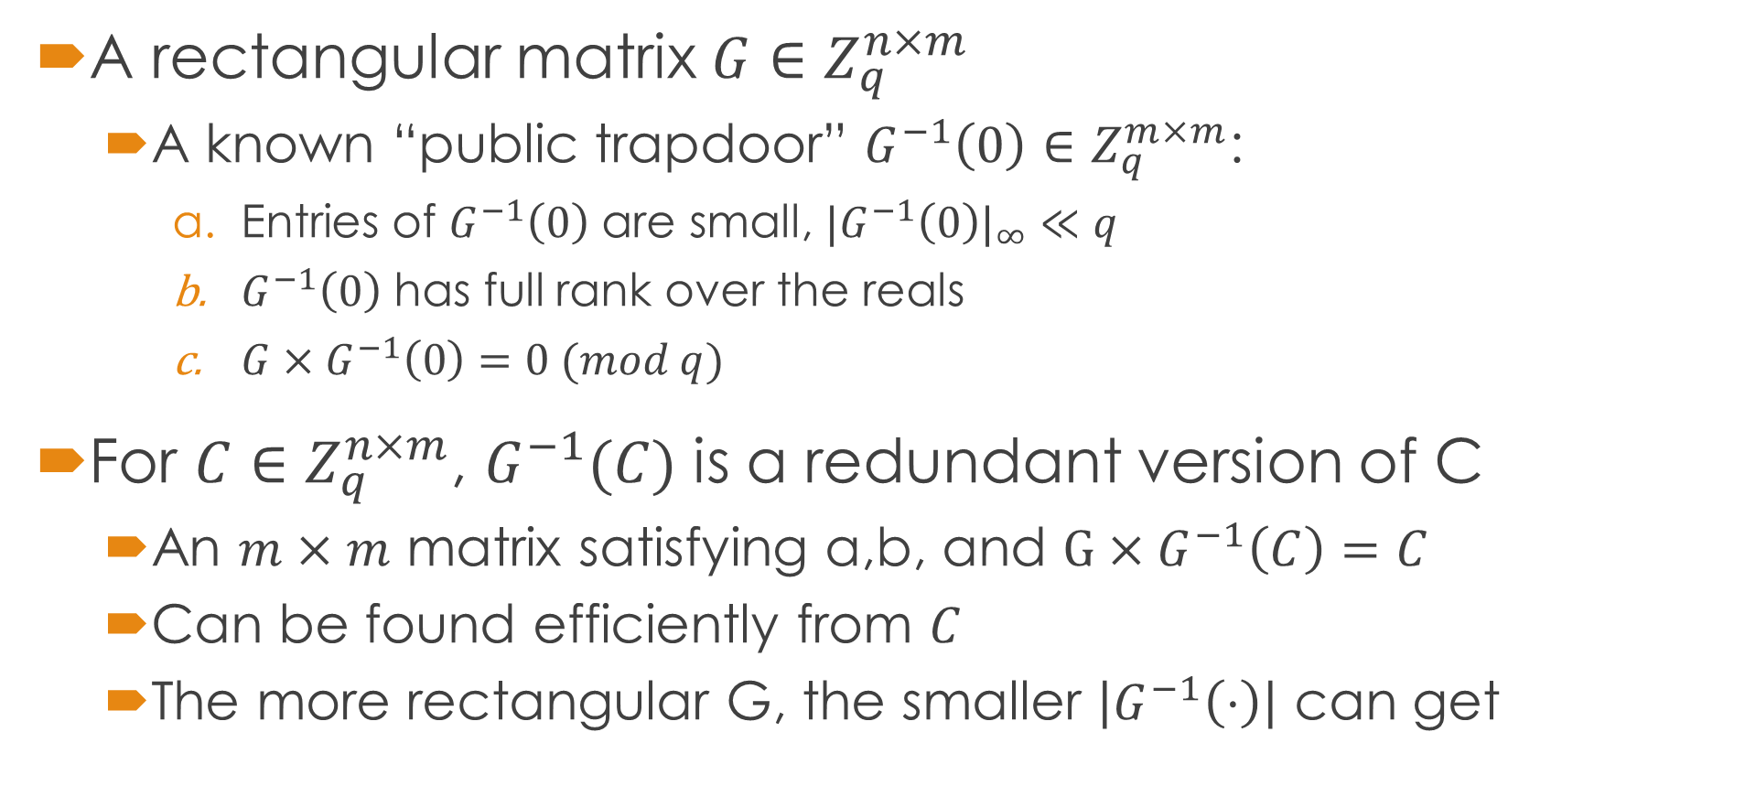
Background: “Gadget Matrices” [MP12]
m
A rectangular matrix $G∈Z_{q}^{n×m}$
A known “public trapdoor” $G^{−1}\left(0\right)∈Z_{q}^{m×m}$:
Entries of $G^{−1}\left(0\right)$ are small, $|G^{−1}\left(0\right)|_{∞}≪q$
$G^{−1}\left(0\right)$ has full rank over the reals
$G×G^{−1}\left(0\right)=0 (mod q)$
For $C∈Z_{q}^{n×m}$, $G^{−1}(C)$ is a redundant version of C
An $m×m$ matrix satisfying a,b, and $G×G^{−1}\left(C\right)=C$
Can be found efficiently from $C$
The more rectangular G, the smaller $\left|G^{−1}\left(⋅\right)\right|$ can get
G
n

Slide 12

Background: “Gadget Matrices” [MP12]
Example, bit-decomposition: $ℓ=\left\lfloor \log{q}\right\rfloor , m=n⋅ℓ$
$G=\left[\begin{matrix}1 2…2^{ℓ−1} & & & \\ & 1 2…2^{ℓ−1} & & \\ & & ⋱ & \\ & & & 1 2…2^{ℓ−1}\end{matrix}\right]$
$G^{−1}\left(0\right)=\left[\begin{matrix}2 & & & & \\ −1 & 2 & & & \\ & −1 & & & \\ & & ⋱ & 2 & \\ & & & −1 & \end{matrix}\right]$
bits-of-q…bits-of-q

Slide 13
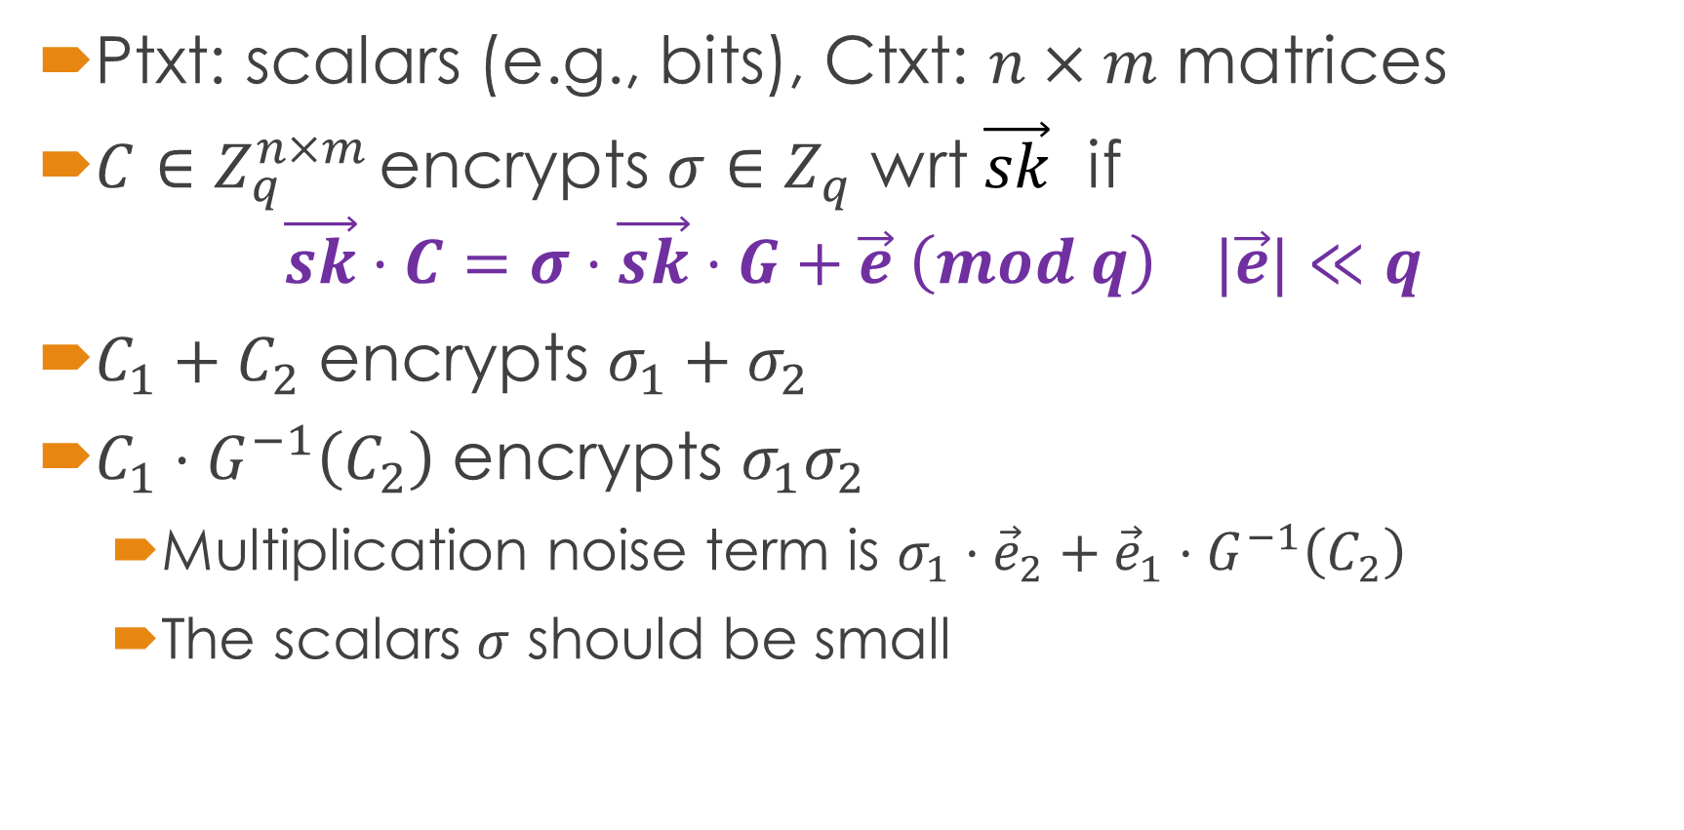
Background: [GSW13] HE Scheme
Ptxt: scalars (e.g., bits), Ctxt: $n×m$ matrices
$C∈Z_{q}^{n×m }$encrypts $σ∈Z_{q}$ wrt $\vec{sk}$ if $\vec{sk}⋅C=σ⋅\vec{sk}⋅G+\vec{e} \left(mod q\right) |\vec{e}|≪q$
$C_{1}+C_{2}$ encrypts $σ_{1}+σ_{2}$
$C_{1}⋅G^{−1}\left(C_{2}\right)$ encrypts $σ_{1}σ_{2}$
Multiplication noise term is $σ_{1}⋅{\vec{e}}_{2}+{\vec{e}}_{1}⋅G^{−1}\left(C_{2}\right)$
The scalars $σ$ should be small

Slide 14
Our Construction

Slide 15
The Two Parts of Our Compressible HE
Low-rate scheme for homomorphism
A slight variant of GSW
High-rate scheme for compression
Somewhat similar to the matrix HE scheme of [HAO16]
Ptxt, ctxt are matrices of similar dimensions
We describe two variants of that scheme
The two parts “play nice” together
They share the same secret key
Can pack many GSW ctxts in one high-rate ctxt
Notes:
Ryo Hiromasa, Masayuki Abe, Tatsuaki Okamoto. Packing messages and optimizing bootstrapping in GSW-FHE. IEICE TRANSACTIONS on Fundamentals of Electronics, Communications and Computer Sciences

Slide 16
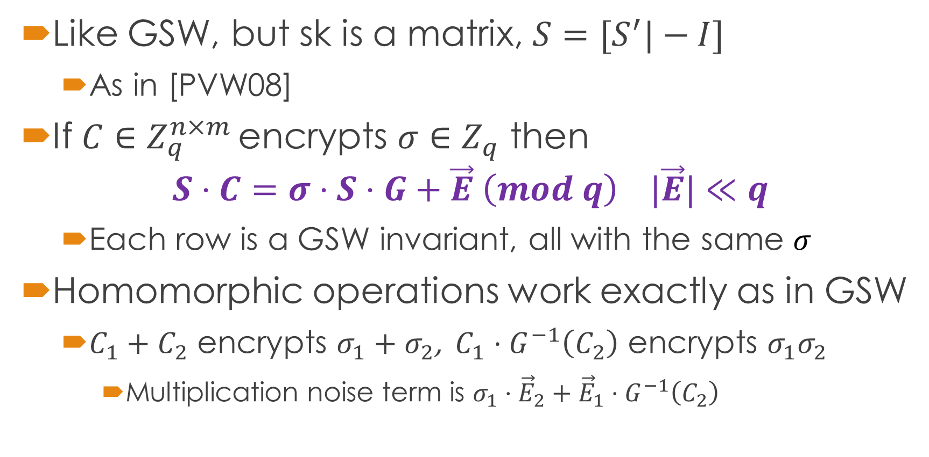
The Low-Rate Scheme
Like GSW, but sk is a matrix, $S=[S^{′}|−I]$
As in [PVW08]
If $C∈Z_{q}^{n×m }$encrypts $σ∈Z_{q}$ then $S⋅C=σ⋅S⋅G+\vec{E} \left(mod q\right) |\vec{E}|≪q$
Each row is a GSW invariant, all with the same $σ$
Homomorphic operations work exactly as in GSW
$C_{1}+C_{2}$ encrypts $σ_{1}+σ_{2}$, $C_{1}⋅G^{−1}\left(C_{2}\right)$ encrypts $σ_{1}σ_{2}$
Multiplication noise term is $σ_{1}⋅{\vec{E}}_{2}+{\vec{E}}_{1}⋅G^{−1}\left(C_{2}\right)$

Slide 17
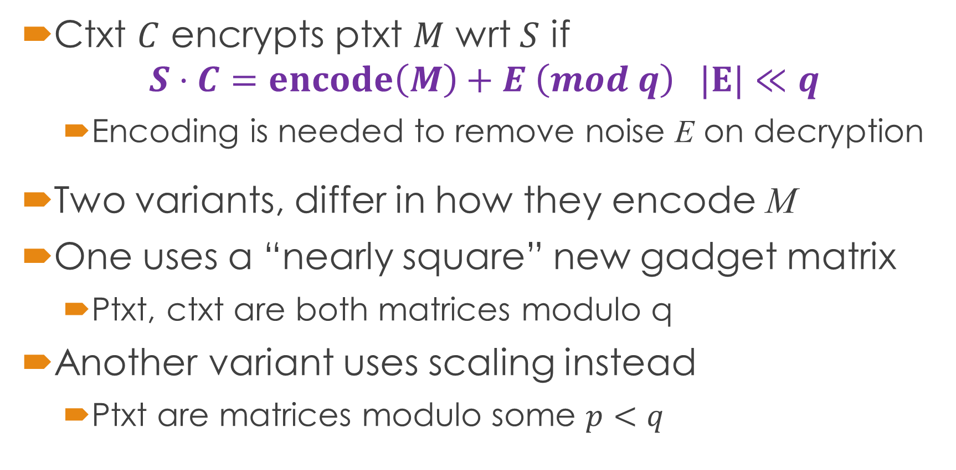
The High-Rate Scheme
Ctxt $C$ encrypts ptxt $M$ wrt $S$ if $S⋅C=encode\left(M\right)+E \left(mod q\right) |E|≪q$
Encoding is needed to remove noise E on decryption
Two variants, differ in how they encode M
One uses a “nearly square” new gadget matrix
Ptxt, ctxt are both matrices modulo q
Another variant uses scaling instead
Ptxt are matrices modulo some $p<q$

Slide 18
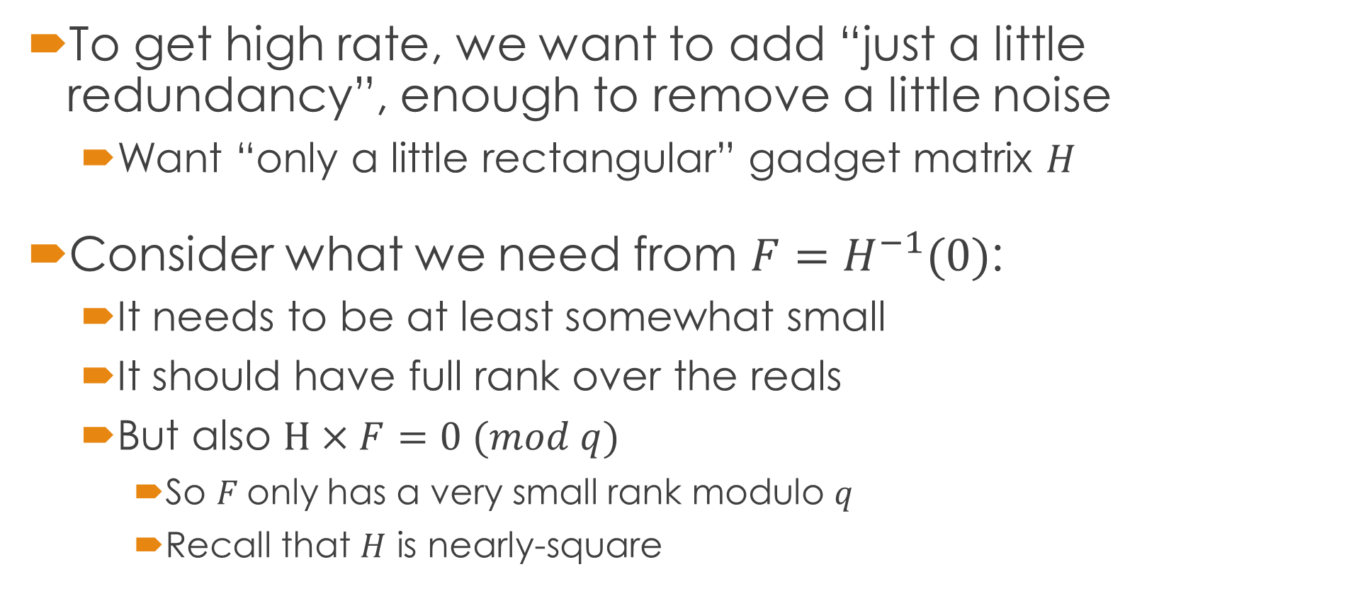
A Nearly-Square Gadget Matrix
To get high rate, we want to add “just a little redundancy”, enough to remove a little noise
Want “only a little rectangular” gadget matrix $H$
Consider what we need from $F=H^{−1}(0)$:
It needs to be at least somewhat small
It should have full rank over the reals
But also $H×F=0 (mod q)$
So $F$only has a very small rank modulo $q$
Recall that $H$ is nearly-square
Notes:
Constructions based on $\left(1,B,B^{2},… \right)$ won’t do, can’t get better than 2-to-1 matrix ➔ rate < 1/2

Slide 19
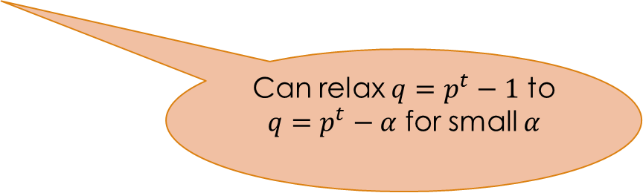
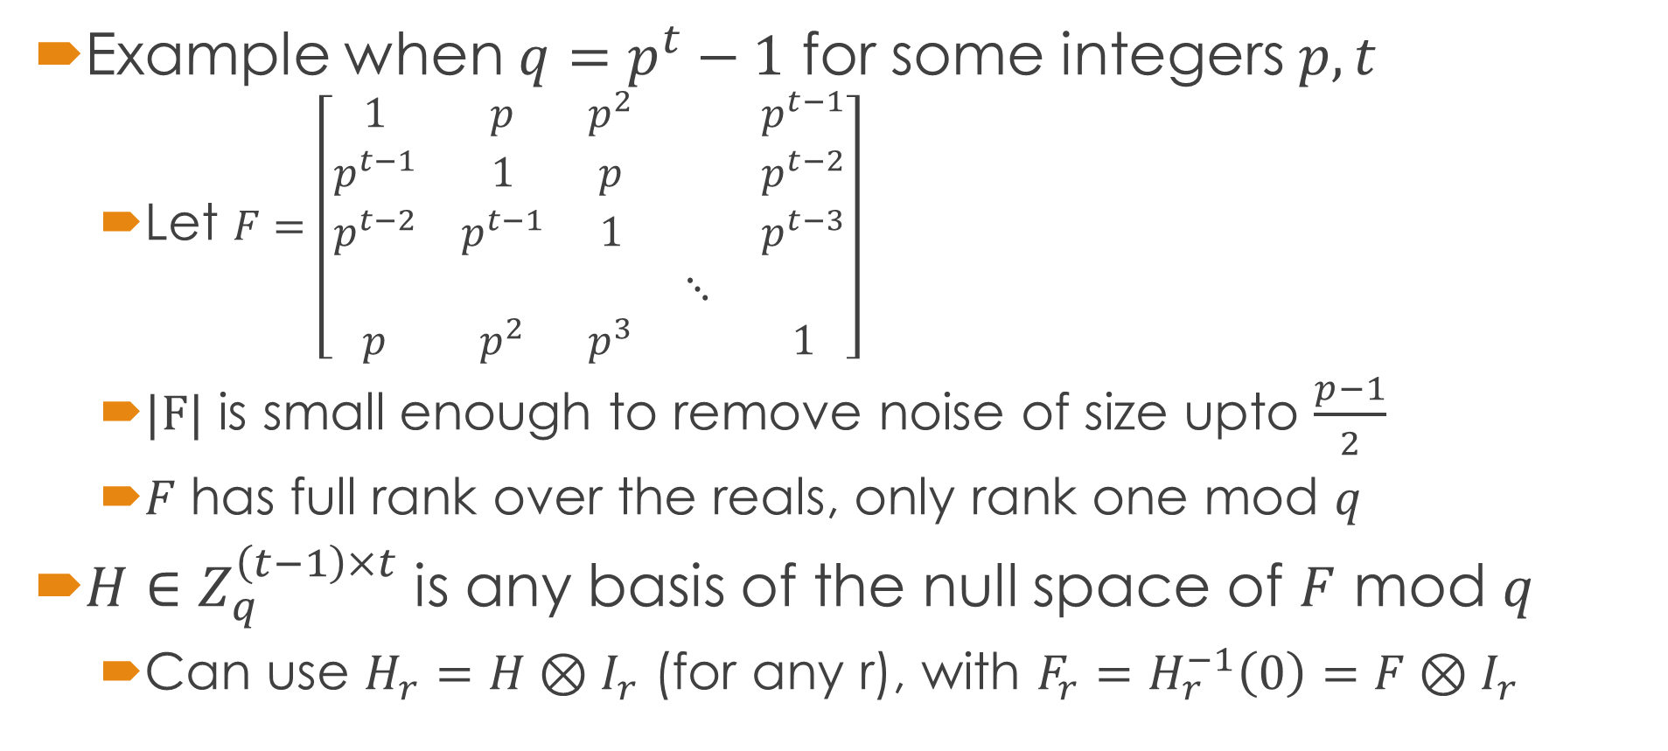
A Nearly-Square Gadget Matrix
Example when $q=p^{t}−1$ for some integers $p,t$
Let $F=\left[\begin{matrix}1 & p & p^{2} & & p^{t−1} \\ p^{t−1} & 1 & p & & p^{t−2} \\ p^{t−2} & p^{t−1} & 1 & & p^{t−3} \\ & & & ⋱ & \\ p & p^{2} & p^{3} & & 1\end{matrix}\right]$
$|F|$ is small enough to remove noise of size upto $\frac{p−1}{2}$
𝐹 has full rank over the reals, only rank one mod 𝑞
$H∈Z_{q}^{\left(t−1\right)×t}$ is any basis of the null space of $F$ mod $q$
Can use $H_{r}=H⊗I_{r}$ (for any r), with $F_{r}=H_{r}^{−1}\left(0\right)=F⊗I_{r}$
Can relax $q=p^{t}−1$ to $q=p^{t}−α$ for small $α$

Slide 20



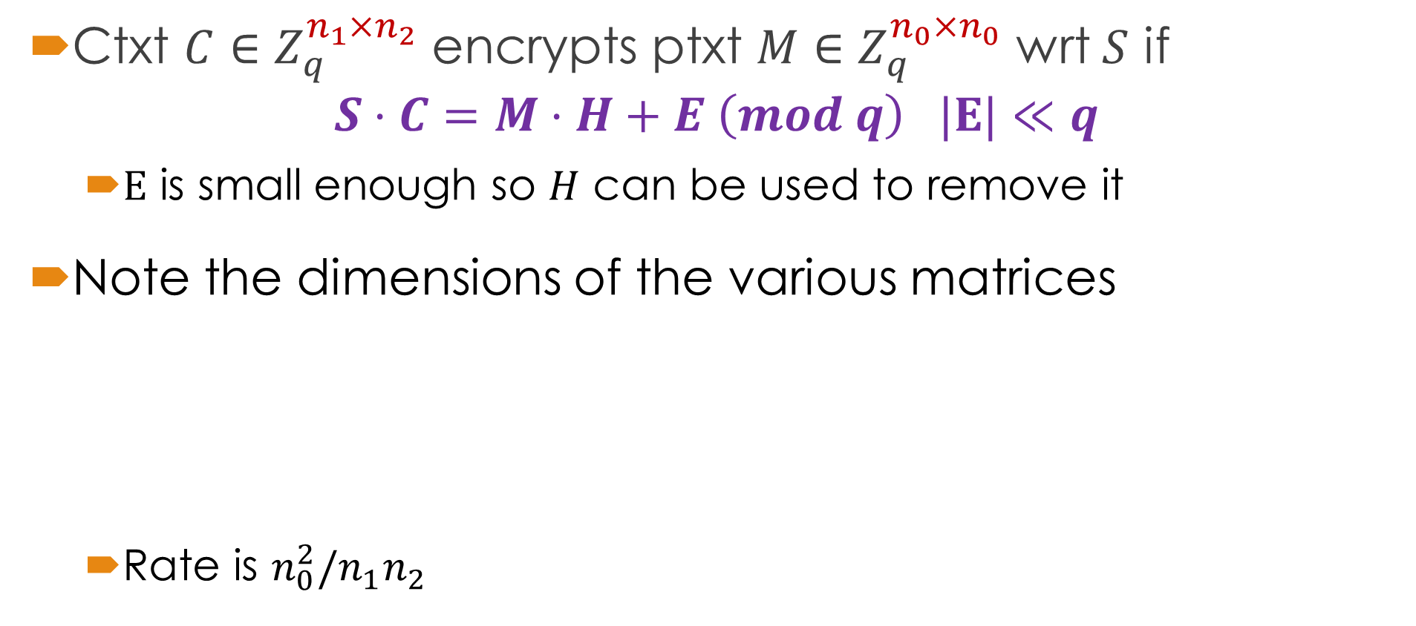



















The High-Rate Scheme (1st Variant)
Ctxt $C∈Z_{q}^{n_{1}×n_{2}}$ encrypts ptxt $M∈Z_{q}^{n_{0}×n_{0}}$ wrt $S$ if $S⋅C=M⋅H+E \left(mod q\right) |E|≪q$
$E$ is small enough so $H$ can be used to remove it
Note the dimensions of the various matrices
Rate is $n_{0}^{2}/n_{1}n_{2}$
$$λ$$
$$n_{0}$$
$$n_{2}$$
$$n_{0}$$
$$n_{2}$$
$$n_{2}$$
$$S^{′}$$
$$−I$$
$$C$$
$$M$$
$$H$$
$$E$$
$$⋅$$
$$+$$
$$⋅$$
$$=$$
$$n_{0}$$
$$n_{0}$$
$$n_{0}$$
$$n_{0}$$
$$n_{1}$$
$$n_{1}=n_{0}+λ$$

Slide 21
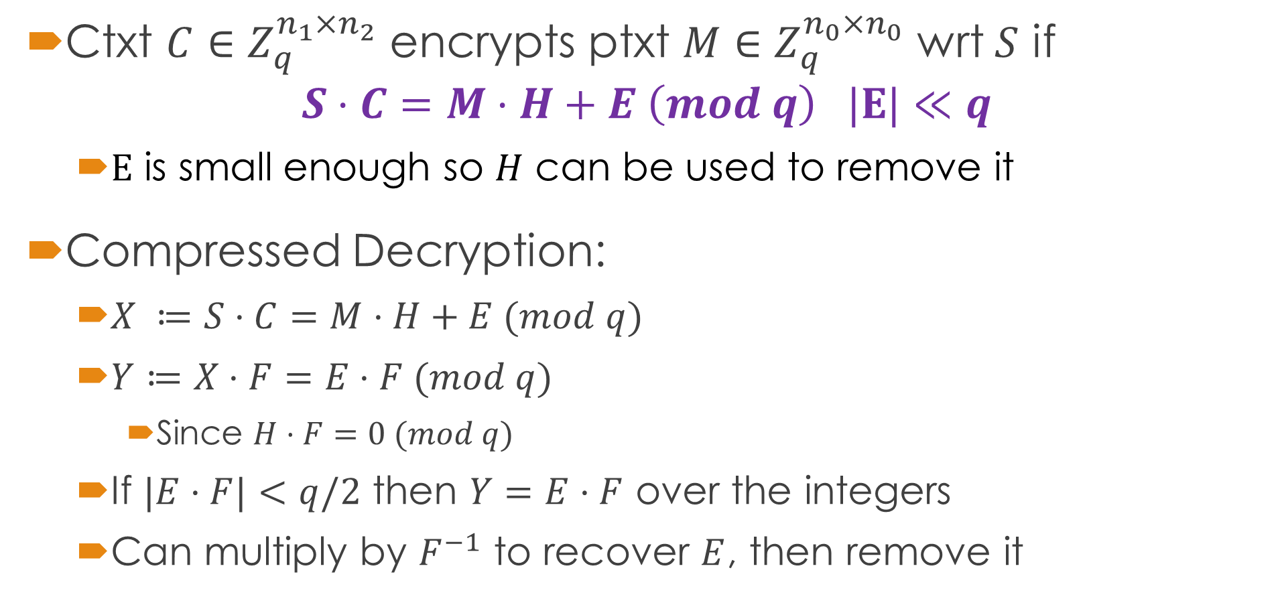
The High-Rate Scheme (1st Variant)
Ctxt $C∈Z_{q}^{n_{1}×n_{2}}$ encrypts ptxt $M∈Z_{q}^{n_{0}×n_{0}}$ wrt $S$ if $S⋅C=M⋅H+E \left(mod q\right) |E|≪q$
$E$ is small enough so $H$ can be used to remove it
Compressed Decryption:
$X ≔S⋅C=M⋅H+E (mod q)$
$Y≔X⋅F=E⋅F (mod q)$
Since $H⋅F=0 (mod q)$
If $|E⋅F|<q/2$ then $Y=E⋅F$ over the integers
Can multiply by $F^{−1}$ to recover $E$, then remove it

Slide 22

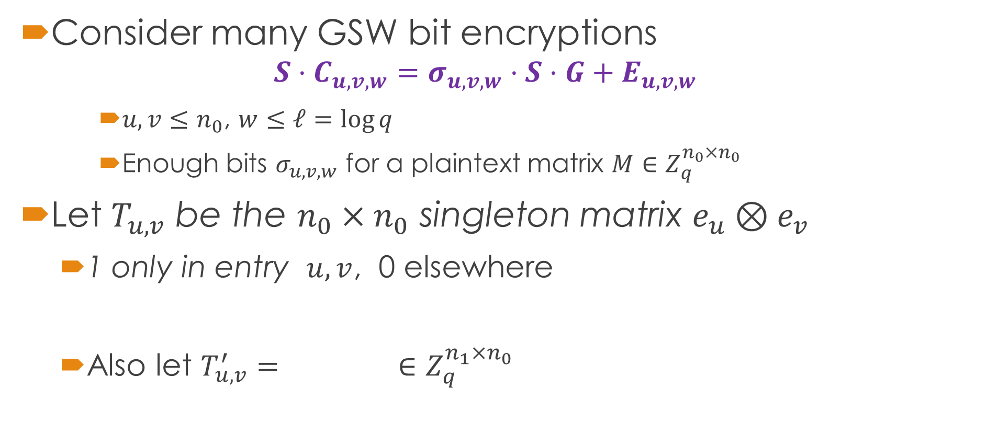





Compression
Consider many GSW bit encryptions
$$S⋅C_{u,v,w}=σ_{u,v,w}⋅S⋅G+E_{u,v,w}$$
$u,v≤n_{0}$, $w≤ℓ=log{q}$
Enough bits $σ_{u,v,w}$ for a plaintext matrix $M∈Z_{q}^{n_{0}×n_{0}}$
Let $T_{u,v}$ be the $n_{0}×n_{0}$ singleton matrix $e_{u}⊗e_{v}$
1 only in entry $u,v$, 0 elsewhere
Also let $T_{u,v}^{′}=$ $∈Z_{q}^{n_{1}×n_{0}}$
$$n_{0}$$
$$0$$
$$λ$$
$$−T_{u,v}$$
Note $\left[S^{′} | −I\right]⋅T_{u,v}^{′}=T_{u,v}$
$$n_{0}$$

Slide 23

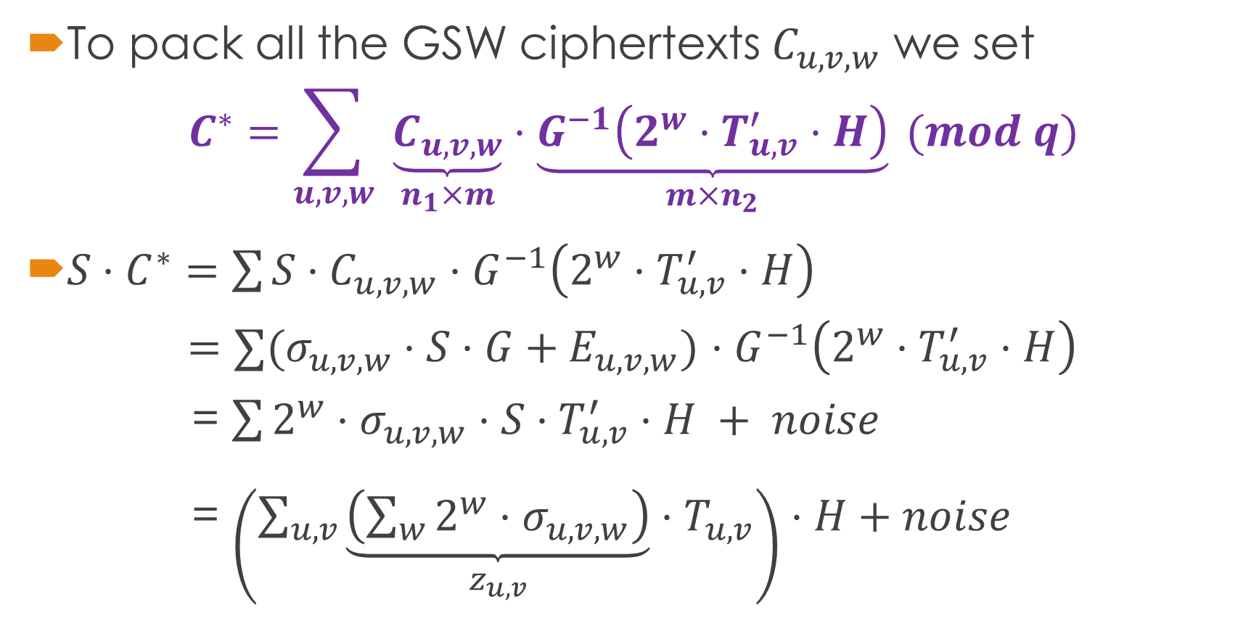
Compression
To pack all the GSW ciphertexts $C_{u,v,w}$ we set
$$C^{∗}=\sum_{u,v,w}{ \underset{n_{1}×m}{\underbrace{C_{u,v,w}}}⋅\underset{m×n_{2}}{\underbrace{G^{−1}\left(2^{w}⋅T_{u,v}^{′}⋅H\right)}}} (mod q)$$
$S⋅C^{∗}=\sum{S⋅C_{u,v,w}⋅G^{−1}\left(2^{w}⋅T_{u,v}^{′}⋅H\right)}$ $=∑(σ_{u,v,w}⋅S⋅G+E_{u,v,w})$ $⋅G^{−1}\left(2^{w}⋅T_{u,v}^{′}⋅H\right)$ = $\sum{2^{w}⋅σ_{u,v,w}⋅S⋅T_{u,v}^{′}⋅H} + noise$ = $\left(\sum_{u,v}{\underset{z_{u,v}}{\underbrace{\left(\sum_{w}{2^{w}⋅σ_{u,v,w}}\right)}}⋅T_{u,v}}\right)⋅H+noise$
$$M$$

Slide 24
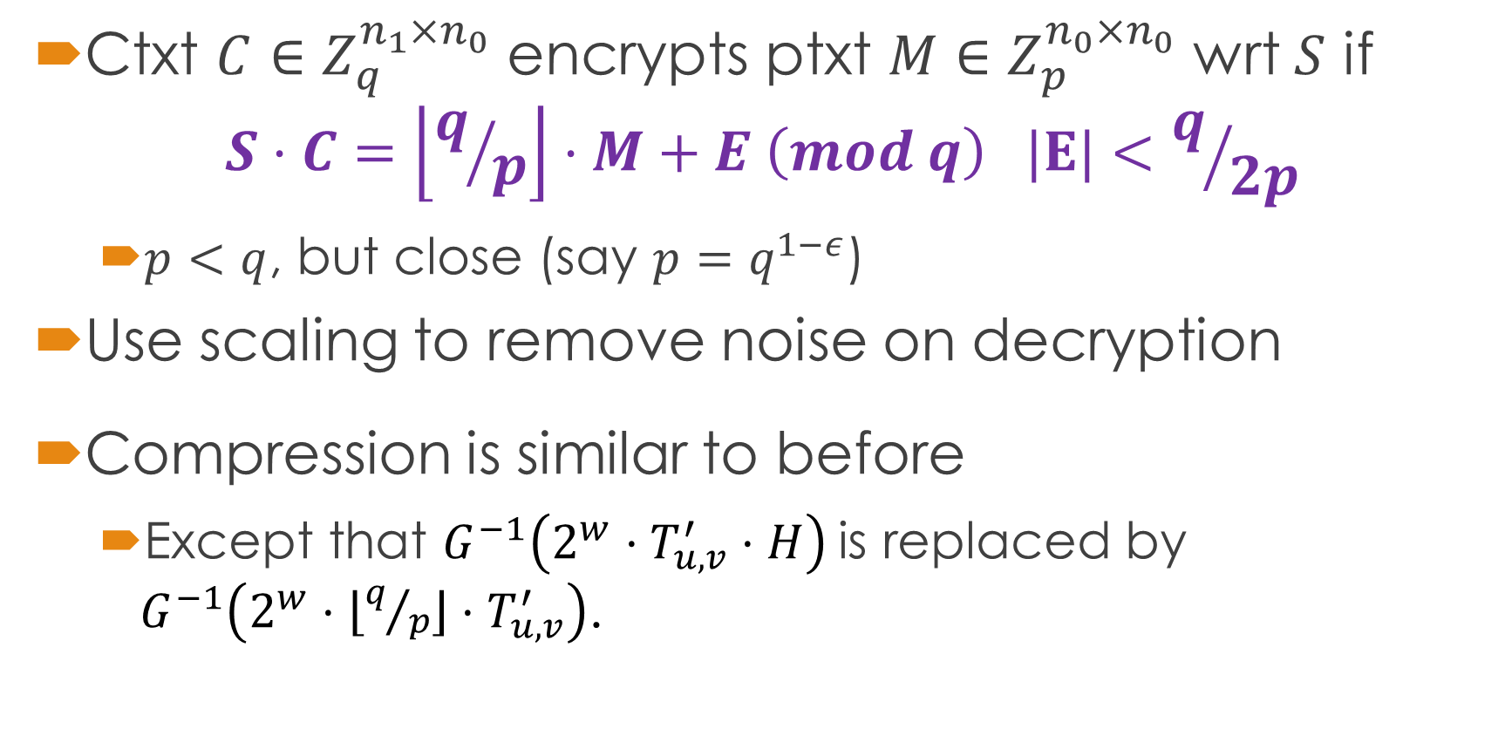
The High-Rate Scheme (2nd Variant)
Ctxt $C∈Z_{q}^{n_{1}×n_{0}}$ encrypts ptxt $M∈Z_{p}^{n_{0}×n_{0}}$ wrt $S$ if $S⋅C=\left\lfloor q/p\right\rfloor ⋅M+E \left(mod q\right) |E|<q/{2p}$
$p<q$, but close (say $p=q^{1−ε}$)
Use scaling to remove noise on decryption
Compression is similar to before
Except that $G^{−1}\left(2^{w}⋅T_{u,v}^{′}⋅H\right)$is replaced by $G^{−1}\left(2^{w}⋅{\left\lfloor q/p\right\rfloor ⋅T}_{u,v}^{′}\right)$.

Slide 25
Single Server PIR

Slide 26
Application to Single-Server PIR
Compressible HE easily yields high-rate PIR
But we also want practical efficiency

Slide 27


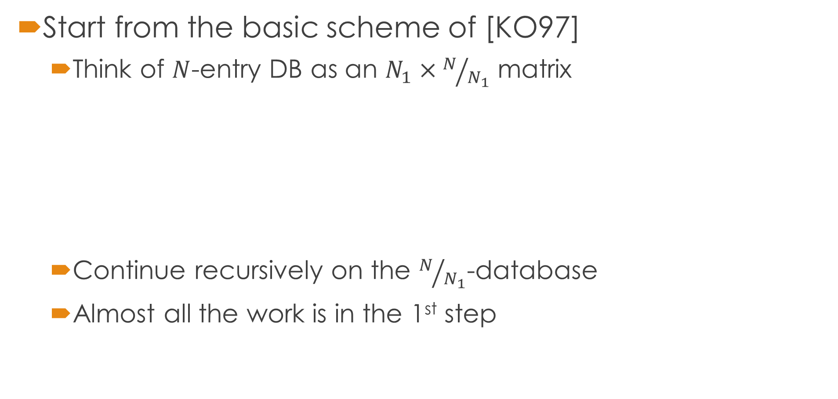



Our Approach to Single-Server PIR
Start from the basic scheme of [KO97]
Think of $N$-entry DB as an $N_{1}×N/{N_{1}}$ matrix
Continue recursively on the $N/{N_{1}}$-database
Almost all the work is in the 1st step
$$0×$$
$$0×$$
$$1×$$
$$0×$$
$$N_{1}$$
$$0×$$
$$+$$

Slide 28
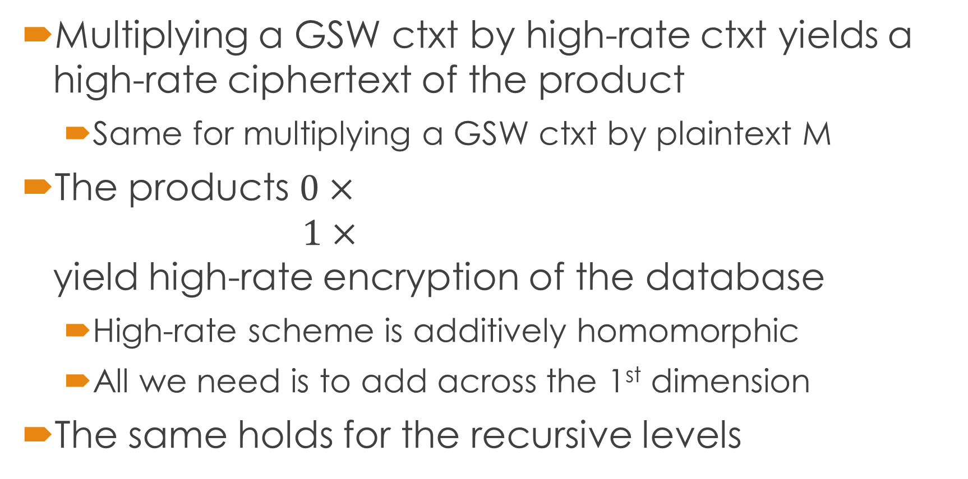
A Few More Pieces of Magic
Multiplying a GSW ctxt by high-rate ctxt yields a high-rate ciphertext of the product
Same for multiplying a GSW ctxt by plaintext M
The products $0×$ $1×$ yield high-rate encryption of the database
High-rate scheme is additively homomorphic
All we need is to add across the 1st dimension
The same holds for the recursive levels

Slide 29
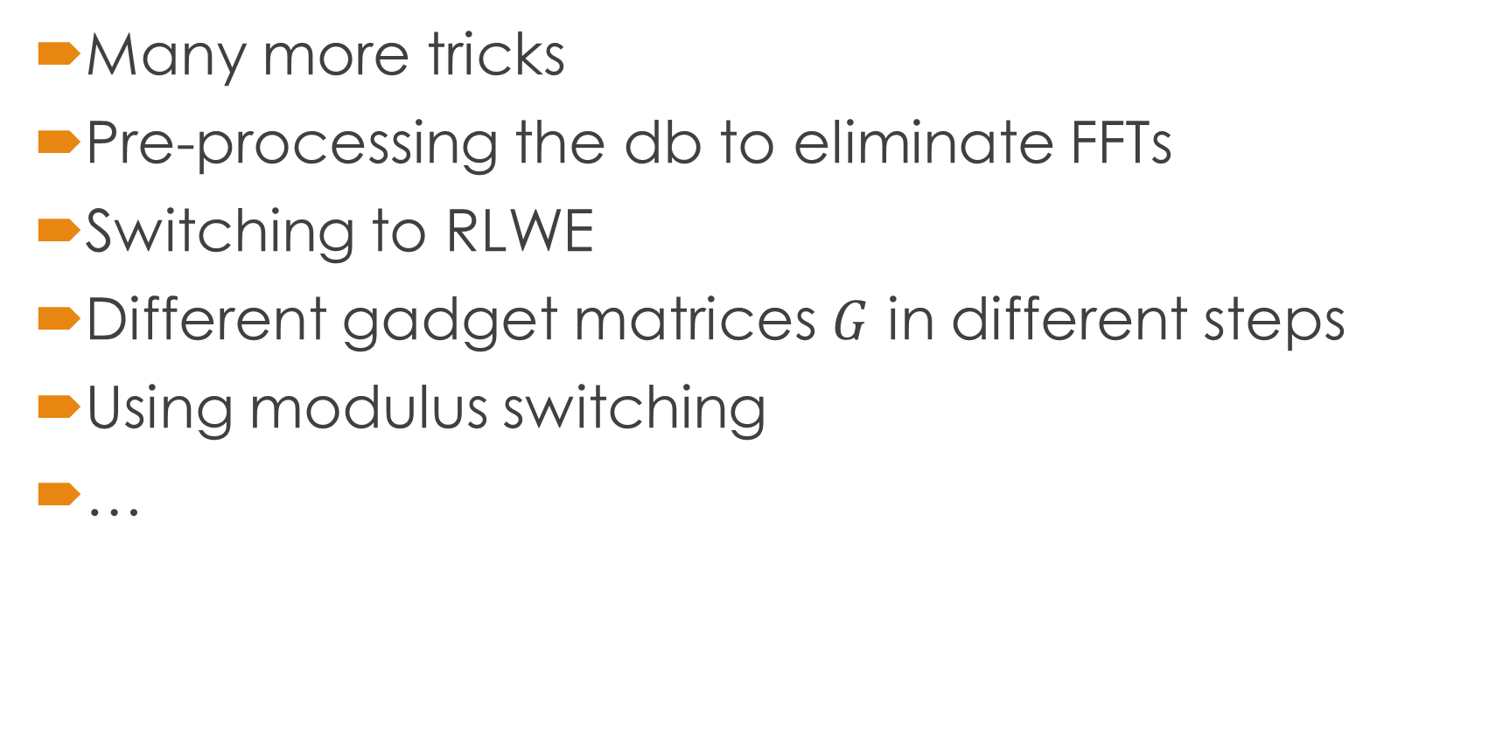
From Here to Practical Single-Server PIR
Many more tricks
Pre-processing the db to eliminate FFTs
Switching to RLWE
Different gadget matrices $G$ in different steps
Using modulus switching
…

Slide 30

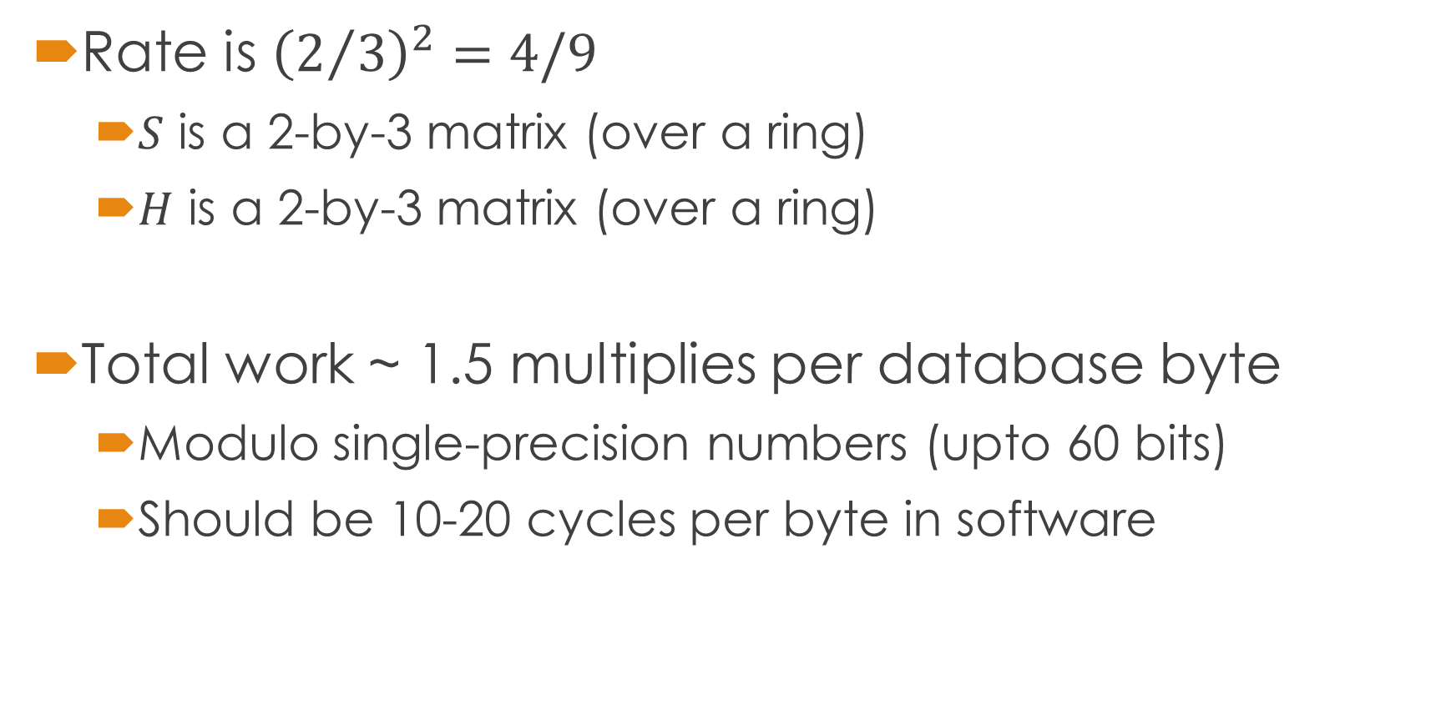
The End-Result PIR
3x3
2x2
Rate is ${\left(2/3\right)}^{2}=4/9$
$S$ is a 2-by-3 matrix (over a ring)
$H$ is a 2-by-3 matrix (over a ring)
Total work ~ 1.5 multiplies per database byte
Modulo single-precision numbers (upto 60 bits)
Should be 10-20 cycles per byte in software
$$S⋅C=M⋅H+E$$

Slide 31
The End-Result PIR
First single-server PIR plausibly efficient enough to handle large databases
Less work than whole database AES encryption
Which you would need (for communication security) if you used the naïve solution
So we beat the naïve solution not only on bandwidth but also on server computation

Slide 32


