Slide 1
INVESTMENT ASSIGNMENT SUBMISSION
Name: Azeruddin Sheik

Slide 2
Spark Funds wants to make investments in a few companies. The CEO of Spark Funds wants to understand the global trends in investments so that she can take the investment decisions effectively.
Business objective: The objective is to identify the best sectors, countries, and a suitable investment type for making investments. The overall strategy is to invest where others are investing, implying that the 'best' sectors and countries are the ones 'where most investors are investing’.

Slide 3
We will be analysing the data sequentially
Investment type analysis: Comparing the typical investment amounts in the venture, seed, angel, private equity etc. so that Spark Funds can choose the type that is best suited for their strategy.
Country analysis: Identifying the countries which have been the most heavily invested in the past. These will be Spark Funds’ favorites as well.
Sector analysis: Understanding the distribution of investments across the eight main sectors. (Note that we are interested in the eight 'main sectors' provided in the mapping file. The two files — companies and rounds2 — have numerous sub-sector names; hence, you will need to map each sub-sector to its main sector.)

Slide 4
Investment Type Analysis
Given that Spark funds wants to invest between 5 MM and 15 MM USD, we find that Venture funding would be best suited for Spark funds. This is because this funding has a representative (median) investment of 5 MM, which is within the range. By getting in at the Venture stage, Spark funds would get the early mover advantage where they can cash in during equity funding and other liquidation stages

Slide 5
Country Analysis
Spark funds wants to invest in English speaking countries only. With this condition, we find that USA, UK and India are the top countries in terms of dollar value invested. USA tops the list with over 100 Billion USD in investments, followed by UK with ~5 Billion and India with ~3 Billion USD respectively

Slide 6
Sector Analysis
We did a sector analysis for venture investments in the top countries (USA, UK and India). In terms of the number of investments and dollar value, we find that “Others”, “Social, Finance, Analytics, Advertising”, “Cleantech / Semiconductors” and “News, Search and Messaging” are at the top. “Others” is too broad of a sector to recommend, so we suggest that Spark funds focus on the “Social, Finance, Analytics, Advertising” sector.
We also did a dive deep on the “Others” sector and found that Software and E-Commerce subcategories receive the maximum investments (>58 Billion USD), so Spark funds may also consider these categories

Slide 7
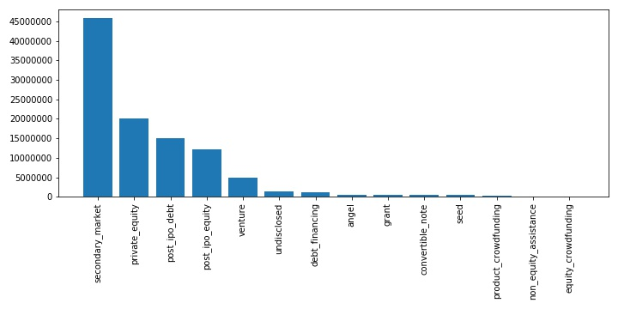
Investment type analysis

Slide 8
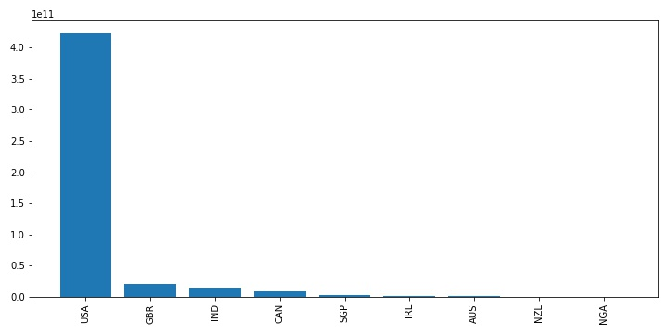
Country analysis

Slide 9
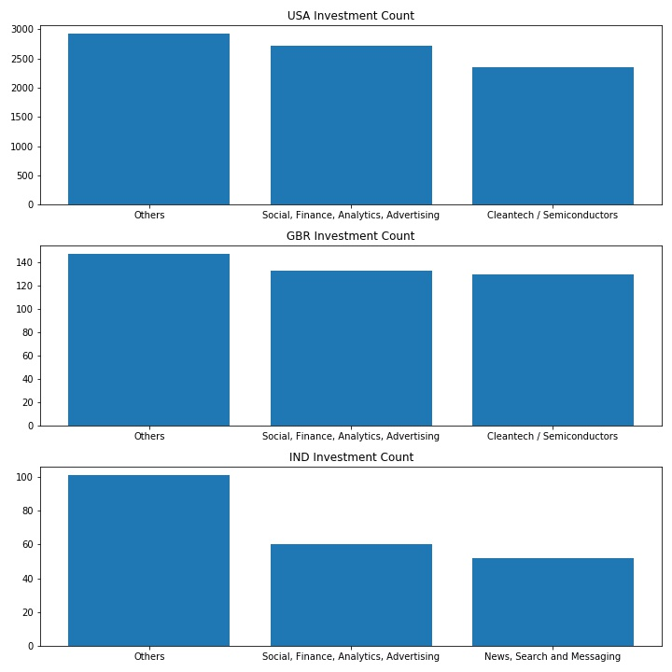
Sector Analysis

Slide 10
Analysis conclusion
Based on our analysis, we recommend Spark funds to invest in the following ways:
Choose venture funding as the funding type, as it falls within the investment range. It also provides early mover advantage where Spark funds can cash in during the equity and other liquidation stages
Invest in USA, UK and India as these are the top investment destinations both in number and dollar value of investments
Invest in the sector “Social, Finance, Analytics, Advertising” which has high number of investments. However, the highest number of investments go to the “Others” sector. Within this sector, we recommend Spark funds to focus on Software and E-commerce categories, which receive >58 Billion USD of venture investments

