Slide 1
HACKOUT 2024
Team Name : Star Coders
Problem Statement : Crop Recommendation and Market Insight Platform for Farmers

Slide 2
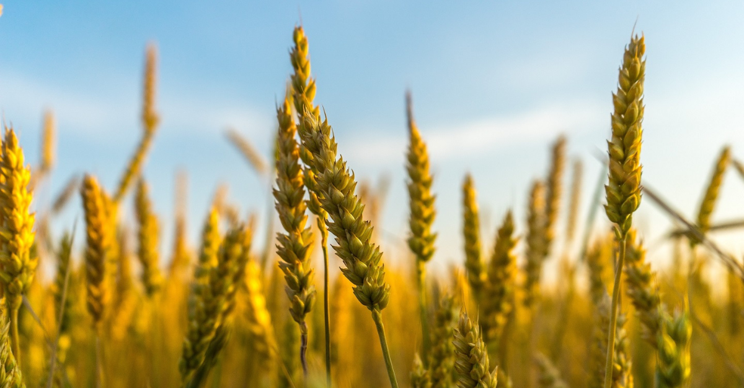
Idea / Approach Details :
Agriculture is a critical sector for many regions, and optimizing crop selection based on local conditions can significantly enhance productivity and profitability.
Farmers often face challenges in choosing the right crops due to varying environmental factors and market conditions.
There is a need for a digital solution that helps farmers make informed decisions about which crops to plant and provides real-time market data to support their choices.

Slide 3

Solution :
Using Data Analysis , Network Analysis , UI/UX , the goal is to provide a tool for farmers to get the best recommendation of crops to be grown according to the surrounding Environment , soil health [ Fertility , pH level ] , Climate , location.
The Current and past Market demands of the Recommended Crop would be shown as well.[To check if its Profitable or not].

Slide 4

Use cases :
User Interface(UI): Using UI we will get information like soil type, soil fertility , geographical conditions to recommend the perfect crop.
Data Analysis : The recommendations would be given according to the data entered by the user which would be compared and stated with data collected of past few years.

Slide 5





Technologies Used :
The market analysis and recommendations would be shown with the help of HTML,CSS,JS.
For data analysis and storage python and SQL.

Slide 6
Frontend :
Used JavaScript , CSS and HTML to create a localhost website to take data from the user.
Created 4 windows :
Home page : giving detailed info about the website and highlighting the main features of our project.
Crop recommendations : Here , Data is taken from the user and the best crop recommendations are presented after analyzing entered data.
Market Insights : Giving Current Market insights and trends about the crop entered by the user in a particular state.
About us : Giving information about the developers and website

Slide 7
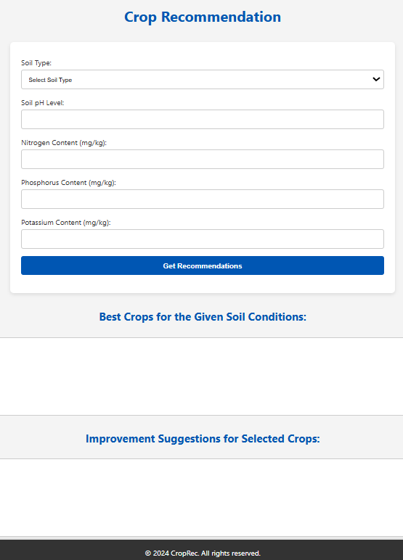
Backend
Used python to compare , store and analyze the entered data with the past datasets.
The best crops and improvement for the selected crops would be shown to the user.

Slide 8
Libraries used :
Flask : Flask is a micro web framework written in Python. It is classified as a microframework because it does not require particular tools or libraries.
Pandas : Pandas (styled as pandas) is a software library written for the Python programming language for data manipulation and analysis. In particular, it offers data structures and operations for manipulating numerical tables and time series.

Slide 9
Frontend backend connection :
Used flask to provide a web framework for the frontend HTML , CSS and JavaScript.
The entered data by the user is accessed by flask through html and provided to the backend part to analyze.
After analyzing the best recommended crops and market insights are sent back to the frontend through flask that is to be shown to user.

Slide 10
Team Details
Name College Mobile Number Semester
Yash Kulkarni[Leader] MBIT 6354430697 3rd
MD Shabbir Ahmad MBIT 9824816113 3rd
Tahir Miya MBIT 8437264022 3rd
Meet Singh Chauhan MBIT 6355977041 3rd

