Slide 1
HELM 3
A Workshop for better understanding

Slide 2
Agenda
Basics

Slide 3
Basic interpretations/context
Chart:
It is name of your chart in case it has been pulled and untarred.
It is <repo_name>/<chart_name> in case the repository has been added but chart not pulled.
It is the URL/Absolute path to the chart.
Name:
It is the name you want to give to your current helm chart installation.
Release:
Is the name you assigned to an installation instance.
Revision:
Is the value from the Helm history command
Repo-name:
The name of a repository.
DIR:
Directory name/path

Slide 4
Basics – Chart Management
helm create <name>
# Creates a chart directory along with the common files and directories used in a chart.
helm package <chart-path>
# Packages a chart into a versioned chart archive file.
helm lint <chart>
# Run tests to examine a chart and identify possible issues:
helm show all <chart>
# Inspect a chart and list its contents:
helm show values <chart>
# Displays the contents of the values.yaml file
helm pull <chart>
# Download/pull chart
helm pull <chart> --untar=true
# If set to true, will untar the chart after downloading it
helm pull <chart> --verify
# Verify the package before using it
helm pull <chart> --version <number>
# Default-latest is used, specify a version constraint for the chart
helm dependency list <chart>
# Display a list of a chart’s dependencies:

Slide 5
Basics - Install and Uninstall Apps
helm install <name> <chart>
# Install the chart with a name
helm install <name> <chart> --namespace <namespace>
# Install the chart in a specific namespace
helm install <name> <chart> --set key1=val1,key2=val2
# Set values on the command line (can specify multiple or separate values with commas)
helm install <name> <chart> --values <yaml-file/url>
# Install the chart with your specified values
helm install <name> <chart> --dry-run --debug
# Run a test installation to validate chart (p)
helm install <name> <chart> --verify
# Verify the package before using it
helm install <name> <chart> --dependency-update
# update dependencies if they are missing before installing the chart
helm uninstall <name>
# Uninstall a release

Slide 6
Basics - Repositories
helm repo add <repo-name> <url>
# Add a repository from the internet:
helm repo list
# List added chart repositories
helm repo update
# Update information of available charts locally from chart repositories
helm repo remove <repo_name>
# Remove one or more chart repositories
helm repo index <DIR>
# Read the current directory and generate an index file based on the charts found.
helm repo index <DIR> --merge
# Merge the generated index with an existing index file
helm search repo <keyword>
# Search repositories for a keyword in charts
helm search hub <keyword>
# Search for charts in the Artifact Hub or your own hub instance

Slide 7
Basics – Release Monitoring
helm list # Lists all of the releases for a specified namespace, uses current namespace context if namespace not specified
helm list --all # Show all releases without any filter applied, can use -a
helm list --all-namespaces # List releases across all namespaces, we can use -A
helm -l key1=value1,key2=value2 # Selector (label query) to filter on, supports '=', '==', and '!='
helm list --date # Sort by release date
helm list --deployed # Show deployed releases. If no other is specified, this will be automatically enabled
helm list --pending # Show pending releases
helm list --failed # Show failed releases
helm list --uninstalled # Show uninstalled releases (if 'helm uninstall --keep-history' was used)
helm list --superseded # Show superseded releases
helm list -o yaml # Prints the output in the specified format. Allowed values: table, json, yaml (default table)
helm status <release> # This command shows the status of a named release.
helm status <release> --revision <number> # if set, display the status of the named release with revision
helm history <release> # Historical revisions for a given release.
helm env # Env prints out all the environment information in use by Helm.

Slide 8
Basics – Release Information
helm get all <release>
# A human readable collection of information about the notes, hooks, supplied values, and generated manifest file of the given release.
helm get hooks <release>
# This command downloads hooks for a given release. Hooks are formatted in YAML and separated by the YAML '---\n' separator.
helm get manifest <release>
# A manifest is a YAML-encoded representation of the Kubernetes resources that were generated from this release's chart(s). If a chart is dependent on other charts, those resources will also be included in the manifest.
helm get notes <release>
# Shows notes provided by the chart of a named release.
helm get values <release>
# Downloads a values file for a given release. use -o to format output

Slide 9
Basics – Plug-In
helm plugin install <path/url1>
# Install plugins
helm plugin list
# View a list of all installed plugins
helm plugin update <plugin>
# Update plugins
helm plugin uninstall <plugin>
# Uninstall a plugin

Slide 10
Chart Development
Template Functions
Quote Strings, Don't Quote Integers
'include' Function
'required' function
'tpl' Function

Slide 11
Chart Hooks
To intervene at certain points in a release's life cycle
Load a ConfigMap or Secret during install before any other charts are loaded.
Execute a Job to back up a database before installing a new chart, and then execute a second job after the upgrade in order to restore data.
Run a Job before deleting a release to gracefully take a service out of rotation before removing it.
Regular templates, but they have special annotations that cause Helm to utilize them differently
Annotation Value | Description
pre-install | Executes after templates are rendered, but before any resources are created in Kubernetes
post-install | Executes after all resources are loaded into Kubernetes
pre-delete | Executes on a deletion request before any resources are deleted from Kubernetes
post-delete | Executes on a deletion request after all of the release's resources have been deleted
pre-upgrade | Executes on an upgrade request after templates are rendered, but before any resources are updated
post-upgrade | Executes on an upgrade request after all resources have been upgraded
pre-rollback | Executes on a rollback request after templates are rendered, but before any resources are rolled back
post-rollback | Executes on a rollback request after all resources have been modified
test | Executes when the Helm test subcommand is invoked ( view test docs)

Slide 12
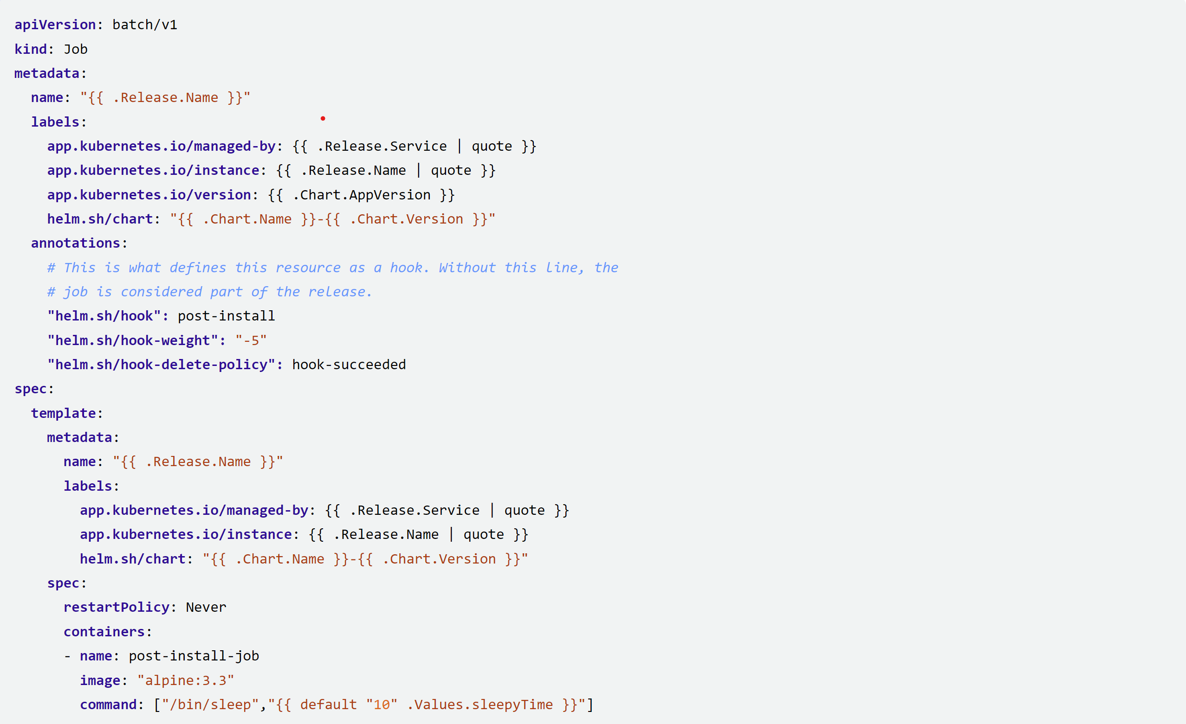
A HOOK

Slide 13
Chart TESTs
A chart contains a number of Kubernetes resources and components that work together
A test in a helm chart lives under the templates/ directory
It is a job definition that specifies a container with a given command to run
Container should exit successfully (exit 0) for a test to be considered a success
Job definition must contain the helm test hook annotation: helm.sh/hook: test
Steps to run a test suite on a release
install the chart on the cluster to create a release
wait for all pods to become active
Immediate test likely to show a transitive failure

Slide 14
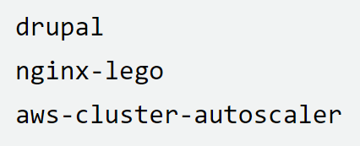
Best Practices
Chart Names
must be lower case letters and numbers
may be separated with dashes (-)
YAML files should be indented using two spaces (and never tabs)
Usage of the Words Helm and Chart
Helm refers to the project as a whole
helm refers to the client-side command
The term chart does not need to be capitalized, as it is not a proper noun
Chart.yaml does need to be capitalized because the file name is case sensitive

Slide 15
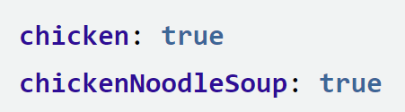
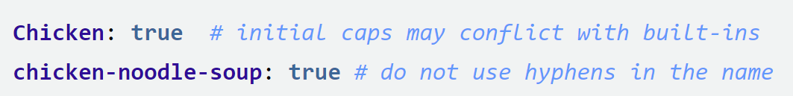
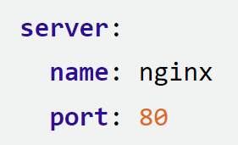
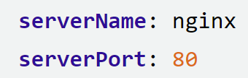
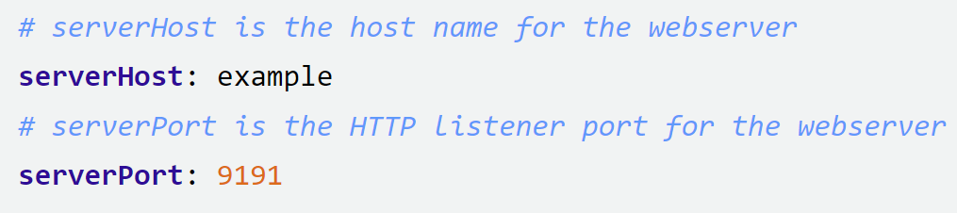
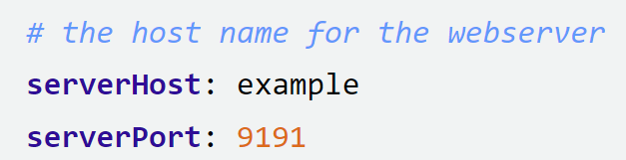
Best Practices - Values
Naming Conventions
should begin with a lowercase letter
should be separated with camelcase
Flat or Nested Values
YAML is a flexible format
values may be nested deeply or flattened
Make Types Clear
Document values.yaml

Slide 16


Best Practices - Versions
use version ranges instead of pinning to an exact version
Include pre-release versions along with patch level

Slide 17
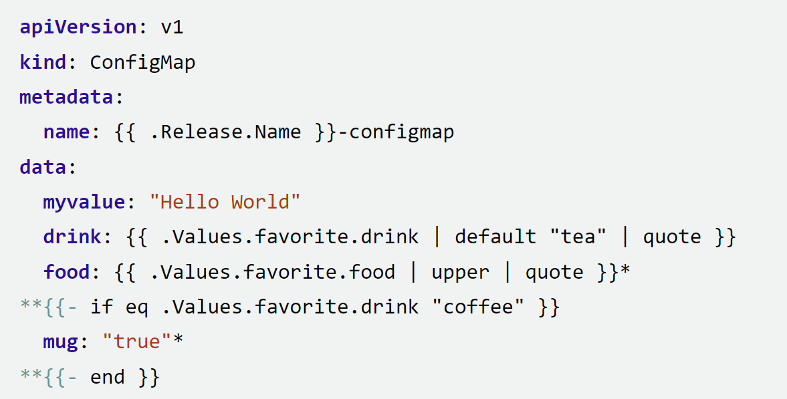
Flow Controls

Slide 18
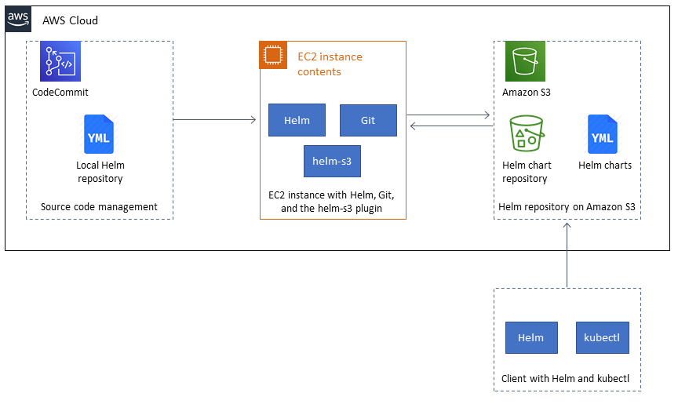
S3 Plug-in

Slide 19
Thank You !
Have a Great Day !!

