Slide 1
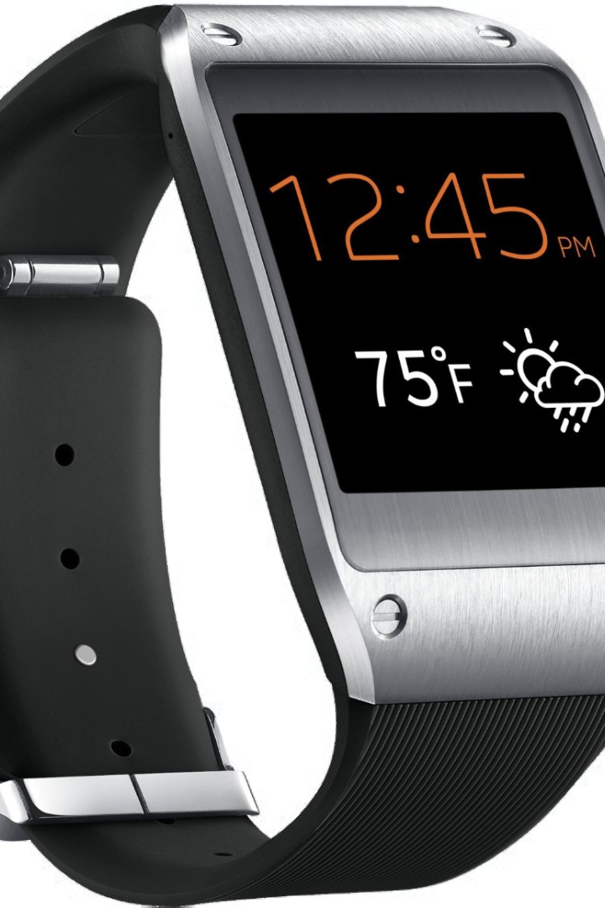



Introduction to iwatch
Discover the next level of smartwatch technology with the iwatch. Stay connected, monitor your health, and express your style effortlessly.

Slide 2
Features and specifications
Advanced Technology
Stylish Design
Seamless Integration
Experience cutting-edge features including ECG, fall detection, and fitness tracking.
Discover a sleek, customizable design with a vibrant display and interchangeable bands.
Connect seamlessly with your Apple devices for a truly integrated tech experience.

Slide 3
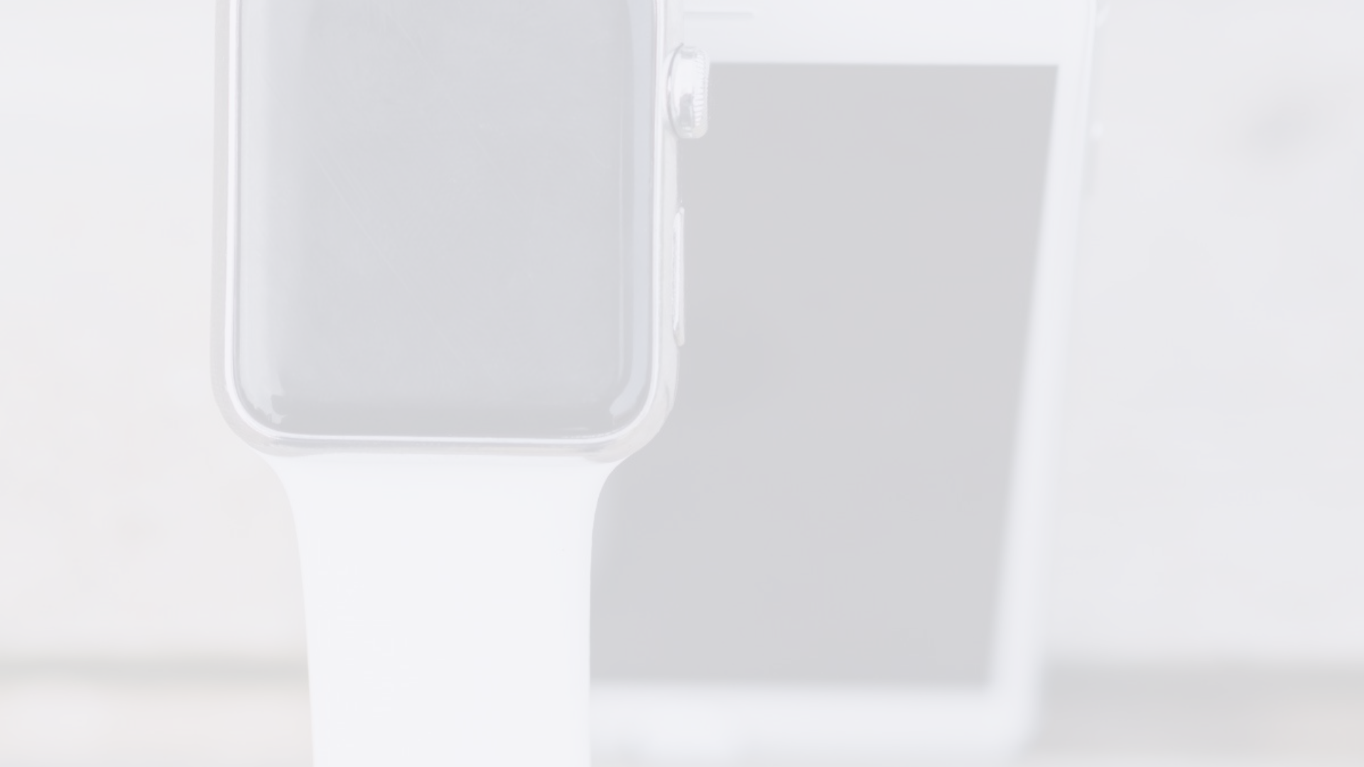
Benefits of using iwatch
1
Health Tracking
2
Convenience
3
Fitness Motivation
Monitor your heart rate, ECG, and overall health easily and accurately.
Receive notifications, calls, and texts right on your wrist, keeping you connected.
Stay inspired and active with personalized coaching and workout tracking.

Slide 4



Customer testimonials
Life-Changing
Connected & Stylish
Motivates & Tracks
"The iwatch has transformed how I monitor my health. It's truly a game-changer!" - Lisa S.
"I never miss a call or message, and the design is stunning. Highly recommended!" - Tom R.
"As a fitness enthusiast, the iwatch has become an invaluable training partner." - Sarah M.

Slide 5
How to purchase iwatch
Online Store
Retail Stores

Slide 6
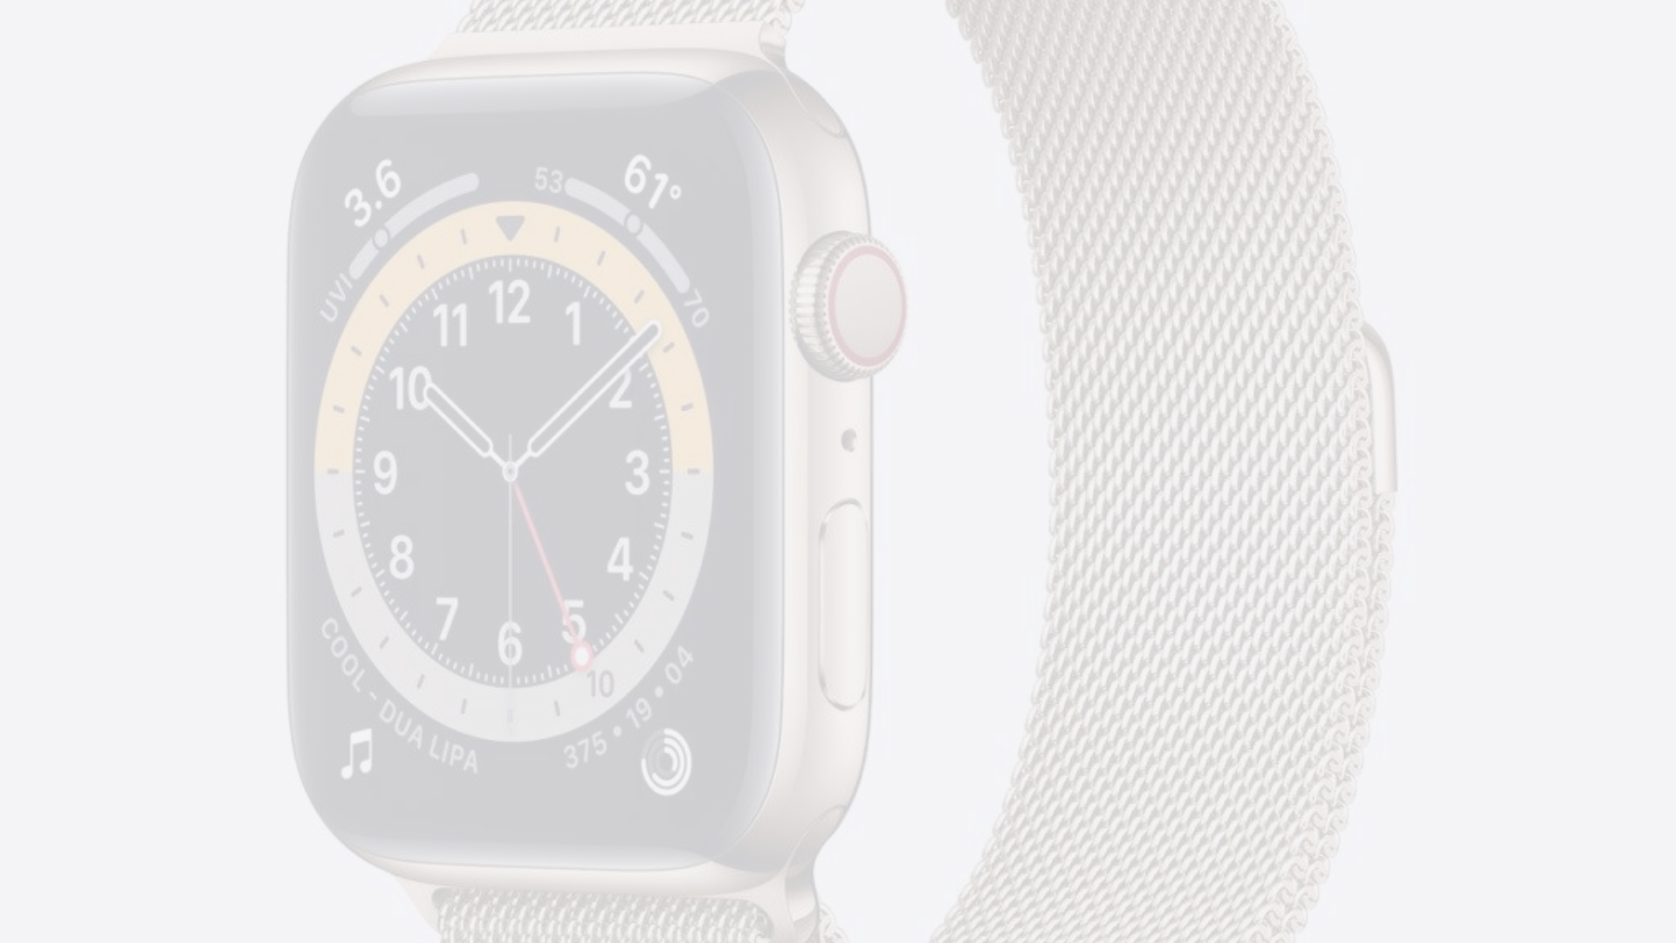
Frequently asked questions
Pricing & Plans
Compatibility

Slide 7
Warranty and support
Extended Warranty
Product Assistance
Repair Services
Receive an extended warranty and personalized support with every iwatch purchase.
Contact our customer support team for any product-related assistance or inquiries.
Access specialized repair services for iwatch directly through our official channels.

Slide 8


Contact us
Reach Out
Feedback & Inquiries
Have questions or need assistance? Contact us directly through phone, email, or live chat.
We value your feedback and are here to address any inquiries or concerns you may have.

