Slide 1


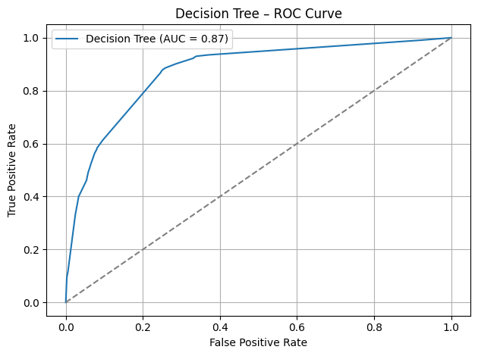
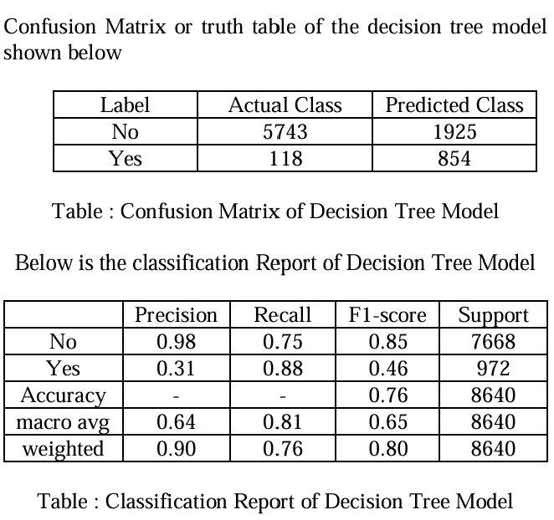
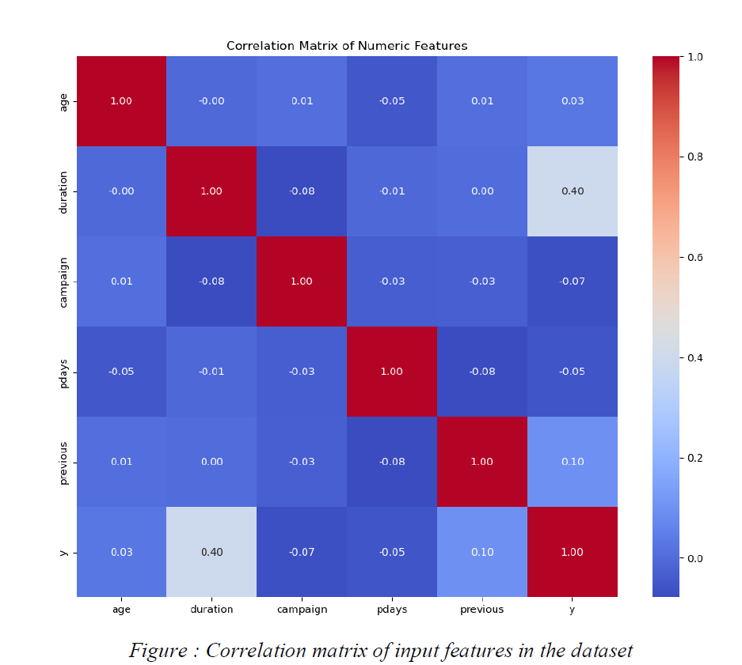
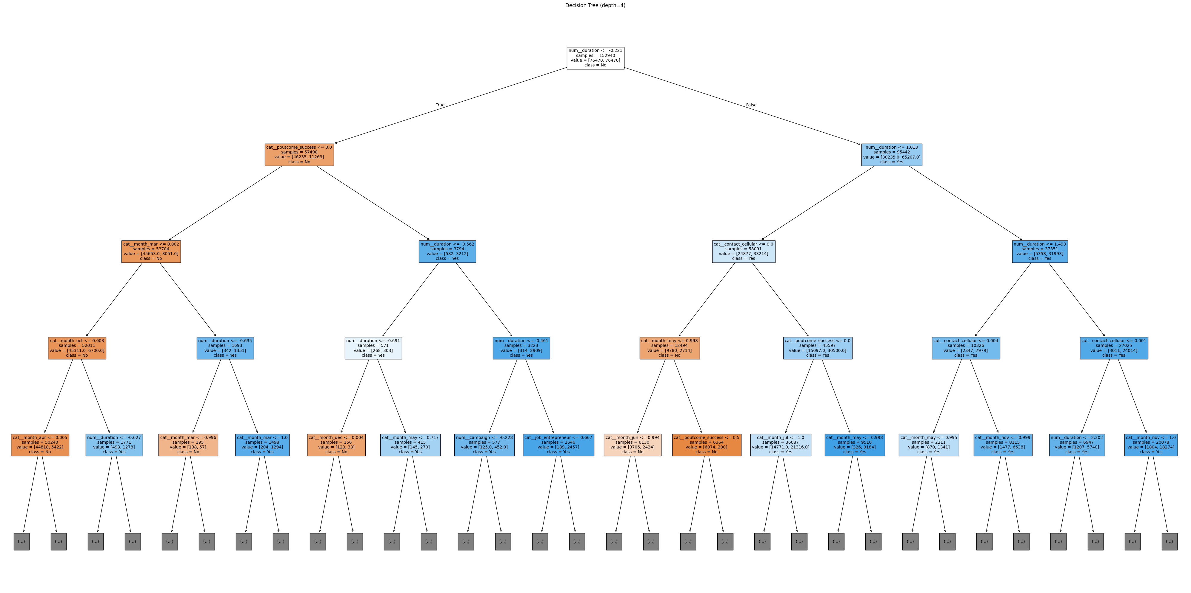
Bank Marketing
Hasan Ahmed Shaik, Shoaib Mohammad, Chandini, Are Ventaka Subba Rao
School of Computing, College of Engineering, Wichita State University
Intro / Abstract
RESULTS
CONCLUSION
Objective Forecast term-deposit uptake to optimize telemarketing efforts
Data Source UCI Portuguese retail-bank dataset (May 2008–Nov 2010)
Preprocessing Data cleaning, feature encoding, and handling of categorical variables
Model Decision Tree classifier
Evaluation • Accuracy: 76.4 % • Precision & Recall • ROC-AUC & Confusion Matrix
Key Outcomes • ↑ Conversion rates via targeted calls • ↓ Total call volume and operational costs
Future Directions • Hybrid/ensemble models • Real-time prediction pipelines • Responsible AI integration
This project aimed to develop a predictive model to identify customers who are likely to subscribe to a term deposit based on their personal and campaign-related attributes. By applying a structured machine learning work, including data preprocessing, handling class imbalance with SMOTE, and using a Decision Tree classifier we were able to achieve meaningful results. The model achieved an accuracy of 76.35% and a recall of 87.86% for the subscribed class, making it a strong candidate for marketing applications capturing as many potential responders as possible is critical. While the model’s precision (30.73%) indicates some false positives, this trade-off is acceptable in many real-world marketing contexts. Overall, the project demonstrates that even a simple, interpretable model like a Decision Tree can be effectively used to guide data-driven marketing strategies. Further improvements can be explored through ensemble models, hyperparameter tuning, or cost-sensitive learning approaches.
RELATED WORKS
Neural Models w/ Feature Selection Outperformed logistic regression and decision trees but did not address class imbalance
MLP with Reduction & Imputation Improved generalizability via feature reduction and missing-value filling; prone to overfitting on smaller samples
Ensemble Methods (RF & SVM) Achieved >90 % accuracy after extensive tuning; assumed balanced classes and omitted minority precision–recall analysis
TSMOTE + Naive Bayes Clustering Combined resampling and clustering to yield G-mean 0.743 and 80.8 % accuracy
his Study Applies SMOTE-enhanced Decision Tree for interpretability and imbalance correction (76.4 % accuracy)
DISCUSSIONS
Baseline Performance 76.4 % accuracy, strong ROC-AUC
Top Drivers Call duration & prior campaign outcomes
SMOTE Impact ↑ Recall for “yes” but slight ↑ in false positives
Limitations Rigid tree structure; synthetic-data trade-offs; below ensemble benchmarks
Next Steps • Explore Random Forest/XGBoost • Apply cost-sensitive learning or adjust thresholds • A/B test on live campaigns
ABOUT THE DATASET
METHODOLOGY AND RESULTS
Status: Clean (no missing values), mix of categorical & numerical, ready for ML.
Source: UCI Portuguese retail-bank telemarketing data (May 2008–Nov 2010)
Size: 86 399 records, 15 common input features
Features:
Demographic: age, job, marital, education
Financial: default, housing, loan
Campaign: contact type, month, call duration, campaign count, pdays, previous, poutcome
Target: “y” – term-deposit subscription (yes/no; highly imbalanced)
EDA
Pipeline: • Data cleaning & encoding • SMOTE for class balance • Decision Tree via sklearn Pipeline with manual hyperparameter tuning
Evaluation Metrics: • Accuracy 76.4 % • Precision 30.7 % • Recall 87.9 % • F1-score 45.5 % • ROC-AUC 87.3 %
Visuals: Confusion Matrix & ROC curve for class-separation assessment
Class Imbalance: 90 % non-subscribers vs 10 % subscribers → SMOTE to even classes (~76 k each)
Univariate:
Peak age 30–40; mostly married & secondary-educated
50 k calls via cellular vs 20 k telephone
Majority have no default, housing, or personal loans
Bivariate: Higher subscription rates for cellular contacts, prior-success clients, and longer calls
Correlation:
Call duration vs subscription (r≈0.40)
Campaign count vs days since last contact
Economic factors (euribor3m, nr.employed) influence outcomes

