Slide 1
HealthAI: Offline Disease Predictor
Built with Python, scikit-learn, and Gradio

Slide 2
📘 Project Overview
HealthAI is a lightweight, offline AI healthcare assistant.
It predicts diseases based on user symptoms and provides home remedies.
✅ No internet APIs or tokens required
✅ Interactive web UI using Gradio
✅ Simple ML model using scikit-learn

Slide 3
⚙️ Technologies Used
- Python 3
- scikit-learn (Naive Bayes classifier)
- pandas for data handling
- Gradio for UI
- Google Colab for development

Slide 4
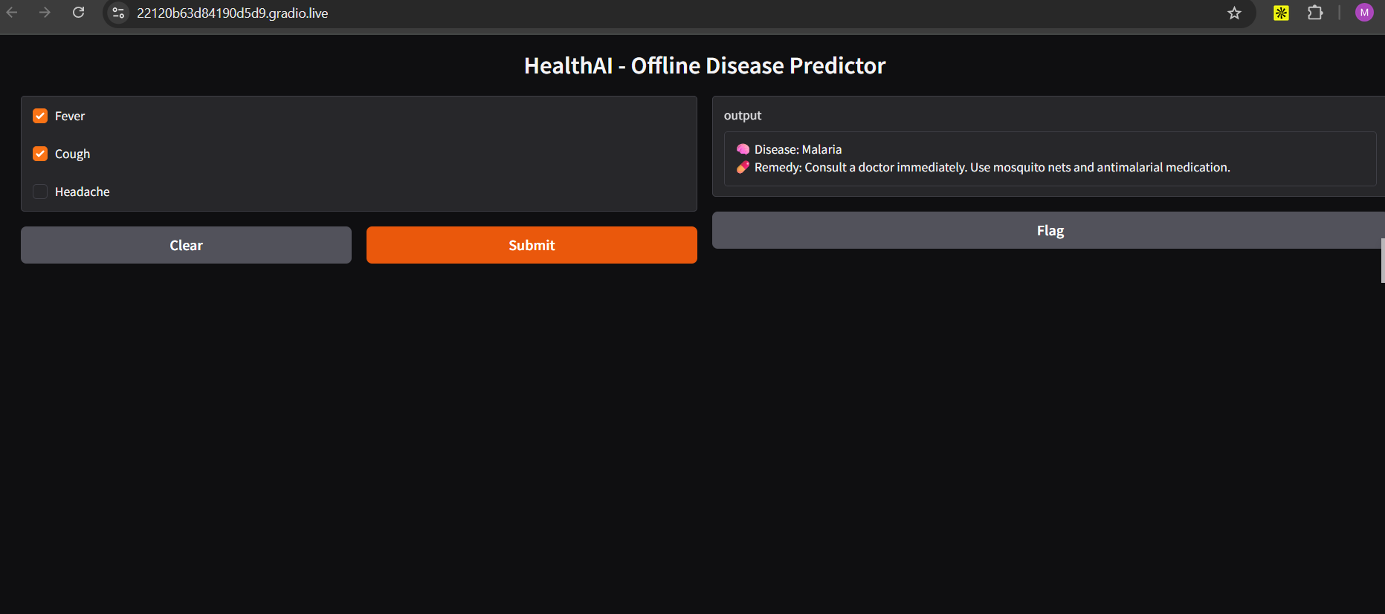
📷 Live App Screenshot

Slide 5
🧪 How It Works
1. User selects symptoms (Fever, Cough, Headache)
2. Model predicts most likely disease
3. Remedy is selected from a local dictionary
4. Results are shown in a Gradio web interface

