Slide 1

Aayuphile Healthcare Analytics
Data-driven insights for inclusive healthcare operations in India
Shaik Muffazzalin Taj

Slide 2
About Aayuphile
• Aayuphile is a health-tech startup concept that focuses on inclusive healthcare access across India.
• It aims to bridge the rural-urban healthcare gap using digital tools, telemedicine, and data analytics.
• The goal is to empower hospitals, clinics, and patients through transparent, data-backed decision-making.
“Aayuphile is designed to make quality healthcare data-driven and accessible to all — especially in underserved regions.”

Slide 3
Analytical Objective
• Design an interactive Excel dashboard to analyze healthcare operations data.
• Measure key performance indicators (KPIs) such as revenue, efficiency, and satisfaction.
• Enable decision-making for departments, doctors, and management using data insights.
• Strengthen analytical, Excel, and visualization skills aligned with business analyst roles.

Slide 4

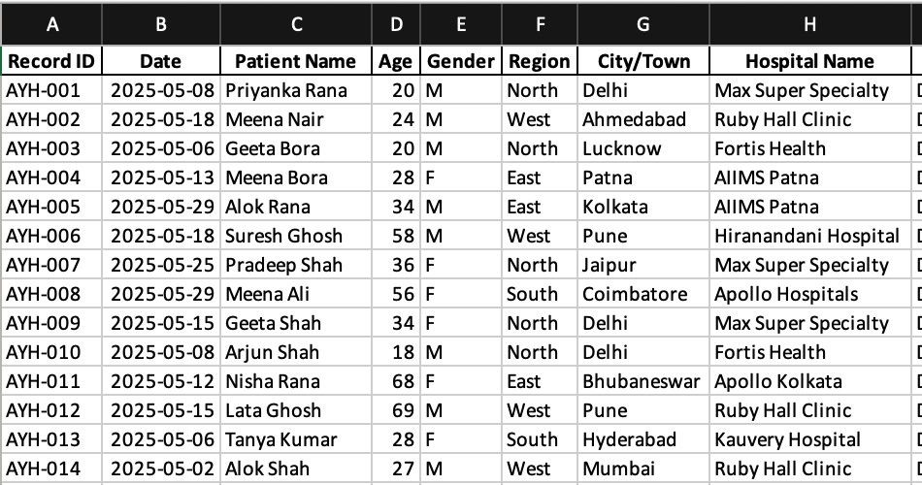
Dataset Overview
• 200+ records representing simulated healthcare operations.
• Core columns include:
• Region, Department, Doctor Name, Subscription Plan
• Treatment Cost, Waiting Time, Response Time, Appointment Type
• User Rating, Appointment Status
• Data prepared manually in Excel (synthetic dataset for learning).

Slide 5
Key Metrics & Calculations
Total Appointments
Measures the total number of appointments booked across all regions and departments. Indicates overall patient engagement and service utilization.
Total Revenue
Represents the total treatment income generated during the analysis period. Reflects financial performance and demand.
Average Waiting Time
Shows the average time patients wait before receiving consultation or treatment. Lower values indicate higher operational efficiency.
Average Response Time
Tracks the average time taken for doctors or staff to respond to appointment or patient queries. Demonstrates responsiveness and service quality.
Emergency Percentage
The proportion of emergency appointments compared to all bookings. A high percentage may indicate system strain or urgent-care demand.

Slide 6
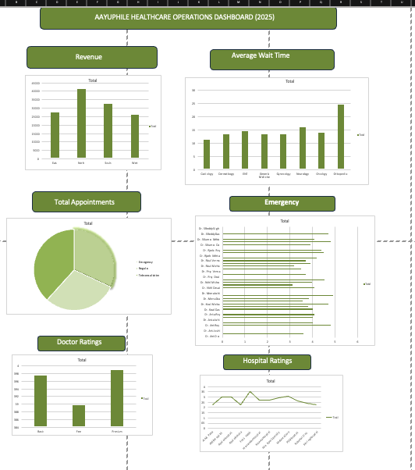
Excel Dashboard Overview
• Interactive slicers for Region, Department, and Subscription Plan.
• KPI summary cards for key metrics.
• PivotCharts showing:
• Revenue by Region
• Average Waiting Time by Department
• Doctor Ratings
• Subscription Distribution
• Designed using consistent Aayuphile theme

Slide 7
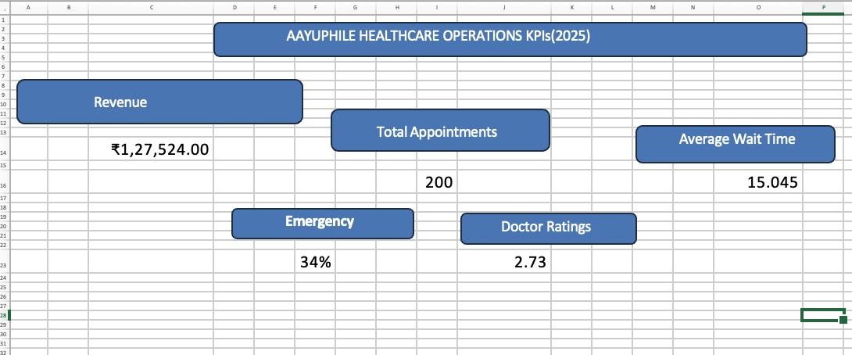
Key Insights
• Revenue: South region contributes the highest share of total revenue.
• Efficiency: ENT and General Medicine departments show the shortest average waiting times.
• Satisfaction: Average user rating is 4.3/5, with teleconsultation performing best.
• Emergency Ratio: Around 22% of all appointments are emergency cases.

Slide 9
Business Impact
• Enables data-driven healthcare management decisions.
• Helps identify bottlenecks in waiting time and doctor performance.
• Improves resource allocation and patient satisfaction.
• Can scale into automation or BI tools (Power BI, Signavio).

Slide 10
Next Steps
. Phase 3: Map end-to-end healthcare process in BPMN 2.0.
. Integrate Miro journey boards for patient enablement journeys.
. Build automated analytics using Excel VBA or Power BI.
. Include RACI and Interest–Influence Matrix for stakeholder analysis.

Slide 11
Thank you for your time
Shaik Muffazzalin Taj

