Slide 1

Aayuphile
Inclusive Healthcare for Rural India
Bridging healthcare accessibility through technology and collaboration

Slide 2
Problem Statement
• 65% of India’s population lives in rural areas, yet access to quality healthcare remains limited.
• Shortage of doctors, lack of awareness, and long travel distances worsen patient outcomes.
• Delays in diagnosis and treatment increase healthcare costs and mortality rates.

Slide 3

Key Features
• Teleconsultation via video/audio
• E-prescriptions & medical history tracking
• Regional language support
• AI-based symptom checker (future roadmap)
• NGO & ASHA worker partnership interface

Slide 4
Target Market & Audience
• Primary Users: Rural patients, ASHA workers, local clinics.
• Secondary Users: NGOs, healthcare providers, and government health programs.
• Market Size: Rural India healthcare market projected at ₹40,000 Cr+ (source: NITI Aayog).

Slide 5
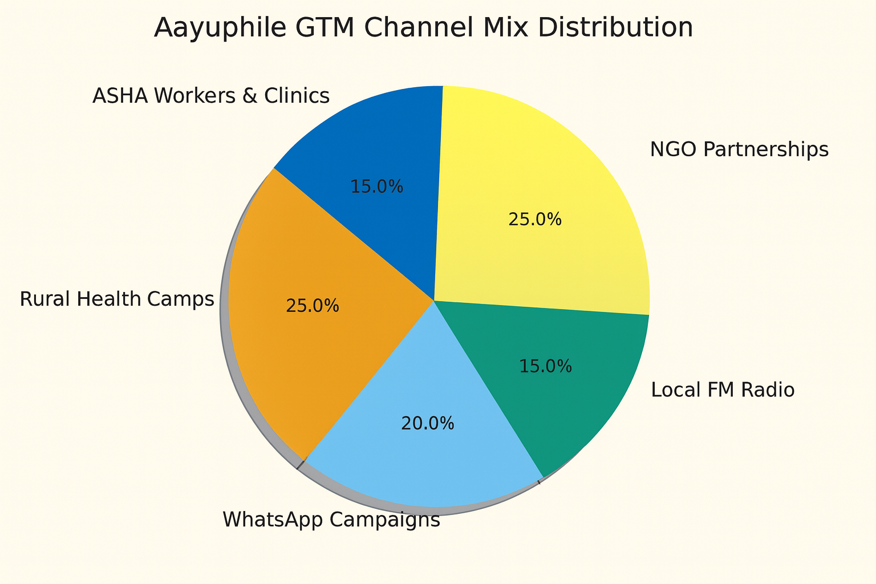
Go-to-Market (GTM) Strategy
Phase 1: Pilot in two districts with NGO collaboration
Phase 2: Expanding to five states in India through public–private health partnerships.
• Channel Mix:
• Rural health camps (on-ground)
•WhatsApp campaigns & TV Ads
• Partnerships with NGOs, ASHA workers, and clinics
• KPIs : Adoption rate, consultations per month, CAC, churn rate

Slide 6
Revenue Model
• Freemium model: Free basic consultations; paid specialist consultations, access to all the prescriptions, smart hospital finder during emergency
• Subscription plans: pro, ultimate plans
• Commission model: Revenue sharing with verified doctors.

Slide 7
Workflow and Stakeholders & Partnerships
• Start → Patient registration → Health worker verification → Doctor consultation → Prescription → Follow-up
• Visualized using BPMN 2.0 to show information flow, decision gateways, and feedback loops.
• Stakeholders: Patients, Doctors, NGOs, Government bodies, ASHA workers, Pharmacies
• Strategic Partners: Local healthcare NGOs, diagnostic labs, and digital payment providers.

Slide 8
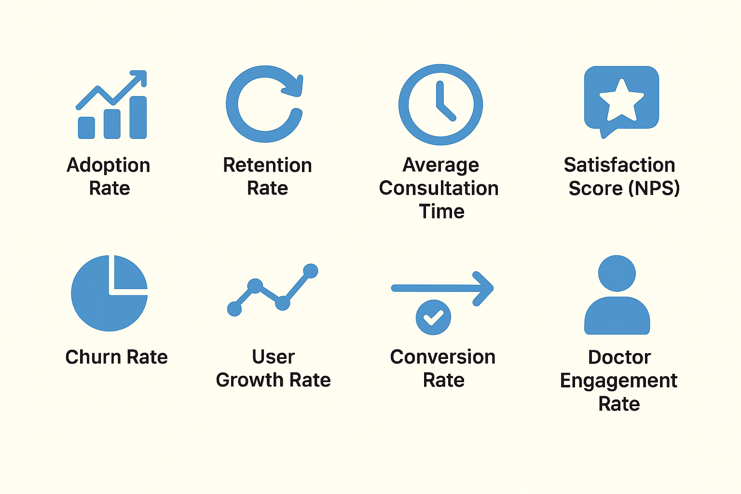
key performance indicator’s
• Adoption Rate: % of registered users actively using the app each month.
• Retention Rate: Measures user loyalty over time (monthly cohort analysis).
• Average Consultation Time: Tracks operational efficiency and user experience.
• Satisfaction Score (NPS): Gauges patient and doctor feedback quality.
• Churn Rate: % of users who stop using the service.
• User Growth Rate: Monthly increase in active users per region.
• Conversion Rate: % of new sign-ups that complete their first consultation.
• Doctor Engagement Rate: Number of doctors actively consulting per week.

Slide 9
Future Roadmap
• Short Term: Add multi-language chatbot & offline support.
• Medium Term: Partner with 100+ NGOs and expand across 10 states.
• Long Term: Integrate insurance and AI diagnostics.

Slide 10

Impact Summary
• 10,000+ rural patients served in first year.
• 3x faster access to doctors.
• 40% cost reduction in primary care delivery.
• Empowering ASHA workers with digital tools

Slide 11
Healing without boundaries — Aayuphile for all.
– shaik muffazzalin taj

