Slide 1
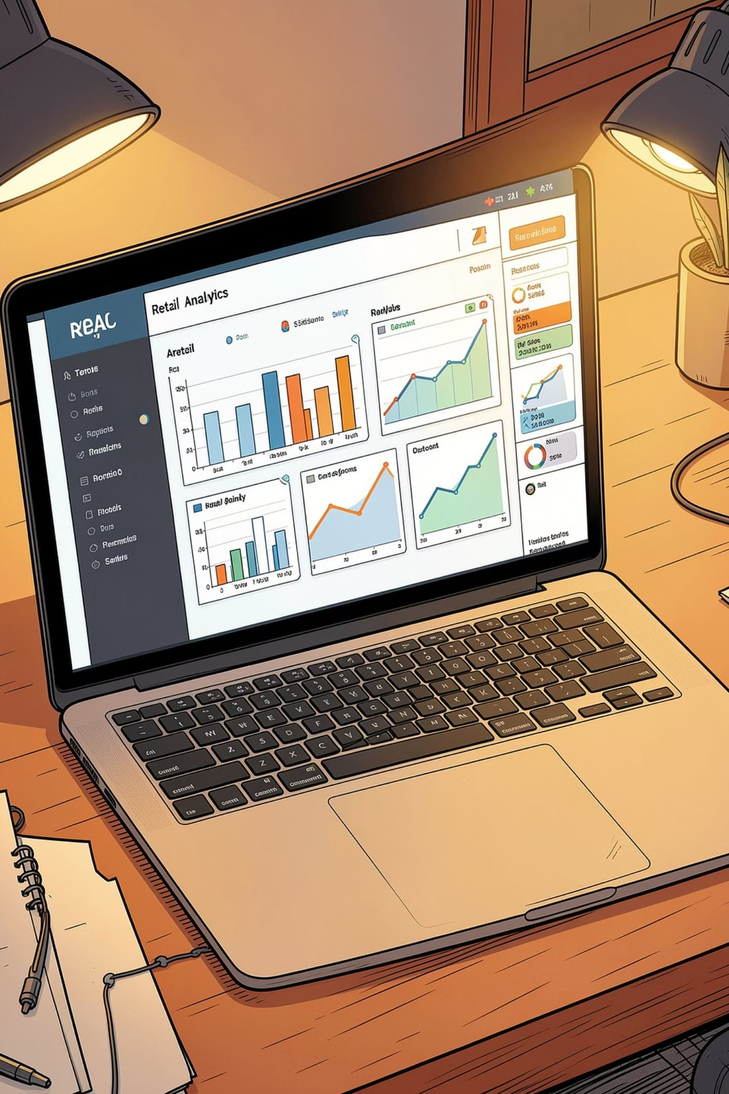
Customer Shopping Behavior Analysis
Analysis of 3,900 transactions to reveal spending patterns, product preferences, subscription behavior, and actionable recommendations for growth.

Slide 2
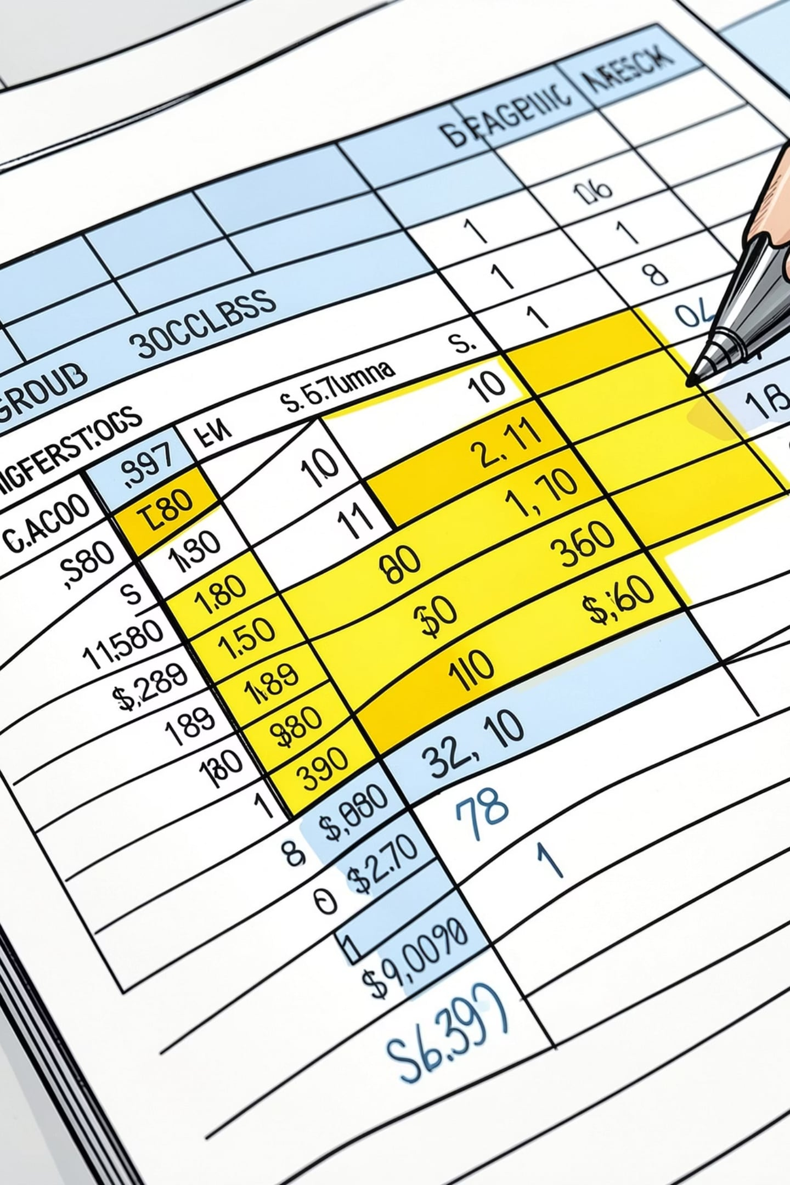
Dataset Snapshot
Rows & Columns
Key Features
3,900 rows · 18 columns
Demographics, purchase details, behavior, shipping, discounts
Missing Data
Review Rating: 37 null values (imputed by category median)

Slide 3

Data Preparation (Python)
Loaded with pandas; used df.info() and describe() to inspect structure and stats. Renamed columns to snake_case for clarity. Imputed missing review ratings by product-category median.
Engineered age_group and purchase_frequency_days. Dropped promo_code_used after redundancy check with discount_applied. Exported cleaned dataframe to PostgreSQL.

Slide 4
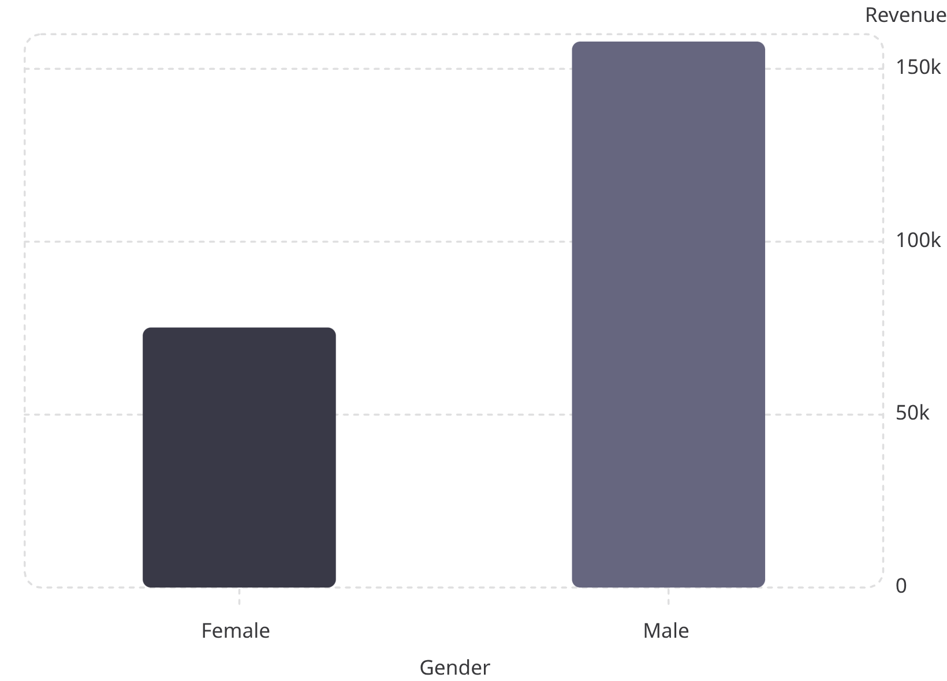
Revenue by Gender (SQL)
Male customers generated higher total revenue in this dataset. Use targeted strategies to balance acquisition and maximize female customer value.

Slide 5



High-Spending Discount Users & Loyalty
High-Spend Using Discounts
Identified 839 rows where customers used discounts but spent above average purchase amount.
Repeat Buyer Loyalty
Repeat buyers segmented by subscription: No = 2,518; Yes = 958. Focus on converting repeat buyers to subscribers.

Slide 6
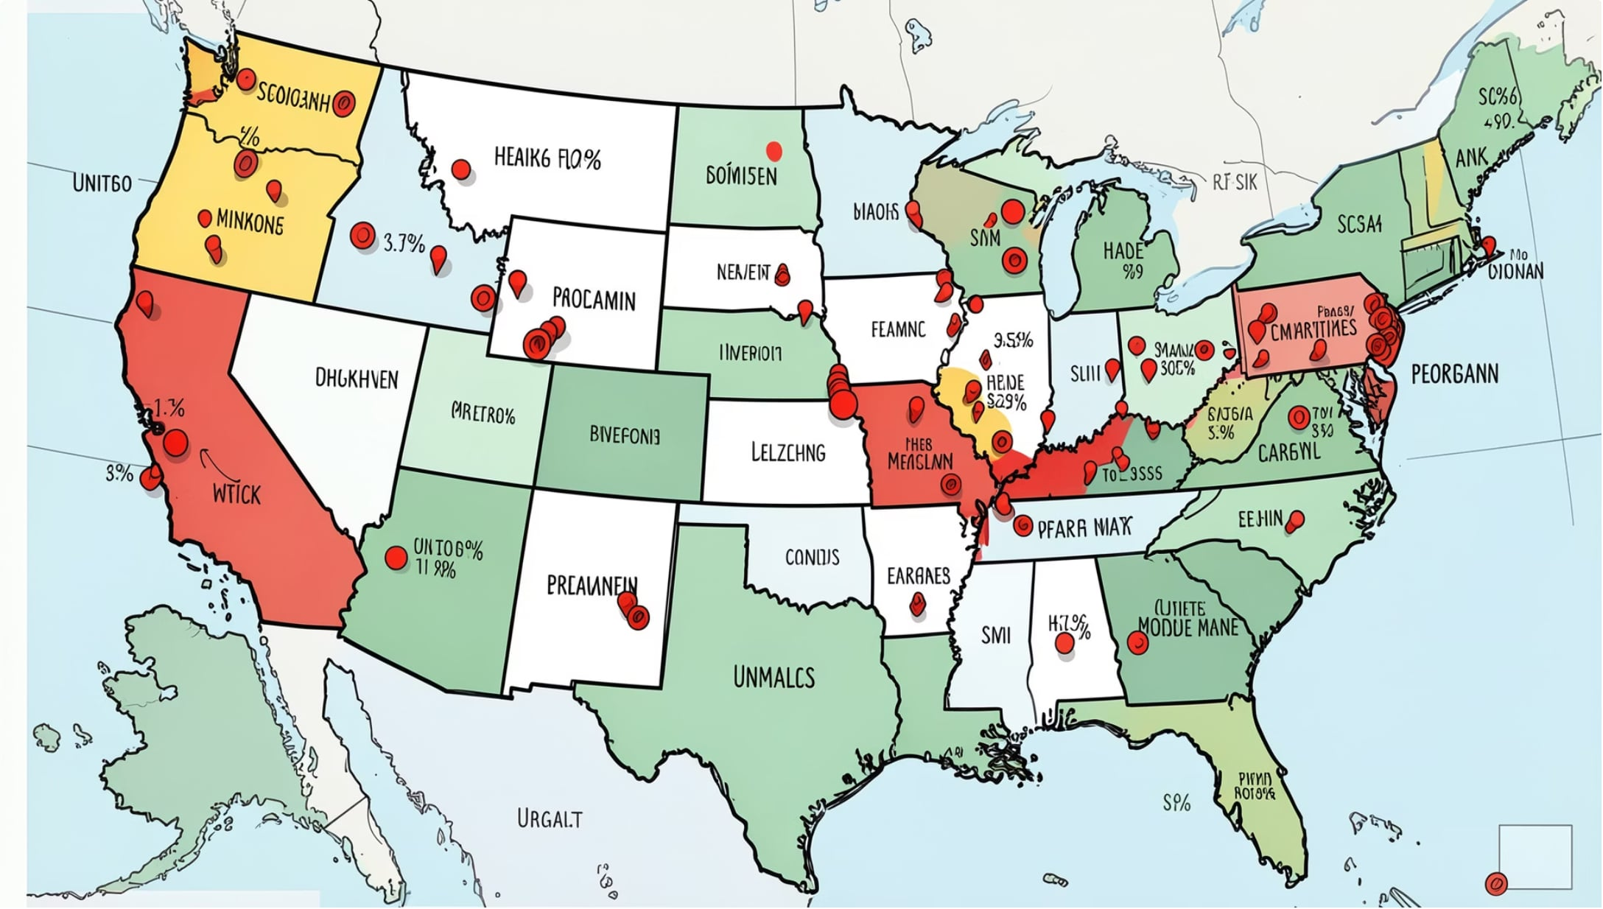
Geographic Distribution
Top locations by unique customer count (sample): Montana 96, California 95, Idaho 93, Illinois 92… data covers 50 locations. Use geo-targeted campaigns where customer density is highest.

Slide 7
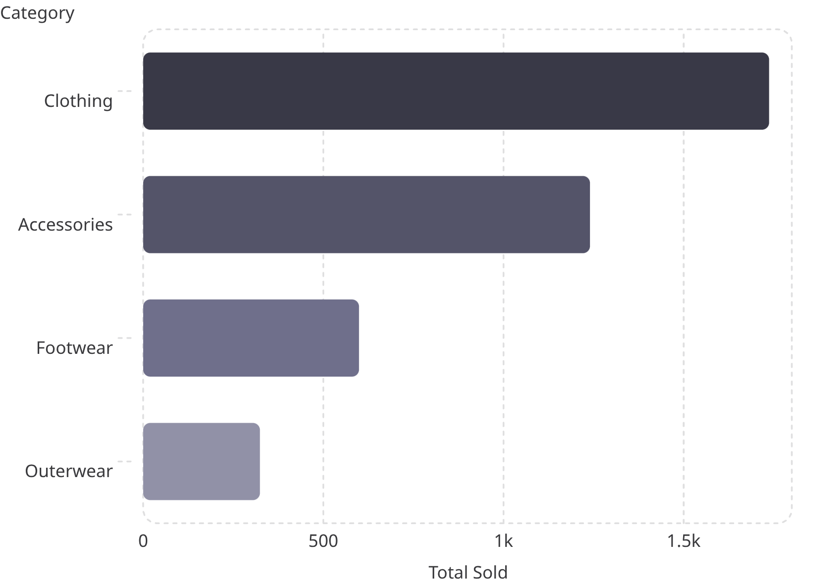
Category Performance
Clothing and Accessories drive volume. Average spend by category: Footwear $60.26, Clothing $60.03, Accessories ~$59.84, Outerwear $57.17 — prioritize high-volume, high-margin promotions.

Slide 8

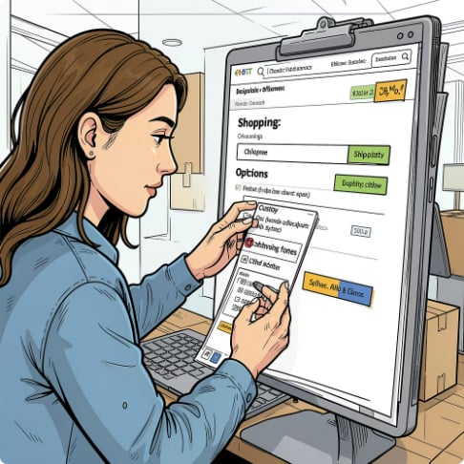
Customer & Payment Insights
Payment Methods
Shipping & Subscription
Balanced distribution: PayPal 677, Credit Card 671, Cash 670, Debit 636, Venmo 634, Bank Transfer 612.
Subscription status: Yes 27%, No 73%. Dashboard shows free shipping and standard options commonly used.

Slide 9
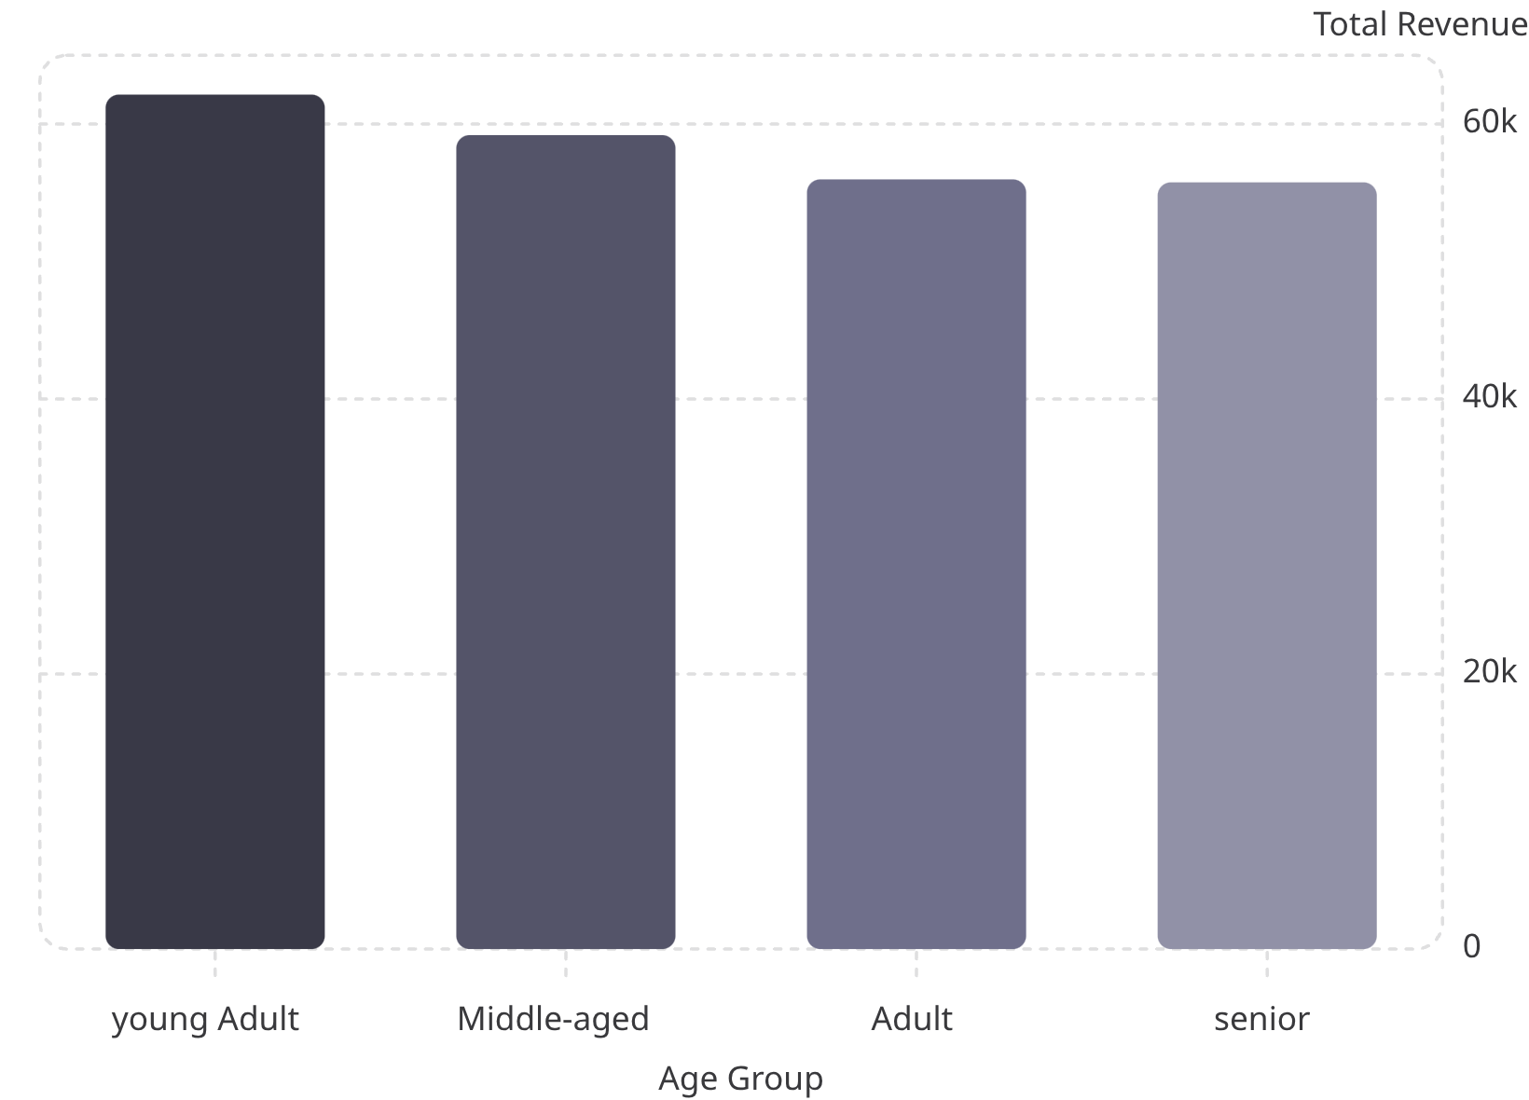
Age & Revenue Segments
Young adults and middle-aged cohorts are primary revenue contributors. Tailor offers and express-shipping promotions to these segments to increase conversion and AOV.

Slide 10
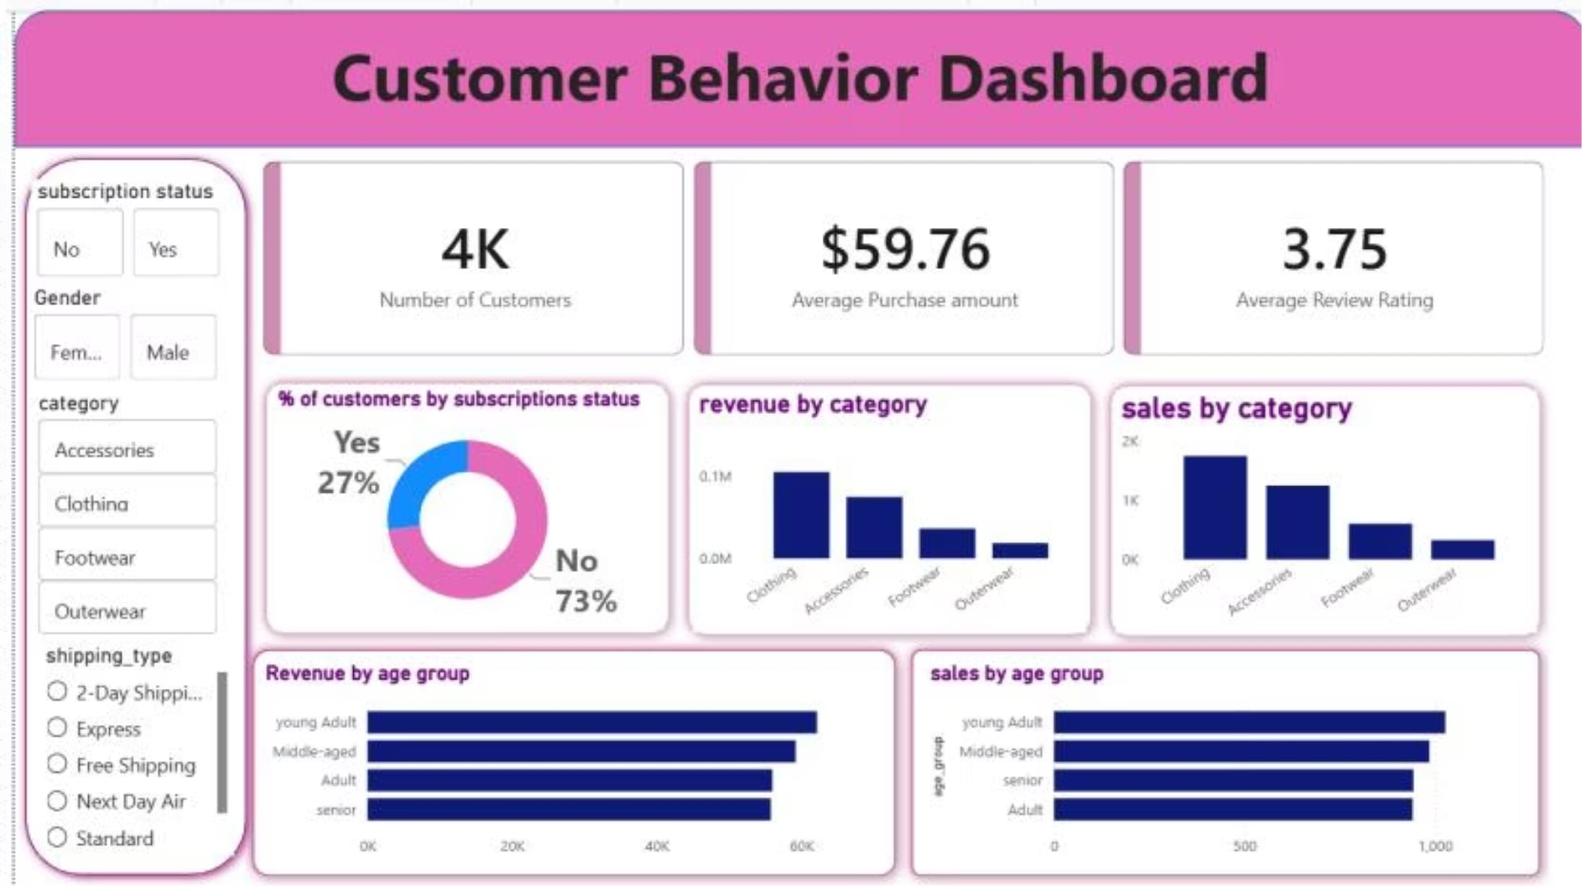
Dashboard Snapshot & Recommendations
Boost Subscriptions
Promote exclusive subscriber benefits to raise the 27% adoption rate.
Customer Loyalty Program
Incentivize repeat buyers to enter a loyal cohort and increase lifetime value.
Review Discount Policy
Balance promotional lift with margin control; target high-spend discount users carefully.
Product Positioning & Targeting
Highlight best-sellers and high-rated items; focus marketing on high-revenue age groups and top locations.

