Slide 1
Network Inversion for Uncertainty-Aware Out-of-Distribution Detection
Shaik Rehna Afroz
22B3932
EE691 R & D Project
IIT Bombay

Slide 2
Problem Statement :
• Classifiers are excellent at distinguishing between in-distribution classes but often struggle when presented with out-of-distribution (OOD) samples, misclassifying them with high confidence
• OOD samples are data points that don’t belong to the same distribution as the classifier’s training data
• A model trained on MNIST digits (0–9) may incorrectly classify inputs like clothing images (e.g., trousers from FashionMNIST) with high confidence. This misclassification is dangerous in real-world deployments (e.g., medical imaging, autonomous driving) where OOD inputs can lead to catastrophic outcomes
Why Should This Problem Be Solved:
• Safety: OOD inputs in medical, industrial, or autonomous systems can cause fatal decisions
• Generalization: Robust systems should recognize when an input does not belong to the training distribution
• Trust: Users need interpretable confidence estimates to trust predictions
• Solving OOD detection is critical for building safe, interpretable, and deployable AI systems

Slide 3
Challenges :
• Data Distribution Gaps: Real-world OOD samples can be very different from training data
• Confidence Miscalibration: Softmax outputs are often overconfident, even for unfamiliar inputs
Previous approaches:
• The Paper “ Autoinverse: Uncertainty Aware Inversion of Neural Networks” (https://arxiv.org/abs/2208.13780v2)
proposes Autoinverse - a highly automated approach for inverting neural network surrogates. This approach seeks inverse solutions in the vicinity of reliable data by taking into account the predictive uncertainty of the surrogate and minimizing it during inversion.
• The paper “Uncertainty-Aware Out-of-Distribution Detection with Gaussian Processes” ”(https://arxiv.org/pdf/2412.20918) proposes a Gaussian-process-based method for out-of-distribution (OOD) detection in deep neural networks (DNNs) that eliminate the need for OOD data during training.
• This approach includes multi-class Gaussian processes (GPs) to quantify uncertainty in unconstrained Softmax scores of a DNN and defines a score function based on the predictive distribution of the multi-class GP to distinguish in-distribution(InD) and OOD samples.

Slide 4
Our approach :
• To address the problem of Out-of-distribution-detection (OOD) detection, Network inversion is used to generate OOD samples from the classifier’s input space. These samples, which deviate from the trained distribution, are assigned to ”garbage” class
• This method uses an n+1 approach, where n is the number of classes present in the training data. Extra ”garbage” class is added to the classifier’s output for ood detection
• To make the classifier familiar with the OOD data, it is trained with an additional ”garbage” class, initially populated by samples generated from random Guassian noise. This helps the classifier learn to recognize and isolate OOD samples
Training Process:
After each training epoch, inverted samples generated by the conditioned generator are added to the ”garbage” class, further augmenting the dataset with OOD examples.
This iterative retraining process helps the classifier differentiate between in-distribution and OOD data, improving its robustness.
The inclusion of the ”garbage” class creates a data imbalance, which is managed using a weighted cross-entropy loss function. This function dynamically adjusts weights to ensure effective learning despite the imbalance.

Slide 5
Network Inversion
The paper ”Network Inversion and its Applications” (https://arxiv.org/pdf/2411.17777) introduces Network Inversion (NI)- a technique that determines the input from a known output and system mapping, providing insights into NN decision-making.
Methodology:
This method involves three key stages:
First, the classifier is trained and set to evaluation mode
Next, an untrained generator (with conditioning mechanisms) learns to synthesize diverse input samples that would produce specific target outputs when fed through the classifier.
This conditioned generator effectively inverts the classifier’s mapping - creating input distributions that reliably trigger desired output classifications while maintaining output diversity.
Key characteristics:
Classifier remains fixed during inversion
Generator training is driven by classifier feedback
Conditioning ensures label-consistency in generated samples
Diversity losses prevent mode collapse

Slide 6
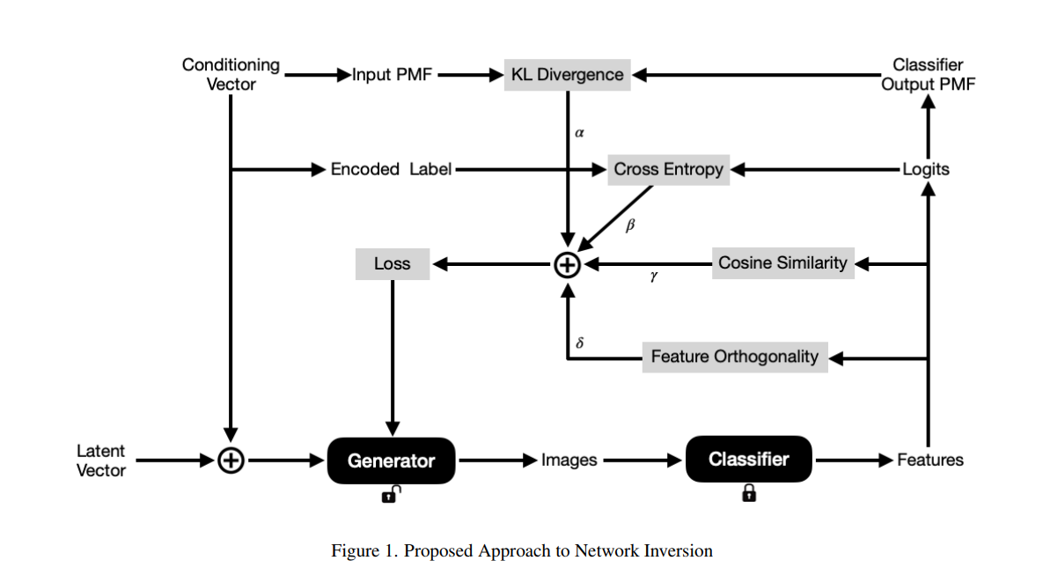
Network Inversion and its Applications
( https://arxiv.org/pdf/2411.17777)

Slide 7
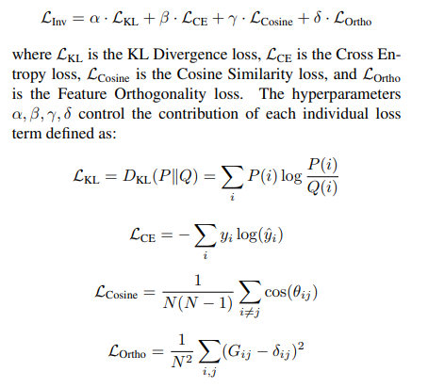
Network Inversion and its Applications
( https://arxiv.org/pdf/2411.17777)

Slide 8





Uncertainty Estimation Method :
To quantify the model’s uncertainty on a given input, a normalized deviation from the uniform distribution is used over class probabilities. The uncertainty estimate lies in the range [0, 1], where values closer to 1 indicate higher uncertainty.
Uncertainty estimate is given by:
Classifier logits z dimension: [B×K] for a batch of B samples and K classes:
Softmax probabilities:
Uniform distribution over K classes:
This normalizes the deviation of the model’s predicted distribution from the uniform baseline. A value of U(x) close to 0 implies high confidence, whereas values near 1 reflect a distribution close to uniform (i.e., maximum uncertainty).

Slide 9
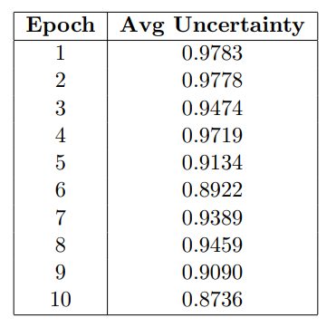
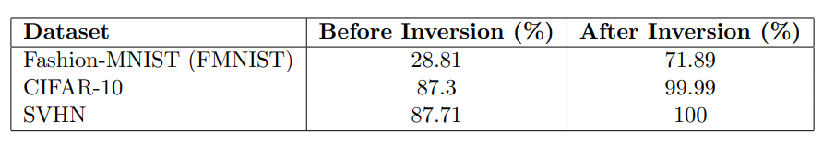
MNIST dataset is used for training and testing was done on FMNIST, CIFAR10, SVHN
Several experiments were conducted, during which the code was iteratively debugged and refined, hyperparameters were tuned. The experiments detailed here were performed using the finalized and corrected implementation.
Results:
Experiment -1
Hyperparameters and Settings
• Inversion Loss Weights: α = 500, β = 500, γ = 6000, δ = 10
• Latent Dimension: 100, Batch Size: 64
• Number of Classes: 11 (MNIST + Garbage class)
• Generator Steps per Epoch: 250
• Number of samples generated in each step = 1000
• Number of Epochs: 10

Slide 10
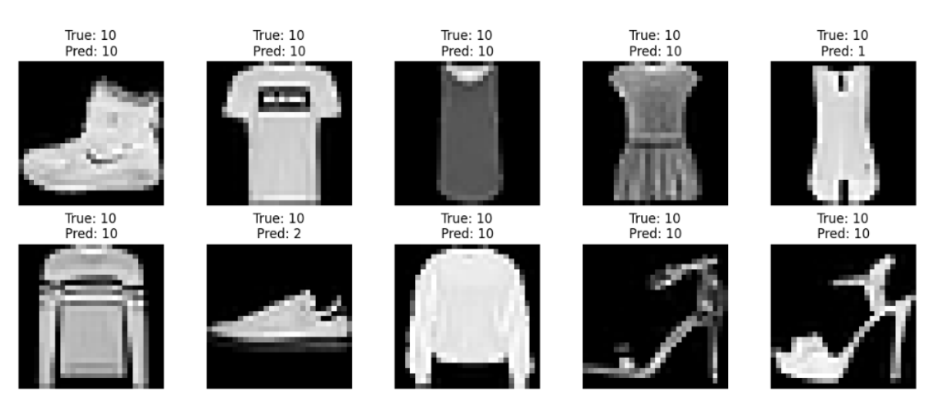
Predictions from EXP-1

Slide 11
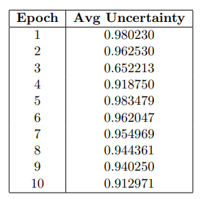
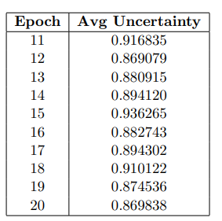
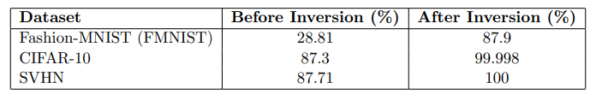
Experiment -2
Hyperparameters and Settings
• Inversion Loss Weights: α = 500, β = 500, γ = 6000, δ = 10
• Latent Dimension: 100, Batch Size: 64
• Number of Classes: 11 (MNIST + Garbage class)
• Generator Steps per Epoch: 250
• Number of samples generated in each step = 1000
• Number of Epochs: 20

Slide 12
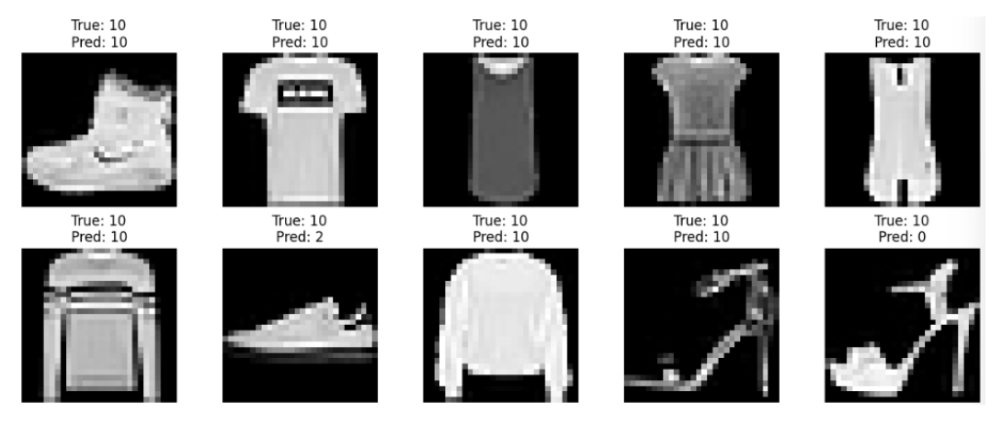
Predictions from EXP-2

Slide 13
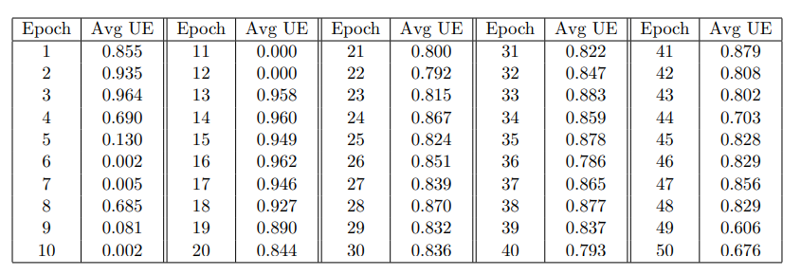
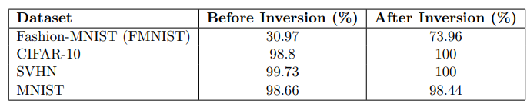
Experiment -3
Hyperparameters and Settings :
• Inversion Loss Weights:
α = 500, β = 500, γ = 6000, δ = 10
• Latent Dimension: 100, Batch Size: 64
• Number of Classes: 11 (MNIST + Garbage class)
• Generator Steps per Epoch: 250
• Number of samples generated in each step = 1000
• Number of Epochs: 50

Slide 14
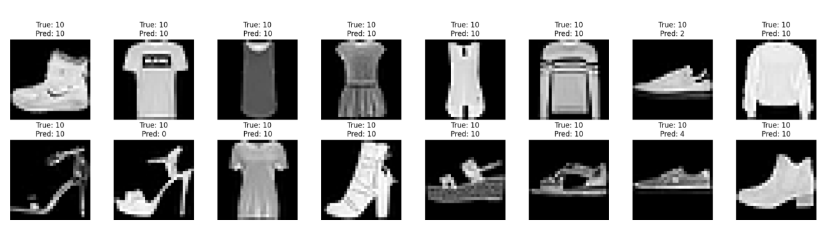
Predictions from EXP-3

Slide 15
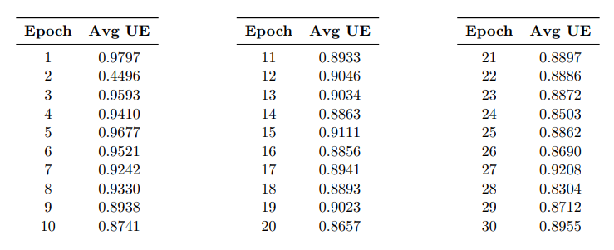
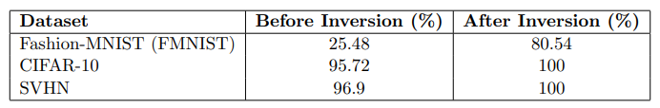
Experiment -4
Hyperparameters and Settings :
• Inversion Loss Weights:
α = 1000, β = 2000, γ = 6000, δ = 100
• Latent Dimension: 100,
Batch Size: 64
• Number of Classes: 11 (MNIST + Garbage class)
• Generator Steps per Epoch: 250
• Number of samples generated in each step = 1000
• Number of Epochs: 30

Slide 16
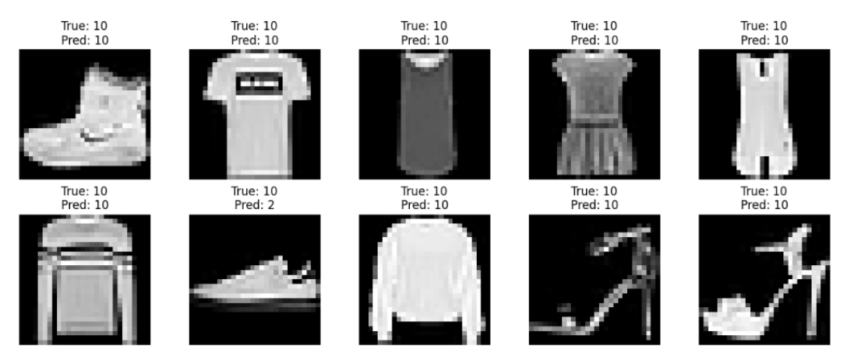
Predictions from EXP-4

Slide 17
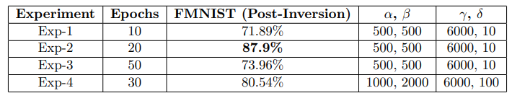
Summary and Analysis:
Across all experiments, network inversion consistently improved test accuracy on OOD datasets (Fashion-MNIST, CIFAR-10, SVHN).
Longer training (Exp-2 with 20 epochs) led to the best FMNIST accuracy (71.89% for 10 epochs to 87.9% for 20 epochs), showing that the model benefits from extended generator refinement.
But further increasing the number of epochs did not show improvement in the performance(87.9% for 20 epochs to 73.96% for 50 epochs)
Experiment-4, with adjusted inversion loss weights ( α = 1000, β = 2000, γ = 6000, δ = 100), outperforms Exp-1 and Exp-3 despite running only 30 epochs—highlighting the importance of tuning loss terms for better generator-classifier synergy.

Slide 18
The uncertainty estimates across epochs reveal how both generator and classifier evolve over time:
Early Epochs (1–3):
High uncertainty (e.g., UE 0.85–0.98) was observed, signaling initial classifier confusion due to noisy or poorly conditioned samples from the generator.
In some cases (e.g., Exp-2 Epoch 3), sharp dips in uncertainty likely indicate mode collapse or unstable generator output.
Mid Epochs (10–20):
Uncertainty becomes more stable and gradually declines, suggesting:
Improved generator conditioning, producing more class-consistent samples.
Classifier adaptation, with increasing confidence on synthetic inputs.
Late Epochs (20–50 in Exp-3, up to 30 in Exp-4):
The system enters a stable phase:
UE stabilizes between 0.79–0.88, indicating a healthy balance between exploration (novel inputs) and exploitation (confidence).
Some fluctuations (e.g., spikes in Exp-4 Epoch 27) reflect natural generator variations but don’t degrade performance.

Slide 19

THANK YOU

