Slide 1

IBM HR ATTRITION
What is Attrition?
A reduction in the number of employees through retirement, resignation or death

Slide 2
IBM HR ATTRITION
REASONS FOR ATTRITION
Better opportunities
Work-Life balance
Compensation and benefits
Excessive working hours and increased pressure
Areas of friction such as a long commute
Generally, it is more cost effective to retain employees than to hire new ones !

Slide 3
IBM HR ATTRITION
PROBLEM STATEMENT
- To identify sustainable model to bring down recruitment process cost.
- Identify ways to improve and tackle the attrition rate.
- Analyze and infer the rate of attrition in organization.

Slide 4
DATASET DICTIONARY
- There are 1470 records and 35 features in the dataset.
Dataset contains :
26 Numerical Variables (Discrete:26, Continuous :0 )
9 Categorical Variables (Ordinal:0 ,Nominal:9 )
The dataset has no missing values in any of the features.
IBM HR ATTRITION

Slide 5
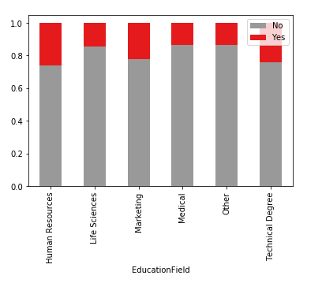
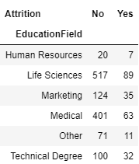
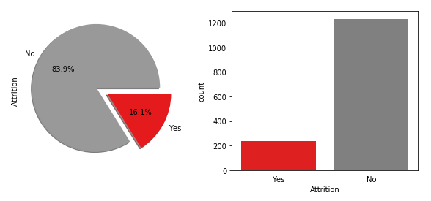

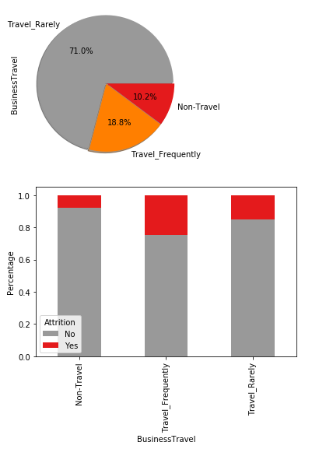
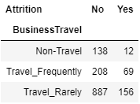
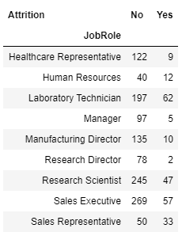
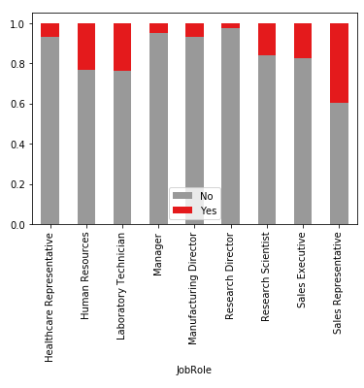
IBM HR ATTRITION
EXPLORATORY DATA ANALYSIS

Slide 6
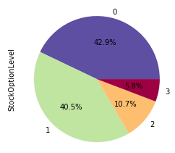
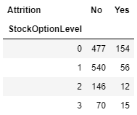
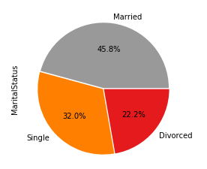
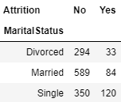
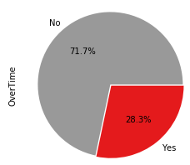
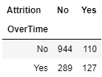
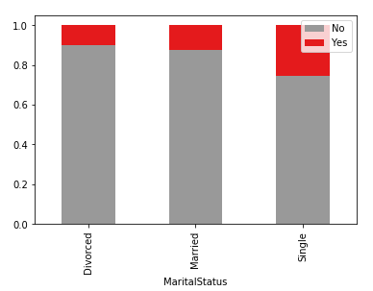
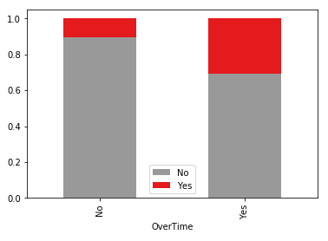
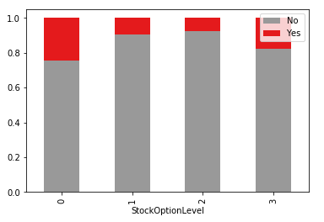
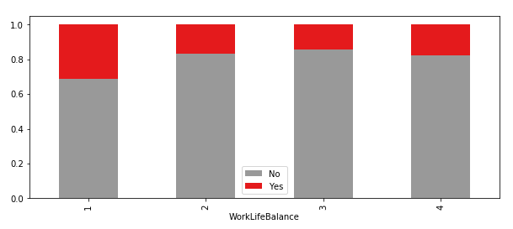
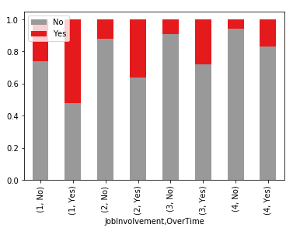
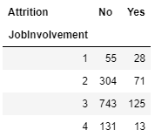
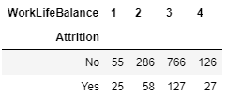
IBM HR ATTRITION
EXPLORATORY DATA ANALYSIS

Slide 7
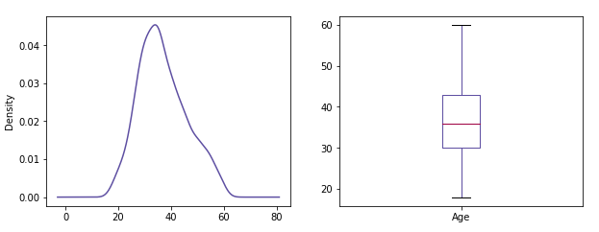
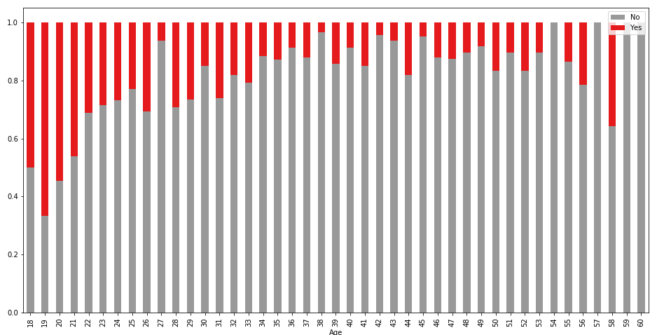
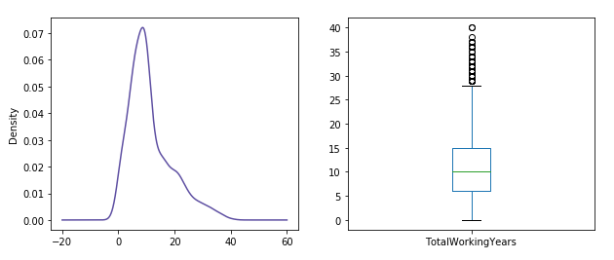
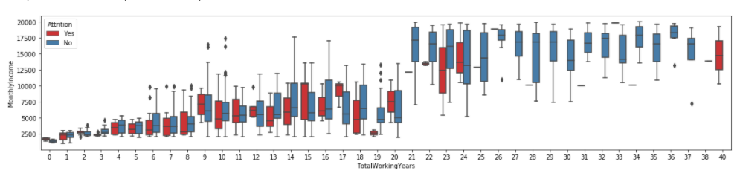
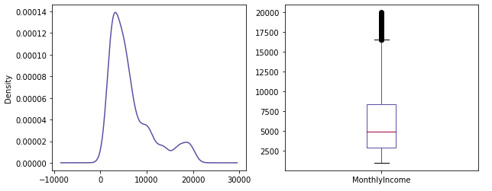
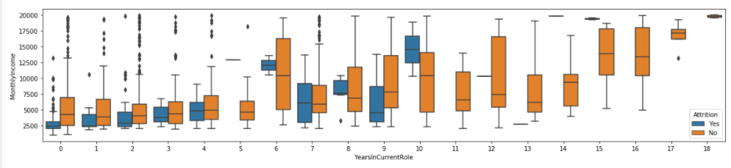
IBM HR ATTRITION
EXPLORATORY DATA ANALYSIS

Slide 8
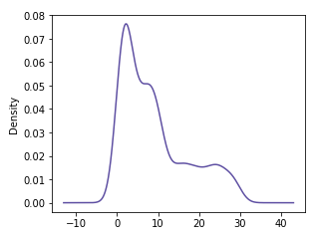
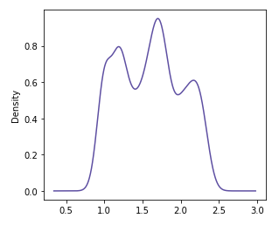
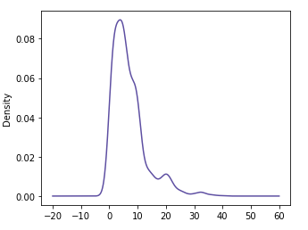
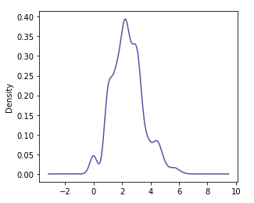
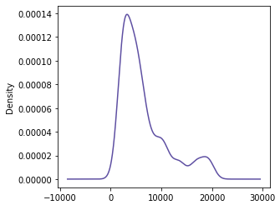
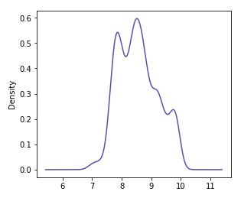
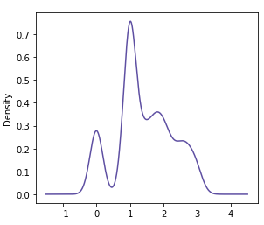
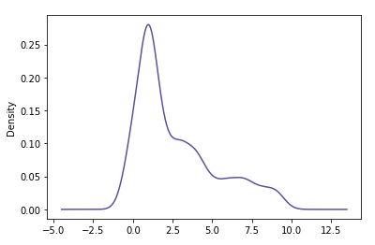
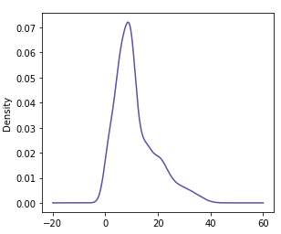
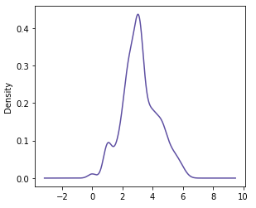
IBM HR ATTRITION
DATA PREPROCESSING
Before Transformation
After Transformation
DistanceFromHome
DistanceFromHome
YearsAtCompany
YearsAtCompany
Skewness: 0.958
Skewness: 0.079
MonthlyIncome
MonthlyIncome
Skewness: 1.764
Skewness: 0.427
NumberOfcompaniesWorked
NumberOfcompaniesWorked
Skewness: 1.369
Skewness: 0.286
TotalWorkingYears
TotalWorkingYears
Skewness: 0.031
Skewness: 1.024
Skewness: 1.117
Skewness: 0.176

Slide 9
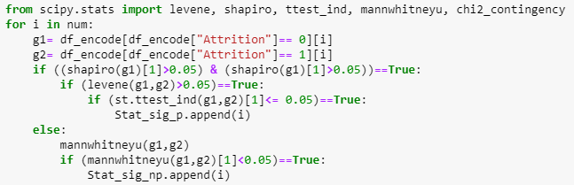

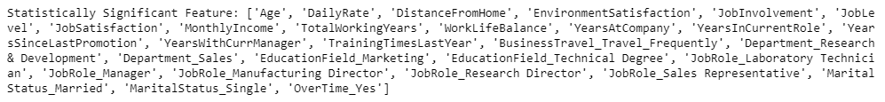
IBM HR ATTRITION
STATISTICAL ANALYSIS
Questions??
Is gender influencing attrition?
Which job role is significant?
Is Distance from home an important attribute?
To answer these intricate questions and to confidentially arrive at a solid conclusion, statistical analysis is performed on each feature.
Selected Analysis

Slide 10
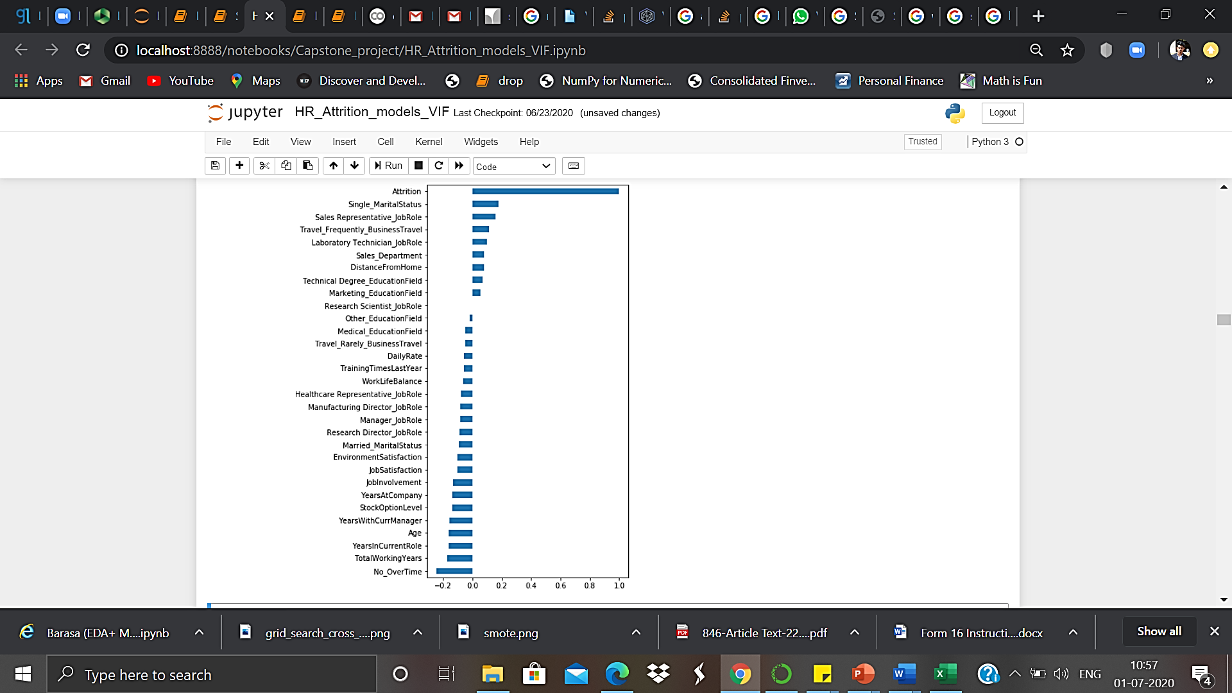
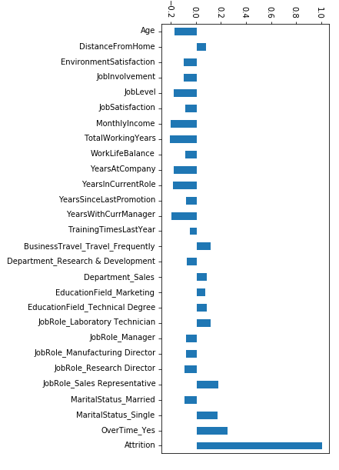
IBM HR ATTRITION
FEATURE SELECTION
Using VIF and correlation matrix Using RFE

Slide 11

IBM HR ATTRITION
Sampling Techniques:
CLASS IMBALANCE
SMOTE

Slide 12
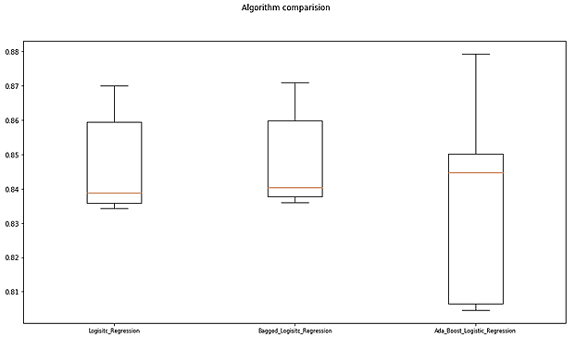
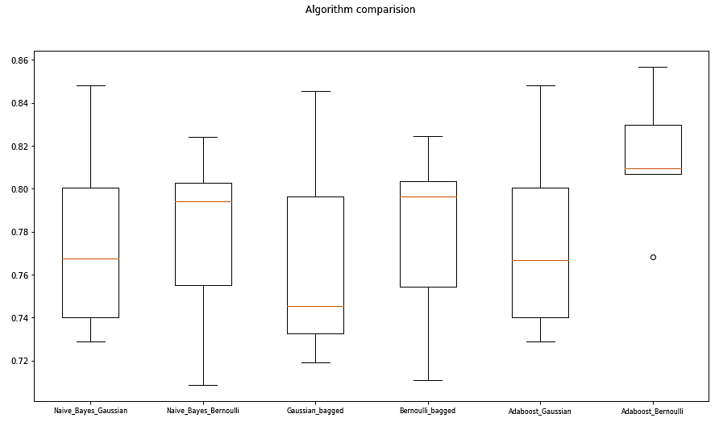
IBM HR ATTRITION
LINEAR MODELS

Slide 13
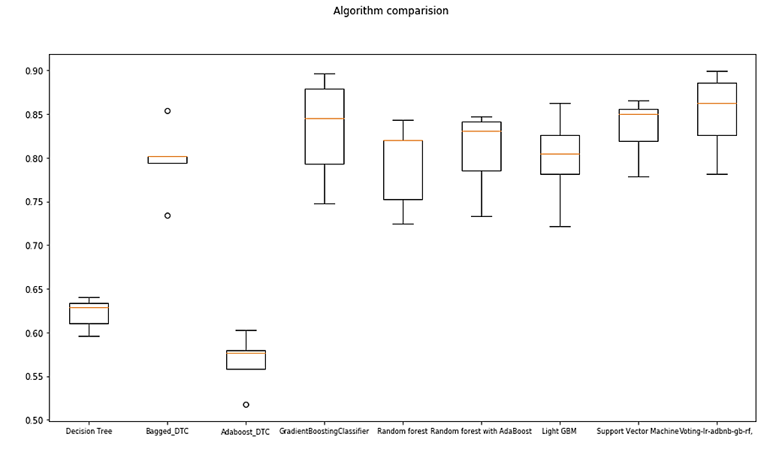
IBM HR ATTRITION
NON-LINEAR MODELS
Algorithms | Bias Error(%) | Variance Error(%)
Decision Tree | 38.435 | 2.585
Bagged_Decision_Tree | 21.307 | 4.06
AdaBoost_Decision_Tree | 43.311 | 3.166
GradientBoostingClassifier | 16.75 | 6.1546
Random forest | 20.771 | 5.084
Random forest with AdaBoost | 19.239 | 4.817
Light GBM | 20.056 | 5.274
Support Vector Machine | 21.6241 | 2.464
Voting(LR, Ad_BNB, GB, Ad_rf) | 14.898 | 4.664

Slide 14
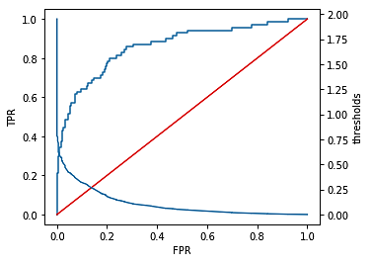
IBM HR ATTRITION
CHOOSING THE BEST MODEL
Percentage decrease in the Bias Error of Ensembled model = (15.102 - 14.898) / ( 15.102) = 1.35%
Percentage decrease in the Variance Error of Logistic Regression w.r.t Ensembled model = (4.664 – 1.555) / (4.664) = 66.6%
Therefore we cannot trade-off 66.6% decrease in variance error to 1.35% decrease in bias error. Hence we choose Bagged Logistic Regression as the Best Model for our Analysis.
ROC curve
BAGGED LOGISTIC REGRESSION
Training Results:
Accuracy score: 89.40%
AUC score: 87.28%
Confusion Matrix:
Testing Results:
Accuracy score: 88.88%
AUC score: 86.11%
Confusion Matrix:
Classification Report:
Attrition | precision | recall | f1-score
(Yes) 0 | 0.97 | 0.9 | 0.94
(No) 1 | 0.44 | 0.76 | 0.56
accuracy |  |  | 0.89
macro avg | 0.71 | 0.83 | 0.75
weighted avg | 0.92 | 0.89 | 0.9
Actual Attrition | Predicted Attrition
 |  | No(0) | Yes(1)
 | No(0) | 846 | 16
 | Yes(1) | 93 | 74
Actual Attrition | Predicted Attrition
 |  | No(0) | Yes(1)
 | No(0) | 361 | 10
 | Yes(1) | 39 | 31

Slide 15
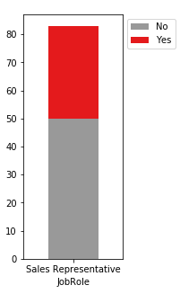
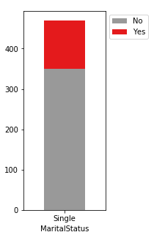
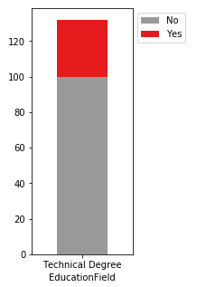
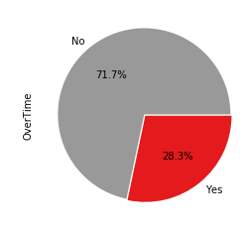
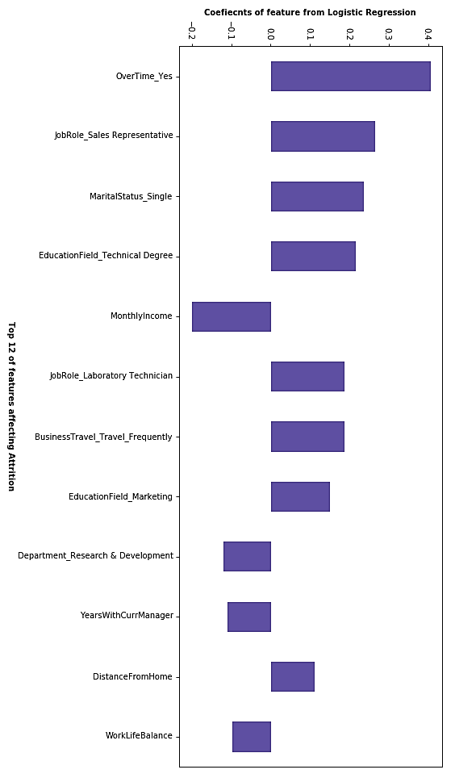

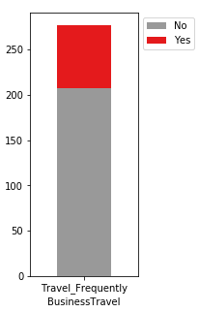


IBM HR ATTRITION
KEY INSIGHTS
Sales Representative
Marital Status
Single
Educational Field
Technical Degree
Over Time
Education Field
Marketing
Department
Research & Development
Job role Laboratory Technician
BusinessTravel
Frequently

Slide 16




IBM HR ATTRITION
KEY INSIGHTS
Monthly Income
Work Balance
Years with the Current Manager
Distance From Home

Slide 17
IBM HR ATTRITION
CONCLUSION
The higher management will know the potential employees who might actually leave so that they can set their attention on them to stop them to do so.
Companies have the ability to forecast and take measures well in advance while smarter retention policies , ESOPs and incentives can be formulated for their respective employees.
It’s a win-win situation all round!!

