Slide 1

Customer Behavior & Sales Analytics

Slide 2
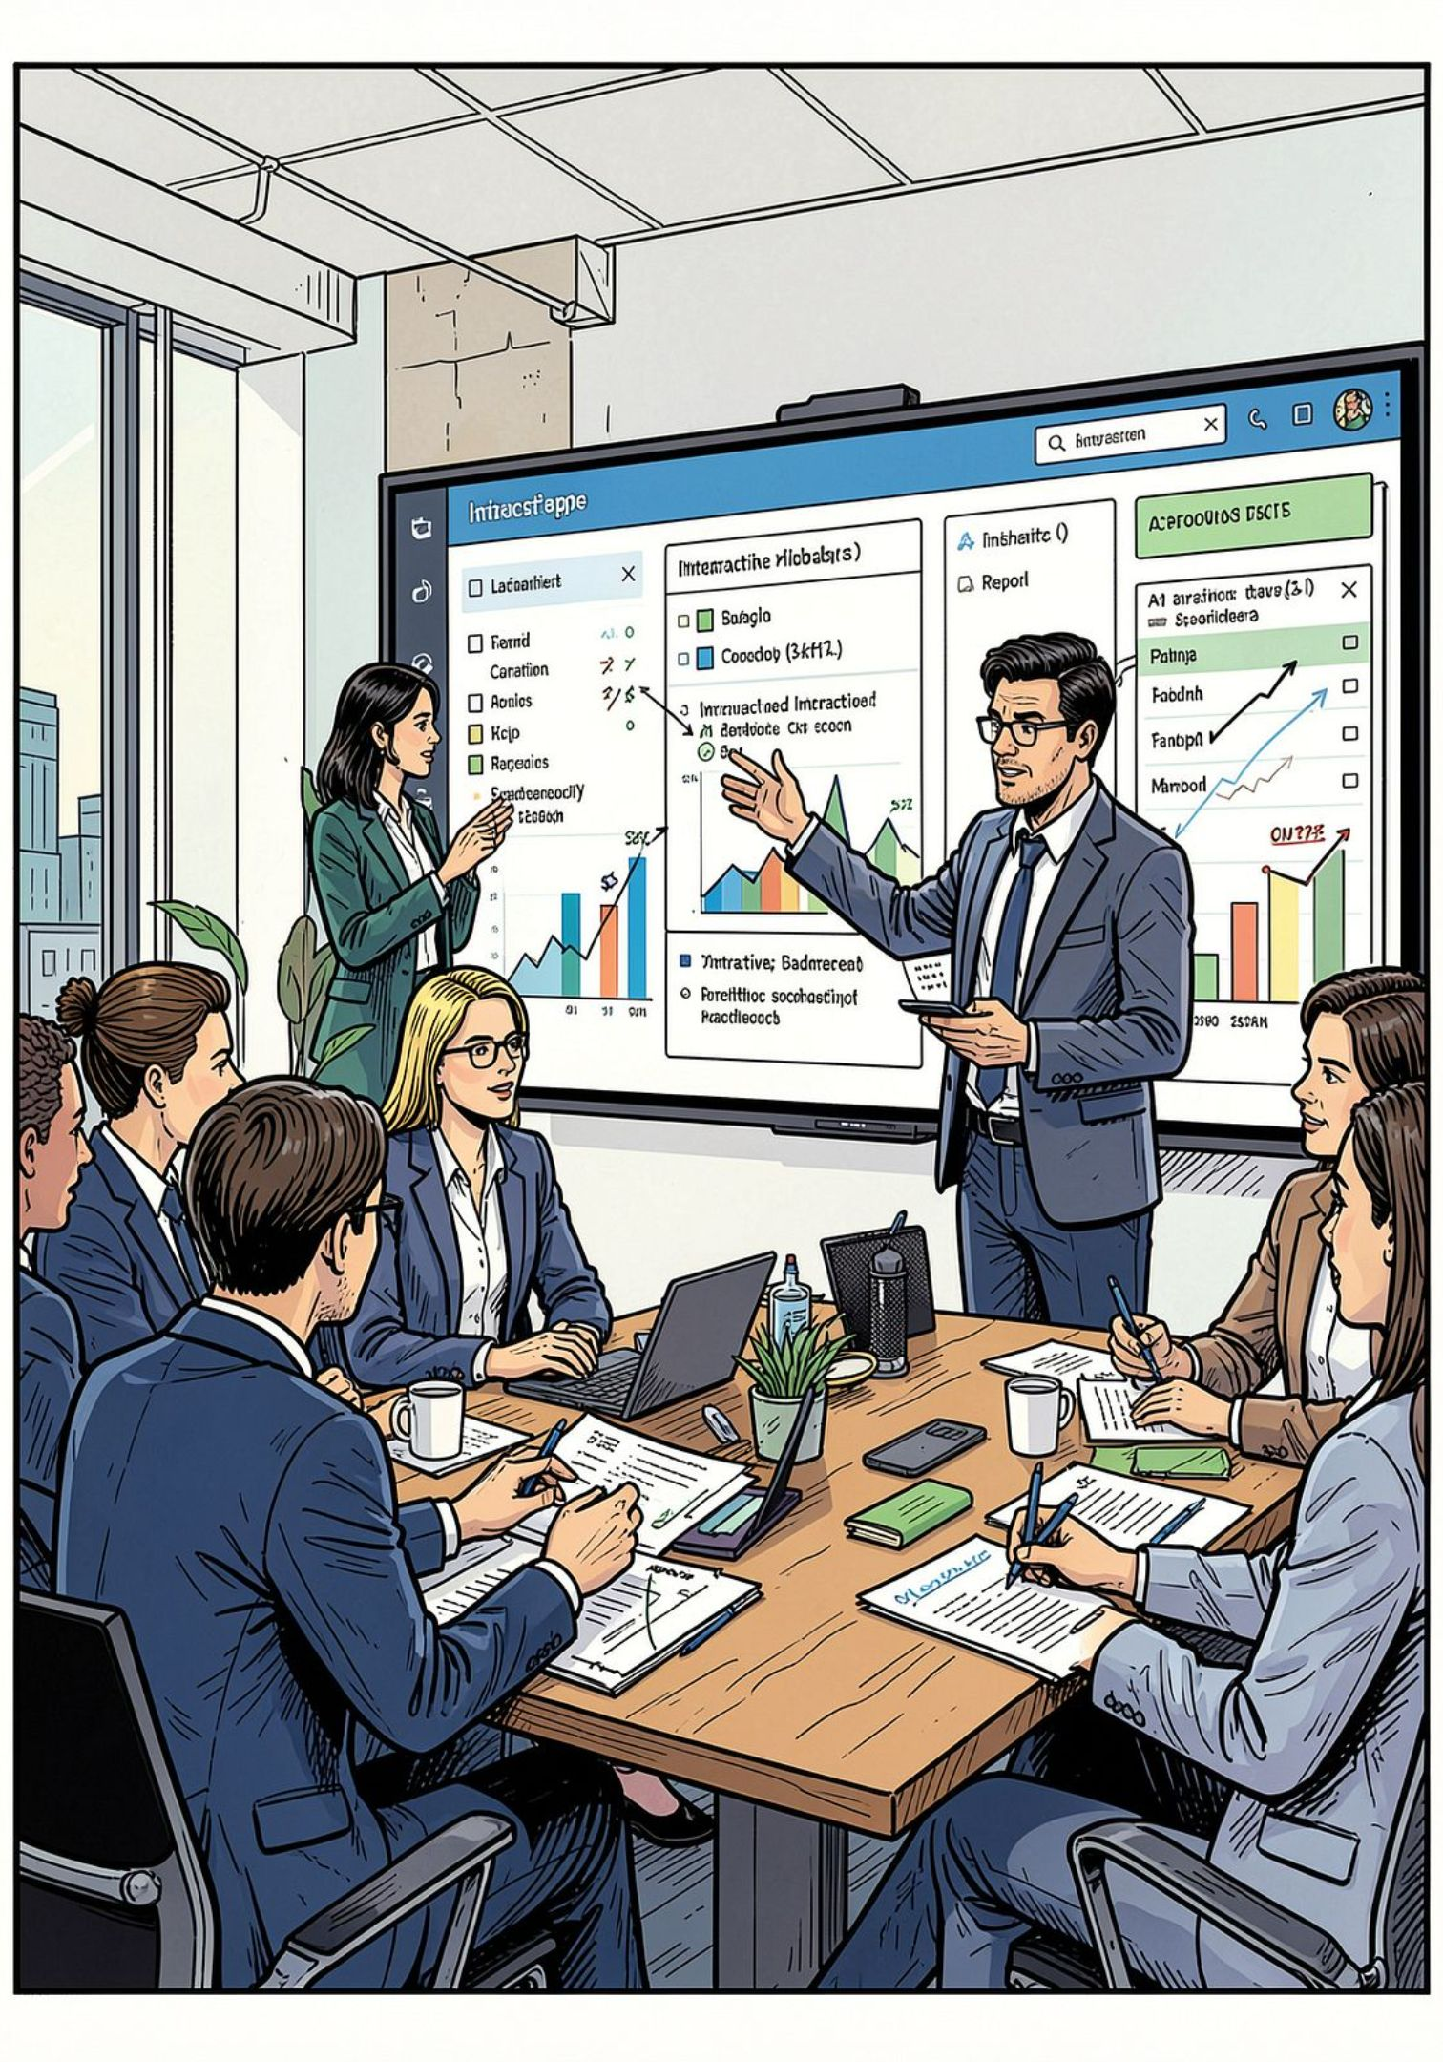
Executive Summary
End-to-end workflow
Dashboard focus
Raw transactions → cleaning → analysis → interactive dashboard
Demographics, subscriptions, categories, revenue, ratings, shipping
Goal
Help business users spot patterns and explore via filters

Slide 3
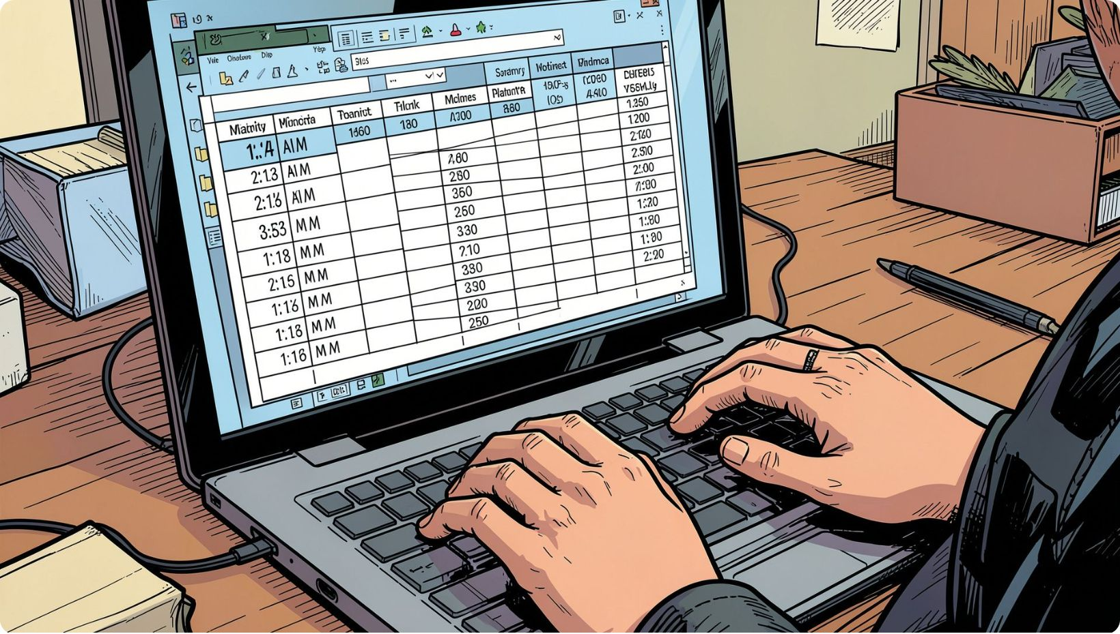
Dataset & Objectives
Dataset
3,900 records · 18 columns · customer, product, transaction, engagement, ops
Objectives
Build practical end-to-end analytics skills; prepare data; visualize in Power BI
Tech
Python / Pandas, SQL, Power BI

Slide 4

Data Preparation & Cleaning
01
02
Handle nulls
Type & columns
Impute or remove missing values (e.g., 37 missing review ratings)
Correct data types; create analytical columns for segmentation
03
Outliers & prep
Detect/handle outliers; export cleaned data for Power BI

Slide 5

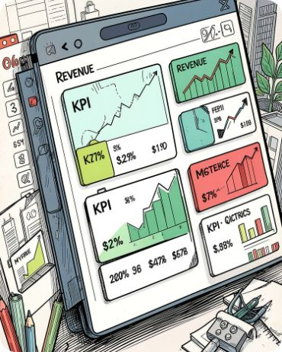
Analytical Workflow & KPIs
Workflow
Key KPIs
Load → Clean (Python) → Query (SQL) → Measures → Dashboard (Power BI)
Customers: 3.9K · Avg purchase: $59.76 · Avg rating: 3.75 · Total revenue: $233K

Slide 6
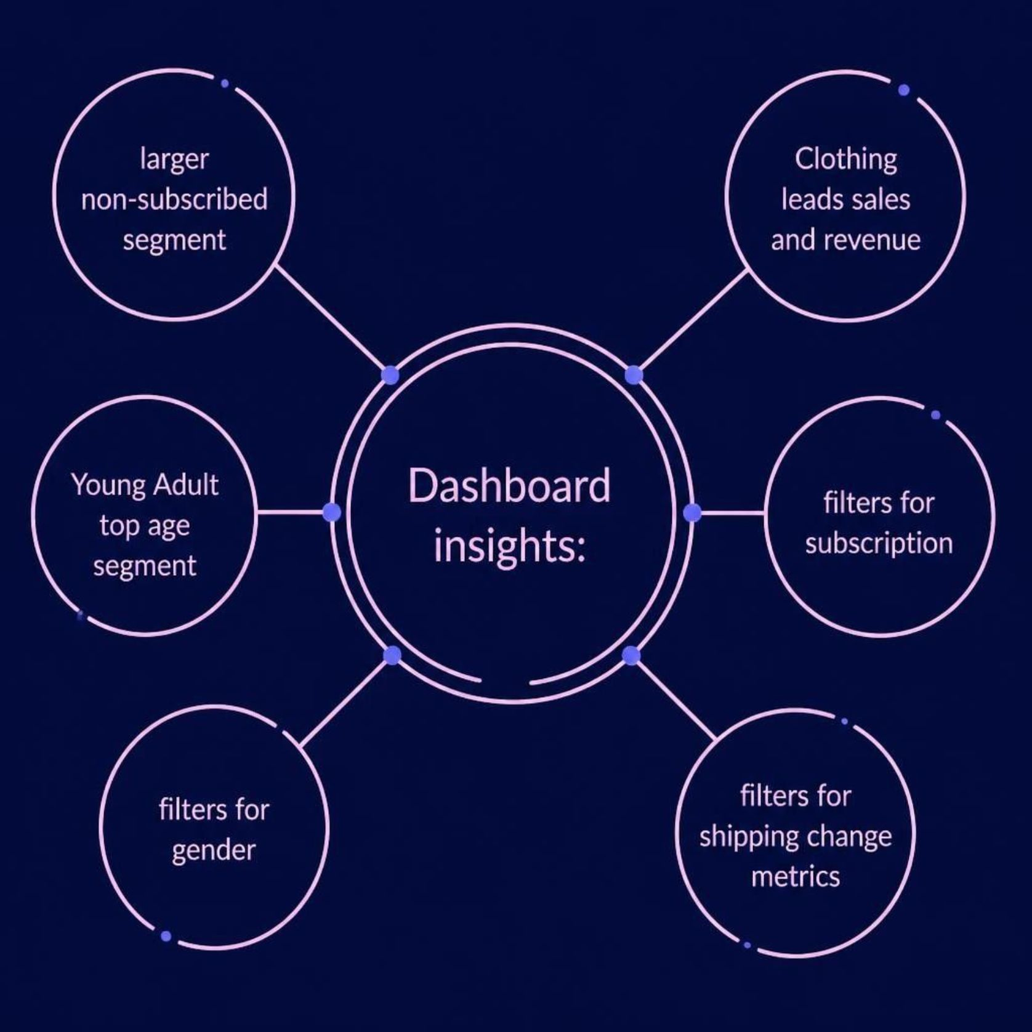
Dashboard Findings
Subscription
Non-subscribed segment much larger — conversion opportunity
Category
Clothing leads in volume and revenue; follow: Accessories, Footwear, Outerwear
Demographics
Young Adult strongest in sales; use age-based targeting

Slide 7

Recommendations & Conclusion
Subscription Offers
Targeted promotions to convert non-subscribed customers
Focus Inventory
Prioritize Clothing promotions and stock for top demand
Segmented Campaigns
Market to strongest age segments; test offers for others
Investigate Low Performers
Analyze pricing, demand, promos, inventory for weaker categories

