Slide 1

ONLINE FOOD DELIVERY
Customer Behavior & Feedback Analysis
SK. AADIL
K. SAGAR
N. SUBAHAN
CH. MANOJ KUMAR
Tech Tiitans

Slide 2
01 · DATASET SELECTED
The Online Food Dataset
A survey-style dataset collected from an online food ordering platform. Each of the 388 rows represents one respondent, capturing their demographics (age, gender, marital status, occupation, income, education, family size), their location (latitude, longitude, pin code), and the outcome of their order experience (whether the order was placed, and their feedback on it).
388
14
2
10
raw rows
columns
outcome fields
(Output, Feedback)
demographic &
location fields
Columns include: Age, Gender, Marital Status, Occupation, Monthly Income, Educational Qualifications, Family size, Customer Type, Latitude, Longitude, Pin code, Output, Feedback.

Slide 3




02 · REASON FOR SELECTION
Why Our Group Chose This Dataset
Real, messy survey data
A clear outcome to study
It isn't pre-cleaned — it contains duplicate rows and a redundant column, giving us genuine cleaning and transformation work to do rather than a toy dataset.
The Output column (order placed or not) and Feedback column (positive/negative) give the analysis a natural focus: what patterns relate to a good or bad outcome.
Rich demographic mix
Right-sized for the timeline
Age, income, occupation, education, marital status, and family size together let us slice the data many ways and compare groups against each other.
At under 400 rows and 14 columns, it's large enough to show real patterns but small enough to clean, transform, and visualize thoroughly within the project schedule.

Slide 4
03 · DATASET SOURCE & LINK
03 · DATASET SOURCE & LINK
Where the Data Came From
PLATFORM
Kaggle
DATASET TITLE
Online Food Dataset
UPLOADED BY
sudarshan24byte
LINK
https://www.kaggle.com/datasets/srisyra02/online-food-ordering-dataset
LICENSE / ACCESS
Publicly available for download on Kaggle
Note: the raw CSV is not included in this submission ZIP (per submission guidelines) — it can be downloaded directly from the link above. The full reference is also recorded in source.txt.

Slide 5
04 · DATA CLEANING PERFORMED
Cleaning the Raw Data
1
2
3
Missing value check
Duplicate rows
Redundant column
Ran a null check across all 14 columns using df.isnull().sum(). Result: 0 missing values — but the notebook still includes automatic mean (numeric) / mode (categorical) filling in case the data source is ever refreshed with gaps.
Ran df.duplicated().sum() and found 103 exact duplicate rows out of 388 (26.5%). These were removed with drop_duplicates(), leaving 285 unique respondent records.
The raw file included a trailing, unnamed column. We confirmed every value in it exactly matched the Output column, then dropped it as duplicate information that added no analytical value.
Result: 388 raw rows -> 285 clean rows, 14 raw columns -> 13 columns.

Slide 6




05 · DATA TRANSFORMATION PERFORMED
Preparing the Data for Analysis
Renamed columns
Derived: age_group
All column names were converted to a consistent snake_case format (e.g. "Marital Status" -> marital_status), removing spaces so columns are easier and safer to reference in code.
Binned the continuous age column into four brackets — 18-22, 23-27, 28-32, 33+ — using pd.cut(), so we can compare behavior across life stages instead of single ages.
Derived: monthly_income_midpoint
Grouping / aggregation
Mapped the categorical income ranges (e.g. "10001 to 25000") to a representative numeric midpoint, turning income into a number that can be averaged and grouped.
Used the two derived columns together — groupby('age_group')['monthly_income_midpoint'].mean() — to summarize average income by age bracket in one line.

Slide 7
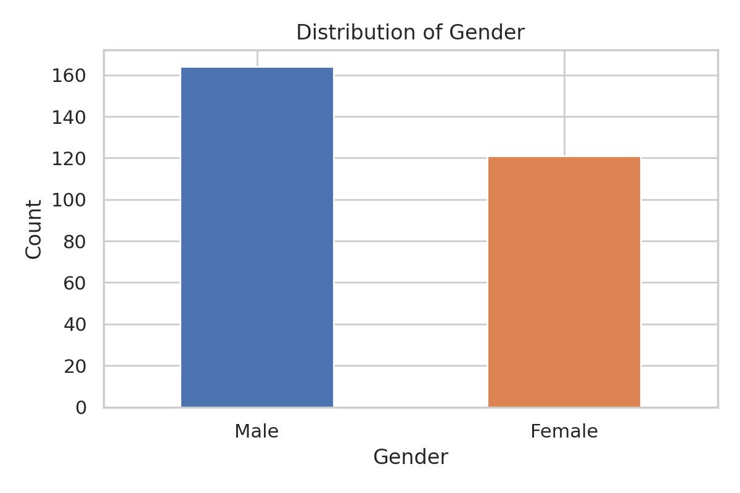
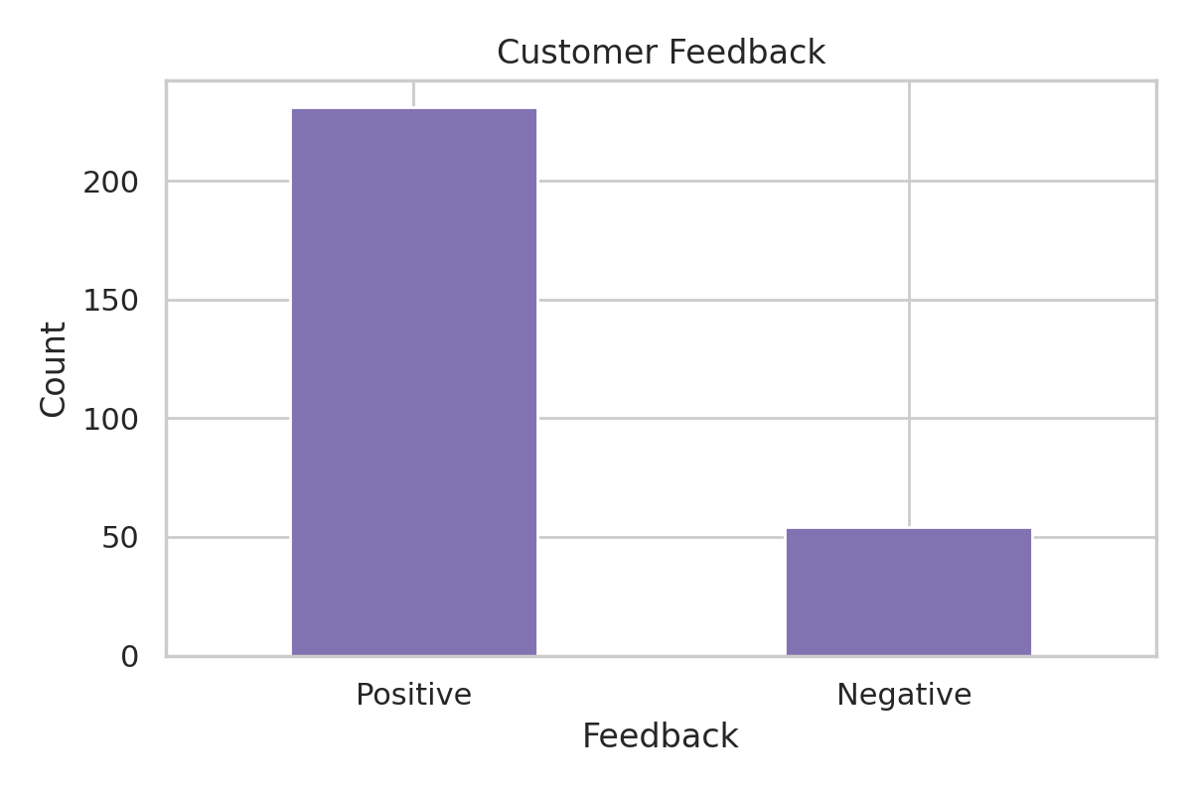
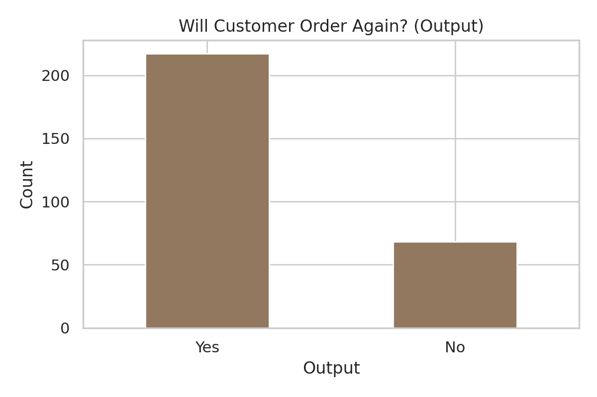
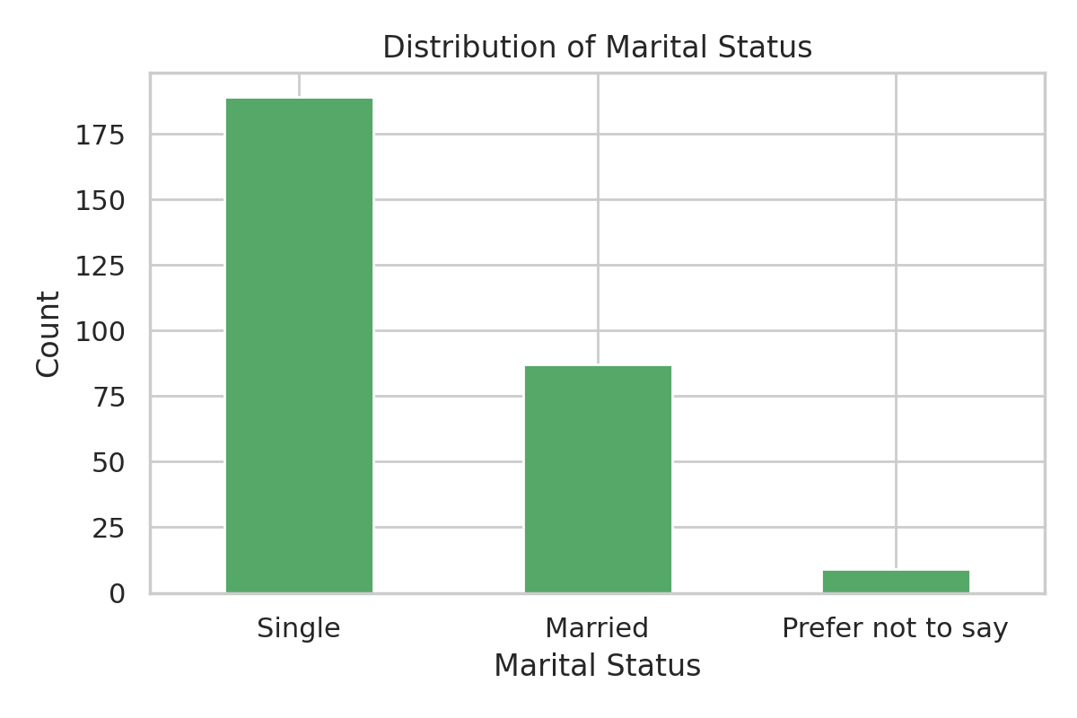
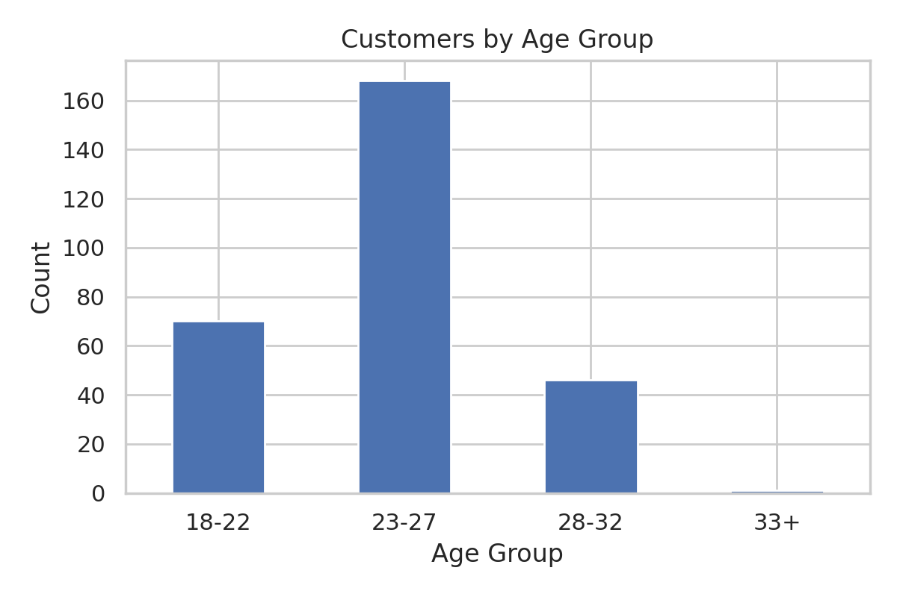
06 · VISUALIZATIONS
Category Distributions (Bar Graphs)
164 male vs 121 female respondents (57%/43%) — a moderate skew, not an extreme imbalance.
231 positive vs 54 negative (81% positive) — feedback leans strongly favorable.
217 orders completed vs 68 not (76%) — most sessions end in a placed order.
Single respondents dominate the sample — consistent with the mostly-20s age range seen in Age Group.
23-27 is by far the largest age bracket (168 of 285) — the survey mainly captures young adults.

Slide 8
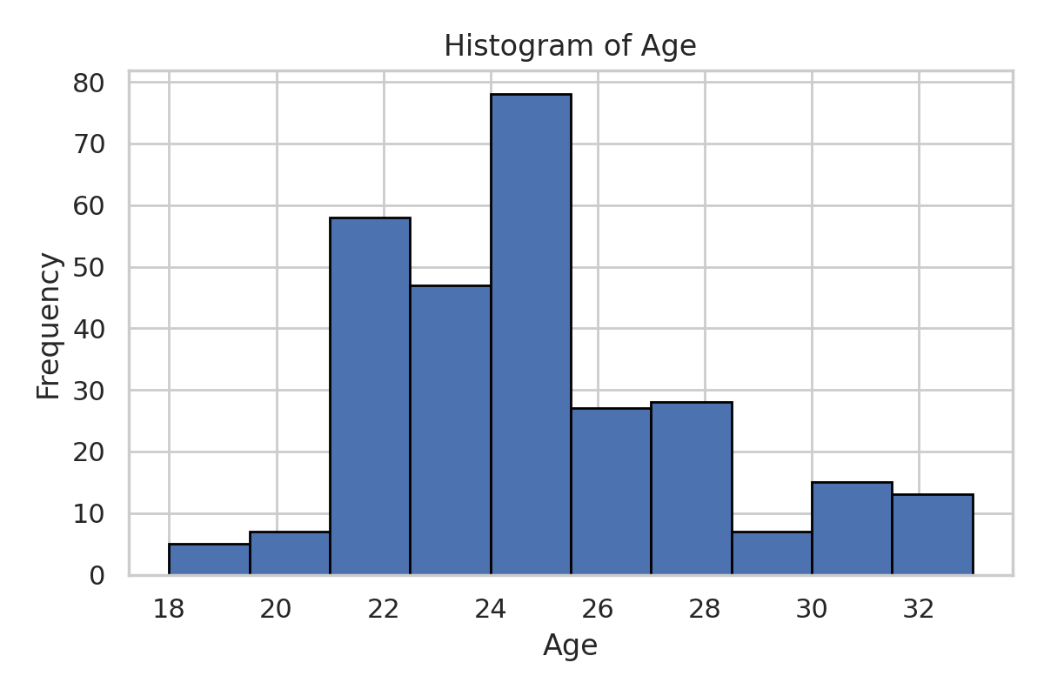
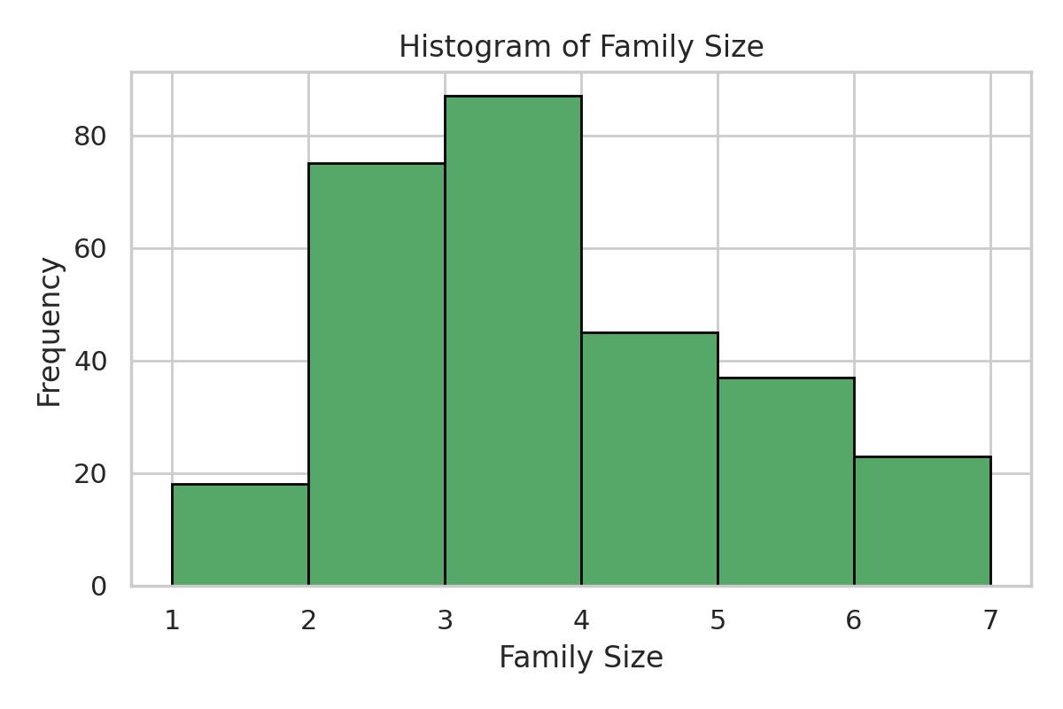
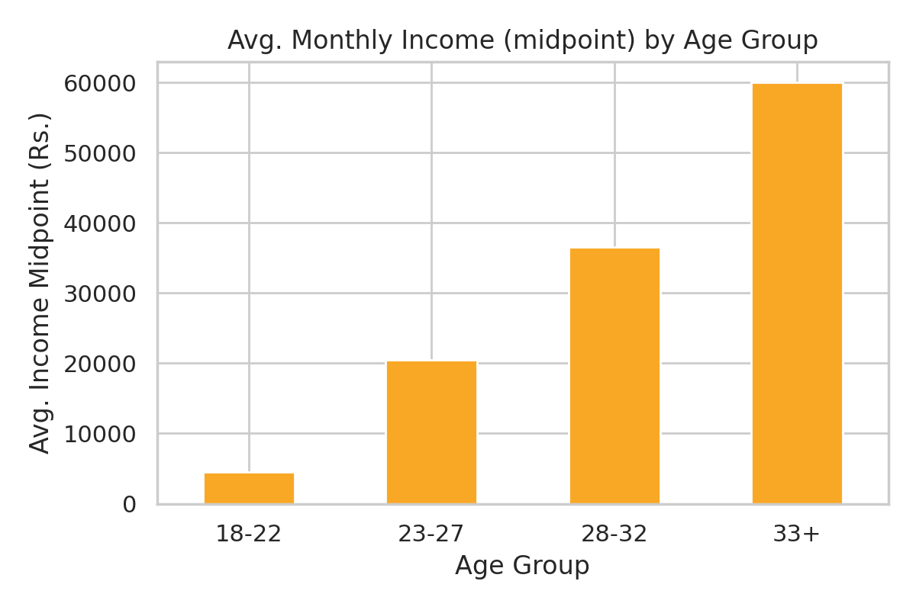
06 · VISUALIZATIONS
Numeric Distributions & a Derived Trend
Ages cluster tightly between 21-26, with a peak around 24-25 — a young, homogeneous respondent pool.
Family sizes of 2-4 are most common, tapering off for larger households (6+).
Built from the derived age_group and monthly_income_midpoint columns (Step 5 transformations).
This is the clearest relationship in the dataset: average income rises consistently across every age bracket, from ~Rs.4,500 (18-22) to Rs.60,000 (33+) — exactly the pattern you'd expect as respondents progress in their careers.

Slide 9




07 · INSIGHTS & FINDINGS
What the Data Tells Us
Income tracks age, not just occupation
Satisfaction and conversion move together
The steady rise in average income across every age bracket (18-22 through 33+) suggests income in this sample is driven mainly by career stage/tenure rather than occupation type alone.
76% of sessions end in a completed order and 81% of feedback is positive — the two outcome measures reinforce each other rather than pulling in different directions, hinting that a good ordering experience and a completed order tend to co-occur.
The sample skews young and single
Duplicates could have skewed early conclusions
58% of respondents fall in the 23-27 bracket and most are single — this is a platform whose active/surveyed users are predominantly young professionals or students, which should be kept in mind before generalizing findings to other age groups.
26.5% of the raw rows were exact duplicates. Had these not been removed, every percentage above would have been calculated on an inflated, double-counted base — a reminder that cleaning isn't cosmetic, it changes the numbers.

Slide 10
CONCLUSION
Conclusion & Next Steps
What we did
Possible next steps
Selected the Online Food Dataset (Kaggle) for its realistic, uncleaned structure and clear outcome columns.
Checked for and handled missing values (mean/mode fill logic).
Cleaned duplicate rows (103 removed) and a redundant column.
Transformed columns: renamed to snake_case, derived age_group and monthly_income_midpoint.
Visualized categorical, numeric, and derived columns; drew out patterns and relationships.
Build a classification model to predict Output using demographic and income features.
Test whether income or age is the stronger driver of positive feedback.
Map geographic patterns using latitude/longitude and pin code.
Re-run the analysis on fresh data pulls to confirm the duplicate-row issue is source-specific.

Slide 11

THANK YOU
Thank You for This Opportunity
We appreciate the chance to explore, analyze, and present this project.
Thank you for your time, guidance, and support along the way.
Tech Tiitans

