Slide 1
BILLING SYSTEM
TEAM MEMBERS
24KB1A05L6
24KB1A05GV
24KB1A05BD
24KB1A05LA

Slide 2
INTRODUCTION
A billing system is a software application designed to handle the process of generating invoices, tracking customer purchases, calculating totals, applying discounts or taxes, and managing payments.
OBJECTIVE
To develop and implement an accurate, efficient, and user-friendly billing system that automates invoice generation, tracks payments, manages customer accounts, and ensures timely financial reporting to support business operations and enhance customer satisfaction."

Slide 3
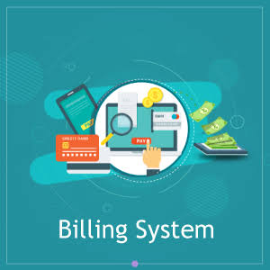
WHY C AND DSA ?
It's fast and efficient, making it suitable for embedded systems or point-of-sale terminals.It gives low-level access to memory, which is useful for optimized performance.
Arrays or linked lists store product details and invoices.Stacks/Queues can manage billing tasks or order processing.Trees/Hash Tables can be used for fast search (e.g., product lookup by code).Files or structures handle permanent storage and quick data access.

Slide 4
Algorithm
Start
Initialize Variablesitem_name, quantity, price, total, grand_totalUse arrays if handling multiple items
Input Number of Items
For each item (loop):Input item_nameInput priceInput quantityCalculate total = price * quantityAdd total to grand_total
After loop ends:Optionally apply tax or discountCalculate final amount
Print BillList items with quantity, price, and totalShow grand_total, tax/discount if any, and final amount
7. End

Slide 5
SOURCE CODE
https://onlinegdb.com/y21Dix-uH

Slide 6
LESSON LEARNT
Use of Functions – Makes code organized and reusable.
Structures – Helps group related data like product details.
File Handling – Useful for saving and retrieving bills.
User Input Handling – Important to avoid errors and crashes.
Menu-driven Program – Makes the system user-friendly.

Slide 7
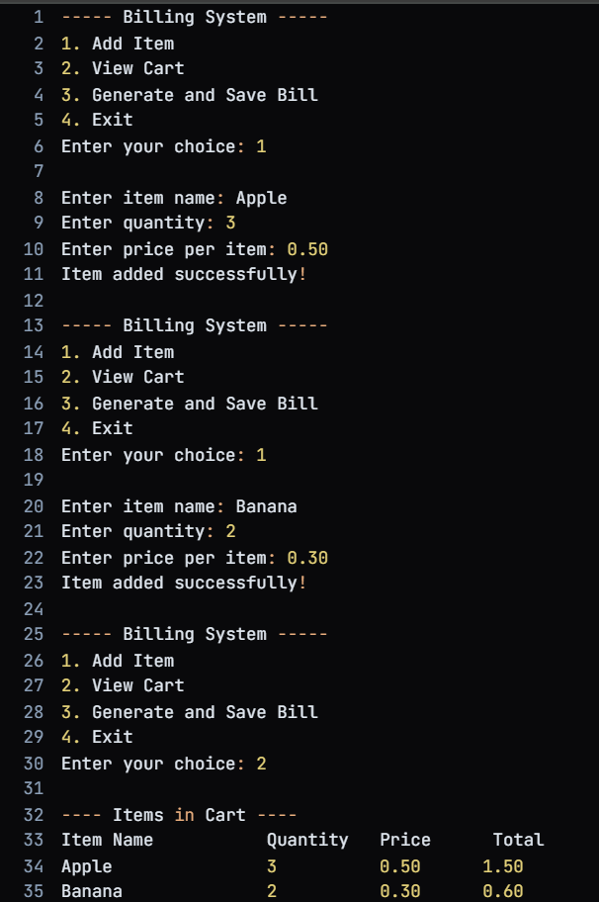
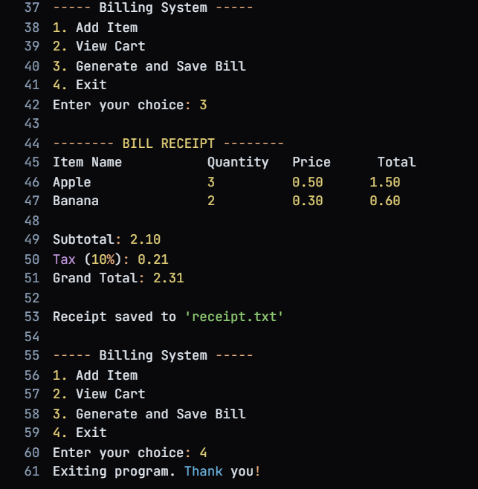
OUT PUT

Slide 8
CONCLUSION
The billing system developed in C successfully demonstrates the essential functionalities required for managing sales transactions efficiently. It allows for accurate recording of items, calculation of totals, application of taxes or discounts, and generation of detailed bills.

Slide 9
THANK YOU

