Slide 1

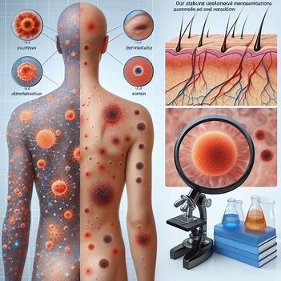

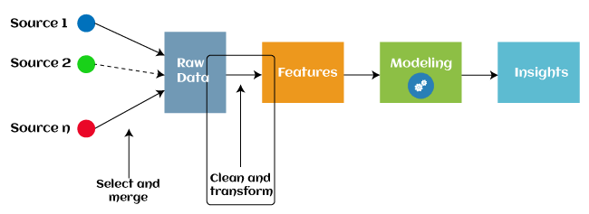
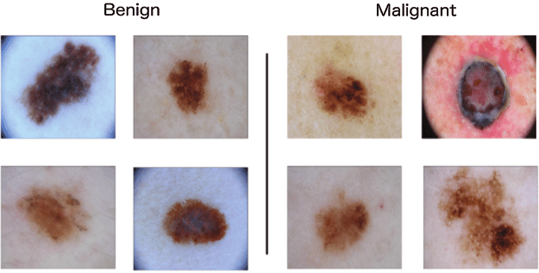

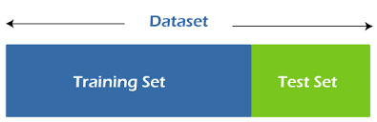
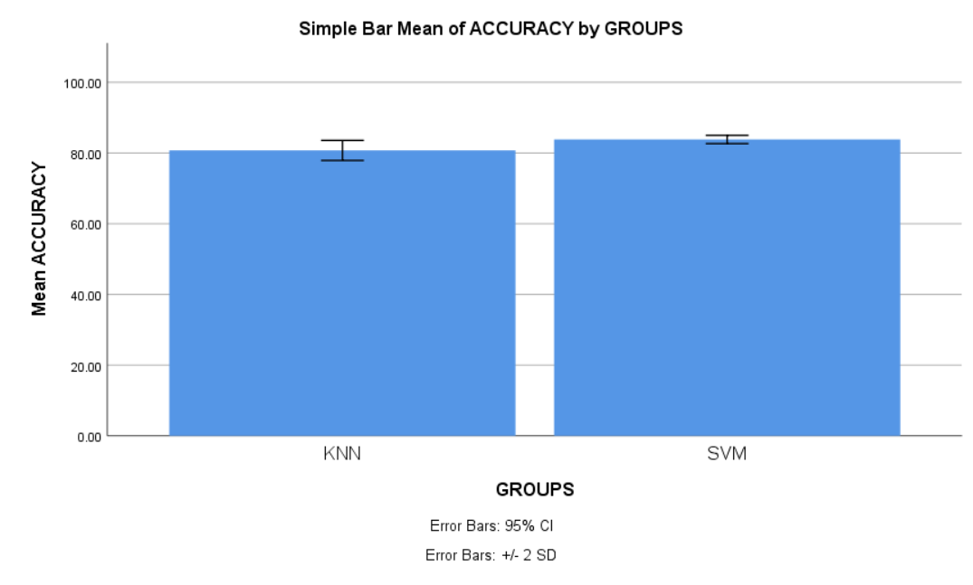
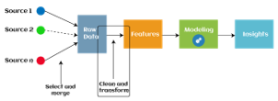
Name: Mr. Shaik Afroz Register Number: 192111374
Guided by Dr. C. Rohith Bhat
Ms. Poorani.S
Guided by Dr. Mary Valantina. G
The effectiveness of Dermatological manifestations of Melanoma disease using Novel Support Vector Machine with entropy in comparison with K-Nearest Neighbor for better accuracy.
INTRODUCTION
The purpose of this research is to observe the accuracy of Melanoma disease using Novel Support Vector Machine with entropy in comparison with K-Nearest Neighbor.
Melanoma is a type of skin cancer that develops when melanocytes (the cells that give the skin its tan or brown color) start to grow out of control. Melanoma is much less common than some other types of skin cancers. But melanoma is more dangerous because it’s much more likely to spread to other parts of the body if not found and treated early.
Utilizing machine learning in dermatological manifestations of melanoma aims to enhance early diagnosis, predict metastasis risk and disease-free survival, and identify decreased serum GM-CSF levels as a potential adverse prognostic marker in early-stage melanoma patients.
The SVM with Entropy boosts accuracy in high-dimensional, non-linear datasets by leveraging entropy as a discriminative feature. Conversely, K-NN prioritizes simplicity and noise resilience but struggles with scalability and parameter sensitivity, affecting accuracy, particularly in large datasets.
I have used the dataset from the Kaggle which has 10,000 rows and 10 columns.
MATERIALS AND METHODS
WORKFLOW OF MELANOMA DISEASE PREDICTION USING MACHINE LEARNING METHOD
Pre-processing
Input data
Feature Extraction
Classification
Split, Train and test
RESULTS
Data preparation involves proper dataset division, shuffling to avoid bias, and preprocessing to standardize data, ensuring consistency for enhanced model training.
Feature extraction captures critical information from dermatological manifestations, facilitating lesion differentiation, while training SVM with entropy and K-NN enables performance comparison in utilizing these features for classification.
Evaluation, analysis, and optimization of models on testing datasets, including hyperparameter tuning and statistical tests, identify the superior classifier for melanoma classification among SVM and K-NN.
By independent sample test, there is a significant difference in accuracy attained by the algorithm is 0.024(p<0.05).Support Vector Machine(SVM) outperforms other machine learning algorithm in Dermatological manifestation of Melanoma disease prediction.
 | ALGORITHMS | N | MEAN | STD.DEVIATION | STD.ERROR MEAN
ACCURACY | SVM | 10 | 83.8310 | .59218 | .18726
 | KNN | 10 | 80.7350 | 1.41463 | .44735
SPSS Analysis of SVM with KNN
DISCUSSION AND CONCLUSION
The Accuracy of Support Vector Machine 83.83% and K- nearest neighbor classifier 80.73%. So, from the two algorithms we found that SVM has better accuracy.
The diagnosis of melanoma is aided by color, texture, and form aspects that capture differences in pigmentation, texture patterns, and lesion geometry. While preprocessing, dimensionality reduction, optimal kernel functions, and distance metrics are essential for accurate classification with SVM and K-NN, the integration of entropy, clinical data, and feature fusion improves discrimination.
This comprise possible biases brought on by unbalanced data, difficulties choosing features that affect how well a model performs, and computational difficulty, especially when dealing with big datasets. Furthermore, complicated entropy-based characteristics may impair interpretability, and external validation is required to improve the generalizability of results outside of the research dataset.
Our study highlights a significant difference in accuracy between SVM and KNN for melanoma dermatological manifestations, with SVM achieving 83.83% accuracy compared to KNN's 80.73%, substantiated by a p-value of 0.024. These findings emphasize SVM's potential as a reliable tool, advancing melanoma prediction with advanced machine learning techniques.
BIBLIOGRAPHY
Aggarwal, Pushkar. 2021. “Performance of Artificial Intelligence Imaging Models in Detecting Dermatological Manifestations in Higher Fitzpatrick Skin Color Classifications.” JMIR Dermatology 4 (2): e31697.
Ingen-House-Oro, Saskia, Brigitte Milpied, Marine Badrignans, Cristina Carrera, Yannick S. Elshot, Benoit Bensaid, Sonia Segura, et al. 2022. “Severe Blistering Eruptions Induced by Immune Checkpoint Inhibitors: A Multicentre International Study of 32 Cases.” Melanoma Research 32 (3).
Dika, Emi, Martina Lambertini, Bruna Gouveia, Martina Mussi, Emanuela Marcelli, Elena Campione, Carlotta Gurioli, Barbara Melotti, Aurora Alessandrini, and Simone Ribero. 2021. “Oral Manifestations in Melanoma Patients Treated with Target or Immunomodulatory Therapies.” Journal of Clinical Medicine Research 10 (6).
Nwabudike, Lawrence Chukwudi, Ana Maria Oproiu, Ioana Mihaela Dogaru, Mariana Costache, and Alin Laurentiu Tatu. 2022. “Clinical, Dermoscopic and Microscopic Features of a ‘Collision Tumor’ Ultimately Confirmed as a Regressing Melanoma - Lessons Learnt from a Chance Diagnosis.” Clinical, Cosmetic and Investigational Dermatology 15 (July): 1325–31.

