Slide 1

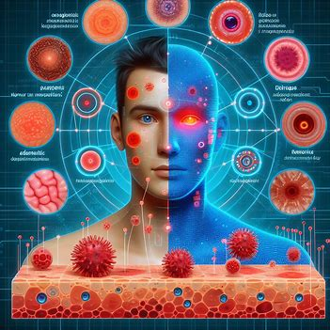

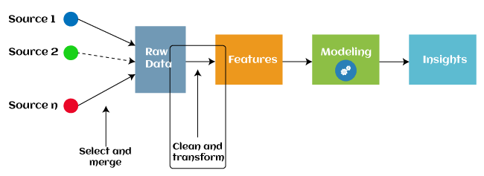
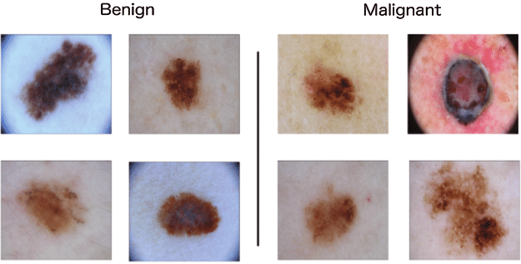

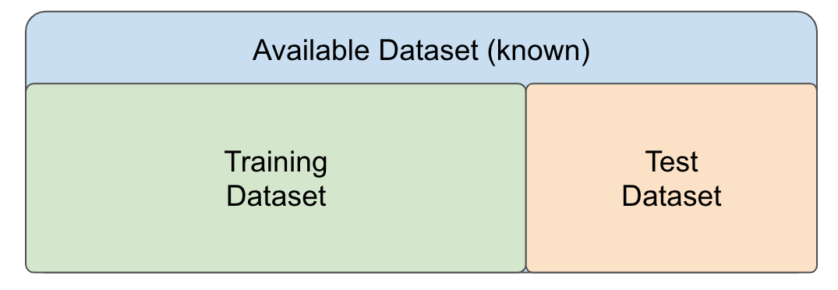
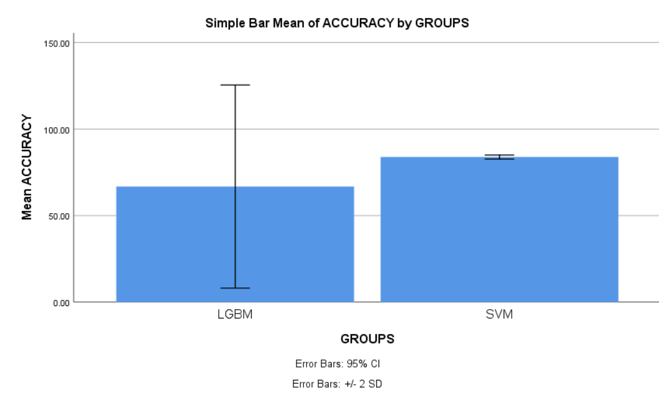
Name: Mr. Shaik Afroz Register Number: 192111374
Guided by Dr. C. Rohith Bhat
Ms. Poorani.S
Guided by Dr. Mary Valantina. G
The effectiveness of Dermatological manifestations of Melanoma disease using Novel Support Vector Machine with data augmentation in comparison with Light Gradient Boosting Machine for better Accuracy.
INTRODUCTION
This study aims to monitor the accuracy of the melanoma diagnosis using Novel Support Vector machine in comparison with LighttGBM.
Melanoma is a kind of skin cancer that is caused by the overgrowth of melanocytes, the cells that give skin its tan or brown color. Melanoma is far less common than certain other types of skin cancer. But melanoma poses a greater risk as it can spread to other parts of the body more easily if treatment is not received.
In order to improve early detection, predict metastasis risk and disease-free survival, and uncover lower serum GM-CSF levels as a possible poor prognostic sign in early-stage melanoma patients, machine learning is being applied to dermatological symptoms of melanoma.
SVM with Data Augmentation optimizes hyperplane separation while enhancing dataset diversity for improved generalization. LightGBM employs an efficient tree-based approach, excelling in scalability and categorical feature handling, enhancing accuracy across diverse machine learning tasks.
I have used the dataset from the Kaggle which has 10,000 rows and 10 columns.
MATERIALS AND METHODS
WORKFLOW OF MELANOMA DISEASE PREDICTION USING MACHINE LEARNING METHOD
Pre-processing
Input data
Feature Extraction
Classification
Split, Train and test
RESULTS
Proper partition of the dataset, shuffles to prevent bias, and preprocesses to normalize the data, guaranteeing consistency for improved model training are all part of data preparation.
Lesion discrimination is made easier by feature extraction, which gathers important information from dermatological manifestations. Performance comparison is made possible by training SVM with data augmentation and LightGBM to use these features for classification.
SVM and LightGBM are the two best classifiers for classifying melanoma; the best classifier is determined by evaluation, analysis, and model optimization on testing datasets, including hyperparameter tuning and statistical tests.
By independent sample test, there is a significant difference in accuracy attained by the algorithm is 0.001(p<0.05).Support Vector Machine(SVM) outperforms other machine learning algorithm in Dermatological manifestation of Melanoma disease prediction.
Group Statistics
 | ALGORITHMS | N | MEAN | STD.DEVIATION | STD.ERROR MEAN
ACCURACY | SVM | 10 | 83.8310 | .59218 | .18726
 | LightGBM | 10 | 66.7970 | 29.32926 | 9.27473
SPSS Analysis of SVM with LightGBM
DISCUSSION AND CONCLUSION
Support vector machines (83.83%) and Light Gradient Boosting Machines(66.79%) have their accuracy rates. Therefore, we conclude that SVM has superior accuracy amongst the two methods.
In order improve accuracy in clinical settings, this study compares SVM with data augmentation and LightGBM for the diagnosis of melanoma symptoms. It aims to find out which method between SVM and LightGBM provides better diagnostic accuracy by increasing the variety of data.
This comparison include potential dependencies on high-quality datasets for SVM with data augmentation, along with computational demands and interpretability issues for both SVM and Light Gradient Boosting Machine. Generalizability concerns and risks of overfitting may further impact the reliability and applicability of the findings.
Our study highlights a significant accuracy difference between SVM and LightGBM for melanoma dermatological manifestations, with SVM achieving 83.83% accuracy compared to LightGBM's 66.79%, supported by a p-value of 0.001. These findings underscore SVM's potential as a reliable tool, emphasizing its importance in enhancing melanoma prediction accuracy.
BIBLIOGRAPHY
Londoño, Ángela, Camila Pérez, Rodrigo Restrepo, Nathalie Morales, Miguel Martínez, and Daniela Morales. 2021. “Exogenous Pigmentation by Silver Nitrate: Dermatological and Toxicological Aspects, Case Report.” Biomedica: Revista Del Instituto Nacional de Salud 41 (2): 234–39.
Neo, Shi Yong, Mariana M. S. Oliveira, Le Tong, Yi Chen, Ziqing Chen, Sonia Cismas, Nutsa Burduli, et al. 2024. “Natural Killer Cells Drive 4-1BBL Positive Uveal Melanoma towards EMT and Metastatic Disease.” Journal of Experimental & Clinical Cancer Research: CR 43 (1): 13.
Alhaddad, Hasan, Oscar E. Ospina, Mariam Lotfy Khaled, Yuan Ren, Peter Forsyth, Yolanda Pina, Robert Macaulay, et al. 2023. “Spatial Transcriptomics Analysis Identifies a Unique Tumor-Promoting Function of the Meningeal Stroma in Melanoma Leptomeningeal Disease.” bioRxiv : The Preprint Server for Biology, December.
Dummer, Reinhard, Mark R. Pittelkow, Keiji Iwatsuki, Adèle Green, and Nagwa M. Elwan. 2011. Skin Cancer - A World-Wide Perspective. Springer Science & Business Media.

