Slide 1

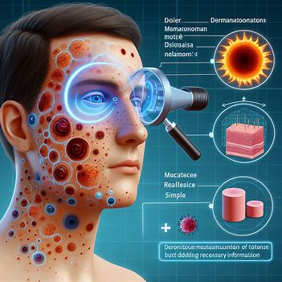
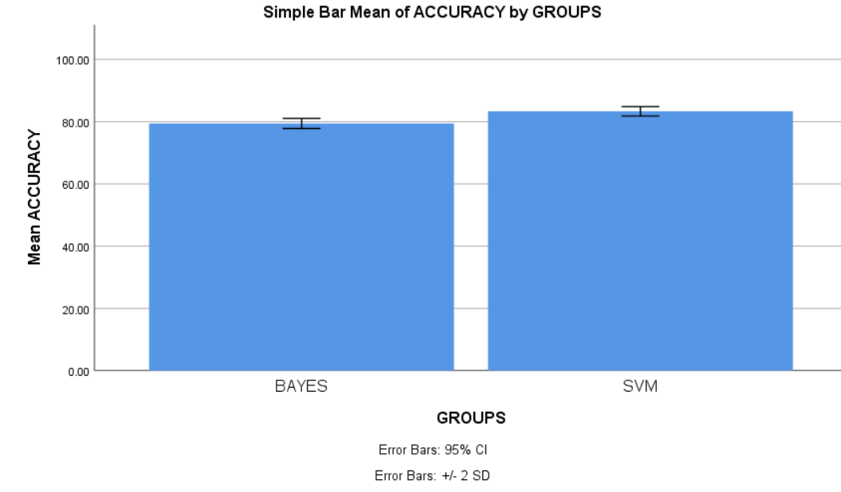
Name: Mr. SHAIK AFROZ Register Number: 192111374
Guided by Dr. C . Rohith Bhat
Ms. Poorani.S
Guided by Dr. Mary Valantina. G
The effectiveness of Dermatological Manifestations of Melanoma disease using Novel Support Vector Machine in comparison with Naïve Bayes classifier for better accuracy.
INTRODUCTION
This study aims to monitor the accuracy of the melanoma diagnosis using Novel Support Vector Machine in comparison with Naïve Bayes classifier .
Melanoma is a kind of skin cancer that is caused by the uncontrolled growth of melanocytes, the cells that give skin its tan or brown color. Melanoma is far less common than certain other types of skin cancer. But melanoma poses a greater risk as it can spread to other parts of the body more easily if treatment is not received.
Machine learning is being used to dermatological symptoms of melanoma in order to enhance early identification, predict metastasis risk and disease-free survival, and identify decreased blood GM-CSF levels as a potential poor prognostic indication in early-stage melanoma patients.
SVM is an excellent choice for datasets with many various characteristics but few samples since it can handle high-dimensional and non-linear data, discover the best hyperplanes for class separation, and support a variety of kernel functions. On the other hand, Naïve Bayes, because of its simplicity and dependence on the Bayes theorem, is effective for small datasets and noise-resistant, but it may not be able to handle highly correlated features or complex interactions between variables.
I have used the dataset from Kaggle ,which has 10,000 rows and 10 columns.
MATERIALS AND METHODS
Input Data
Pre-processing
Feature Extraction
Classification Model
Split, Train and test
.
Output
WORKFLOW OF MELANOMA DISEASE PREDICTION USING MACHINE LEARNING METHOD
RESULTS
Data preparation includes things like properly segmenting the dataset within itself, shuffles to reduce bias, and preprocessing to normalize the data so that it is consistent for better model training.
Feature extraction, which gathers pertinent data from dermatological drawings, helps in lesion discrimination. Comparing performance is achievable when using Naive Bayes and SVM training.
The two best classifiers are SVM and Naive Bayes, which are found by testing datasets for assessment, analysis, and model optimization—which involves statistical tests and hyperparameter manipulating.
An independent sample test reveals that the method produces a significant improvement in accuracy of 0.000 (p<0.05). Support Vector Machine (SVM) outperforms other machine learning algorithms in predicting the dermatological manifestation of melanoma.
Group Statistics
 | ALGORITHMS | N | MEAN | STD.DEVIATION | STD.ERROR MEAN
ACCURACY | SVM | 11 | 83.29 | .75735 | .23950
 | BAYES | 11 | 79.39 | .80732 | .25530
SPSS Analysis of SVM with Naïve Bayes
DISCUSSION AND CONCLUSION
Support vector machines (83.29%) and Naïve Bayes (79.39%) have similar accuracy rates. Therefore, we determine that SVM has superior accuracy amongst the two
method.
Aspects of color, texture, and shape that depict variations in pigmentation, texture patterns, and lesion geometry contribute in the diagnosis of melanoma. With SVM and
Naïve Bayes , accurate classification requires preprocessing, dimensionality reduction, optimum kernel functions, and distance metrics; still classification is enhanced by
the combination of entropy, clinical data, and feature fusion.
This includes potential biases resulting from data imbalances, challenges selecting characteristics that impact a model's performance, and computational complexity, particularly when working with large datasets. Additionally, complex entropy-based features could make results harder to comprehend, and results outside of the study dataset need to be externally validated in order to make them more broadly applicable.
Based on a p-value of 0.955, our study highlights a substantial discrepancy in accuracy between SVM and Naïve Bayes for dermatological signs of melanoma, with SVM obtaining 83.29% accuracy vs 79.39% for Naïve Bayes. These results highlight SVM's potential as an even better tool for melanoma manifestation prediction, supporting the use of cutting-edge machine learning methods in dermatological treatment to increase precision and efficiency.
BIBLIOGRAPHY
Anastasopoulou, Amalia, Panagiotis T. Diamantopoulos, Panagiotis Kouzis, Maria Saridaki, Konstantinos Sideris, Michael Samarkos, and Helen Gogas. 2023. “COVID-19 in Patients with Melanoma: A Single-Institution Study.” Cancers 16 (1).
Azeem, Muhammad, Kaveh Kiani, Taha Mansouri, and Nathan Topping. 2023. “SkinLesNet: Classification of Skin Lesions and Detection of Melanoma Cancer Using a Novel
Multi-Layer Deep Convolutional Neural Network.” Cancers 16 (1).
Beltran-Ontiveros, Saul A., Jose A. Contreras-Gutierrez, Erik Lizarraga-Verdugo, Erick P. Gutierrez-Grijalva, Kenia Lopez-Lopez, Emilio H. Lora-Fierro, Miguel A.
Trujillo-Rojas, et al. 2023. “National Burden and Trends for 29 Groups of Cancer in Mexico from 1990 to 2019: A Secondary Analysis of the Global Burden of Disease Study
2019.” Cancers 16 (1).
Bosserhoff, Anja K. 2017. Melanoma Development: Molecular Biology, Genetics and Clinical Application. Springer.

