Slide 1

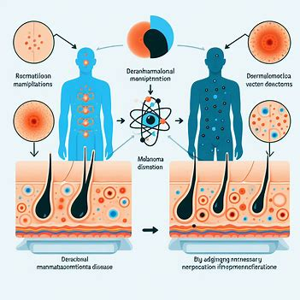
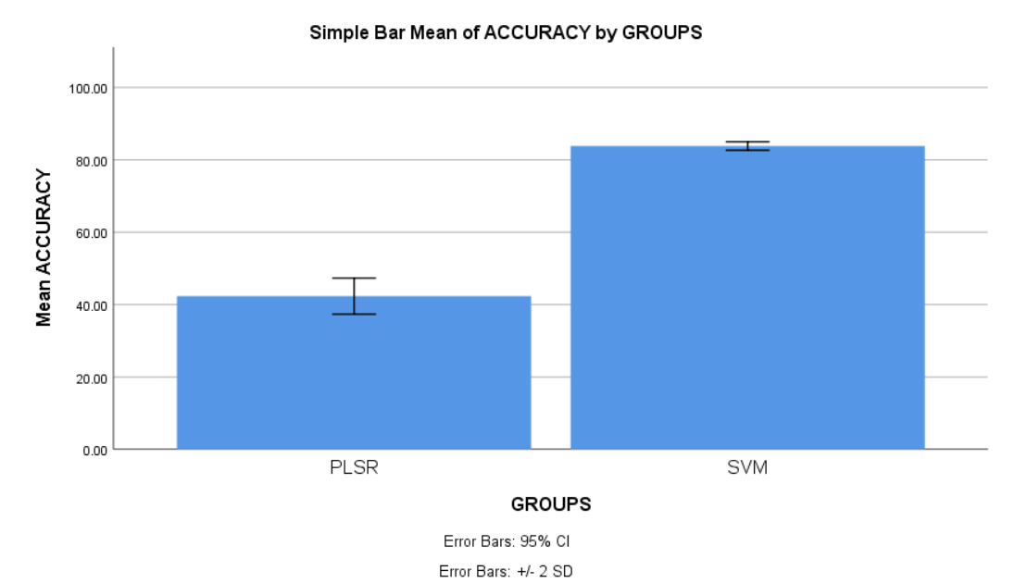
Name: Mr. SHAIK AFROZ Register Number: 192111374
Guided by Dr. C . Rohith Bhat
Ms. Poorani.S
Guided by Dr. Mary Valantina. G
The effectiveness of Dermatological Manifestations of Melanoma disease using Novel Support Vector Machine in comparison with Partial Least Squares Regression for better accuracy.
The purpose of this research is to observer the accuracy of Melanoma disease using Novel Support Vector Machine in comparison with Partial Least Squares Regression .
Melanocytes, the cells which give skin its tan or brown color, can grow out of control and cause melanoma, a kind of skin cancer. Comparing melanoma to some other forms of skin cancer, it is far less prevalent. However, melanoma is more hazardous because, if left untreated, it has a higher likelihood of spreading to other body areas.
In order to improve early detection, predict metastasis risk and disease-free survival, and uncover lower serum GM-CSF levels as a possible poor prognostic sign in early-stage melanoma patients, machine learning is being applied to dermatological symptoms of melanoma.
SVM efficiently separates classes in high-dimensional spaces using various kernel functions, making it suitable for both linear and non-linear tasks, while also being robust against overfitting. PLSR, combining PCA and multiple linear regression, extracts latent variables to handle multicollinearity and high-dimensional data, offering interpretable results and resilience to outliers.
I have used the dataset from Kaggle ,which has 10,000 rows and 10 columns.
INTRODUCTION
MATERIALS AND METHODS
Input Data
Pre-processing
Feature Extraction
Classification Model
Split, Train and test
.
Output
WORKFLOW OF MELANOMA DISEASE PREDICTION USING MACHINE LEARNING METHOD
RESULTS
Proper split within the dataset, shuffles to prevent bias, and preprocesses to normalize the data, providing consistency for improved model training are all part of data preparation.
A lesion discrimination is made easier by feature extraction, which extracts important from dermatological illustrations. Performance comparison is made possible by training SVM with entropy and PLSR.
SVM and PLSR are the two best classifier is determined by evaluation, analysis, and model optimization on testing datasets, including hyperparameter tuning and statistical tests.
The algorithm achieves an important improvement in accuracy of 0.002 (p<0.05) according to an independent sample test, Support Vector Machine(SVM) performs better than other machine learning algorithm for predicting the dermatological manifestation of Melanoma.
Group Statistics
 | ALGORITHMS | N | MEAN | STD.DEVIATION | STD.ERROR MEAN
ACCURACY | SVM | 10 | 83.8310 | .59218 | .18726
 | PLSR | 10 | 42.32 | 2.49623 | .78938
SPSS Analysis of SVM with PLSR
DISCUSSION AND CONCLUSION
Support vector machines (83.83%) and Partial Least Square Regression (42.32%) have similar accuracy rates. Therefore, we determine that SVM has superior accuracy amongst the two methods.
This study compares SVM with data augmentation and PLSR for identifying signs of melanoma in an effort to improve clinical accuracy. Its objective is to use dataset diversification to ascertain which is more accurate in terms of diagnosis between SVM and PLSR.
The potential use of high-quality datasets for SVM with data enrichment, as well as the computing needs and interpretability issues for both SVM and Partial Least Square Regression, are discussed in this paper. The results' validity and applicability may be impacted by worries about generalizability and the possibility of overfitting.
Despite SVM obtaining 83.83% accuracy, confirmed by a calculated p-value of 0.002, our study shows a significant difference in accuracy between SVM and PLSR for dermatological indicators of melanoma. This highlights the potential of SVM as a more accurate tool for predicting melanoma manifestations.
BIBLIOGRAPHY
Anastasopoulou, Amalia, Panagiotis T. Diamantopoulos, Panagiotis Kouzis, Maria Saridaki, Konstantinos Sideris, Michael Samarkos, and Helen Gogas. 2023. “COVID-19 In Patients with Melanoma: A Single-Institution Study.” Cancers 16 (1).
Azeem, Muhammad, Kaveh Kiani, Taha Mansouri, and Nathan Topping. 2023. “SkinLesNet: Classification of Skin Lesions and Detection of Melanoma Cancer Using a Novel Multi-Layer Deep Convolutional Neural Network.” Cancers 16 (1).
Boudreault, Julien, Ni Wang, Mostafa Ghozlan, and Jean-Jacques Lebrun.2024. “Transforming Growth Factor-β/Smad Signaling Inhibits Melanoma Cancer Stem Cell Self- Renewal, Tumor Formation and Metastasis.” Cancers 16 (1).
Clavero-Rovira, Laia, Álvaro Gómez-Tomás, Patricia Bassas-Freixas, Domingo Bodet, Berta Ferrer, Javier Hernández-Busa, Eva Muñoz-Courseo, Assumpció Pérez- Benavente, Vicente García-Patas, and Carla Ferrándiz-Pulido. 2024. “Mucosal Melanoma Clinical Management and Prognostic Implications: A Retrospective Cohort Study.” Cancers 16 (1).

