Slide 1
Student Expense Tracker
Android app • Detect → Confirm → Analyse
Track. Understand. Save.
Hi, Student 👋
Transaction Detected
A student-only expense tracker that detects eligible payment notifications, suggests categories, and explains where money is going.
THIS MONTH
Paid to: Unknown Person
₹6,250
₹20
Top Categories
What is this expense for?
ANDROID PROJECT
Food
● Travel
₹2,100
Travel
○ Food
₹1,200
○ Education
Education
₹1,000
○ Shopping
○ Other
CONFIRM & SAVE
1

Slide 2
Project Idea
The main question: “Where did my money go?”
• Students track food, travel, education, shopping, recharge and other expenses.
Hi, Student 👋
• When a supported payment notification appears, the app extracts amount and payee.
THIS MONTH
₹6,250
• Known payments get a category suggestion.
• Unknown payments are shown with category choices so the student decides.
Top Categories
Food
₹2,100
• Confirmed expenses update totals, budget and charts.
Travel
₹1,200
Education
₹1,000
2

Slide 3
Systems & Technologies Used
What we use to build the Android application
Android Studio
Java / Kotlin
Main software used to create, run and test the Android app.
Used to write the app logic: adding expenses, calculations and category handling.
XML
SQLite / Room
Used to design the app screens such as Login, Dashboard and Add Expense.
Used to save expenses, categories, dates and budget details inside the phone.
Notification Listener
Charts / Graphs
Used, with user permission, to read supported payment notifications and detect transactions.
Used to show spending by Food, Travel, Education, Shopping and Other.
Transaction input: Bank SMS / notification (with user permission) → extract only amount + available payee/merchant details.
Note: Python/HTML are not necessary for a native Android version. If your actual project uses them, we can add them to the stack.
3

Slide 4
How It Works
Complete flow from payment to analysis
Payment completed
Notification detected
Amount + payee extracted
Category suggested / asked
User confirms
Database + analytics updated
Example logic: known merchant → suggest category | unknown person → show Travel / Food / Education / Shopping / Other.
4

Slide 5
How to Add an Expense
Automatic detection + manual entry
Transaction Detected
Automatic mode
Paid to: Unknown Person
• Notification appears after payment.
₹20
• App extracts amount and payee.
What is this expense for?
● Travel
• Category suggestion is displayed.
○ Food
• Student confirms or changes it.
○ Education
• Expense is saved and analytics refreshes.
○ Shopping
Manual mode: user can enter amount, description, date and category directly.
○ Other
CONFIRM & SAVE
5

Slide 6
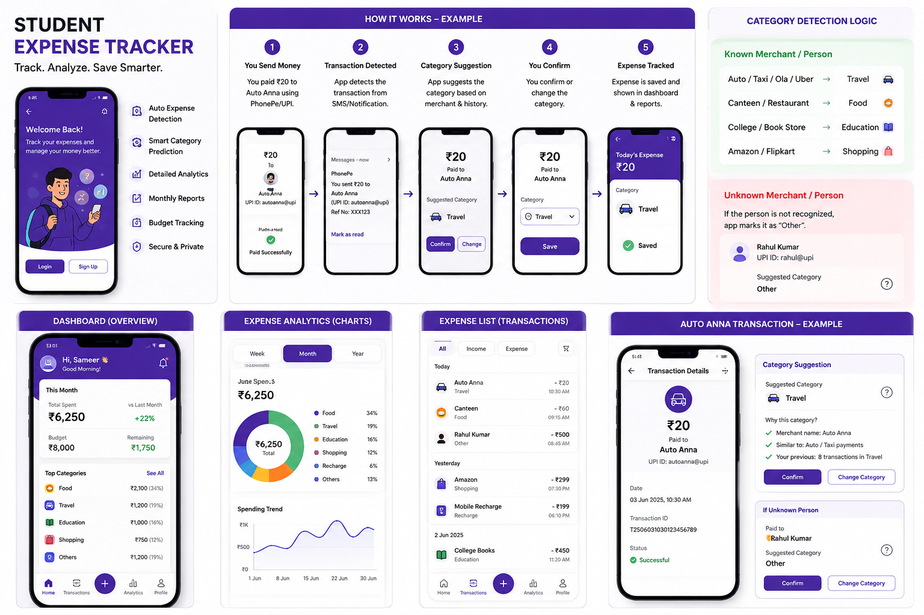
Unknown Person? — The App Asks
Instead of guessing, the student chooses the category.
Transaction Detected
Question shown by the app
Paid to: Unknown Person
₹20
“We detected a payment to an unknown person. What was this expense for?”
What is this expense for?
● Travel
Travel
Food
Education
○ Food
○ Education
Shopping
Recharge
Other
○ Shopping
After selection → Confirm → Save → Include in reports.
○ Other
CONFIRM & SAVE
6

Slide 7
Category Detection Logic
Known = suggest • Unknown = ask
Auto / Taxi / Ola / Uber
Travel
Important: The app should not blindly assume the purpose of an unknown payment. User confirmation prevents wrong categories.
Canteen / Restaurant
Food
College / Book Store
Education
Shopping merchant
Shopping
Unknown person
Ask user
7

Slide 8
Dashboard & Graphs
Where the student sees the final analysis
Hi, Student 👋
Spent
₹6,250
THIS MONTH
₹6,250
Budget
₹8,000
Top Categories
Food
₹2,100
Left
₹1,750
Travel
₹1,200
Education
₹1,000
8

Slide 9
Database Design
What the app stores for analysis
TRANSACTION
CATEGORY
id • amount • payee • date • category • source
id • name • icon
BUDGET
USER
month • limit • spent
id • name • email
Production version: use encrypted local storage and never store UPI PIN, OTP or bank passwords.
9

Slide 10
Advantages
Simple benefits of the Student Expense Tracker
⚡ Less Work
📊 Easy to Understand
🧠 Smart Choice
Expenses can be detected from supported bank transaction messages.
Graphs show where the student spends money.
Known payments get a category suggestion.
👤 User Control
💰 Budget Check
🎓 Made for Students
Unknown payments are confirmed by the student.
Student can see how much money is left.
Food, travel, education and other student expenses are easy to track.
PAYMENT → TRACK → ANALYSE → SAVE
10

Slide 11
Disadvantages
A few simple limitations of the app
📩 Permission Needed
❓ Sometimes It Won’t Know
The student must allow the app to read supported bank transaction messages.
If the message does not show enough details, the app may ask the student.
🏷️ Category Can Be Wrong
🔒 Privacy Is Important
A merchant name may not always tell the real purpose of the payment.
Bank messages contain private information, so the app must protect it.
📱 Not Every Payment Is Same
🌐 Internet Is Not the Main Source
Different banks/apps may send messages in different formats.
The app depends on available transaction messages, not direct bank access.
⚠ Permission → Detection → Confirmation
11

Slide 12
Security & Privacy
What the app reads — and what it does NOT do
Example Chat Flow: Unknown Transaction
🏦 Bank SMS: “₹200 debited from your account to XYZ”
↓
App detects: ₹200 + XYZ
🤖 App: “We detected ₹200. What is this expense for?”
🚌 Travel 🍔 Food 📚 Education 🛍️ Shopping Other
👤 Student: “Food”
↓
✅ Saved: ₹200 → Food
🔒 The app only uses the required transaction details for expense tracking. It does NOT control the bank account or payment, and it does NOT need UPI PIN, OTP or bank password.
12

Slide 13
What Our App Can Read & Cannot Read
For privacy, the app uses only relevant transaction messages.
✅ CAN READ
❌ CANNOT / DOES NOT ACCESS
🏦 Relevant bank transaction SMS / notification
💳 Bank account control
🔑 UPI PIN
💰 Debit amount
🔐 OTP or bank password
👤 Available payee / merchant name
💸 Transfer or spend money
📅 Date & time, if present in the message
📱 PhonePe account details
💬 Other personal messages
“The app reads only the information needed from relevant transaction messages for expense tracking.”
13

Slide 14
Future Scope
Simple improvements we can add later
1. Better Auto Detection
2. Better Category Suggestion
More payment apps can be supported so more expenses are detected automatically.
The app can learn from the student's previous choices and suggest the right category.
3. Budget Alert
4. Monthly Report
If spending becomes too high, the app can show a simple warning.
At the end of the month, the app can show a simple report of total spending.
5. Backup
6. Voice Add Expense
Expenses can be backed up so they are not lost if the phone changes.
Student can say “Food 100 rupees” and the app can add it.
13

Slide 15
Conclusion
Easy way to explain the project in the presentation
What our app does
It tracks student expenses, detects supported payment notifications, asks the user to choose a category when needed, and shows where the money was spent.
Why it is useful
Students can see total spending, category-wise spending and remaining budget in one place.
“The main aim is to help students understand where their money is going and manage it better.”
Thank You • Questions & Answers
14

