Slide 1

Netflix Analysis Report
A comprehensive exploration of Netflix's content library using SQL queries and Excel visualizations — uncovering trends in movies, TV shows, genres, and global distribution.
SQL + EXCEL + POWER BI

Slide 2

Project Overview
Objective
Analyze the Netflix dataset to uncover patterns in content type, genre, release trends, and country distribution.
Tools Used
SQL
Excel
Power BI
Querying & analysis
Cleaning & data validation
Visualization dashboards

Slide 3


Data Cleaning in Excel
Duplicate Removal
Removed duplicates and standardized values (e.g., "Movie" vs "TV Show").
Date Formatting
Converted release dates into proper year format for consistent analysis.
Pivot Tables
Created pivot tables for type, genre, and country breakdowns.

Slide 4
SQL Insights — Core Queries
Row Count & Type Breakdown
Top Genres
SELECT COUNT(*) FROM netflix_titles;
SELECT listed_in, COUNT(*)
FROM netflix_titles
GROUP BY listed_in
ORDER BY COUNT(*) DESC;
SELECT type, COUNT(*)
FROM netflix_titles
GROUP BY type;
Groups titles by genre and ranks them by frequency to identify the most common categories.
These queries reveal the total catalog size and the split between Movies and TV Shows.

Slide 5
SQL Insights — Trends & Distribution
Yearly Release Trends
Country Distribution
SELECT release_year, COUNT(*)
FROM netflix_titles
GROUP BY release_year
ORDER BY release_year;
SELECT country, COUNT(*)
FROM netflix_titles
GROUP BY country
ORDER BY COUNT(*) DESC;
Tracks content volume over time to reveal growth patterns in Netflix's catalog.
Ranks countries by number of titles to highlight regional content dominance.

Slide 6





Power BI Visualizations
Bar Chart
Movies vs TV Shows — approx. 5.5K movies vs 2.5K TV shows.
Line Chart
Releases per year — sharp increase from 2016, peaking in 2020.
Pie Chart
Top 10 countries by content share — USA leads at 31.1%.
Treemap
Distribution of seasons across countries.

Slide 7
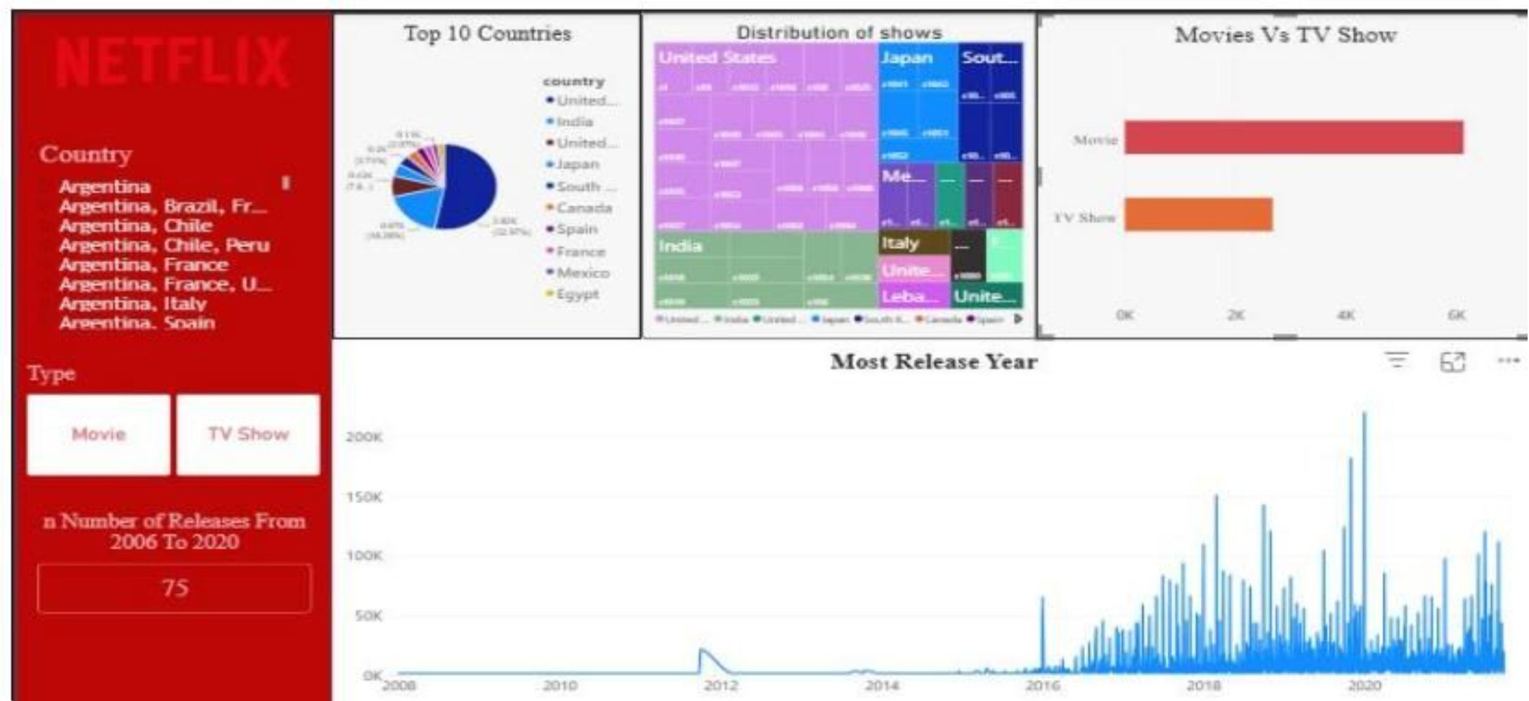
Dashboard Deep Dive
Top 10 Countries
United States (31.1%), India (10.7%), United Kingdom (9.4%), South Korea (7.1%), Canada (5.8%), Spain (4.5%), France (3.2%), Mexico (2.9%), Italy (2.6%), Egypt (2.3%).
Most Release Year
Releases surged from 2016 onward, peaking in 2020. The dashboard also tracks 75 releases from 2006–2020 in the sample view.

Slide 8
Key Findings
🎬 Movies Dominate
🌎 USA & India Lead
🎭 Drama & Comedy
Netflix catalog has significantly more movies than TV shows.
USA (31.1%) and India (10.7%) dominate in content production.
The most frequent genres across the entire catalog.
📈 Sharp Growth
🤝 Strong Partnerships
Content releases increased sharply in recent years, peaking in 2020.
Certain directors and actors appear repeatedly, showing strong partnerships.

Slide 9
SQL Query Reference
Filtering & Exploration
Aggregation & Ranking
SELECT * FROM netflix_titles
WHERE release_year = 2020;
SELECT director, COUNT(*) AS total_titles
FROM netflix_titles
WHERE director IS NOT NULL
GROUP BY director
ORDER BY total_titles DESC
LIMIT 10;
SELECT DISTINCT(country)
FROM netflix_titles
WHERE country IS NOT NULL;
SELECT title, date_added
FROM netflix_titles
WHERE YEAR(date_added) >= YEAR(CURDATE()) - 5;
SELECT * FROM netflix_titles
WHERE rating = 'PG-13';

Slide 10

Conclusion
Diverse but Movie-Skewed
Netflix's library spans many countries and genres, but movies significantly outnumber TV shows.
Regional Dominance
USA and India's leading share highlights key target markets for content investment.
Genre Trends Guide Strategy
Drama and Comedy dominance can inform future acquisition and production decisions.

