Slide 1
Loading ADLS Folder Names and File Counts
into SQL Table
using Azure Data Factory
By Anjum Shaik
23rd July 2024

Slide 2
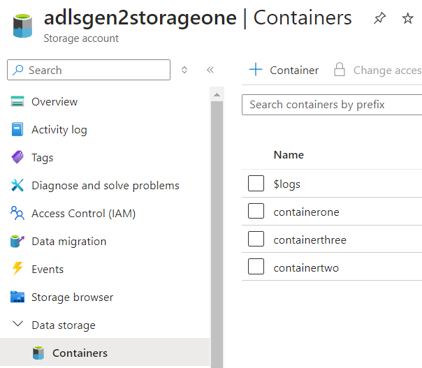
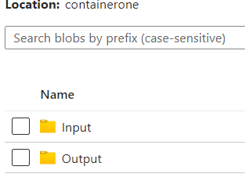
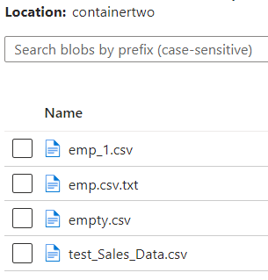
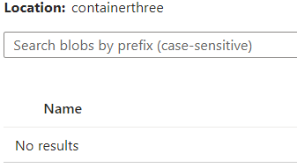
Use Case Description
Retrieve ADLS folder names.
Get the count of files and subfolders within each folder.
Load this data into a SQL table.
Project url
https://github.com/shaikanjum432/ADF_RealTimeScenarios/tree/main/FolderFileCountPipeline

Slide 3
Azure Data Factory Pipeline Setup
Create a new pipeline in Azure Data Factory
Pipeline Workflow
Get Metadata Activity
ForEach Activity
Get Metadata Inside ForEach
Filter Activity Inside ForEach
Lookup Activity Inside ForEach

Slide 4
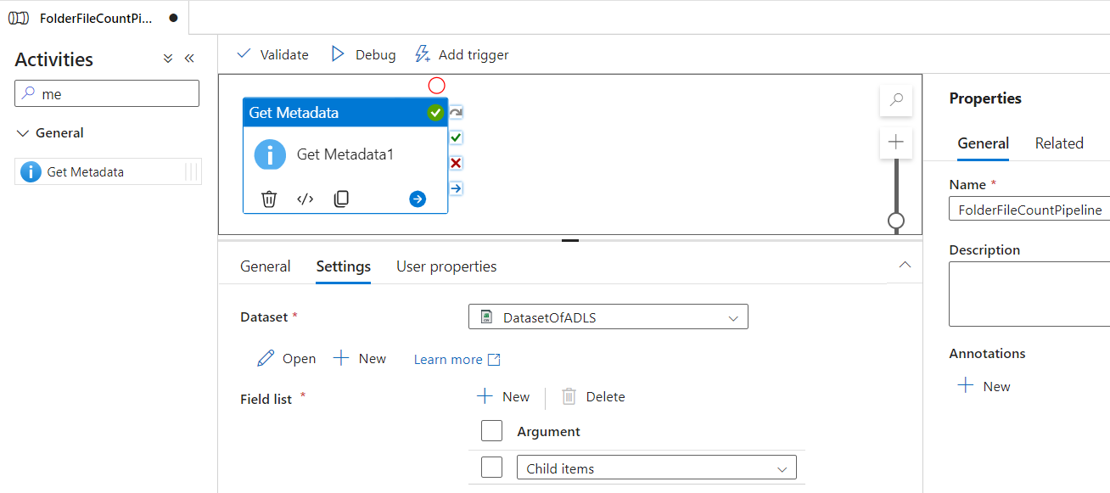
Get Metadata Activity :
Purpose: Retrieve folder names.
Point to ADLS Gen2 storage.
Use 'Child Items' to get folder names.

Slide 5
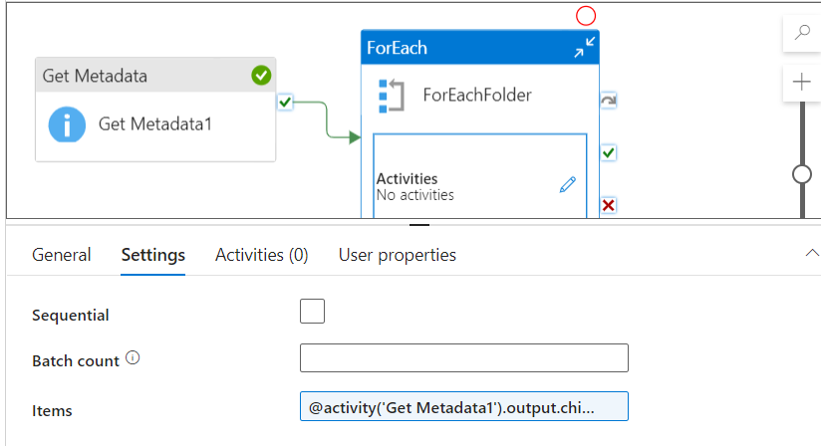
ForEach Activity:
Purpose: Iterate through each folder.
Set items to the output from Get Metadata1 (child items).

Slide 6
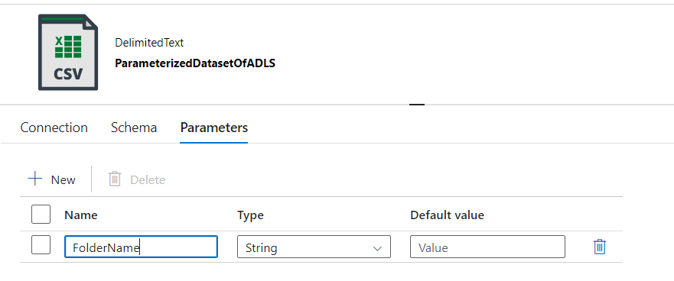
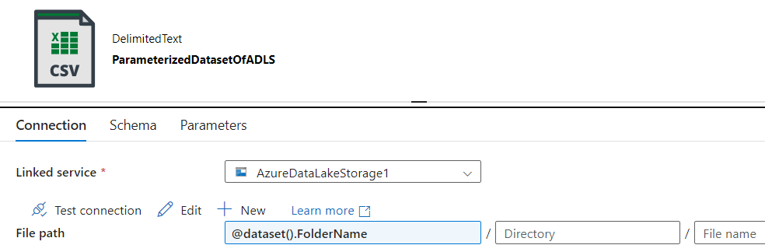
Parameterizing Dataset
Create a parameter for the Folder Name.
Pass the folder name dynamically from the ForEach activity.

Slide 7
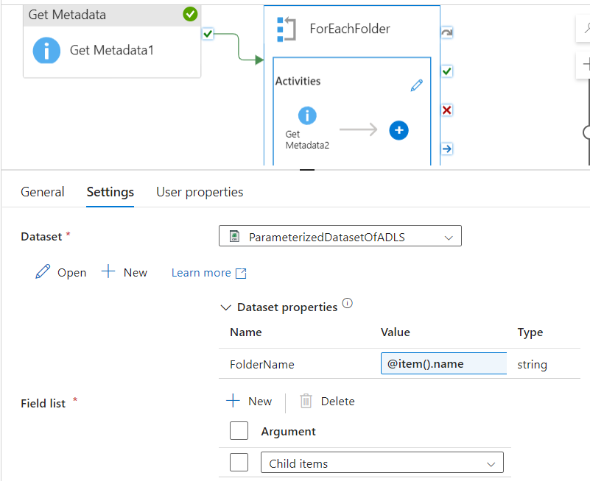
Get Metadata2 Activity :
Purpose: Retrieve file names inside each folder.
Parameterize dataset to point to each folder.
Use 'Child Items' to get file names.

Slide 8
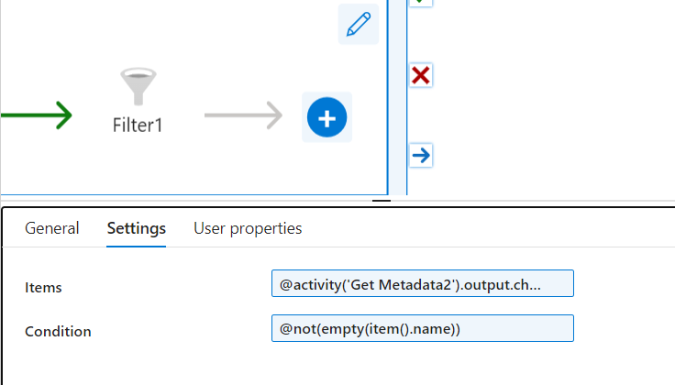
Filter Activity:
Purpose: Get count of files inside each folder.
Always return true to get all items.
Output the item count.

Slide 9
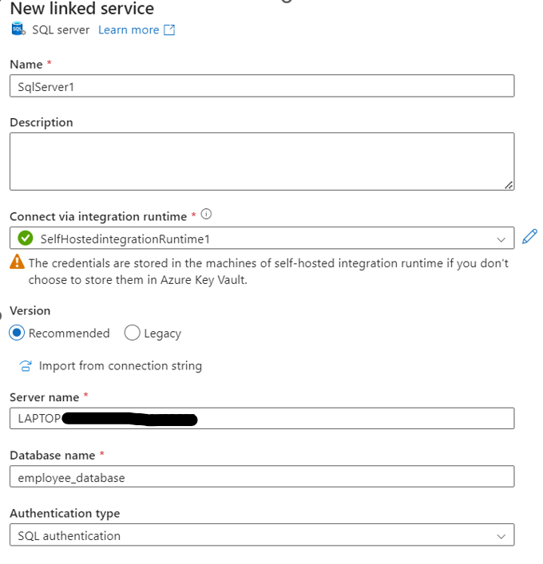
Lookup Activity
Purpose: Insert folder names and file counts into SQL table.
Create a Dataset that refers to the table in SQL server.
Write query to insert data into SQL table.
Use dynamic content to include folder names and file counts.
INSERT INTO dbo.folderfilescount (FolderName,countOfFiles)
VALUES ('@{item().name}',@{int(activity('Filter1').output.ItemsCount)});
SELECT 1 AS output

Slide 10
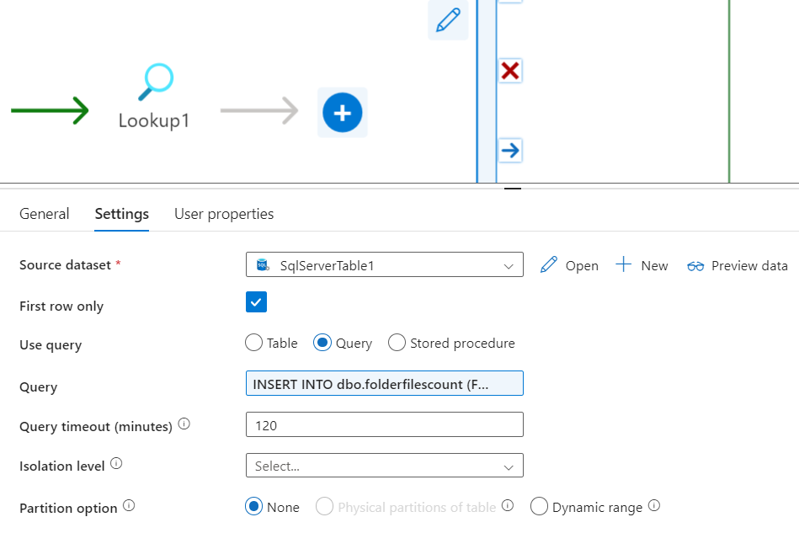

Slide 11
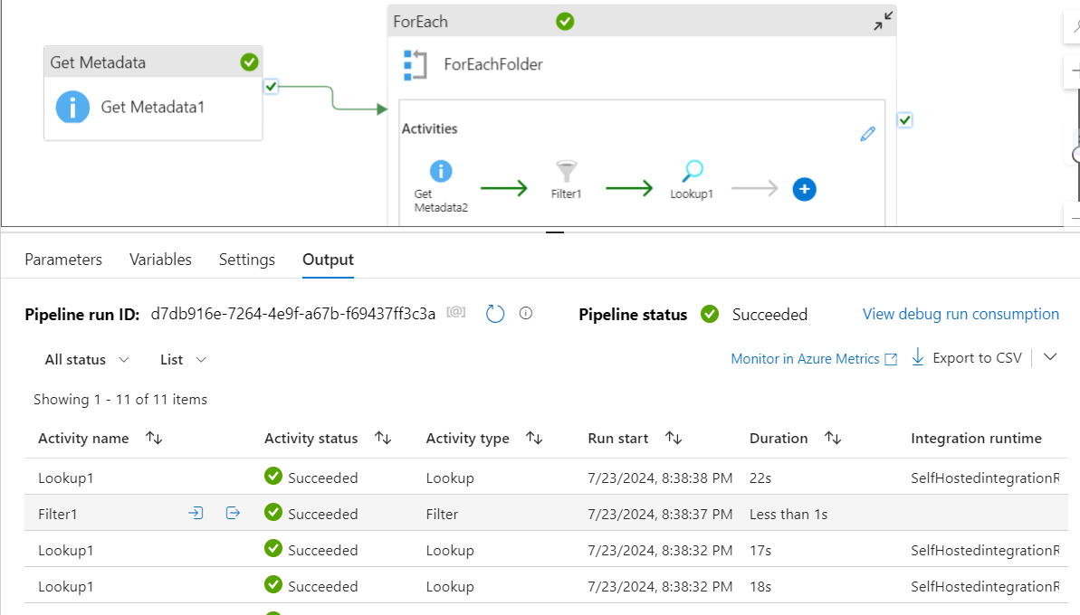
Debug and Execute Pipeline
Run pipeline to verify setup.
Check SQL table for inserted data.

Slide 12
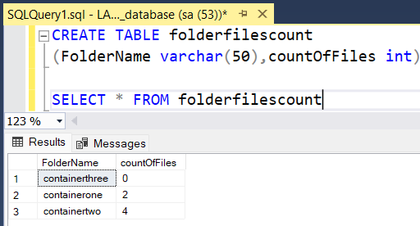
Conclusion
Successfully loaded folder names and file counts into SQL using ADF pipeline.
Achieved requirement using Get Metadata, Filter, ForEach, and Lookup activities.

Slide 13
Thank you

