Slide 1
Copying All Files in Azure Data Lake Storage
Using ADF Pipelines
By Anjum Shaik

Slide 2
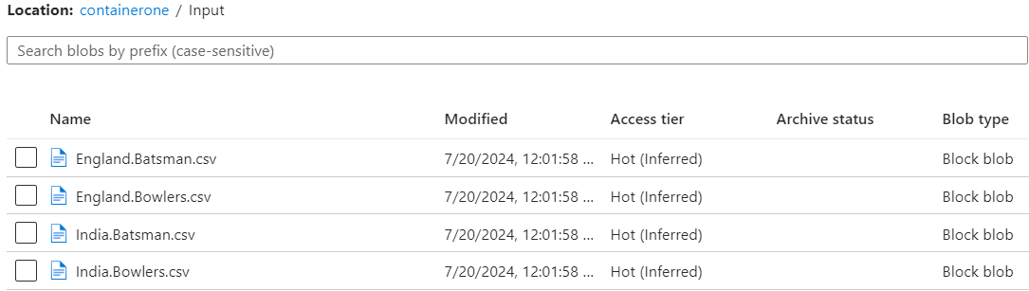
Use Case Description
In this use case, we copy all files from one Azure Data Lake Storage (ADLS) folder to another using Azure Data Factory (ADF) pipelines.
Project url
https://github.com/shaikanjum432/ADF_RealTimeScenarios/tree/main/CopyAllFilesPipeline

Slide 3
Azure Data Factory Pipeline Setup
Create a new pipeline in Azure Data Factory with below activities -
Get Metadata Activity :
Use Get Metadata activity to retrieve file names from the input folder.
Configure the dataset to point to the folder level.
Select "Child Items" to get an array of all file names in the folder.
ForEach Activity:
Iterate through each file name retrieved by the Get Metadata activity.
Set the items property to the output of the Get Metadata activity.
Use the dynamic content expression: @activity('Get Metadata1').output.childItems
Copy Data Activity:
Inside ForEach activity, add Copy Data activity.
Set up source and sink datasets dynamically using parameters.
Set the parameter to @item().name

Slide 4
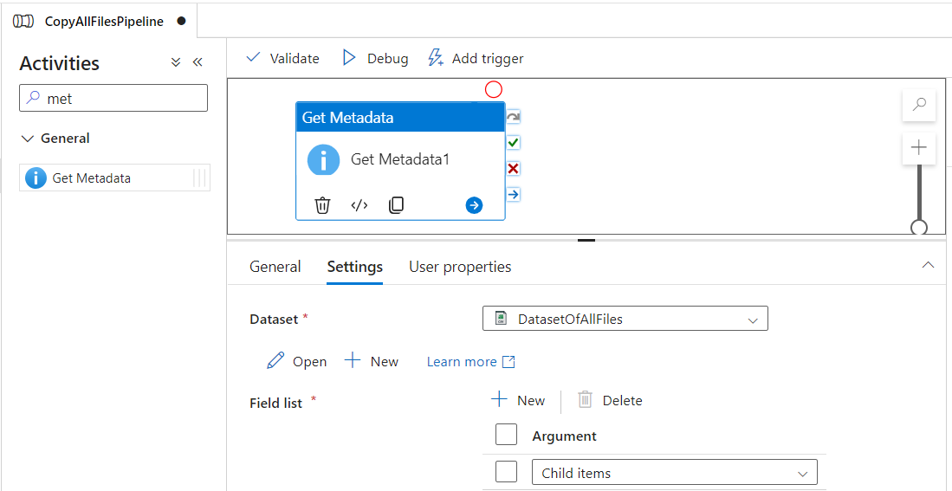
Get Metadata Activity :

Slide 5
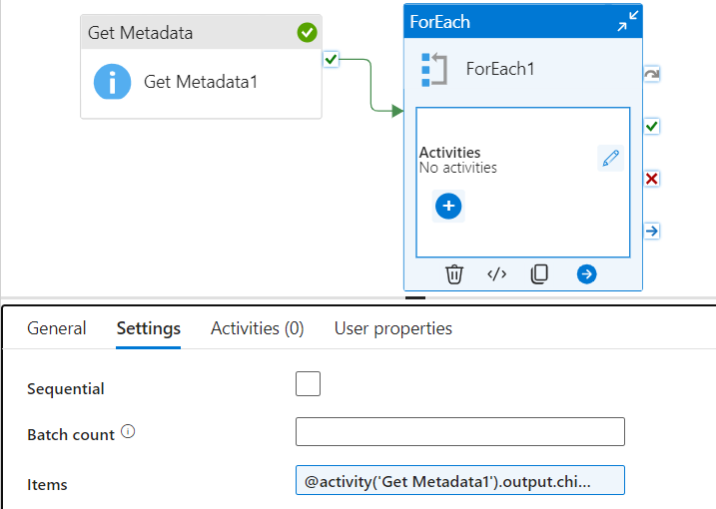
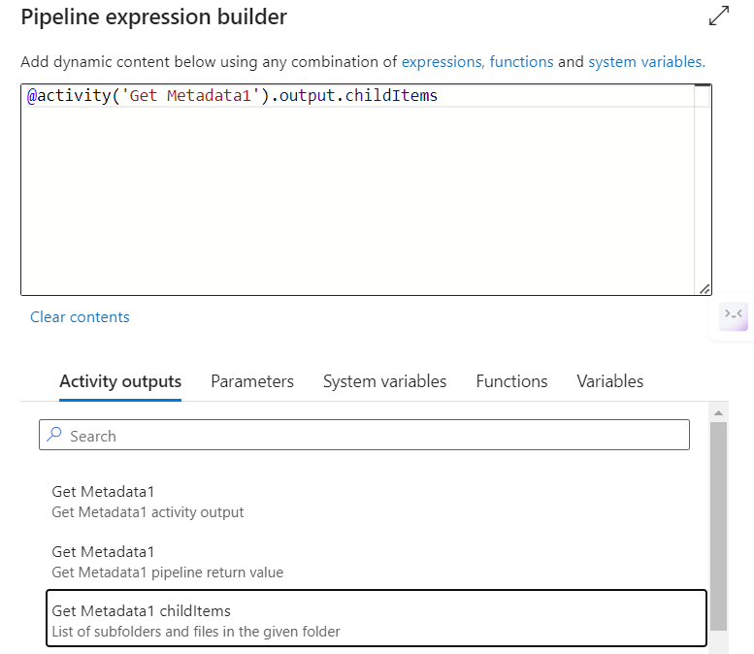
ForEach Activity:

Slide 6
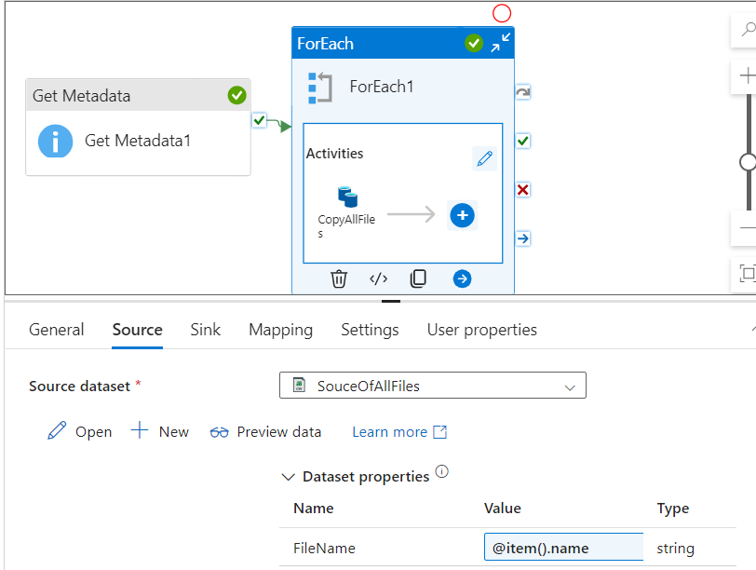
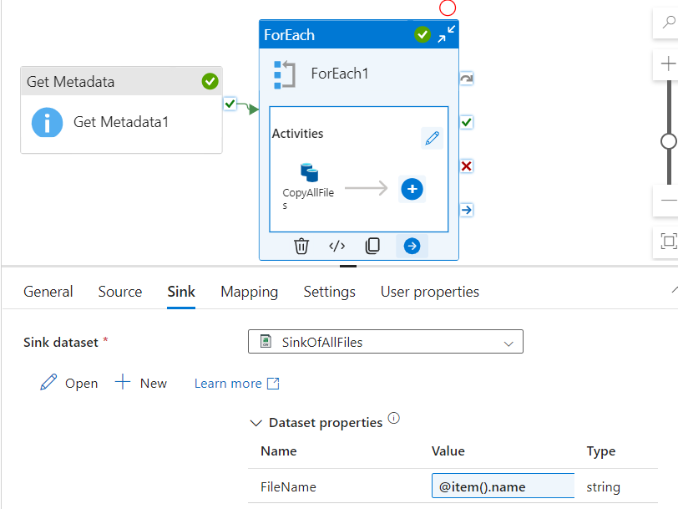
Copy Data Activity:

Slide 7
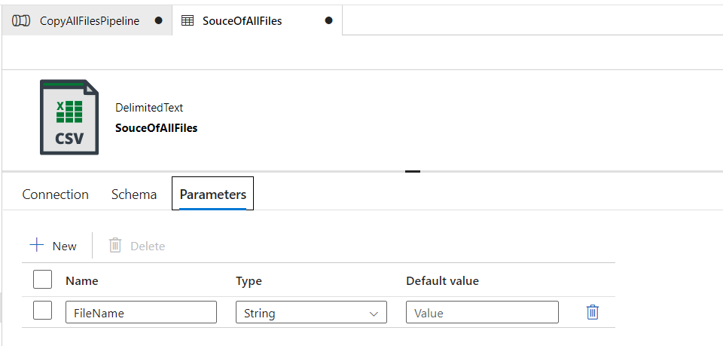
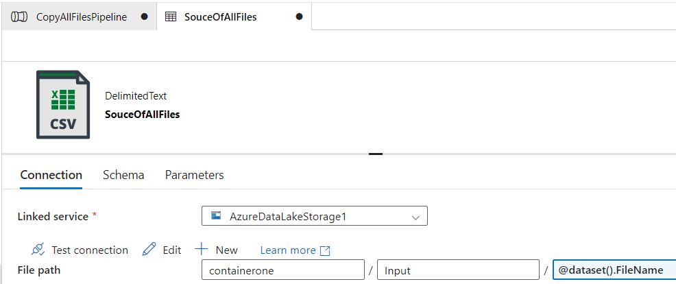
Parameterizing Source Dataset
Create a parameter for the file name.
Pass the file name dynamically from the ForEach activity.

Slide 8
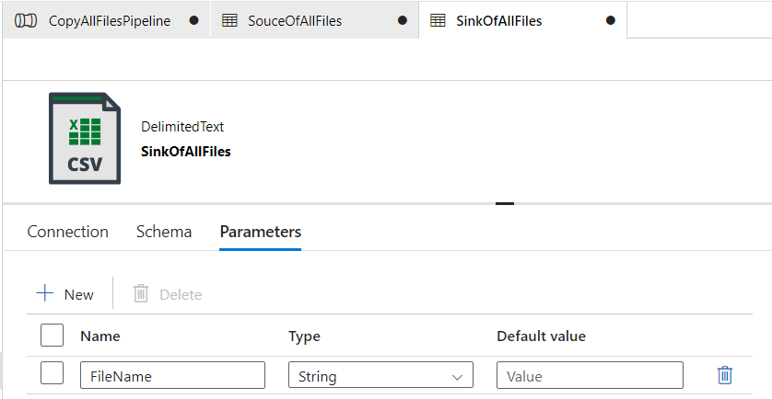
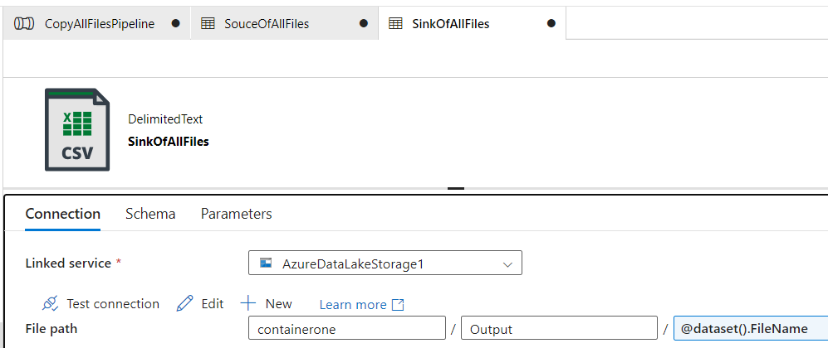
Parameterizing Sink Dataset
Create a parameter for the file name in the sink dataset.
Ensure the file name in the output matches the source file name.

Slide 9
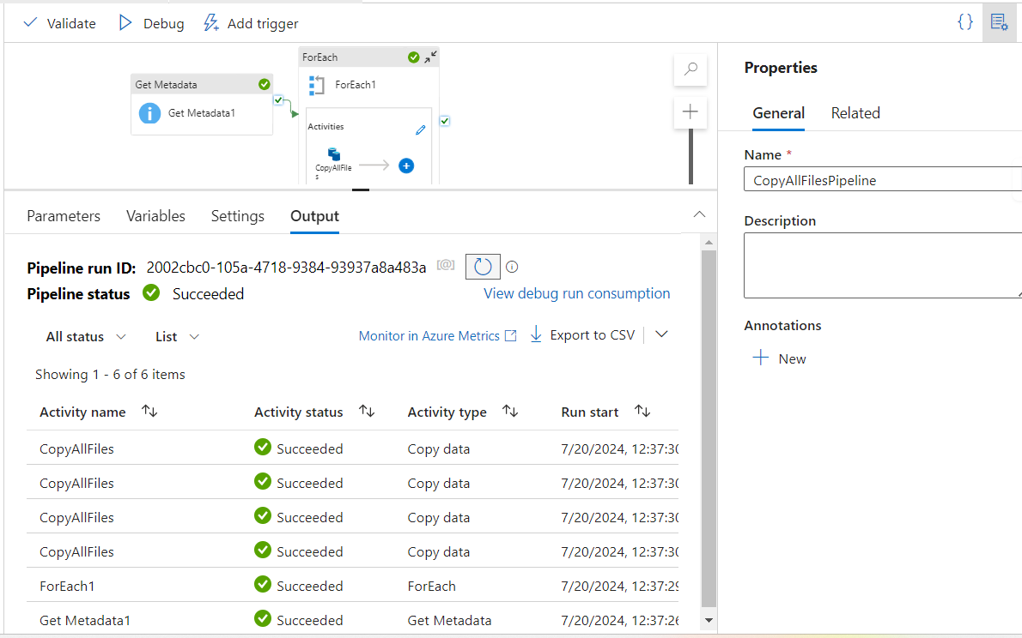
Debug and Execute Pipeline
Debug the pipeline to ensure all activities are set up correctly.
Execute the pipeline and verify the results.

Slide 10
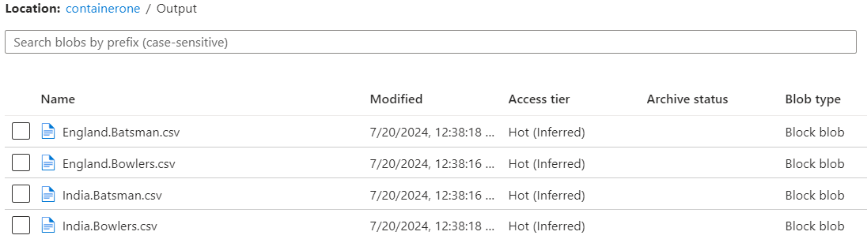
Conclusion
Successfully copied all files from input to output folder using ADF pipeline.
Dynamic file handling and parallel execution were achieved.

Slide 11
Thank you

