Slide 1
Automating File Deletion
in Azure Data Factory Based on Modified Date
By Anjum Shaik
30th July 2024

Slide 2
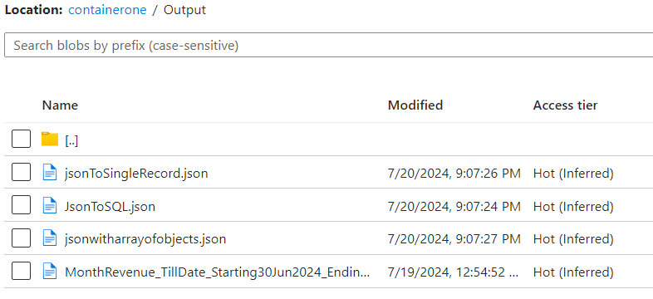
Use Case Description
Goal: Automate the deletion of files older than a specified number of days in Azure Blob Storage.
Tools: Azure Data Factory, Get Metadata Activity, ForEach Activity, If Condition Activity, and Delete Activity
Project url
https://github.com/shaikanjum432/ADF_RealTimeScenarios/tree/main/DeleteOldFilesPipeline_support_live

Slide 3
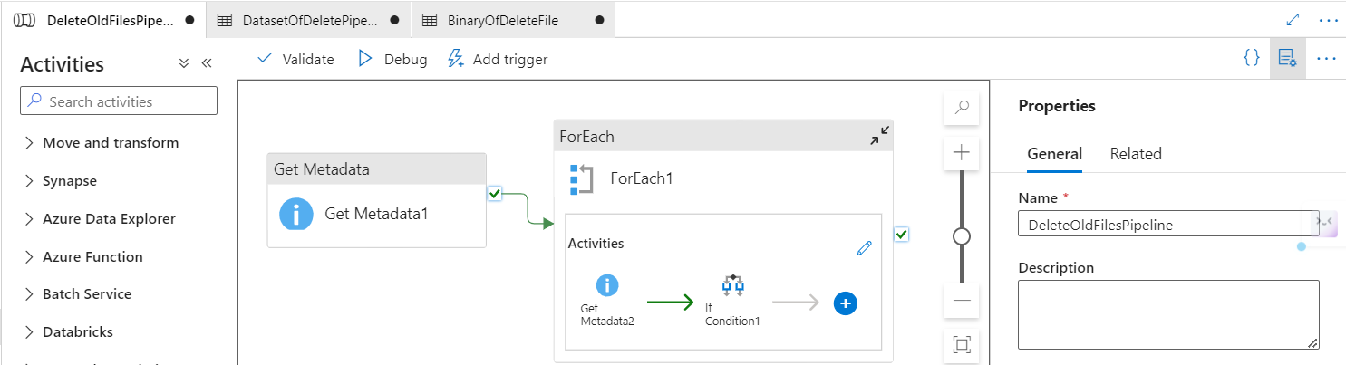
Azure Data Factory Pipeline Setup
Create a new pipeline in Azure Data Factory with below activities –
Get Metadata Activity
ForEach Activity
If Condition Activity
Delete Activity

Slide 4
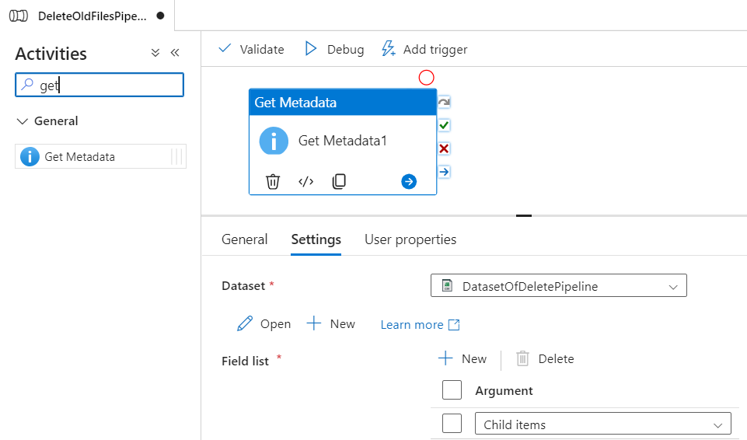
Get Metadata Activity :
Purpose: Retrieve all files in the folder.
Configure the data set to point to the Azure Blob Storage.

Slide 5
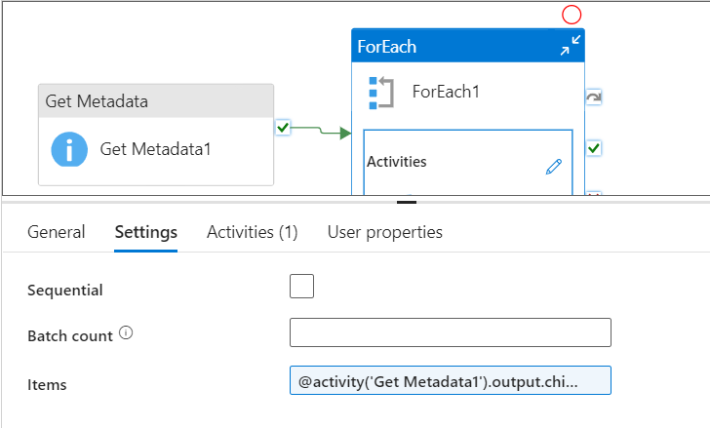
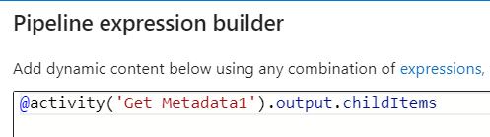
ForEach Activity:
Use ForEach Activity to process files one by one.
Connect ForEach Activity with Get Metadata Activity.
Process each file individually to fetch details like file name and last modified date.

Slide 6
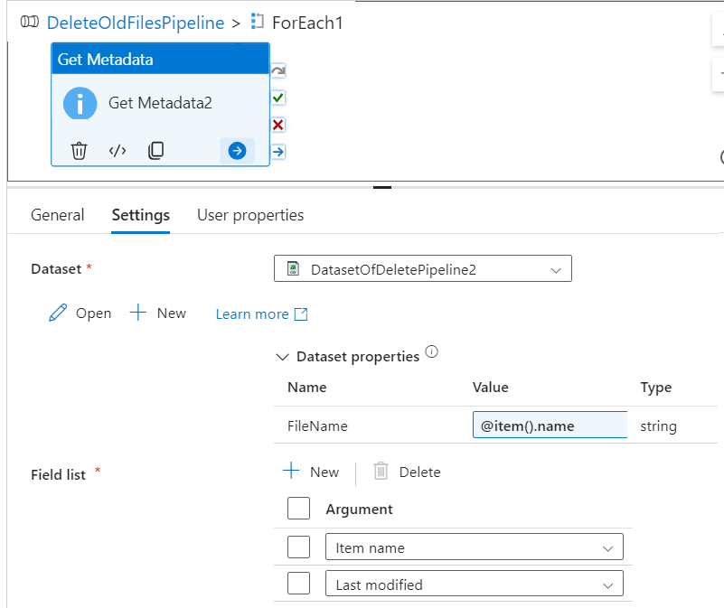
Nested Get Metadata Activity:
Purpose: Fetch the last modified date of each file.
Configuration:
- Create a new data set pointing to Azure Blob Storage.
- Make file names dynamic using parameters.
Fetch file names dynamically from ForEach Activity.

Slide 7
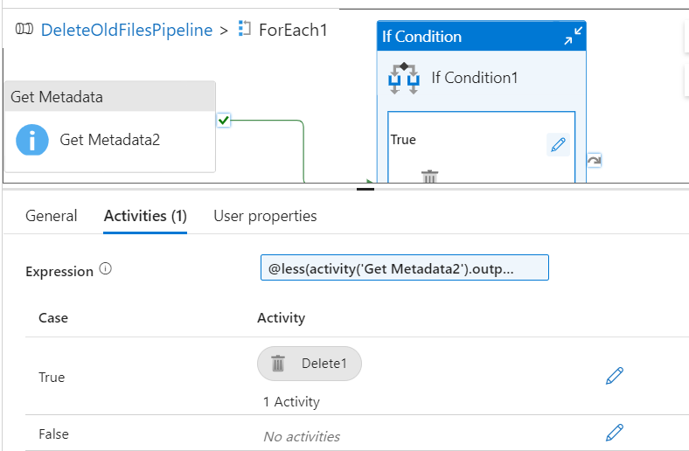
If condition Activity:
Purpose: Check if the last modified date is older than 10 days.
Expression: Compare the last modified date with current date minus 10 days.
@less(activity('Get Metadata2').output.lastModified, formatDateTime(adddays(utcnow(),-10),
'yyyy-MM-ddThh:mm:ssZ' ))

Slide 8
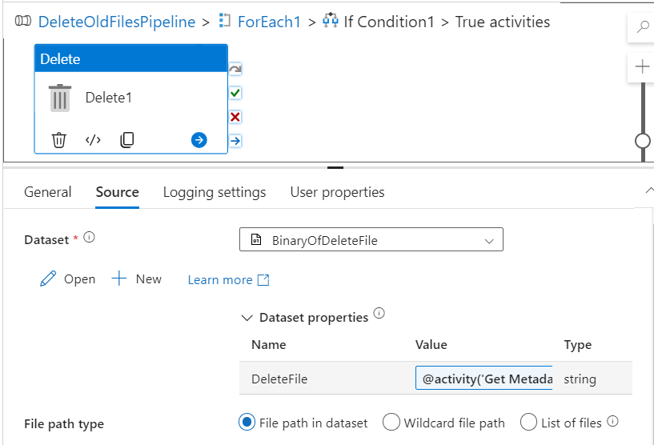
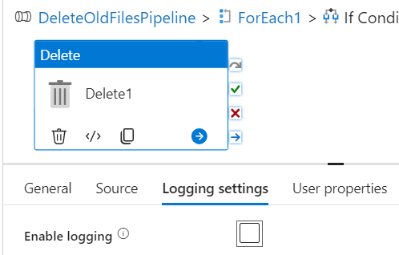
Delete Activity:
Purpose: Delete files based on the condition.
Setup:
Create a new data set for the Delete Activity.
Make file names dynamic to delete specific files.
Connect the data set with the parameter for dynamic file names.

Slide 9
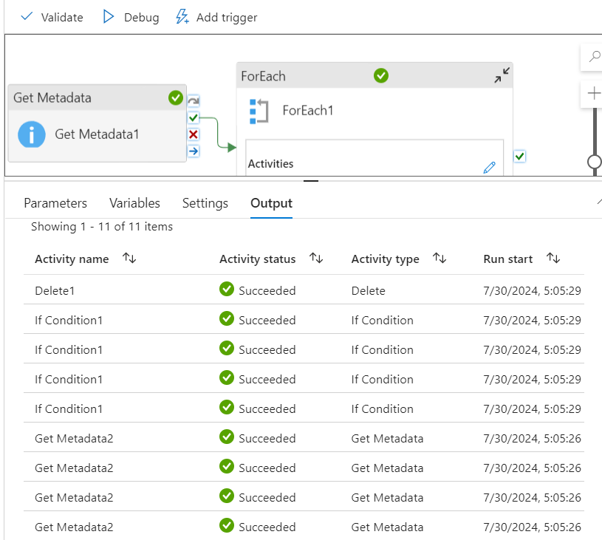
Debug and Execute Pipeline
Debug the pipeline to ensure all activities are set up correctly.
Execute the pipeline and verify the results.

Slide 10
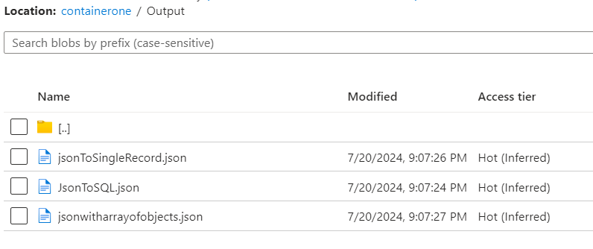
Conclusion
Successfully Automated file deletion process in Azure Data Factory.
Benefits: Efficiently manage and maintain storage by removing outdated files.
Customization: Adjust the number of days in the expression to 30, 40, 50, etc., based on requirements.

Slide 11
Thank you

