Slide 1
Dynamic File Naming With Dates in Azure Data Factory
Content:
Dynamically naming target files based on pipeline run date in Azure Data Factory.
Use case: Load data from SQL table to CSV file with dynamic file naming.
By Anjum Shaik

Slide 2
Use Case Description
In this use case, we will learn how to generate a dynamic filename for a target CSV file using date functions in Azure Data Factory.
Source TableName: MonthRevenue_TillDate
TargetFileName: MonthRevenue_TillDate_Starting(Previous Month EndDate)_Ending(RunDate).csv
Example:
Run on 19Jul2024: MonthRevenue_Till Date_Starting30Jun2024_Ending19Jul2024.csv
Run on 20Jul2024: MonthRevenue_Till Date_Starting30Jun2024_Ending20Jul2024.csv
Run on 15Aug2024: MonthRevenue_Till Date_Starting31Jul2024_Ending15Aug2024.csv
Run on 05Sep2024: MonthRevenue_Till Date_Starting31Aug2024_Ending05Sep2024.csv
Project url
https://github.com/shaikanjum432/ADF_RealTimeScenarios/tree/main/DynamicFileNamingPipeline

Slide 3
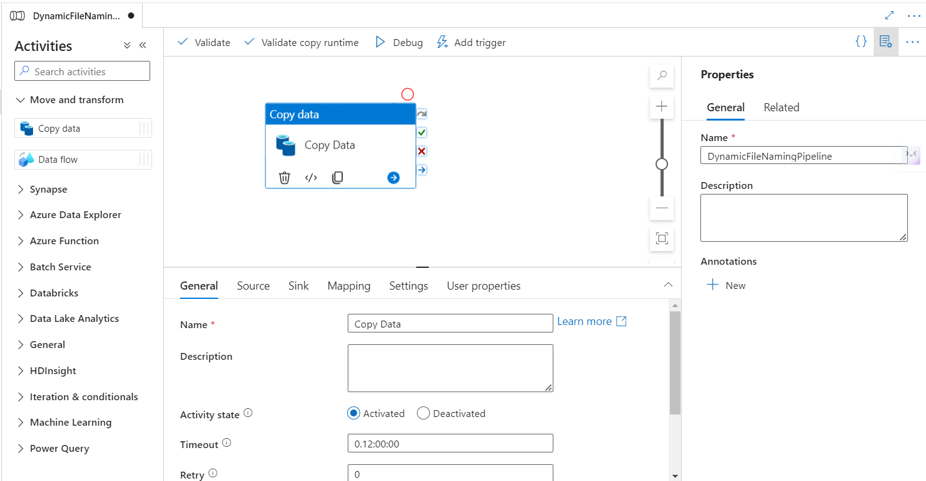
Azure Data Factory Pipeline Setup
Create a new pipeline in Azure Data Factory.
Use the Copy Data activity to move data from SQL to CSV.

Slide 4
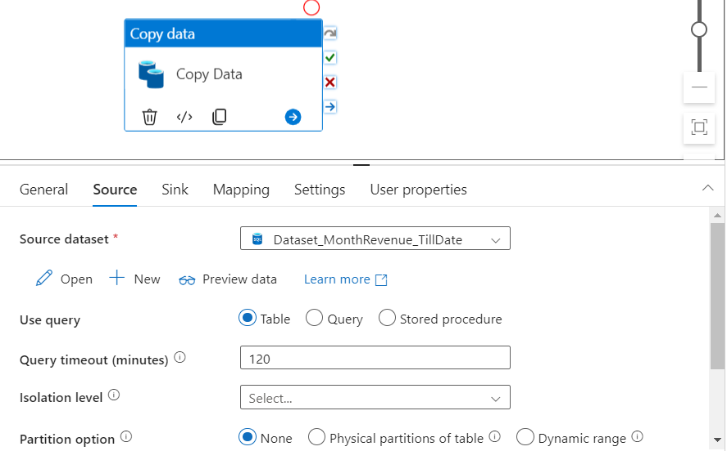
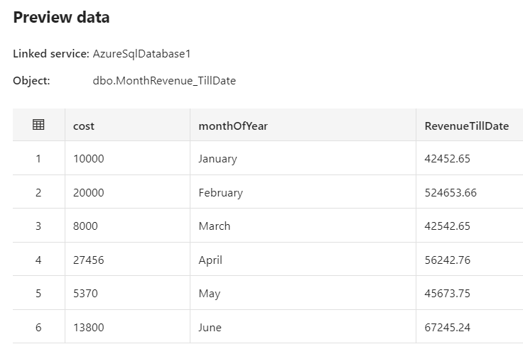
Source Dataset Configuration
Create a source dataset pointing to the Azure SQL database.
Provide server details, authentication, and table name.
Import schema from the table.

Slide 5
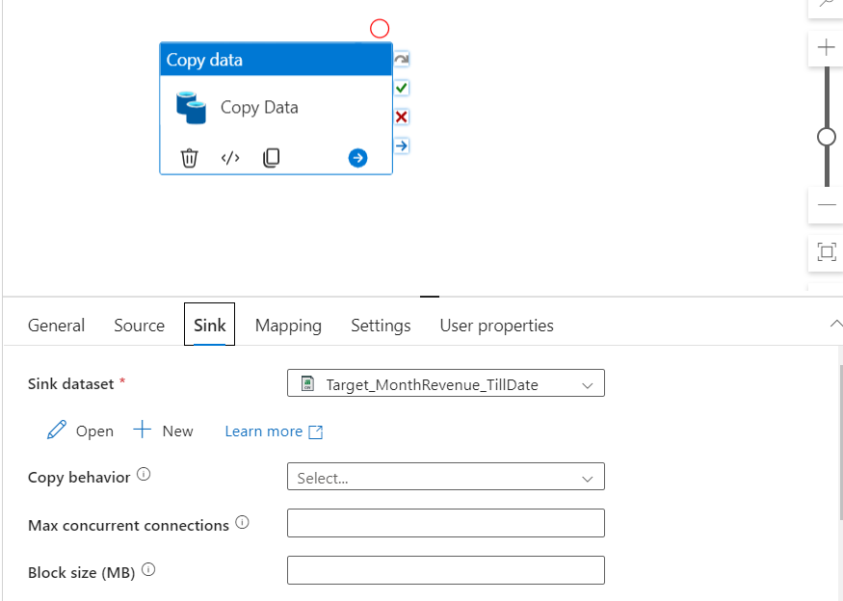
Sink Dataset Configuration
Create a sink dataset pointing to Azure Data Lake Storage (ADLS) Gen2.
Select CSV format and provide storage account details.
Define file path and container.

Slide 6
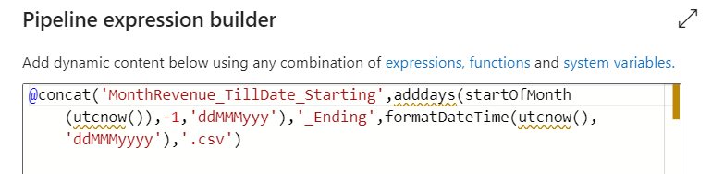
Dynamic File Naming
Use dynamic content to generate file names based on pipeline run date.
Functions used: concat, utcNow, startOfMonth, addDays.
Expression:
@concat('MonthRevenue_TillDate_Starting',adddays(startOfMonth(utcnow()),-1,’ddMMMyyy'),'_Ending',formatDateTime(utcnow(), ‘ddMMMyyyy'),'.csv')

Slide 7
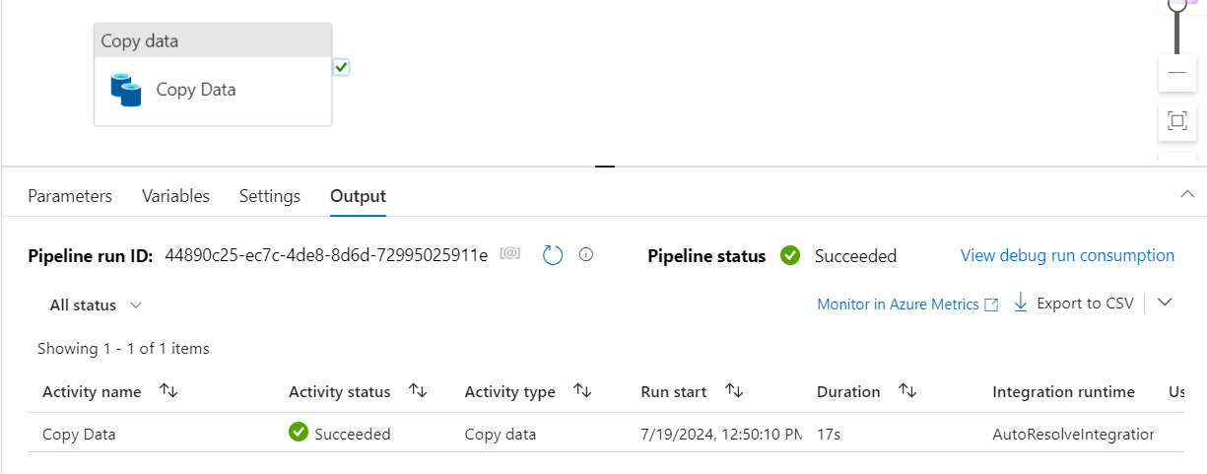
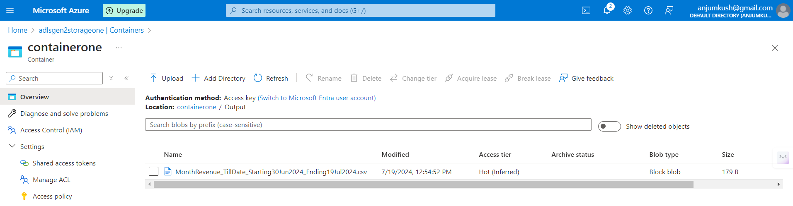
Testing the Pipeline
Run the pipeline and check the output folder in ADLS.

Slide 8
Conclusion
Successfully implemented dynamic file naming in ADF.
The file name changes based on pipeline run date.

Slide 9
Thank you

