Slide 1
Copying Specific File Formats in Azure Data Lake Storage
using Azure Data Factory
By Anjum Shaik
20th July 2024

Slide 2
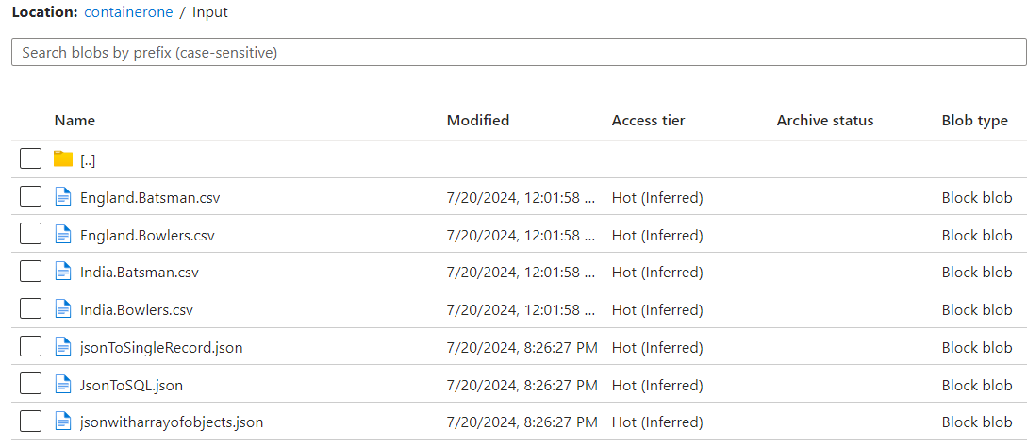
Use Case Description
In this use case, we copy only files of a specific format (JSON) from one ADLS folder to another using ADF pipeline.
Files in Input Folder: 4 CSV files, 3 JSON files.
Requirement: Copy only JSON files (3 files) to the output folder.
Project url
https://github.com/shaikanjum432/ADF_RealTimeScenarios/tree/main/CopySpecificFileFormatPipeline_support_live

Slide 3
Azure Data Factory Pipeline Setup
Create a new pipeline in Azure Data Factory with below activities -
Get Metadata Activity :
Use Get Metadata activity to retrieve file names from the input folder.
Configure the dataset to point to the folder level.
Select "Child Items" to get an array of all file names in the folder.
Filter Activity:
Filter out JSON files from the list of files retrieved by the Get Metadata activity.
Use the output of the Get Metadata activity, which is an array of child items (file names).
Use @item().name to check file names, applying a condition to include only JSON files using the contains function.
ForEach Activity:
Iterate through each file name retrieved by the Filter activity.
Set the items property to the output of the Filter activity.
Use the dynamic content expression: @activity('Filter').output.value
Copy Data Activity:
Inside ForEach activity, add Copy Data activity.
Set up source and sink datasets dynamically using parameters.
Set the parameter to @item().name

Slide 4
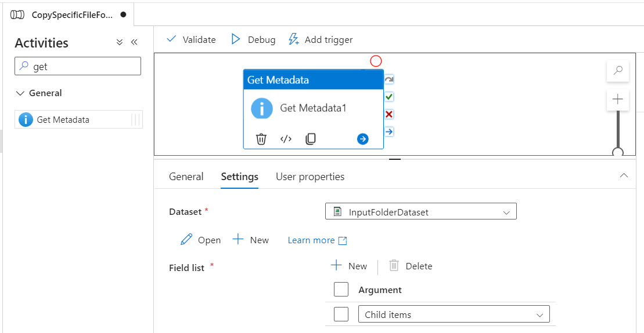
Get Metadata Activity :

Slide 5
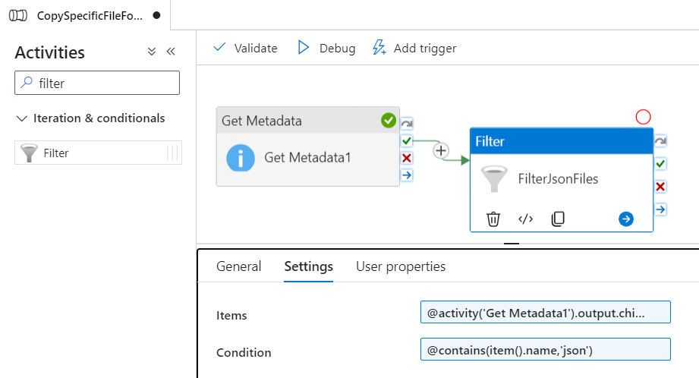
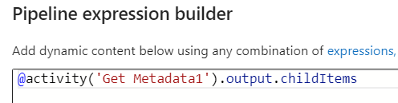
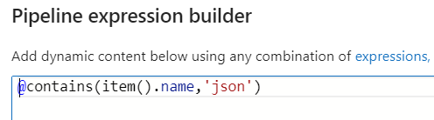
Filter Activity:

Slide 6
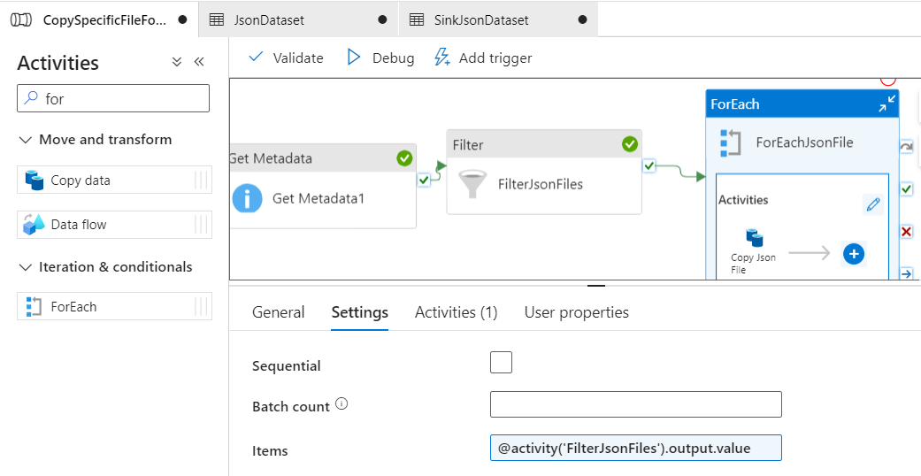
ForEach Activity:

Slide 7
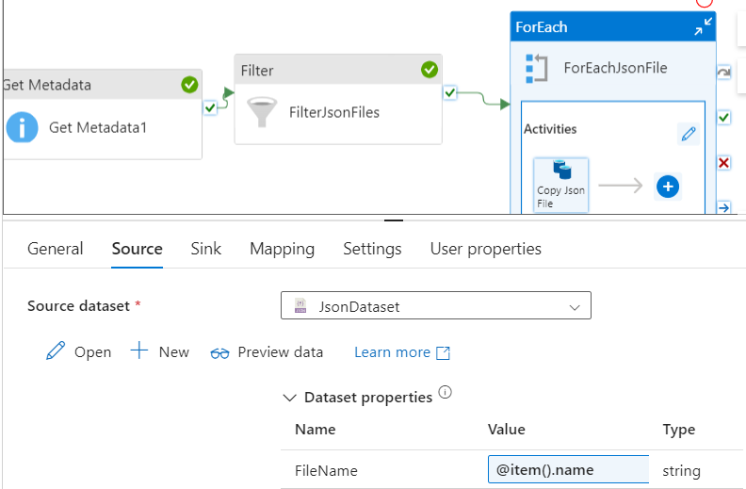
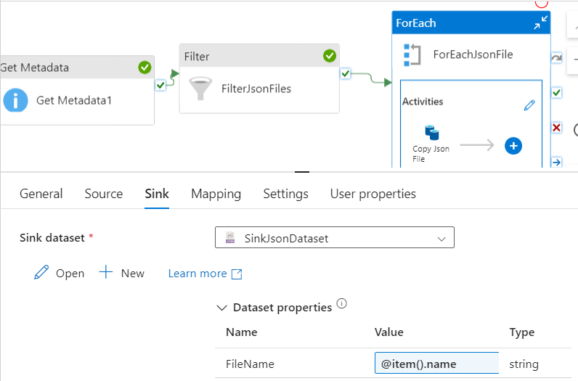
Copy Data Activity:

Slide 8
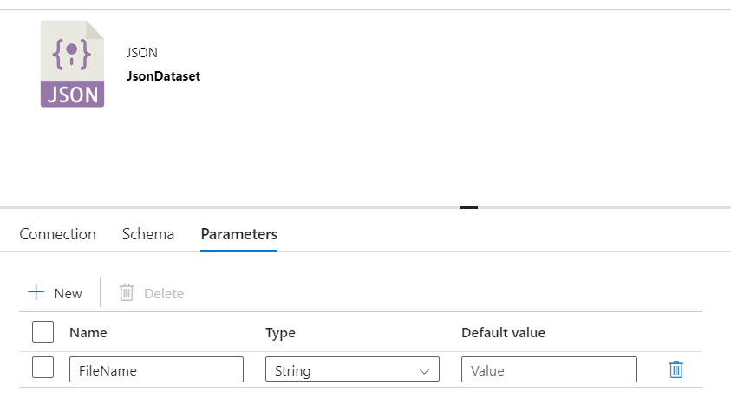
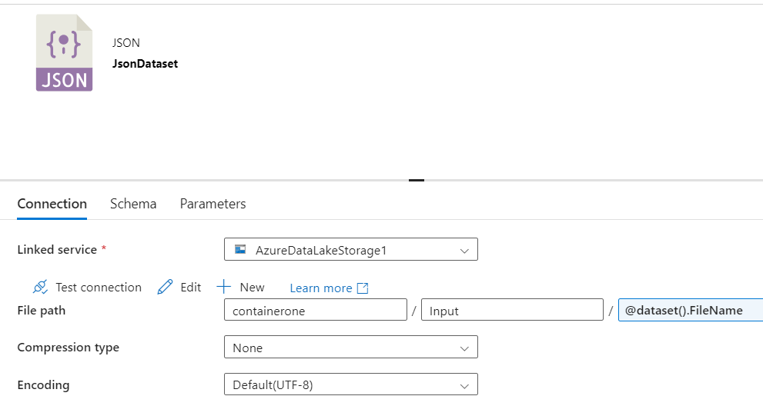
Parameterizing Source Dataset
Create a parameter for the file name.
Pass the file name dynamically from the ForEach activity.

Slide 9
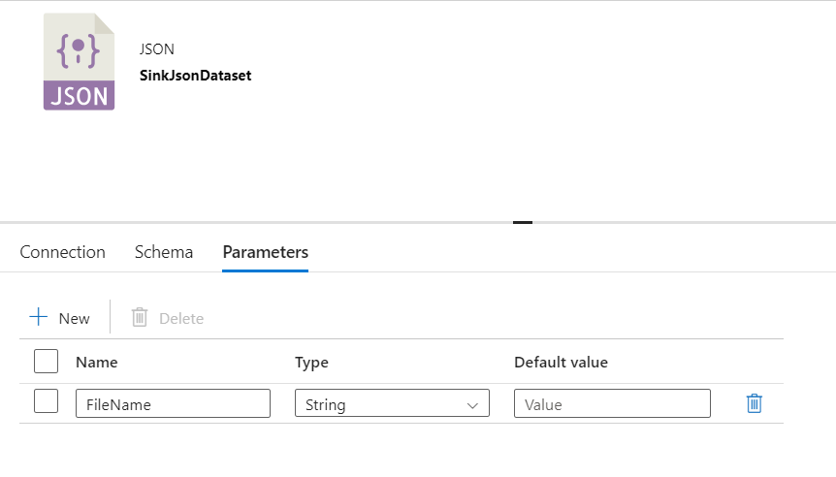
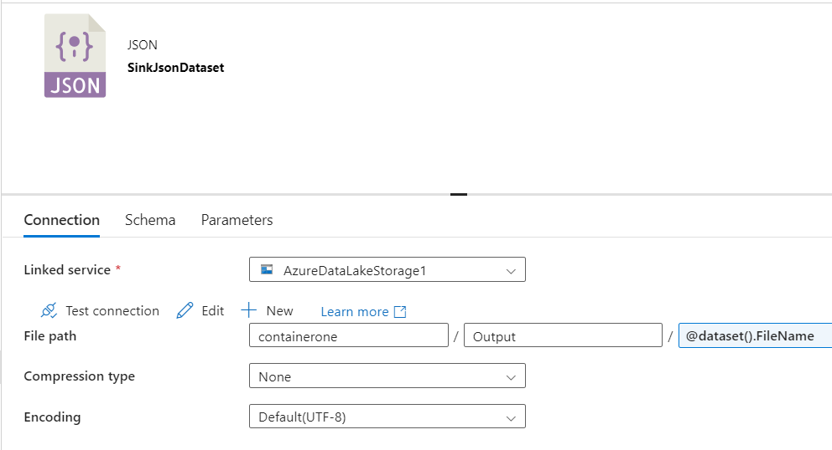
Parameterizing Sink Dataset
Create a parameter for the file name in the sink dataset.
Ensure the file name in the output matches the source file name.

Slide 10
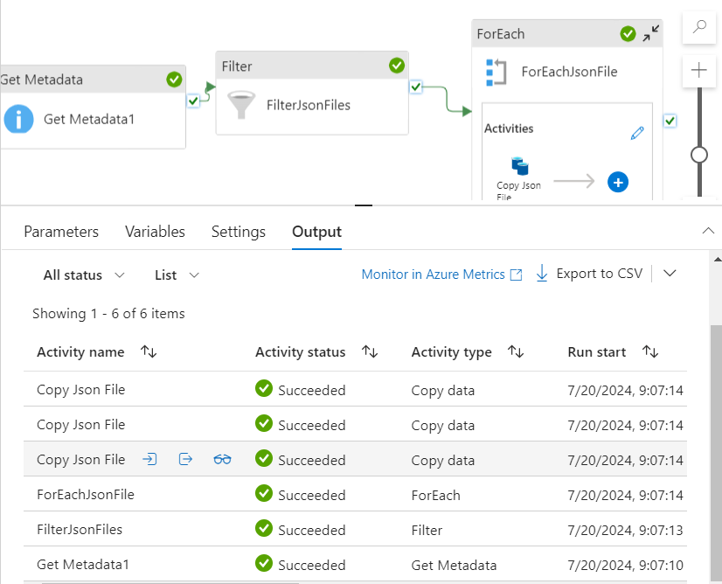
Debug and Execute Pipeline
Debug the pipeline to ensure all activities are set up correctly.
Only JSON files are copied to the output folder.

Slide 11
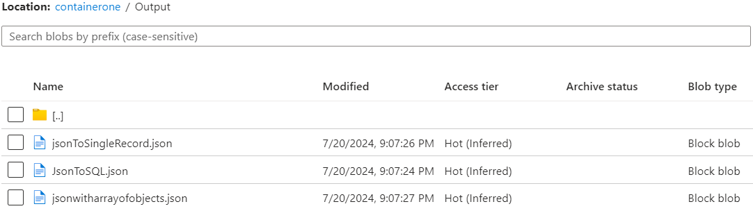
Conclusion
Successfully copied specific files from input to output folder using ADF pipeline.
Achieved requirement using Get Metadata, Filter, ForEach, and Copy Data activities.

Slide 12
Thank you

