Slide 1
Creating Daily, Weekly, and Monthly Reports using Databricks
Content:
Welcome note
Brief overview of the project
Importance of report generation for stakeholders
By Anjum Shaik

Slide 2
Project Objective
Generate daily, weekly, and monthly sales reports
Provide stakeholders with insights into sales trends
Automate the report generation process
Project url
Databricks Dumps - Databricks

Slide 3
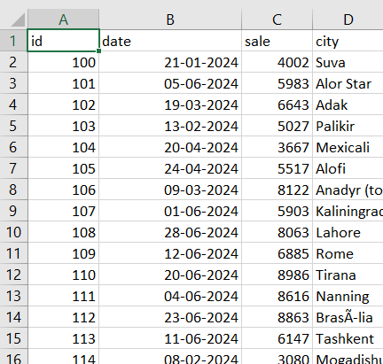
Data Source
Sales data available in a CSV file
Data includes multiple ID, date, sales, city

Slide 4
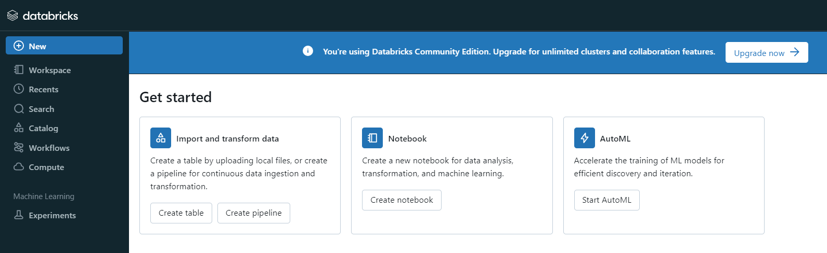
Databricks
Databricks is cloud-based big data analytics service. It combines the power of Apache spark and
Azure cloud services to provide a unified analytics platform.
Azure Databricks simplifies the process of building big data and AI solutions.

Slide 5
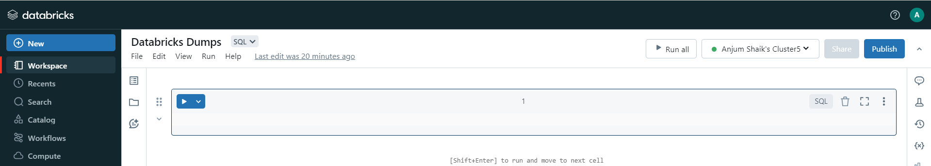
Setting Up Databricks
Create a Databricks notebook
Set up a cluster
Load the sales data into a Databricks table
The cluster is a collection of virtual machines that work together to perform large-scale data processing tasks. This cluster can scale up or down automatically based on the workload, enabling efficient handling of big data computations.

Slide 6
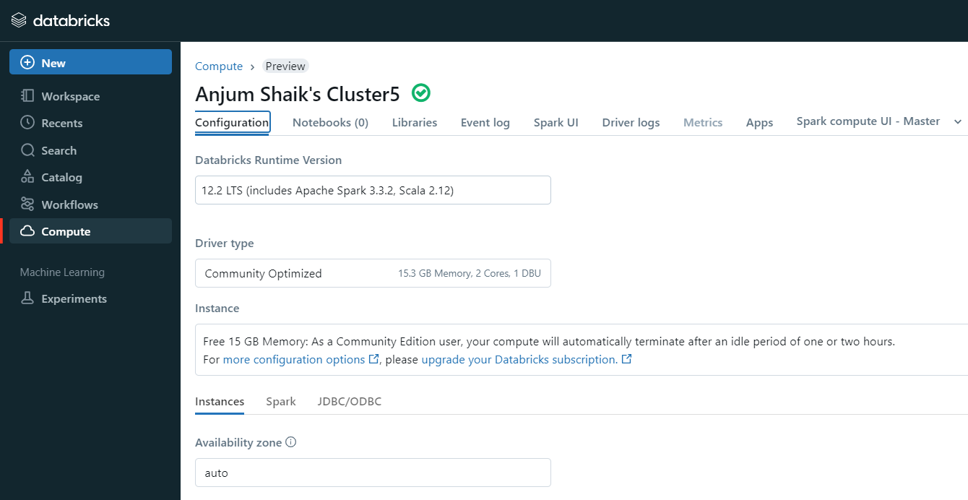
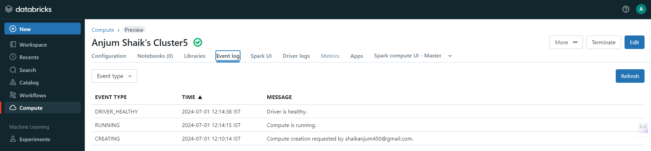

Slide 7
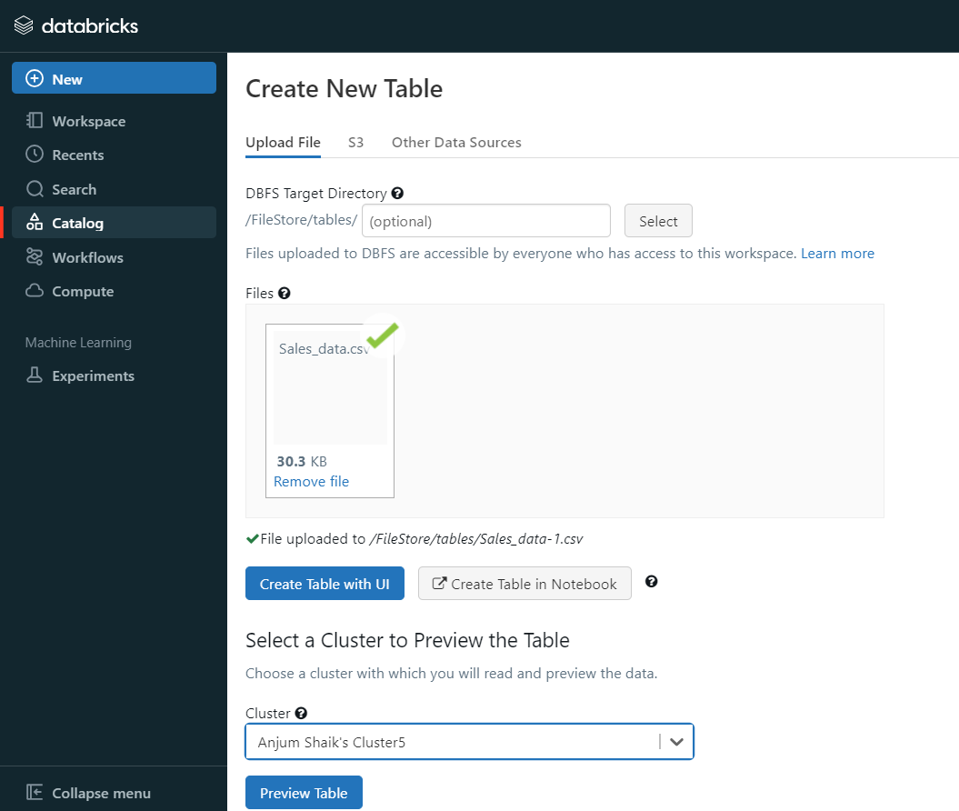
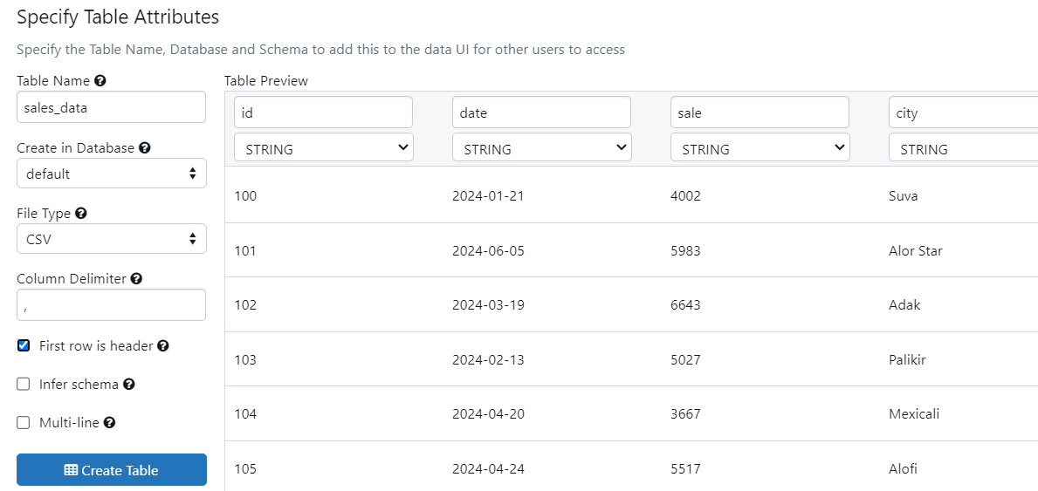
Creating the Databricks Table

Slide 8
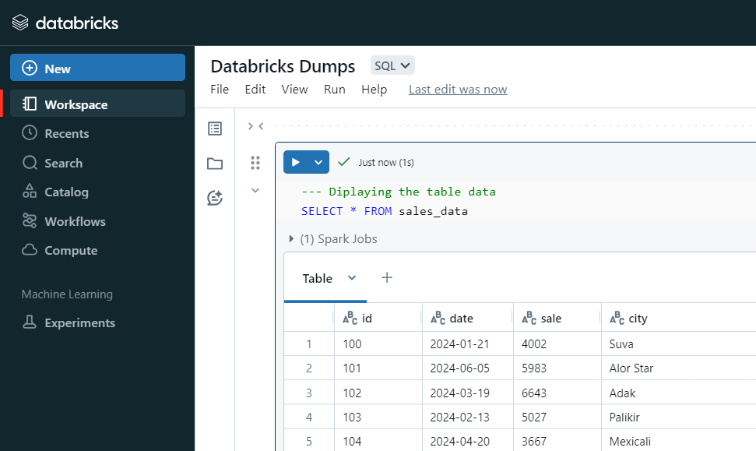
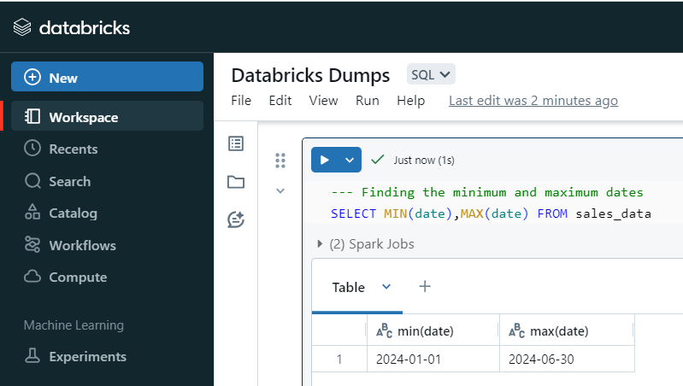
Data Overview
Query to display data and minimum and maximum dates

Slide 9
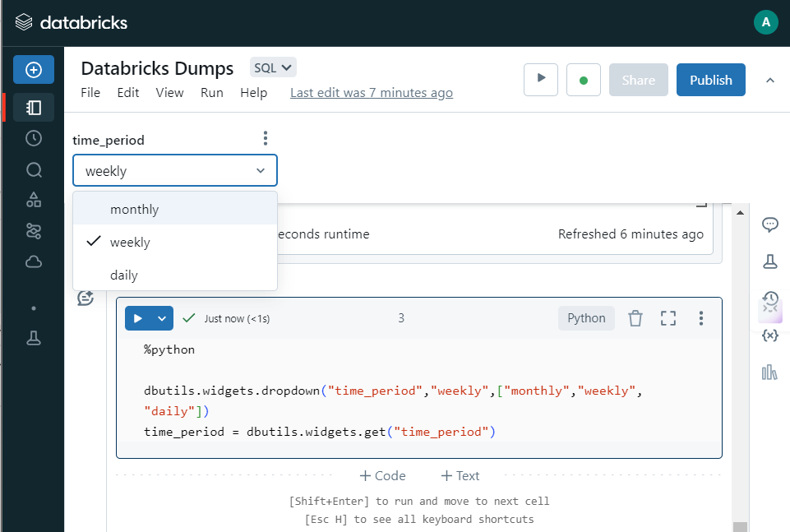
Dropdown Functionality
Creating a dropdown menu for report type selection (daily, weekly, monthly)
Using Python code to handle dropdown selections

Slide 10
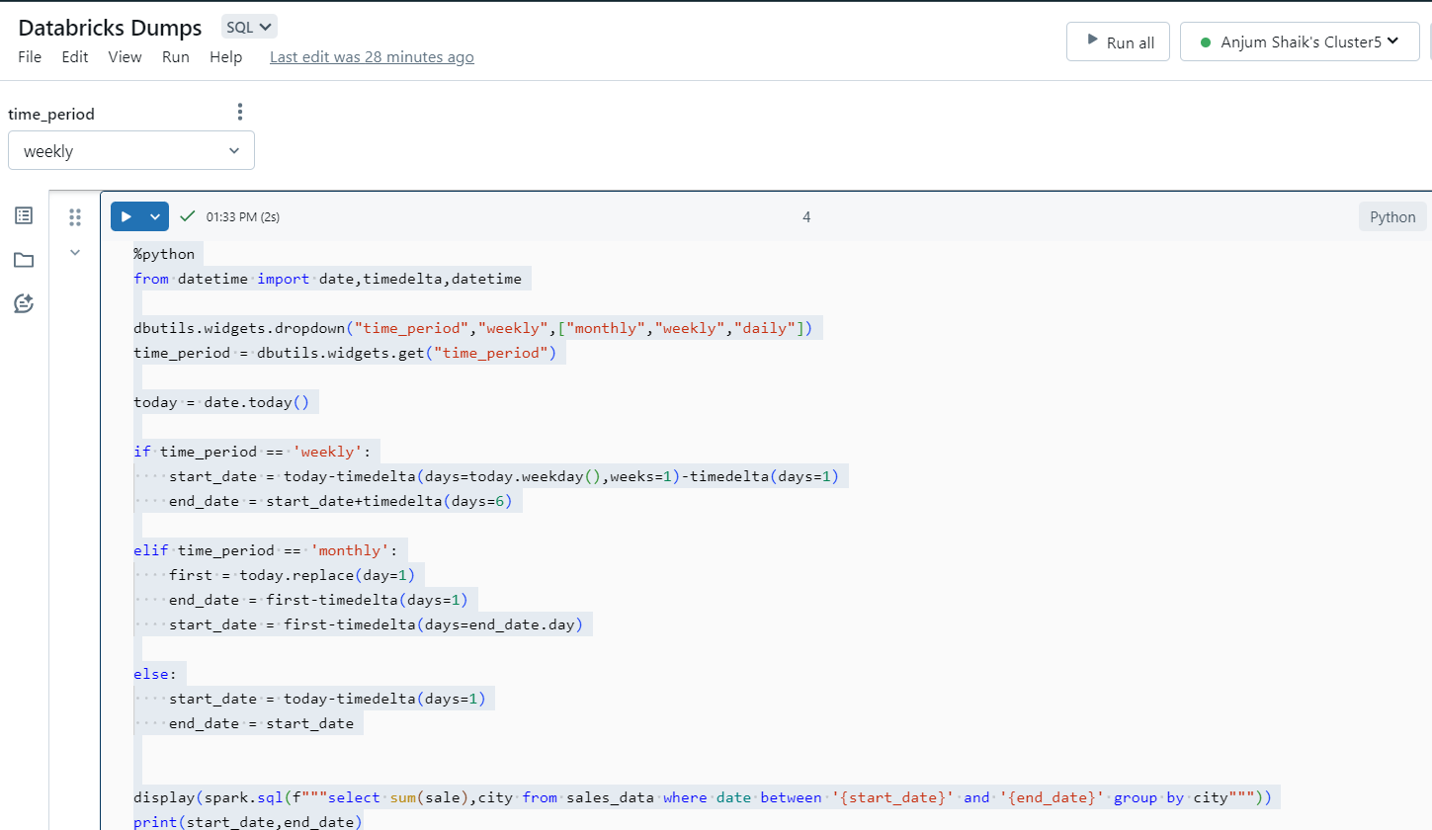
Report Logic
Generate daily, weekly, and monthly sales reports
Provide stakeholders with insights into sales trends
Automate the report generation process

Slide 11
%python
from datetime import date,timedelta,datetime
dbutils.widgets.dropdown("time_period","weekly",["monthly","weekly","daily"])
time_period = dbutils.widgets.get("time_period")
today = date.today()
if time_period == 'weekly':
start_date = today-timedelta(days=today.weekday(),weeks=1)-timedelta(days=1)
end_date = start_date+timedelta(days=6)
elif time_period == 'monthly':
first = today.replace(day=1)
end_date = first-timedelta(days=1)
start_date = first-timedelta(days=end_date.day)
else:
start_date = today-timedelta(days=1)
end_date = start_date
display(spark.sql(f"""select sum(sale),city from sales_data where date between '{start_date}' and '{end_date}' group by city"""))
print(start_date,end_date)

Slide 12
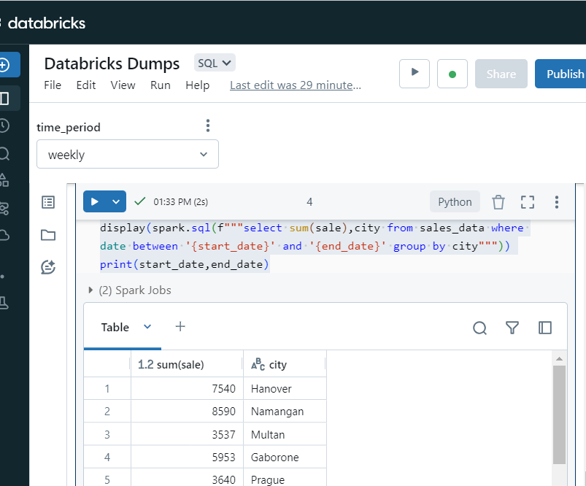
Automating the Reports
Automating report generation based on dropdown selection
Ensuring reports are generated without manual execution
Weekly Report : Sum of Sales

Slide 13
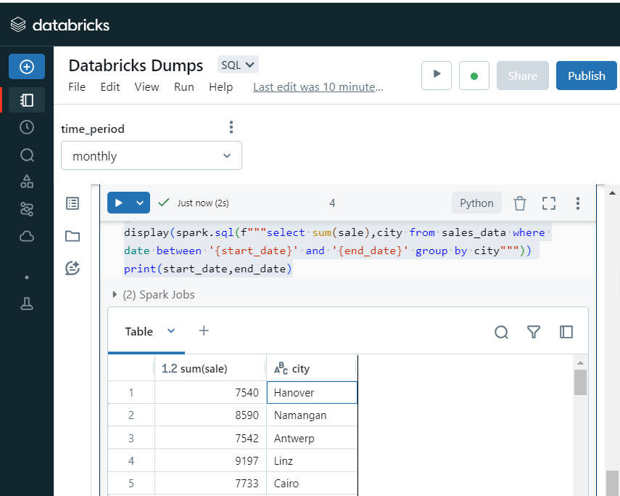
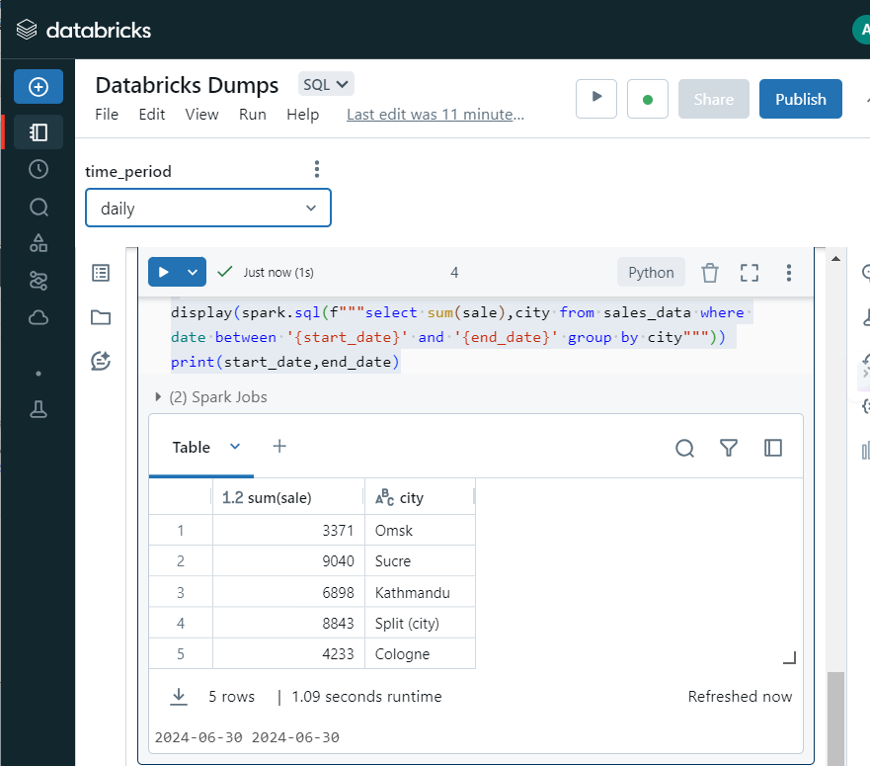
Monthly Report : Sum of Sales
Daily Report : Sum of Sales

Slide 14
Conclusion
Summary of the Project:
Developed an automated system for generating daily, weekly, and monthly sales reports using Databricks.
Implemented dropdown functionality to allow stakeholders to easily select the desired report type.
Ensured reports are generated accurately based on the selected date ranges.
Key Takeaways:
Automation: Streamlined the report generation process, saving time and reducing manual effort.
Flexibility: Enabled stakeholders to access up-to-date sales data on demand.
Real-Time Insights: Provided valuable insights into sales trends, helping stakeholders make informed business
decisions.

