Slide 1

T E C H V RU K · A I AG E NT I C SY ST E M C H A L L E NG E 2 0 2 6
01 / 05
Self-Improving Research Agent
A research agent that lcavns from its own mistakes.
Ask a question. It plans, researches with real tools, writes a cited report, checks every number, gets reviewed by a critic, and saves lessons for the next run.
R U N 1 · F I R S T D R AF T
10 GB × $0.33/GB = $3.33 per month [1][2][3]
CI TAT I O N CH E CK · NO LLM
FAIL not_in_source: $3.33 not found in any cited source, and not computed with the calculator
CR I T I C · GP T- O S S - 120 B
3/10 · needs_research
“the task required the official pricing page”
TH E G OA L
An agent that checks its own work — and doesn’t repeat the same mistake twice.
TH E P ROBL EM · REA L FA I L URES F ROM EA RLY RUN S
1
Wrong source
Price copied from a blog when the task said “official page”
2
Mental arithmetic
10 × $0.33 written as $3.33
3
Misattributed citation
A number cited to a source that doesnʼt contain it
4
Unit mix-up
“per 1M dimensions” shown as “per GB-month”
SA
Shaik Asad Ahmed
B.Tech CSE (AI) · AI & agentic systems
Self-Improving Research Agent · Problem
asad-research-agent.streamlit.app

Slide 2

Plan → research → write → review → lcavn
A RC H I T E C T U RE · L A NG G RA P H , O NE SH A RE D STAT E
02 / 05
One shared state across every node. The critic routes to more research, a rewrite, or done.
next run: lessons + trusted URLs go into the plan
1 · PL 6 N s RE SE 6 RC H
2 · W RI T E s RE V I E W
3 · L E A RN
recall
memory lookup · no LLM
writer
cited markdown report
memory
SQLite + FTS5
planner
task → 3–6 steps
citation check
every cited number is in its source · no LLM
needs_rewrite
TOOLS
web_search fetch_page calculator
executor
ReAct: think → act → observe
critic
score 1–10 + verdict · gpt-oss-120b
reflect
new lessons + source trust scores
accept
advance
save result · loop to next step
plan done
final report · END
needs_research → planner adds fix-up steps
Plan-and-Execute planner
ReAct loop executor
Tool use search · fetch · calc
Critic + smart routing
≤ 2 revisions
Reflection + long-term memory reflect · recall
Self-Improving Research Agent · Architecture
Shaik Asad Ahmed

Slide 3



SE L F - I M P ROV E M E NT P RO O F · C O NT RO L L E D C O M PA RI SO N
03 / 05
The fourth run got it right F2c fiivsF Fiэc.
5 → t
first critique score, out of 10
1 → 0
revisions needed
−52%
tokens used · 28,411 → 13,604
R U N 1 · E MPT Y ME MOR Y
R U N 4 · W I T H ME MOR Y
F I RST C RI TI QUE SC ORE P ER RUN
First critique | 3/10 | needs_research | 9/10 | accept
Revisions | 1 |  | 0
Tokens | 28,411 |  | 13, 604
Memory recalled | nothing |  | 4 lessons + 1 trusted URL
Plan step 1 | web search |  | fetch the official pricing page
9
accept ≥ 7
6
4
3
SE TUP Both runs: qwen3.8-27b for every role, critic gpt-oss-120b, fresh memory database, model fallbacks off. Only the memory changed.
Run 1
Run 2
Run 3
Run 4
HO N E ST
Run 3 dropped to 4/10. The fix for how trusted pages are read came from that failure.
Self-Improving Research Agent · Results
Shaik Asad Ahmed

Slide 4



D E M O H I G H L I G H T S · L I V E A P P
04 / 05
What you see in the app
Live at asad-research-agent.streamlit.app — run a task, or replay a recorded one.
G/G
known failure cases caught by the citation check + critic
Live plan checklist
Steps tick off as they finish. Steps the critic asked for are marked fix-up .
Step-by-step trace
memory · plan · think · act · observe · verify · critique · learn
— as they happen.
Score + cited report
Critic score, revisions, the report with a download button, and tokens per model.
Unit error: per 1M dimensions shown as per GB
RESEARCH TAB
RESEARCH TAB
RESEARCH TAB
Contradiction: Qdrant “$25 minimum” vs “no minimum”
Contradiction: Pinecone $16/M vs
$0.00000025/RU
Misattribution: $0.33 cited to a source without it
Memory tab
Runs chart, lessons with used / helpful counts, and trusted sources with verified facts.
Replay mode
Any recorded run, step by step, with zero API calls — a demo that survives quota limits.
Same story in the CLI
python cli.py "task" prints PLAN, THINK, ACT, OBSERVE, VERIFY, CRITIQUE, LEARN.
Missed constraint: official page never fetched → fix-up step
No false alarm: calculator result $3.30 not flagged
MEMO RY TAB
SIDEBAR · REPLAY
TERMINAL · CLI. PY
+ clean control report accepted (8/10)
Self-Improving Research Agent · Demo
Shaik Asad Ahmed

Slide 5
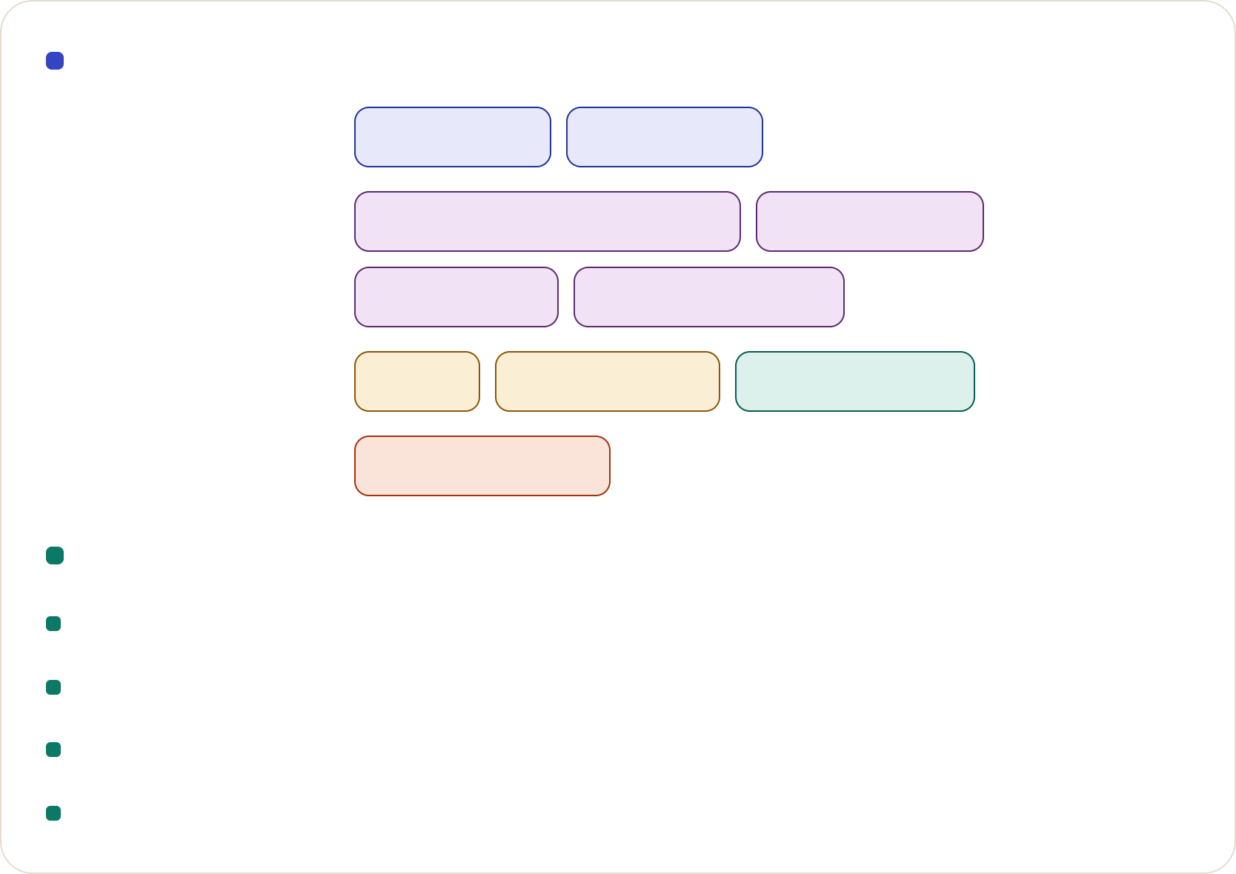
Built entirely on fivcc Ficvs — and what that costs
T E C H s L I M I T S
05 / 05
Stack
Limits
OR CHE STR 6TI ON
Python 3.11 LangGraph
Groq gpt-oss-20b / 120b qwen3.8-27b NVIDIA NIM Gemini 2.5 Flash
Tavily DuckDuckGo SQLite + FTS5 Streamlit Cloud
Quotas: ≈200k tokens/day per Groq model; a broad comparison costs 70–100k
Small models: gpt-oss-20b rarely fetches pages without memory Evidence: one task family, four runs — a demonstration, not a benchmark Recall: keyword-based (FTS5), not semantic
MOK E LS
TOOLS s K6T6
Next
Semantic recall with embeddings
Prune lessons that donʼt help; re-check trusted sources on a schedule
U I s K E PLOY
Resilience
5-model fallback chain across separate free quotas
Rate-limit retry using the providerʼs own wait time Graceful stop with a partial report — never a crash Public demo capped at 15 live runs/day · 81 unit tests
Thank you.
LIVE
CO D E
asad-research-agent.streamlit.app
github.com/shaikasadahmed2k23/self-improving-research-agent_Submission
Shaik Asad Ahmed
github.com/shaikasadahmed2k23
Disclosure: built with Claude Code as a coding assistant; the workflow and self-improvement design are my own. All APIs used on free tiers (Groq, Gemini, Tavily, NVIDIA NIM).

