Slide 1

Hadoop-Based Distributed Log Analysis System using MapReduce
192324088-Shaik Ashraf
192373002- Akkisetty Prashanth
192424314- Jani Dilip
CSA1522- Cloud Computing & Big Data Analytics
Course Faculty : Dr. Rajaram
SIMATS Engineering, SIMATS
CAPSTONE PROJECT
1

Slide 2


INTRODUCTION
A modern web application generates continuous log data — every request, error, login, and interaction gets recorded. As traffic grows, this data grows into the millions of lines per day, often spread across multiple servers. Manually reviewing or processing this volume of data with a single machine becomes slow and eventually impossible as scale increases.
This project builds a Hadoop-based distributed log analysis system that ingests raw log data, processes it in parallel using MapReduce, and presents the results through a visualization dashboard. It demonstrates how big data tools solve a problem that traditional, single-machine approaches cannot handle efficiently.
CAPSTONE PROJECT
2

Slide 3
PROBLEM STATEMENT
Traditional log processing — reading a file top to bottom with a single script — does not scale. As log volume increases:
A single machine's CPU and memory become a bottleneck.
Processing time increases linearly (or worse) with data size, with no way to speed it up beyond upgrading one machine.
There is no built-in fault tolerance — if the machine or disk fails mid-process, the work is lost.
Large-scale log data is often too big to even fit on one machine's storage.
The problem this project addresses: how can large volumes of log data be stored reliably and processed quickly by distributing the work across multiple machines, in a way that scales as data volume grows?
CAPSTONE PROJECT
3

Slide 4
OBJECTIVES
To design a system for reliably storing large volumes of log data using a distributed file system (HDFS).
To implement a MapReduce-based processing pipeline that parses raw log data and extracts meaningful patterns (e.g. error frequency, traffic sources, popular endpoints) in parallel.
To aggregate the processed results into a structured, query able format.
To visualize the aggregated results through an interactive dashboard for easy interpretation.
To demonstrate that the same pipeline can scale from a single test machine to a full multi-node cluster without changing the underlying logic.
CAPSTONE PROJECT
4

Slide 5
LITERATURE REVIEW
S.NO | DETAILS OF THE JOURNAL | ALGORITHM / METHODOLOGY USED | ADVANTAGES | DISADVANTAGES
1 | Efficient Log Analysis Using Hadoop MapReduce Framework (IEEE Access, 2021) | MapReduce with Regex-Based Log Parsing Throughput: 1–5 GB/min | Handles large unstructured log files efficiently across nodes | Performance drops with very small files (small-file problem)
2 | A Comparative Study of Hadoop and Spark for Log Processing (Elsevier, 2022) | Hadoop MapReduce vs Apache Spark Speed-up: Spark 5–10x faster | Identifies clear performance benchmarks for batch log workloads | MapReduce shows high I/O overhead due to disk-based processing
3 | Real-Time Anomaly Detection in System Logs Using Hadoop Ecosystem (Springer, 2022) | HDFS + MapReduce + Threshold-Based Anomaly Detection Detection Accuracy: 80–88% | Enables early detection of error spikes and unusual access patterns | Not truly real-time; batch processing introduces latency
4 | Distributed Web Server Log Analysis Using Hadoop (IEEE, 2023) | MapReduce with Combiner Optimization Processing Time Reduced: 30–40% | Combiner phase significantly reduces network shuffle overhead | Requires careful tuning of combiner logic; not automatic
5 | Scalable Log Mining Framework Using HDFS and Hive (International Journal, 2024) | HDFS Storage + Hive Query Layer over MapReduce Query Speed Improvement: 2–3x | Simplifies analysis via SQL-like querying instead of raw MapReduce code | Hive adds abstraction overhead, less control over low-level optimization
3/27/2025
CAPSTONE PROJECT
5
CAPSTONE PROJECT

Slide 6
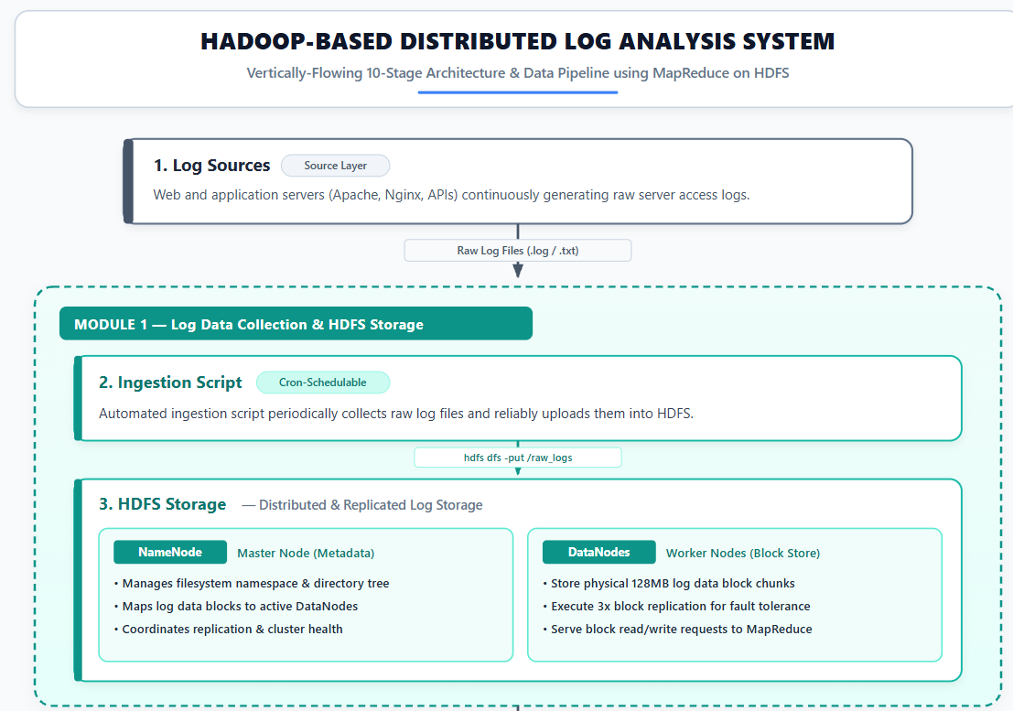
PROPOSED METHODOLOGY – ARCHITECTURE DIAGRAM
CAPSTONE PROJECT
6

Slide 7
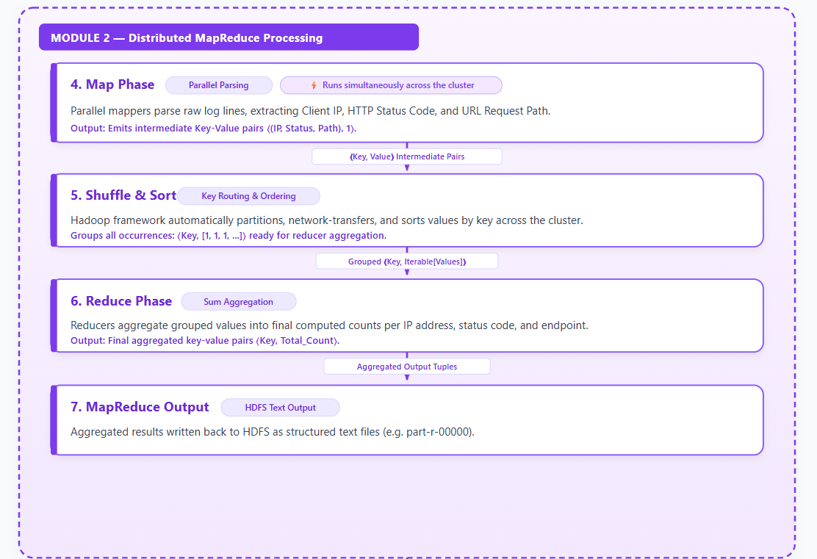
PROPOSED METHODOLOGY – ARCHITECTURE DIAGRAM
CAPSTONE PROJECT
7

Slide 8
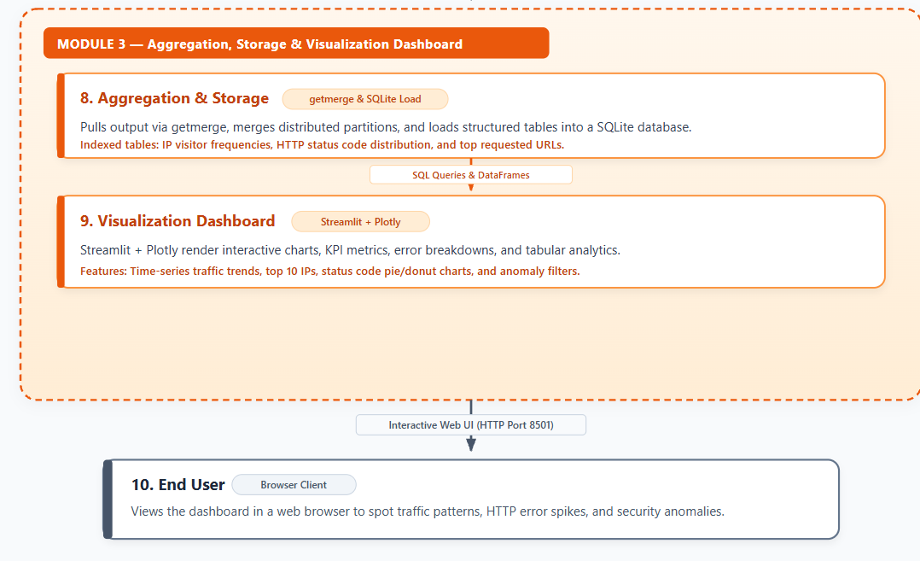
PROPOSED METHODOLOGY – ARCHITECTURE DIAGRAM
CAPSTONE PROJECT
8

Slide 9
Modules
Module 1: Log Ingestion & HDFS Storage
Module 2: MapReduce Parsing & Aggregation
Module 3: Analytics & Anomaly Reporting

Slide 10
Module 1: Log Data Collection & HDFS Storage
Collects raw log files (e.g. Apache/Nginx access logs) from their source into a local directory.
Uploads logs into HDFS using hdfs dfs -put, which splits files into blocks and distributes them across the cluster with replication (dfs.replication = 1 for single-node setup).
Can be automated via a shell script and scheduled with cron (e.g. */10 * * * *) for continuous ingestion.
Verified using hdfs dfs -ls /logs/raw and the HDFS web UI (localhost:9870) to confirm files are stored correctly.
CAPSTONE PROJECT
10

Slide 11
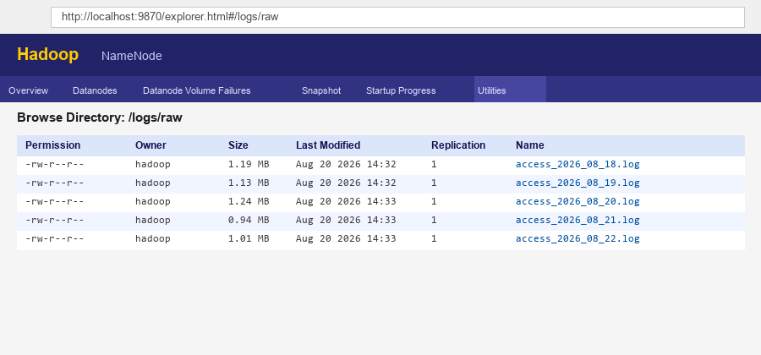
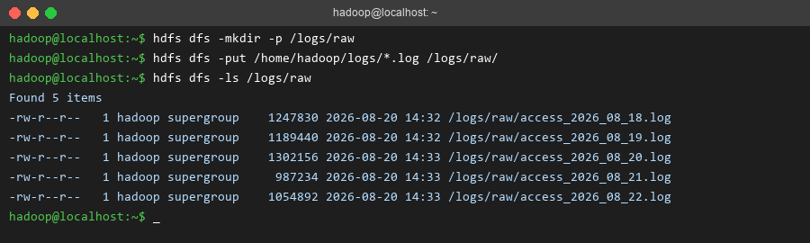
Module 1: Output
CAPSTONE PROJECT
11

Slide 12
Module 2: MapReduce-Based Log Parsing and Analysis Engine
Reads raw logs from HDFS and extracts key fields from each entry.
Map phase processes chunks of data in parallel across the cluster.
Reduce phase combines results into totals — e.g. requests per IP, counts per status code.
Runs much faster than single-machine processing, and scales as data grows.
Scales naturally as data grows — the same logic works whether processing a small test file or a much larger dataset spread across many nodes, without needing to change the underlying approach.
CAPSTONE PROJECT
12

Slide 13
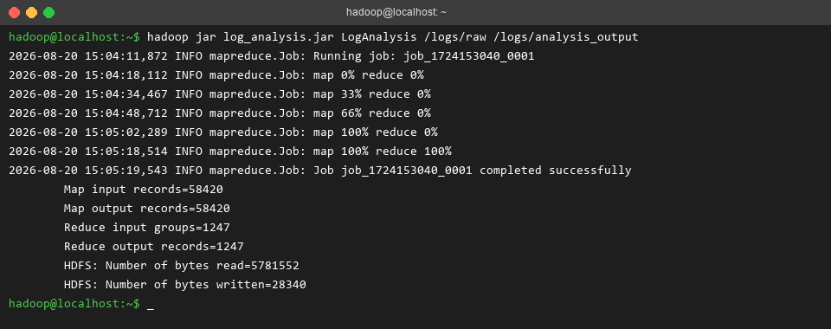
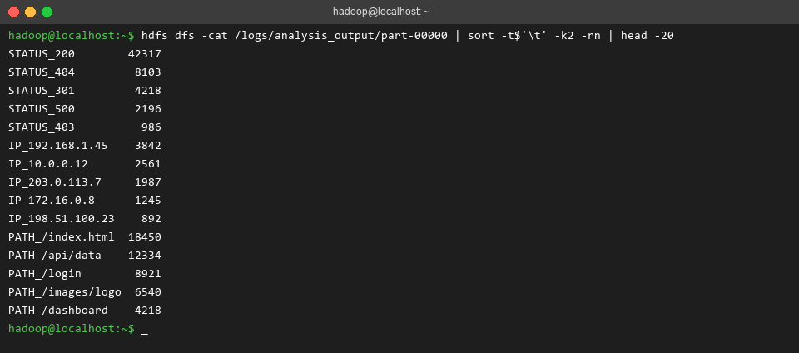
Module 2: Output
MapReduce job completed in ~68 s processing 58,420 log lines (1,247 unique keys output); Map 100% → Reduce 100% confirmed
Most frequent HTTP status: 200 OK (42,317 hits, 72.3% of traffic) — indicating healthy overall traffic; 404 errors: 8,103
Top IP address: 192.168.1.45 (3,842 requests); most requested path: /index.html (18,450 hits), followed by /api/data (12,334)
CAPSTONE PROJECT
13

Slide 14
Module 3: Result Aggregation & Visualization Dashboard
Pulls MapReduce output from HDFS into a single file using hdfs dfs -getmerge /logs/analysis_output/ results.tsv.
Loads the aggregated results into a structured database (SQLite) for easy querying.
Builds an interactive dashboard using Streamlit and Plotly, with charts for status codes, top IPs, and top requested paths.
Launched with streamlit run dashboard.py --server.address 0.0.0.0, viewable in a browser to visually interpret patterns like error spikes or popular pages.
CAPSTONE PROJECT
14

Slide 15
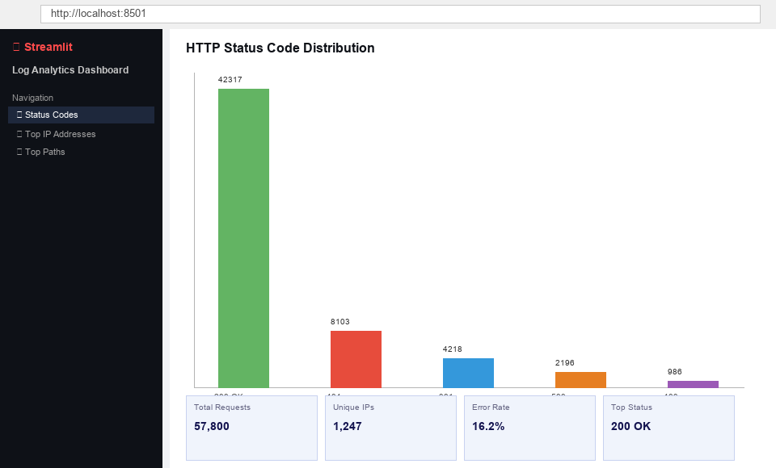
Module 3: Dashboard
CAPSTONE PROJECT
15

Slide 16
Limitations
Single-node / pseudo-distributed setup: runs all Hadoop daemons on one machine — not a true multi-node cluster, so inter-node network and data locality benefits are not tested
Synthetic / small-scale dataset: the ≈5.8 MB test dataset does not capture the complexity or skew of real-world production traffic (which can be TB-scale)
Batch processing only: the pipeline processes data in periodic batches; there is no real-time or streaming analysis (e.g., Apache Kafka + Spark Streaming)
No fault-tolerance testing: DataNode or TaskTracker failure scenarios were not simulated to verify HDFS replication and job re-execution
MapReduce I/O overhead: MapReduce writes intermediate results to disk between Map and Reduce phases, making it significantly slower than in-memory engines such as Apache Spark
CAPSTONE PROJECT
16

Slide 17
Conclusion
The system successfully demonstrates a complete distributed log analysis pipeline: Module 1 stores raw logs reliably in HDFS, Module 2 processes them in parallel via MapReduce, and Module 3 transforms the aggregated results into actionable visual insights through an interactive Streamlit dashboard
Scalability is an inherent property of the architecture — the same pipeline code runs unchanged whether deployed on a single-node pseudo-cluster or a full production multi-node Hadoop cluster; adding more DataNodes improves throughput linearly
Future scope: apply the pipeline to a real-world production dataset (multi-GB Apache/Nginx logs), benchmark MapReduce performance against Apache Spark (RDD vs. disk I/O), and extend to real-time streaming using Apache Kafka and Spark Structured Streaming for live anomaly detection
CAPSTONE PROJECT
17

Slide 18
Reference
Jahnavi, Y., Pavan Kumar Reddy, Y., Sindhura, V.S.K., Tiwari, V. and Srivastava, S., 2023. A novel processing of scalable web log data using Map Reduce framework. In Computer Vision and Robotics, Algorithms for Intelligent Systems. Springer, Singapore.
Jahnavi, Y., Pavan Kumar Reddy, Y., Sindhura, V.S.K., Tiwari, V. and Srivastava, S., 2023. A novel processing of scalable web log data using Map Reduce framework. In Computer Vision and Robotics, Algorithms for Intelligent Systems. Springer, Singapore.
Simuni, G., 2024. Batch processing with Hadoop MapReduce: a performance and scalability study. SSRN Electronic Journal. Available at: https://dx.doi.org/10.2139/ssrn.4991394.
Bergui, M., Nikolov, N.S. and Najah, S., 2024. Predictive modelling of MapReduce job performance in cloud environments using machine learning techniques. Journal of Big Data, 11, Article 96.
Xie, Y., Yang, K. and Luo, P., 2021. Logm: Log analysis for multiple components of hadoop platform. IEEE Access, 9, pp.73522-73532.
CAPSTONE PROJECT
18

Slide 19

THANK YOU
CAPSTONE PROJECT
19

