Slide 1

Merkle trees, Nonce and Hashing
in Blockchain Data Structure
Presented to Shaikat Majumder, Faculty at Creative IT Institute
Presented By
Md. Abdur Rahman

Slide 2
Merkle Trees
Also known as Binary Hash Trees.
Useful where the same data should exist in multiple places.
Made up of hashes of various data blocks that summarize all the transactions in a block.
It allows the network participant to verify whether the transaction got included in the block or not.

Slide 3
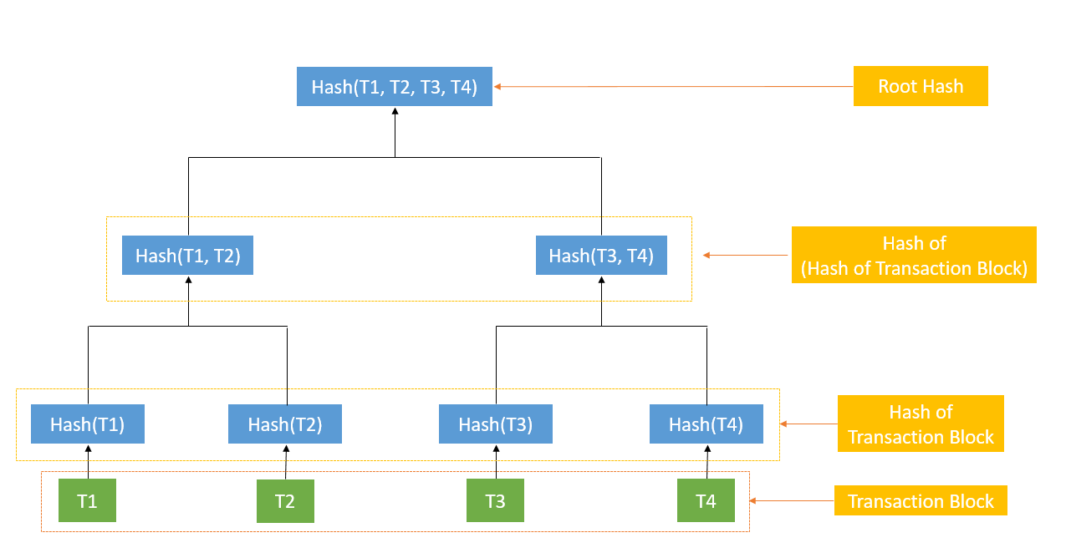
Merkle root
Merkle root

Slide 4
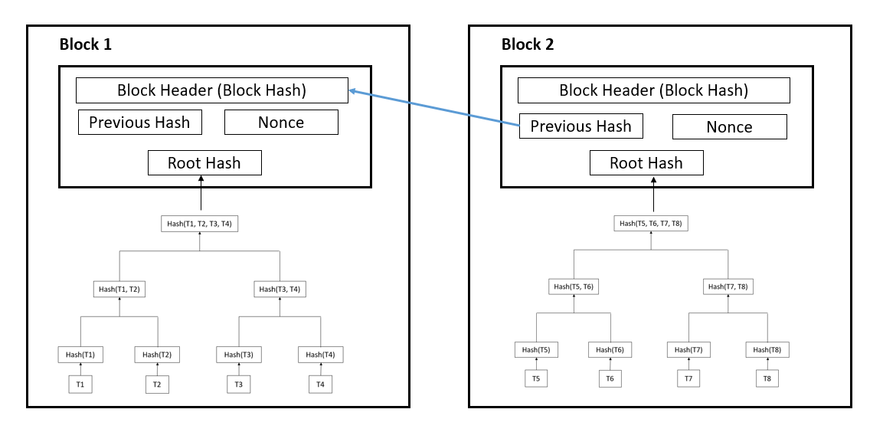
How is Merkle Tree useful in Blockchain?
Using Merkle root, the network participants can verify the transactions have not been tampered with.

Slide 5
Nonce
Nonce = Number used only once
Miners parse through millions of nonce values to ultimately find the golden nonce that will suit the blockchain.
The target hash must be lower or equal for the block to be added to the blockchain.
By changing the nonce, we can change the hash value.

Slide 6
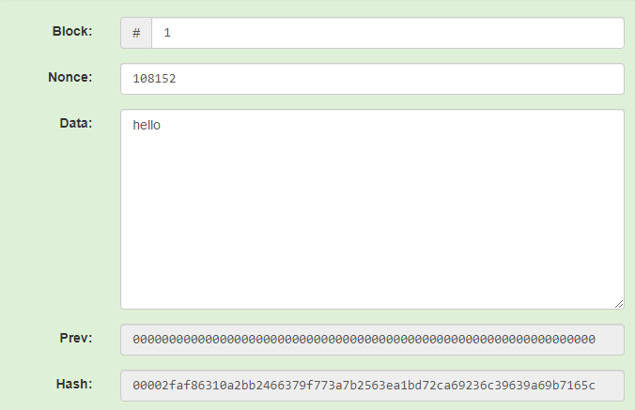
Nonce
Largest
All possible hashes
ffffffffffff
Target: 00002fa
000000000000
Block Structure
Smallest

Slide 7
Hashing
The process of taking an input and converting it into a fixed length of output.
Normally converted by using SHA – 256 algorithm.
One-way function
Designed to be irreversible
Salt can be added for freshness

Slide 8
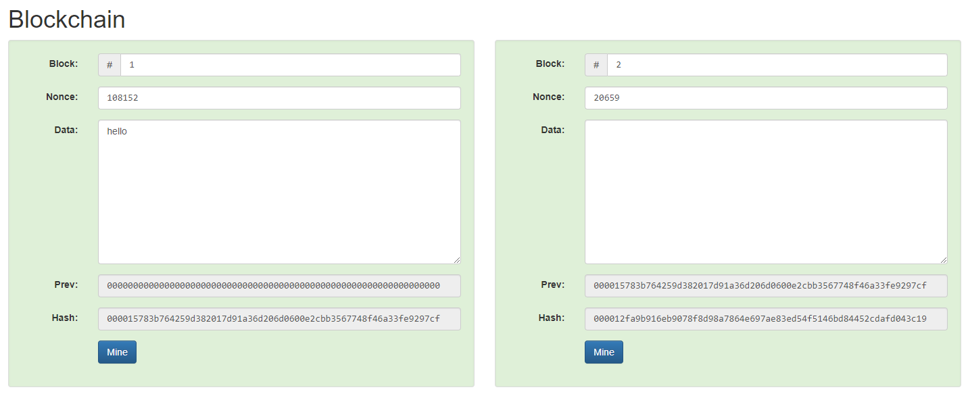
Blockchain structure
A single change in a block will tamper with the entire blockchain network. Click here to witness the example

Slide 9
ANY QUESTIONS?

Slide 10
THANK YOU!!!

