Slide 1

CSS – Day 2
Styling & Structure

Slide 2


Quick Revision
Let's refresh what we learned in Day 1 before we build upon it.
What is CSS?
Box Model
Selectors
Cascading Style Sheets control the presentation and layout of HTML documents. CSS separates content from design, making websites visually appealing and maintainable.
Every element is a box with content, padding, border, and margin. Understanding this model is crucial for precise spacing and layout control.
Target elements using tags, classes, IDs, or attributes. Specificity determines which styles apply when multiple rules match the same element.

Slide 3

Text Properties
CSS gives you powerful control over how text appears on your webpage. From color to spacing, these properties transform plain text into professional typography.
1
color
Sets the text color using names, hex codes, RGB, or HSL values
2
text-align
Aligns text left, right, center, or justified
3
text-decoration
Adds underline, overline, or line-through effects
4
text-transform
Uppercase, lowercase, or capitalize text
5
line-height
Controls spacing between lines of text
6
letter-spacing
Adjusts space between individual characters
Try This: Create a paragraph element and experiment with different combinations of these properties. Notice how they work together to create professional typography!

Slide 4
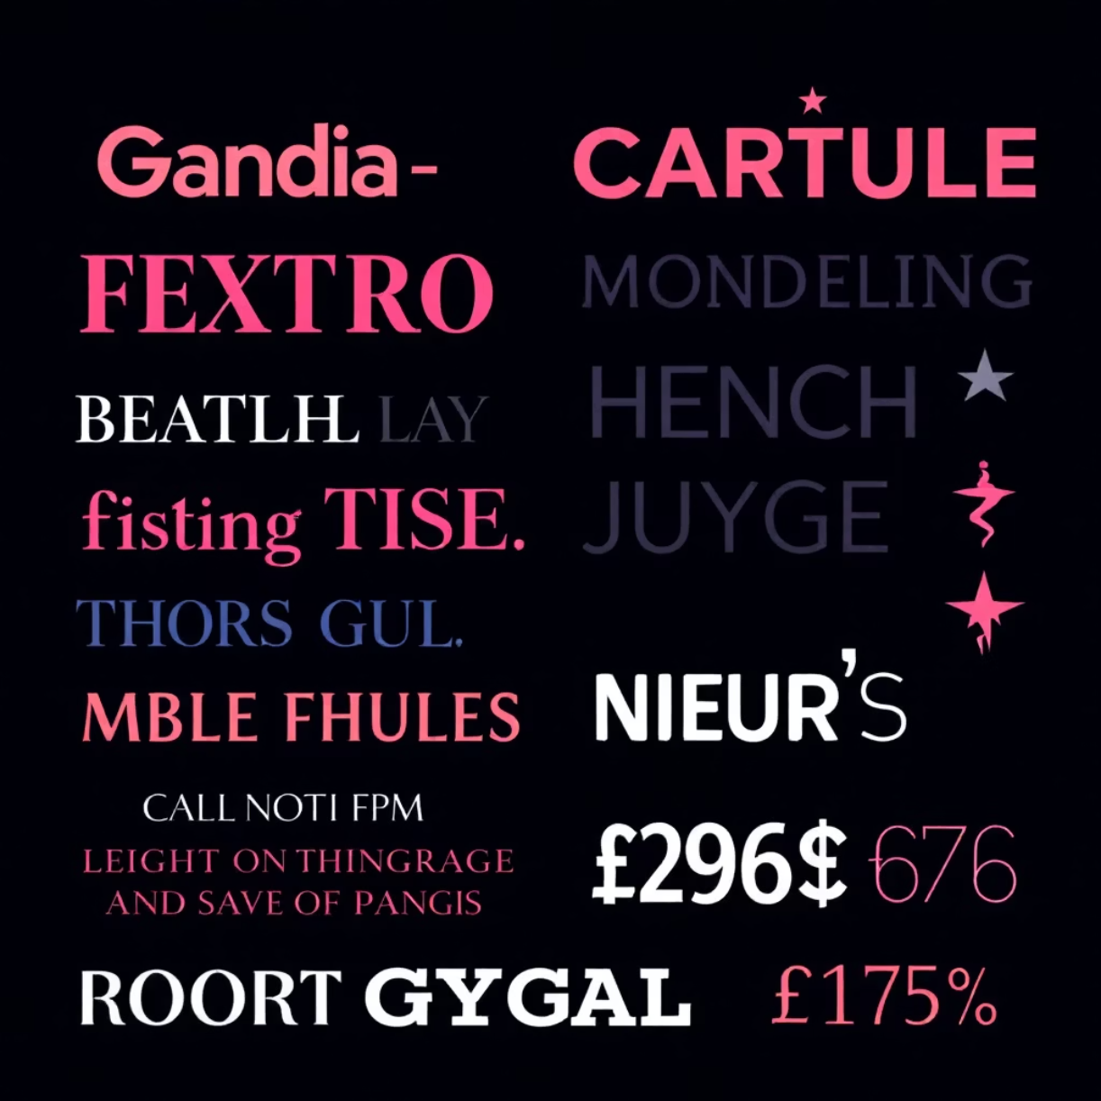




Font Properties
Controlling Font Appearance
Font properties determine the typeface, size, weight, and style of your text. Master these to create readable, beautiful interfaces.
font-family: Specifies the typeface stack
font-size: Sets text size in px, em, rem, or percentages
font-weight: Controls boldness (400=normal, 700=bold)
font-style: Italic or normal text
Serif Fonts
Sans-Serif Fonts
Monospace Fonts
Traditional fonts with decorative strokes. Great for formal content and print-style layouts.
Modern, clean fonts without decorative strokes. Perfect for web interfaces and digital screens.
Fixed-width fonts where each character takes equal space. Ideal for code blocks and technical content.
Pro Tip: Always provide a font stack with fallback options! If your preferred font isn't available, the browser will use the next option.

Slide 5





Links & Pseudo Classes
Make your links interactive and responsive! Pseudo-classes let you style links based on user interaction states.
a:link
a:visited
Unvisited link state
Previously clicked links
a:hover
a:active
Mouse over state
Currently being clicked
LVHA Order Matters!
Remember the order: Link → Visited → Hover → Active. This ensures proper styling precedence. Using the wrong order can cause some styles to be overridden.
Good Example ✅
Wrong Order ❌
a:link { color: blue; }
a:visited { color: purple; }
a:hover { color: red; }
a:active { color: orange; }
a:hover { color: red; }
a:active { color: orange; }
a:link { color: blue; }
a:visited { color: purple; }
Try This: Create a navigation menu with 3-4 links and apply different colors to each state. Test them in your browser to see the transitions!

Slide 6


Lists
Lists are essential for organizing content. CSS gives you complete control over their appearance, from bullet styles to positioning and layout.
01
list-style-type
Choose bullet style: disc, circle, square, or numbered (decimal)
02
list-style-position
Inside (bullets in content) or outside (bullets in margin)
03
Remove Bullets
Set list-style: none to create clean, bullet-free lists
04
Horizontal Navigation
Use display: inline to create horizontal navigation menus
Vertical List (Default)
Horizontal Navigation
Home
About
Services
Contact
Home
About
Services
Contact
Challenge: Create a horizontal navigation bar where each link changes background color on hover. This is a common pattern in web design!

Slide 7

Tables
Tables display structured data beautifully. From simple borders to zebra-striped rows, CSS transforms tables into professional data displays.
border Property
Padding Control
Add borders to table elements. Use border-collapse: collapse to remove spacing between cell borders.
Adjust cell padding for better readability. More padding = more professional, spacious tables.
Text Alignment
Zebra Striping
Align text left, center, or right within cells using text-align property.
Use nth-child(even) selector to alternate row colors for better readability.
Without Styling
With CSS Styling
Name
Age
Name
Age
Alice
25
Alice
25
Bob
30
Bob
30
Try This: Create a table with 4 columns and 5 rows. Add borders, center-align the header, and apply zebra striping using nth-child!

Slide 8

Display Property
The display property controls how elements flow on the page. Understanding block, inline, and inline-block is fundamental to web layout.
1
2
block
inline
Takes full width, starts on new line, has height and width. Examples: div, p, h1-h6, ul
Takes only needed width, flows in text, no height/width. Examples: span, a, strong, em
3
4
inline-block
none
Flows inline but can have height/width. Perfect for navigation items and grid layouts
Hides the element completely from rendering. Use for conditional content display
Visual Comparison
block
inline
inline-block
Each element starts on a new line and spans the full width available.
Elements flow together in a line, wrapping naturally like text.
Flows inline but respects width and height properties.
Important: Understanding display is crucial for Day 3's layout topics! Practice converting between these types to see the differences.

Slide 9
Practice Task: Profile Card
Apply everything you've learned today! Build a complete profile card with styled text, links, lists, and a table.
1
Create the Structure
Start with a div container. Add a heading for the name, paragraph for bio, and organize content into sections.
2
Style the Text
Use font properties for professional typography. Apply text-align, line-height, and letter-spacing for readability.
3
Add Styled Links
Include social media links with hover effects. Use the LVHA order to ensure proper styling precedence.
4
Create a List
Add skills or interests as a list. Style it with custom bullets or remove them entirely for a clean look.
5
Build a Small Table
Display contact information or stats in a table. Apply borders, padding, and zebra striping for polish.
6
Apply Display Properties
Use block, inline, or inline-block to control layout flow. Experiment with display: none for conditional content.
Time to Code! You have 15 minutes to build your profile card. Reference today's slides as needed. Don't worry about perfection—focus on applying the concepts!

Slide 10

Day 3
Navigation & Website Layout
You've mastered styling and structure! Next session, we'll dive into creating navigation systems and complete website layouts using flexbox, grid, and positioning.
Navigation Menus
Build responsive navigation bars that adapt to different screen sizes
Flexbox Layout
Create flexible, modern layouts with CSS Flexbox properties
Grid System
Design complex multi-column layouts using CSS Grid
Positioning
Control element placement with absolute, relative, fixed, and sticky positioning
Prepare for an exciting session where we bring all your CSS skills together to build complete, professional web layouts!

