Slide 1

CSS Workshop — Day 1
CSS Fundamentals

Slide 2


What is CSS?
CSS (Cascading Style Sheets) is the language used to describe how HTML elements are presented — layout, colors, spacing, and typography.
Why CSS?
HTML vs CSS
Real-world Analogy
Separates content (HTML) from presentation so pages are easier to maintain and look great across devices.
HTML = structure (headings, paragraphs). CSS = design (colors, spacing, fonts).
HTML is the building frame; CSS is the paint, furniture, and finishes that make it attractive.

Slide 3
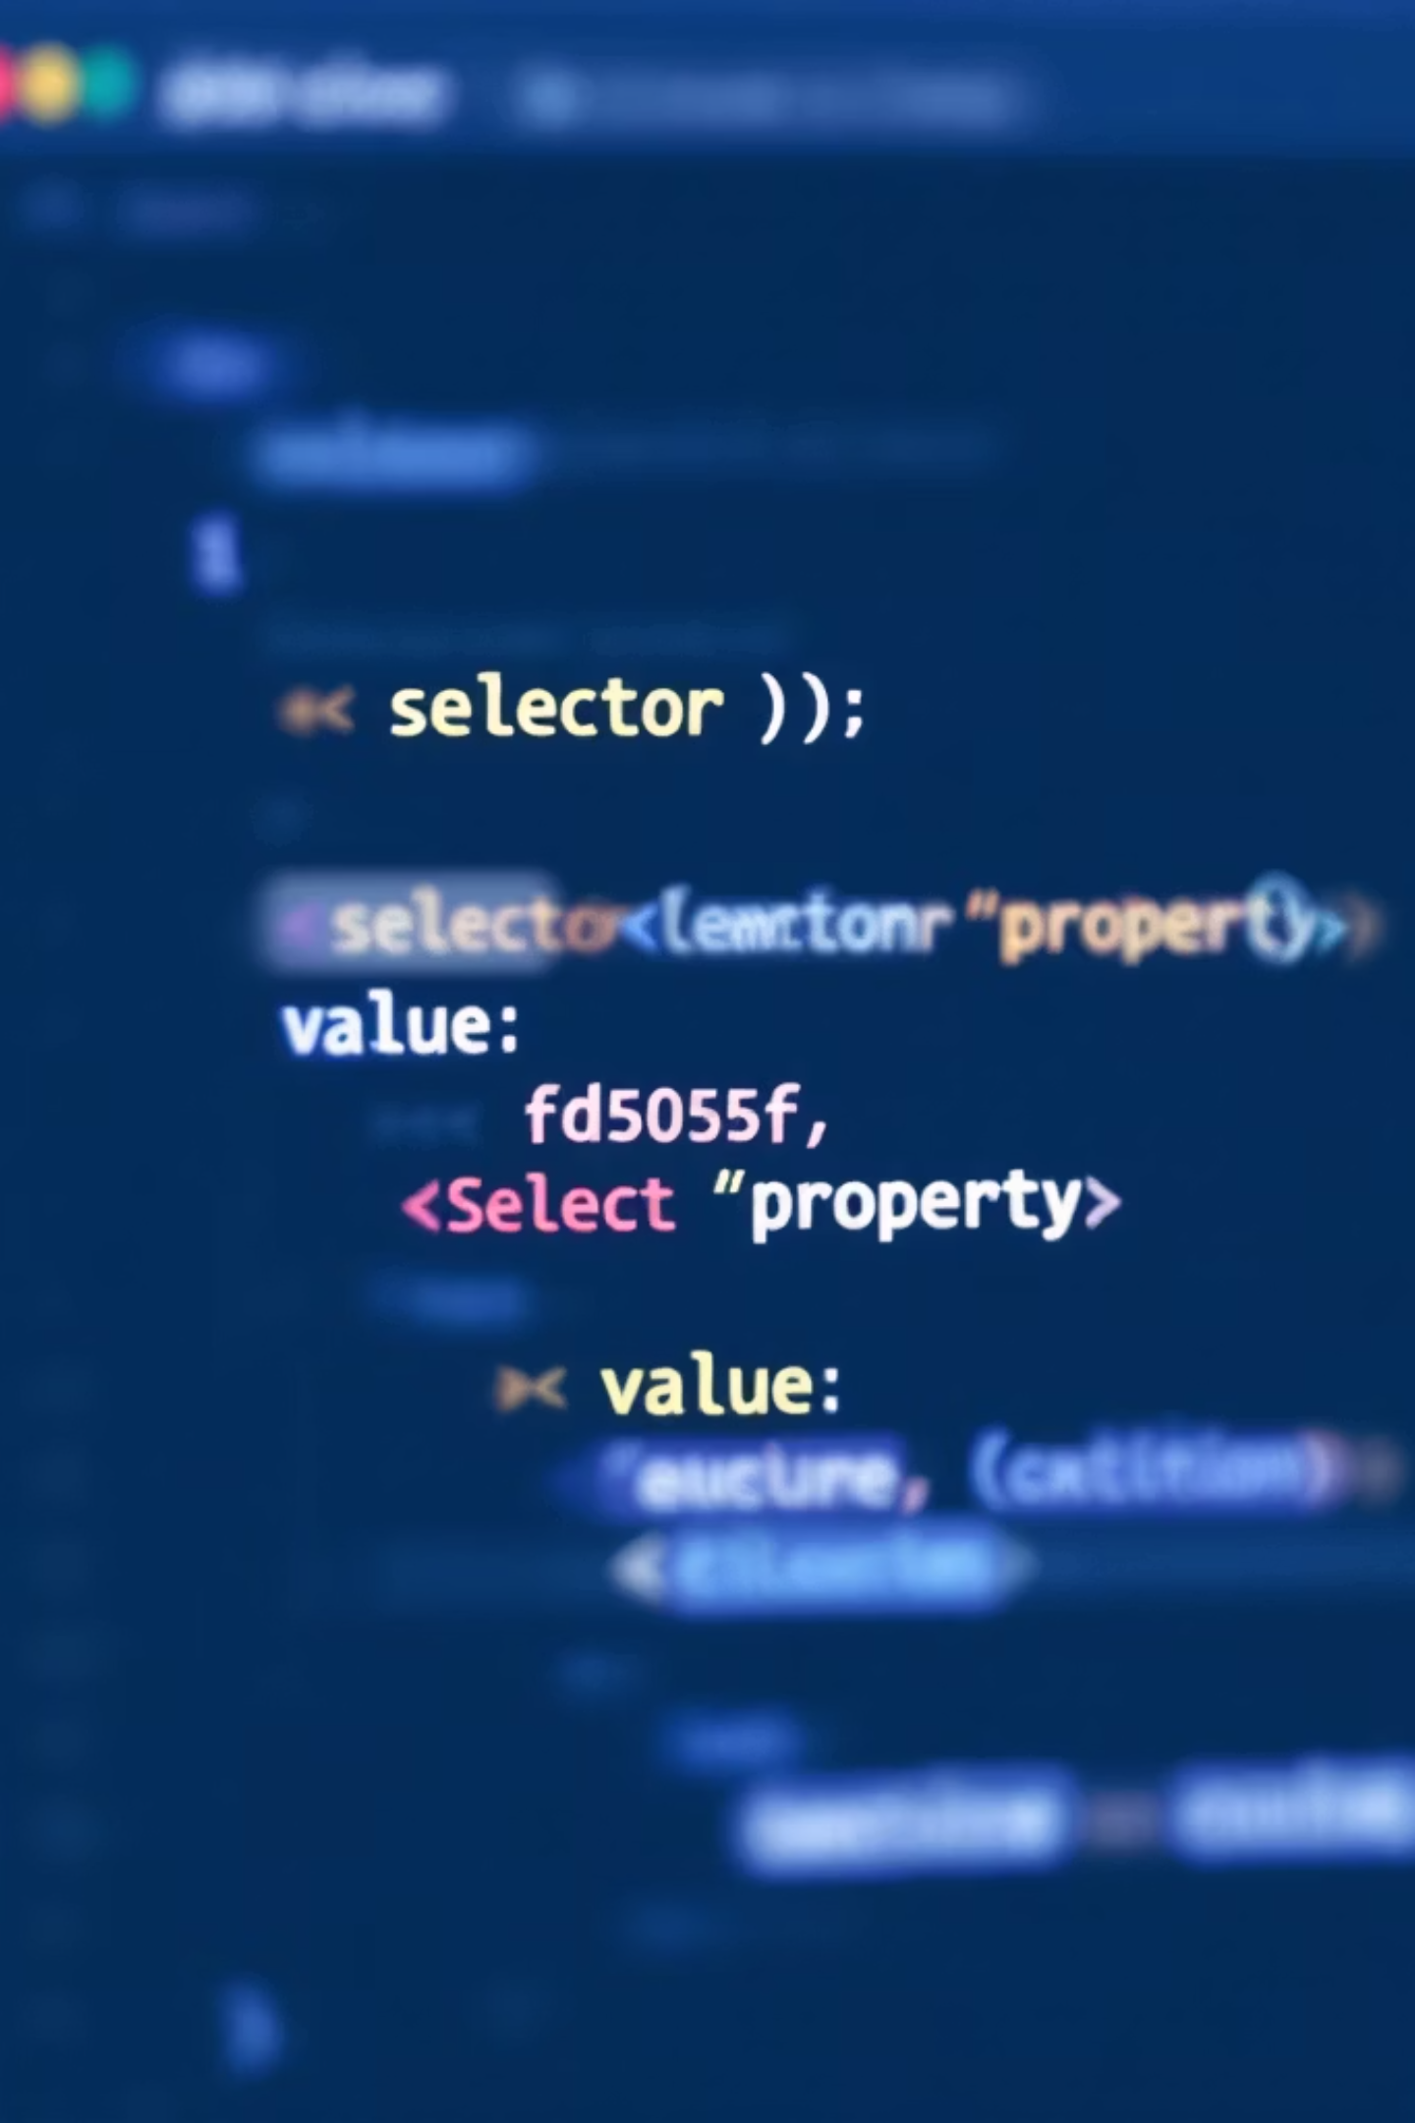
CSS Syntax — The Basics
CSS rules follow a simple pattern: selector { property: value; }
/* Example */
p {
color: #1B1744;
font-size: 16px;
}
Selector
Property
Value
Targets which element(s) to style (e.g., p, .class, #id).
The style attribute (e.g., color, margin, font-size).
The setting for the property (e.g., #fd505f, 16px, center).

Slide 4



Types of CSS
1
2
Inline CSS
Internal CSS
Styles written directly on an HTML element. Quick but not reusable.
Placed inside a <style> tag in the HTML head — good for single-page overrides.
<h1 style="color:#fd505f;">Title</h1>
<style> .btn { background:#261C4E; } </style>
3
External CSS
Separate .css file linked with <link rel="stylesheet">. Best for maintainability and reuse across pages.
<link href="styles.css" rel="stylesheet">
Try This: Convert an inline style to an external stylesheet — it’s a great refactor exercise.

Slide 5
Common CSS Selectors
Element Selector
Targets elements by name. Example: p { color: blue; }
Class Selector
Targets by class with a dot. Example: .highlight { background:#fd505f; }
ID Selector
Unique per page, uses #. Example: #hero { padding: 20px; }
Universal Selector
Targets all elements. Example: * { box-sizing: border-box; }
Group Selector
Apply same styles to multiple selectors: h1, h2, h3 { margin:0; }
Try This: Add a .highlight class to one paragraph and style it with a background and padding.

Slide 6
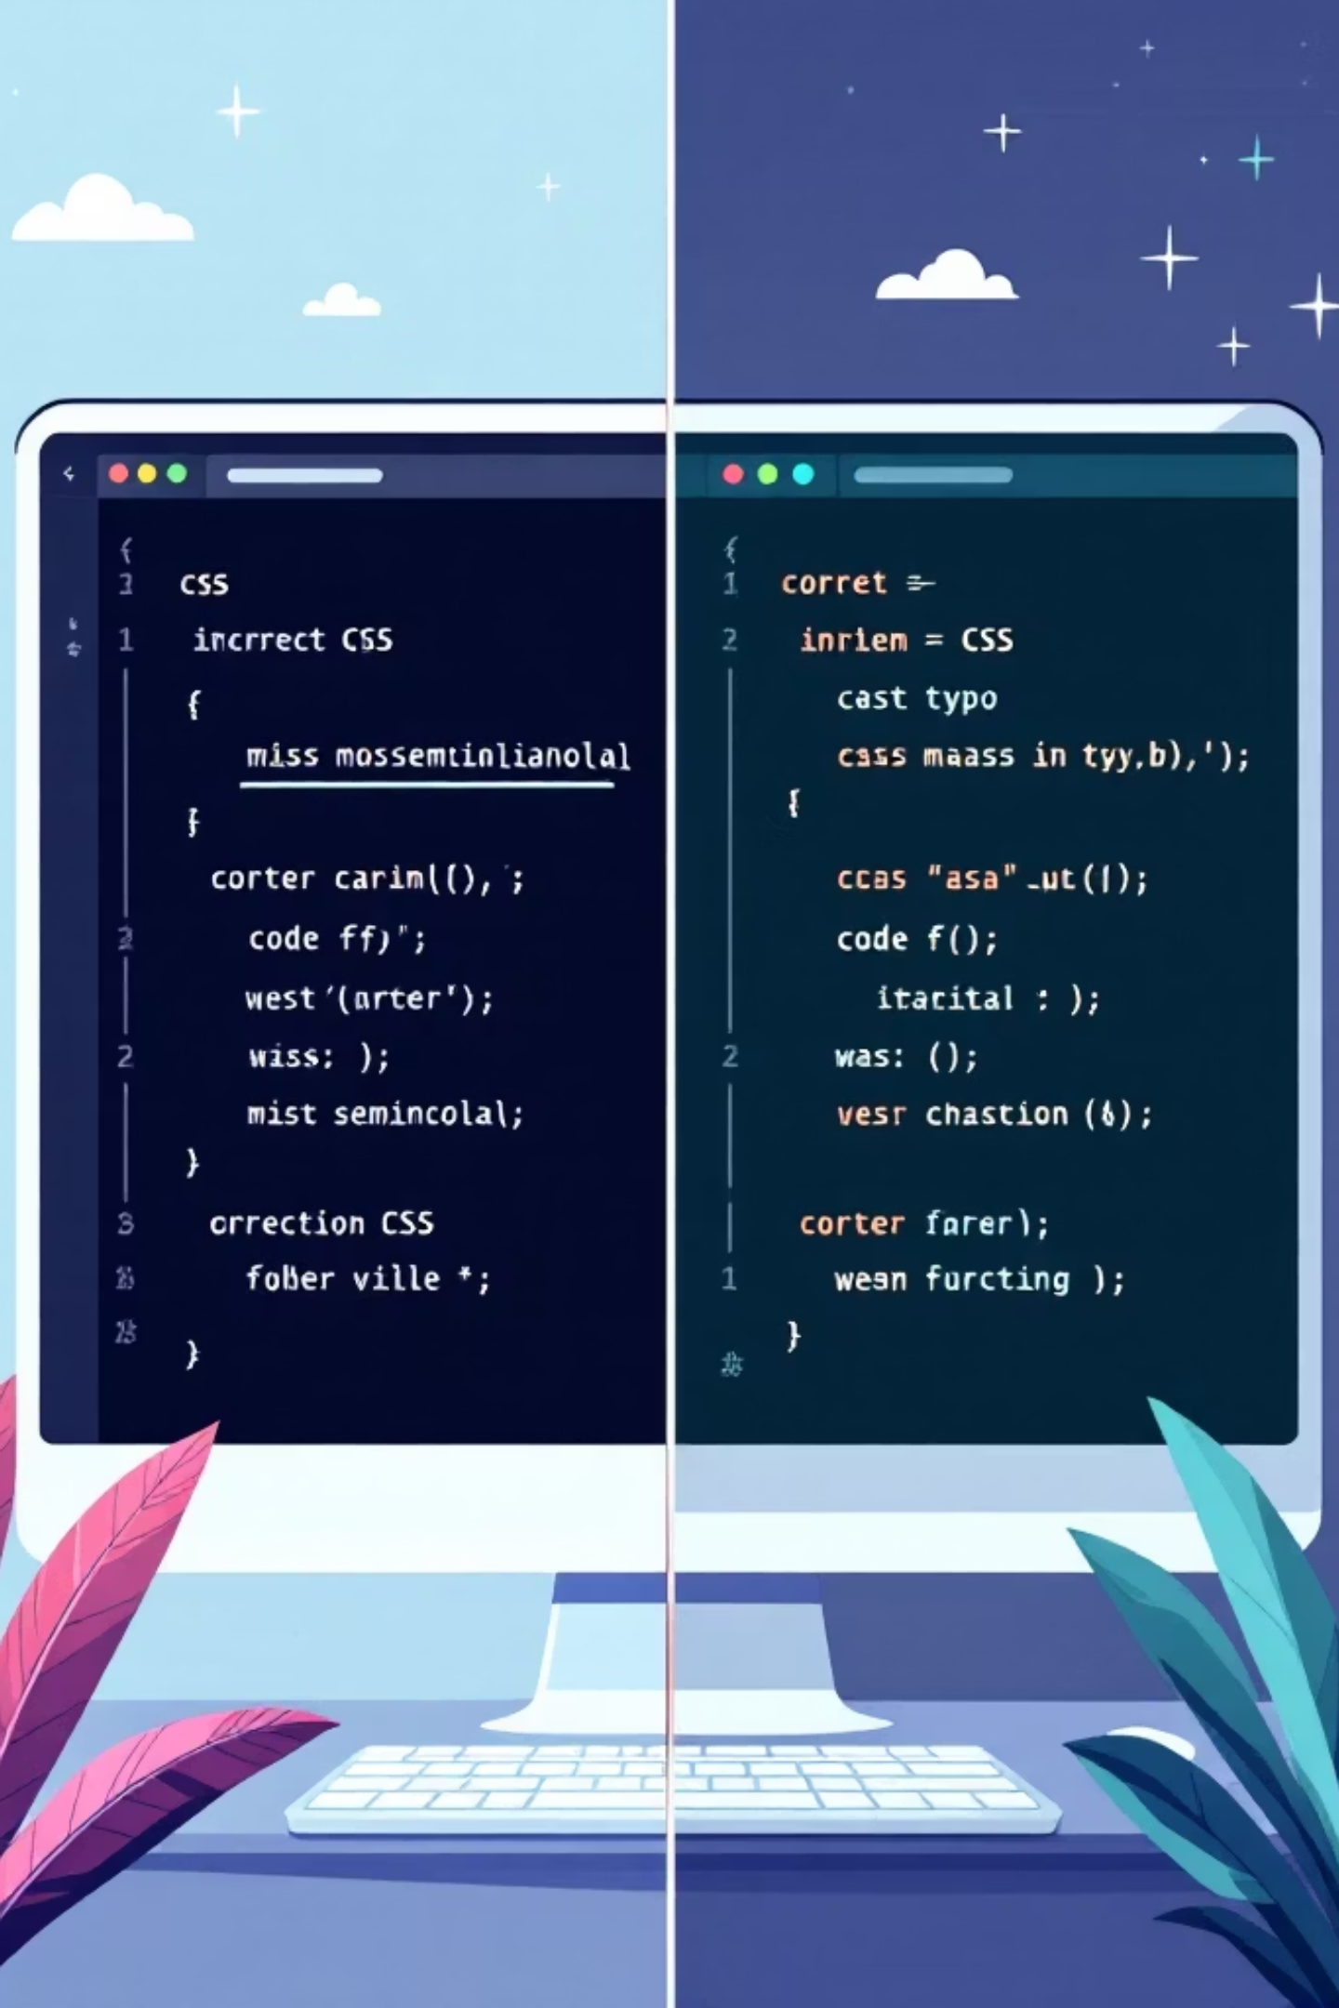
Comments & Common Errors
Comments help explain code. Common mistakes can be fixed quickly if you know what to look for.
Comments
Missing Semicolon
Write with /* comment */ inside CSS files or <style> blocks.
Every property should end with ; — missing it can break the rule.
/* This styles the header */
color: red
/*

Slide 7
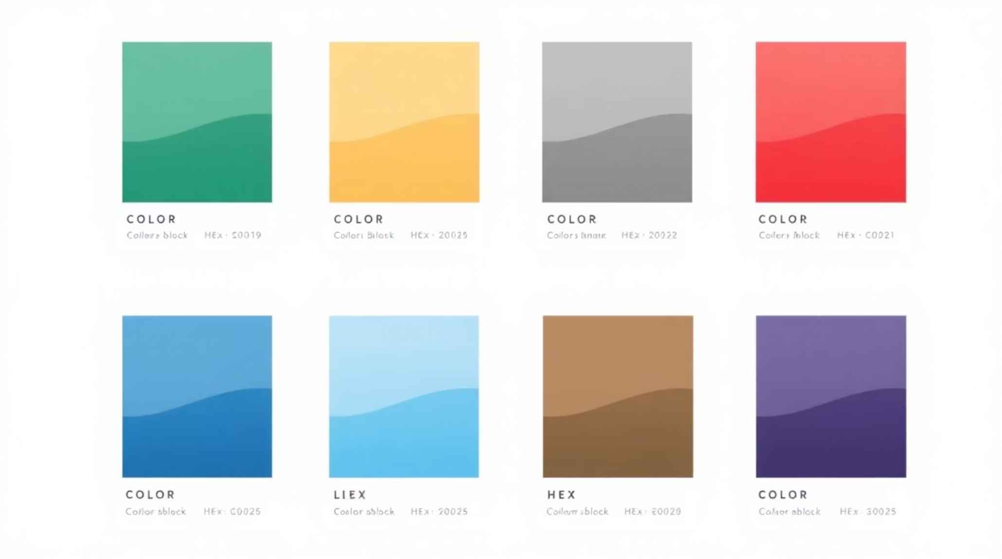
Colors in CSS
Common ways to define colors:
Named Colors
color: navy; — simple but less precise.
HEX
color: #fd505f; — compact and widely used.
RGB / RGBA
color: rgb(253,80,95); or rgba(253,80,95,0.8); for transparency.
Try This: Change a paragraph’s text color to #1B1744 and its background to #fd505f — observe legibility.

Slide 8
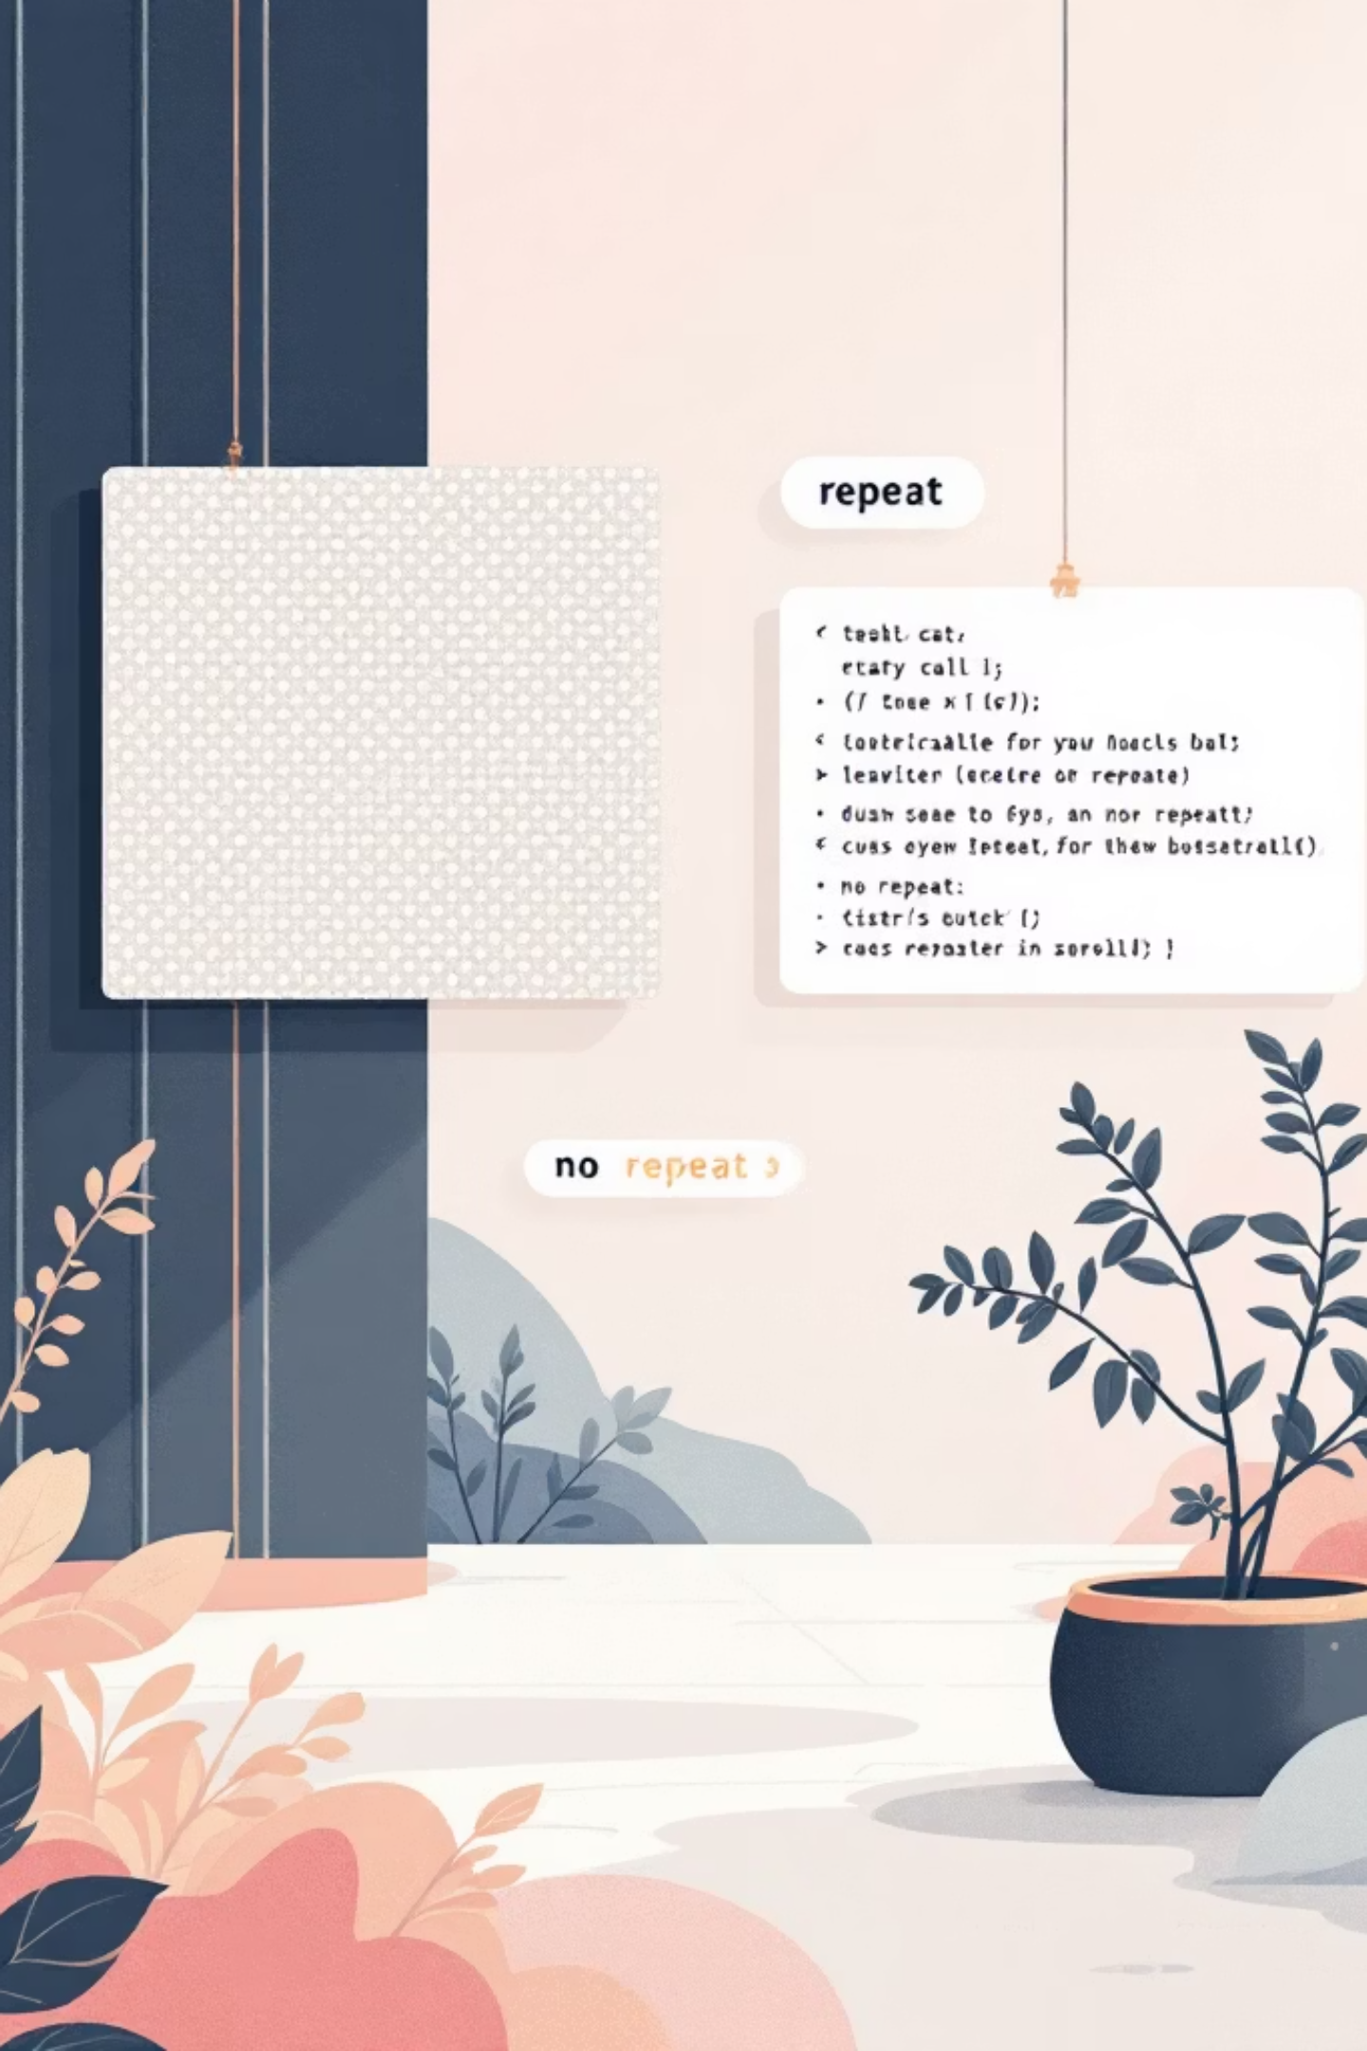
Background Properties
Control the visual backdrop of elements using:
background-color
background-color: #261C4E;
background-image
background-image: url('pattern.png');
background-repeat
background-repeat: repeat | no-repeat | repeat-x;
Simple demo:
.card { background-color: #fd505f; background-image: url('dots.png'); background-repeat: no-repeat; padding: 20px; }

Slide 9


Border & Margin
2px solid border · 24px margin
Padding
16px (inside)
Content
200×100px
The box model defines how space is calculated for elements. Content → Padding → Border → Margin. Use box-sizing: border-box; to include padding and border in the element’s declared width.
Try This: Inspect a div in DevTools and toggle box-sizing to see how layout changes.

Slide 10



