Slide 1




Pre-defense
Remote Sensing IoT Based Obstacle Avoiding Robot
Presented by
Supervised by
Md. Khalid Bin Hasan Sarker
ID: 181-15-1789
Solaiman Hossain Tuhin
ID: 173-15-1639
Md. Masbahul Islam Shaik
ID: 181-15-1773
Tajim Md. Niamat Ullah Akhund Lecturer
Department of CSE Daffodil
International University
Saturday, 30th October 2021

Slide 2
Content
1. Introduction
2. Objectives
3. System Architecture
4. Algorithm
5. Flow Chart
6. Result Discussion
7. Features Statistical Graphically Representation
8. Features
9. Limitations
10. Future Plans
11. Conclusion

Slide 3
Introduction
Obstacle avoidance is a crucial task in robotics as the independent robotics’ intention is to attain the vacation spot without collision. One kind of self-reliant robot that may hit upon boundaries and edges and take opportunity paths free of boundaries and edges is a real-time obstacle avoiding detection robotic. This paper proposes a robot with intelligence built into it that publications itself each time an obstacle comes along its manner by using a bug set of rules. This robot became designed to consider its daily potentialities. Being a completely self-sufficient robotic, it correctly maneuvered in unknown environments with no collision. cheaper which makes the robotic effortlessly replicable.

Slide 4
Objective
It can go to a remote and obscure place where man cannot go.
This robot easily collects information from unknown environment & stored it in cloud.

Slide 5
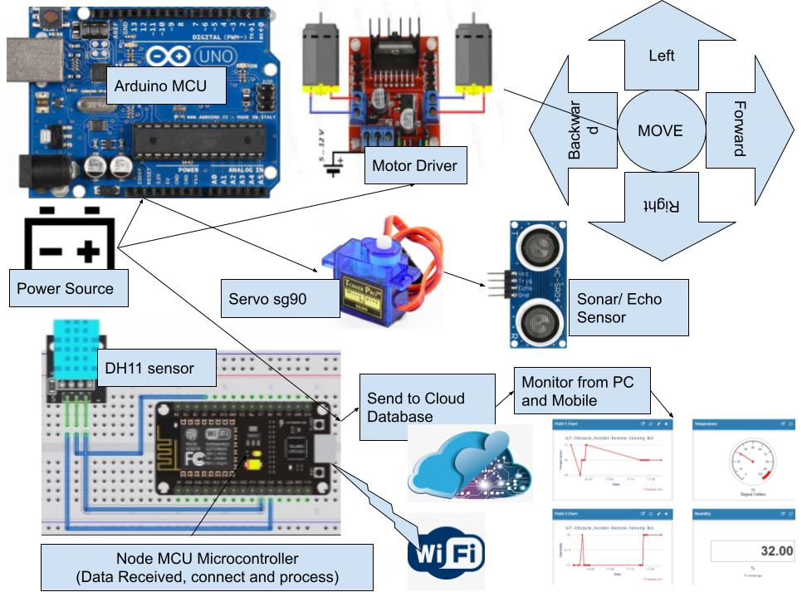
System Architecture

Slide 6















Algorithm
While its going it will sense temperature and humidity
All the information of the sensors may be saved in Node MCU
Start
After detecting the obstacle, it will undergo in the direction of free space.
Anyone from a faraway area can see the sensing information at any time
through ‘Thingspeak’.
Power the Arduino from the battery.
Initializing Ultrasonic sensor, servo motor, and motor driver.
Start to examine the obstacle distance for avoiding.
Again we will go back to
Sensing data Step and
then continue the whole process accordingly
Remote Sensing IoT based Obstacle Avoider Robot

Slide 7
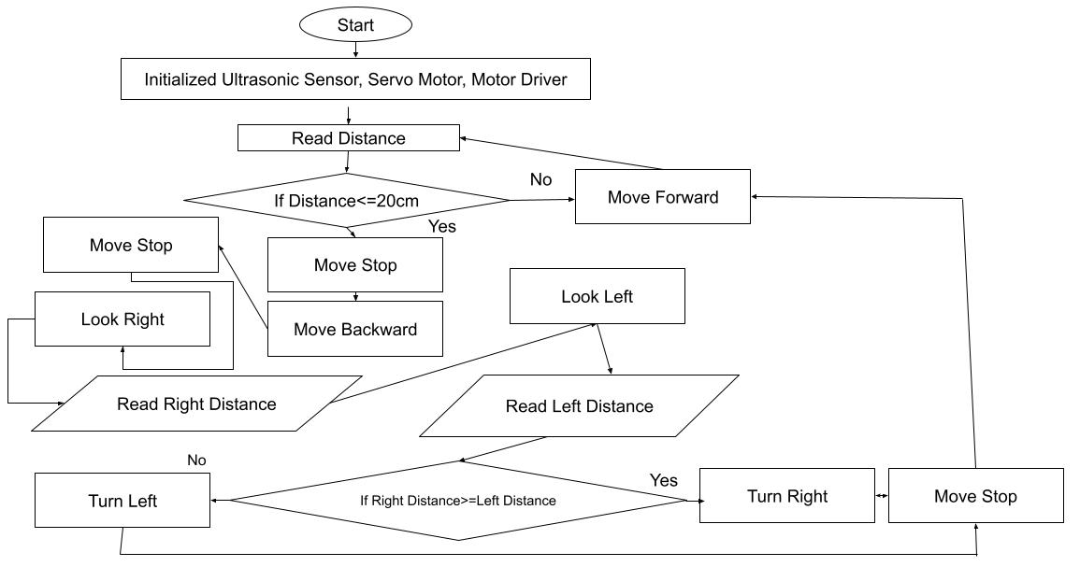
Flow Chart

Slide 8
Result Discussion
Features | Outcome
Temperature sensing of DHT11 sensor Humidity sensing of DHT11 sensor Obstacle Sensing of Sonar Sensor Obstacle avoiding command of sonar sensor Motor rotating of Servo motor Receiving the data from Node MCU Transmitting the data from Node MCU Running wheels functions of Motor Driver | 98% 98% 93% 94% 95% 98% 98% 96%

Slide 9
Features Statistical Graphically Representation

Slide 10
Features
It can detect obstacle and avoid it in.
After detecting obstacle by sonar sensor, we can also detect the freeways.
It can detect the freeways in 3 directions continuously by using servo motor.
It also can detect temperature and humidity by DHT11 sensor.
It can store the data in cloud by using Node MCU.
It can go where man cannot go to earn some information.
Using cloud server anyone can analyze the data remotely.
It can use in many dangerous missions.

Slide 11
Limitations
It can't produce tons power in cloudy and foggy weather.
We need a power deliver to boost up both the microcontrollers.
In wet days, there is a danger of unfavorable the components if there is no water-resistant case.

Slide 12
Video of our project
We can visit to our project by this link –
https://drive.google.com/file/d/10On_bSgv0v3thX35Sgiq5ErLX7cN91BY/view?usp=sharing

Slide 13
Future works
This paper is all approximately Obstacle Avoidance Robot the usage of Arduino which avoids barriers which it encounters. It also senses data and send it to the server. The most probable future plans are underneath it.
In the future, this project could be improved by connecting a Bluetooth module.
We will add some camera for more accurate detection.
We will add some more sensors that will collect different types data.
.

Slide 14
Conclusion
This challenge developed an obstacle-avoiding robot to stumble on and keep away from
barriers in its route. Also, it is able to stumble on extraordinary subjects through using the usage of sensors. This robotic is completely self-contained, and it does not require any human assistance beyond the initial code loading. It moved while warding off all impediments with great precision when placed in an unfamiliar environment with hazards. These elements majorly affected the sensors. These factors have a significant impact on the sensors. The robotics’ precision is determined by the sensors employed. As a result, the sensor's characteristics and accuracy described the precision of my robot.

Slide 15


