Slide 1
AI
There is NO Magic

Slide 2
Agenda
AI/ML/DL overview
Problems to solve
Machine Learning methods and algorithms
Deep Learning magic
AI how-to for newbie
Recent NLP researches and applications
Q&A

Slide 3
What is the “AI” that everybody is talking about?
AI
AI
Machine solving human problems
Strong AI can do anything
Machine Learning
Teach machine to do a specific task
Automatically “learning” from data
Deep Learning
Originally deep neural networks
Nowadays any deep structured model
Machine Learning
Deep Learning

Slide 4
Black tea or green tea? (Machine learning tasks)
Data:
Randomly picked people around the world with information like: name, sex, age, residence, occupation, weight, height, …, etc.
Classification problem:
To predict if a person likes black tea or green tea
Regression problem:
To predict tea consumption
Clustering problem:
To group people with “similar features”
Diana | F | Paradise Island | Green | 5 cups per day
Bruce | M | Gotham City | Black | 20 cups per day
Clark | M | Krypton | Black | 1 cups per day

Slide 5
Types of learning methods and algorithms
Supervised learning
Can solve the classification and regression problems
Human knowledge is involved. E.g. we know people’s black-or-green tea preference
Linear regression, Support vector machines, multilayer perceptron, etc.
Unsupervised learning
Can solve grouping and clustering problem
For data that has not been labeled, classified or categorized
Reinforcement learning
Teach computer agent to take actions in an environment
Game AI, self-driving car

Slide 6
Deep Learning
Learning “deep” (multi-layer) neural networks
Different architectures of NN:
Multi-layer perceptron (MLP)
multiple layers of linear projection and non-linear activation
Convolutional neural network (CNN)
convolutional layers, applying convolution operations to input
2-D CNN for computer vision problems
Recurrent neural network (RNN)
use internal state (memory) to process sequences of inputs
For sequential data like: stock, text, voice, etc.

Slide 7
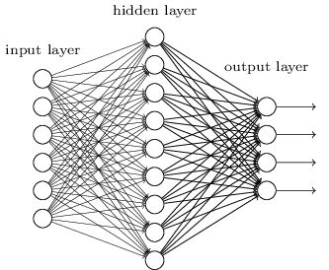
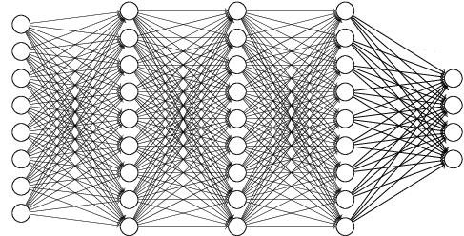
Going deeper and deeper
Neural Network
A simple fully-connected MLP: --->
Werbos's (1975) backpropagation algorithm to train neural network
Multi-hidden-layer neural network:--->
Hinton et al. (2006) proposed an efficient way to train stacked restricted Boltzmann machines

Slide 8
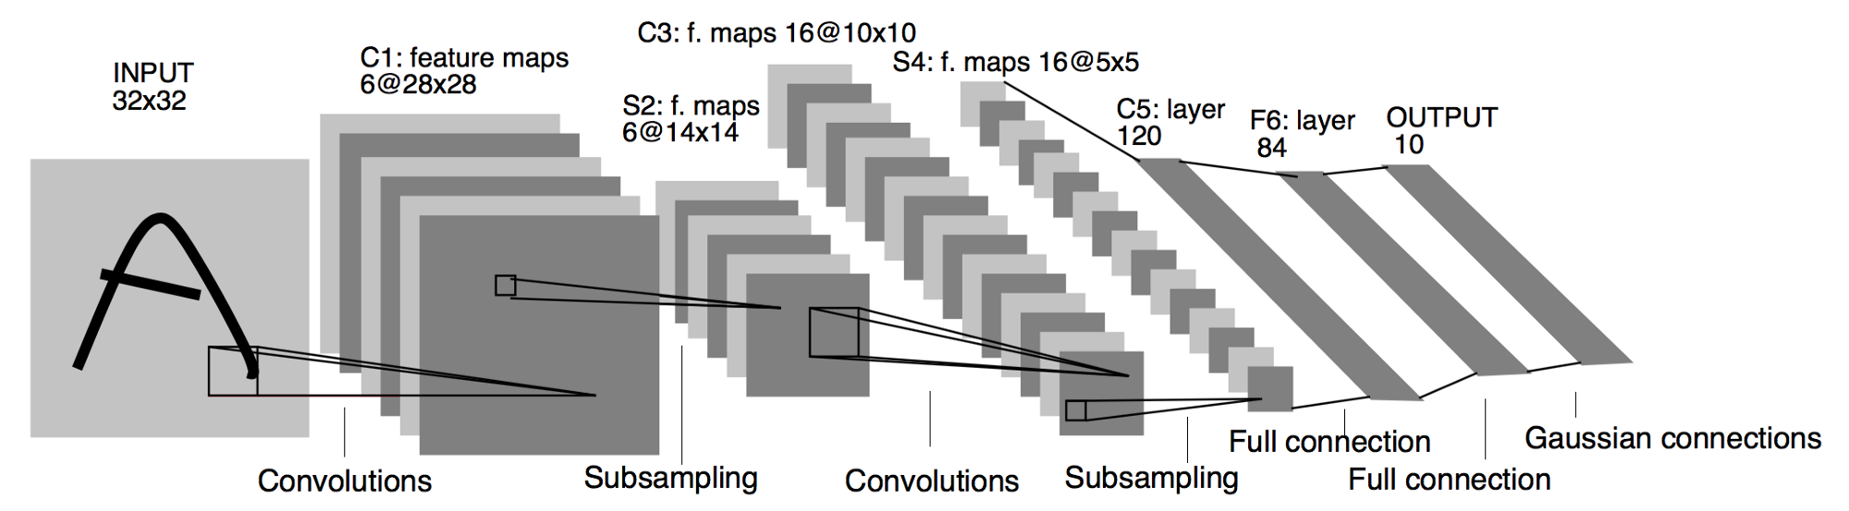
Deep Learning
Convolutional Neural Network (CNN)
LeNet-5, a pioneering 7-level convolutional network by LeCun et al. in 1998

Slide 9
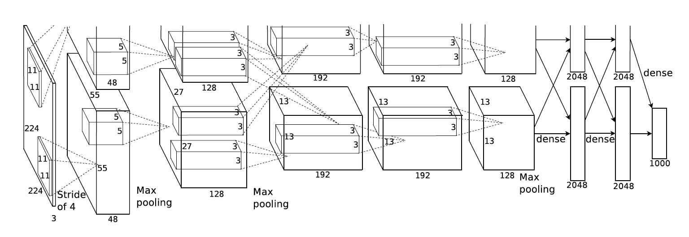
Deep Convolutional Neural Network
AlexNet
Alex Krizhevsky et al. (2012)
5 conv layers, 3 fully-connected layers
ResNet (Residual Network)
Kaiming He et al. (2015)
Can be more than 1000 layers, usually 50/101/152 layers

Slide 10
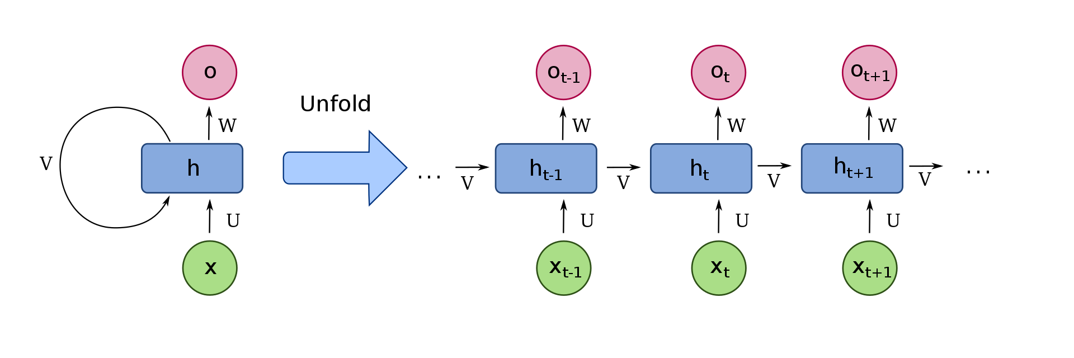
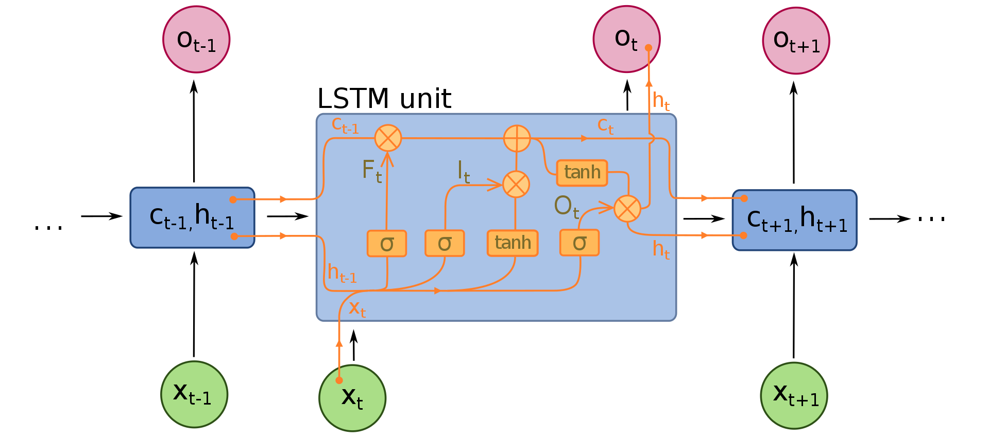
RNN for NLP
RNN:
based on David Rumelhart's work in 1986
LSTM (long short-term memory)
proposed in 1997
modified and effectively trained since 2005
its variants revolutionize NLP problems from 2014:
Sequence to Sequence Learning
speech recognition, machine translation, language modeling, etc.

Slide 11
AI/ML/DL - Where to start?
Specify a task(s)
Understand the problems
Prepare the data
Design and train a model
Evaluation

Slide 12
Specify a task
What do you want computer to do?
Can this task be able to handle by humans?
E.g. “computer, show me the summary of MOHLTC funds and disbursement for FY 2016-17”
This is not a single machine learning task
1) show me a doc related to MOHLTC (RG67-5)
3) show me a report (classification)
2) show me a doc with summary table or chart (classification)
3) show me a doc with key words “funds”, “disbursement”, “FY”, “2016-17” (search engine)

Slide 13
Understand the problems
Find a doc that is a report
Text feature extraction: tf-idf, doc2vec, etc
Feature vector to train classifier (can also do clustering)
Find a doc with summary table or chart (classification)
Natural language processing or Computer Vision?
If NLP, use sentence(s) which describes the table or chart to train RNN
If CV, convert page to image then train CNN to do object detection, or classification
Find a doc with key words “funds”, “disbursement”, “FY”, “2016-17” (search engine)
Reduce the complexity by searching “description” instead of full article (text summarization)
contains as much “useful” keywords as possible (extract v.s. abstract)
search keyword is missing in the “description” (similar words, word2vec, etc)

Slide 14
Design and train a model
Machine learning skill levels (high to low)
Design a model from scratch and train
Modify a model and train
Train a model and converge
Fine-tune a pre-trained model
Run a pre-trained model
Train a model and converge is not easy
Model is not designed to handle your dataset
Dataset is not big enough
Transfer learning: Pre-training + Fine-tuning
Many startup companies do transfer learning and succeed
E.g. Pre-train ResNet on ImageNet dataset and fine-tune with own data
Improving language understanding by generative pre-training (e.g. BERT)

Slide 15
Recent NLP researches and applications
Tasks:
Language Modeling
Machine Translation
Question answering and commonsense reasoning
Semantic Similarity
Text Summarization
……
Popular base models:
Sequence to Sequence Learning (LSTM)
Transformer
CNN based
Popular training methods:
Semi-supervised Sequence Learning (w/ LSTM, 2015)
Unsupervised Pre-training + Supervised fine-tuning (w/ Transformer, 2018)

