Slide 1
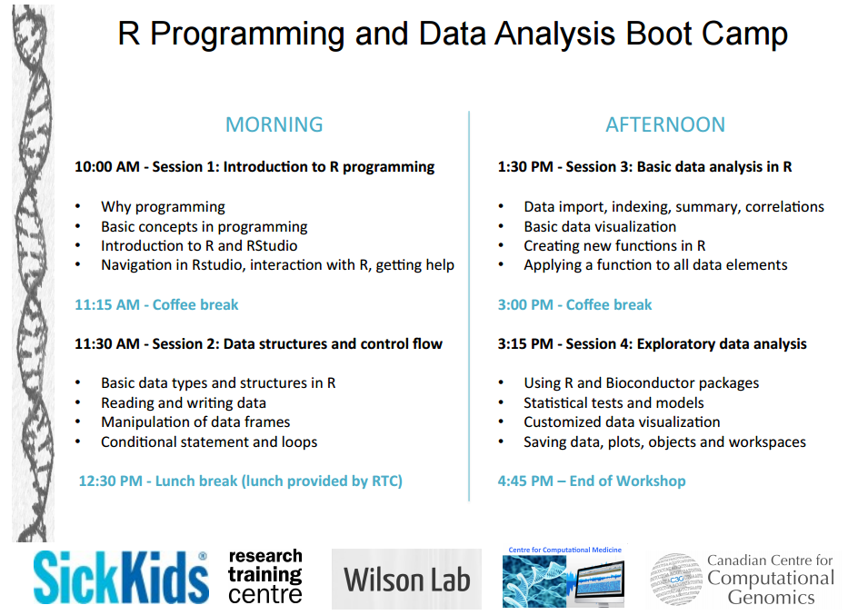

Slide 2
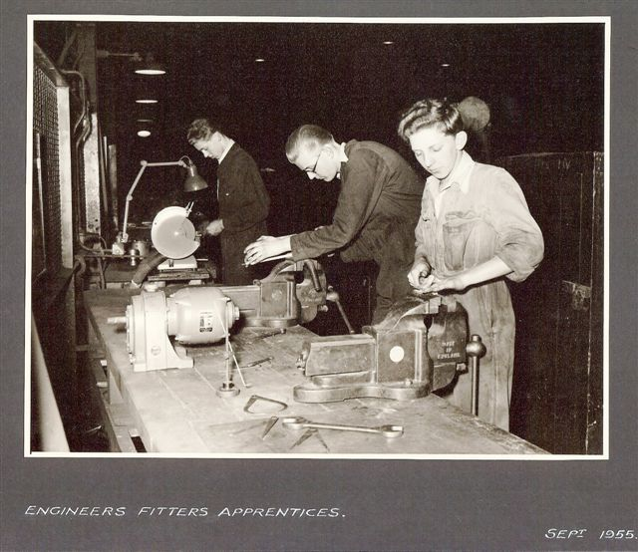
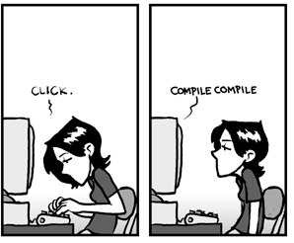
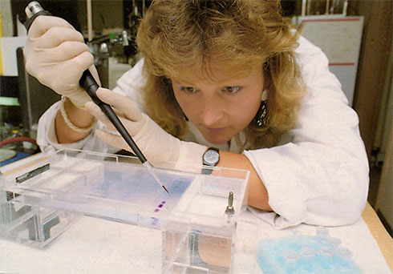
Why programming?
Engineers ca. 1950
Engineers ca. 2000
Repetition
Save time
Reduce error
Self-documenting
Scales with large data
Hub of interdisciplinary science
Any lab, present time
The future?

Slide 3

What is a computer
Central Processing Unit
Memory
Input Devices
Output Devices
Secondary Memory

Slide 4
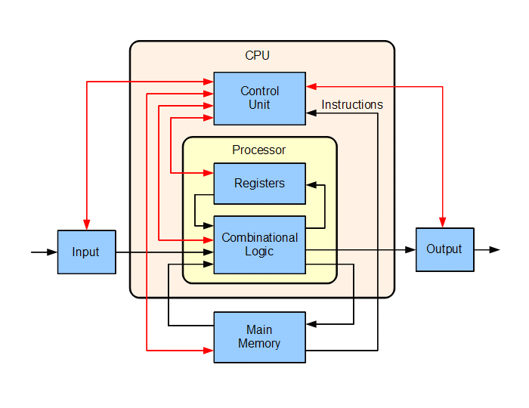
What is a computer
Central Processing Unit:
Executes instructions
Runs simple instructions (in/out)
Basic Math operations
Simple logical comparisons
Understands machine language
000100111000010100100110101111001
By Lambtron - Own work, CC BY-SA 4.0, https://commons.wikimedia.org/w/index.php?curid=37716438

Slide 5
What is a program?
Series of (detailed & concise) instructions for a computer to do something
writing a recipe to make a dish
writing a protocol for an experiment
…
writing a protocol for an undergrad to do an experiment

Slide 6
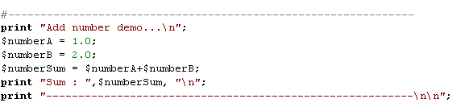
What is a program?
Commands to perform a task
Data values used in performing the task
Variables that are assigned values and can be manipulated

Slide 7
What is a language?
Languages are sets of conventions used to write programs
ie. Perl, Java, Python, R, Matlab, C, C++, etc.
Languages have their own conventions/rules/grammar/syntax
Most languages are high-level (ie. people oriented/ human readable) to make it easier for programmers to create programs

Slide 8
What is a language?
Computer doesn’t “understand” high-level language. Needs to be translated.
Compiler: Program itself translates high-level source-code into a lower language
Interpreter: Line-by-line translation
High-Level Language
Program
if (($numberOfStudents) > $max_students) { $workshopFull = “yes”; }
Compiler/Interpreter
Machine Language
Program (executable code)
executed
CPU
000100111000010100100110101111001

Slide 9
What is R
R is a language and environment for statistical computing and graphics
Free, open-source, runs on most computing platforms
Coherent collection of many statistical and data analysis tools
Powerful for computation on arrays and matrices
Fully functional, simple, and effective programming language
Large user-base amongst biologists (easy to find answers to questions)

Slide 10
Introduction to RStudio

Slide 11
Exercise 1:
Calculate the area of a triangle with base 4 and height 6 (hint a=(b*h)/2)
Calculate area of a circle with radius 3 and assign to a variable areaCirc (hint a=π*r²)
> 4*6/2
[1] 12
> areaCirc <- pi*3^2
> areaCirc
[1] 28.27433

Slide 12
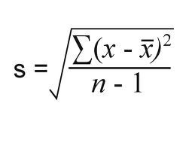
Exercise 2:
Define a variable `someNums` and set it equal to the series (2, 4, 6, … 30)
Calculate the mean and standard deviation of someNums (hint below)
> someNums <- (1:15) * 2
> someNums
[1] 2 4 6 8 10 12 14 16 18 20 22 24 26 28 30
> mean(someNums)
[1] 16
> sqrt(sum((someNums - mean(someNums))^2)/(15-1))
[1] 8.944272

Slide 13
Exercise 3:
Create a vector with the numbers 1 to 4. Store it in a variable
Concat the string “notANum” to the vector. What happens to the class?
Coerce the new vector back into a numeric. What happens?
> moarNums <- 1:4
> moarNums <- c(moarNums, “notANum”)
> class(moarNums)
[1] “character”
> as.numeric(moarNums)
[1] 1 2 3 4 NA
Warning message:
NAs introduced by coercion

