Slide 1
Novartis ESG AI-Enabled Authoring Studio
Capabilities, workflow, and the path to the Novartis environment
Report on Nonfinancial Matters (RNFM) · FY2026 · Prepared for Novartis SI&S / ESG FRA

Slide 2
OVERVIEW
What this deck covers
1 · Capabilities
2 · The Editor
3 · Roles & Approval
• What the studio does end to end
• How AI drafting is grounded
• Compliance, evidence, export
• Step-by-step authoring
• Track-changes review
• AI assistance in the doc
• Who can do what, and when
• Two-level sign-off model
• Audit trail
4 · Versioning
5 · Datapoints & Confidence
6 · Roadmap & Inputs
• Automatic version history
• Side-by-side comparison
• Re-approval rules
• ESRS/ISSB/GRI/TCFD mapping
• Coverage + rationale
• How confidence is scored
• What is still to complete
• The wider report suite
• What Novartis provides
7 · Architecture & AWS
• Solution architecture
• AI components at the core
• AWS services used

Slide 3
1 · Capabilities
An AI-drafted, human-governed studio for the annual RNFM.

Slide 4
CAPABILITY MAP
What the platform does
Each capability is designed to remove a manual, error-prone step in today's process.
AI first draft
Compliance mapping
Word-like editor
• Generates each section from your indexed documents (RAG).
• Rolls last year's approved report forward and flags what changed.
• Every claim carries a citation to its source.
• Maps content to ESRS, GRI, TCFD, ISSB, MSA & NTA.
• Coverage: covered / partial / missing, with rationale.
• AI-suggested fill text for gaps, grounded in evidence.
• Track changes with per-change accept / reject.
• In-editor AI chat that drafts and revises.
• Source-evidence attachment per section.
Governed workflow
Versioning
Peer benchmarking
• Role-based review; two-level sign-off.
• Immutable audit trail with before/after.
• MDD-compliant Word + PDF export.
• A version is frozen on every save and sign-off.
• Side-by-side comparison of any two versions.
• Re-editing an approved section is controlled.
• Cited Q&A against indexed peer reports.
• Evidence-based disclosure decisions.
• Prioritises the customer's own datapoints.

Slide 5
2 · The Editor
How a section is drafted, reviewed and approved — step by step.

Slide 6
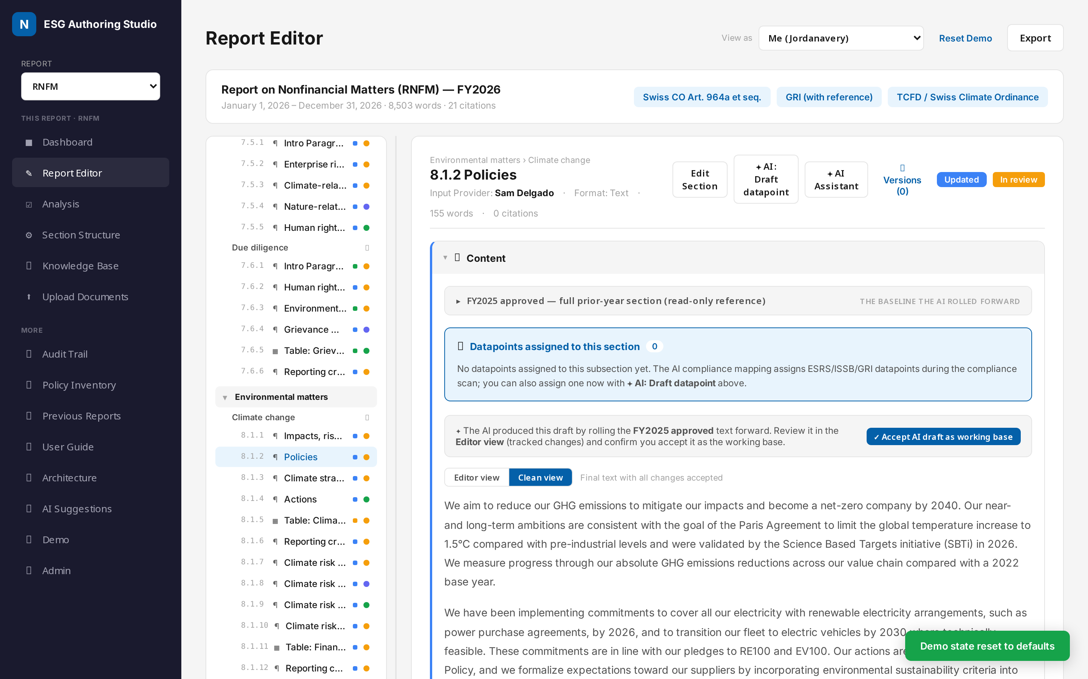
EDITOR · ORIENTATION
The authoring surface
WHAT IT IS
One subsection at a time: the AI draft, its citations, the assigned datapoints, and the prior-year approved baseline it was rolled forward from.
KEY POINTS
• Left: the 86-subsection tree, colour-coded by status.
• Collapsible cards: Content, Roll-forward, Evidence, Comments, Approval.
• Header shows Input Provider, word count, status and version count.
• “View as” switch previews any role's experience (demo aid).
Report Editor — a single subsection open for review

Slide 7
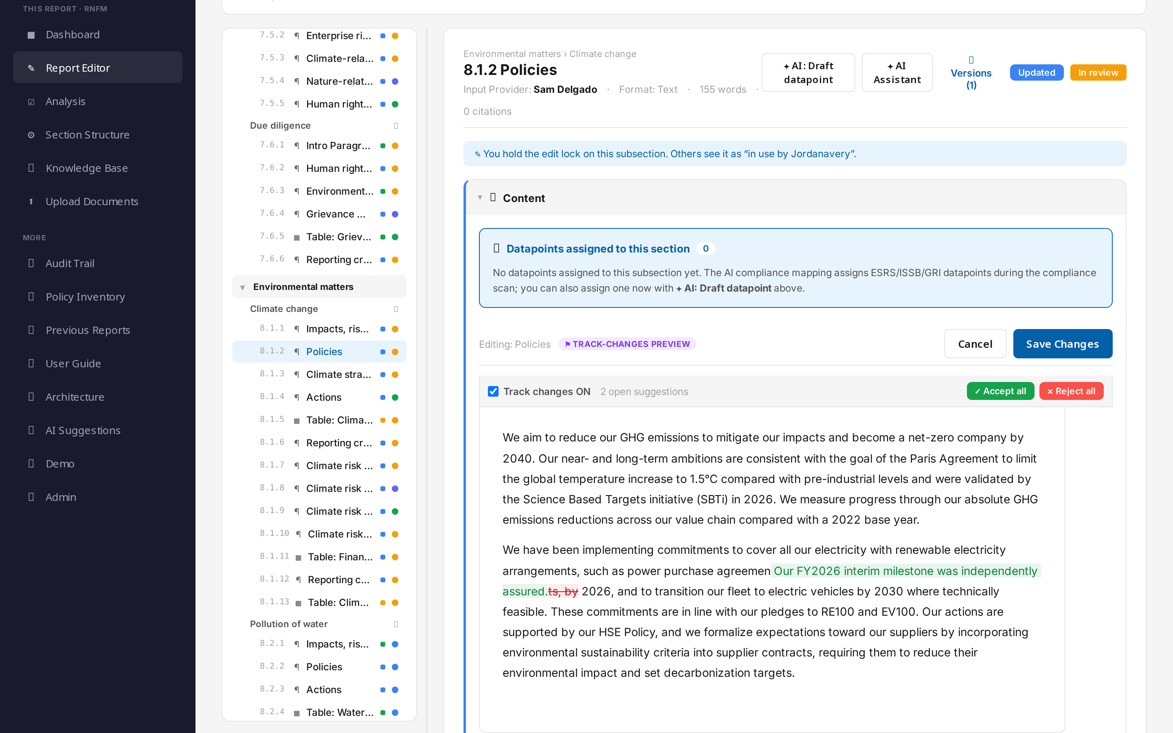
EDITOR · TRACK CHANGES
Reviewing edits like Word
WHAT IT IS
A single editing view with track changes always on: what you type is a green insertion, what you delete is a struck-through deletion — nothing is applied until it is accepted.
STEP BY STEP
1. Open a section and choose Edit.
2. Type or delete — edits appear inline, marked.
3. Review each suggestion: accept (✓) or reject (✗).
4. Or resolve all at once with Accept all / Reject all.
5. Save — the accepted text becomes the working draft.
Inline insertions (green) and deletions (struck-through) with per-change accept/reject

Slide 8
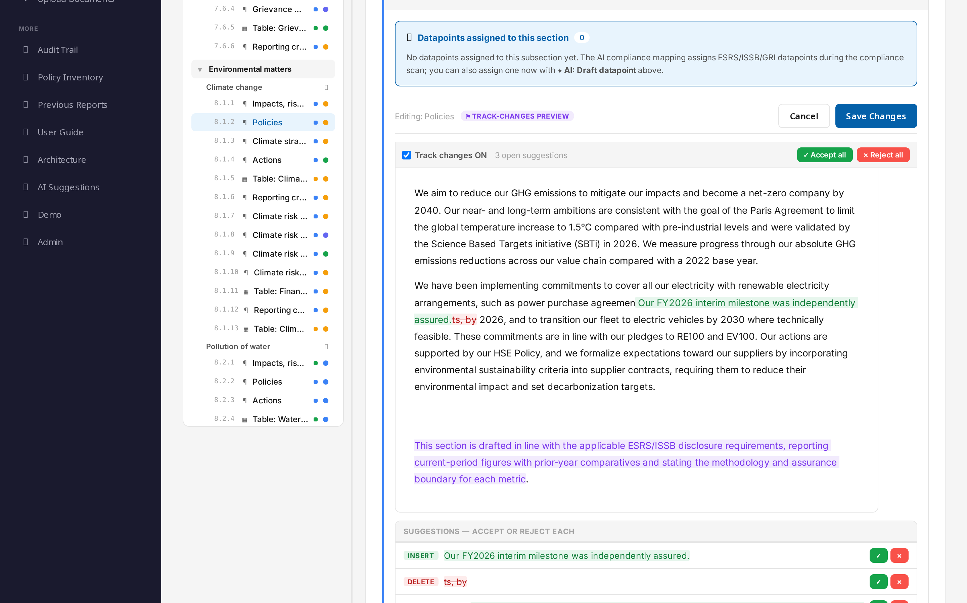
EDITOR · AI ASSISTANCE
Draft and revise with AI, in the document
WHAT IT IS
Ask the AI to draft a paragraph or revise a passage. Its output arrives as tracked suggestions you accept or reject — the AI never changes approved text silently.
KEY POINTS
• “Draft a paragraph on …” or select text and ask to rephrase.
• AI edits are marked as AI-origin and reviewed like any change.
• Grounded in the section's attached evidence when provided.
• Same governance path as human edits — full traceability.
AI-proposed text enters as an accept/reject suggestion

Slide 9
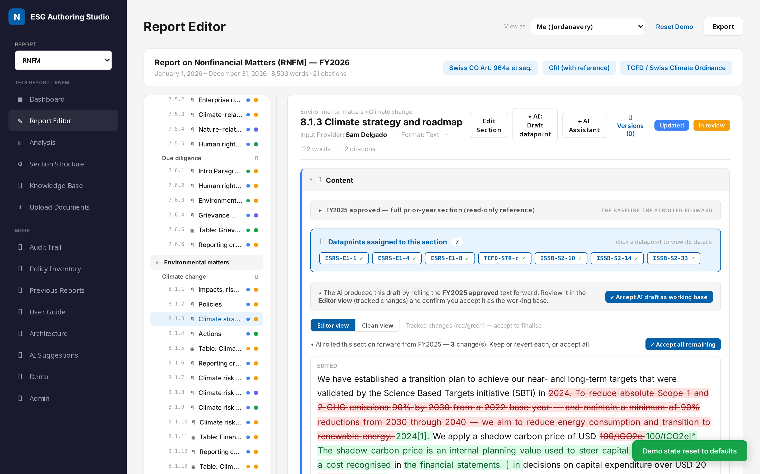
EDITOR · ROLL-FORWARD
Carrying last year forward, change by change
WHAT IT IS
The AI rolls the FY2025 approved section forward to FY2026 and shows every change. The author keeps or reverts each paragraph, or accepts them all as the working base.
KEY POINTS
• Each changed / added / removed paragraph is listed with its redline.
• Keep FY2026 wording, or revert a paragraph to FY2025.
• “Accept all remaining” finalises the rest in one click.
• Reduces re-drafting to a focused review of what actually changed.
Change-by-change acceptance of the AI roll-forward

Slide 10
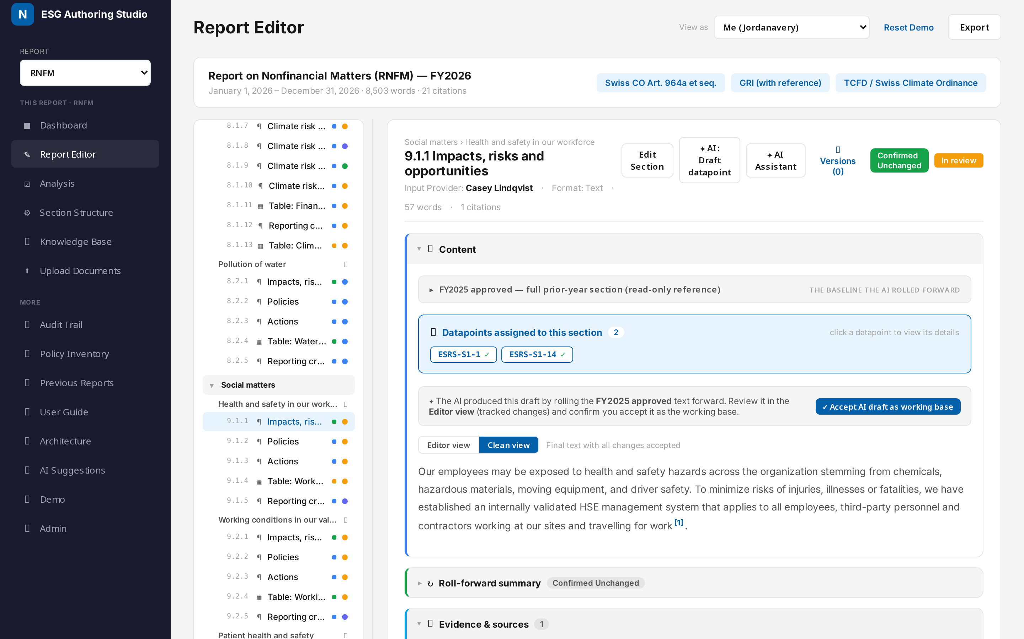
EDITOR · EVIDENCE
Attaching source evidence to a claim
WHAT IT IS
Input Providers attach the proof behind a figure — a screenshot, SOP excerpt, email or report page — anchored to the exact claim it supports. Recorded in the audit trail.
KEY POINTS
• Distinct from the AI's automatic citations — this is human provenance.
• Each item names what it evidences and who added it.
• Feeds the AI as grounding context for that section.
• Read-only reviewers can view but not change evidence.
“Evidence & sources” — human-supplied provenance per section

Slide 11
3 · Roles & Approval
Who can approve what, and when.

Slide 12
GOVERNANCE · ROLES
The five roles and what each can do
Role
Can edit
Approves
When
Input Provider
Own subsection, in track changes; can comment
Signs off L3 (subsection)
During drafting; sign-off locks it to them
Owner (1+)
In track changes; comments. Absorbs the legal reviewer.
Signs off L2 (section) — ALL owners must sign
After all subsections signed off by their IPs
Editor
Any section, with/without tracking; accepts/rejects changes
Curates; does not sign off
Any time — the only role that accepts/rejects
Admin
Full access (superset of Editor)
Can also sign off at L2
Any time (ESG Reporting Lead seat)
Guest
Read-only; can comment
Never
For reviewers who see + comment only

Slide 13
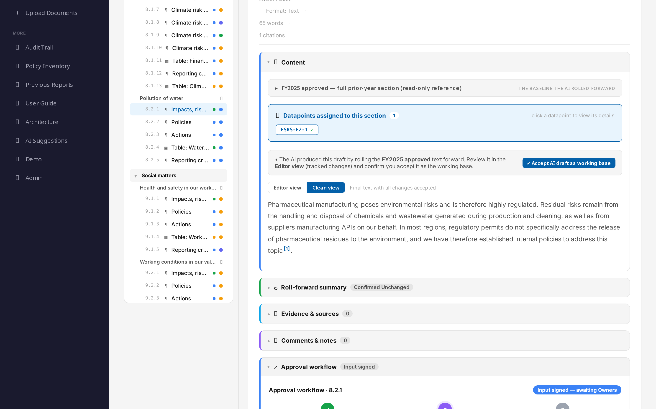
GOVERNANCE · SIGN-OFF
The approval workflow
WHAT IT IS
Two sign-off levels: L3 is the subsection (its Input Provider); L2 is the section (its Owners). A section is fully approved only when every assigned owner has signed off.
STEP BY STEP
1. Input Provider drafts and signs off their subsection (L3).
2. When all subsections in a section are L3-signed, Owners review at L2.
3. Every assigned Owner must sign off to approve the section.
4. Editors accept/reject tracked changes throughout.
5. Re-editing an approved section resets it for re-approval.
Visual stepper: Input Provider → Owner(s), with per-step status

Slide 14
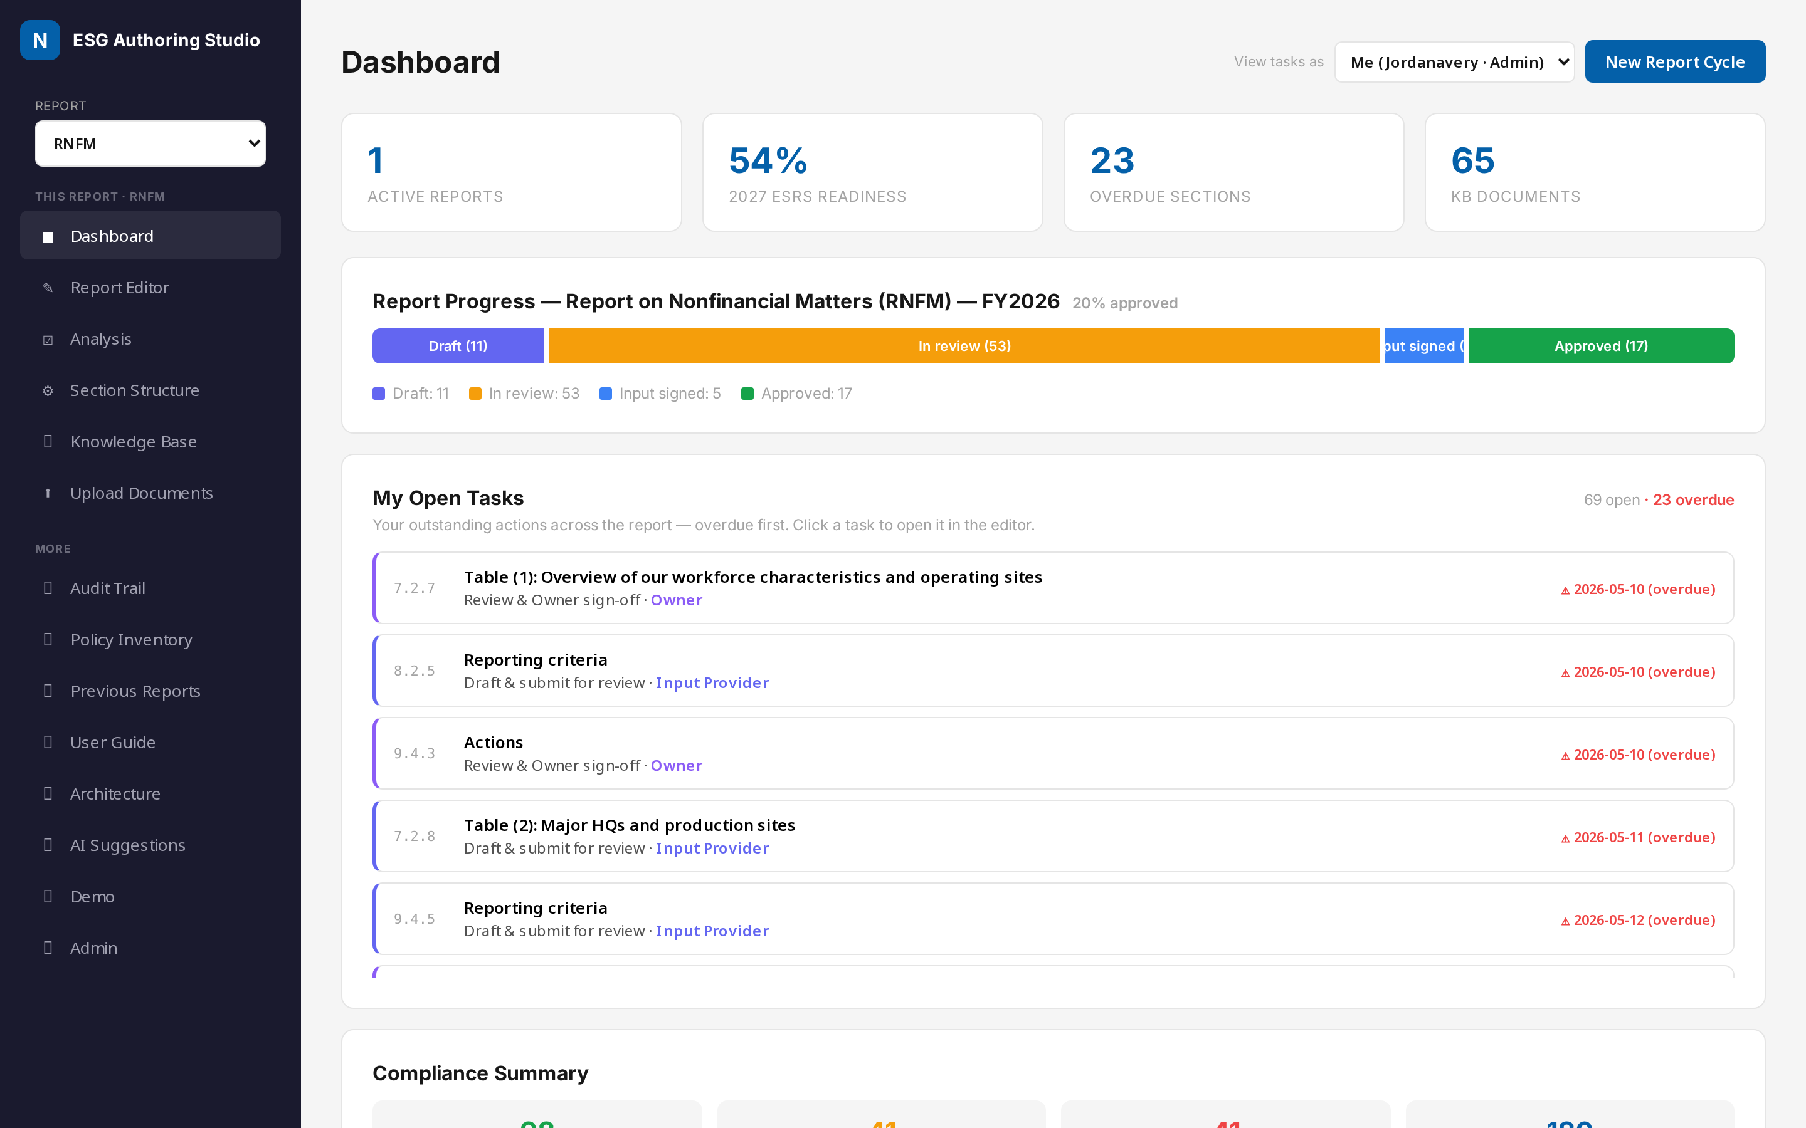
GOVERNANCE · DASHBOARD
Every role sees its own open tasks
WHAT IT IS
The dashboard shows a personalised task queue. A “View tasks as” switch previews each role's queue — and it is validated against that role's permissions, so it never shows an action the role cannot perform.
KEY POINTS
• Input Provider sees drafting tasks; Owner sees sign-off tasks.
• Editor/Admin see everything in flight; Guest has none.
• Overdue-first ordering; click a task to open that subsection.
• Live progress by stage across all subsections.
“My Open Tasks” with the role switch in the page header

Slide 15
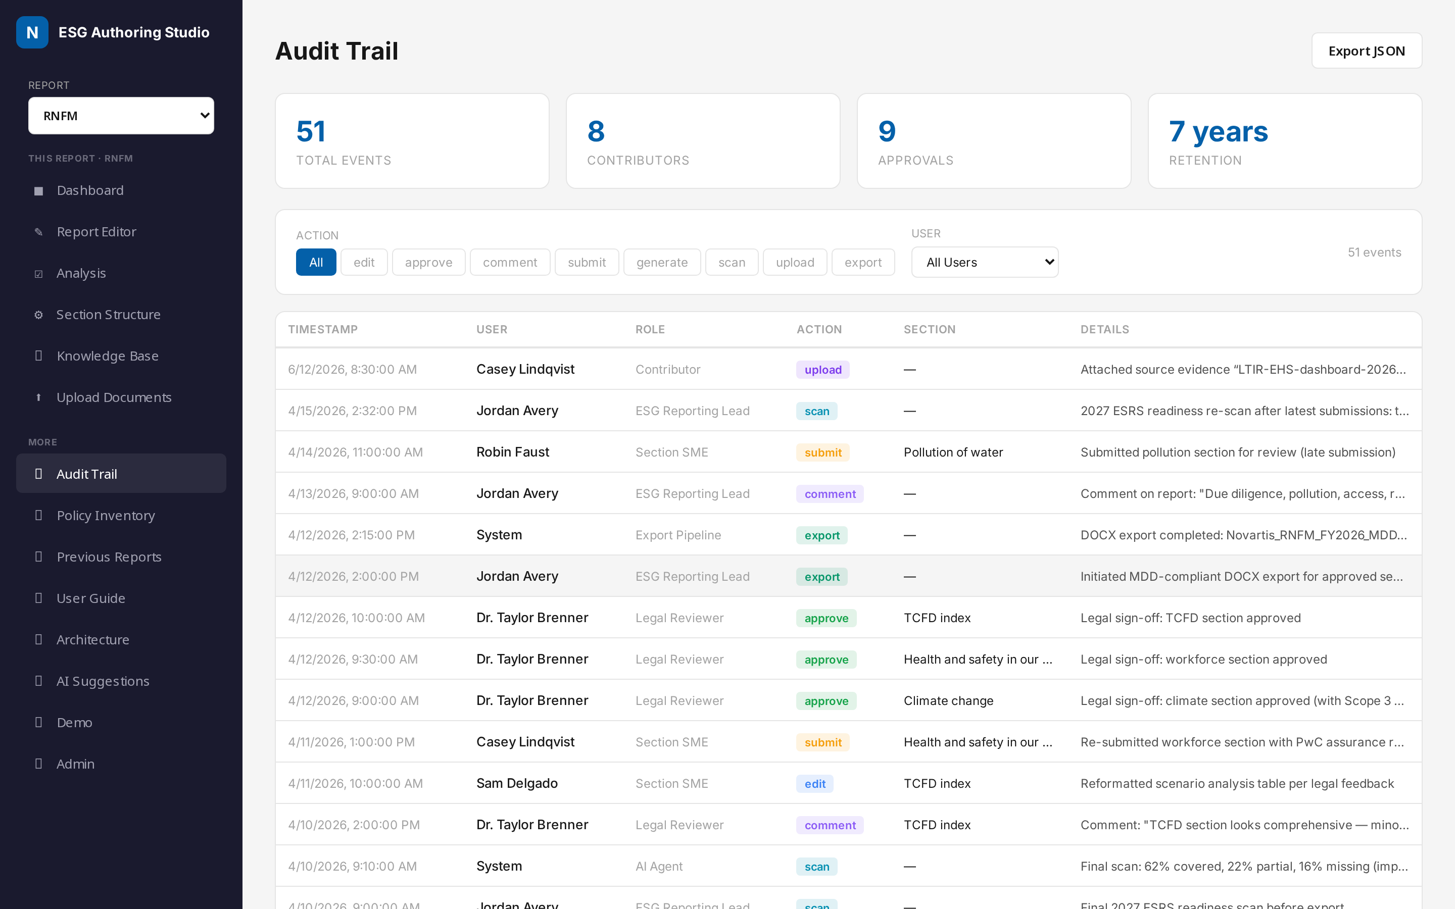
GOVERNANCE · AUDIT
An append-only record for assurance
WHAT IT IS
Every edit, approval, upload, scan, export and evidence attachment is captured with user, timestamp and before/after context — the primary evidence source for external assurance.
KEY POINTS
• Attached source evidence appears here automatically.
• Nothing is overwritten silently; full traceability.
• Filterable by action and user; exportable.
• Designed for 7-year retention.
Audit Trail — the assurance-grade activity log

Slide 16
4 · Versioning & comparison
Every change is captured and comparable.

Slide 17
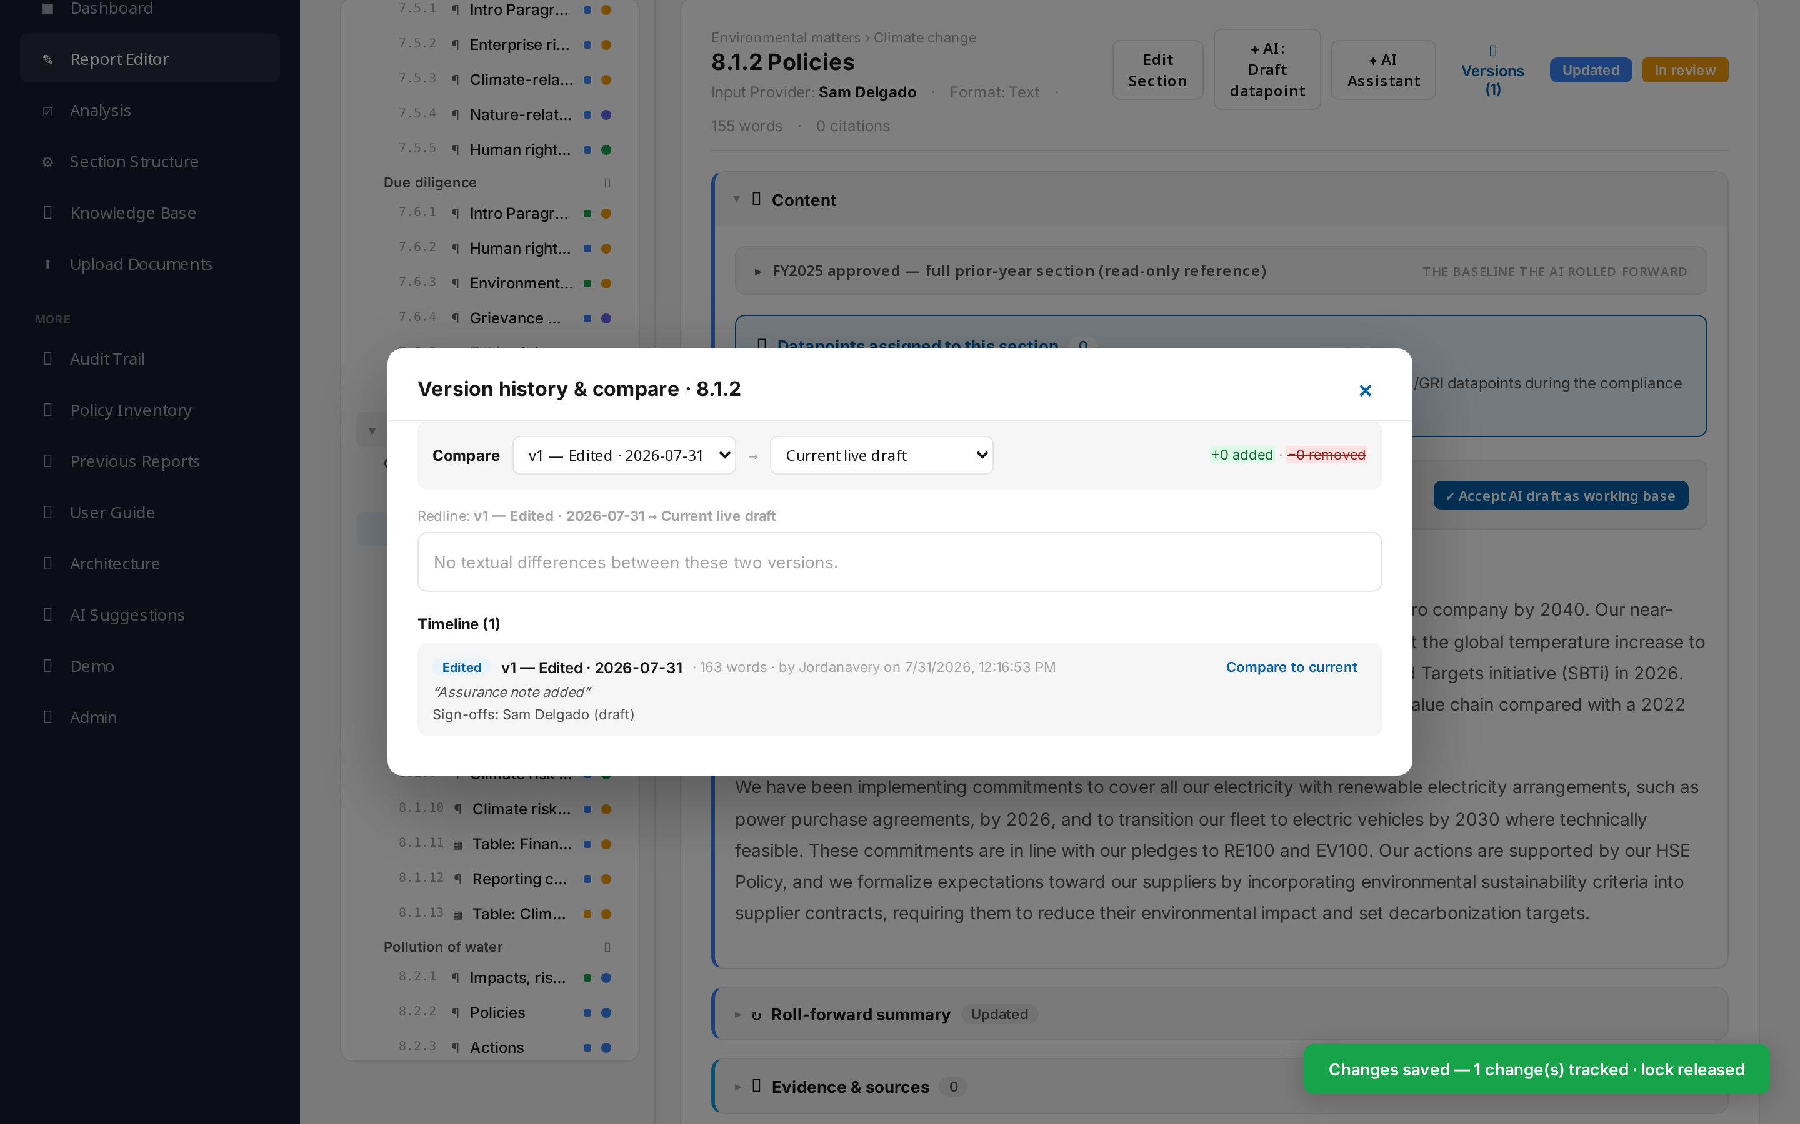
VERSIONING
Version history & side-by-side compare
WHAT IT IS
A version is frozen automatically on every saved edit and every sign-off. Any two versions can be compared as a redline, so a reviewer sees exactly what changed between two points in time.
STEP BY STEP
1. Each save/sign-off adds a timestamped, attributed version.
2. Open Versions on a subsection to see its timeline.
3. Select a version to see its redline vs the current draft.
4. Use it to answer “what changed since Legal last saw this?”
Version timeline with an inline redline comparison

Slide 18
5 · Datapoints & confidence
How disclosure requirements are assigned and scored.

Slide 19
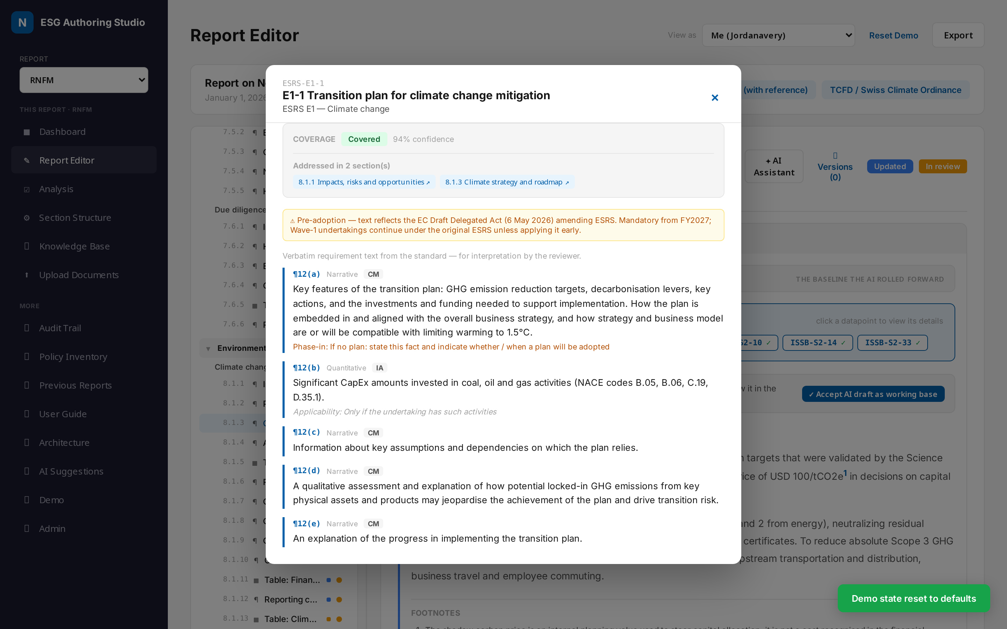
DATAPOINTS · ASSIGNMENT
Datapoints assigned to a section
WHAT IT IS
Each subsection is tagged with the disclosure requirements it addresses (ESRS, ISSB, GRI, TCFD, MSA, NTA). Clicking a datapoint opens one details view — coverage, rationale and the verbatim requirement text — without leaving the editor.
KEY POINTS
• Datapoints are assigned by the AI compliance mapping.
• Status dot per datapoint: covered / partial / missing.
• One “View details” popup — no navigating away and back.
• Bi-directional: jump to every section that addresses a datapoint.
Datapoint details — coverage, rationale and standard text in one popup

Slide 20
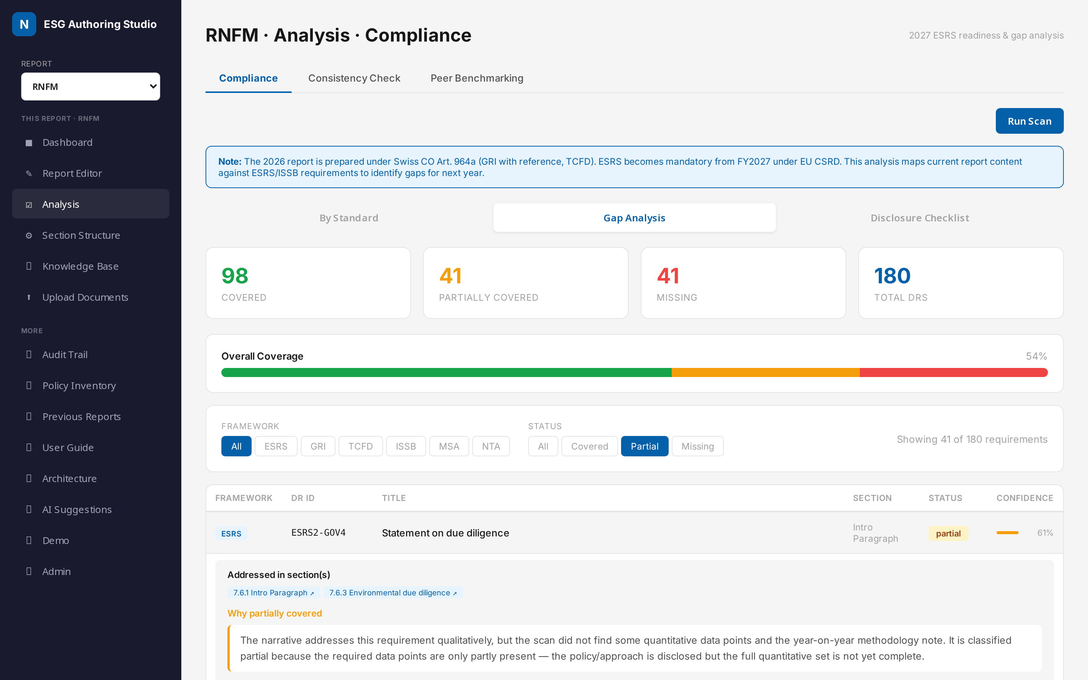
DATAPOINTS · GAP ANALYSIS
Why partial, why missing, and what to add
WHAT IT IS
For every requirement the system shows coverage, a confidence score, and — for partial or missing — a rationale explaining what is present versus still needed, plus whether adding it is beneficial.
KEY POINTS
• “Why partially covered” names the data points still outstanding.
• “Why missing” / “Should this be added?” guides the decision.
• AI-suggested fill text, grounded in the knowledge base.
• Filter by framework and by materiality.
Gap detail with rationale and suggested fill

Slide 21
DATAPOINTS · CONFIDENCE
How the confidence score is calculated
The confidence score expresses how sure the compliance mapping is that a disclosure requirement is genuinely satisfied by the mapped section — shown as a 0–100% bar next to each datapoint.
Semantic coverage
Signals combined
How to read it
• The mapping compares the requirement's expected data points against the section text.
• A higher share of expected data points present → higher confidence.
• Covered ≈ high, partial ≈ medium, missing ≈ low.
• Presence of the required quantitative figures and prior-year comparatives.
• Methodology / boundary statements the standard expects.
• Citation coverage — whether claims trace to a source.
• High: the requirement is well evidenced — light-touch review.
• Medium: present but incomplete — see the “why partial” note.
• Low: little or no matching content — candidate to draft or justify.
Today's scores reflect a curated mapping; in the Novartis environment the score is produced by the compliance agent from the live section text and requirement library (see roadmap).

Slide 22
6 · Roadmap & inputs
What is still to complete, and what we need from Novartis.

Slide 23
ROADMAP
What is still to be completed
Capabilities designed and scoped, to be finished as the application moves into the Novartis environment.
Compliance validation
Admin & monitoring panel
Knowledge base at scale
• Automated validation of coverage against the full ESRS/ISSB requirement library.
• Blocking rules for mandatory disclosures at sign-off.
• Confidence produced live from section text.
• Central console for users, roles and assignments.
• Pipeline / job monitoring and ingestion status.
• Usage, adoption and cycle-time dashboards.
• Full ingestion of Novartis source corpus.
• Retrieval tuning for precision and cost.
• Trusted external standards as reference sources.
Live MDD tables
Real generation
Enterprise integration
• Direct pull of table data from MDD (source of truth).
• Round-trip on export with MDD codes.
• Refresh-from-MDD in the editor.
• Section drafting, compliance scan and peer Q&A on the managed AI service.
• Style-guide and consistency enforcement.
• Assurance-ready citation coverage.
• SSO / identity, roles from corporate groups.
• Secure document storage and retention.
• Deployment into the Novartis-approved environment.

Slide 24
ONE PLATFORM · MANY REPORTS
The wider report suite
Everything so far is the RNFM. The same studio and one shared knowledge base extend to Novartis's other sustainability disclosures — so a figure is drafted, cited and approved once, then reused everywhere.
RNFM — active
ESG Index — new
Update on Public Commitments — new
• Swiss CO Art. 964a today; ESRS-compliant from FY2027.
• AI: first-draft RAG generation, roll-forward, citations.
• The primary report and source of truth for the rest.
• Consolidated index of every ESG metric + disclosure.
• AI: auto-generates ESRS / GRI / ISSB / SASB cross-refs.
• Pointers resolve to the authoritative RNFM section.
• SI&S targets, performance tables and narrative.
• AI: reuses RNFM numbers + methodology, drafts narrative.
• No re-collection — figures reconcile across documents.
Australian ASRS — from FY2027
Human Rights Statement — 2026
Why one platform
• AASB S1 / S2 report for the Australian legal entity.
• AI: maps global ISSB content → local ASRS requirements.
• Drafted once from the ISSB basis, reused locally.
• Modern-slavery / transparency across UK, AU, CA, NO, CH acts.
• AI: drafts from the same human-rights evidence base.
• Standalone for 2026, then folds into the RNFM from 2027.
• One indexed source of truth — no reconciliation gaps.
• Cross-references keep every report consistent.
• One governance + audit trail across the whole suite.

Slide 25
WHAT WE NEED FROM NOVARTIS
Inputs that make the move fast, low-risk and low-complexity
The more of these are ready, the more the move becomes configuration rather than build — keeping integration and setup straightforward.
Content & standards
Source data & systems
• Current MDD / Master Document Design template (Word styles).
• Novartis Style Guide.
• Recent approved RNFMs (2–3 years) for structure & baseline.
• GRI / TCFD requirement text to match ESRS/ISSB coverage.
• The document corpus to index (policies, SOPs, standards, peer reports).
• MDD table data + access method for the live pull.
• The datapoint / DR list per report to prioritise mapping.
• Report structures for the other reports (ESG Index, UPC, ASRS).
People & governance
Environment & security
• Role assignments: Input Providers, Owners, Legal, Editors, Admins.
• Approval rules to confirm (e.g. owner sign-off policy).
• Materiality assessment outcomes to scope disclosures.
• Business KPIs / ROI targets to measure success.
• Target AWS environment and identity provider (SSO) details.
• Data-handling, retention and residency requirements.
• DDIT / security review path and approvers.
• Integration points with existing Novartis systems.

Slide 26
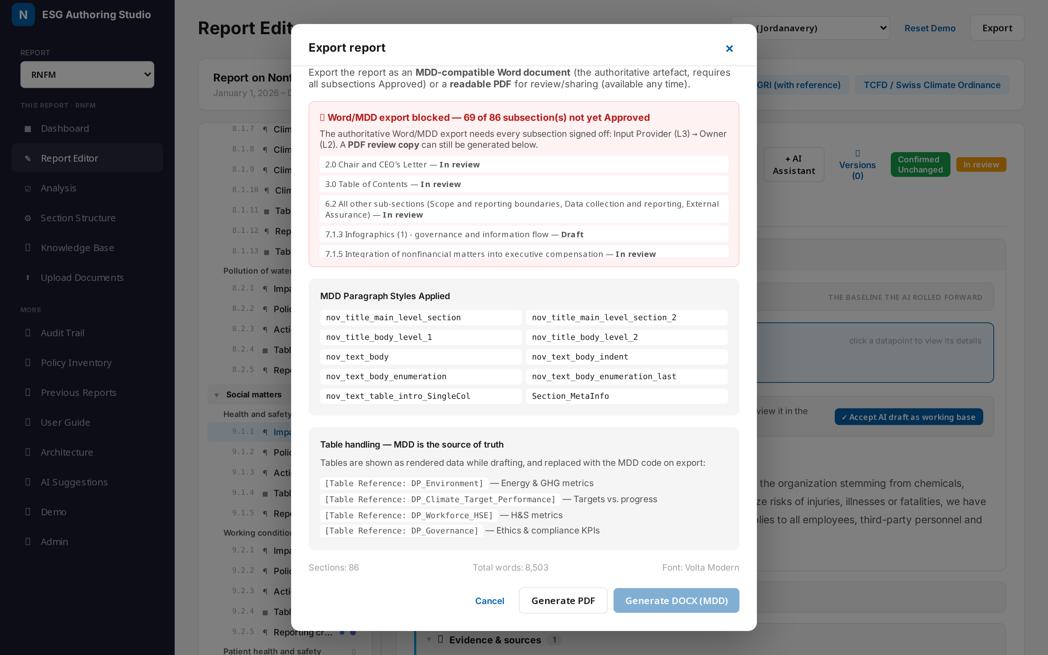
OUTPUT · EXPORT
Export: MDD Word + PDF
WHAT IT IS
The report exports as an MDD-compatible Word document — the authoritative artefact, produced once every subsection is approved — or as a readable PDF for review and sharing at any time.
KEY POINTS
• Word/MDD applies Novartis paragraph styles; tables map to MDD codes.
• PDF is a review copy — available before full approval.
• Disabled actions explain why (e.g. approvals still pending).
• Word/MDD remains the single source of truth for publication.
Export panel — Generate PDF (any time) or DOCX/MDD (once approved)

Slide 27
7 · Platform tour
A visual walk through the main screens.

Slide 28
TOUR · DASHBOARD
Dashboard — the reporting command centre
Live progress by stage, 2027 ESRS readiness, roll-forward status, personalised open tasks and recent activity — one place to run the cycle.
IMPACT One live view of the whole cycle replaces status chased across email and spreadsheets.

Slide 29
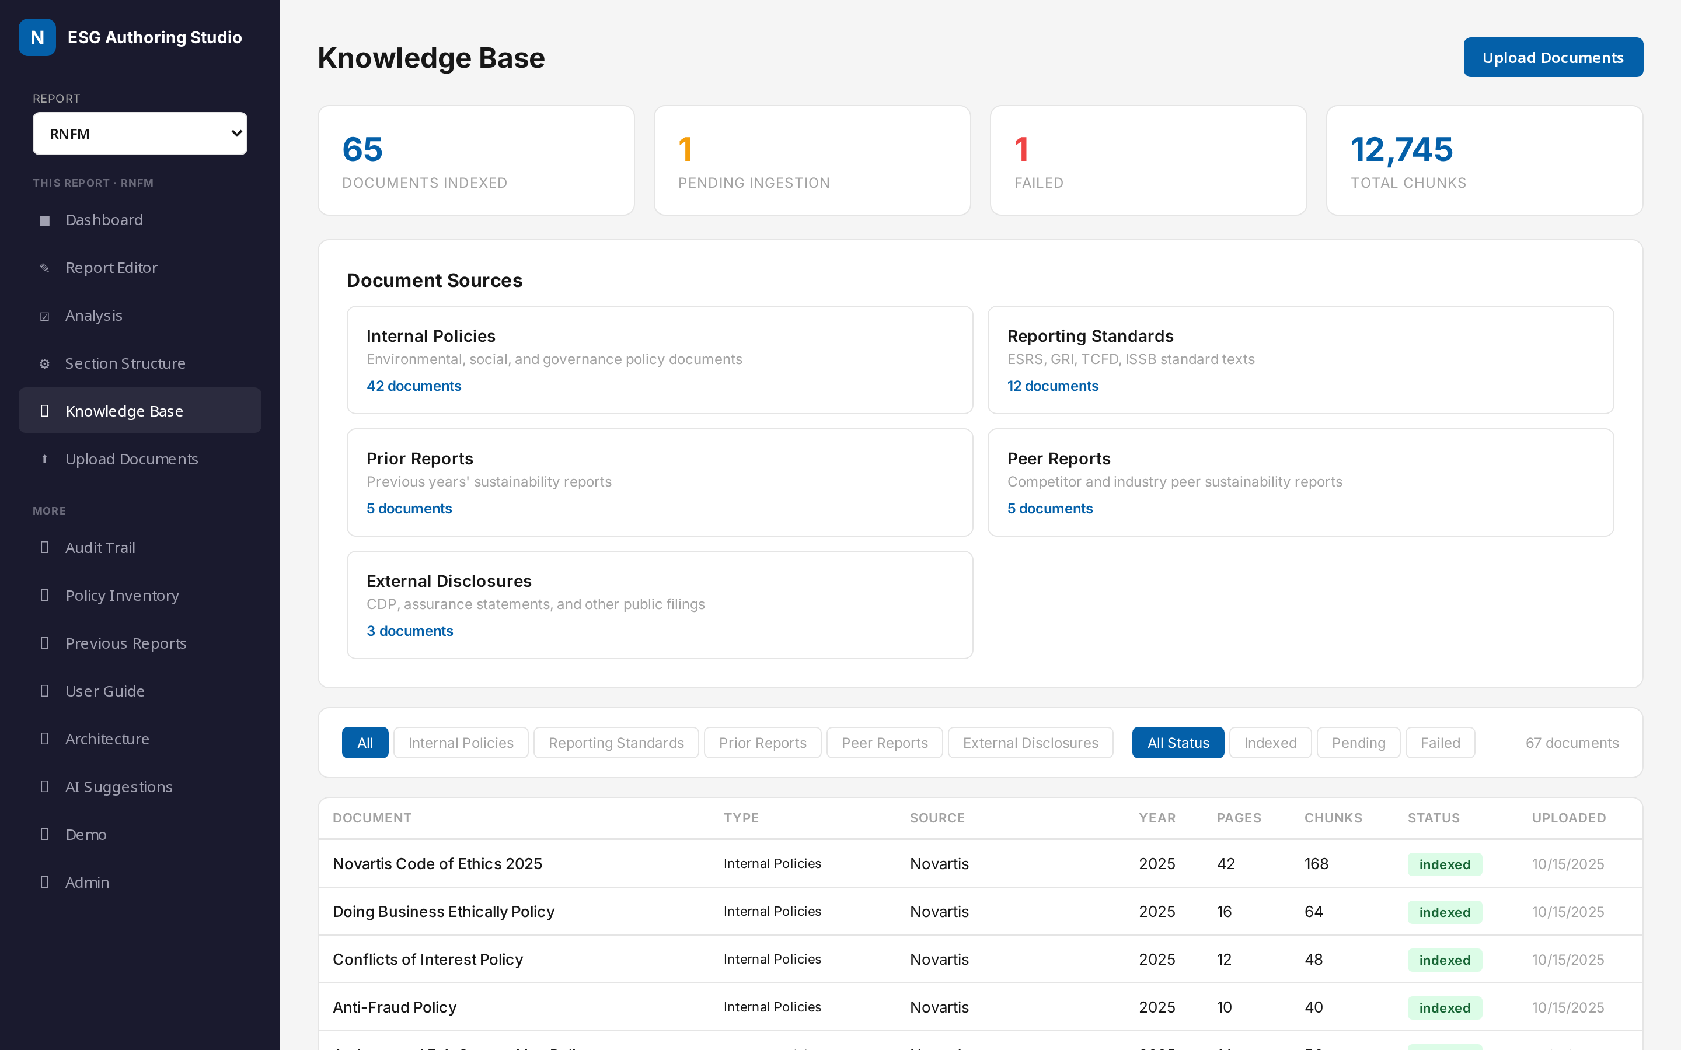
TOUR · KNOWLEDGE BASE
Knowledge Base — grounded in Novartis's own documents
These are Novartis's own documents — policies, standards, prior RNFMs, peer reports and the Style Guide (a few shown here). In the Novartis environment this connects to Novartis's trusted document systems (SharePoint / DMS) so the library stays current automatically. Every AI claim traces back to a source indexed here.
A few example documents shown — the indexed library is far larger and scrolls.
IMPACT AI drafts only from Novartis-trusted sources — nothing invented, every claim citable to its origin.

Slide 30
TOUR · REPORT EDITOR
Report Editor — a subsection open for review
The AI draft with its citations, assigned datapoints, the prior-year baseline, and the collapsible workflow cards — all for one subsection at a time.
IMPACT Reviewers start from a cited draft, not a blank page — the bulk of first-draft effort is removed.

Slide 31
TOUR · TRACK CHANGES
Editor — Word-like track changes
Insertions (green) and deletions (struck-through) are shown inline with per-change accept/reject, plus an in-document AI assistant.
IMPACT Familiar Word-style review with full attribution — no new tool to learn, every edit is auditable.

Slide 32
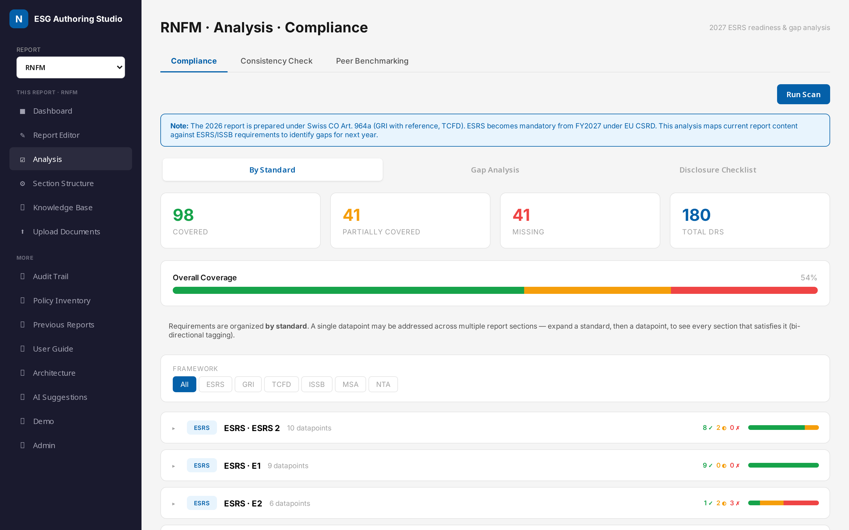
TOUR · COMPLIANCE
2027 ESRS Readiness — coverage overview
A forward-looking gap analysis mapping today's report to ESRS/ISSB/GRI/TCFD, with traffic-light coverage per requirement.
IMPACT See CSRD/ESRS gaps years ahead of the FY2027 mandate — de-risks the transition.

Slide 33
TOUR · COMPLIANCE BY STANDARD
Coverage by standard, datapoint by datapoint
Expand any standard to see each disclosure requirement, its coverage status and the report sections that address it.
Top of the coverage grid shown — every framework and requirement continues below.
IMPACT Evidence of mandatory-disclosure coverage on demand — ready for external assurance.

Slide 34
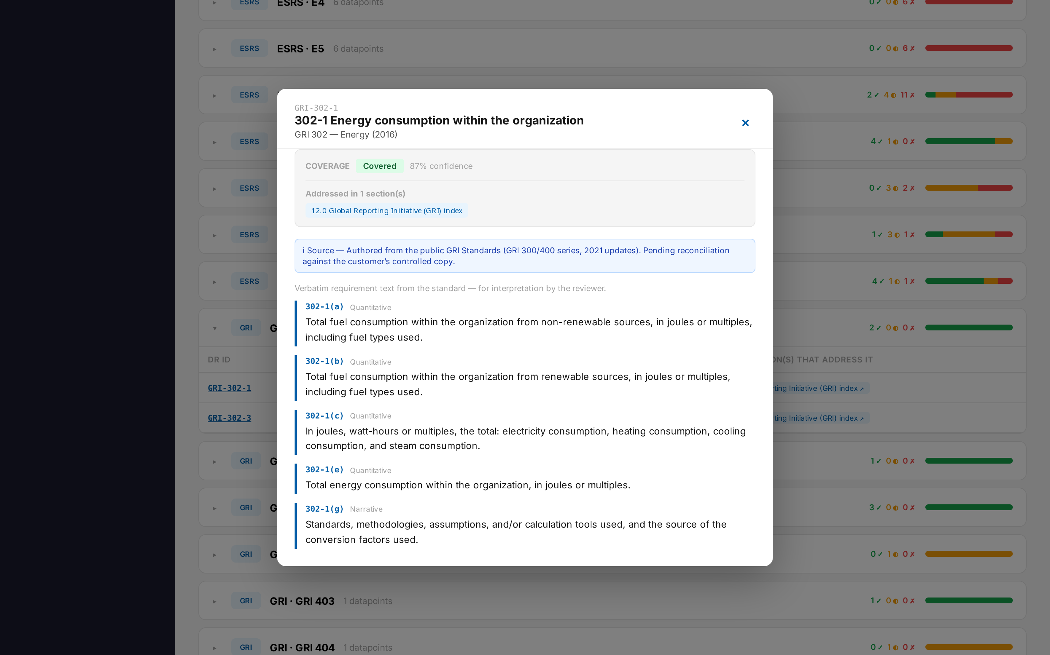
TOUR · GRI REQUIREMENT TEXT
Requirement text for every framework
ESRS, ISSB, GRI, TCFD, MSA and NTA requirements open the actual standard wording — so a reviewer interprets the source, not an AI paraphrase.
IMPACT Reviewers judge against the real standard text — removes interpretation risk on compliance calls.

Slide 35
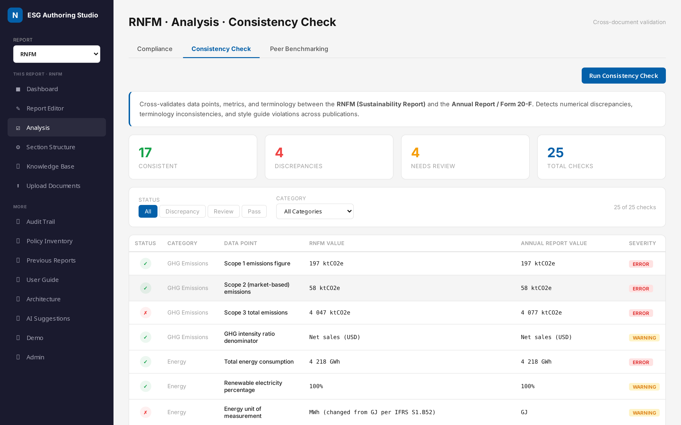
TOUR · CONSISTENCY
Consistency Check — cross-document validation
Compares figures and terminology across the RNFM and the Annual Report and flags discrepancies for resolution.
A few example checks shown — the full validation list scrolls.
IMPACT Catches numbers that don't reconcile between documents before they reach publication.

Slide 36
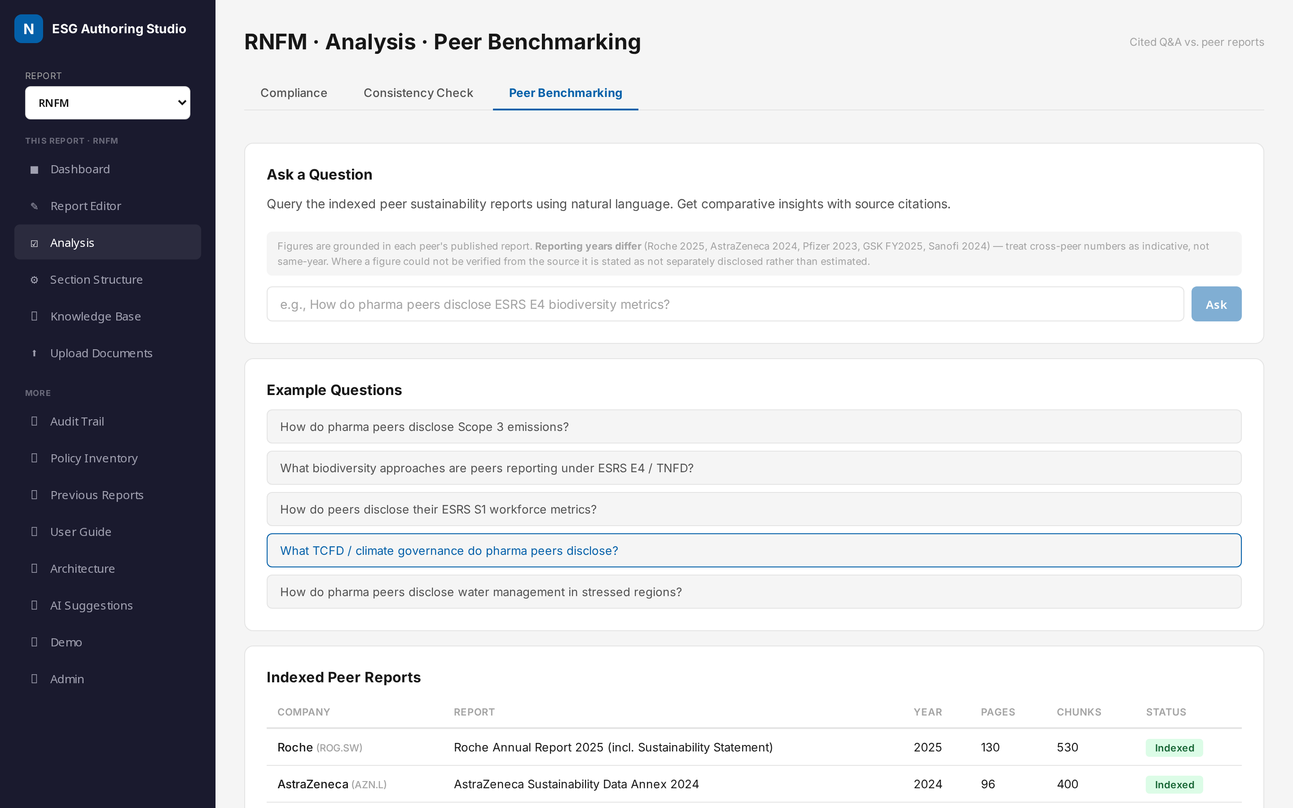
TOUR · PEER BENCHMARKING
Peer Benchmarking — cited Q&A
Natural-language questions answered from indexed peer sustainability reports, with citations to the source and page.
IMPACT Benchmark disclosure approaches in minutes instead of manual peer-report reading.

Slide 37
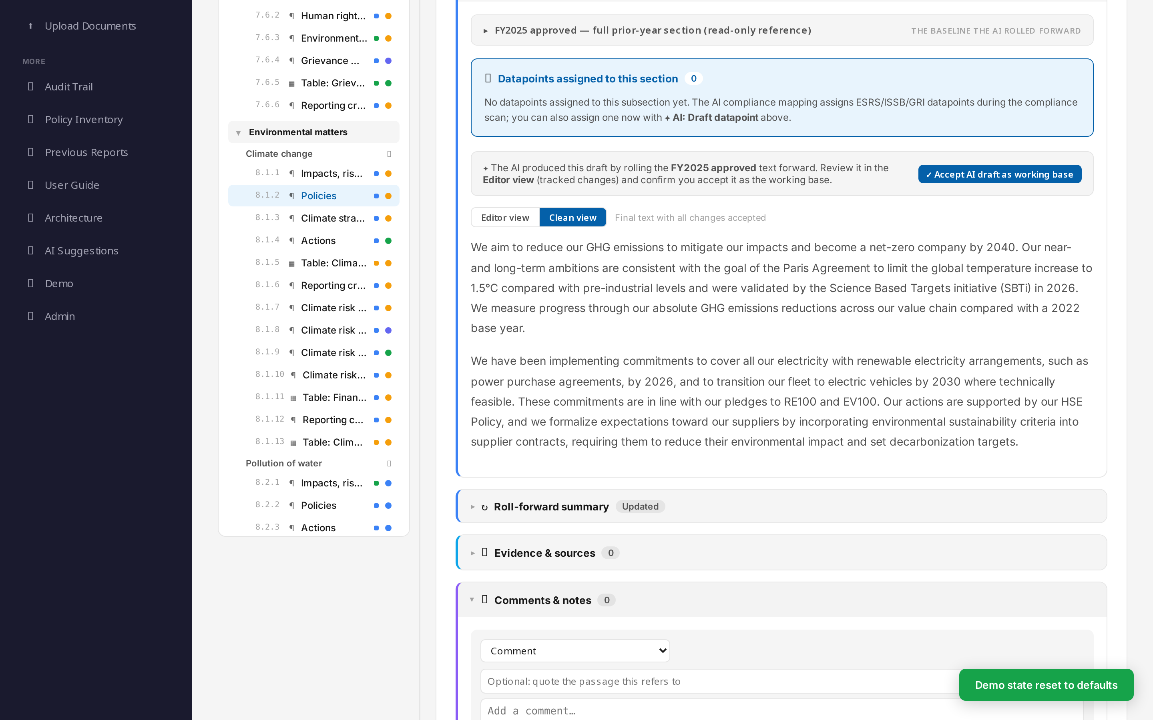
TOUR · COMMENTS
Comments & change requests
Any role can comment; comment-only roles raise change requests that route to Editors, who apply them as tracked changes.
IMPACT Review conversation lives in the document — no context lost across email threads.

Slide 38
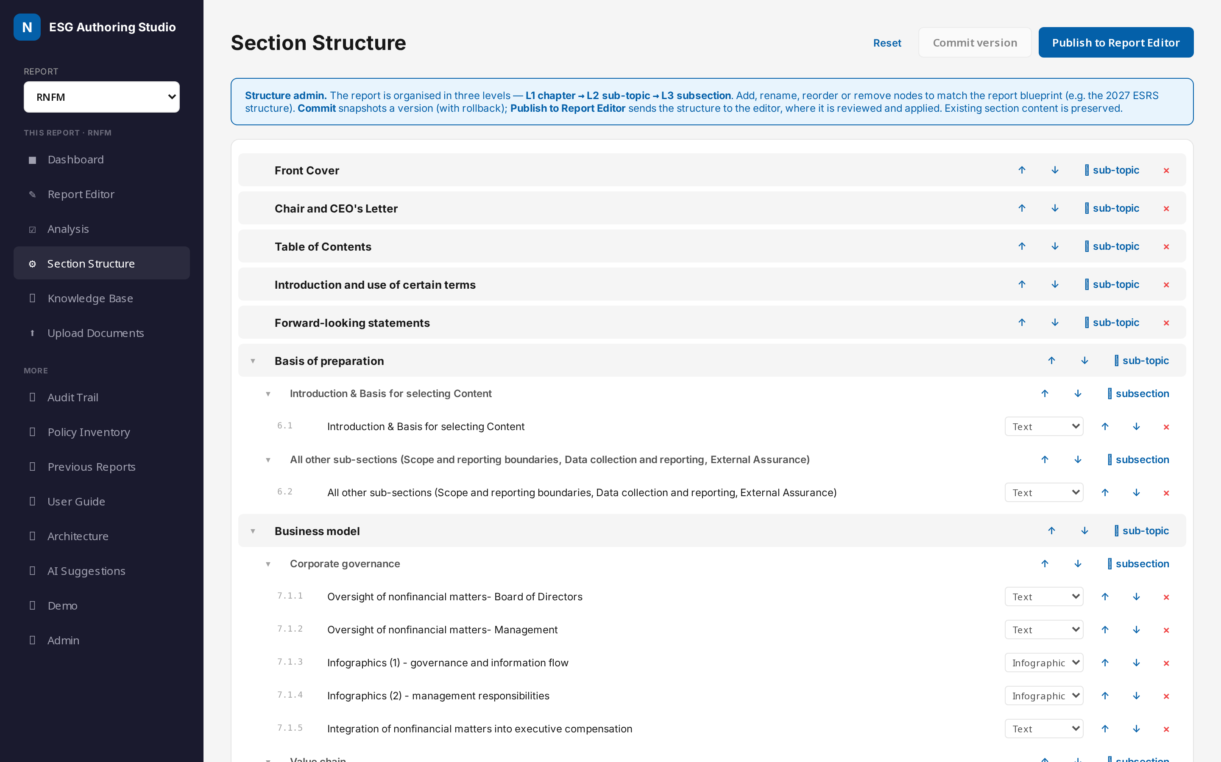
TOUR · SECTION STRUCTURE
Section Structure — configure the report tree
Add, rename, move or remove chapters / sub-topics / subsections, then publish a reviewed, versioned structure change to the editor.
Top of the section tree shown — the full report structure continues below.
IMPACT The report structure adapts to Novartis as standards evolve — a governed, versioned change.

Slide 39
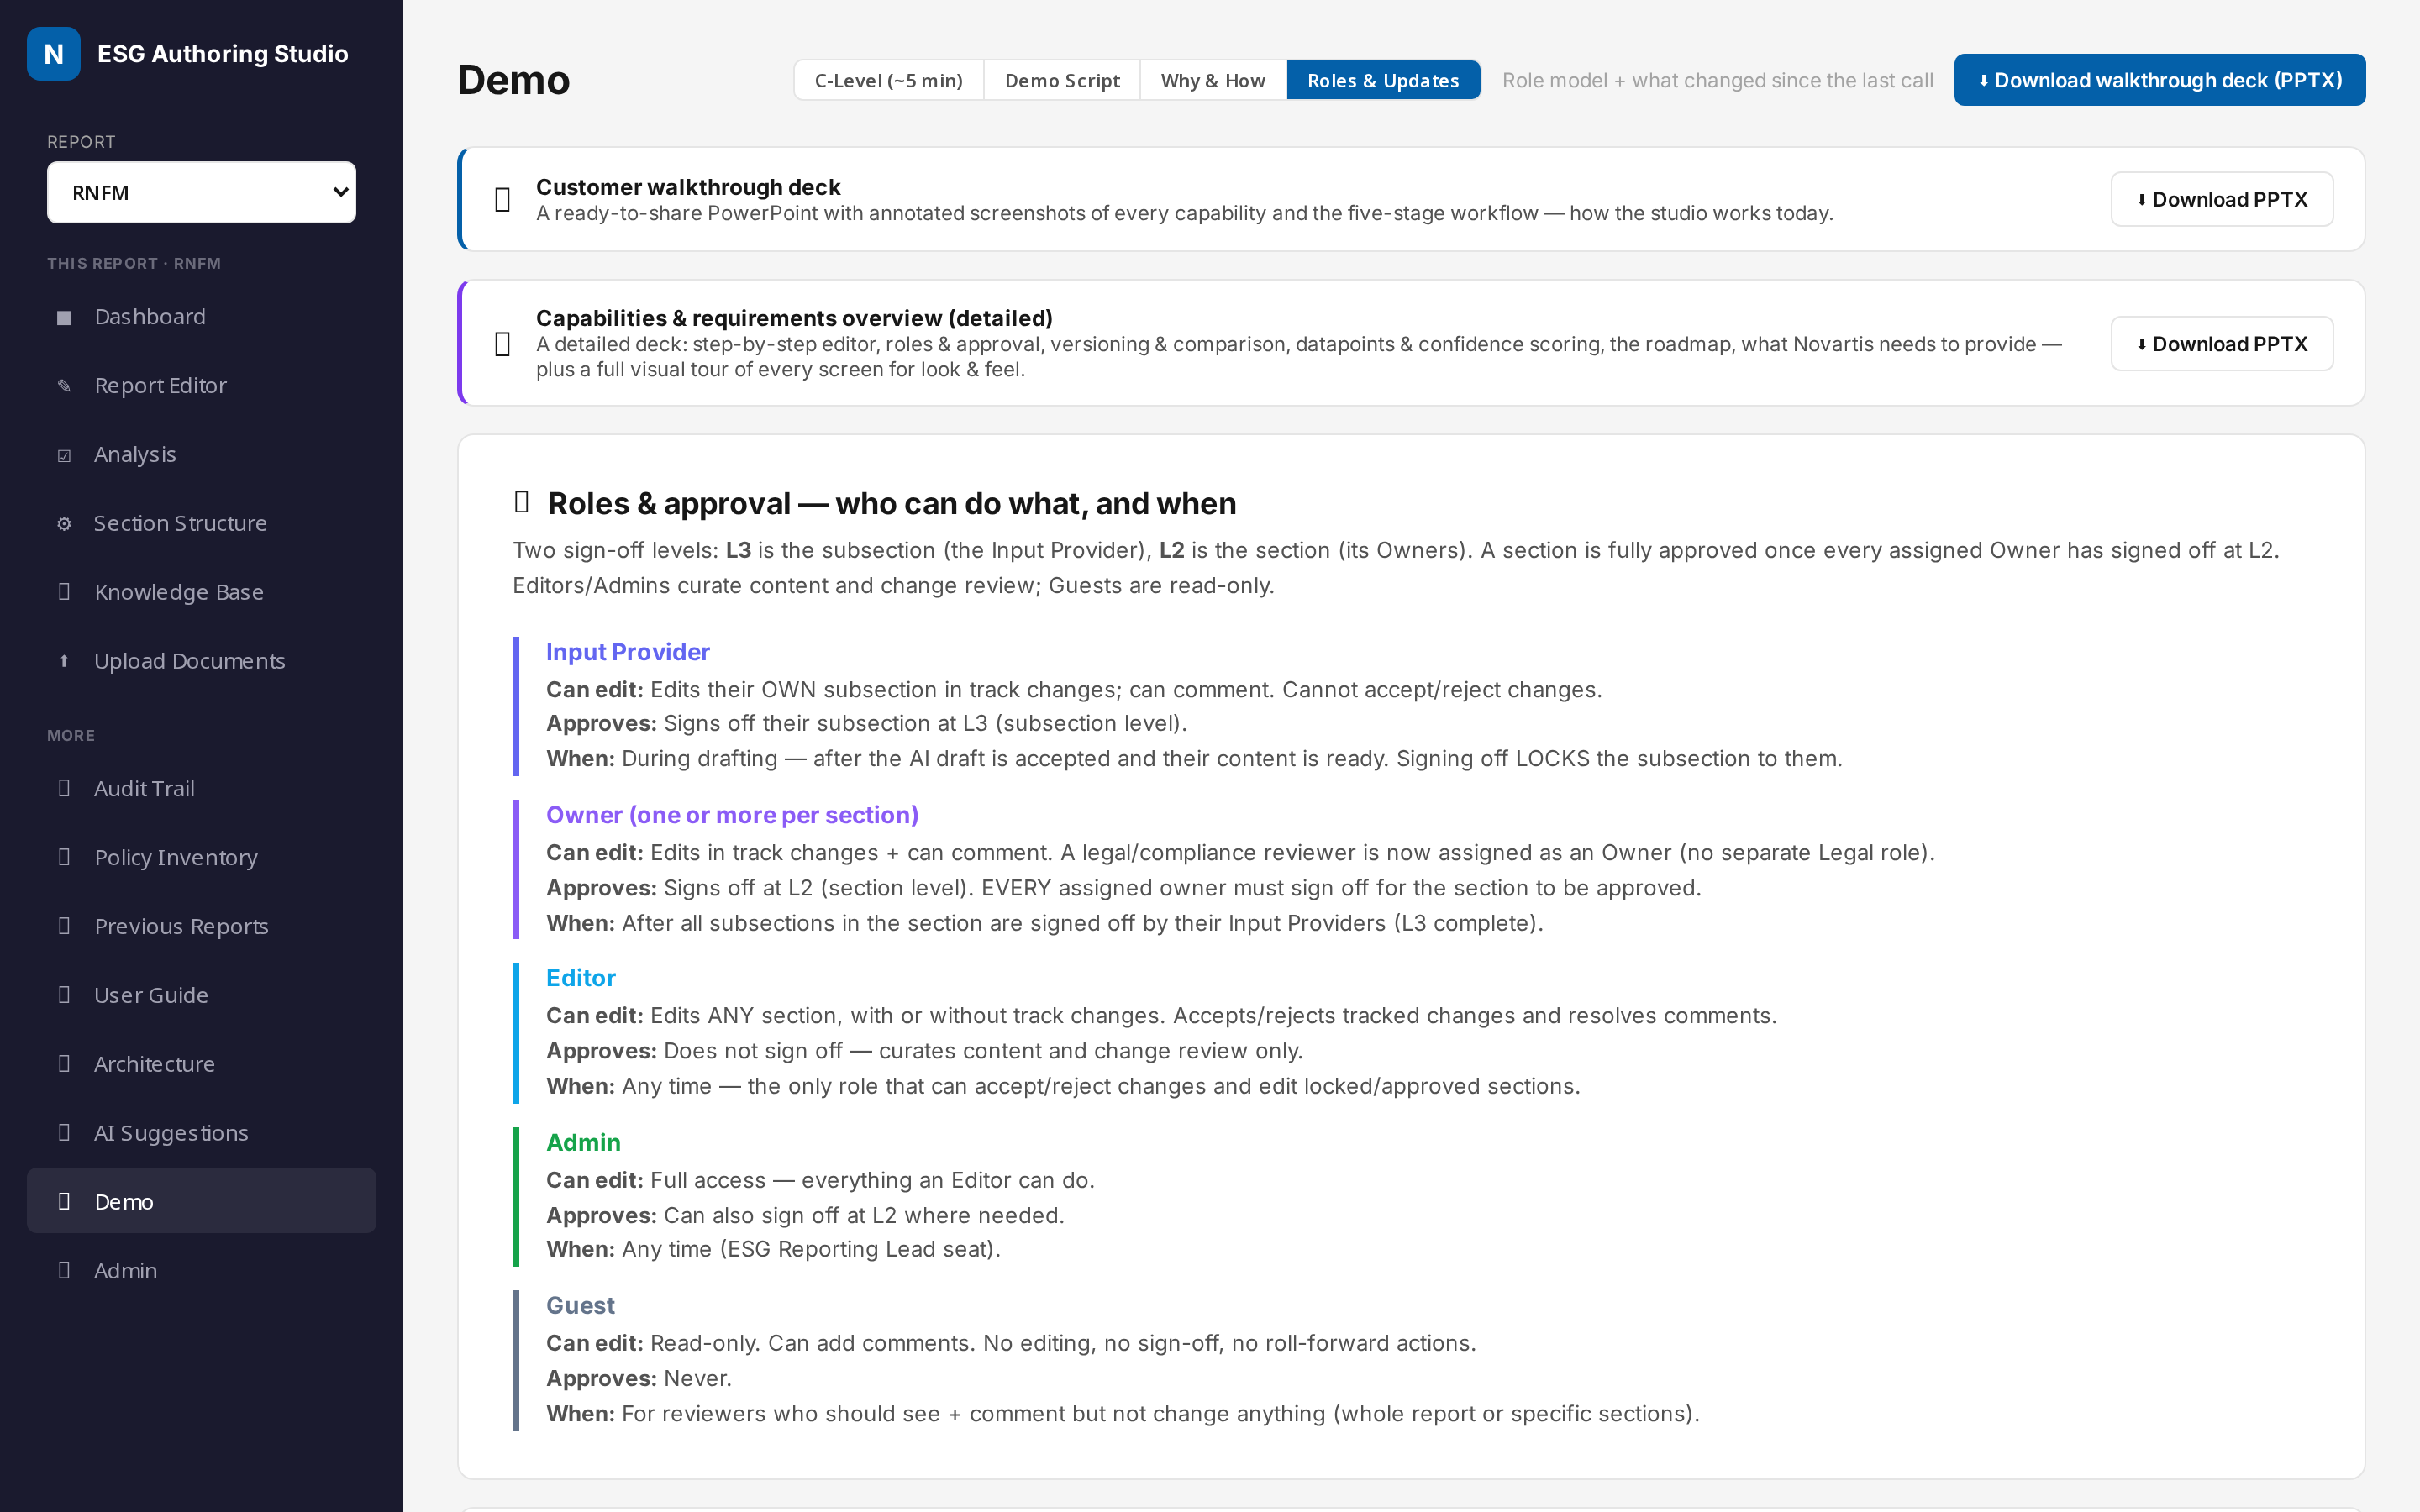
TOUR · ROLES & UPDATES
In-app roles & change reference
The studio also carries an in-app reference of the role model and the latest changes — useful for onboarding reviewers.
IMPACT New reviewers onboard from inside the app — less ramp-up per reporting cycle.

Slide 40
8 · Architecture & AWS
How the solution is built — with AI at its core — and the AWS services that run it.

Slide 41
SOLUTION ARCHITECTURE
Overall architecture — AI components highlighted
A serverless AWS application: a static web studio, a governed API/workflow tier, and — at its core — Amazon Bedrock AI agents grounded in an indexed knowledge base. AI components are shown in purple.
Users
ESG Lead · SME · Legal · Editor · Admin
Sign in via corporate SSO (Cognito → Novartis IdP)
Presentation
Authoring Studio SPA (React)
CloudFront + S3 static hosting
Amazon Cognito
SAML/OIDC federation, role claims
Application
API Service (ECS Fargate + ALB)
Document CRUD, workflow, RBAC, audit queries
Workflow & Audit Service
State machine, sign-off rules, immutable log
SQS job queues
Async draft / scan / export dispatch
AI core
RNFM Draft Agent
Bedrock AgentCore · Claude
Compliance Gap Agent
ESRS/GRI/ISSB coverage
Peer Benchmarking Agent
Cited Q&A over peers
Bedrock Knowledge Base
Titan embeddings · OpenSearch
Data & pipelines
DynamoDB
Docs, sections, mappings, workflow, audit
S3 (KMS)
Source docs + MDD exports
Ingestion (Step Functions + Textract)
Parse → chunk → embed → index
DOCX Export (Lambda)
MDD-compliant Word / PDF
Purple = AI components. All AI runs on Amazon Bedrock inside Novartis's own AWS tenancy; content is never used to train foundation models. Every AI claim traces back to an indexed source in the knowledge base.

Slide 42
AWS SERVICES
AWS services needed for this solution
Fully serverless and managed — no servers to patch, and AI is a managed Bedrock capability rather than self-hosted models.
Front end & identity
Compute & API
AI / ML (Amazon Bedrock)
• Amazon CloudFront + Amazon S3 (static SPA).
• Amazon Cognito (SAML/OIDC federation to Novartis IdP).
• AWS WAF on the ALB.
• Amazon ECS (Fargate) — API + Workflow/Audit services.
• Application Load Balancer.
• AWS Lambda — DOCX/PDF export + ingestion steps.
• Bedrock AgentCore — the three Strands agents.
• Claude (Sonnet / Opus / Haiku) for drafting & analysis.
• Titan Embeddings + Knowledge Bases for RAG.
Retrieval & search
Data, messaging & orchestration
Security & operations
• Amazon OpenSearch Serverless (vector store).
• Amazon Bedrock Knowledge Bases (managed RAG).
• Amazon Textract — PDF/DOCX text extraction.
• Amazon DynamoDB (docs, workflow, audit, mappings).
• Amazon S3 (KMS-encrypted source + exports).
• Amazon SQS, AWS Step Functions, Amazon EventBridge, SNS.
• AWS KMS (customer-managed keys), AWS Secrets Manager.
• AWS IAM — least-privilege roles + Cognito groups.
• Amazon CloudWatch + AWS X-Ray observability.

Slide 43
AI-assisted, human-governed, audit-ready
• A Word-like editor with true track changes, per-change review and in-document AI.
• Framework mapping with coverage, rationale and confidence for ESRS/ISSB/GRI/TCFD.
• Governed roles, two-level sign-off, versioning and an assurance-grade audit trail.
• Clear roadmap and a short list of Novartis inputs to move into the environment with confidence.

