Slide 1
Novartis ESG AI-Enabled Authoring Studio
Product walkthrough — capabilities, workflow and how it works
Report on Nonfinancial Matters (RNFM) · FY2026 · Prototype build

Slide 2
What the platform does
An AI-drafted, human-governed studio for the annual Report on Nonfinancial Matters (RNFM).
AI first draft
Compliance mapping
Governed workflow
• Generates each section from your own indexed documents (RAG).
• Rolls last year's approved report forward and flags what changed.
• Every claim carries a citation to its source.
• Maps content to ESRS, GRI, TCFD, ISSB, MSA & NTA.
• Traffic-light coverage: covered / partial / missing.
• AI-suggested fill text for gaps, grounded in evidence.
• Role-based review with tracked changes.
• Two-level sign-off: Input Provider → Owner → Legal.
• Immutable audit trail; MDD-compliant Word export.

Slide 3
How the workflow runs
Every subsection moves through the same five stages — no stage can be skipped.
1 AI Draft Generation
2 Input & SME Review
3 Legal Sign-off
4 Owner Sign-off
5 Exported
AI drafts each subsection from the knowledge base and the prior-year baseline.
Input Providers draft and subject-matter experts verify facts, edit, and check citations.
Legal / Compliance sign off per subsection; blocked if a mandatory DR is missing.
Section Owner is accountable for content accuracy and signs off at section (L2) level.
MDD-compliant DOCX generated and delivered once every subsection is approved.
→
→
→
→

Slide 4
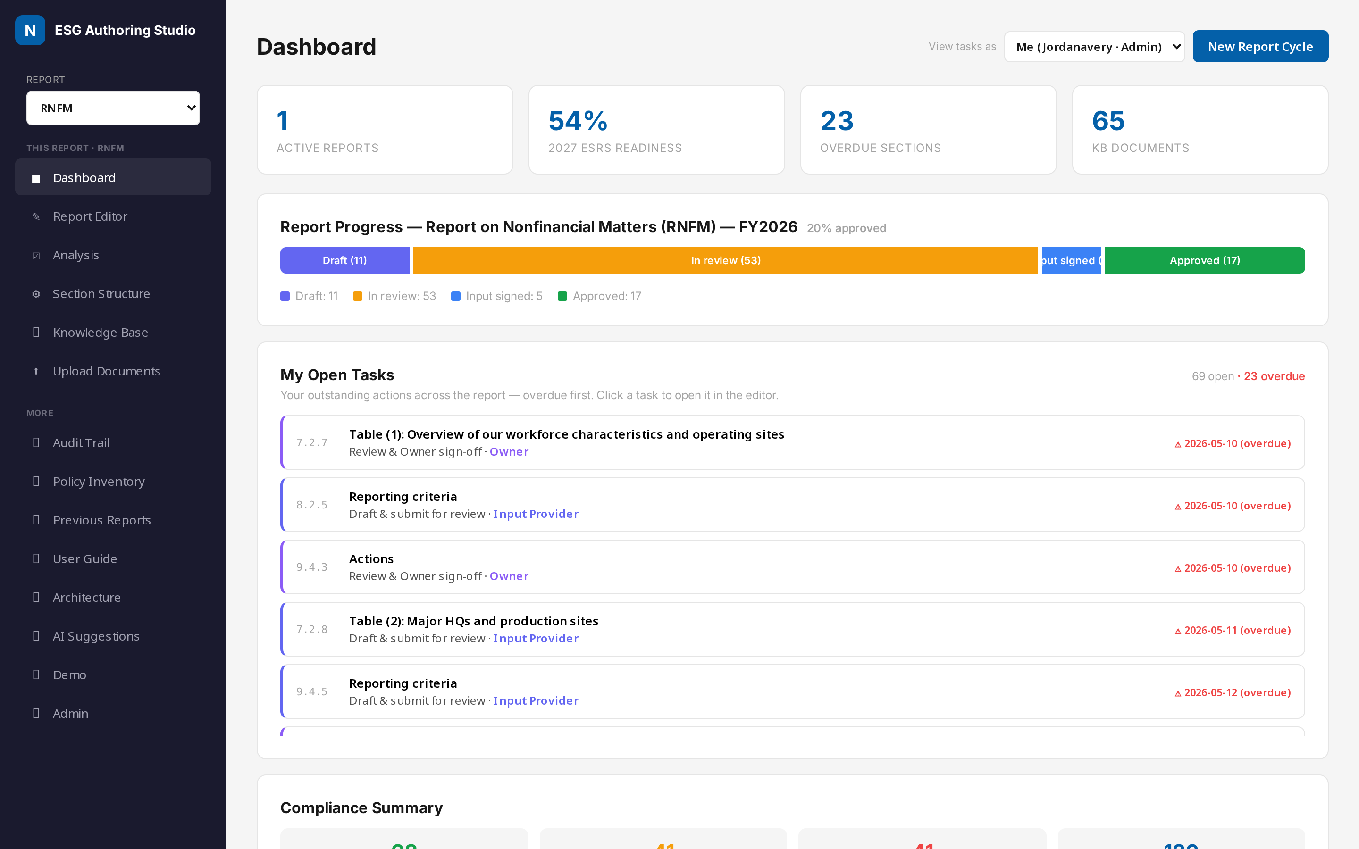
CAPABILITY · COMMAND CENTRE
Dashboard
WHAT THIS IS
The single control centre for the whole reporting cycle.
HOW IT WORKS
Live rollups read from the working data: progress by stage, 2027 ESRS readiness, roll-forward status and per-subsection assignments.
KEY POINTS
• 86 subsections tracked independently across five stages.
• Year-on-year roll-forward: updated / needs update / unchanged / new.
• Compliance summary and recent activity at a glance.

Slide 5
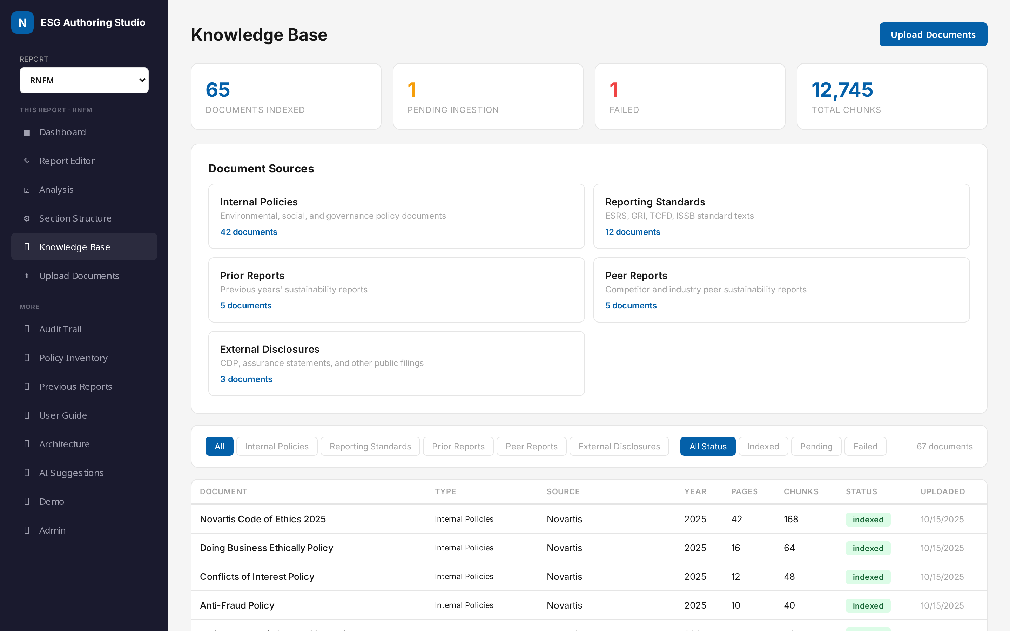
CAPABILITY · GROUNDING
Knowledge Base
WHAT THIS IS
The indexed source library that grounds every AI output.
HOW IT WORKS
Documents are parsed, chunked and embedded into a vector index; the AI retrieves from here so nothing is invented.
KEY POINTS
• Policies, standards, prior RNFMs, peer reports, style guide.
• Tagged by framework, year, type and source.
• This is what makes every claim traceable to a source.

Slide 6
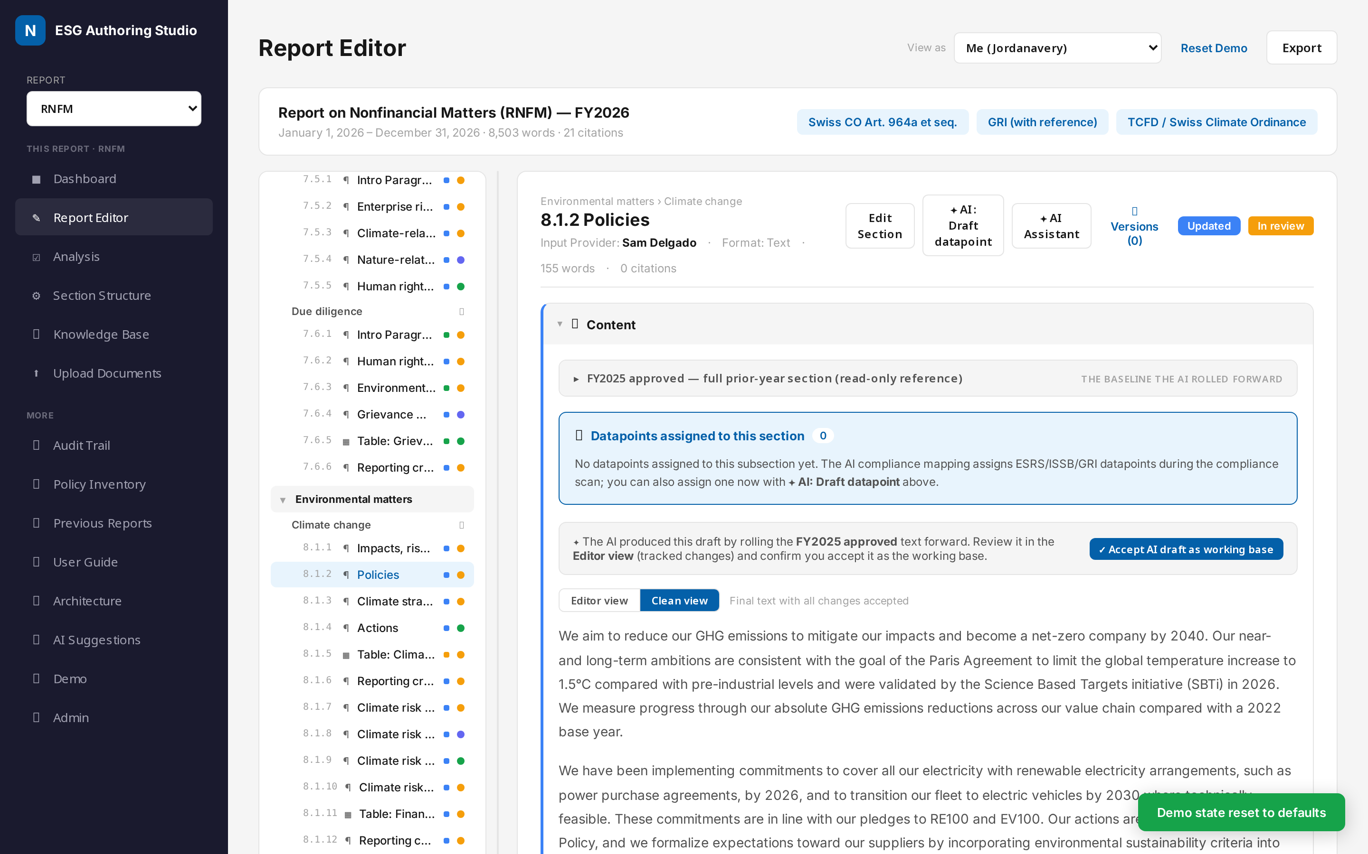
CAPABILITY · AUTHORING
Report Editor
WHAT THIS IS
A Word-like editor where AI drafts are reviewed and approved.
HOW IT WORKS
Each subsection shows the AI draft, its citations, and an expandable FY2025 approved panel — the baseline the AI rolled forward.
KEY POINTS
• Collapsible cards: roll-forward, content, comments, approval.
• Citation markers open the source evidence panel.
• Editor vs Clean view tabs separate review from reading.

Slide 7
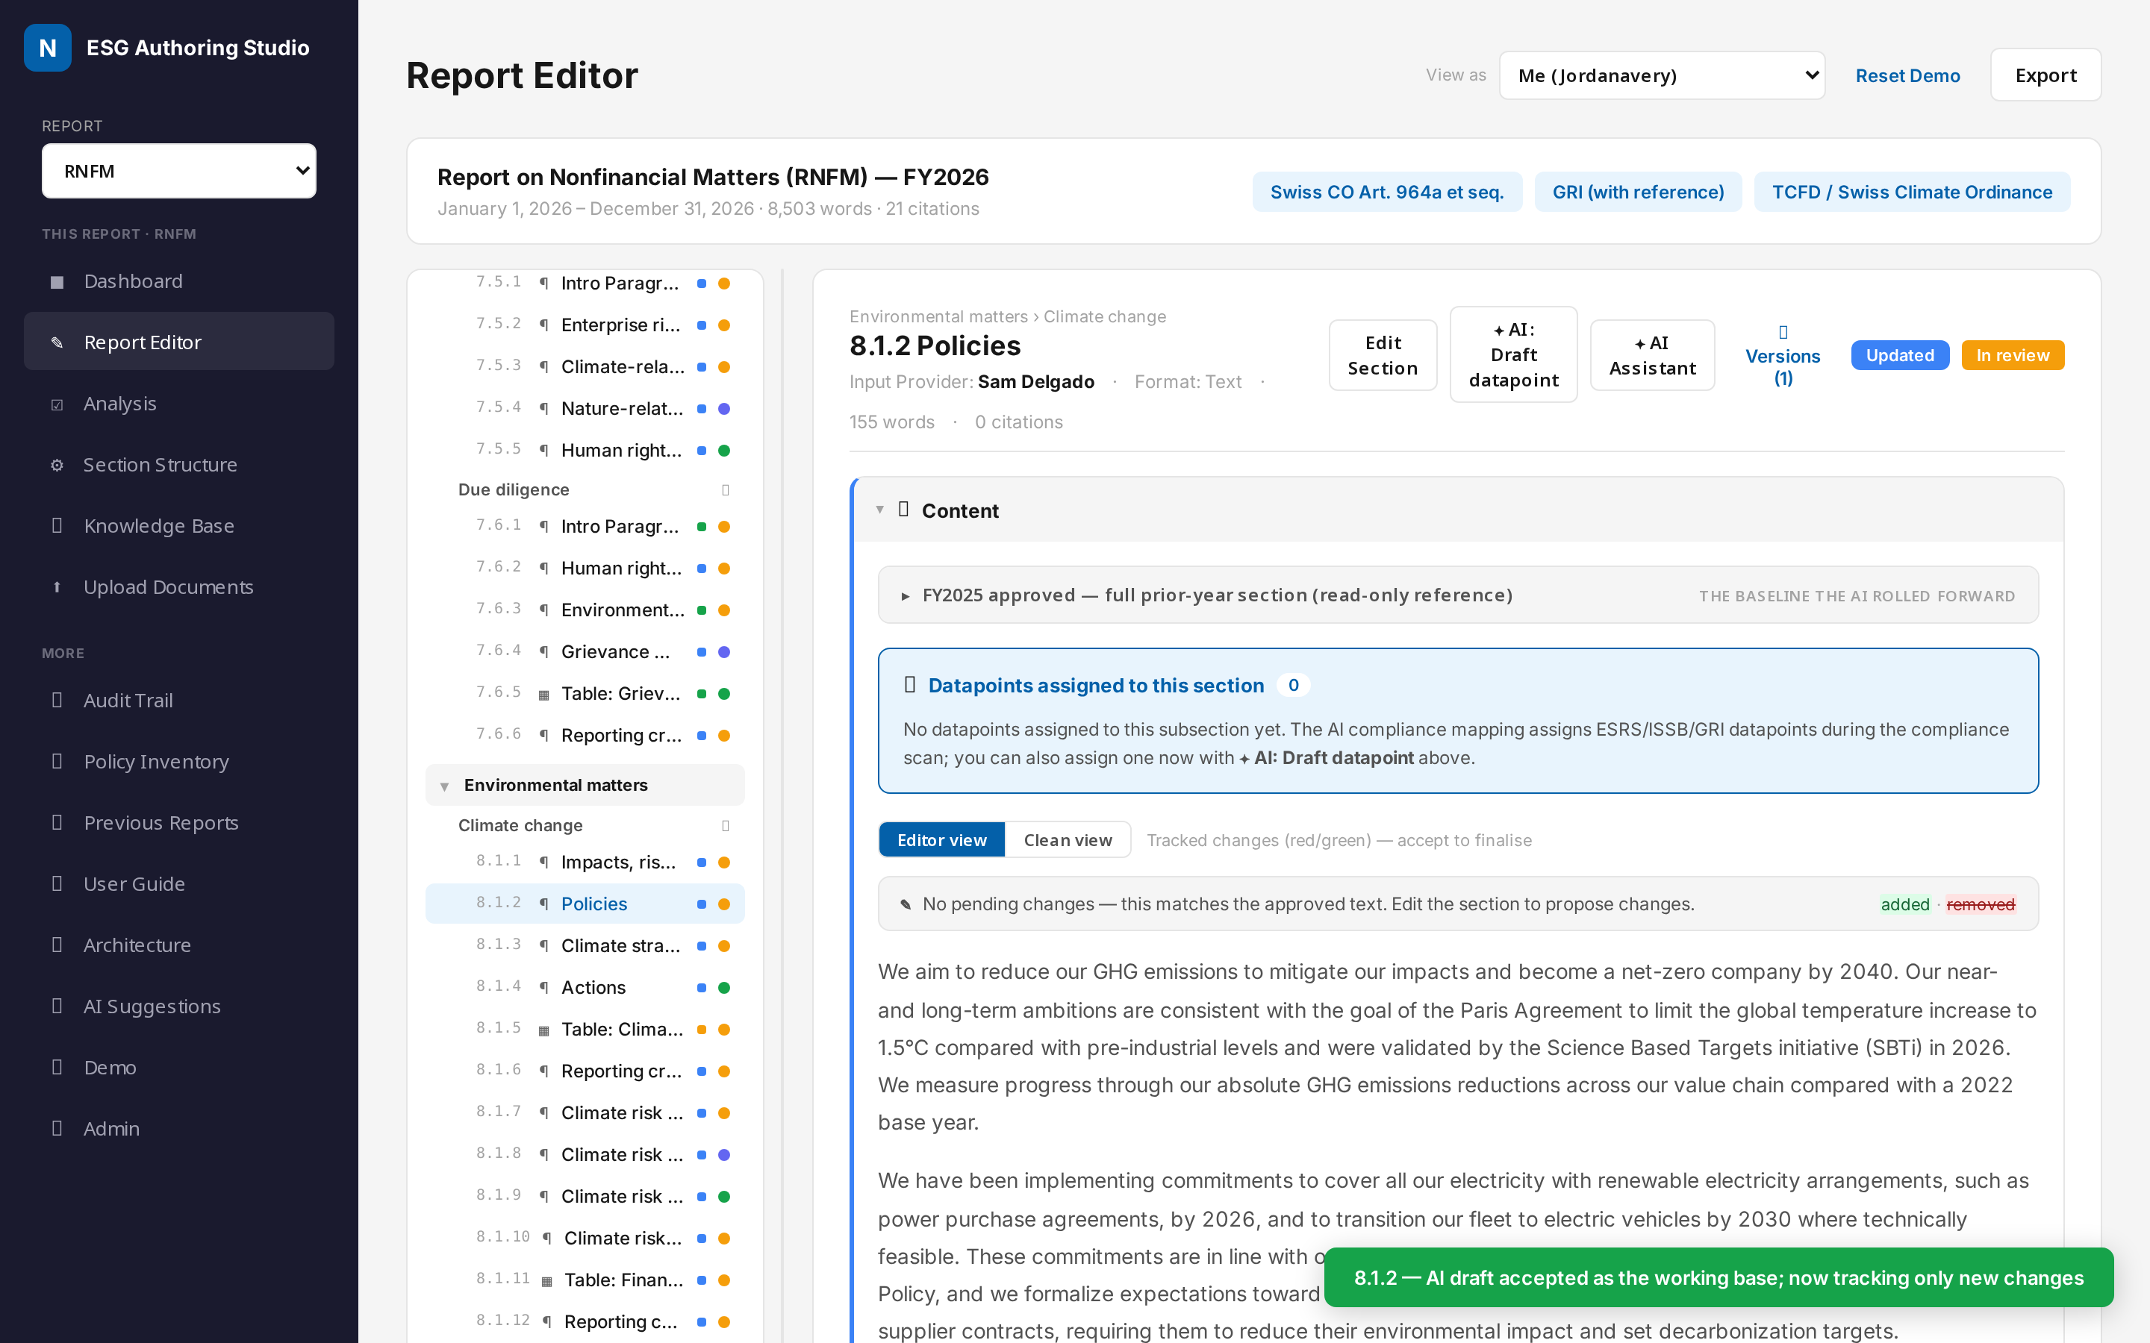
CAPABILITY · REVIEW
Tracked changes
WHAT THIS IS
Full-section inline redline of what the AI or a person changed.
HOW IT WORKS
The Editor view shows the whole section with edits marked inline; only the Editor role accepts/rejects. Clean view shows approved text only.
KEY POINTS
• Green = added, red = removed, shown in context.
• Unapproved edits never leak into the clean reading view.
• Every change is attributed and audit-logged.

Slide 8
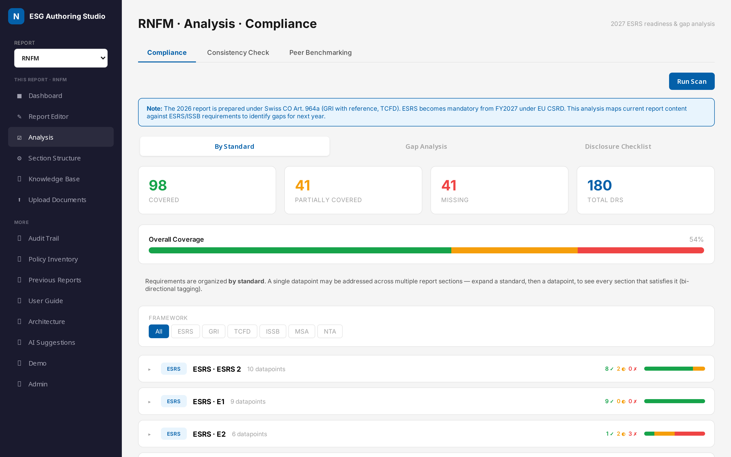
CAPABILITY · COMPLIANCE
2027 ESRS Readiness
WHAT THIS IS
A forward-looking gap analysis against future ESRS requirements.
HOW IT WORKS
Today's report is filed under Swiss CO Art. 964a; this overlay maps it to ESRS/ISSB/GRI/TCFD to show 2027 readiness by standard.
KEY POINTS
• Traffic-light coverage per disclosure requirement.
• Filter by framework and by materiality (DMA).
• AI-suggested fill text for partial / missing items.

Slide 9
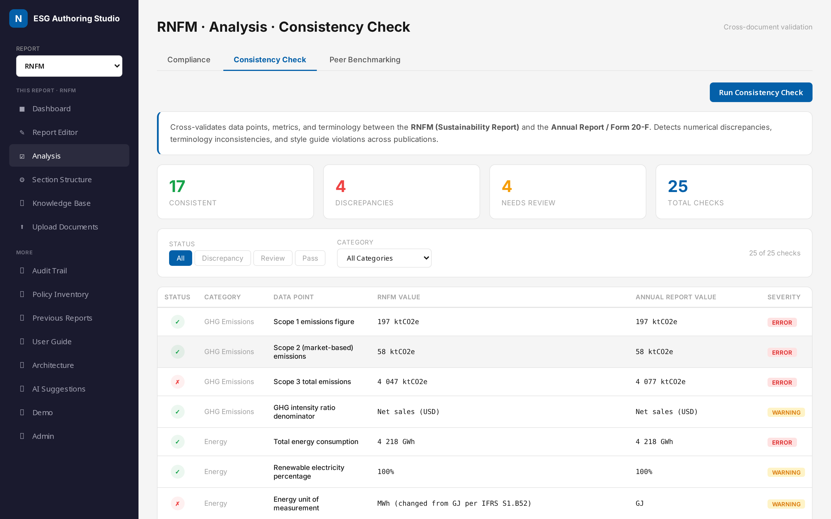
CAPABILITY · QUALITY
Consistency Check
WHAT THIS IS
Automated cross-document validation of the numbers and terms.
HOW IT WORKS
Compares figures and terminology across the RNFM and Annual Report and flags discrepancies for resolution.
KEY POINTS
• Catches Scope 3 totals, unit mismatches, terminology drift.
• Flags IFRS error corrections needing alignment.
• Quality assurance that manual review often misses.

Slide 10
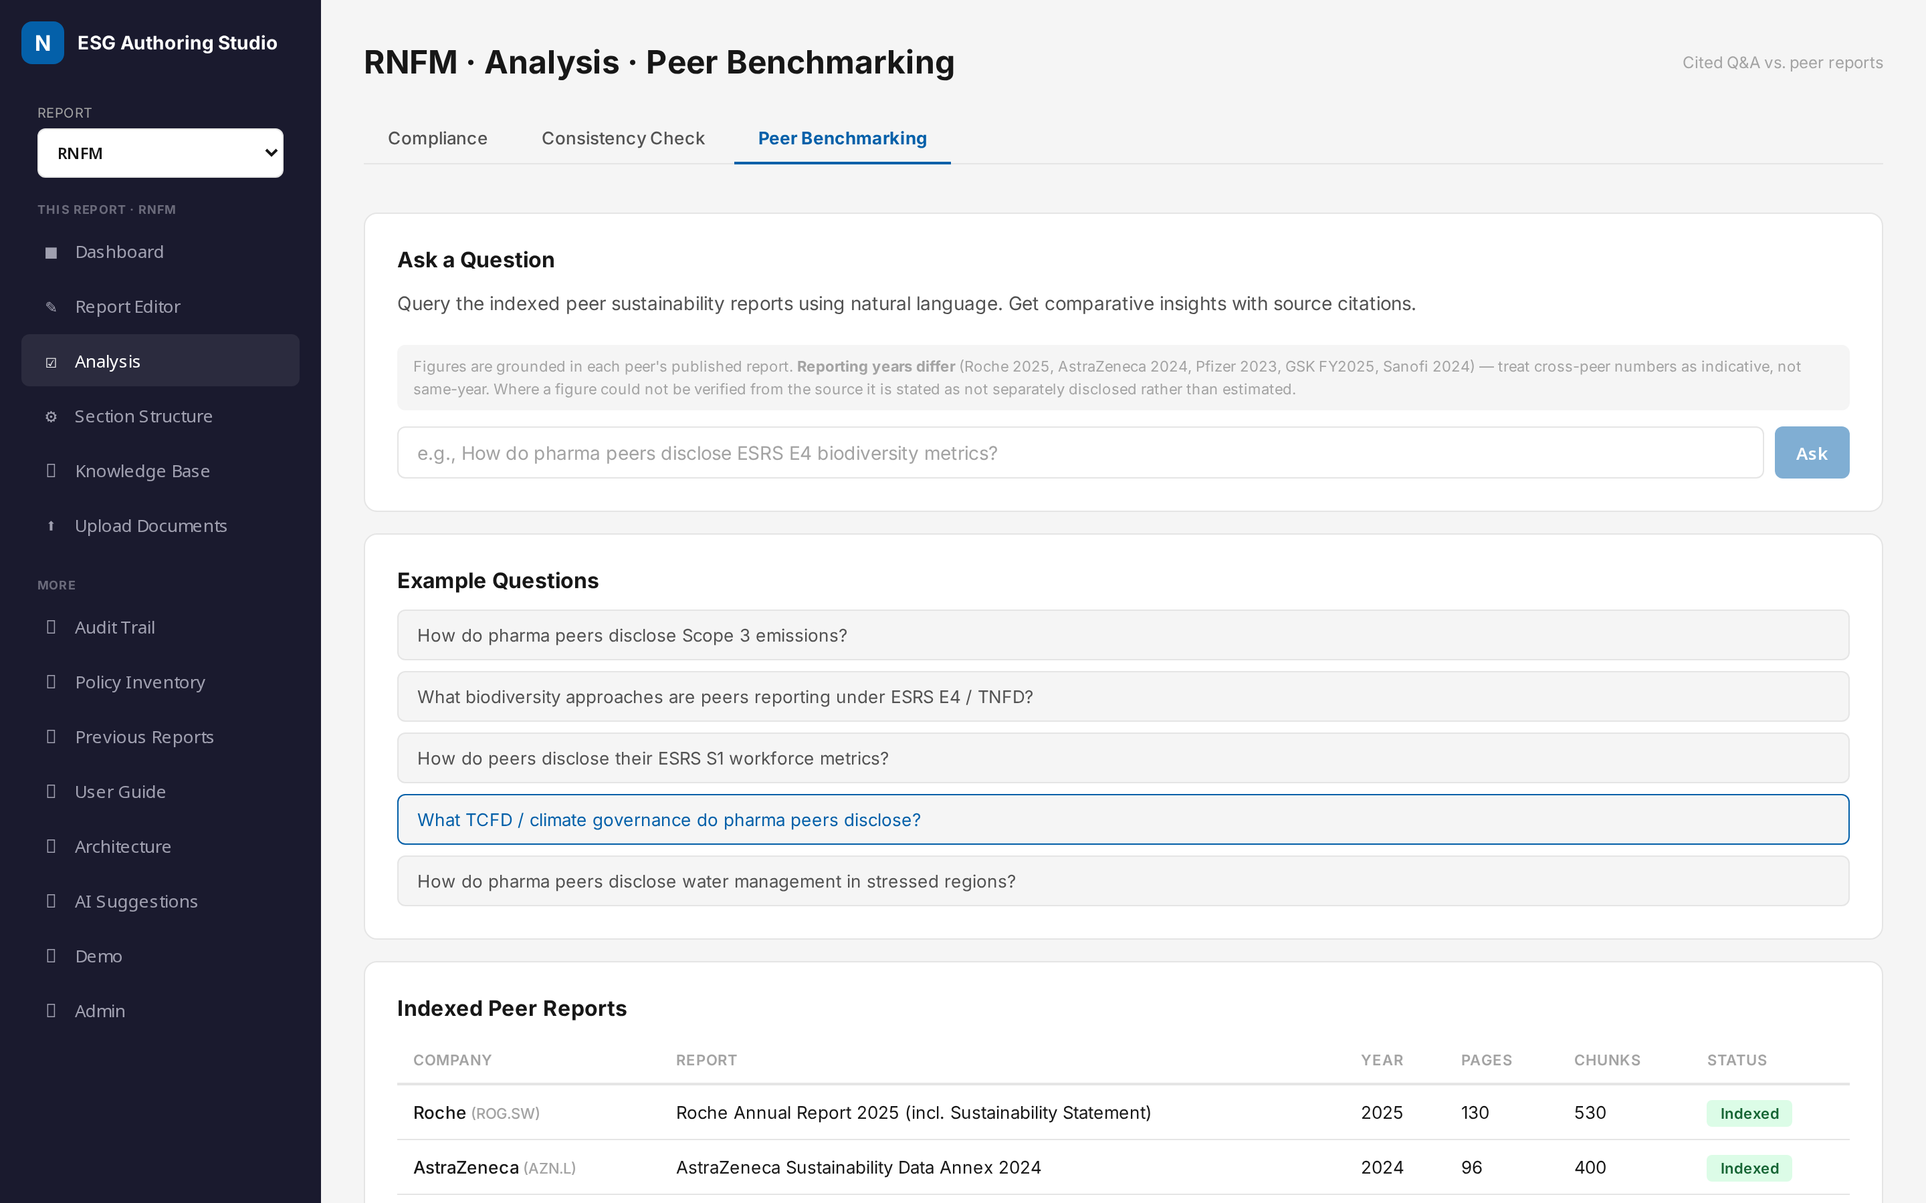
CAPABILITY · INSIGHT
Peer Benchmarking
WHAT THIS IS
Cited Q&A against indexed peer sustainability reports.
HOW IT WORKS
Ask a natural-language question; the AI retrieves from Roche, AstraZeneca, Pfizer, GSK and Sanofi reports and answers with citations.
KEY POINTS
• Evidence-based disclosure decisions before drafting.
• Every answer links to the peer report and page.
• Compare approaches on Scope 3, biodiversity, social KPIs.

Slide 11
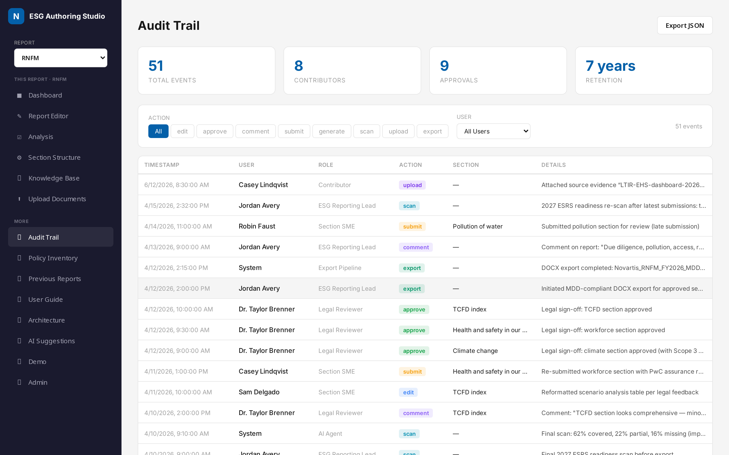
GOVERNANCE · EVIDENCE
Audit Trail
WHAT THIS IS
An append-only record of every action for assurance.
HOW IT WORKS
Edits, approvals, uploads, scans and exports are captured with user, timestamp and before/after snapshots — retained for seven years.
KEY POINTS
• Primary evidence source for external assurance.
• Nothing is overwritten silently.
• Full traceability from claim to source to sign-off.

Slide 12
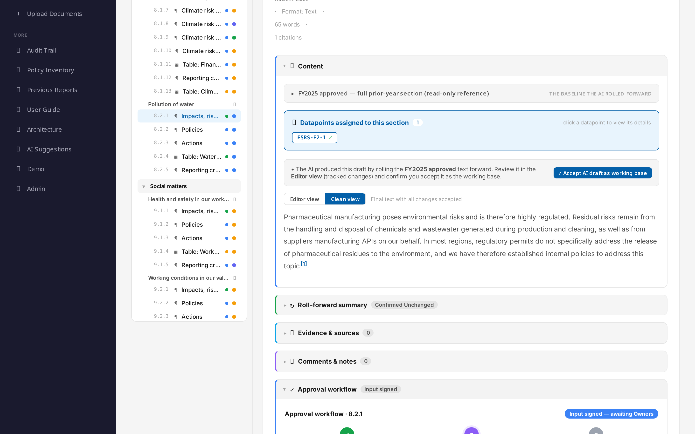
GOVERNANCE · SIGN-OFF
Approval Workflow
WHAT THIS IS
A visual stepper showing exactly where a section stands.
HOW IT WORKS
Input Provider → Owner → Legal, with per-step status and details. Legal sign-off is blocked while mandatory disclosures are missing.
KEY POINTS
• Two-level model: subsection (L3) then section (L2).
• Re-editing an approved section resets it for re-approval.
• Clear accountability at every step.

Slide 13
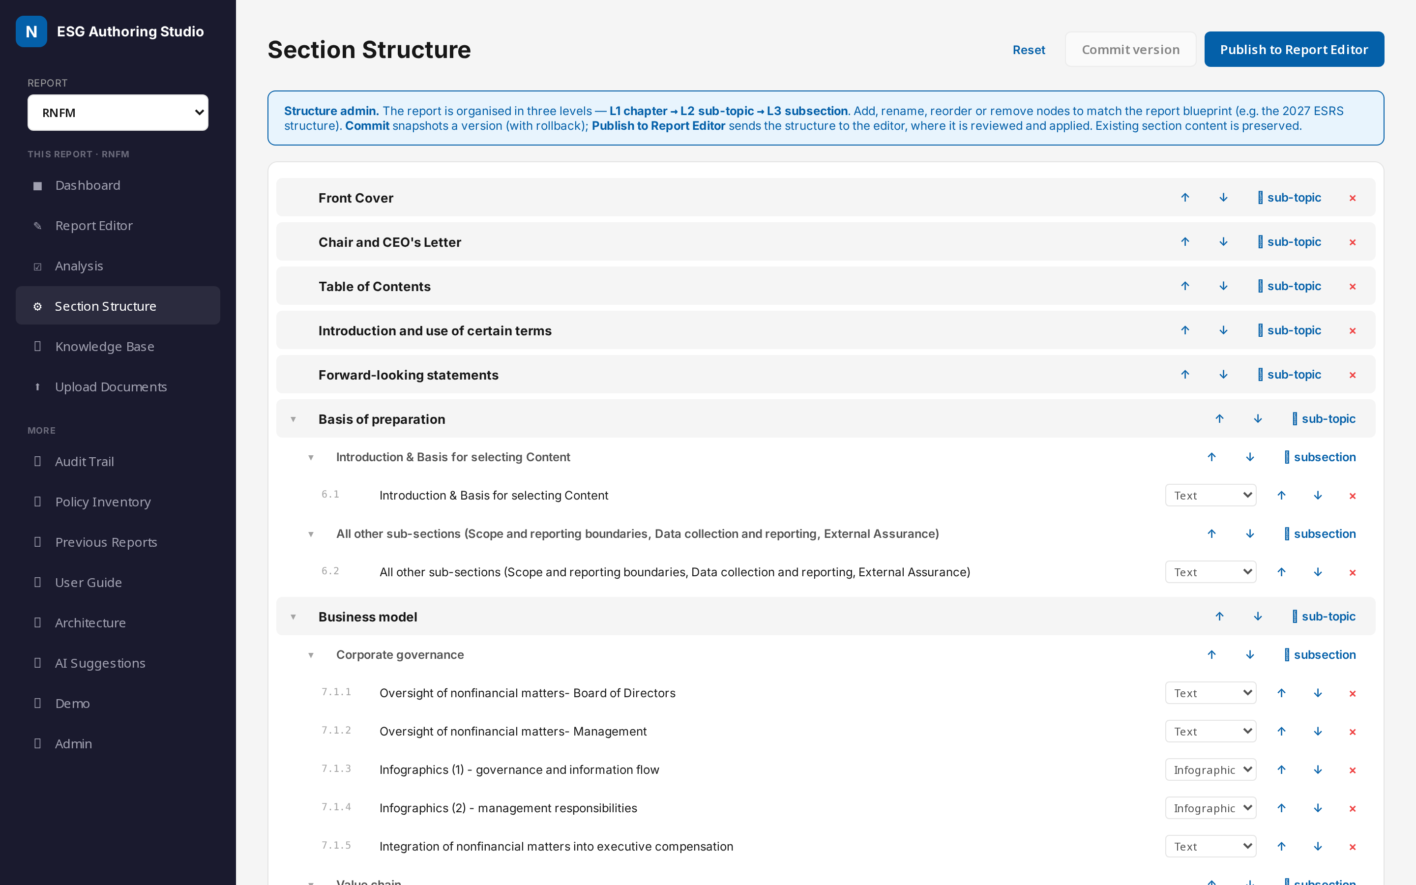
CAPABILITY · CONFIGURATION
Section Structure
WHAT THIS IS
Manage the report's chapter / sub-topic / subsection tree.
HOW IT WORKS
Add, rename, move or remove sections, then publish the structure to the editor with a reviewed, versioned change.
KEY POINTS
• Mirrors the customer's RNFM section breakdown 1:1.
• Publish is confirmed and version-tracked.
• Editor is notified and reviews before applying.

Slide 14
AI-assisted, human-governed, audit-ready
• 80%+ faster first-draft generation — from weeks to minutes.
• 100% citation traceability — every claim links to a source.
• Automated ESRS/ISSB gap detection ahead of the 2027 mandate.
• Governed workflow and immutable audit trail for assurance.

