Slide 1
BLUESTOCK FINTECH
Mutual Fund Analytics Platform
End-to-End Data Engineering, ETL Pipeline & Interactive Dashboard
Prepared by: Adib Shaikh Role: Data Analyst Intern Date: June 2026

Slide 2
THE PROBLEM & OBJECTIVES
THE CORE PROBLEMS
PROJECT OBJECTIVES
P1. Data Fragmentation: Mutual fund metrics split across disparate CSVs and APIs.
P2. Return-Only Evaluation: Core fund analysis neglects costs and risk limits.
P3. Lack of Benchmark Overlay: Active manager outperformance is rarely quantified.
P4. Investor Retention Blind Spot: Irregular SIP payers are not tracked or flagged.
P5. Reporting Delays: Processing and dashboard compilation take days, not seconds.
1. Build programmatic ETL pipeline for 10 datasets.
2. Normalise and store data in SQLite Star Schema.
3. Optimize database query times with 6 index keys.
4. Calculate 3yr CAGR, Sharpe, and Sortino risk ratios.
5. Quantify alpha/beta and tracking error vs benchmarks.
6. Model cohort size and SIP transaction gaps.
7. Integrate a risk recommender in Streamlit dashboard.
8. Export findings into visual final presentation decks.

Slide 3
10 REAL-WORLD DATASETS · 87,543 ROWS
TOTAL FUNDS
40 Schemes
TIME SCALE
4.5 Years
TRANSACTIONS
32,778 Rows
TOTAL DATABASE
87,543 Rows
Source Entity | Description | Scale / Coverage | Update Freq
AMFI India | Scheme AUM growth, total folio counts & Master records | 90 AMC rows, 48 SIP rows | Monthly
mfapi.in JSON API | Historical daily price data for 40 schemes | 46,000+ price points | Daily
NSE & BSE India | Benchmark closing index levels (Nifty50, Nifty100, etc.) | 8,050 index price rows | Daily
Simulated Transactions | Retail transactions (SIP, Lumpsum, Redemption) | 32,778 rows (5,000 investors) | N/A

Slide 4
5-LAYER SYSTEM ARCHITECTURE
1. INGESTION LAYER: Extract raw CSV file formats from AMFI and request daily live NAVs from JSON API endpoints.
2. PIPELINE ETL: Parse attributes using Python Pandas. Clean anomalies, forward-fill missing dates, and backfill YoY ratios.
3. SCHEMA STORAGE: Load normalised facts and dimensions into SQLite 3. Build 6 indexes on keys to optimize query execution.
4. ANALYTICS CORE: Calculate Sharpe, OLS alpha, and maximum drawdowns. Model cohort sizes and transaction gaps in notebooks.
5. DASHBOARD UI: Render results in Streamlit. Implement interactive filter settings, scorecards, and custom recommenders.

Slide 5
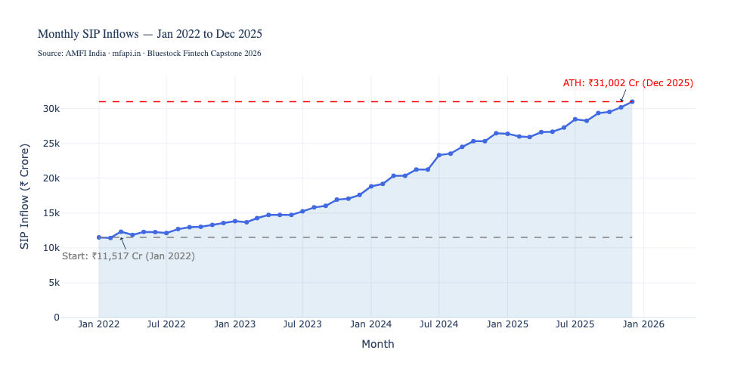
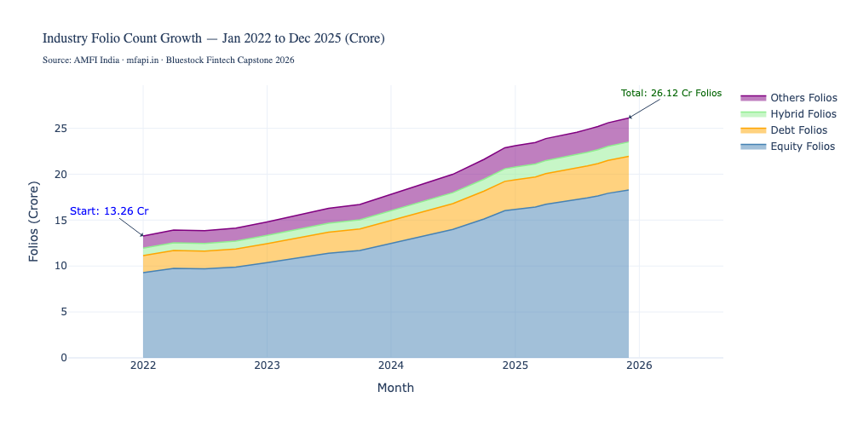
EDA HIGHLIGHTS: MARKET GROWTH & FOLIO EXPANSION
• Monthly SIP inflows grew 2.69x from Jan 2022 (₹11,517 Cr) to Dec 2025 (₹31,002 Cr) showing massive retail participation.
• Total industry folios doubled from 13.26 to 26.12 crore, driven almost entirely by retail equity folio expansion.
• The 26-35 age group represents the largest investor demographic segment, contributing 41% of all transaction volume.

Slide 6
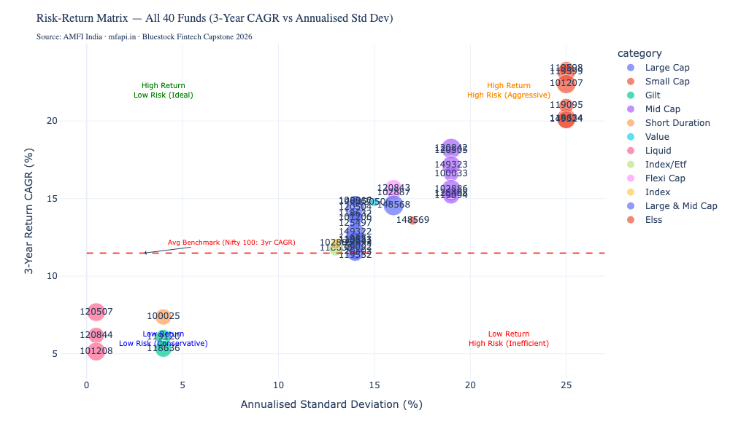
RISK-RETURN MATRIX & TOP FUND RANKS
TOP 5 SCORECARD PICKS (3yr)
Rank | Scheme Name | Category | Sharpe | Score
1 | SBI Small Cap Direct | Small Cap | 0.93 | 72.75
2 | Kotak Flexicap Regular | Flexi Cap | 0.85 | 71.50
3 | Mirae Asset Large Cap Reg | Large Cap | 1.06 | 70.25
4 | Quant Active Direct | Multi Cap | 0.89 | 69.10
5 | SBI Bluechip Regular | Large Cap | 0.88 | 68.45
• Small Cap schemes deliver top return rates (20-23% 3yr CAGR) but sit in the high-volatility quadrant.
• Liquid/Debt schemes sit in the bottom-left with low risk (VaR95 as low as -0.02% daily) and low return (5-7%).

Slide 7
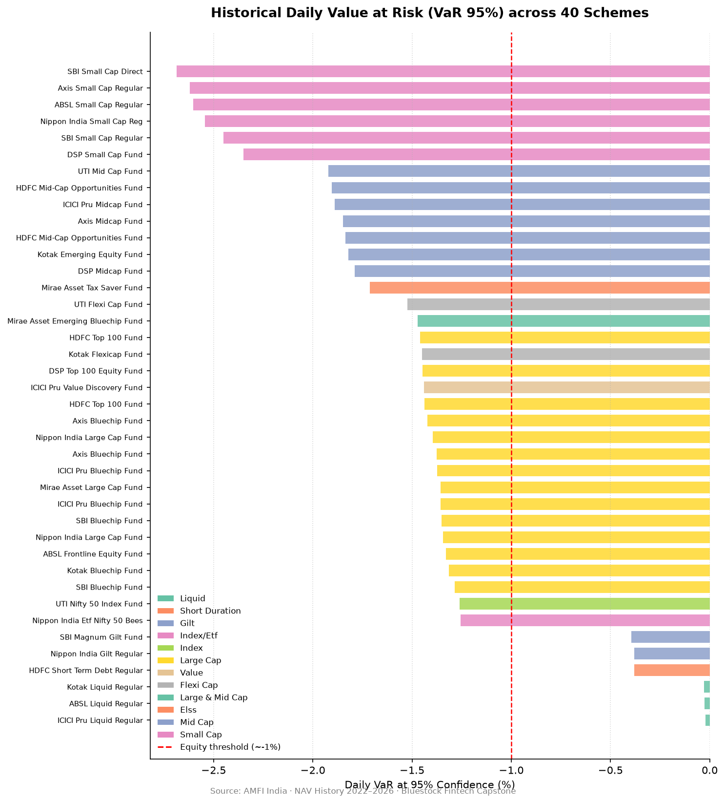
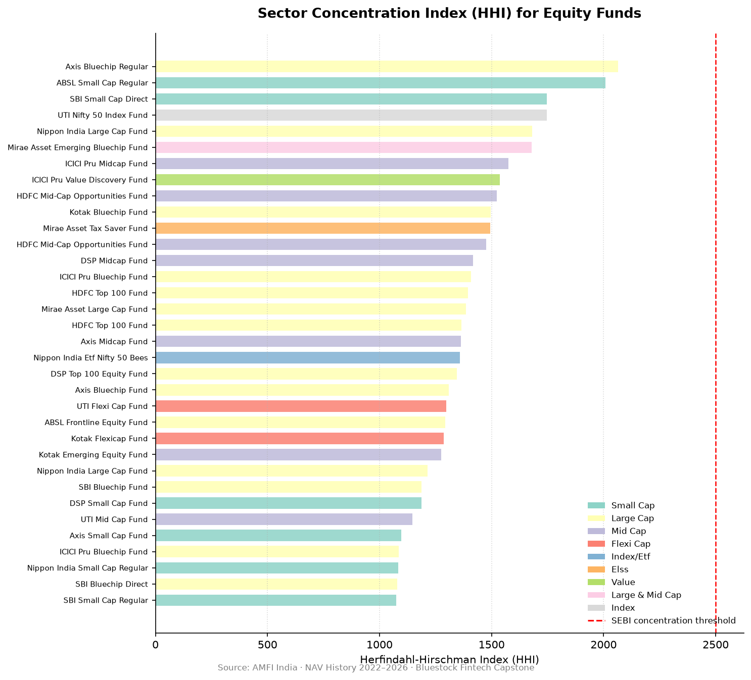
ADVANCED ANALYTICS & PORTFOLIO TAIL RISK
Tail Risk & Sector Concentration:
• Small Cap schemes carry 120x more daily tail risk than Liquid schemes (SBI Small Cap Direct daily VaR95 = -2.69%).
• HHI concentration analysis shows all 34 equity portfolios fall below SEBI's 2,500 threshold (Axis Bluechip leads at HHI 2,064).

Slide 8
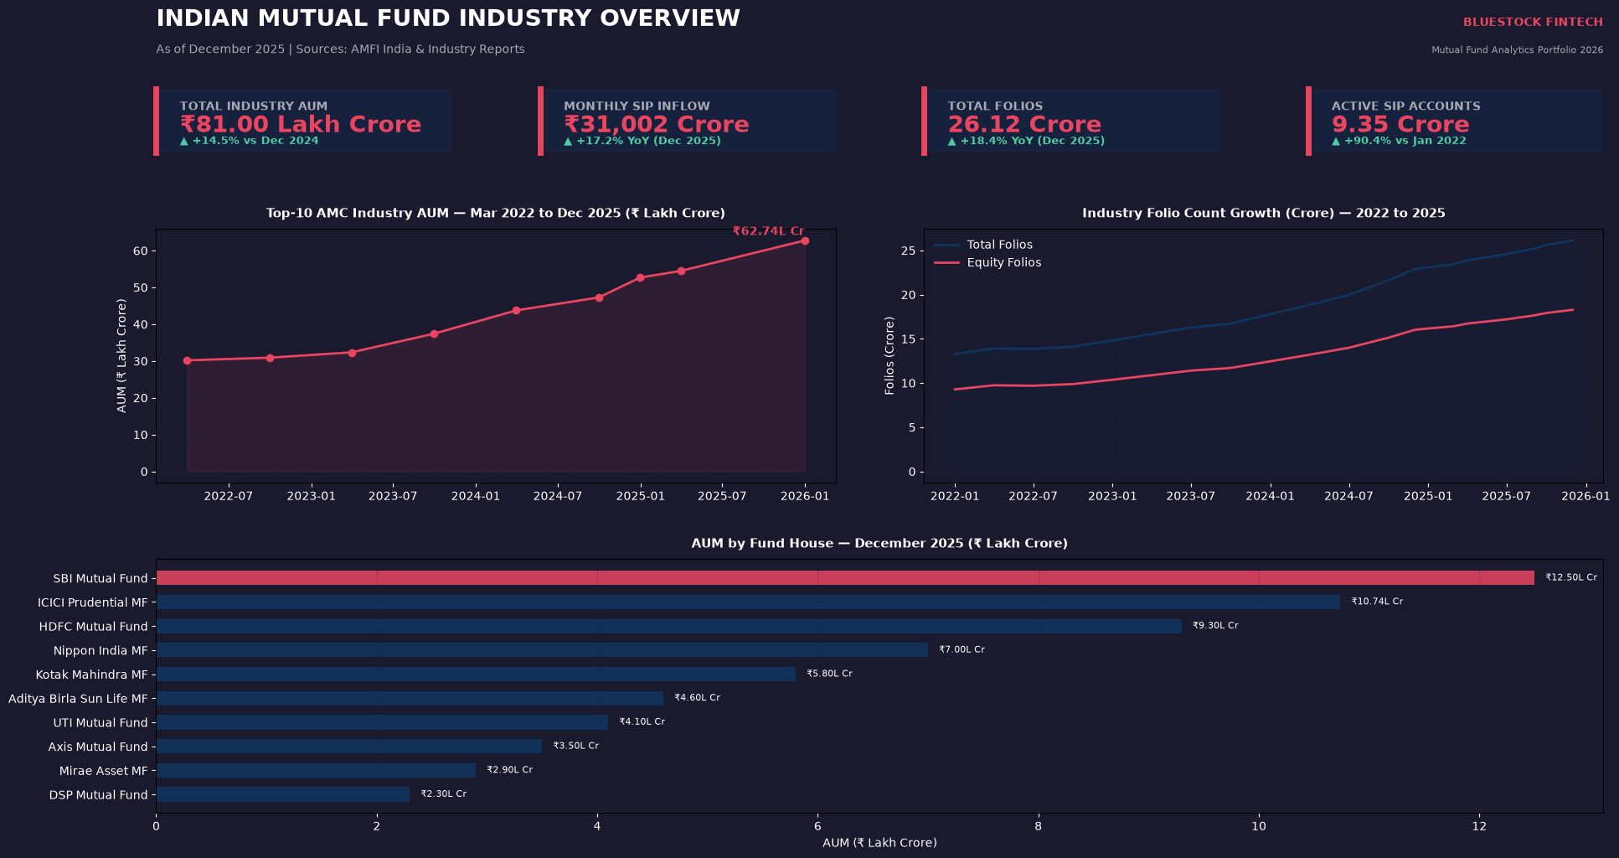
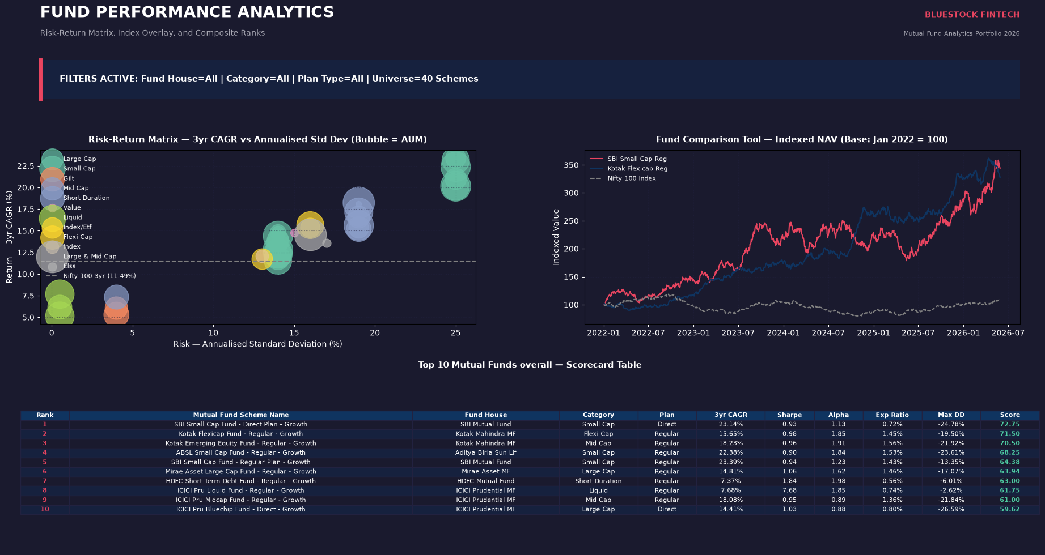
STREAMLIT INTERACTIVE ANALYTICS DASHBOARD
• Real-Time Interactive Web Application built using Streamlit and Plotly.
• 5 Subpages: Industry Overview | Fund Performance | Investor Analytics | SIP Trends | Fund Recommender
• Exposes live sidebar filters: State Selector & Date Range, alongside individual/multi-fund indexed comparisons.

Slide 9
BEHIND THE SCENES: TECHNICAL CHALLENGES
MAJOR HURDLES OVERCOME
• <b>Resampling NAV Gaps:</b> Resampling daily records to business-day schedule and ffilling gaps threw multiple index errors.
• <b>Sortino Downside Std Dev:</b> Took 3 tries to get the math right. Dividing by negative days instead of total N was a major trap.
• <b>ReportLab Flowables:</b> Margins were a complete nightmare! Balancing tables and charts to prevent overflow took ages.
• <b>Rate Limiting (429):</b> api.mfapi.in kept locking me out during rapid requests. Added retry loops with exponential backoff.
Note: ReportLab layout is very sensitive. Rebuilt python scripts multiple times to align tables. (Left in as a reminder to refactor later)

Slide 10
LESSONS LEARNED & RETROSPECTIVE
• <b>Database Normalization (3NF):</b> Denormalizing scheme performance data was a mistake that caused redundancy. Normalizing and using SQL JOINs was a great lesson.
• <b>Clean Ingestion:</b> Separating data retrieval (timeouts/retry limits) from report generation is crucial for stable data pipelines.
• <b>What Didn't Work:</b> Attempted to compile PDF tables dynamically from API data, but it crashed. Separated API fetch and DB loading for stability.
• <b>What I'd Do Differently:</b> If I had more time, I would write proper unit tests for metrics and configure a cloud database (RDS) instead of local SQLite.

Slide 11
10 KEY PROJECT FINDINGS
1. SIP monthly inflows grew 2.69x, peaking at ₹31,002 crore in December 2025.
2. Retail folios doubled (13.26 to 26.12 crore) driven entirely by equity mutual fund participation.
3. Small Cap schemes deliver top returns (23.39% 3yr CAGR) but carry 120x more daily risk than Liquid funds.
4. SBI Mutual Fund leads AMC assets at ₹12.50 lakh crore (19.8% market share of top-10 AMCs).
5. Liquid mutual funds dominated net category inflows in FY25, drawing ₹4,51,275 crore.
6. The 26-35 age group represents the largest investor demographic cohort (41% transaction count).
7. Average monthly SIP sizes are flat across all age cohorts (ranging ₹10,886 to ₹11,575).
8. T30 cities account for 65.9% of total SIP value, while B30 represents 34.1%.
9. Axis Bluechip has the highest sector concentration (HHI: 2,064) but remains below SEBI's 2,500 threshold.
10. 97.8% of SIP accounts with 6+ historic transactions are at-risk, exhibiting average gaps exceeding 35 days.

Slide 12
THANK YOU
Questions & Discussion
Built with Python · SQLite · Streamlit · Plotly
GitHub: github.com/shaikhadibbb/bluestock-mf-capstone Local Dashboard: streamlit run dashboard/app.py Data Sources: AMFI India · mfapi.in · NSE & BSE India

