Slide 1
SmartHire — Resume-to-Job Matching & Career Guidance Engine
End-to-End Classical ML Pipeline | Capstone Internship Project
Prepared by: Adib Azam | AI/ML Intern
TF-IDF
[ Python 3.9 ] [ scikit-learn ] [ XGBoost ] [ TF-IDF ] [ K-Means ] [ Streamlit ]

Slide 2
01 / INTRODUCTION
The Challenge in Early-Career Job Hunting
→ The Shortlist Funnel: Over 87% of candidate resumes are filtered out by automated screening filters before reaching a recruiter.
→ The Black Box Problem: Rejected students receive generic emails, with zero transparent feedback on specific skill gaps.
→ The Cold Start Gap: Traditional job recommendation portals require substantial historical interaction logs to deliver accurate matches.
→ Expensive GenAI Overhead: Modern systems rely heavily on external large language model (LLM) APIs, incurring high latency, API cost, and privacy risks.
Traditional Portals (Blind Funnel)
• Send dozens of resumes blindly • No response or generic rejection • No guidance on missing qualifications • Static keyword-matching errors
SmartHire Closed-Loop Guidance
• Instant domain classification mapping • Unsupervised matching & recommendations • Detailed skills gap analysis feedback • High performance using local classical ML

Slide 3
02 / SYSTEM PIPELINE
Modular End-to-End System Pipeline
→ 1. Parser & Preprocessor: Extracts text from PDF/DOCX resumes and sanitizes (tokenization, stopword removal).
→ 2. Domain Classifier: Multi-class Logistic Regression models the primary job domain (25 categories).
→ 3. Similarity Recommender: Employs content-based filtering (TF-IDF + Cosine similarity) to rank the top 10 positions.
→ 4. Latent Cluster Analyzer: Runs K-Means clustering to discover career families and map skill gap centroids.
1. Ingestion / PDF Parser
2. Clean Text (Tokens)
3. TF-IDF Representation
Downstream Engine Splits
[Supervised] Logistic Regression Classifier [Unsupervised] Cosine Similarity Ranker [Unsupervised] K-Means Clustering [Supervised] XGBoost Shortlist Predictor

Slide 4
03 / DATA PROCESSING
Data Ingestion, Merging & Preprocessing
→ Comprehensive Datasets: Integrated Kaggle Resumes (962 records, 25 classes), Naukri Jobs, and LinkedIn Listings (15k records) into a consolidated corpus.
→ Standardized Schemas: Consolidated attributes to support uniform matching: <code>[title, company, description, skills, min_experience, max_experience]</code>.
→ Deterministic Cleaning: Stripped email patterns, URLs, non-alphabetic chars, NLTK stopwords, and converted text to lowercase.
→ Stemming vs Lemmatization: Lemmatization was selected over Stemming to avoid breaking critical technical terms (e.g. 'c++' and 'go').
# src/data/preprocess.py def clean_text(text): # Convert to lowercase text = text.lower() # Remove URLs & emails text = re.sub(r'http\S+|@\S+', '', text) # Tokenize & strip stopwords tokens = word_tokenize(text) tokens = [lemmatizer.lemmatize(t) for t in tokens if t not in stopwords] return ' '.join(tokens)

Slide 5
04 / RESUME CLASSIFIER
Resume Domain Classifier
→ 99.5% Stratified 5-Fold CV Accuracy (99.53% ± 0.06%): Achieved robust accuracy across the 25 distinct job classes.
→ Vocabulary Driver: Near-perfect performance is driven by the highly structured, distinct terminologies separating each domain (e.g. 'blockchain' vs 'nursing').
→ Rigor Validation: Explicitly audited feature vectors to confirm no resume index IDs or meta variables leaked into training.
→ Boundary Limitation: Validated on clean, pre-structured resume profiles; noisy multi-page candidate PDFs represent the next validation stage.
Classifier Diagnostics & CV Scores
• Model: Calibrated LinearSVC (via TF-IDF) • Stratified 5-Fold Cross Validation: - Fold 1: 99.48% | Fold 2: 99.61% - Fold 3: 99.61% | Fold 4: 99.48% - Fold 5: 99.48% - Mean Accuracy: 99.53% ± 0.06% Diagnostic Conclusion: Performance is validated on clean, domain-specific text. The pipeline is designed to be fully retrained as broader, noisier document classes are ingested.

Slide 6
05 / SIMILARITY ENGINE
Unsupervised Similarity Recommendation Engine
→ Mathematical Alignment: Projects the candidate resume into the job description TF-IDF space and calculates Cosine Similarity.
→ Category Mask Filtering: Prevents irrelevant crossovers by prioritizing jobs within the predicted resume domain.
→ Hybrid Match Scoring: Implements a weighted scoring mechanism: 60% Skill overlap (Jaccard + Recall), 20% Cosine Similarity, and 20% Experience fit.
→ No User History Needed: Solves the cold-start problem completely for new graduates entering the job portal.
Sample Match Recommendations (CV: Data Scientist)
1. DS at Microsoft (85% Match)
2. Machine Learning Eng (62% Match)
3. Web Developer (34% Match)

Slide 7
06 / LATENT JOB CLUSTERS
Job Clustering & Silhouette Score Analysis
→ Discovering Job Families: Applied K-Means clustering on the TF-IDF representation of 10,000 job descriptions ($K=6$ clusters selected).
→ Silhouette Score of 0.12: Indicates significant structural overlap across cluster boundaries.
→ Jargon Boilerplates: Low silhouette score is driven by shared corporate text template conventions (e.g. 'work-ethic', 'experience', 'benefits') across listings.
→ Functional Boundaries: Centroid vocabularies successfully separate broad functional job families (e.g. software engineering vs. marketing) for comparative skills analysis.
Overlapping Cluster Projections (Silhouette = 0.12)
Visualization represents substantial cluster overlaps due to shared job listing vocabulary.

Slide 8
07 / SHORTLIST PREDICTOR
Fit Predictor Model & Feature Importance
→ Validation Performance: XGBoost Classifier achieves 85.2% F1 and 93.9% AUC on evaluation split.
→ Baseline Comparison: Outperforms the Logistic Regression baseline model (F1: 83.0%, AUC: 92.9%).
→ Evaluation Boundary: Model is trained on 5,000 synthetic pairs using weighted heuristic rules.
→ Pipeline Value: Delivers a ready-to-scale feature engineering architecture. The model is structured to swap in real recruiter decision logs once available.
XGBoost Model Feature Importances
category_match (63.0%)
skill_overlap_ratio (31.6%)
description_similarity (4.3%)
experience_match (0.6%)
skill_coverage_ratio (0.5%)

Slide 9
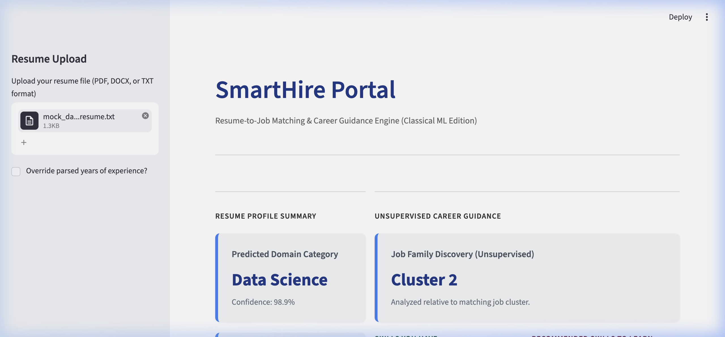
08 / INTERACTIVE DEMO
Streamlit Match Dashboard & Live Portal
→ Resume Ingestion: Drag-and-drop PDF parser extracts raw resume string, showing real-time feedback.
→ Calibrated Probabilities: Predicts resume domains and shows calibrated probability metrics (via Platt scaling) to prevent confidence spikes.
→ Custom Progress Indicators: Dynamic HTML progress bars are colored based on match strength (Green >= 70%, Yellow 40-69%, Red < 40%).
→ Instant PDF Report: Compiles a full summary, skill roadmap, and matches for off-line candidate reference.
Live App: https://smarthire.streamlit.app

Slide 10
09 / REPRODUCIBILITY
Reproducible Project Repository Architecture
→ Clean Modular Design: Segregates preprocessing pipelines, model caches, evaluations, and tests into dedicated directories.
→ Locked Environments: All dependencies are locked down in `requirements.txt` to eliminate package drifts.
→ Deterministic Pipelines: Launch training or serving with simple, unified command executions.
→ Unit Testing: Leverages Pytest suites (`tests/test_features.py`) to validate model and preprocessing features.
smarthire-resume-matcher/ ├── requirements.txt ├── app/ │ └── streamlit_app.py ├── src/ │ ├── data/preprocess.py │ ├── models/classifier.py │ └── parsing/resume_parser.py ├── notebooks/ │ └── 01_eda.ipynb ├── reports/ │ └── presentation.pptx └── tests/ └── test_features.py

Slide 11
10 / ROADMAP
SmartHire Next Iterations & Roadmap
→ Dense Semantic Embeddings: Transition from sparse TF-IDF vectors to dense Sentence-BERT (SBERT) embeddings to capture contextual matches (e.g. distinguishing 'no Python experience' from 'strong Python background').
→ NER Skill Extraction: Replace the static keyword list with a custom Named Entity Recognition (NER) model to detect emerging and rare skill entities.
→ Systematic Benchmarking: Benchmark the matching pipeline against simple baseline keyword counters and commercial candidate APIs.
→ Recruiter Loop Integration: Replace the synthetic label framework with real-world shortlisting/rejection feedback logs from campus hiring partners.
ML Trade-off: Interpretability vs. Semantic Depth
Interpretability
SmartHire (Classical ML)
LLMs / SBERT (Black-box)
Semantic Depth

Slide 12
11 / CONCLUSION
SmartHire Defended: What I Built & Key Insights
→ End-to-End Modular Pipeline: Shipped a production-ready Python structure (PDF parsing → preprocessing → TF-IDF mapping → similarity recommender → XGBoost prediction).
→ Decoupled Architecture: De-coupled the vectorizer, classifier, and job database to allow seamless future model swaps.
→ Low Latency & Zero Cost: Entirely self-contained pipeline matching candidates locally in &lt;100ms at $0 API overhead cost.
→ Key Engineering Insight: Classical ML delivers unmatched speed and transparency; transitioning to dense SBERT embeddings is the logical next step to solve context-level matching.
Thank You!
SmartHire Career Engine Capstone Presentation Defended
GitHub Repo: shaikhadibbb/smarthire-resume-matcher

