Slide 1


Voice-Genie AI
A smart, voice-powered assistant that transforms natural speech into meaningful actions — hands-free, intelligent, and built for the future of human-computer interaction.
VOICE AI
PROTOTYPE

Slide 2
What VoiceGenie Does
VoiceGenie AI uses speech recognition and Natural Language Processing (NLP) to understand user intent and execute real-world tasks through simple voice commands.
🌐 Web Automation
🎬 Movie Recommendations
Open YouTube, Google, and other sites instantly with a voice command.
Get personalized movie suggestions powered by real-time API data.
🕐 Real-Time Info
💳 Banking Simulation
Display time, date, and real-Time information.
Simulate demo banking operations and financial tasks through natural speech.

Slide 3
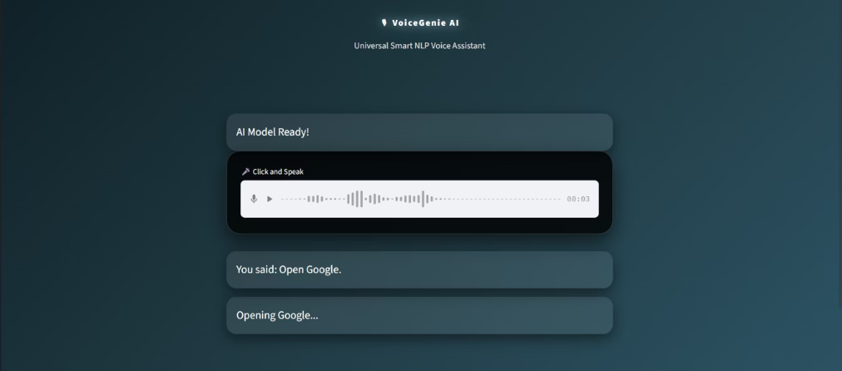

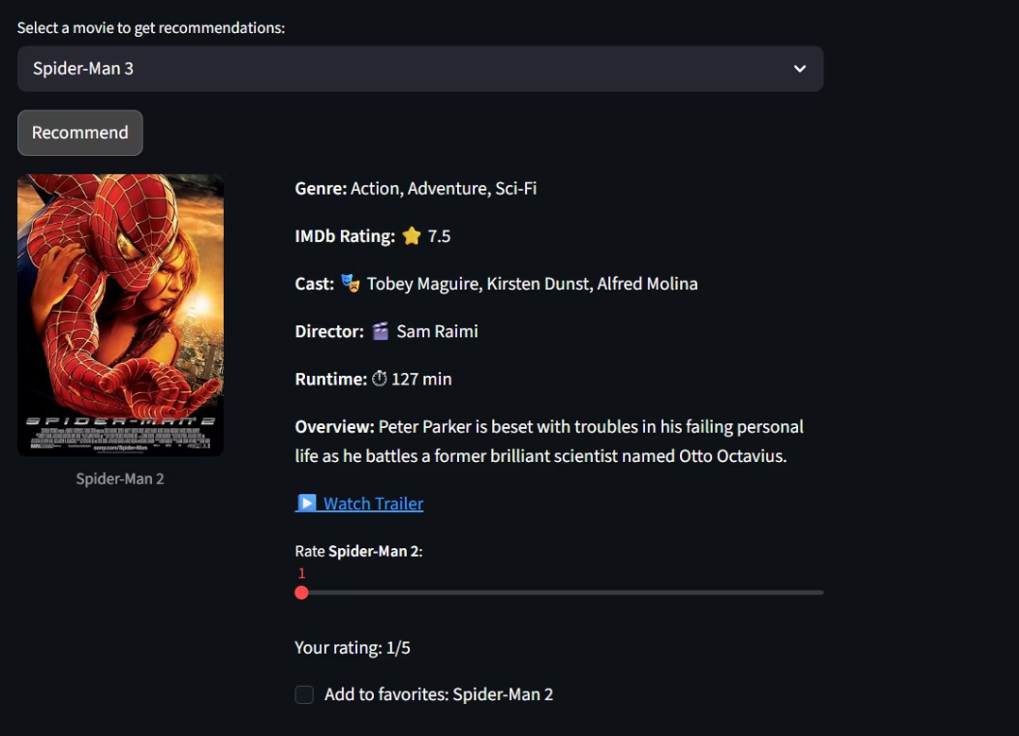
Key Feature
Intent-to-Action Conversion
Speech-to-Text Conversion
Opening websites (YouTube, Google)
Displaying time and date
Greeting! hi , hello
The recorded audio is processed using the Whisper model
which converts speech into text with high accuracy.
Redirecting to a movie recommendation system
Recommendation Engine
Genres , Cast , Overview
User selects a movie name
Movie poster & watching Trailer

Slide 4
Technical Approach
Rule-Based NLP
implement
We use rule-based NLP where user input text is matched with predefined keywords to detect intent.
Check for keywords like:
YouTube, Google , Movie , Time , Date , Balance Check.
Match → Assign intent → Action
Uses Whisper AI for speech-to-text conversion
Built with Python + Stream-lit for UI and interaction
Integrates ML (movie recommender) + API for enhanced features
Fetches extra details (poster, rating, etc.) using OMDB API
The system uses content-based filtering
cosine similarity for recommendations
Movies are loaded from a preprocessed local dataset using pickle
keyword-based intent detection - Voice To Text → Action
The ML model analyzes movie features and recommends similar movies based on similarity
integrates the OMDB API to fetch real-time movie details.

Slide 5
Future Scope
VoiceGenie's vision extends beyond the prototype — toward a complete AI-powered personal assistant for daily life and financial management.
Live Banking APIs
1
Real transaction support with secure, voice-authenticated banking.
Voice Authentication
2
Biometric voice recognition for enhanced security and fraud detection.
Conversational AI
3
Advanced NLP for natural, human-like multi-turn dialogue.
Mobile & Wearable
4
Deployment on smartphones and smartwatches for on-the-go access.

