Slide 1

SMART INDIA HACKATHON 2026
HARVESTIQ — Intelligent Solar Cold Storage
Decentralized Solar Preservation & Last-Mile Cold-Chain Technology for Smallholder Farmers
OFFICIAL SUBMISSION DETAILS
PROBLEM & REGIONAL CHALLENGE (NER)
Problem Statement ID: 26005
The Northeast Perishable Value Chain Bottleneck (Root-Cause Chain):
Problem Statement Title: Solar-Powered Smart Mini Cold Storage System for Fresh Vegetables in North Eastern Region (NER)
1. FRESH HARVEST
Field picking
➔
2. HIGH PERISHABILITY
Rapid decay
➔
3. NO LOCAL COLD CHAIN
Decentralized gap
➔
4. POWER INTERRUPTIONS
Grid deficit
Theme: Agriculture, FoodTech & Rural Development
↳ ➔
5. HILLY TRANSIT
Slow connectivity
➔
6. FORCED EARLY SALE
Buyer distress
➔
7. VALUE LOSS
Income erosion
PS Category: Hardware
• High Vegetable Perishability
Fresh vegetables respire rapidly after harvest. In warm, humid climates, loss of moisture and nutrient decay degrades marketable quality within 24–48 hours without immediate cooling.
• Difficult NER Terrain & Transport
Hilly topography, scattered smallholdings, and vulnerable road networks severely delay farm-to-market transit, turning short distances into multi-day transit bottlenecks.
Team Name: HarvestIQ
Team ID: [Registered on Portal]
PROJECT POSITIONING & ARCHITECTURE
• Unreliable Rural Grid Electricity
Remote rural and hilly farming pockets experience frequent power outages or complete off-grid conditions, making conventional AC compressor cold rooms unfeasible.
• Distress Selling & Loss of Value
Lacking accessible decentralized cold storage close to the farm, smallholders are forced into immediate distress selling at buyer-dictated low prices to avoid complete spoilage.
• Core Positioning: Bringing intelligent, solar-powered preservation closer to the farmer through a compact, modular and IoT-enabled system.
• Strategic Gap: Existing cold-storage systems address bulk storage. HarvestIQ focuses on the last-mile preservation gap between harvest and the larger cold chain.
• Prototype Tech: 20–40 L Chamber • 100W Solar PV + LiFePO4 Battery • Peltier Thermoelectric Cooling • ESP32 Multi-Sensor Telemetry
CORE PROJECT OBJECTIVE
“Preserve freshness closer to the farm and give farmers greater flexibility in when to sell.”
Visual Flow: Farmer ➔ Fresh Harvest ➔ Solar Energy ➔ HarvestIQ Storage ➔ Transport ➔ Fair Market Value

Slide 2
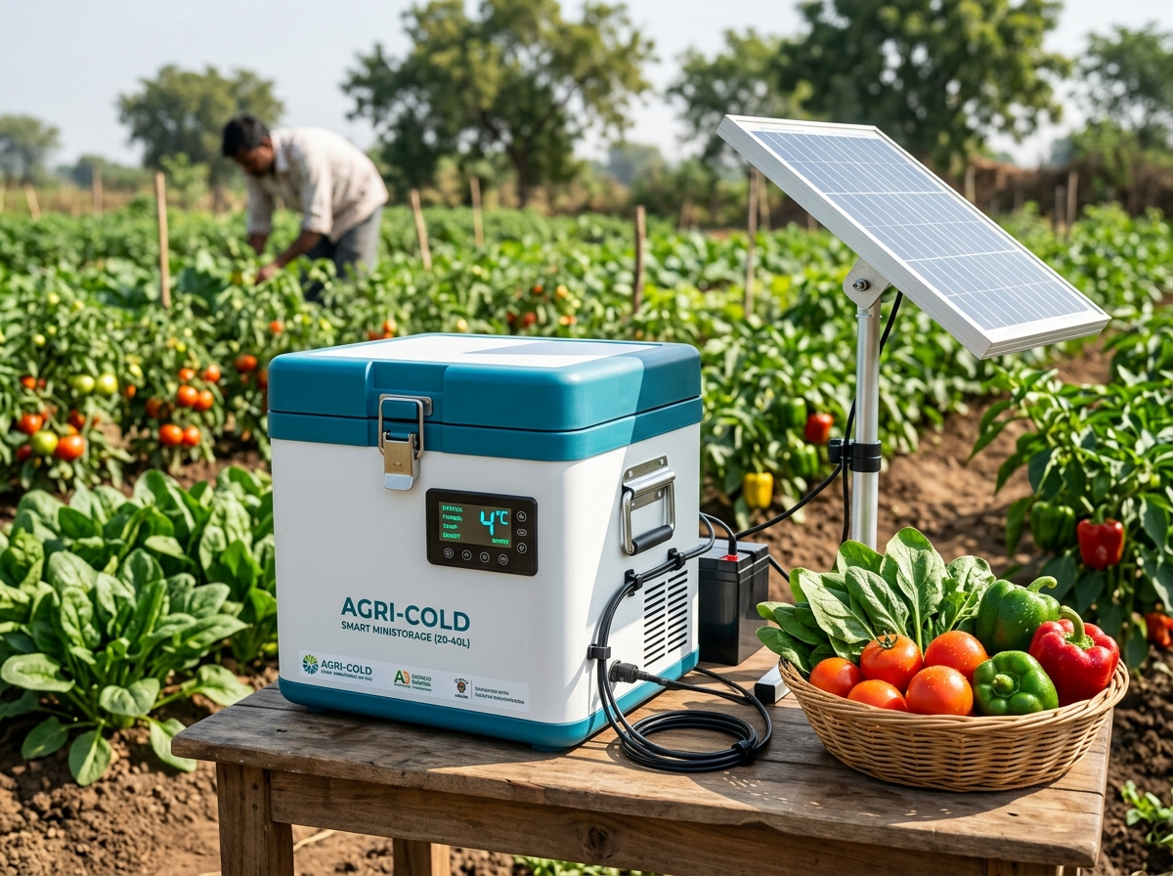
HARVESTIQ — THE PROPOSED SOLUTION
HarvestIQ
Decentralized, Solar-Powered Micro-Preservation Addressing the Last-Mile Cold Chain Gap
PRODUCT CONCEPT & PROTOTYPE PILLARS
COMPACT
20–40 L farm-level portable cold chamber designed for smallholder harvest batching.
SOLAR POWERED
100W Solar PV + LiFePO4 battery backup for 100% off-grid reliability.
SMART CONTROL
ESP32 microcontroller automating closed-loop cooling and thermal stability.
IoT MONITORING
Multi-parameter telemetry: chamber temperature, humidity, door status & battery.
FARMER INTERFACE
Simple local indicators, mobile dashboard alerts & proactive anomaly warnings.
• Solid-state Peltier-based cooling maintains suitable storage conditions for the compact prototype.
HarvestIQ Farm-Gate Micro Solar Cold Storage Concept
EXISTING INFRASTRUCTURE
Large / bulk cold-storage infrastructure and centralized compressor facilities. High capital cost, grid-reliant, and situated far from remote hilly farmsteads.
THE UNADDRESSED GAP
Small & marginal farmers need a compact, accessible preservation layer right at harvest / collection points for short-term (24–72h) buffer storage before transit.
HARVESTIQ SOLUTION
Compact (20–40L) + 100% Solar DC + LiFePO4 battery + Solid-state Peltier + ESP32 edge control + Multi-sensor IoT telemetry.
STRATEGIC DIFFERENTIATION: “Not replacing large cold rooms — filling the last-mile preservation gap.”
INNOVATION & SYSTEM UNIQUENESS
1. Decentralized Farm Architecture
Micro-storage situated directly at farm level for immediate post-harvest heat removal.
2. 100% Off-Grid Solar + Battery
Dedicated DC power bus with LiFePO4 battery buffer eliminating grid dependence.
3. Multi-Parameter Sensing Suite
Real-time telemetry of temp, humidity, door ajar status, and battery state of charge.
4. Automated Edge Cooling Control
Autonomous ESP32 firmware executes local hysteresis cooling logic without internet latency.
5. Proactive Alerting System
Instant buzzer & mobile notifications for prolonged door openings or thermal deviations.
6. Crop-Specific Storage Profiles
[Proposed / Future Intelligence] Target temperature & humidity presets tailored for specific crops.
7. Predictive Pre-Cooling
[Proposed / Future Intelligence] Energy-aware pre-cooling scheduled during peak solar hours.

Slide 3
TECHNICAL APPROACH
HarvestIQ
System Architecture, Closed-Loop Control Logic & Solid-State Thermal Management
END-TO-END SYSTEM ARCHITECTURE & DATA FLOW
PATHWAY A: HARDWARE & ENERGY FLOW (100% Off-Grid Dedicated DC Architecture)
☀ SOLAR PV
100W Monocrystalline
➔
MPPT CHARGER
High-efficiency buck
➔
LiFePO4 BATTERY
12V 20–40Ah pack
➔
DC POWER BUS
Regulated 12V/5V rail
➔
PELTIER MODULE
TEC1-12706 unit
➔
INSULATED BOX
PUF chamber 20–40L
➔
FRESH PRODUCE
4–8°C storage hold
PATHWAY B: SENSING, EDGE CONTROL & IoT TELEMETRY FLOW (Closed-Loop Edge Execution)
SENSORS ARRAY
Temp, RH, Door, Power
ESP32 CONTROLLER
Dual-core FreeRTOS logic
MOSFET DRIVER
PWM cooling modulation
ALERTS & BUZZER
Local LED + Audio alarm
IoT DASHBOARD
Cloud / Wi-Fi / 4G telemetry
FARMER MONITORING
Mobile alerts & historical logs
➔
➔
➔
➔
➔
TECHNOLOGY LAYERS & CLOSED-LOOP CONTROL
SOLID-STATE THERMOELECTRIC PRINCIPLE
• HARDWARE LAYER: 100W Solar PV, MPPT charge controller, 12V LiFePO4 battery, Peltier module (TEC1-12706), internal fan, external extruded heatsink + 120mm exhaust fan, ESP32 MCU, DS18B20 temp probe, SHT31 humidity sensor, reed door switch, INA219 power telemetry.
• SOFTWARE & FIRMWARE: Embedded C/C++ (ESP-IDF / Arduino core), FreeRTOS dual-task execution, MQTT & HTTP REST protocols, responsive web IoT dashboard.
STORAGE CHAMBER
Enclosed 20–40L insulated space
COLD SIDE PLATE
Absorbs heat from storage chamber
PELTIER MODULE
TEC solid-state heat pump transfer
HOT SIDE BASE
Conducts rejected thermal energy
CLOSED-LOOP WORKFLOW: INPUT ➔ PROCESS ➔ DECISION ➔ OUTPUT ➔ FEEDBACK
INPUT: Continuous sensor acquisition: chamber temperature, ambient RH, door contact, and battery voltage/current.
PROCESS: ESP32 firmware evaluates real-time sensor readings against crop target setpoint band (4–8°C) and battery low-voltage threshold.
DECISION: Is chamber temp > Setpoint + Hysteresis? Is battery charge safe (>11.5V)? Is chamber door securely closed?
OUTPUT: Actuate PWM power MOSFET to power Peltier & fans; trigger audio-visual buzzer if door ajar; push telemetry to cloud.
FEEDBACK: Continuous 5-second polling loop provides closed-loop regulation, preventing thermal overshoot and battery over-discharge.
HEATSINK + FAN
Forced-air heat dissipation to outside
• Technical Principle: The Peltier module transfers heat via the thermoelectric Seebeck/Peltier effect rather than creating cold.
• Thermal Isolation: Cold side actively absorbs heat from chamber; hot side rejects heat externally to ambient air via high-CFM exhaust — hot air is NEVER directed into the storage chamber.
Commercial Note: For larger-capacity commercial variants, the refrigeration technology can be selected according to the required thermal load, while retaining the IoT/control architecture.

Slide 4
FEASIBILITY AND VIABILITY
HarvestIQ
Technical Viability, Operational Practicality, Economic Model & Defensible Risk Mitigation
A. TECHNICAL FEASIBILITY
B. OPERATIONAL FEASIBILITY
C. ECONOMIC & COST MODEL
• COTS Availability: Built entirely from commercially available off-the-shelf components (PV panels, battery, MCU, sensors).
• Proven Embedded Control: ESP32 multi-sensor telemetry, FreeRTOS logic, and PWM switching are mature and field-proven.
• Established Solar Tech: Monocrystalline PV + LiFePO4 chemistry provides dependable, safe off-grid energy storage.
• Thermoelectric Status: Peltier cooling is being evaluated for the compact prototype through thermal characterization.
• Critical Thermal Factors: High-density PUF insulation and efficient hot-side heat dissipation are primary design determinants.
• Farmer-Centric UI: Simple local indicators (LED/Buzzer) and intuitive multilingual mobile dashboard requiring zero tech training.
• Low Maintenance: Solid-state thermoelectric module contains zero mechanical compressors, belts, or refrigerant piping to service.
• True Off-Grid Autonomy: Direct solar daytime operation with LiFePO4 battery buffer sustains continuous 24-hr cooling.
• Automated Anomaly Alerts: Real-time notifications for door-ajar, high temperature, or low battery level prevent produce loss.
• Deployment Flexibility: Designed for individual farm-gate placement or shared Farmer Producer Organization (FPO) hubs.
ESTIMATED PROTOTYPE COST: ₹25,000
Targeted low-cost prototype architecture; commercial pricing requires field validation and production costing.
• Energy Subsystem (~48%): 100W Solar PV + MPPT + 12V LiFePO4 battery pack.
• Enclosure & PUF (~20%): Insulated 20–40L box, seals, and aluminum cold-plate.
• Control & Sensors (~10%): ESP32 MCU, DS18B20, SHT31, INA219, and wiring.
• Peltier Cooling Kit (~8%): TEC1-12706 module, extruded heatsink, and dual fans.
• Assembly & Spares (~14%): Connectors, protective enclosure, and hardware.
• Commercial Outlook: Commercial production cost to be determined after pilot-scale engineering and bulk sourcing.
D. RISKS & ENGINEERING MITIGATION MATRIX
EMPIRICAL VALIDATION FRAMEWORK
1. High Ambient Heat & Peltier Efficiency Drop: Peltier cooling performance decreases as ambient temperature and hot-side temperature increase. — ✔ Mitigation: High-density multi-layer PUF insulation + oversized extruded heatsink with high-CFM external exhaust fan.
2. Battery Degradation over 3–5 Years in Rural Conditions: Frequent deep discharge cycles degrade standard lead-acid batteries. — ✔ Mitigation: High-cycle LiFePO4 chemistry (2000+ cycles) with integrated BMS low-voltage cutoffs.
3. Sensor Calibration Drift in High Field Humidity: Moisture in NER climate can corrode exposed electronic sensors. — ✔ Mitigation: Sealed IP67 waterproof DS18B20 stainless temperature probes + conformal coating on PCB.
4. Seasonal Monsoon / Cloudy Solar Variations: Extended cloud cover reduces daily solar energy harvesting. — ✔ Mitigation: Sized LiFePO4 energy reserve + adaptive energy-aware cooling logic with dynamic hysteresis.
5. Thermal Shock from Fresh Warm Produce: Loading field-hot vegetables creates a sudden thermal spike. — ✔ Mitigation: Internal circulation pre-cooling and staggered batch-loading guidelines for farmers.
6. Farmer Digital Literacy & Adoption Resistance: Smallholders may hesitate to use complex smartphone applications. — ✔ Mitigation: Autonomous local edge control (cooling operates without app) + simple multilingual voice/LED alerts.
CURRENTLY DEMONSTRATED (Prototype Architecture):
✔ End-to-end solar PV, MPPT, battery, and DC power bus integration.
✔ ESP32 multi-sensor telemetry (temperature, humidity, door, power).
✔ Automated closed-loop hysteresis cooling control logic & low-voltage protection.
✔ Live web IoT dashboard demonstration with real-time alert dispatch.
PLANNED LAB & FIELD VALIDATION STEPS:
• Chamber pull-down time from ambient to target setpoint (4–8°C).
• Steady-state temperature maintenance & recovery after door openings.
• Internal relative humidity stability (85–95% RH) for leafy vegetables.
• 24-hr watt-hour energy consumption & LiFePO4 battery autonomy duration.
• Cooling performance under varying ambient temperatures (25°C to 40°C).
• Shelf-life extension and produce weight retention across vegetable varieties.

Slide 5
IMPACT AND BENEFITS
HarvestIQ
Socio-Economic Value Creation, Post-Harvest Preservation & Sustainable Micro-Cold-Chain
FARM-TO-MARKET VALUE JOURNEY
1. FARM HARVEST
Picked at peak freshness
2. HARVESTIQ STORAGE
Immediate pre-cooling buffer
3. PRESERVED QUALITY
Moisture & freshness held
4. MARKET TIMING
Avoid distress sales
5. VALUE CREATION
Higher net farmer profit
➔
➔
➔
➔
FIVE PILLARS OF MEASURABLE VALUE
FARMER EMPOWERMENT
• Greater autonomy over harvest buffer storage.
• Reduced dependence on immediate distress sales.
• Enhanced bargaining power with traders.
ECONOMIC VALUE
• Potential reduction in post-harvest physical loss.
• Opportunity to time sales for peak market rates.
• Accessible modular micro-capex model.
RURAL ACCESSIBILITY
• Designed for remote, hilly NER geographies.
• 100% off-grid; zero rural grid dependence.
• Simple multilingual interface for rural farmers.
SUSTAINABILITY
• 100% solar powered; zero operational emissions.
• No chemical refrigerants (CFC/HFC) in prototype.
• Reduces food waste, saving water & resources.
DATA & VISIBILITY
• Real-time multi-parameter telemetry & logging.
• Automated closed-loop edge thermal control.
• Proactive mobile alerts for temperature & door.
MEASURE IN PILOT: TARGET VALIDATION METRICS
FUTURE INTELLIGENCE ROADMAP [Proposed Capabilities]
*Rigorous evidence-driven approach — establishing empirical benchmarks during field trials rather than unsupported claims:
• Pull-Down Time: Hours required to achieve 4–8°C storage setpoint under rated crop thermal load.
• Temperature Stability: Chamber thermal variation margin (±0.5°C) under fluctuating ambient temperatures.
• Energy Consumption: Average 24-hour watt-hour (Wh) energy profile under full solid-state cooling cycle.
• Battery Autonomy: Sustained operating hours achieved solely on LiFePO4 storage during overcast days.
• Shelf-Life Improvement: Measured extension in marketable days compared to ambient control samples.
• Spoilage Reduction: Quantified reduction in produce physical decay and post-harvest weight loss.
IoT Telemetry
Real-time microclimate & energy data collection
Data Analytics
Storage patterns, decay trends & baseline profiling
Shelf-Life Prediction
AI estimation of remaining marketable produce days
Demand-Aware Storage
Market-coordinated cooling & dispatch scheduling
“From cold storage hardware to an intelligent micro-cold-chain platform.”

Slide 6
RESEARCH AND REFERENCES
HarvestIQ
Prior Art Benchmarking, Scientific Literature, Institutional Sources & Defensible Conclusion
RESEARCH FOUNDATION & BENCHMARKING
INSTITUTIONAL & SCIENTIFIC REFERENCES
1. PUSA FARM SUNFRIDGE (Benchmark Inspiration):
• Developed by Dr. Sangeeta Chopra (IARI) in collaboration with Michigan State University.
• Off-grid, solar-powered farm cold storage facility demonstrating the fundamental viability of decentralized solar preservation for smallholders.
• System Differentiation: Pusa SunFridge is a larger (~1–2 tonne) farm-level cold room; HarvestIQ targets a compact (20–40L) micro-storage unit with battery buffer, solid-state cooling, and IoT monitoring for individual smallholders and quick harvest batching.
• Core Benchmark Positioning: “Existing solutions validate the need for decentralized solar-based preservation; HarvestIQ focuses on a compact, IoT-enabled micro-storage architecture.”
2. POST-HARVEST AGRONOMIC RESEARCH:
• Rapid field heat removal is the single most critical agronomic factor in suppressing vegetable respiration and moisture transpiration.
• Hilly Northeast logistics necessitate immediate decentralized pre-cooling at the farm gate before multi-day transit.
[1] NITI Aayog Frontier Tech: “Solar-Powered Cold Storage: A Sustainable Solution for India's Agricultural Sector.” (frontiertech.niti.gov.in)
[2] NITI Aayog Frontier Tech: “Reimagining Cold Chains: Tech-Driven Storage Solutions for India’s Perishable Agriculture.” (frontiertech.niti.gov.in)
[3] Inclusive IAS: “Issues with Transportation of Agricultural Produce in India: Infrastructure Bottlenecks.” (inclusiveias.com)
[4] Times of India: “From Farm to Fork: Rethinking India’s Cold Chain Architecture.” (timesofindia.indiatimes.com)
[5] ICAR Literature: “Guidelines for On-Farm Cooling and Handling of Perishable Horticultural Crops.” (icar.gov.in)
PROJECT TEAM & ACADEMIC MENTORSHIP
• Team Members: Sk Aman (Team Leader), P. Gopi Chand, P. Uday Kiran, K. Manu Vidya, S. Greeshma, G. Naveen Kumar
• SIH Academic Mentor: Dr. B. Satya Sri, Professor – Department of ECE
DEFENSIBLE CONCLUSION & EXECUTION ROADMAP
1. PROBLEM: Smallholders in remote, hilly NER lack decentralized preservation, causing rapid spoilage & distress sales.
2. SOLUTION: HarvestIQ integrates 100% solar PV, LiFePO4 battery, solid-state Peltier cooling, ESP32 intelligence & IoT telemetry.
3. EVIDENCE: Prototype architecture, edge control, and telemetry workflow demonstrated; thermodynamic pull-down and field trials are the defined validation steps.
4. IMPACT: Protects produce quality, grants farmers market timing flexibility, and establishes an accessible micro-cold-chain layer.
5. RECOMMENDATION: Proceed to thermal characterization → farmer pilot in NER clusters → optimization → scalable deployment.
PHASED IMPLEMENTATION ROADMAP
NOW
Prototype & Thermal Testing: Characterize pull-down rate & steady-state COP
NEXT
Field Pilot & Farmer Trials: Validate in real NER farming cluster with user feedback
THEN
Optimization & Sourcing: Optimize insulation k-value, battery capacity & BOM cost
FUTURE
Intelligent Micro-Cold-Chain: Scale modular units with predictive cloud shelf-life AI
“Preserve Freshness. Choose When to Sell. Create Better Value.”

