Slide 1







Future-Proofing: Analyzing Survey Data to Identify Tomorrow's Skills
Arif Shaikh
28th March, 2023

Slide 2



OUTLINE
Executive Summary
Introduction
Methodology
Results
Visualization – Charts
Dashboard
Discussion
Findings & Implications
Conclusion
Appendix

Slide 3

EXECUTIVE SUMMARY
Present and Future of Tech
Current technologies Preferred
Future Technology Trend
Demographics
Tech Enthusiastic per country
Gender gap in jobs
Age Group using the Tech most

Slide 4

INTRODUCTION
Aim : Analyzing the Trends in Technologies
Research Questions Answered :
Which Programming Languages are in Demand?
What are Popular Databases in Market?
Platforms and Web-Frames Preferred by Users
Audience : Stakeholders, Technical & Human Resource Team
End-Goal: Keep Pace with Changing technologies, Emerging Skills and Remain Competitive

Slide 5

METHODOLOGY
Data Collection
Job Postings
Training Portals
Surveys
Data Wrangling
Exploratory Data Analysis
Data Visualization
Dashboard Creation
Presentation of Findings

Slide 6

RESULTS
The Survey Dataset from Stackoverflow was Analysed and Visualization created are included further to help organisation to take data-driven decision
There are 11552 responses
It has 85 columns or features

Slide 7
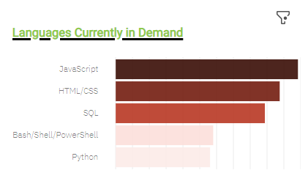
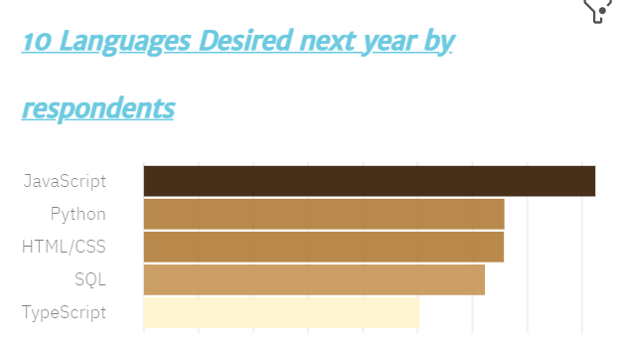
PROGRAMMING LANGUAGE TRENDS
Current Year
Next Year

Slide 8
PROGRAMMING LANGUAGE TRENDS - FINDINGS & IMPLICATIONS
Findings
JavaScript, HTML/CSS, SQL will sustain its positions for next few years
Python and Typescript has high chances of becoming popular next year
PowerShell drops from Top Charts next year
Implications
Web development Skills are still in high demand
Big Data technology in companies still requires SQL
With AI and ML in rising demand, Python is best choice

Slide 9
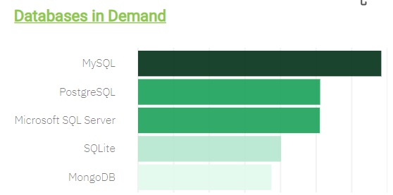
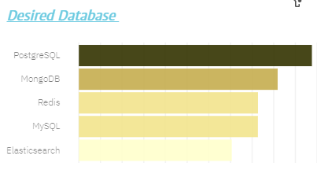
DATABASE TRENDS
Current Year
Next Year

Slide 10
DATABASE TRENDS - FINDINGS & IMPLICATIONS
Findings
MySQL most popular
Microsoft SQL popularity Decreases
MongoDB and Redis are upcoming favorites
Emerging Database: Elasticsearch
Implications
Open-source databases like SQL, SQLite are still preferable in companies
NoSQL databases will make an impact for storing non-relational data
Redis supports abstract data types

Slide 11

DASHBOARD
Link To Cognos Dashboard:
https://eu-de.dataplatform.cloud.ibm.com/dashboards/eb9cd316-8d74-40c4-aefe-2037e908416f/view/517ba63f01bd35d656c5f6e407982d537c34260eb0bbd70481847b4909357197a93845c5c82d195fdd115064a2be170cc8

Slide 12
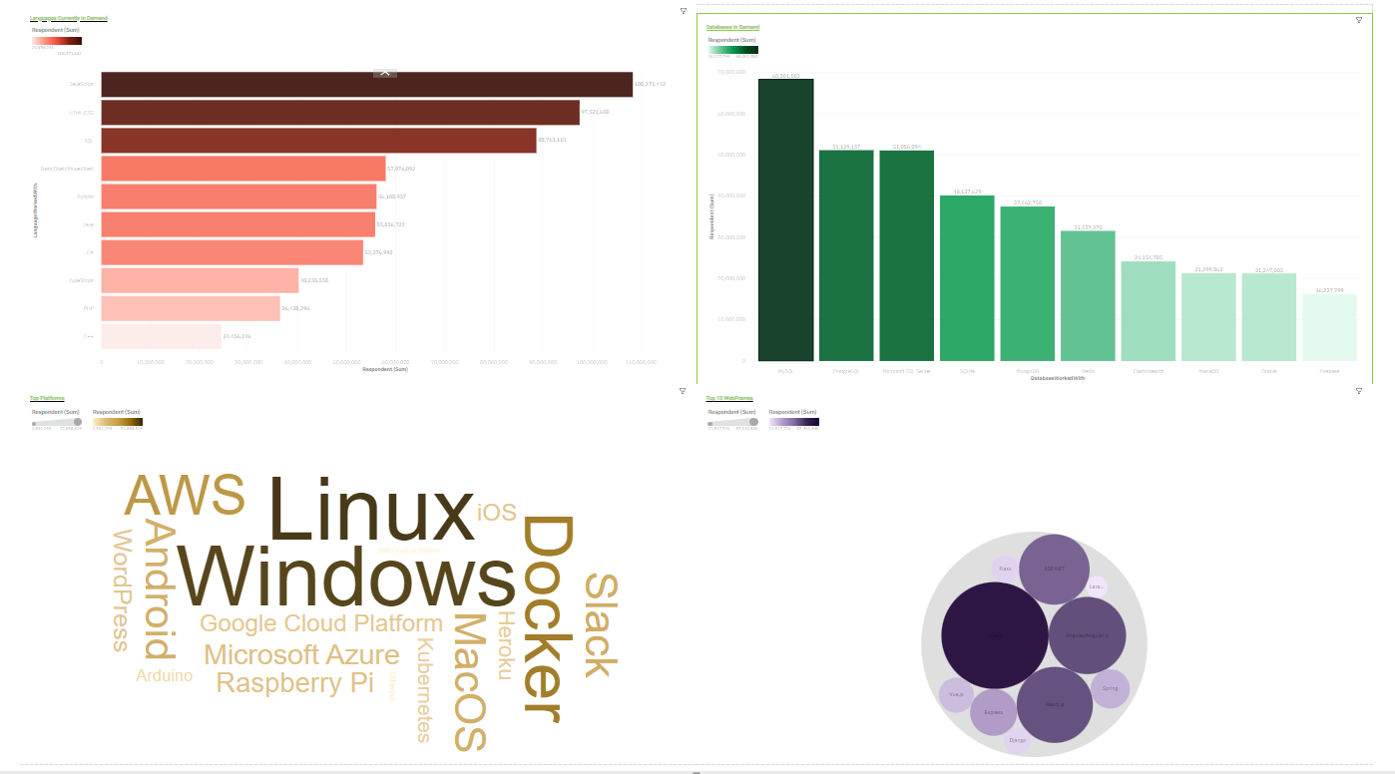
DASHBOARD TAB 1

Slide 13
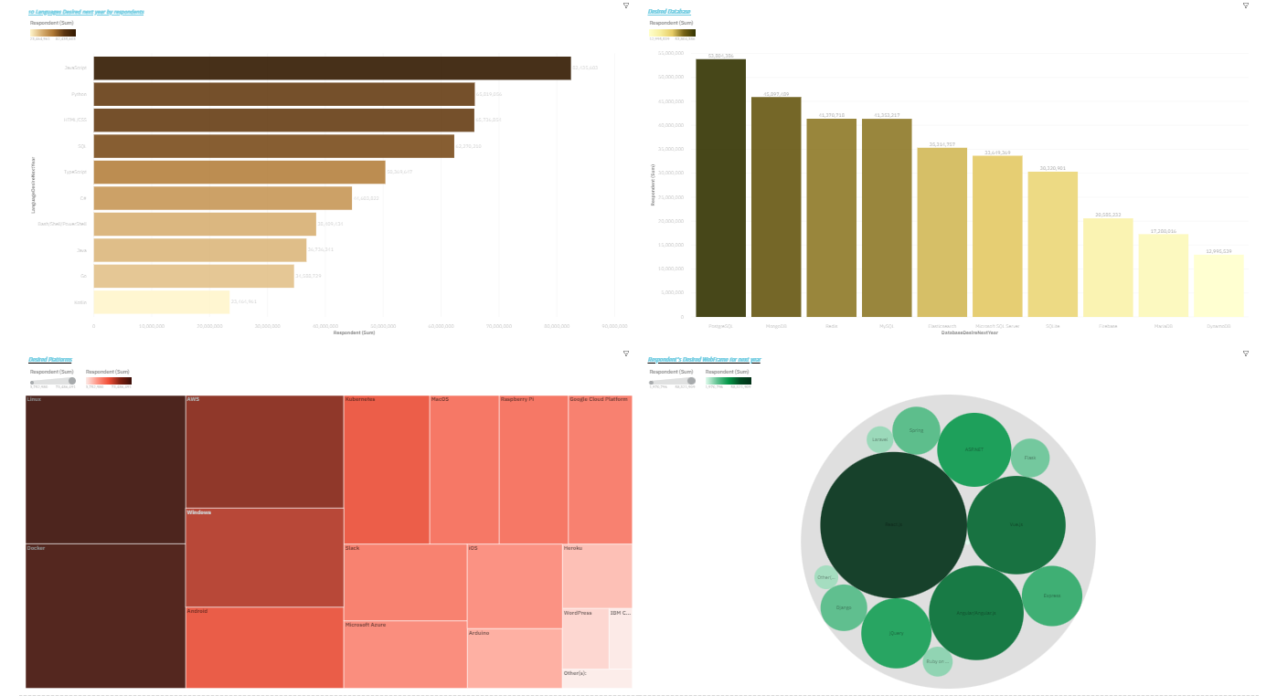
DASHBOARD TAB 2

Slide 14
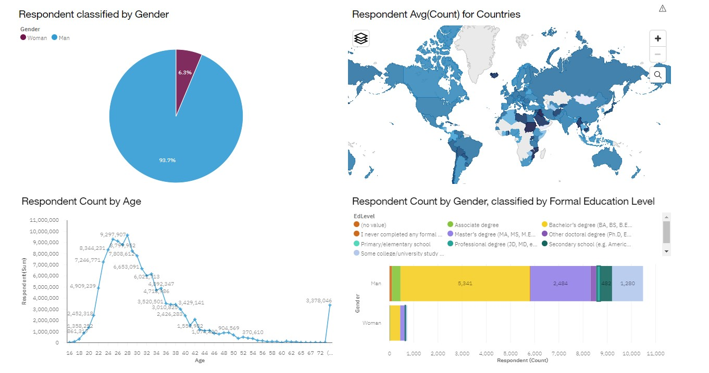
DASHBOARD TAB 3

Slide 15
DISCUSSION
Current and Future Technology Trends
Training and Reskilling Workers to Keep Pace with Technology
Measures to Increasing Female Participation in the Technology Field
Targeting Developing Countries to Bridge the gap
Eliminating Employment Discrimination Based on Age and Education

Slide 16
OVERALL FINDINGS & IMPLICATIONS
Findings
Rapidly Evolving Technology Landscape
Technology Development Concentrated in Few Developed Countries such as USA
Gender Disparities in Technology Employment
Growing Popularity of Platforms like Docker, Slack and AWS
Implications
Necessity for Companies to Adapt to Rapid Changes and Remain Flexible
Urgent Need to Promote Technology Spread in Less Developed Countries
Anticipated Shift Towards Faster App Deployments and Widespread Adoption of Cloud Services in the Future

Slide 17

CONCLUSION
Overview of Technology Trends for the Current and Upcoming Year
Summary of Popular Programming Languages, Databases, and Platforms
Analysis of Technology Industry Demographics
Proposed Actions for Advancing Technology Development and Inclusion
Future Plan to use Cloud Platform and Machine Learning

Slide 18

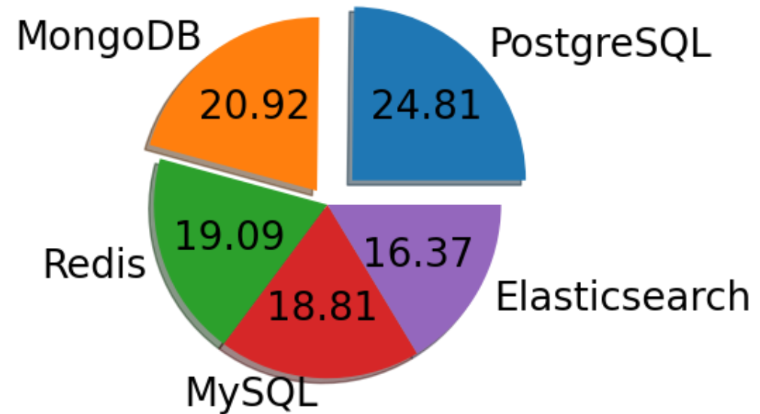
APPENDIX
Databases Desired next year

Slide 19
JOB POSTINGS

Slide 20
POPULAR LANGUAGES

